Slide 1
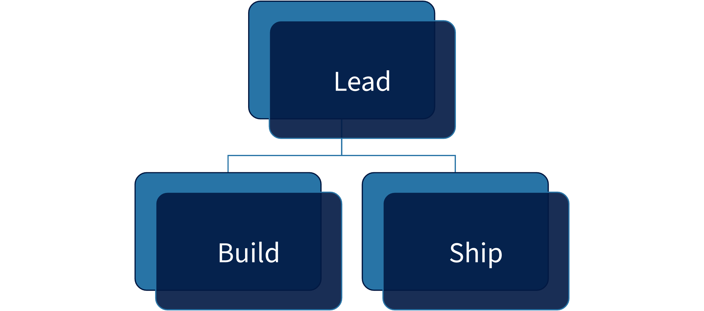
Measured hierarchy geometry
Lead
Build
Ship

