Slide 1
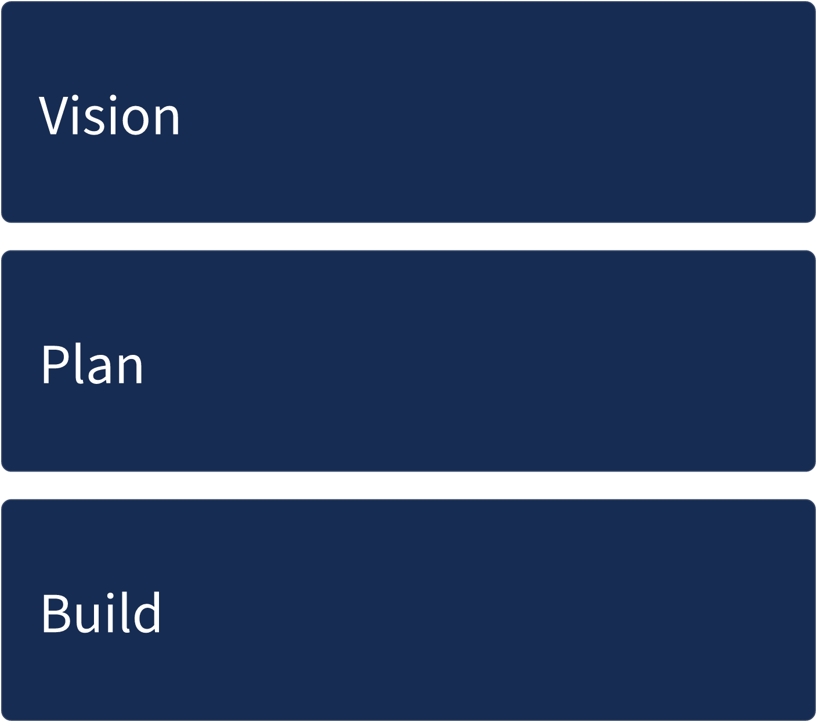
Editable stages
Vision
Plan
Build

