Slide 1

A smaller pilot. A clearer decision.
A six-week pilot with two teams

Slide 2
Test before scaling
Part 2: the evidence

Slide 3
From the problem to the next decision
Define the problem
Review the pilot evidence
Agree the next decision

Slide 4
Three parts, one decision
Define the problem
Review the pilot evidence
Agree the next decision

Slide 5
Start small enough to learn quickly
Learn with two teams before expanding the rollout.

Slide 6
Agree the pilot team and start date
Next step: name the pilot lead and agree the start date.

Slide 7
Learn before scaling
Test with two teams for
Keep the scope narrow,
Compare the results
six weeks. Measure
collect feedback
with the baseline.
task completion and
weekly and give each
Expand only when the
time before deciding
decision a named
evidence supports the
what to scale.
owner.
next step.

Slide 8
Make the next step explicit
Close the audit gaps
Hire two engineers
Agree the budget
Pilot with two teams
Ship the mobile beta
Name the owners
Report every week
Retire the old portal
Review in March

Slide 9
A shared view makes decisions easier
“We can now see where participants need
help.”
Pilot lead – Illustrative quotation

Slide 10
Opportunity and constraints
Test with two teams for six weeks. Measure task completion and time
before deciding what to scale.
Keep the scope narrow, collect feedback weekly and give each decision
a named owner.

Slide 11
Scope, evidence and the next decision
Test with two teams for six weeks. Measure task completion and time
before deciding what to scale.
Keep the scope narrow, collect feedback weekly and give each decision
a named owner.
Compare the results with the baseline. Expand only when the evidence
supports the next step.

Slide 12
Three conditions for a useful pilot
Clear scope
Consistent
An explicit
measures
decision
Two teams and one
Track completion
Agree the evidence
workflow keep the
and task time
needed before
pilot focused.
against a baseline.
expanding.

Slide 13
Choose the smallest useful test
Option A: focused pilot
Two teams, six weeks. Low setup cost and a clear baseline.
Option B: broad rollout
All teams, three months. Wider reach with greater coordination needs.
Recommendation: establish the evidence with Option A before
committing to Option B.

Slide 14
Three steps from evidence to decision
Establish a baseline
Run the pilot
Decide what to
Measure the current
Test with two teams and
scale
completion rate and task
review feedback each
Compare outcomes with
time.
week.
the baseline and agree
the next step.

Slide 15
Six weeks to an informed decision
Week 1
Weeks 2–5
Week 6
Baseline
Pilot
Review and decide
Test with two teams for six weeks. Measure task completion and time before deciding what to scale.

Slide 16
What the pilot involves
Who takes part?
Two field teams, with 52 participants in
total.
How long does it run?
Six weeks, including a baseline
measurement.
What happens next?
Review completion and task time before
expanding.

Slide 17
Pilot outcomes in three measures
52
84%
6.2
min
Trial participants
Task completion
Median task time
Illustrative six-week pilot
Up from 68% at baseline
Down from 9.4 min
Test with two teams for six weeks. Measure task completion and time before deciding what to
scale.

Slide 18
Track performance against a target
52
84%
6.2
min
Trial participants
Task completion
Median task time
Target: 50 participants
Target: at least 80%
Target: under 7 min

Slide 19

Give the visual room to speak

Slide 20

Explain what the audience should notice
Test with two teams for six weeks. Measure task completion and time before deciding what to scale.

Slide 21



Compare three visual directions

Slide 22
Completion rose through the pilot
Share of tasks completed, by week of the pilot
Test with two teams for six weeks. Measure task completion and time before deciding what to scale.

Slide 23
The largest gain came in week four
Test with two teams for six weeks. Measure task completion and time before deciding what to scale.

Slide 24
Compare outcomes on consistent measures
Team | Participants | Completion | Median time (min)
A | 28 | 89% | 5.8
B | 24 | 79% | 6.7
Test with two teams for six weeks. Measure task completion and time before deciding what to scale.

Slide 25
Team B needs targeted support
Team | Participants | Completion | Median time (min)
A | 28 | 89% | 5.8
B | 24 | 79% | 6.7
Test with two teams for six weeks. Measure task completion and time before deciding what to scale.

Slide 26
Keep the implementation easy to inspect
The reducer adds each item’s value to a running sum. Starting at zero also makes an empty list return zero.
javascript
const total = items.reduce((sum, item) => sum +
item.value, 0);
console.log(total);

Slide 27
One team. One outcome.
Test with two teams for six weeks. Measure task completion and time before deciding what to scale.
Keep the scope narrow, collect feedback weekly and give
each decision a named owner.
Compare the results with the baseline. Expand only
when the evidence supports the next step.
Test with two teams for six weeks. Measure task
completion and time before deciding what to scale.

Slide 28
Pilot performance at a glance
52
84%
6.2
min
Trial participants
Task completion
Median task time
Illustrative six-week pilot
Up from 68% at baseline
Down from 9.4 min

Slide 29
Give each workstream a clear owner
Ana Ruiz
Sam Lee
Kai Moreau
Pilot lead
Product lead
Analytics lead
Coordinates the two
Turns participant
Measures
teams and weekly
feedback into
completion and task
reviews.
product changes.
time consistently.

Slide 30



Recognize the partners

Slide 31
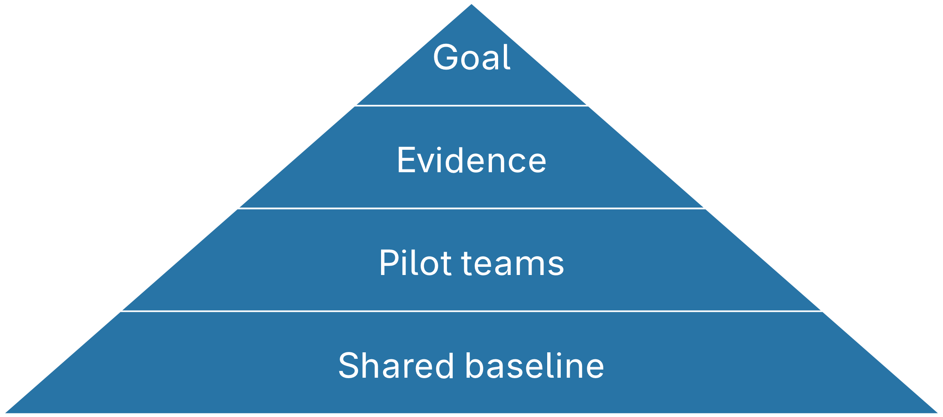
What the pilot builds on
Goal
Evidence
Pilot teams
Shared baseline

Slide 32
Four ways to run the pilot
Small, fast
Small, slow
Broad, fast
Broad, slow

Slide 33
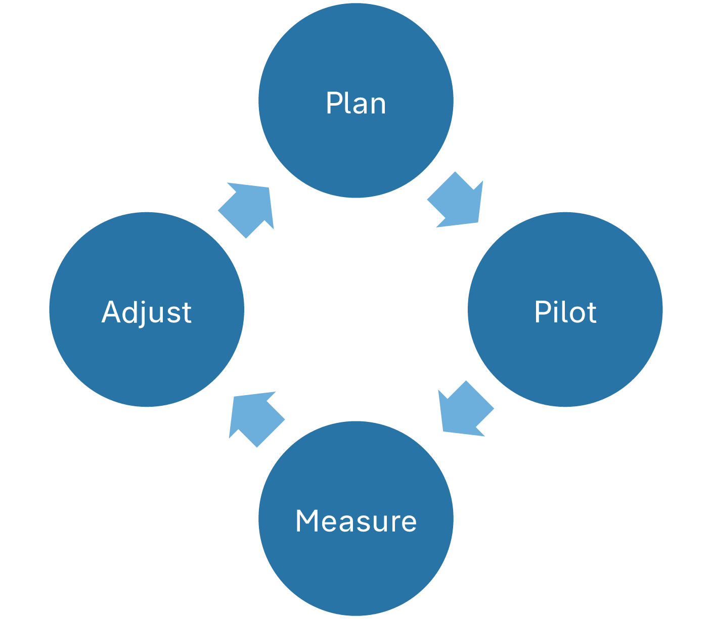
How each pilot round feeds the next
Plan
Pilot
Measure
Adjust

Slide 34
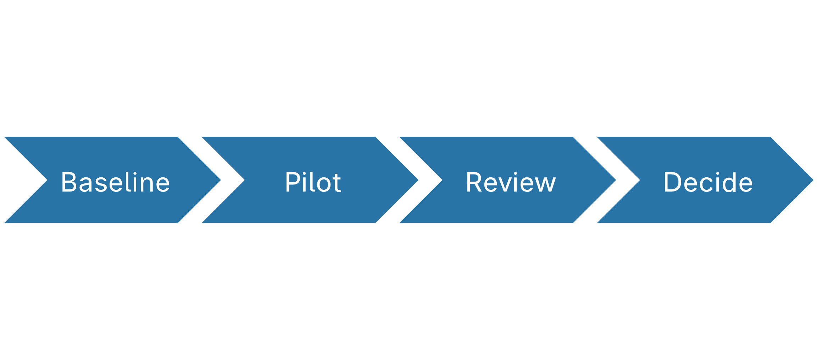
Four stages of the pilot
Baseline
Pilot
Review
Decide

Slide 35
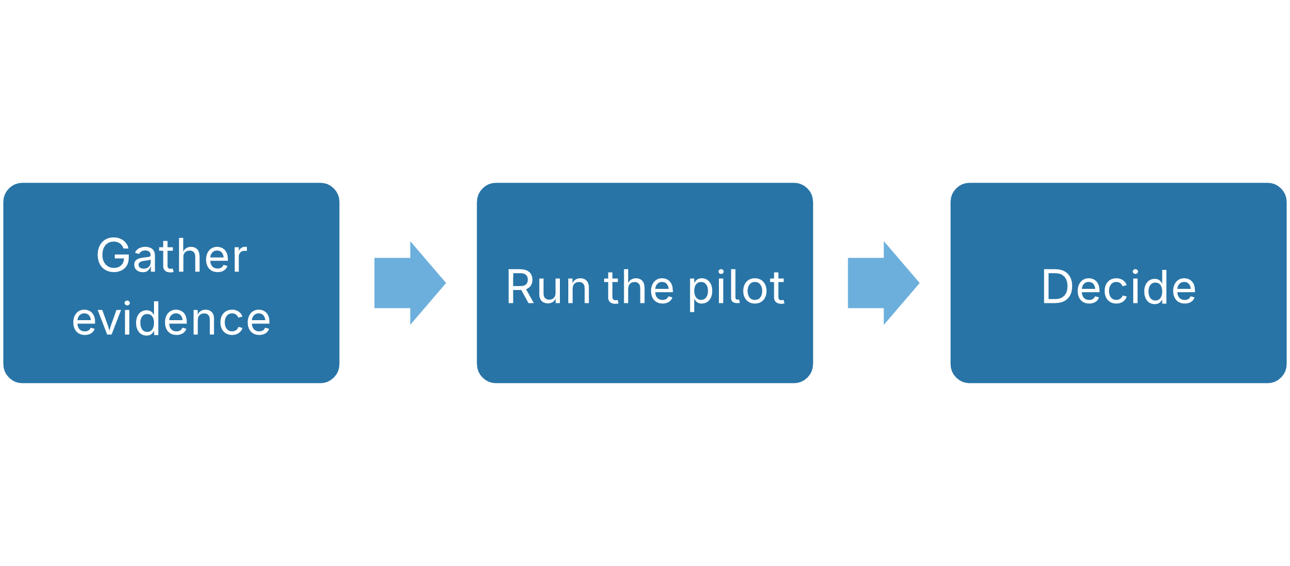
From evidence to decision
Gather evidence
Run the pilot
Decide

Slide 36
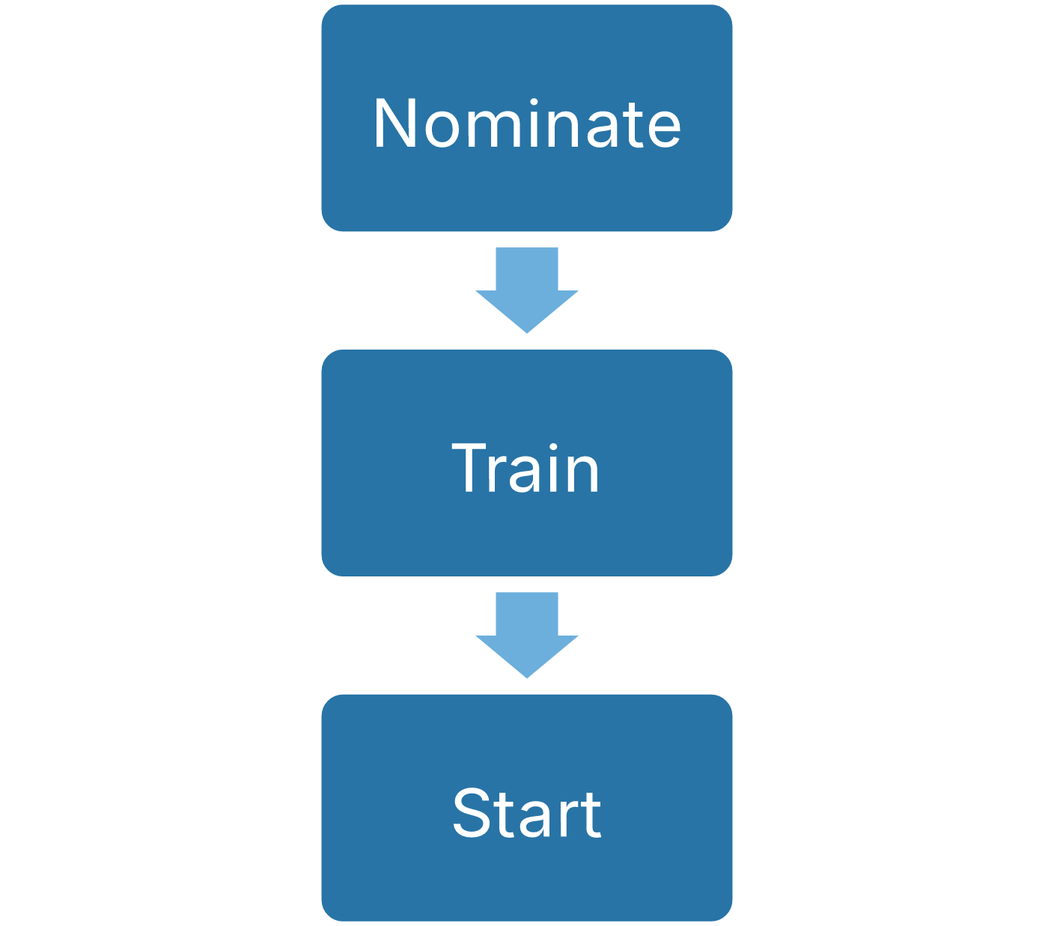
How a team joins the pilot
Nominate
Train
Start

Slide 37
Lead with the recommendation
Run a six-week pilot with two teams before expanding. The pilot gives us a baseline, weekly feedback and one clear decision at the end.
Cost: two team leads at 20% for six weeks.

Slide 38
What makes a pilot worth running
Consistent
An explicit
Clear scope
measures
decision
Two teams and one
Track completion and
Agree the evidence
workflow keep the pilot
task time against a
needed before
focused.
baseline.
expanding.

Slide 39
Pilot outcomes in four measures
52
84%
Trial participants
Task completion
Across two field teams
Up from 68% at baseline
6.2
2
min
Median task time
Teams
Down from 9.4 min
One workflow each

Slide 40
Completion rose every week
Task completion climbed from 68% to 84% over the first four weeks of the pilot.

Slide 41
What the first four weeks show
Completion rose 16 points
The largest gain came in week four
Team B needs targeted support

Slide 42
Week four brought the biggest gain
+8 pts
Week four gain
From 76% to 84%
The new checklist reached both teams at the
start of week four.

Slide 43
What the pilot asks of us
The pilot shows a clear gain in completion with modest effort.
Two teams must release a lead at 20%
Weekly reviews need a fixed slot
Analytics needs read access to both workflows

Slide 44
From baseline to decision in six weeks
52
84%
6.2
min
Participants
Completion
Median time
Week 1
Weeks 2–5
Week 6
Baseline
Pilot
Review and decide

Slide 45
What participants noticed
Participants said the checklist made the next step obvious.
“We can now see where
participants need help.”
Pilot lead – Illustrative quotation

Slide 46
Where Team B falls behind
Results to the end of week four
Team | Participants | Completion | Median time (min)
A | 28 | 89% | 5.8
B | 24 | 79% | 6.7
Team B trails on both measures. Pair its lead with Team A for weeks five and six.

Slide 47
Six lessons from the pilot
Keep the scope to one workflow.
Start with a baseline.
Name one owner per decision.
Review feedback every week.
Decide with the evidence, not the calendar.
Share results with both teams.

Slide 48
How the running total works
javascript
The reducer adds each item’s value to a running sum. Starting at zero also makes an empty list return zero.
const total = items.reduce((sum, item) => sum +
item.value, 0);
console.log(total);

Slide 49
The numbers and the voice agree
“
The weekly
review keeps the
next step clear.”
Product lead – Illustrative quotation

