Slide 1
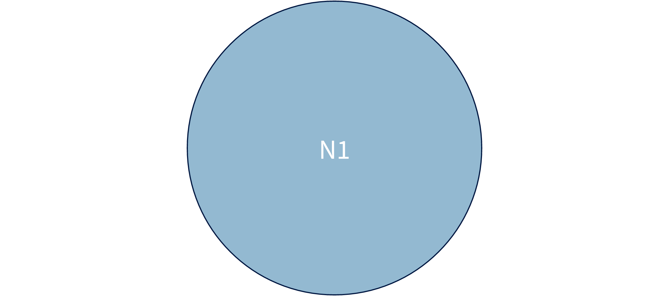
Measured venn geometry
N1

