Slide 1
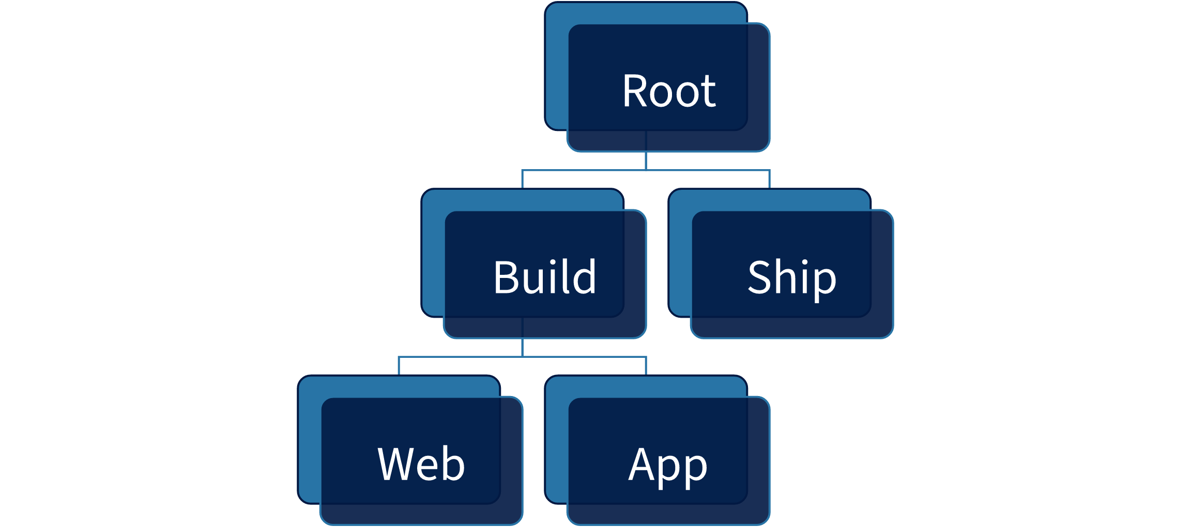
Measured hierarchy geometry
Root
Build
Web
App
Ship

