Slide 1
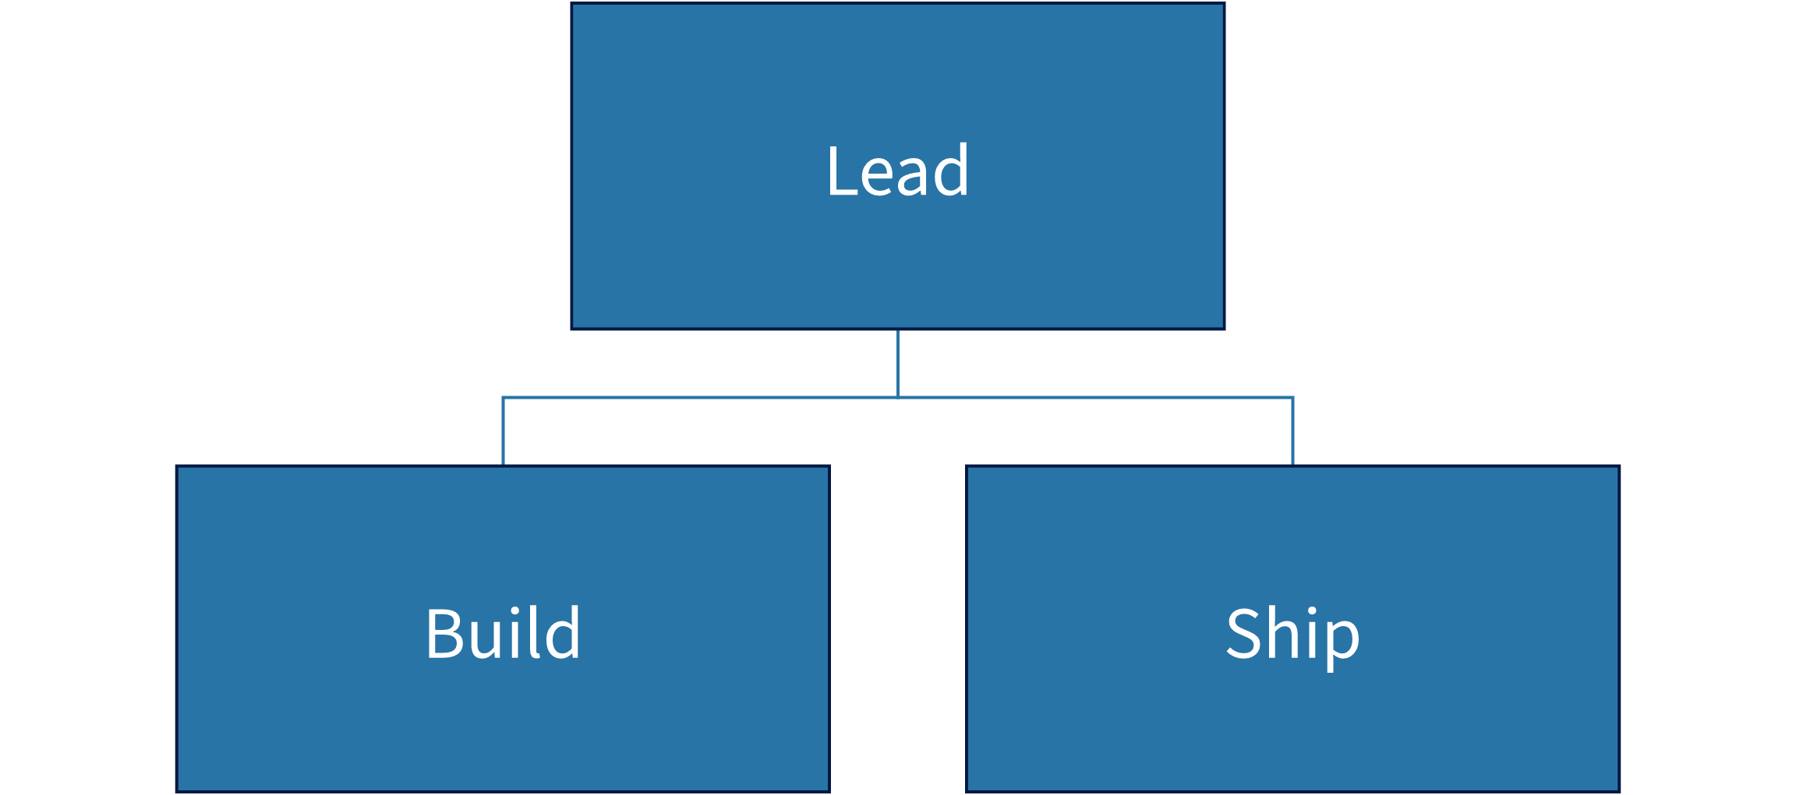
Measured org-chart geometry
Lead
Build
Ship

