Slide 1
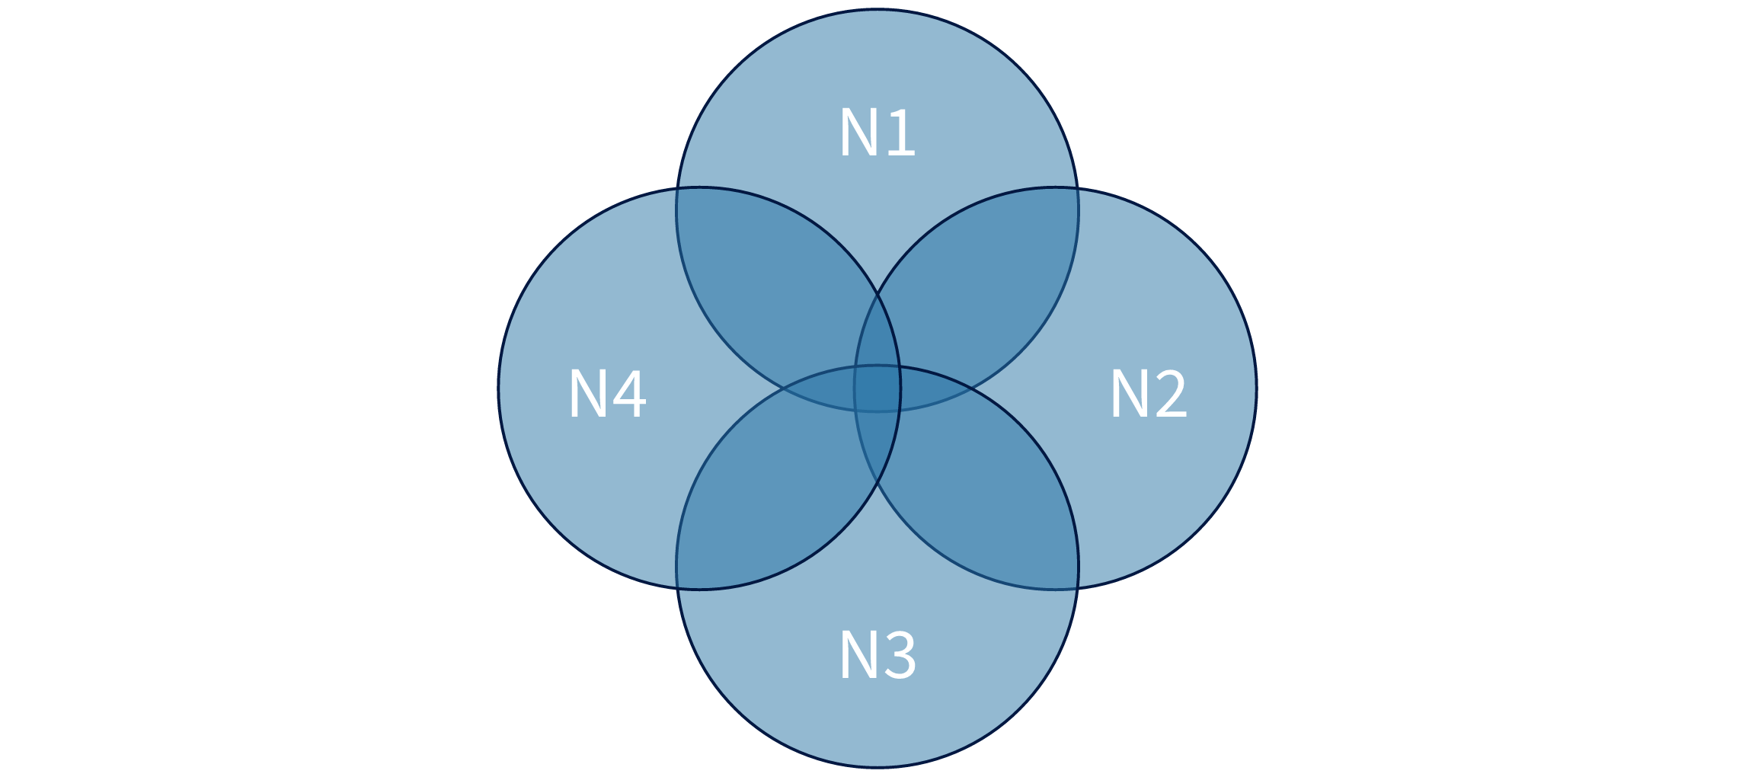
Measured venn geometry
N1
N2
N3
N4

