Slide 1
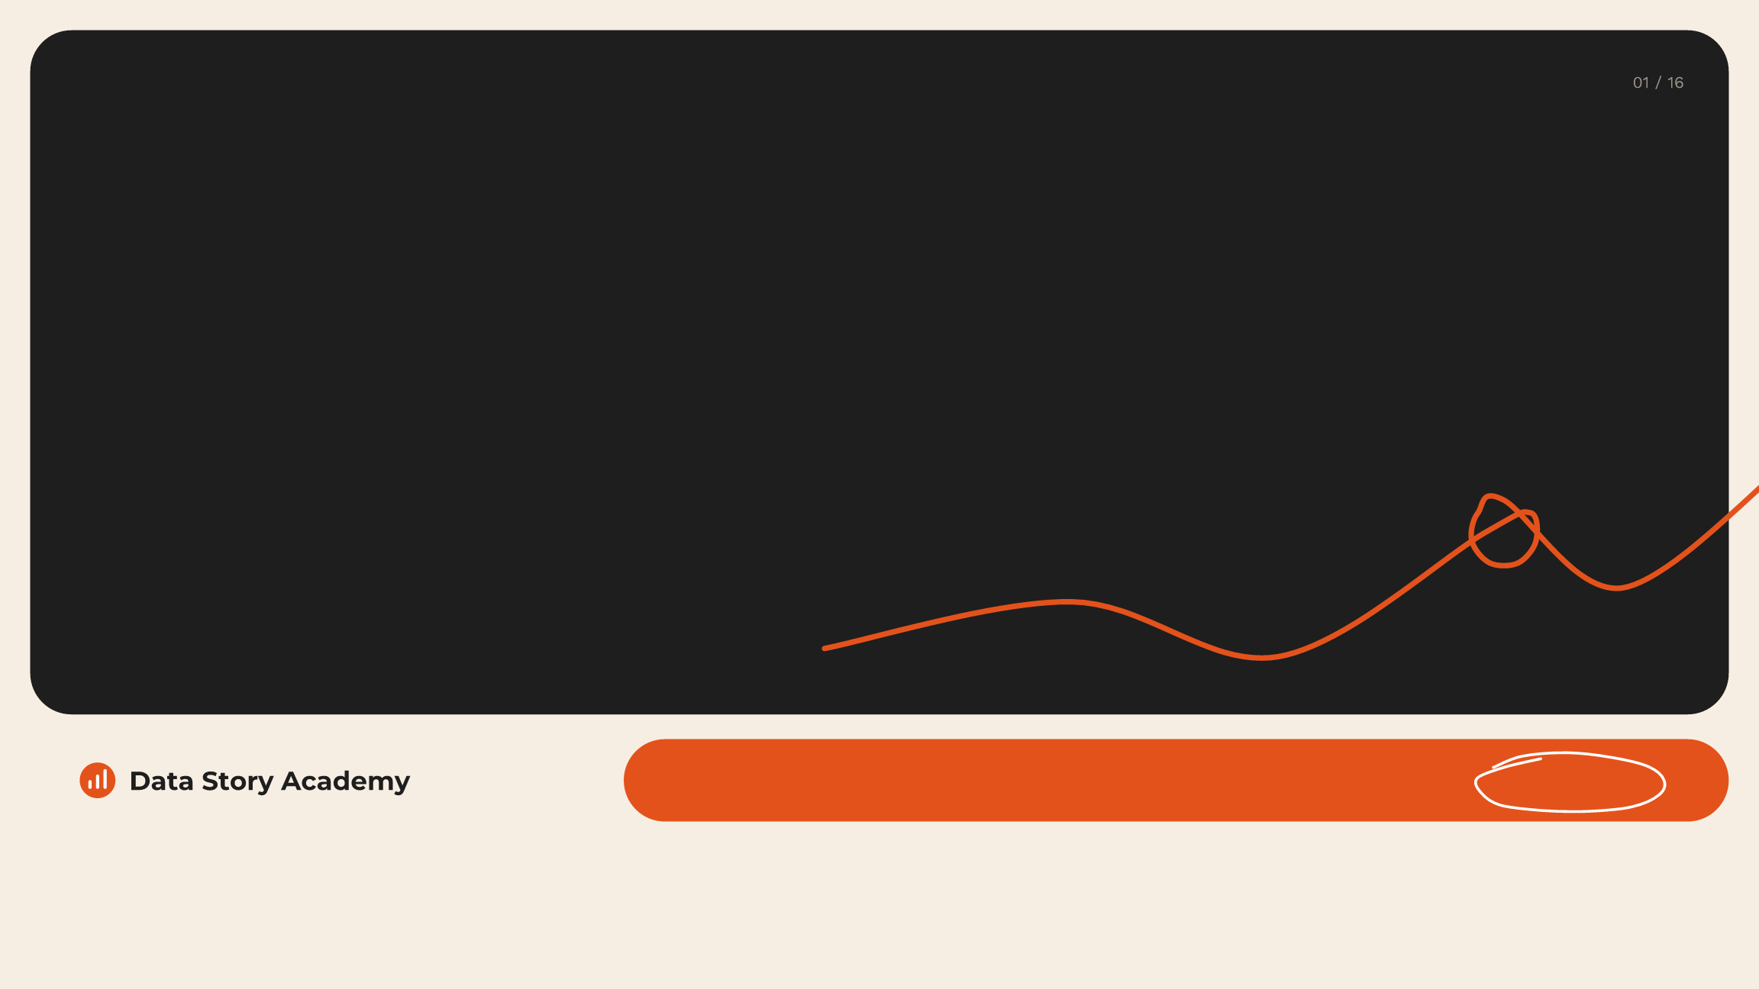
Corporate programs that turn data into decisions · 2027
Data Storytelling
for Leaders
datastoryacademy.com | Corporate programs for 2027 | Book a call
Notes:
Thank you for the time. In the next fifteen minutes I want to show you why data storytelling is now an executive skill, how we build it, and what a 2027 program for your teams could look like.

Slide 2

Why data storytelling
Your people have the data.
Few feel ready to use it.
74%
21%
48%
feel overwhelmed or
are confident in their
frequently rely on gut
unhappy working with
data literacy skills
feeling over data
data
Source: Accenture & Qlik, 2020 (n = 9,000)
Notes:
These numbers come from Accenture and Qlik's survey of nine thousand employees. Three in four feel overwhelmed working with data, only one in five is confident, and nearly half still go with their gut. The data is there. The skill to turn it into a decision is not.

Slide 3

Data skills gaps cost US companies $109B a year
The cost of the gap
01
5+ working days
lost per employee, every year
02
61% feel overloaded
say data overload adds to stress
03
36% avoid data
would find a way to avoid it
Source: Accenture & Qlik, 2020 (n = 9,000)
Notes:
Accenture and Qlik estimated what this costs in lost productivity: one hundred and nine billion dollars a year in the US alone. That is more than five working days per employee, every year, lost to procrastination and stress around data.

Slide 4

87% value data. Only 21% feel confident.
The confidence gap
01
The gap is skill, not belief
87% see data as an asset
02
Confidence drives use
50%+ more likely to feel empowered
03
Training is the lever
37% say training lifts productivity
Source: Accenture & Qlik, 2020 (n = 9,000)
Notes:
This is the gap we close. Eighty-seven percent believe in data. Only one in five is confident using it. The belief is already there, so the investment goes straight into skill.

Slide 5

Where AI fits
AI will draft the stories. Your people
decide what they mean.
Gartner predicted data storytelling would become the most
We teach teams to prompt AI well
widespread way to consume analytics, with 75% of data stories
and keep human judgment in charge:
generated by machines (2021).
AI in service of human agency, not in
place of it.
Notes:
AI changes the volume, not the job. Machines will draft more charts and more slides than ever. The people who learn to use AI well, and who still decide what matters, will outperform the people who don't.

Slide 6

Why we're different
Our job is done when your leaders act
on the story.
We start with the business question, find the story that matters,
15+ years in data and communication.
design it so it's clear at a glance, and coach your people to
2025 Brandon Hall Group Silver
Award for Best Competencies and
present it with confidence.
Skill Development.
Data Story Academy
Notes:
We are not a software training company. We don't teach buttons in Tableau or Power BI. We teach people to find the story, design it, and present it so a leader can act. That's how we measure success.

Slide 7

Find. Design. Present.
The method
Find
Design
Present
the story that matters
so it's clear at a glance
so leaders act
— Start with the question
— Pick the chart by intent
— Open with a strong outline
— Map questions to actions
— Design numbers for
— Engage and check in
leaders
— Write question titles
— Narrate with emotion
— Cut clutter, show the
point
Data Story Academy
Notes:
Every program is built on one method. Find the story that matters. Design it so it's clear at a glance. Present it so leaders act. Our frameworks and templates sit under each step.

Slide 8
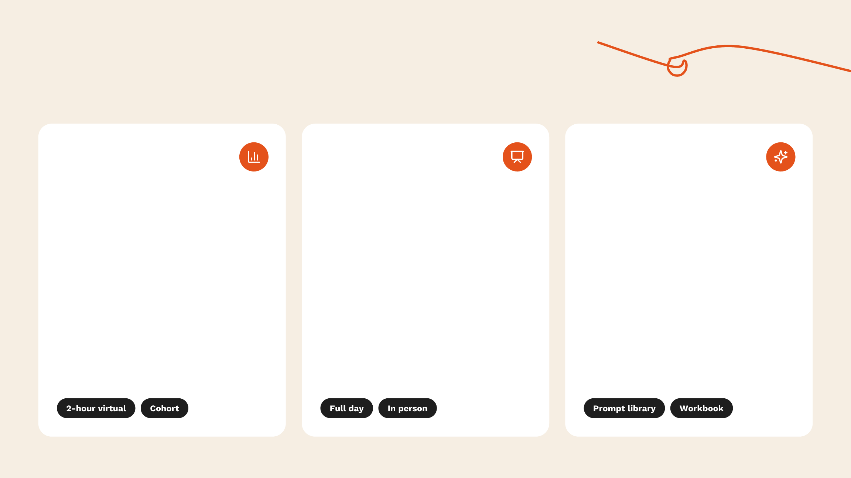
Three workshops. One for each gap.
Corporate programs
01
02
03
Data Storytelling
Slides to Story
Data Stories + AI
Workshop
Workshop
Workshop
Find, design and present
Map, plan, design and
Our prompt library and the
the most important stories
present. Everyone brings a
method behind it: prompt
in your data, so insights
real deck and leaves with it
AI to find the story, design
drive decisions.
rebuilt and presented.
the visual and structure the
deck.
Data Story Academy
Notes:
Three workshops, each built for one gap. Data Storytelling for teams with data but no story. Slides to Story for decks nobody can follow. Data Stories plus AI for teams that have AI but don't use it well.

Slide 9
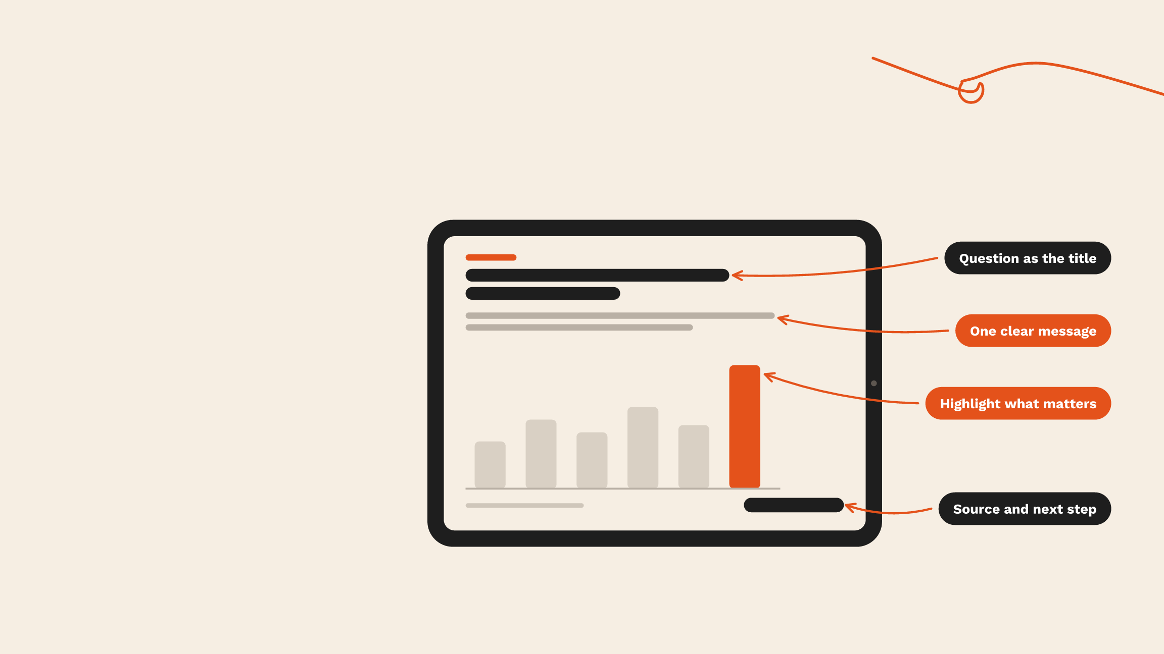
What a rebuilt slide looks like
Slides to Story, in practice
One question, one
message, one next step.
Every participant brings a real deck
and leaves with it rebuilt this way,
ready for the next leadership
meeting.
Data Story Academy
Notes:
This is what every participant walks out with. A slide that asks one question in the title, makes one clear point, highlights the number that matters, and ends with the source and the next step.

Slide 10

Six formats. Mix them to fit your year.
How we deliver
Executive keynotes
Workshops
8-week cohorts
Set the standard for how
Two-hour virtual sessions to
Weekly 30-minute live
leaders expect data to be
full days in person, hands-on.
sessions with practice and
presented.
feedback.
1:1 coaching sprints
Skill Labs & Toolbox
Program licensing
Private coaching for senior
Monthly labs plus templates,
On-demand courses in your
leaders on their real decks.
charts and AI prompts.
LMS with SCORM 1.2 tracking.
Data Story Academy
Notes:
Most clients combine two or three of these. A kickoff workshop, a cohort for the core team, and coaching for the leaders who present most often.

Slide 11

A complete toolkit, not just a session
What every learner gets
3
20
60
foundational courses with
practice challenges with
page digital workbook
22 videos
real data
20
1
3
templates for PowerPoint
data visualization guide
storytelling frameworks
and Google Slides
Data Story Academy
Notes:
Every learner leaves with more than notes from a session: three courses, twenty practice challenges, a sixty-page workbook, twenty templates, a visualization guide and our three frameworks.

Slide 12
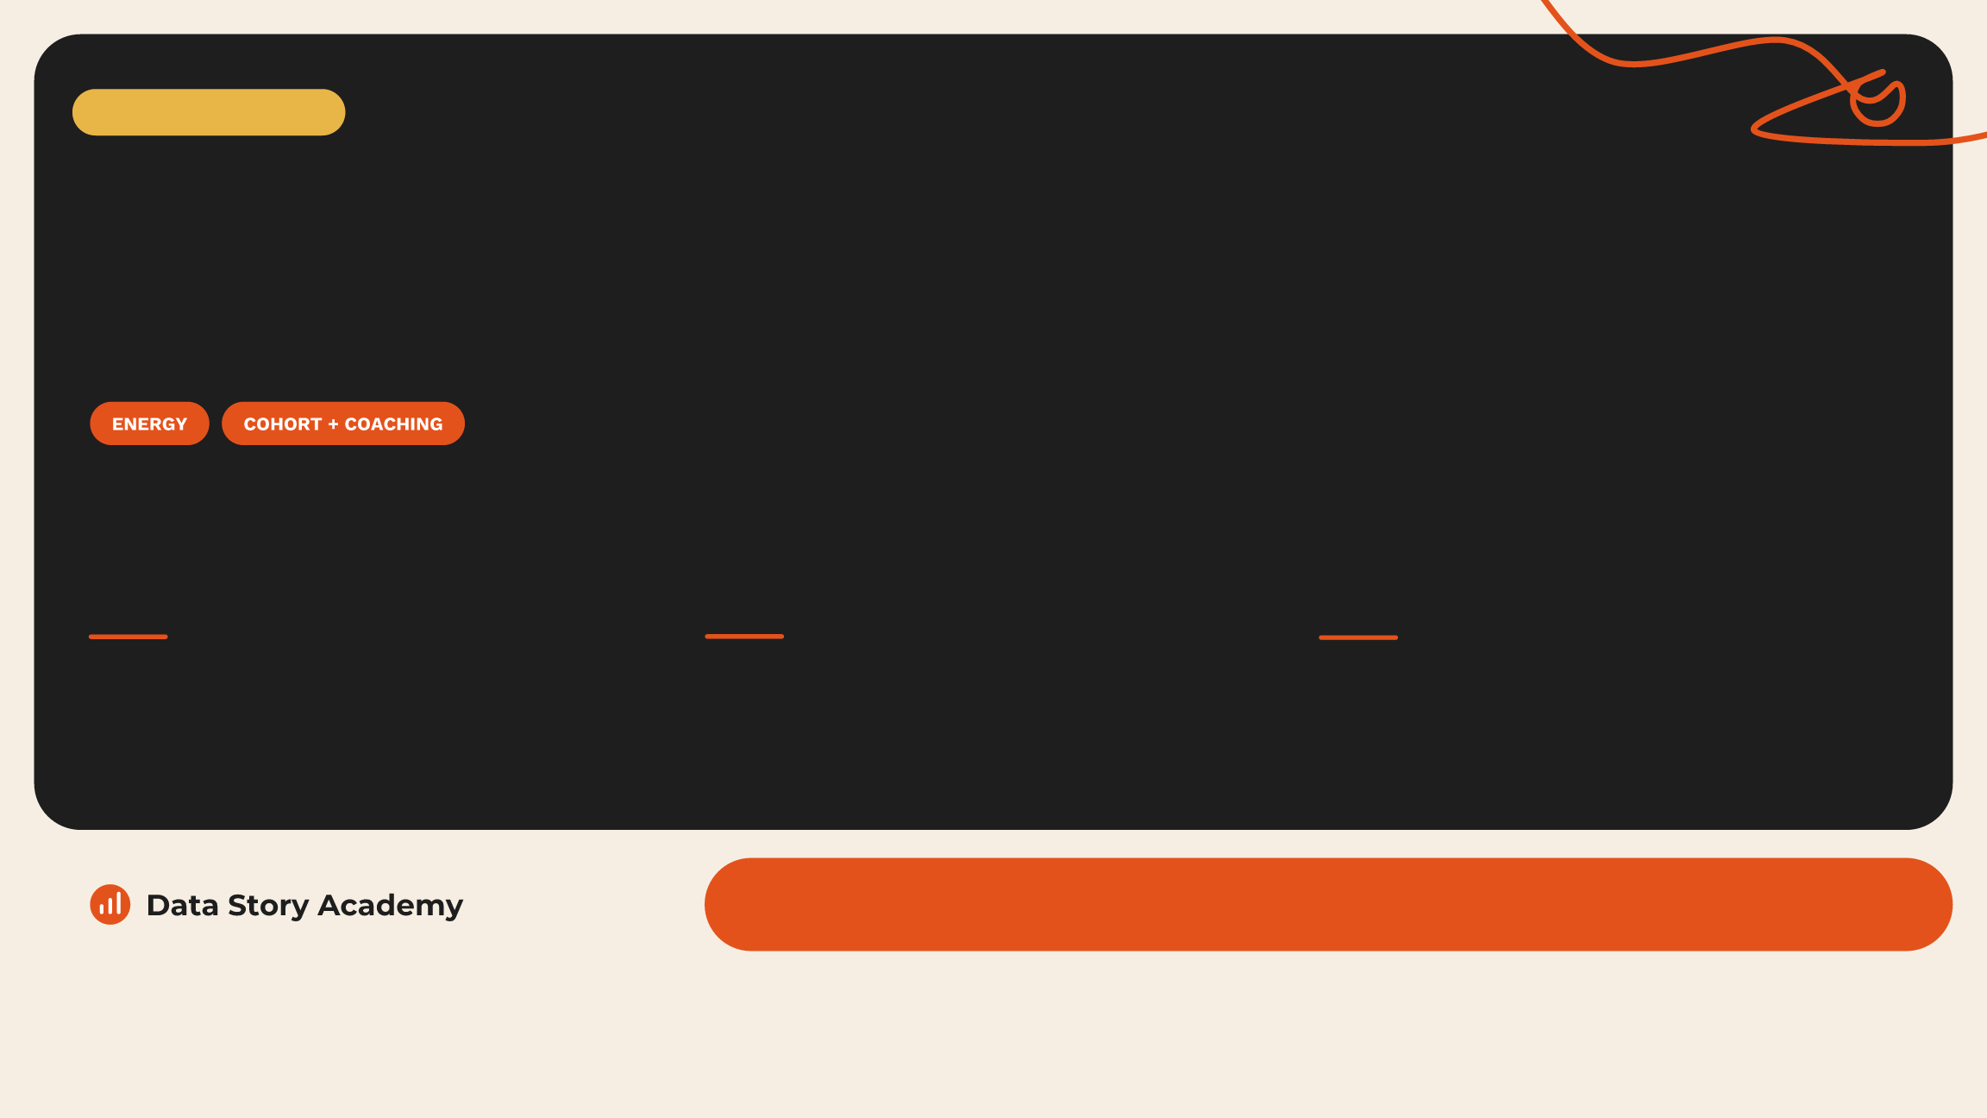
Case study
An energy company trained 33 people
to tell the story behind its numbers
8
33
4
week cohort with live weekly sessions
participants trained on their own data
senior leaders coached one-on-one
Result: the sponsor asked us to design a continuing program for 2027
Notes:
One example. An energy company ran an eight-week cohort with thirty-three participants, plus private one-on-one coaching for senior leaders on their real decks. At the end, the sponsor asked us to design a continuing program for 2027.

Slide 13

Practical, immediate, organization-wide
What leaders say
“This program is
“Great investment creating
“Absolute game
improving the work of
mutual value for both the
changer!”
my entire organization!”
company and my team.”
Senior Manager
Trade Terms Controller
Director, Finance
“One of the most
“I recently got a nomination
“The way this is broken
practical programs I
at work for a presentation I
down makes it really easy to
have ever taken.”
did using all the techniques.”
follow and very valuable.”
Supply Chain Leader
Lead Analyst
Sales Leader
Data Story Academy
Notes:
In their own words. The theme is the same across finance, supply chain and sales: practical, immediate, and it spreads across the team.

Slide 14

One year, one standard for every deck
A sample 2027 program
Q1
Q1–Q2
Q2–Q4
Q4
Kickoff
Cohort
Practice
Results
Workshop and
An 8-week cohort
Monthly Skill Labs and
Storytelling review and
capability assessment
builds the skill on real
1:1 coaching sprints.
a results scorecard.
set the baseline.
work.
Data Story Academy
Notes:
Here's what a year can look like. A kickoff workshop to set the standard, a cohort to build the skill, monthly labs and coaching to make it stick, and a review at the end to measure it.

Slide 15

Start with a 15-minute call
Next steps
01
02
03
Book the call
Pick the program
Kick off
We learn your teams, your data
Choose the workshops and
We tailor every example to your
and your 2027 goals.
formats that fit.
data and launch.
datastoryacademy.com | Book a 15-minute call
Data Story Academy
Notes:
The next step is small. A fifteen-minute call. We learn about your teams and your goals, recommend the right mix, and tailor every example to your own data.

Slide 16

Data Story Academy · Corporate Programs 2027
What's your
story?
datastoryacademy.com | Corporate programs for 2027 | Book a call
Notes:
Thank you. If one of these sounds like your 2027, let's find fifteen minutes this week.

