Slide 1
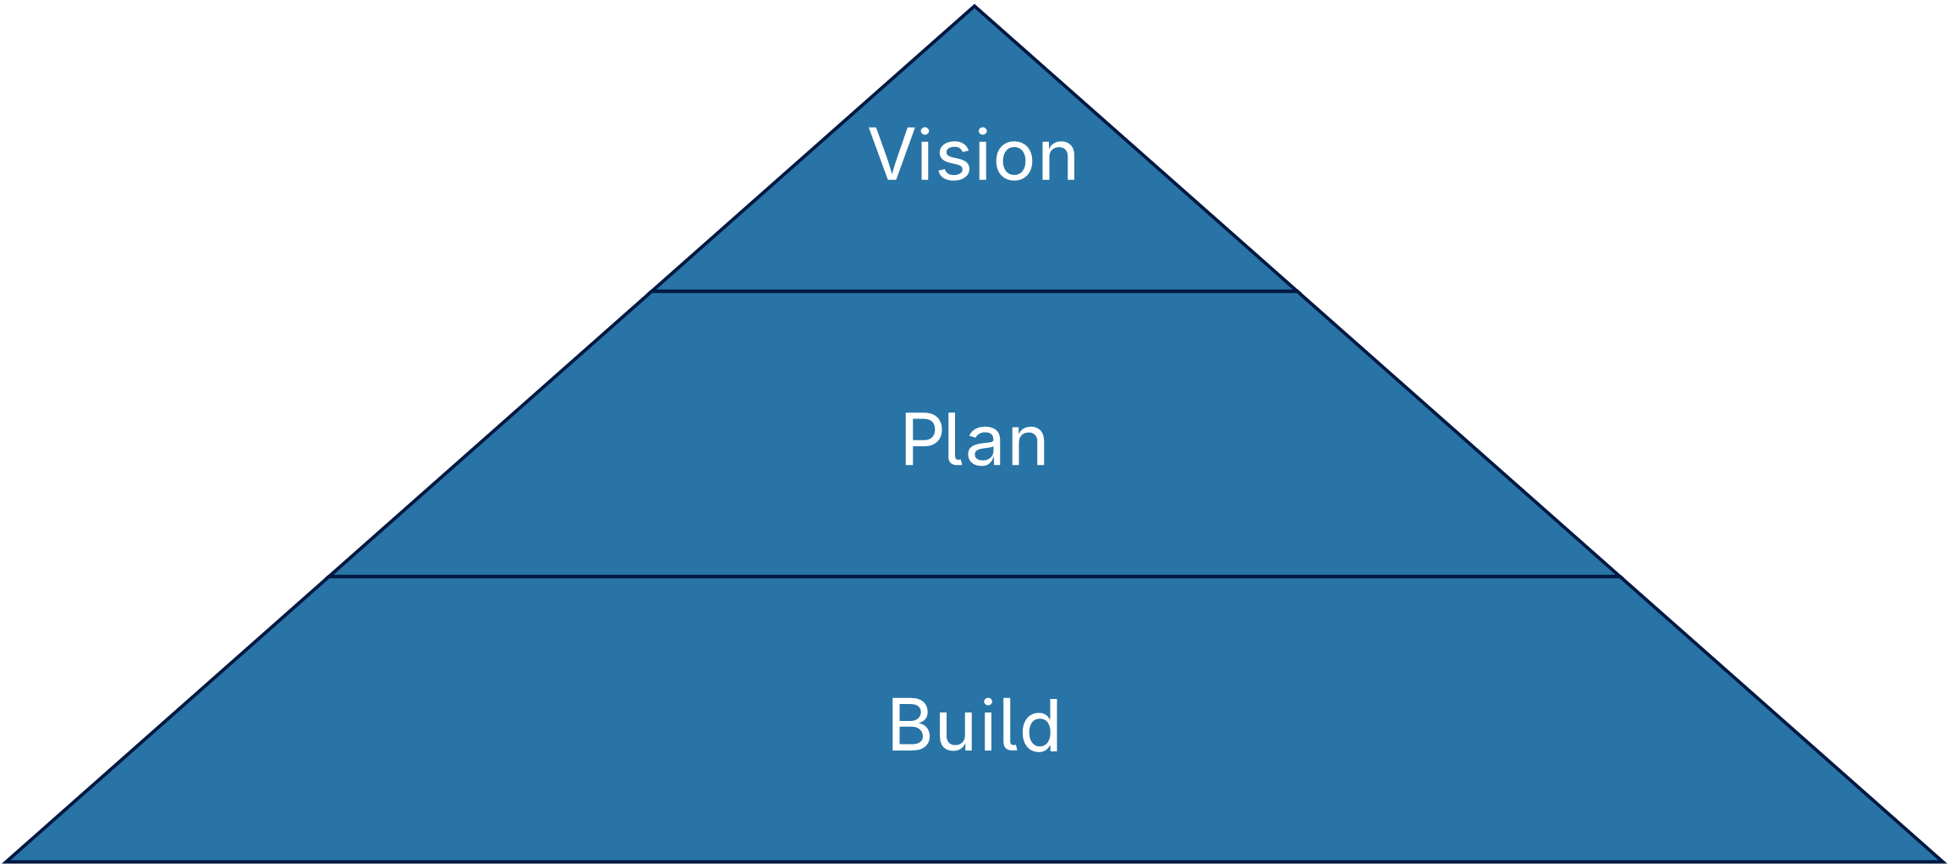
Our priorities

Slide 2
What the plan rests on
Why we exist and who we serve
The few goals that matter this year
How teams plan, decide and ship
The reviews that keep plans honest
Data everyone can see and trust
Feedback loops measured in days

Slide 3
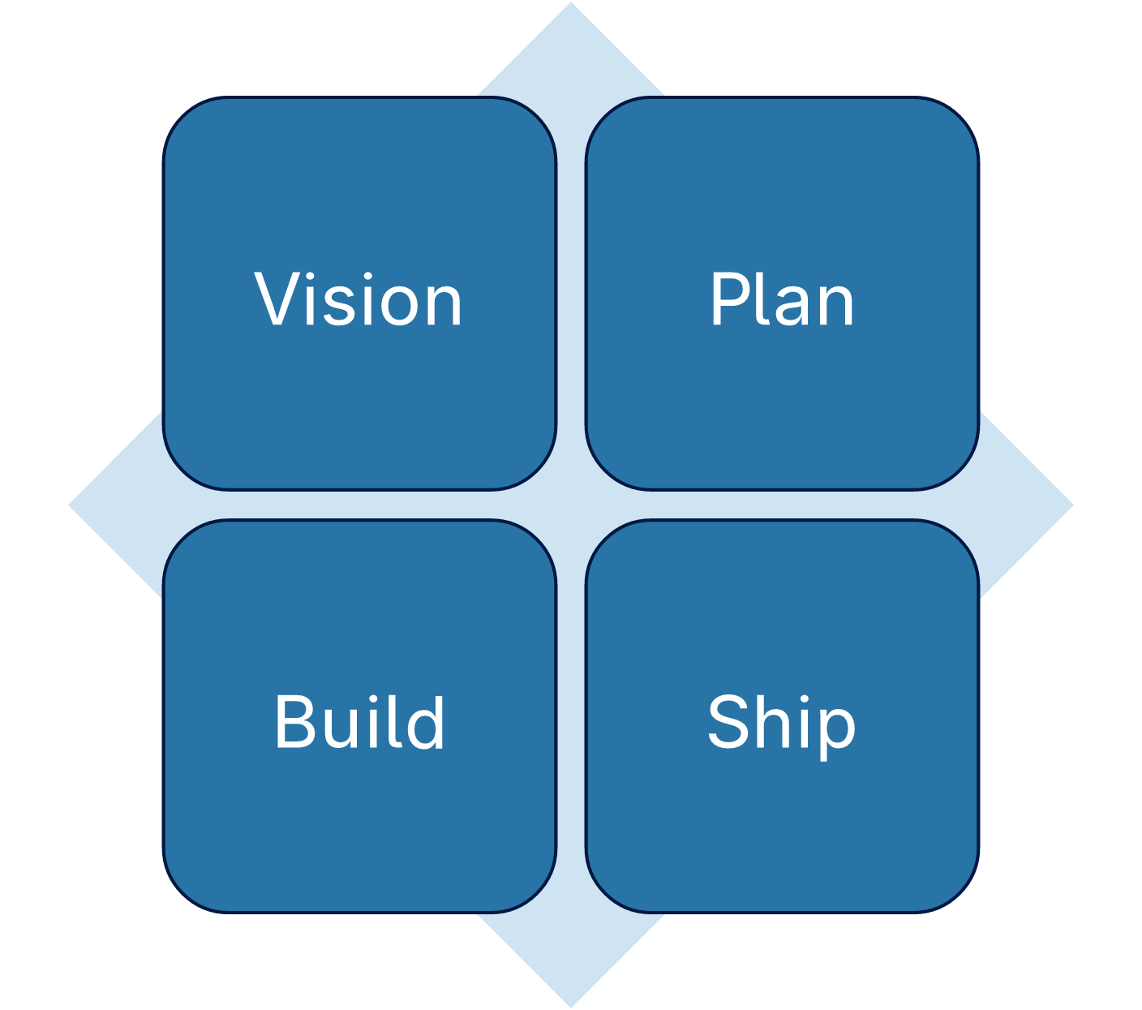
Four quadrants

Slide 4
Clear purpose
Three operating
Shared goals
habits
Team habits

Slide 5
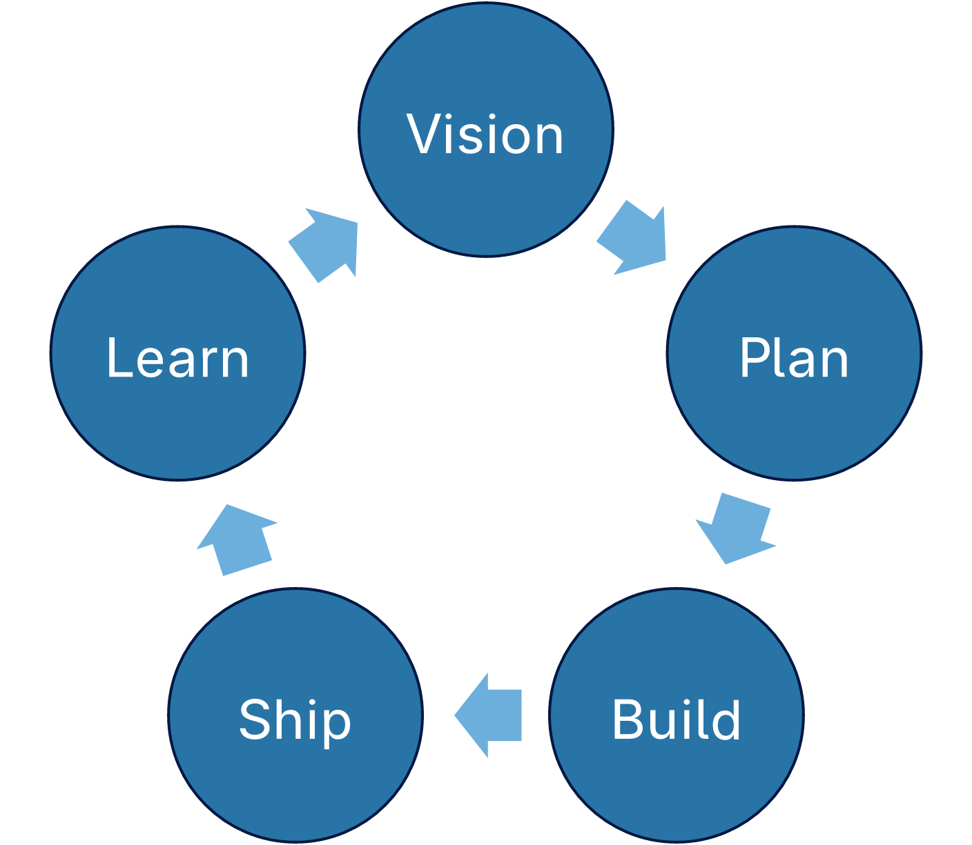
The review loop

Slide 6
The few
How
The
Why we
goals
teams
reviews
exist
that
plan,
that
and
matter
decide
keep
who we
this
and
plans
serve
year
ship
honest
How the
year repeats
Releases
Feedback
Data
that land
loops
everyone
every single
measured
can see
week
in days
and trust

Slide 7
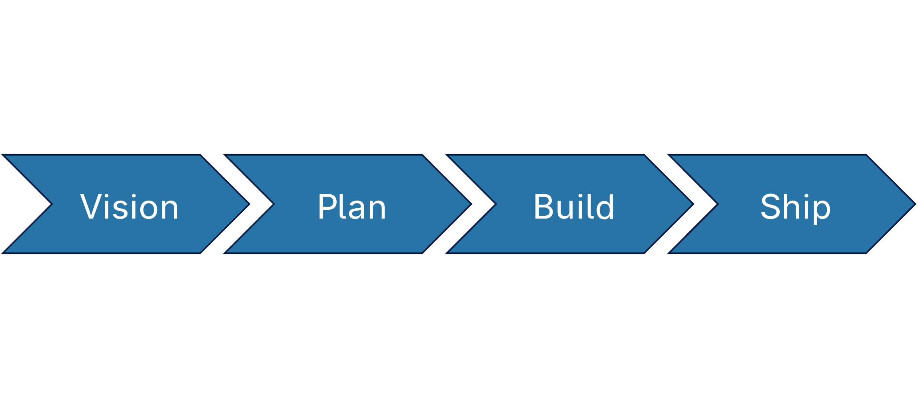
From idea to release

Slide 8
Eight stages of delivery
Clear
Shared
Team
purpose
goals
habits
Weekly
Open
Fast
reviews
roadmap
feedback
Steady delivery
Happy customers

Slide 9
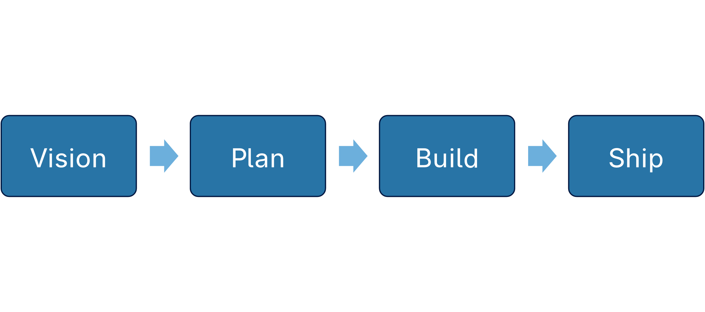
How a request moves

Slide 10
Seven steps to a habit
Clear
Shared
Team
Weekly
purpose
goals
habits
reviews
Steady
Open
Fast feedback
delivery
roadmap

Slide 11
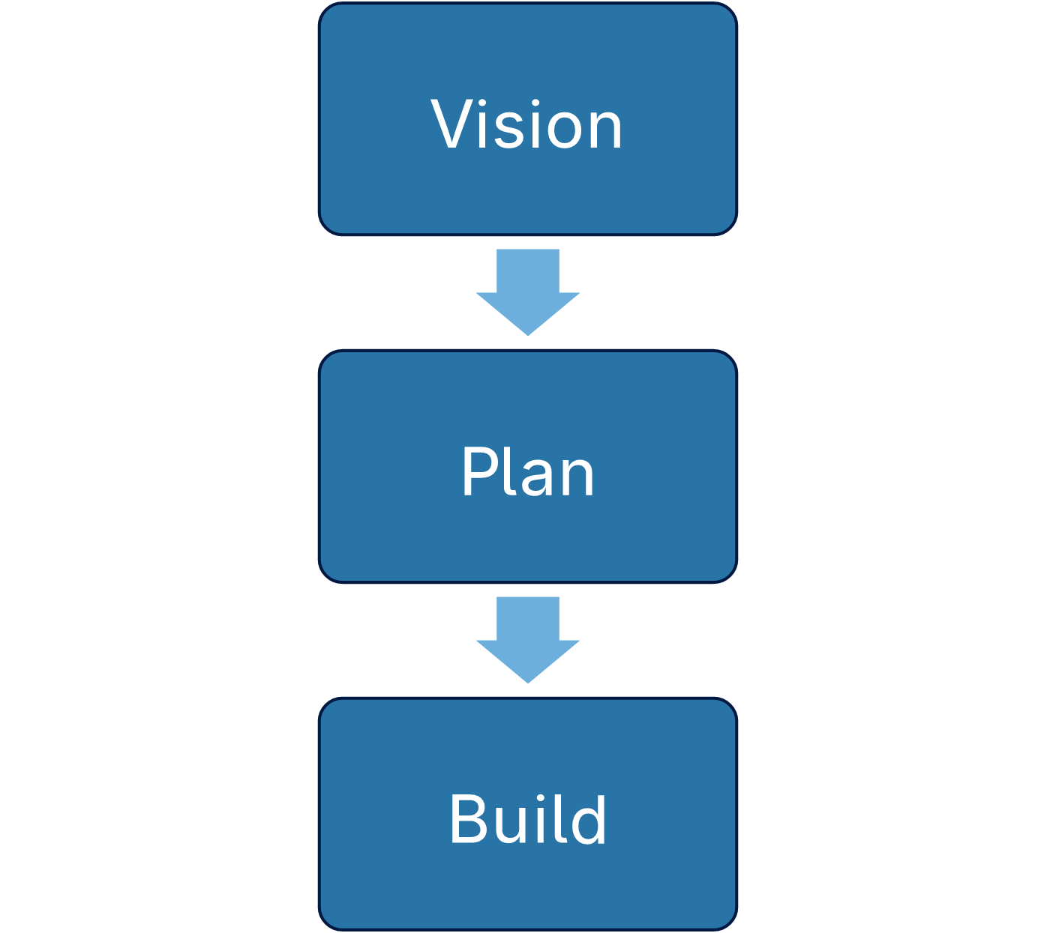
Three steps

Slide 12
Clear
Fast
purpose
feedback
Six steps to
Open
Shared goals
steady delivery
roadmap
Weekly
Team habits
reviews

Slide 13

Seven layers

Slide 14
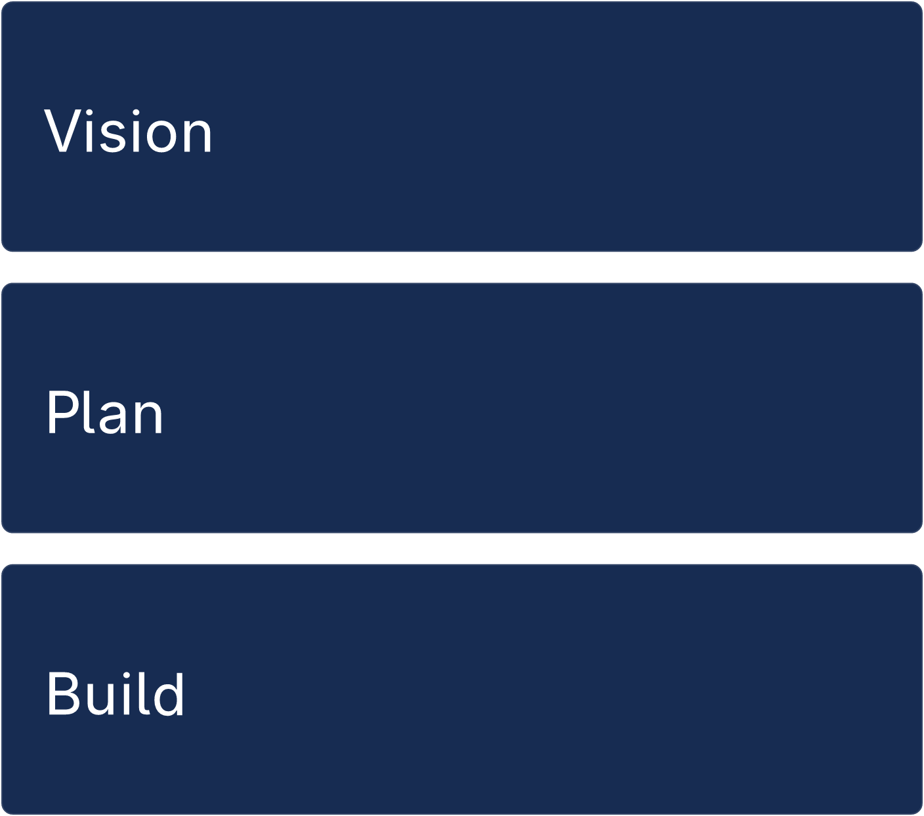
Three habits

Slide 15
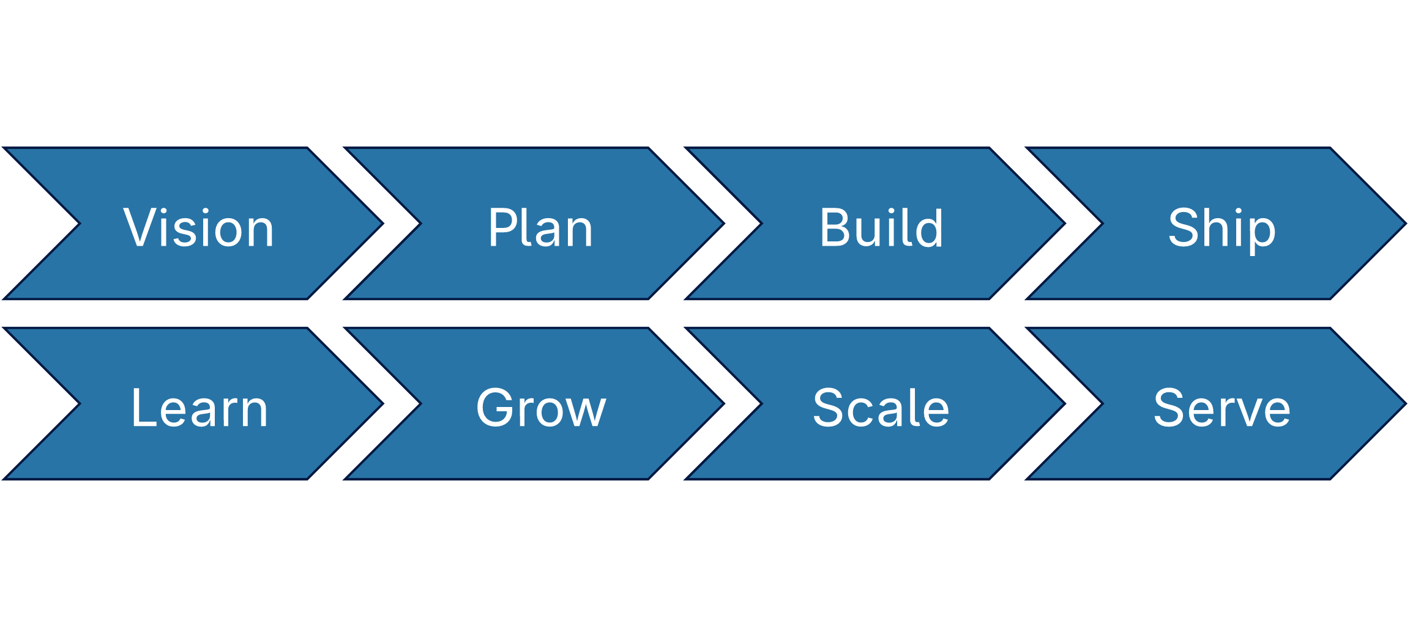
Eight stages

Slide 16
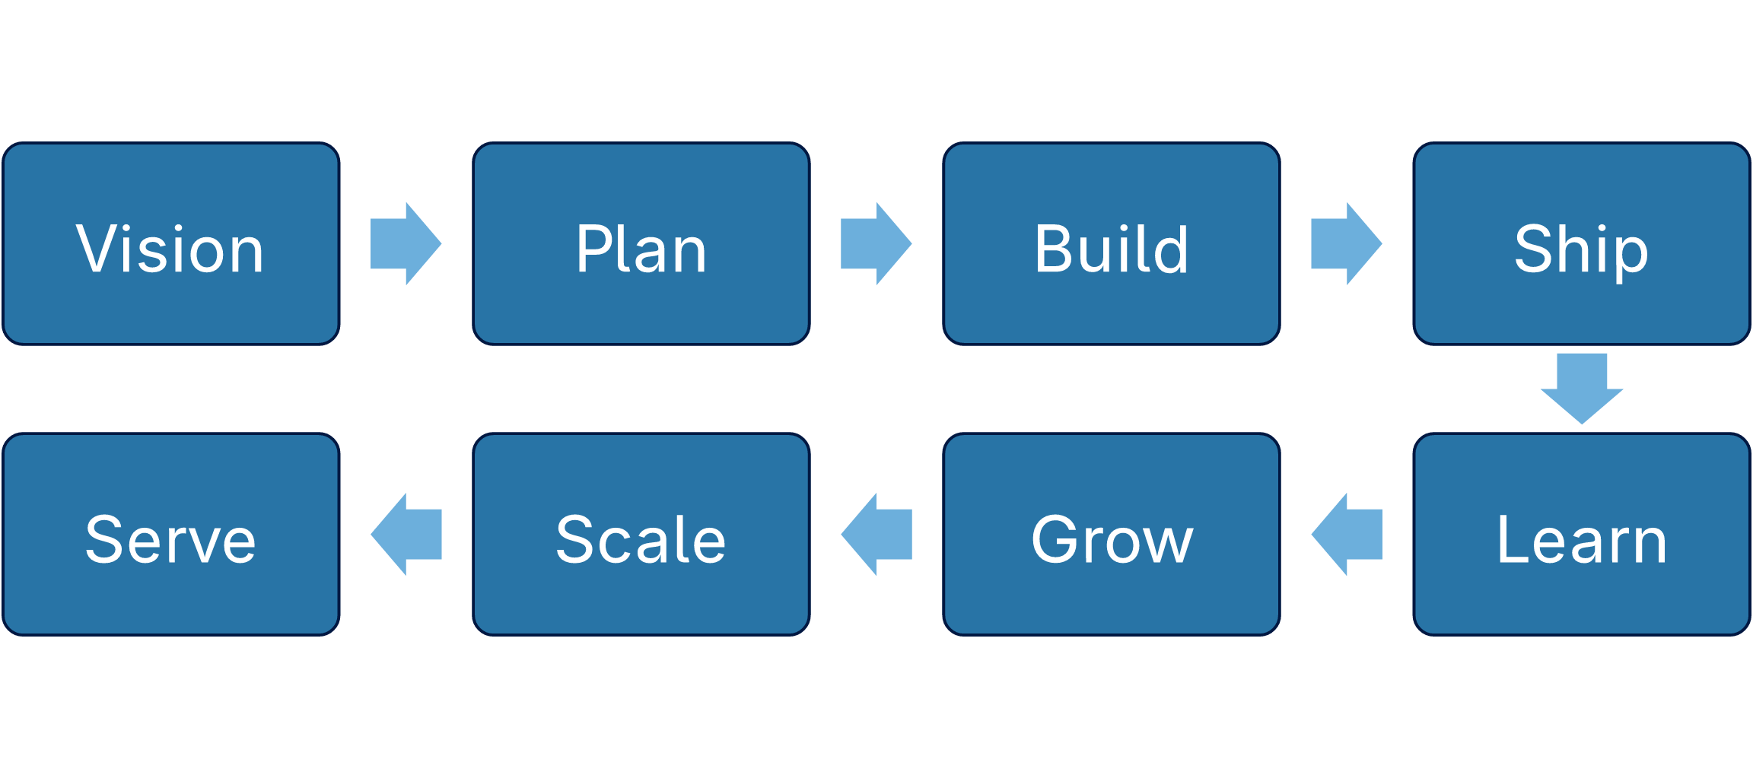
Eight steps

Slide 17
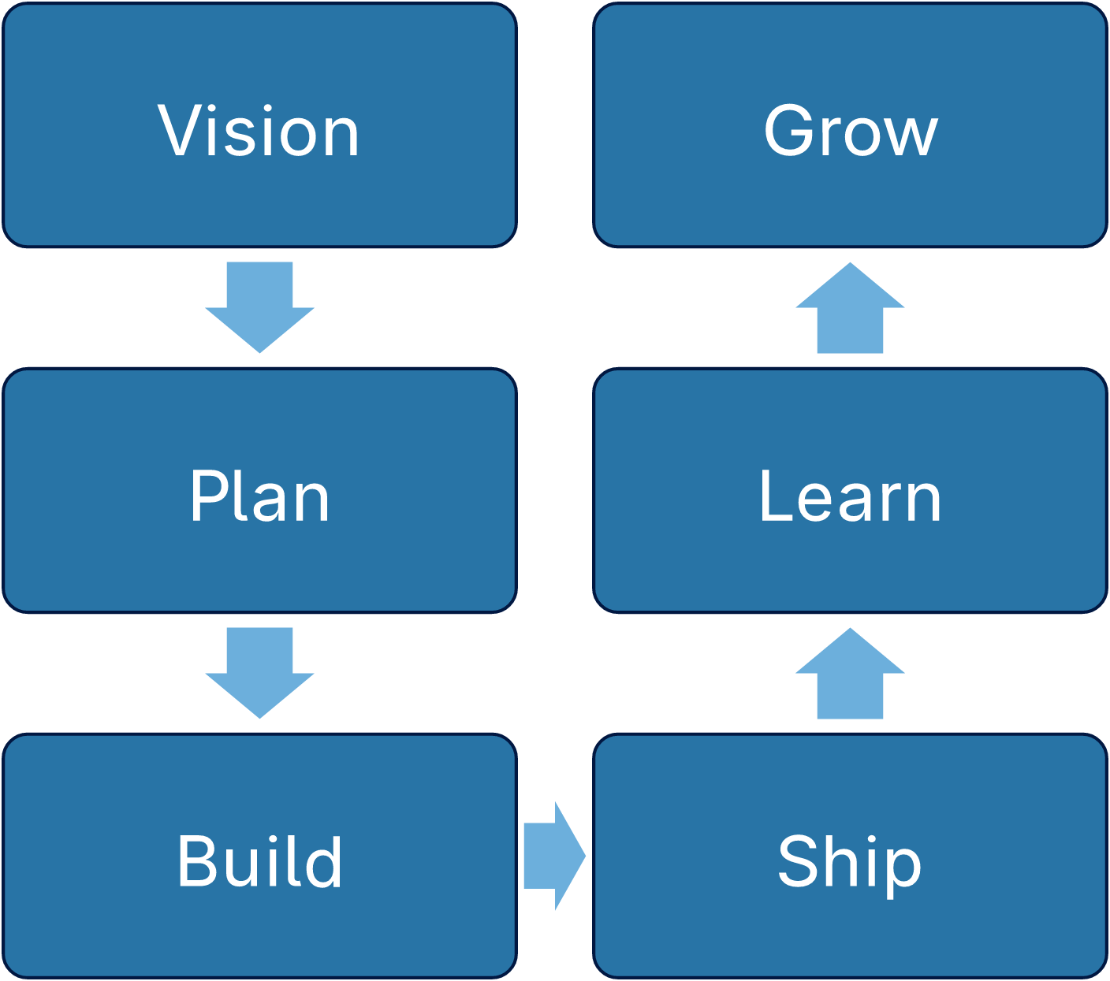
Six steps

