Slide 1
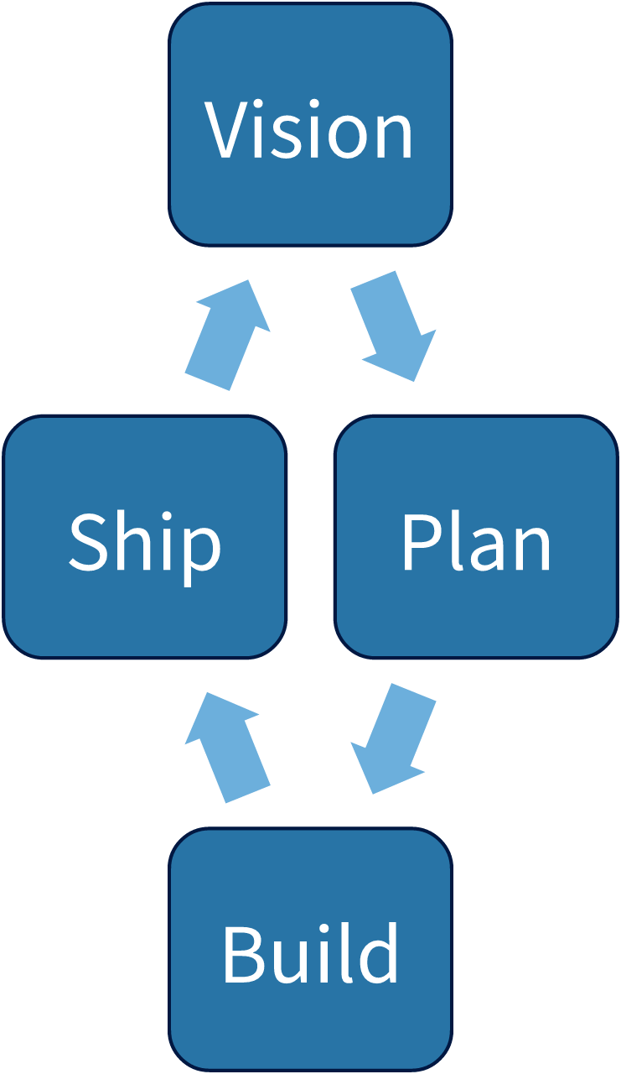
Vision
Plan
Build
Ship
How we
work

