Slide 1
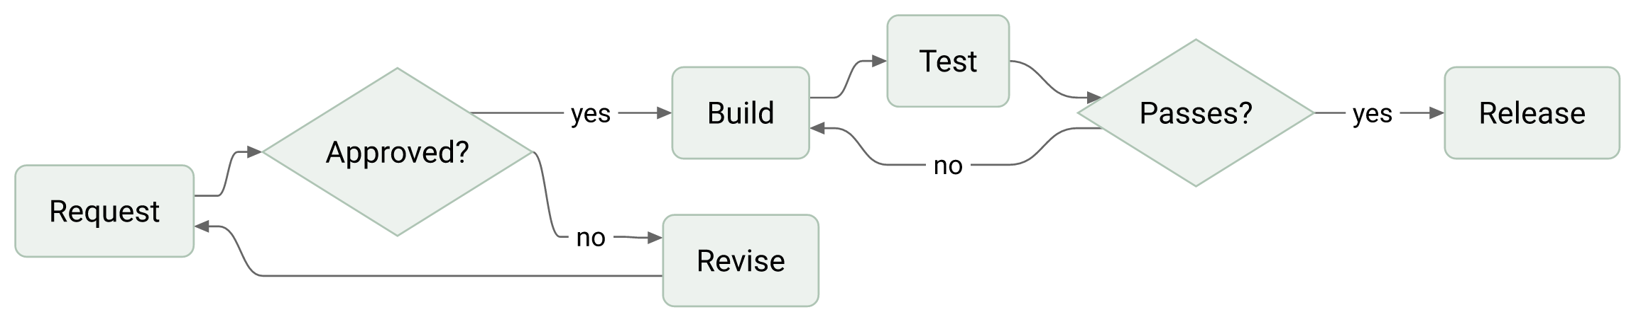
Every request is reviewed before it ships

Slide 2
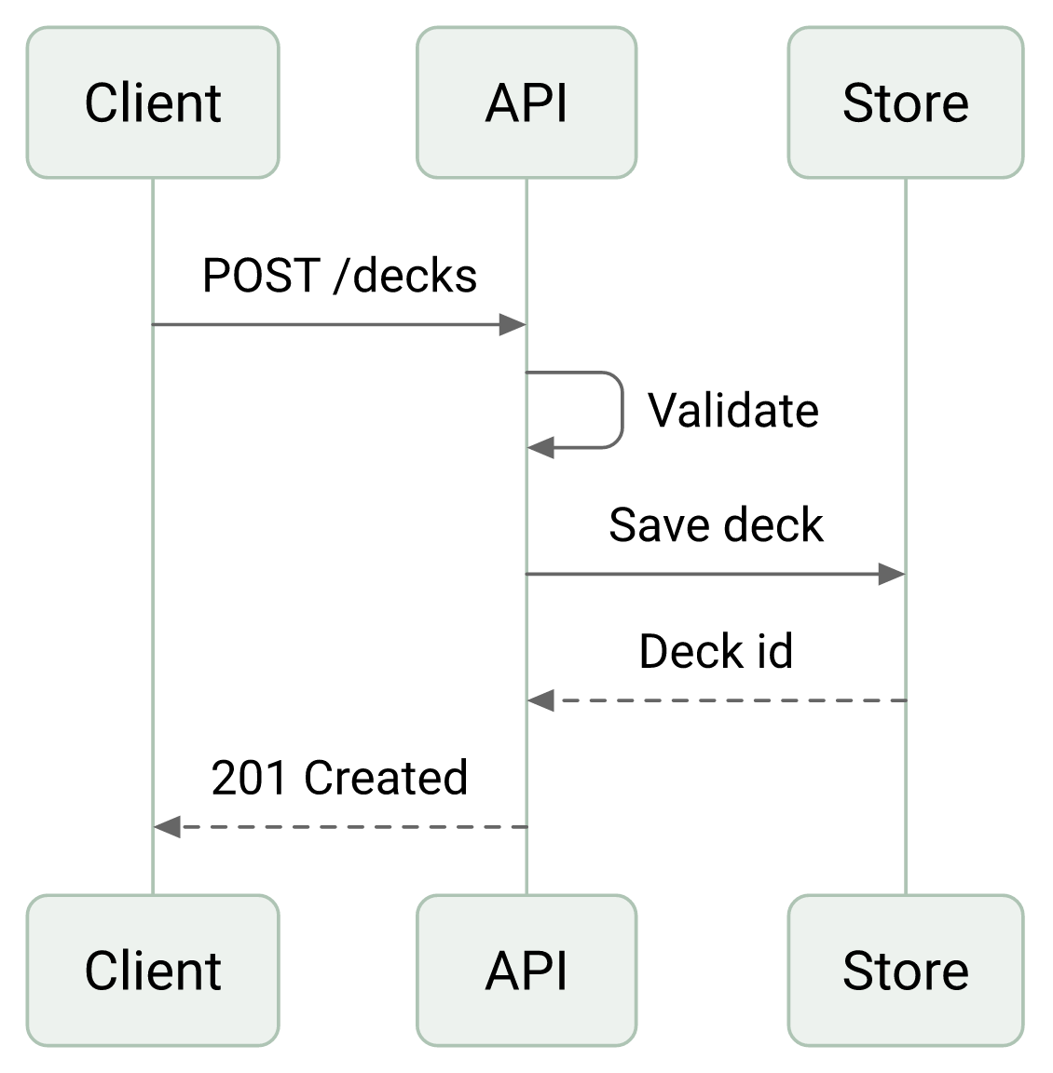
The client talks to one API
The client creates a deck with one call
The API validates it before it answers
Rendering happens later, on request

Slide 3
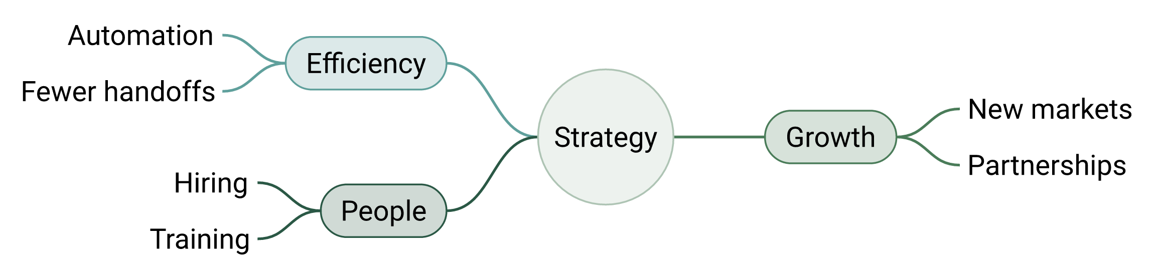
Strategy rests on three themes

Slide 4
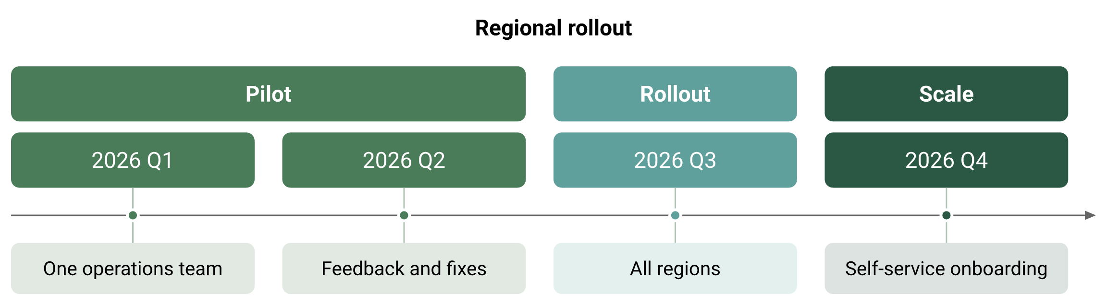
The rollout runs in three phases

Slide 5
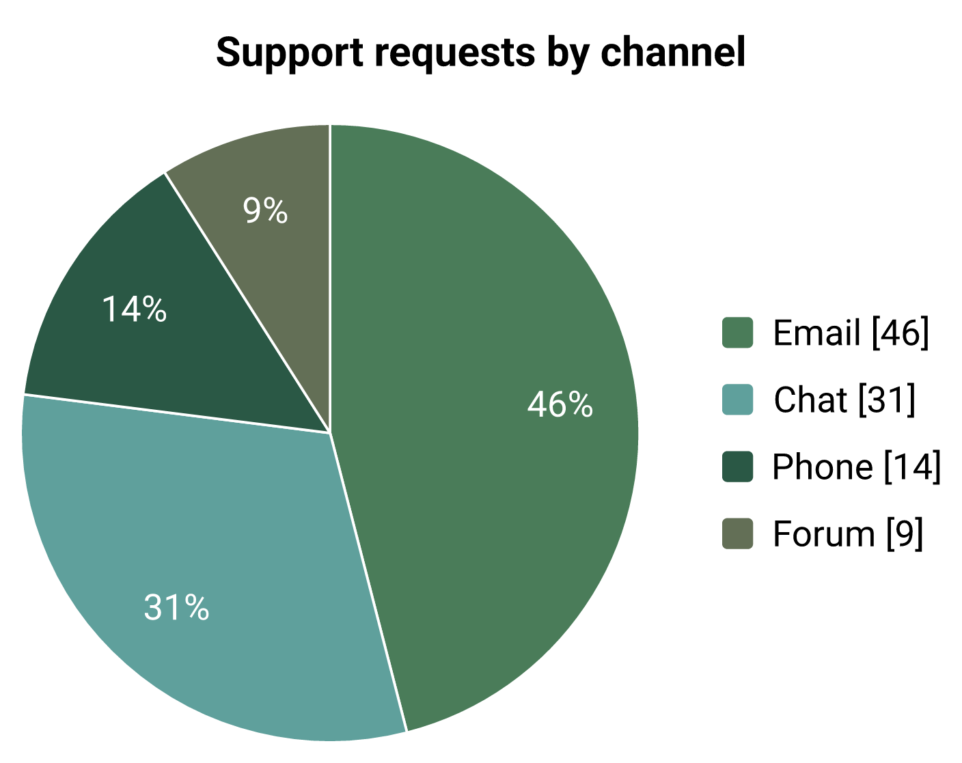
Support requests come mostly from two sources

Slide 6
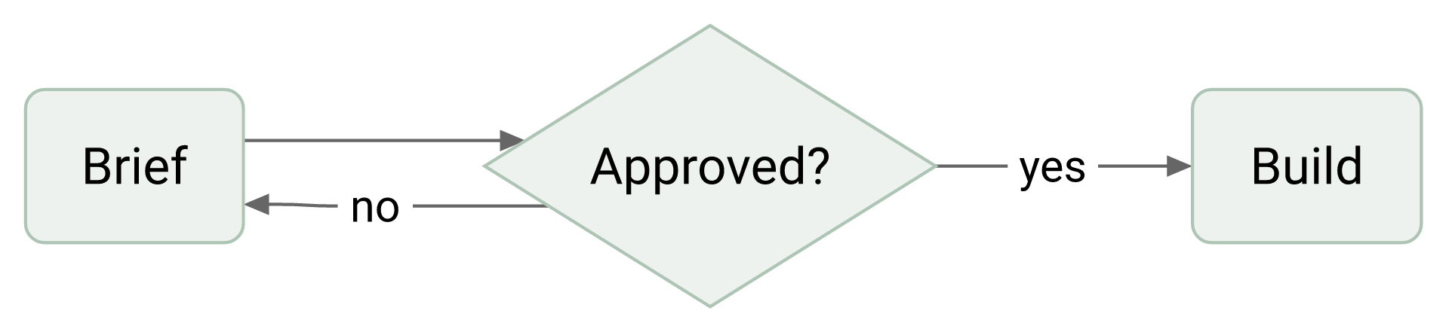
A rejected brief returns to its author

Slide 7
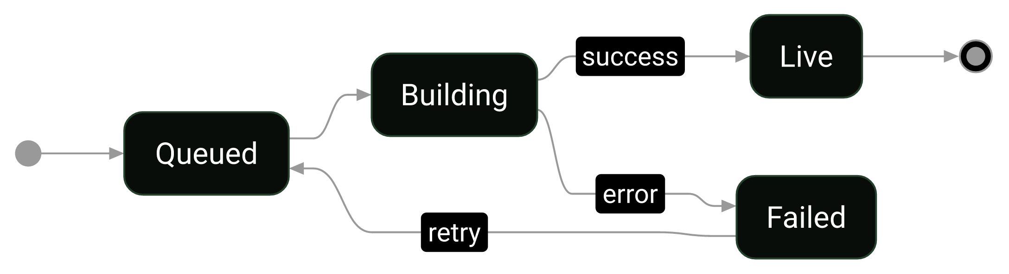
Deploys move through four states

