Slide 1


RBQM Workshop
Building Open-Source Tools paired with Central Monitoring Best Practice
Jeremy Howells, Roche
Björn Koneswarakantha, Roche
Chris Wells, Roche
Mariia Lapaeva, Roche
Lawrence Dennison-Hall, Roche
Pekka Tiikkainen, Bayer
Frederik Collin, Boehringer Ingelheim
phuse.global/working_groups

Slide 2
Getting Started
Set up Project on Posit Connect
Open Repo: https://github.com/OpenRBQM/openRBQM-workshop-EU25
Open Link to Posit Cloud Project
Log in/Create an Account
Click on the 'assignment' to make yourself a copy
Follow along with hands on exercises

Slide 3
Agenda
5 min – OpenRBQM/IMPALA – Jeremy Howells
10 min – RBQM Overview – Chris Wells
5 min – Introduction {gsm} – Björn Koneswarakantha
15 min – Hands on Analytics – Mariia Lapaeva
15 min – Deep Dive – Björn Koneswarakantha
10 min – Introduction {ctas} – Pekka Tiikkainen
20 min – Hands on Analytics – Pekka Tiikkainen
10 min – Wrap-up – Jeremy Howells

Slide 4
Workshop Objectives
Understand what RBQM is and how it’s done
Learn about open-source collaboration and contribution
Learn how to evaluate KRIs on your own studies
Learn how to detect anomalies in your clinical trial data

Slide 5


Cross Industry Organisation
Founded 2022
19 industry members
https://impala-consortium.org/
Statistical Open Source Packages
Scientific Publications
Quality Frameworks (RAPID, Quality Briefs)
Joint Health Authority Engagement
Founded 2024
> 3 industry members
RBQM focus (Critical to Quality, Centralized Monitoring, Quality Tolerance Limits)
6 Projects
Open Source Packages

Slide 6
Part 1 - Intro To RBQM & CM
Chris Wells

Slide 7
RBQM
Increased study quality
What is RBQM?
An adaptive, cross-functional, study monitoring process that begins with protocol design (including Quality by Design), identifies areas most critical to the study (including critical data and critical processes), & directs monitoring focus to risks & factors critical to safety & quality.
Focuses Resources on Most Impactful Activities
Early ID of Issues
Prevents Gaps &
Recurrence
Benefits of RBQM
Leverages technology for ongoing remote data surveillance & comprehensive risk management throughout the trial lifecycle.
Standardized Tools & Systems
Improved
Operational
Efficiency
Employs various tools, platforms and dashboards to identify signals, which indicate potential issues.
Alignment to Current & Future
Regulatory
Expectations
Allows study teams to concentrate on high value tasks and focuses resources on activities with the most potential to impact patient safety and data quality.
Also can lead to Transparently & proactively sharing the end to end compliance story, (RBQM Quality Brief ‘output’ to Regulators

Slide 8

Quality
Quality is the absence of meaningful errors.

Slide 9
CtQ: Data & Process
Critical Data
Critical Process
Data deemed important to the reliability of the study findings, specifically those that support primary and key secondary endpoints, as well as data related to safety and key eligibility criteria.
(exploratory/tertiary Endpoints are not considered critical)
Any process that is essential to the reliability of study findings and/or related to ensuring participant safety and rights
Examples:
Informed consent process
Randomization process
Protocol specific intervention or procedures
Dosing

Slide 10
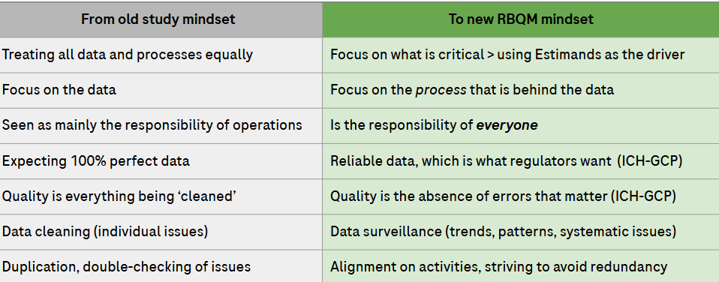
Quality – What is different this time?

Slide 11

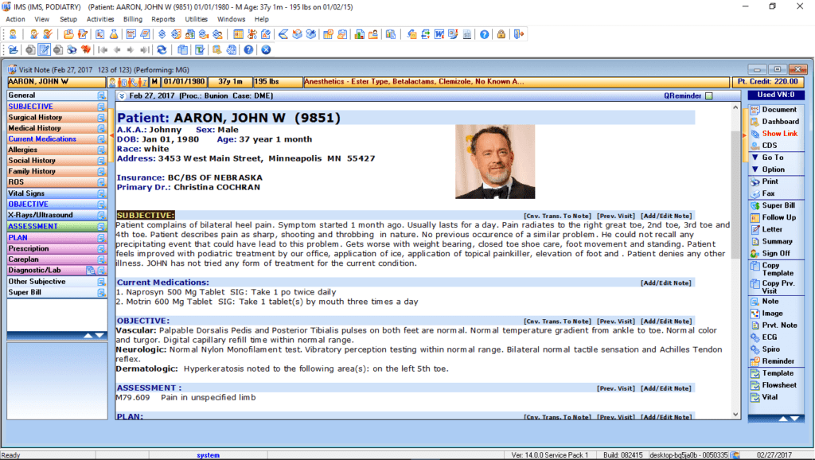
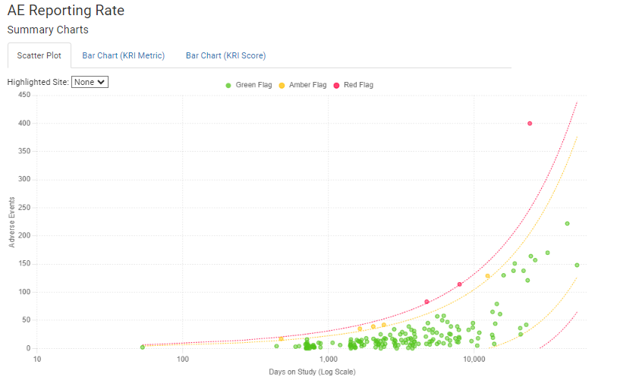
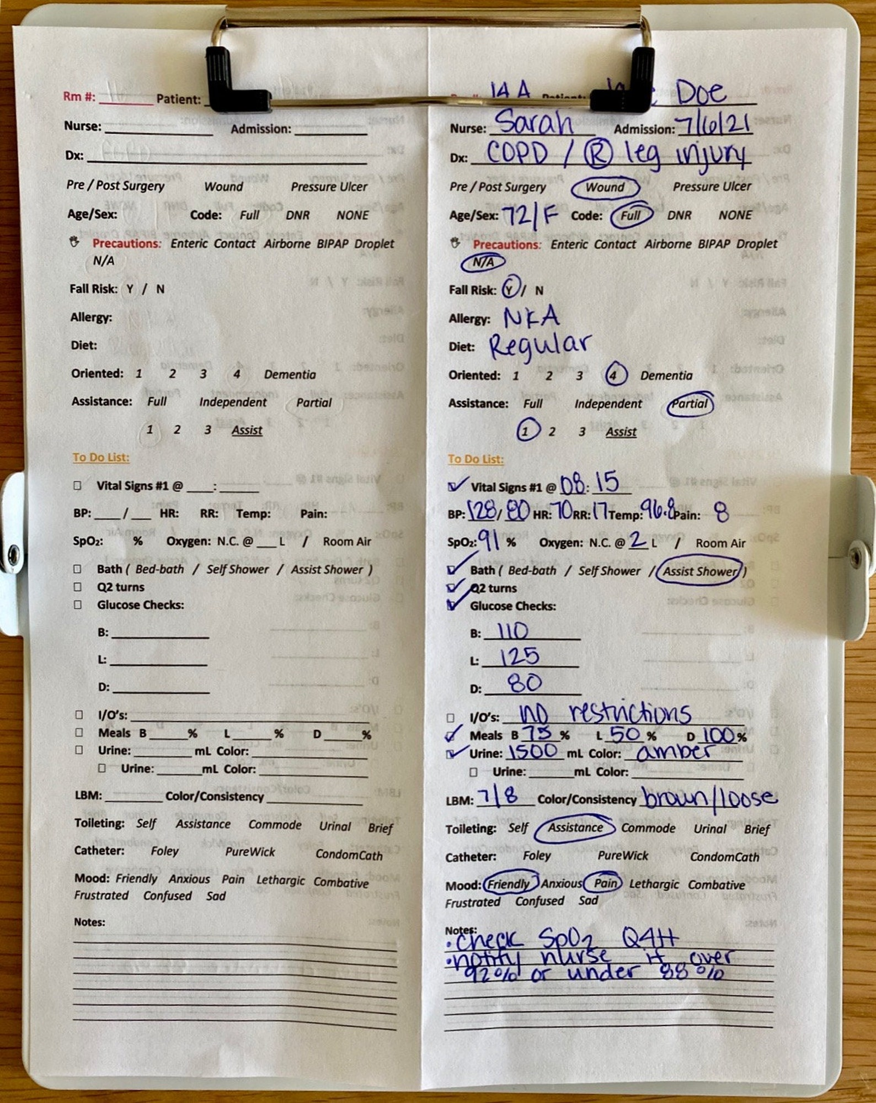
Centralized Monitoring (CM)
Centralized monitoring is a holistic view of the data used to identify trends, patterns, unusual variation in the data (aligned with ICH)
This is a vantage point that operations teams do not have
Helps operations teams target specific process risks at the study, region, country, or site level
Should focus primarily on the CtQ factors identified for the study
What CRAs see is extremely limited.
CM Enables a Unique, Holistic View.

Slide 12
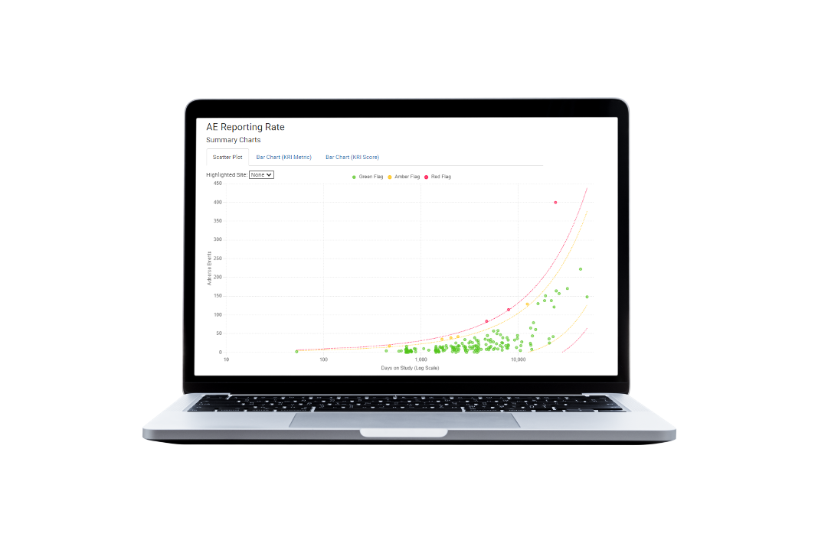


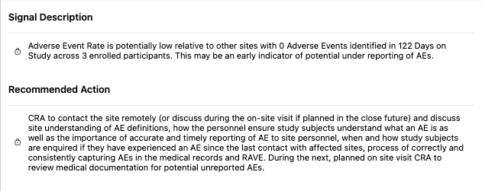

Taking Action on CM Signals
Central Monitor evaluates data signal & translates into something operational teams can easily understand and action.
Signal is tracked in CTMS (or other system) where it becomes a part of the CRA’s regular site monitoring process.
The CRA then evaluates the site’s process with the study coordinator and/or PI via RCA to evaluate potential gaps. Mitigation is then implemented.

Slide 13
Part 2 – Good Statistical Monitoring {gsm}
Björn Koneswarakantha

Slide 14
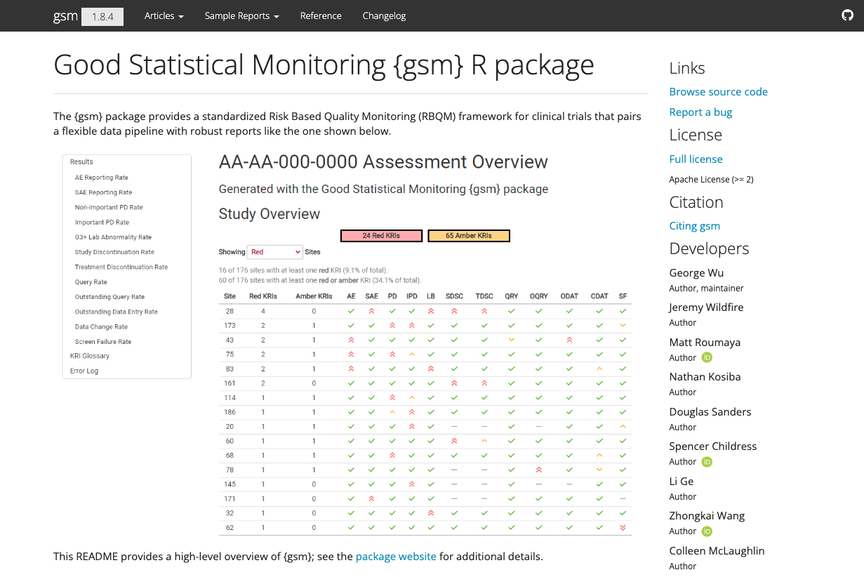
The Good Statistical Monitoring or “gsm” package is a free and open-source framework for RBQM analytics. The package provides a standardized Risk Based Quality Monitoring (RBQM) framework for clinical trials that pairs a flexible data pipeline with interactive reporting.
Learn more at https://gilead-biostats.github.io/gsm.core/

Slide 15


Slide 16


Slide 17
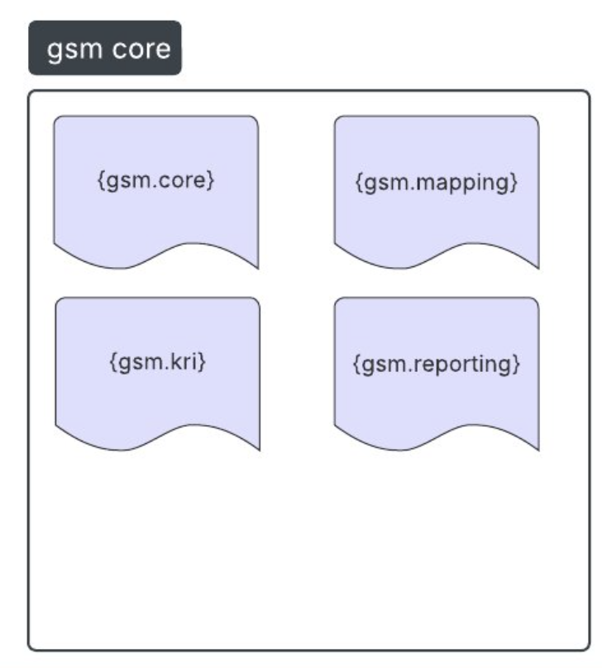
{gsm} is now {gsm.core}

Slide 18
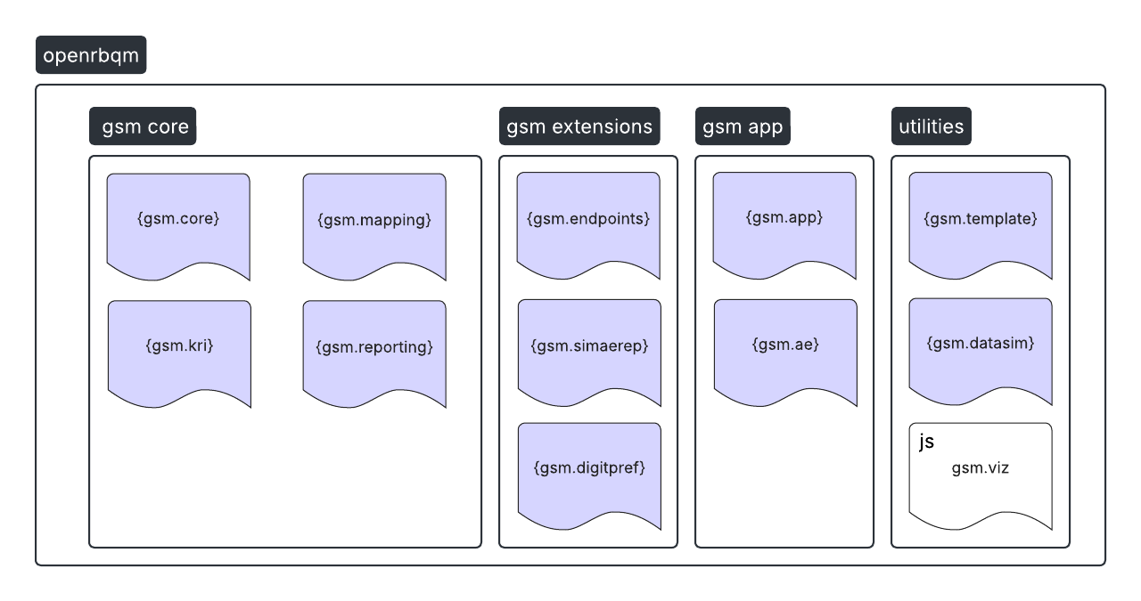
A. i

Slide 19
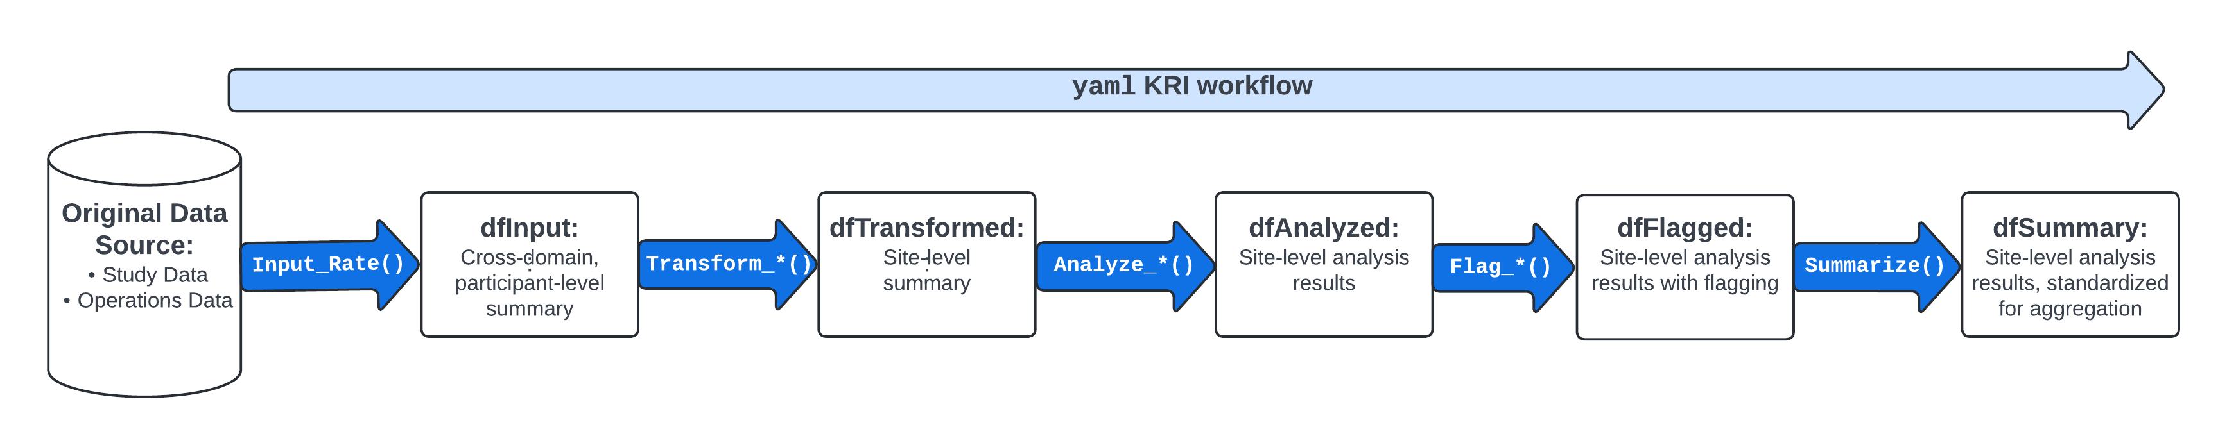
Analysis Pipeline

Slide 20
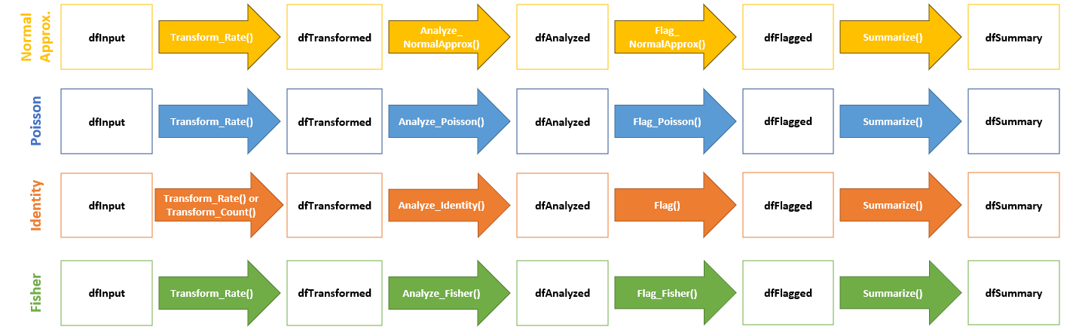
Statistical Models Available For Each Assessment
{gsm.simaerep}
Bootstrap
dfMapped
Input_CumCount()
dfInput
Analyze_Simaerep()
dfAnalyzed
Flag_Simaerep()
dfFlagged
Summarize()
dfSummary

Slide 21
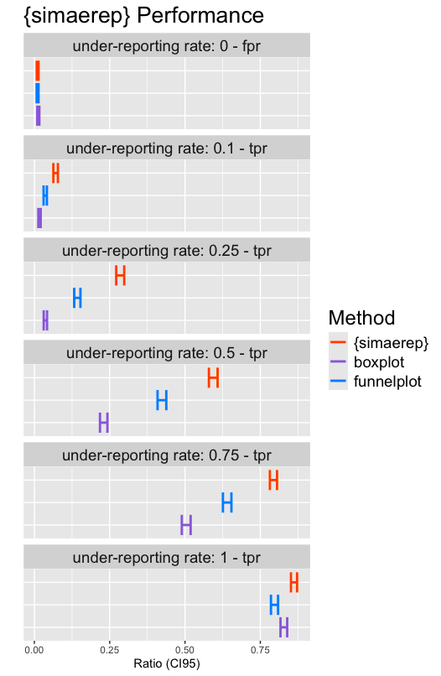





{gsm.simaerep} bootstrap
Bootstrap Simulations Redistribute Patients between sites
Higher Performance than traditional outlier detection methods
Presented at PHUSE EU Connect 2024
https://github.com/IMPALA-Consortium/gsm.simaerep
https://phuse.s3.eu-central-1.amazonaws.com/Archive/2024/Connect/EU/Strasbourg/PRE_AR04.pdf
True positive rate (tpr), false positive rate (fpr)

Slide 22
Part 3 – {gsm} Analytics
Mariia Lapaeva

Slide 23
Overview
How to create and run single metric
Analysis pipeline overview
Hands-on
Open Posit Workbench
Review the setup/file structure
Run analysis pipeline
Review KRI report

Slide 24
Create and Run Single Metric
Open and explore `sae-kri.R` file:
source() data from 'R/DataIO.R’ to load data input/output helpers
Use gsm.core::Input_Rate() function to calculate SAE reporting rate
Use gsm.core::Transform_Rate() to transform the input for analysis
Use gsm.core::Analyze_NormalApprox() to analyze the transformed data using normal approximation
Use gsm.core::Flag() to flag sites based on thresholds with threshold values of c(-3, -2, 2, 3)
Note: AE KRI transformed into SAE KRI by applying filter to aeser variable
Resources: Step-by-Step Analysis Workflow

Slide 25
Part 3 – {gsm} Deep Dive Pipelines
Björn Koneswarakantha

Slide 26
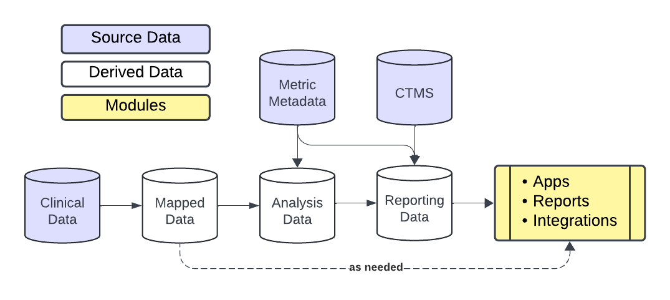
Analysis Pipeline

Slide 27
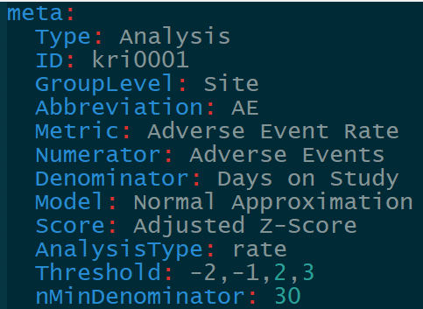
Analysis Pipeline

Slide 28
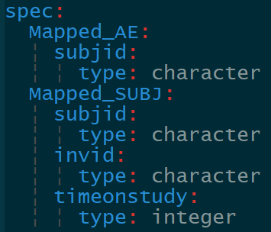
Analysis Pipeline

Slide 29
Analysis Pipeline

Slide 30
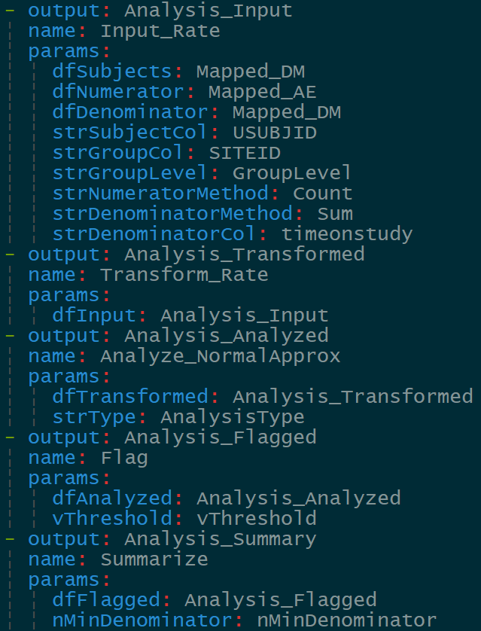
Analysis Pipeline

Slide 31
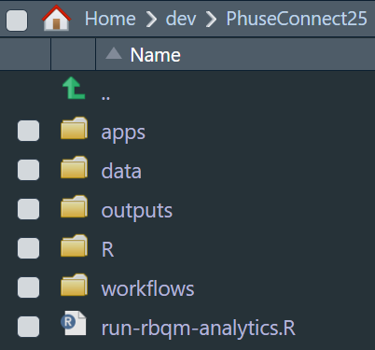
Hands-on
Open Posit Workbench with requisite packages in the OpenRBQM ecosystem installed
Review the setup/file structure

Slide 32
Hands-on
Run analysis pipeline
View Files (CMD/CTRL+SHIFT+5)
Click run-rbqm-analytics.R
Run each step interactively
Open report in ./outputs

Slide 33
Hands-on
Create a new KRI: SAE Reporting Rate (time permitting)
Under./workflows/2_metrics copy adverseEventReportingRate.yaml and rename seriousAdverseEventReportingRate.yaml
Open the new workflow and update the information in meta
Add aeser to data spec for Mapped_AE
Add a new step that filters Mapped_AE on serious AEs
Pass the output of the step above to the dfNumerator of Input_Rate
Rerun analysis pipeline

Slide 34
Part 4 – {ctas} Time series anomalies
Pekka Tiikkainen

Slide 35
Clinical Trial Anomaly Spotter (CTAS)
CTAS (Clinical Trial Anomaly Spotter) is a CSM tool focused on identifying anomalous time series of continuous variables.
“Unsupervised” tool which does not use pre-specified KRIs. The identified anomalies can be such that were not anticipated during study design.
Our vision for CTAS: a widely accepted open-source for tool for time series anomaly detection used by both the industry and regulators alike.
May 2022 In production at Bayer
Nov 2022 Presented at PHUSE EU Connect 22 [1], [2]
Jul 2023 Shared for co-development with IMPALA partners
Dec 2023 R package published [3]
[1] https://phuse.s3.eu-central-1.amazonaws.com/Archive/2022/Connect/EU/Belfast/PRE_AR04.pdf [2] https://phuse.s3.eu-central-1.amazonaws.com/Archive/2022/Connect/EU/Belfast/PAP_AR04.pdf [3] https://github.com/IMPALA-Consortium/ctas

Slide 36
Who is CTAS for?
Quality Assurance
Choose sites for inspections and audits.
Guide audits and inspections to focus on parameters with most anomalies.
Clinical Operations
Monitor study data of on-going trials for signs of issues. Act early on to minimize impact to project.
Identify anomalies that would potentially go undetected with more traditional methods.
Regulators
Screen submissions for anomalies in (critical) parameters.
Motivate sponsors to use advanced tools like CTAS to pre-emptily avoid data findings during submission.
Reduce manual data review.

Slide 37
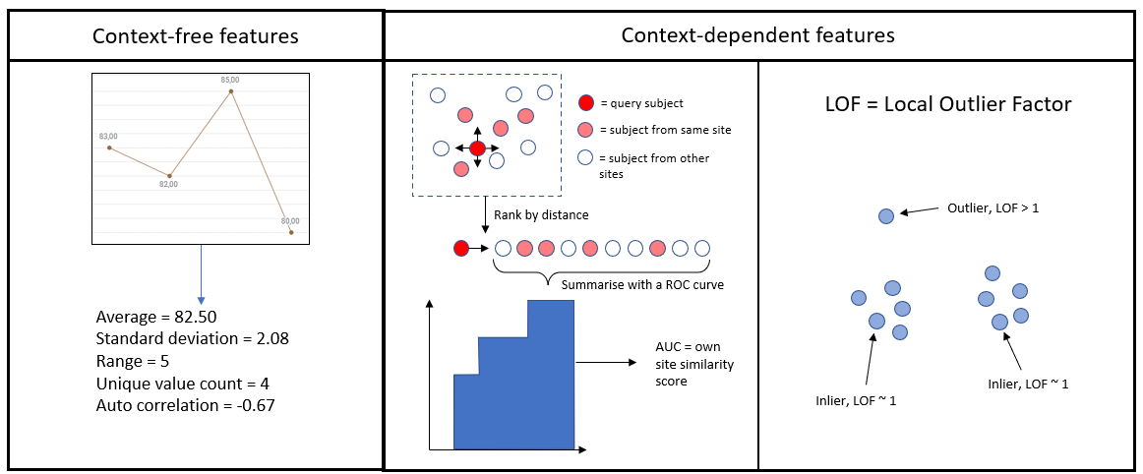
CTAS algorithm – time series features

Slide 38
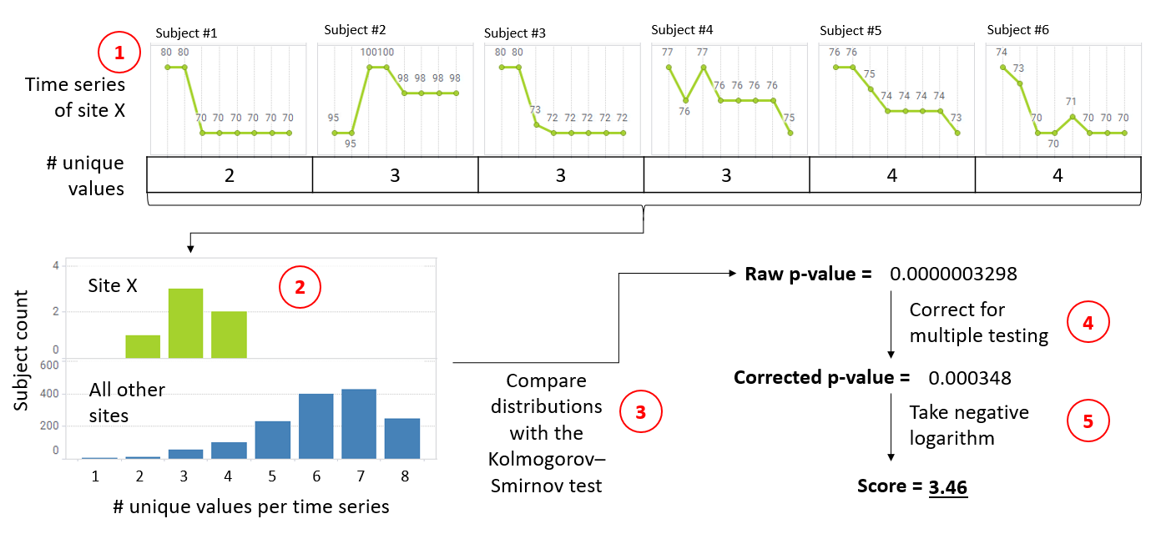
CTAS algorithm – flagging sites

Slide 39
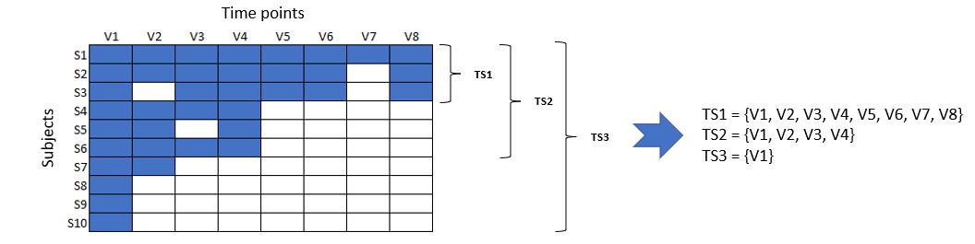
CTAS algorithm – defining a time series
Time series is a sequence of time points where a parameter of interest has been measured.
More than one time series might be defined per parameter. By default, the package defines these in a data-driven manner
The minimum number of time points per series, the minimum number of subjects per series and the maximum share of missing values per subject are hyperparameters the user can choose.
In addition to the automated time series generation, the package also accepts pre-specified time series (e.g. time points of the first two cycles of an oncology trial).

Slide 40
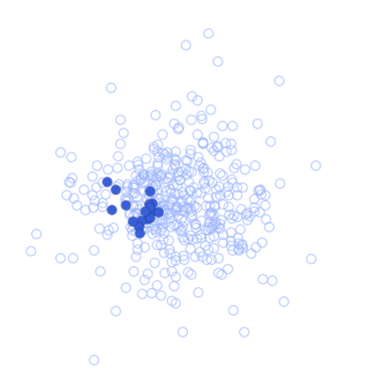
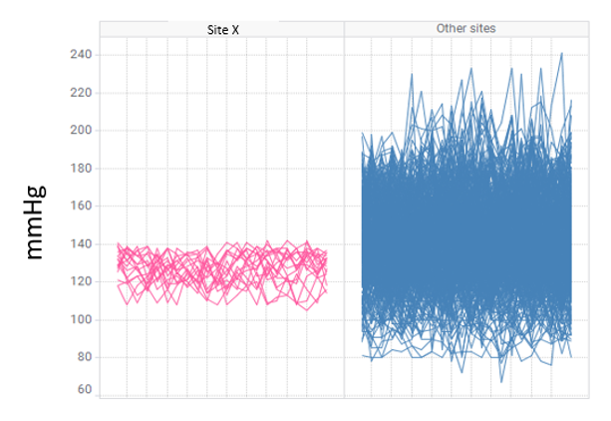
Examples of anomalies identified with CTAS
Site with co-clustered blood pressure profiles (Bayer)
Potential reasons: result fabrication, “sample” splitting, bias in subject selection

Slide 41
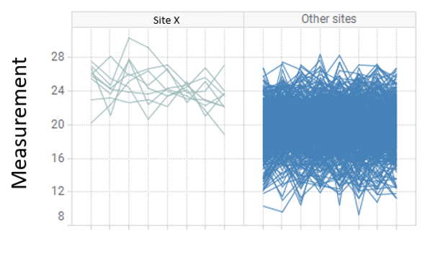
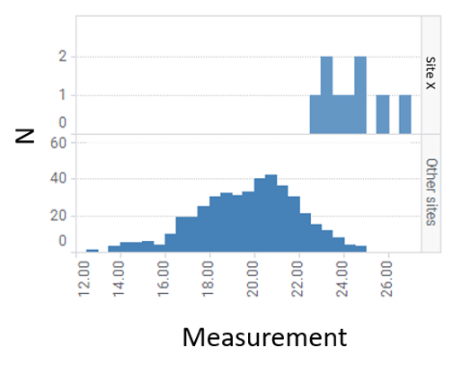
Examples of anomalies identified with CTAS
Site with unusually large laboratory assay results (Bayer)
Potential reasons: bias in subject selection, in-correct assay calibration (local labs), errors in sample handling (central labs)

Slide 42
Hands-on
Run analysis pipeline
View Files (CMD/CTRL+SHIFT+5)
Click ctas_workshop.R
Run each step interactively

Slide 43

Thank You!
Course Material will stay available on github
Visit our Presentation to learn more
X12 Wednesday

