Slide 1
Check installation
Nobuhiko Miyamoto
National Institute of Advanced Industrial Science and Technology
Industrial Cyber-Physical Systems Research Center
Software Platform Research Team
Notes:
You will need to install some software in the programming practice of Part 2.

Slide 2
Check installation(Windows)
OpenRTM-aist
OpenRTM-aist-1.2.2-RELEASE_x86_64.msi
Python
python-3.7.5-amd64.msi
CMake
cmake-3.15.4-win64-x64.msi
Doxygen
doxygen-1.8.14-setup.exe
Visual Studio
Visual Studio 2019
2
Notes:
2
If you are using Windows, please install these software.

Slide 3
Check installation(Ubuntu)
OpenRTM-aist
$ wget https://raw.githubusercontent.com/OpenRTM/OpenRTM-aist/master/scripts/pkg_install_ubuntu.sh
$ sudo sh pkg_install_ubuntu.sh -l all --yes
CMake
$ sudo apt-get install cmake cmake-gui
Doxygen
$ sudo apt-get install doxygen
Java
$ sudo apt-get install openjdk-8-jdk
Code::Blocks
$ sudo apt-get install codeblocks
RaspberryPiMouseSimulatorComp
sudo apt install git premake4 freeglut3-dev
$ wget https://raw.githubusercontent.com/OpenRTM/RTM_Tutorial/master/script/install_raspimouse_simulator.sh
sh install_raspimouse_simulator.sh
3
Notes:
3
If you are using Ubunts, please install these software.

Slide 4
Download materials
Download and unzip RTM_Tutorial.zip
https://github.com/OpenRTM/RTM_Tutorial/releases/download/online_0.2/RTM_Tutorial.zip
Contents of the extracted RTM_Tutorial.zip
ppt
Part 2 slides
RTMTutorial_2_online.pdf
WEBpage
Part 2(Windows)
Part 2(Ubuntu)
script
Simulator installation script(Ubuntu)
EXE
RaspberryPiMouseSimulatorComp.exe(Simulator)
sample
RobotController(Sample code)
4
Notes:
4
Please, download and unzip RTM_Tutorial.zip.
Send the URL in chat.

Slide 5
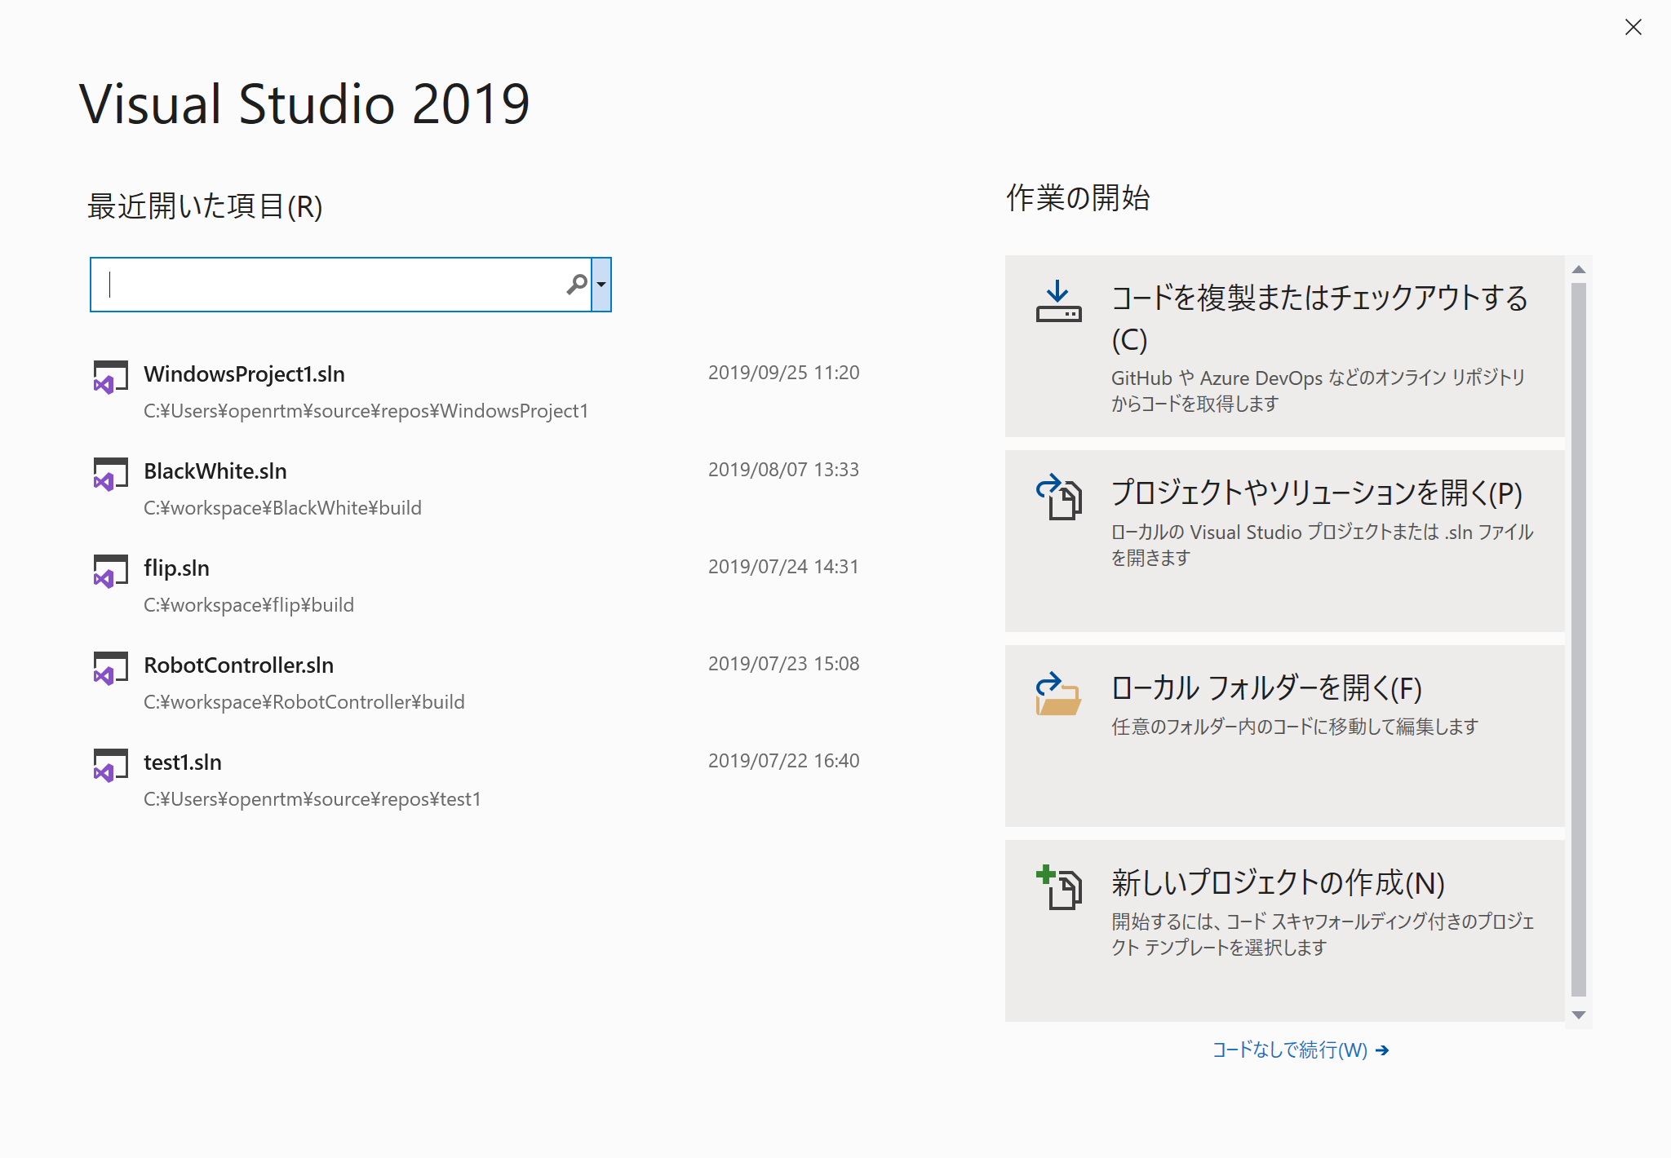
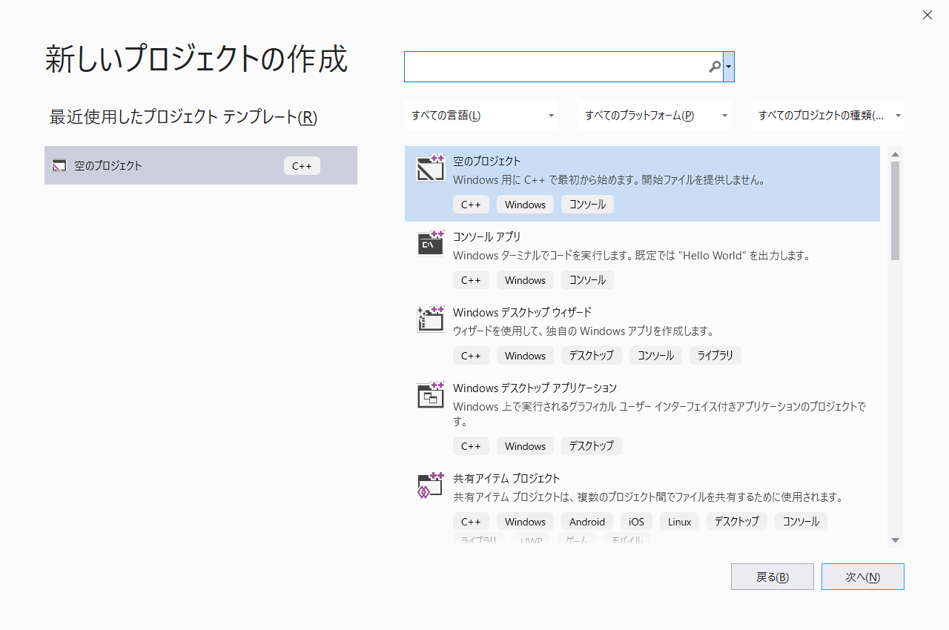
If you have not installed or downloaded the materials
Please install software during breaks.
https://openrtm.org/openrtm/ja/node/7041#toc7
https://github.com/OpenRTM/RTM_Tutorial/releases/download/online_0.2/RTM_Tutorial.zip
Make sure you have Visual C ++ installed.
5
Notes:
5
If you haven't installed the software yet, install it during the break.
Send the URL in chat.

Slide 6
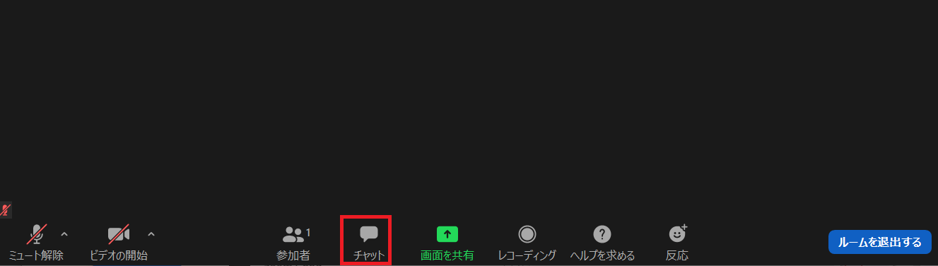
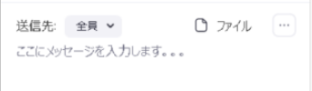
If you have any questions
Ask a question in Zoom’s chat.
Display the Zoom Group Chat screen
Please set the destination to everyone.
If the problem is not solved by chat, we will provide individual support.
6
Notes:
6
If you have any questions, please use Zoom’s chat.
If the problem is not solved by chat, we will provide individual support.

