Slide 1
第3部 RTシステム構築実習
宮本 信彦
国立研究開発法人産業技術総合研究所
ロボットイノベーション研究センター
ロボットソフトウェアプラットフォーム研究チーム

Slide 2
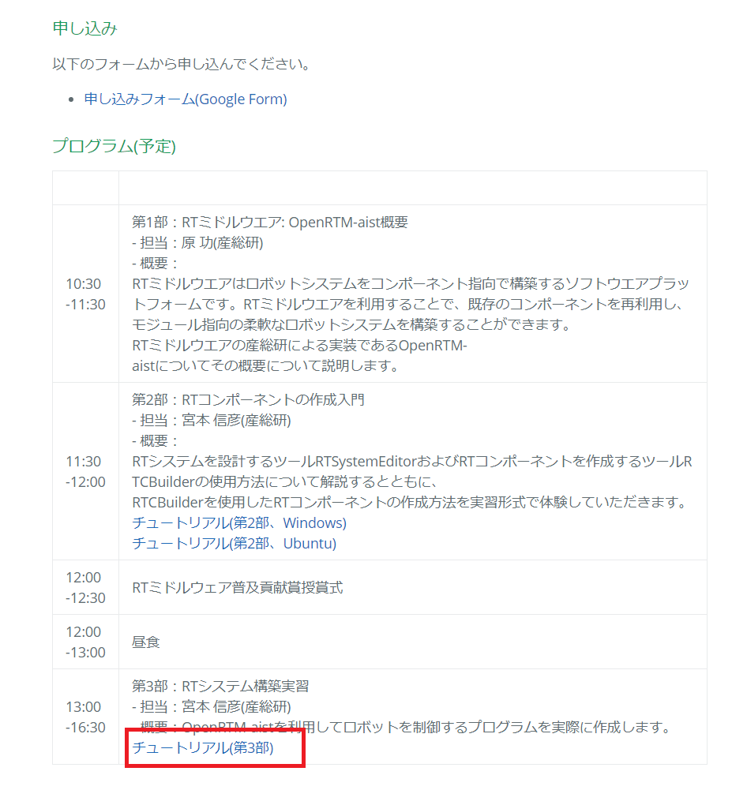
資料
USBメモリで配布
「WEBページ」フォルダのHTMLファイルを開く
チュートリアル(RTM講習会、第3部) _ OpenRTM-aist.html
もしくはRTミドルウェア講習会のページからリンクをクリック
チュートリアル(第3部)
2
Notes:
2
At first, I’d like to mention about RT.
What is RT?
RT means Robot Technology.
This is not only standalone robots like this, but also robotic elements, sensors, actuators and so on.
We have studied on RT-Middleware.
RT-Middleware is software platform to integrate these RT-elements.

Slide 3
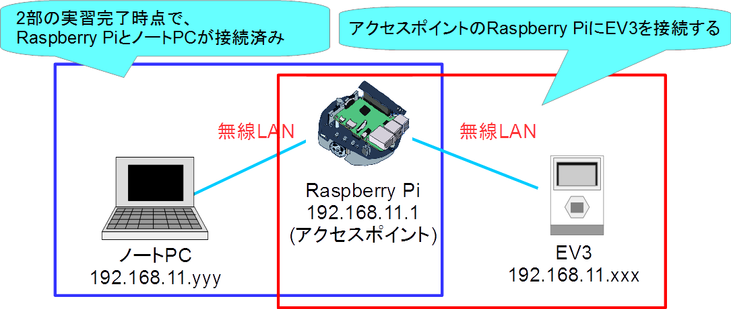
複数台のロボットが連携するシステムの構築
アクセスポイントのRasperry PiにノートPCとLEGO Mindstroms EV3を接続する
3
Notes:
3
At first, I’d like to mention about RT.
What is RT?
RT means Robot Technology.
This is not only standalone robots like this, but also robotic elements, sensors, actuators and so on.
We have studied on RT-Middleware.
RT-Middleware is software platform to integrate these RT-elements.

Slide 4
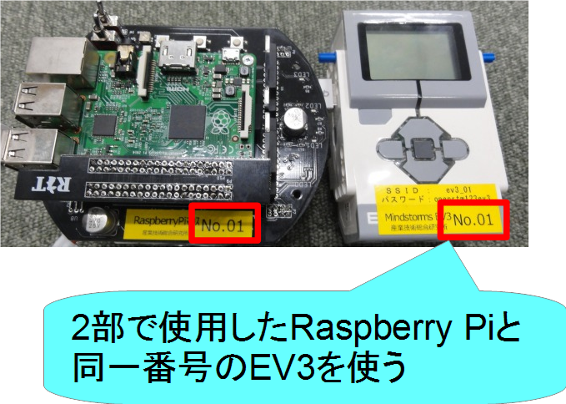
EV3配布
Raspberry Pi、EV3の番号を確認
4
Notes:
4
At first, I’d like to mention about RT.
What is RT?
RT means Robot Technology.
This is not only standalone robots like this, but also robotic elements, sensors, actuators and so on.
We have studied on RT-Middleware.
RT-Middleware is software platform to integrate these RT-elements.

Slide 5
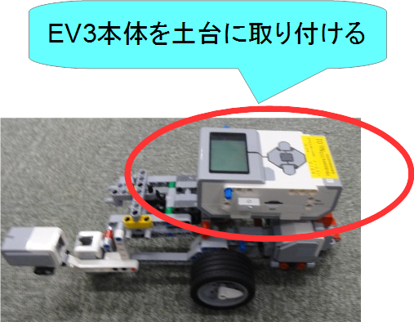
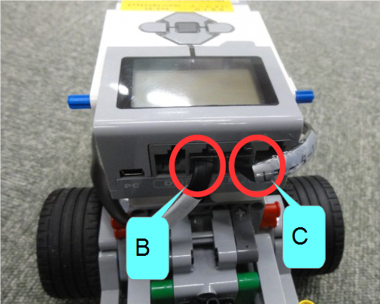
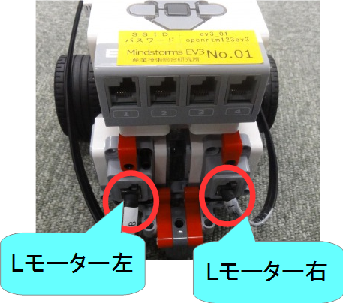
Educator Vehicle組立て
Educator Vehicleの組立て
EV3を本体に装着
EV3とLモーターをケーブルで接続
B → Lモーター(左)
C → Lモーター(右)
5
Notes:
5
At first, I’d like to mention about RT.
What is RT?
RT means Robot Technology.
This is not only standalone robots like this, but also robotic elements, sensors, actuators and so on.
We have studied on RT-Middleware.
RT-Middleware is software platform to integrate these RT-elements.

Slide 6
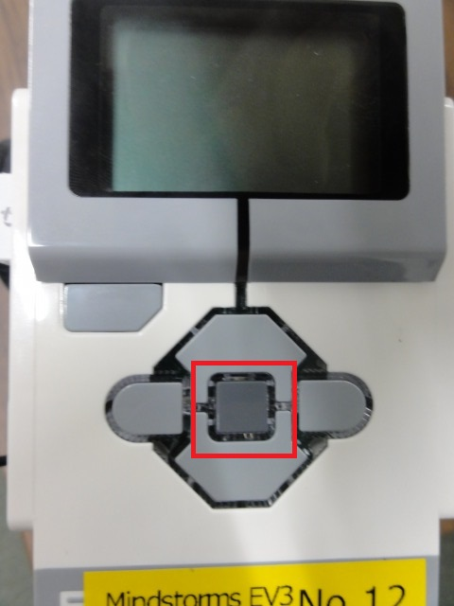
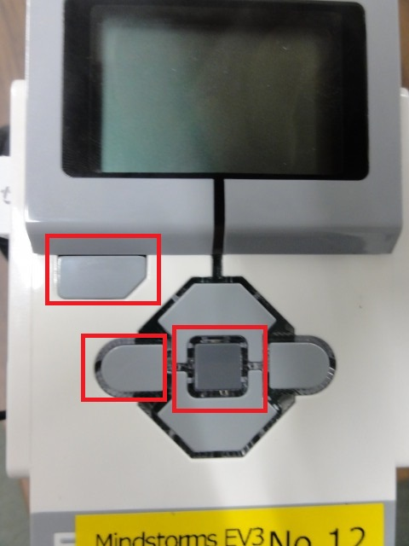
EV3の接続
電源投入
中央のボタンを押す
起動すると自動的にアクセスポイントに接続
起動しない場合はリセットを実行する
6
Notes:
6
At first, I’d like to mention about RT.
What is RT?
RT means Robot Technology.
This is not only standalone robots like this, but also robotic elements, sensors, actuators and so on.
We have studied on RT-Middleware.
RT-Middleware is software platform to integrate these RT-elements.

Slide 7
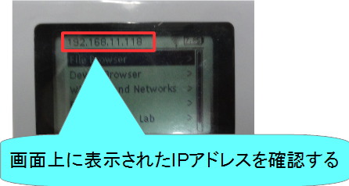
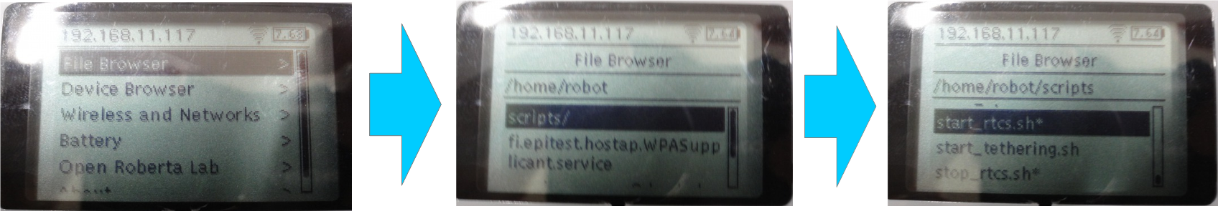
EV3の接続
IPアドレスが192.168.11.xxxになっているかを確認する
接続には多少時間が必要
スクリプトファイル実行(RTCの起動)
ボタン操作で「File Browser」→「scripts」→「start_rtcs.sh」を選択
7
Notes:
7
At first, I’d like to mention about RT.
What is RT?
RT means Robot Technology.
This is not only standalone robots like this, but also robotic elements, sensors, actuators and so on.
We have studied on RT-Middleware.
RT-Middleware is software platform to integrate these RT-elements.

Slide 8
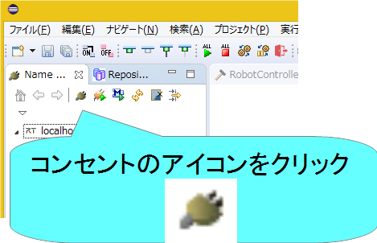
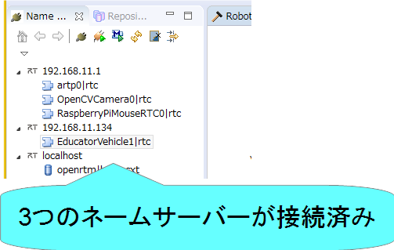
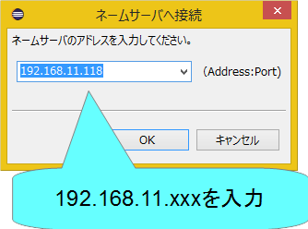
EV3(2台目の接続)
ネームサーバーの接続
EV3の画面上に表示されたIPアドレスを入力する
8
Notes:
8
At first, I’d like to mention about RT.
What is RT?
RT means Robot Technology.
This is not only standalone robots like this, but also robotic elements, sensors, actuators and so on.
We have studied on RT-Middleware.
RT-Middleware is software platform to integrate these RT-elements.

Slide 9
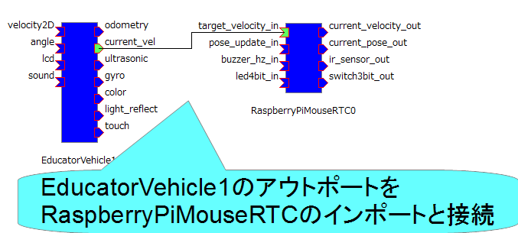
動作確認
データポートの接続
EducatorVehicle0の現在の速度出力をRaspberryPiMouseRTC0の目標速度入力に接続する。
current_vel(EducatorVehicle0) → target_velocity_in(RaspberryPiMouseRTC0)
9
Notes:
9
At first, I’d like to mention about RT.
What is RT?
RT means Robot Technology.
This is not only standalone robots like this, but also robotic elements, sensors, actuators and so on.
We have studied on RT-Middleware.
RT-Middleware is software platform to integrate these RT-elements.

Slide 10
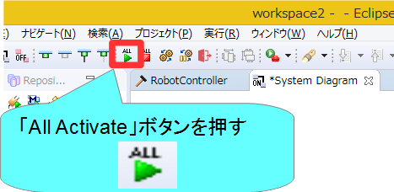
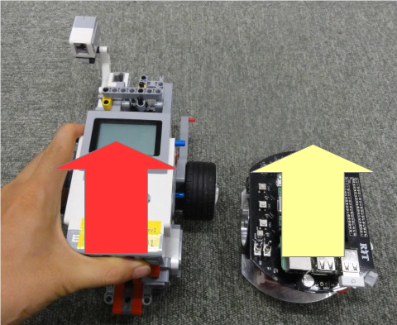
動作確認
RTCをアクティブ化する
10
Notes:
10
At first, I’d like to mention about RT.
What is RT?
RT means Robot Technology.
This is not only standalone robots like this, but also robotic elements, sensors, actuators and so on.
We have studied on RT-Middleware.
RT-Middleware is software platform to integrate these RT-elements.

Slide 11
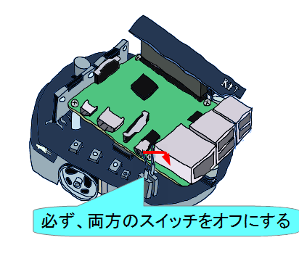
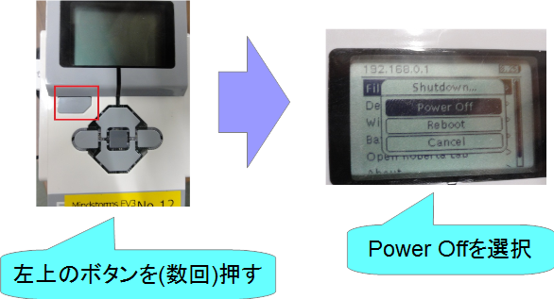
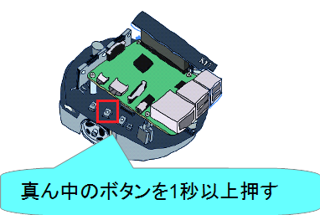
おわりに
これで実習は一通り終了です。
時間が余った場合は、以下のような課題に挑戦してみてください。 (手順はWEBページ資料で説明)
EV3のタッチセンサのオンオフでRaspberry Piを操作
ジョイスティックコンポーネントで2台同時に操作
EV3を喋らせる
マーカーを認識してRaspberry Piマウスを追従させる
カメラは2台まで貸し出し
実習を終了する際について
タッチセンサなどの実習中に取り付けた部品は、取り外して実習前の状態で返却してください
Raspberry Piマウス、EV3の電源をオフにして返却してください
11
Notes:
11
At first, I’d like to mention about RT.
What is RT?
RT means Robot Technology.
This is not only standalone robots like this, but also robotic elements, sensors, actuators and so on.
We have studied on RT-Middleware.
RT-Middleware is software platform to integrate these RT-elements.

