Slide 1
ConTextractors
Contract + Text + Extractors
11 Automatic Contract Analysis
Hack4Rail 2026

Slide 2
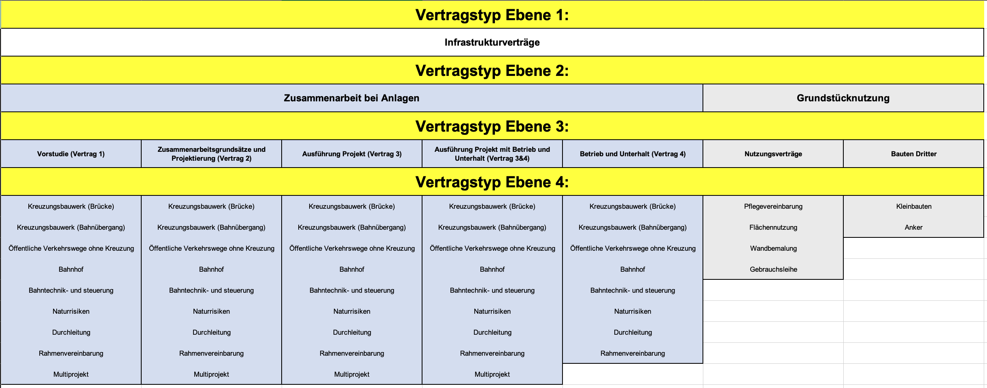

Slide 3





/The Problem/
10’000+ infrastructure contracts
Manuel work, slow &
expensive
contracts from 1926
& handwritten

Slide 4




/Our Solution/ Taxonomy + LLM Pipeline
Step 1
Create Taxonomy
Contract types as machine-readable schema
3 disjoint building-block pools
Step 2
Extraction Pipeline
PDF → markitdown → LLM + System Prompt → JSON
Step 3
Validation
Quality indicator + source reference per field
Only allowed taxonomy combinations pass

Slide 5
Results: AI vs. Human
Test: Contract 90051045 (ASTRA/SBB Bridge Balsberg)
✅ 7/10 fields match with Masterdatei
✅ Cost split correctly extracted (CHF 15.8M, 45%/55%)
✅ Predecessor contract identified (from 1968)
1 field: AI is MORE CORRECT than human data!
❌ Masterdatei: "Bahnübergang" <-> Contract says: "Bahnbrücke" ✅
→ The AI found an error humans missed.

Slide 6
Roadmap: Manual → Automated
TODAY (Hackathon)
Taxonomy-ready
2 contract, manual QA
Multi-LLM verification
NEXT (3–6 months)
Batch 10,000 contracts
Human-in-the-Loop
SAP Prefill
FUTURE
Asset linking (contract → physical structure via UUID)
Contract relationship graph
⚡ The AI proposes, the human decides.
Uncertain fields always go to human verification.

Slide 7
We are the ConTextractors.
Contract + Text + Extractors
From Aktenordner to structured, validated data.
With source references. In seconds, not days.

