Slide 1
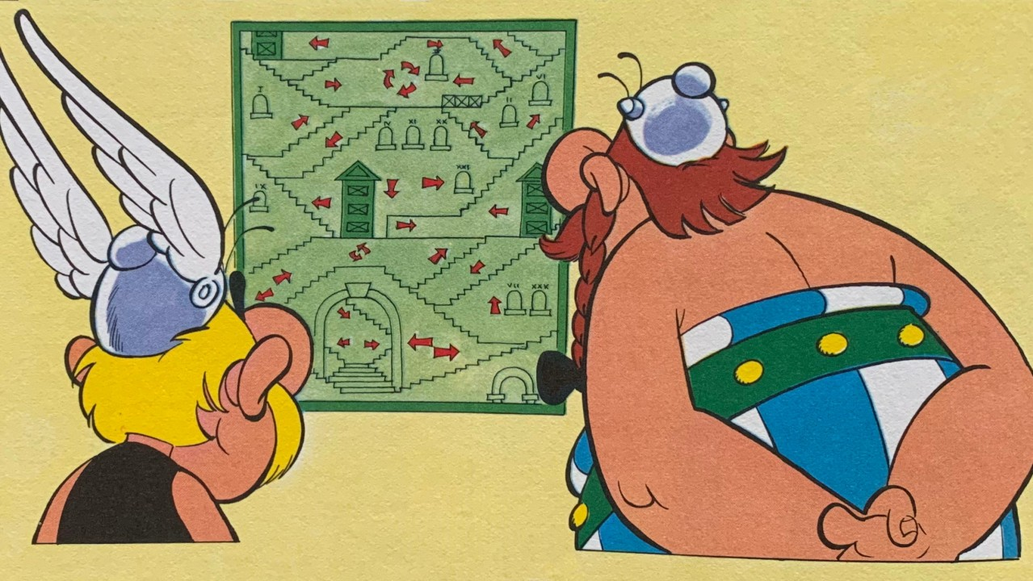
A 38
Team A38
Machine-Readable Railway Governance
Hack4Rail 2026 – Who Makes the Rules?

Slide 2
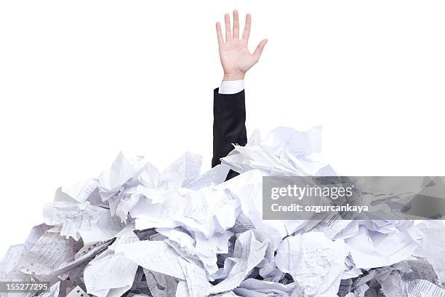
The Problem

Slide 3



The Solution = The Paradigm Shift
TODAY:
Word → PDF → humans extract and interpret what applies
OUR PROPOSAL:
Machine-readable FIRST, PDF/other second.
The canonical source is structured data als single point of truth
does it (OSCAL). adopted it.
We bring it to rail: OSCAL4Rail.

Slide 4
The Solution = The Paradigm Shift
Does it
Adopted it
We bring it to Rail – OSCAL4Rail

Slide 5
Idea for Standardization: OSCAL4Rail
Lightweight profile of NIST OSCAL (Open Security Controls Assessment Language) for railway regulations
Catalog One regulation
Groups One chapter
Controls One rule, verbatim text

Slide 6
Proof of Concept: BS-KI (Switzerland)
Branchenstandard Kundeninformation
44 rules × 6 channels × 4 transport modes
What we did:
Excel matrix → parsed deterministically
PDF (64 pages) → chapter-level text extraction
Combined → one OSCAL Catalog YAML
Validated against NIST JSON Schema ✅
What changed between 2024 and 2025?
→ git diff. Done.

Slide 7


Proof of Concept: BS-KI (Switzerland)
Branchenstandard Kundeninformation
(National Standard for Passenger Information)
44 rules × 6 channels × 4 transport modes
Plus referenced annexes and documents

Slide 8

Versioning & History
Because it's in Git and Json/Schema:
Full version history of every rule
Diff: what changed, when, by whom
Rollback: revert to any previous state
Audit trail: who approved what
No more: "Which version is current?"
No more: "What exactly changed in §4.2?"

Slide 9
Next Steps: Establishing the Standard
1. Start with IT/ITS regulations (already structured, digital-native)
- Verify automated creation of schemata with governance owners
2. Import existing governance documents
→ validate → publish as OSCAL
3. Expand: safety regulations, cross-border (TSI), operational rules
4. Find easy tools for non technical governance Owners to participate to create structured rules
Little change in workflow. Massive gain in usability.
→ Cross-railway interoperability (DB / SBB / ÖBB / SCNF / …)

Slide 10
The Vision
┌──────────────┐ ┌─────────────┐ ┌──────────────┐
│ Web Editor │ ──► │ OSCAL4Rail │ ──► │ PDF (view) │
│ (looks like │ │ (canonical │ │ API (machine)│
│ Word) │ │ source) │ │ Diff/Change │
└──────────────┘ └─────────────┘ └──────────────┘
Governance owners keep writing like they always have.
But the output is structured, versioned, machine-readable.
→ Automated compliance checks
→ Bridge to ACA: contracts validated against regulations

Slide 11
OSCAL4Rail
Machine-readable governance for railways.
Who makes the rules? Humans.
How we publish, version, and compare them?
That's a machine's job.
Starting today.

