Slide 1
HACK THE PLANET
( not ours )
E A R T H -> V E N U S -> E A R T H
Michelle Thompson W5NYV
Open Research Institute
RF VILLAGE // DEF CON >_
Notes:
Hi, I'm Michelle Thompson, W5NYV, with Open Research Institute. This talk is called Hack the Planet, and we are going to bounce a signal off Venus and hear it back on Earth. I have ten minutes to talk about how we get our signal all the way there and back. Then Pete takes you inside the waveform that makes it possible. Let's break in.

Slide 2
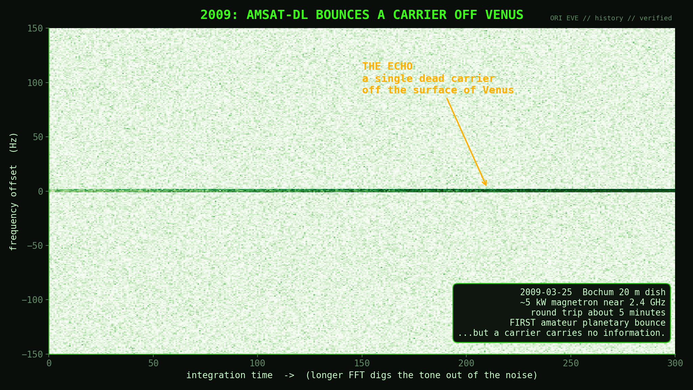
> 02 // 2009 // the dead carrier
Notes:
It starts in 2009. On March 25th, a team from AMSAT-DL aimed a dangerously powerful magnetron transmitter at the Bochum observatory at Venus. About five minutes later, the round-trip light time, they heard their own echo come back off the surface of another planet. First time amateurs ever did that, and it is a genuine landmark. But look at what came back: a single line. A dead carrier. A pure tone with no information in it. Detecting a tone is one thing. We wanted to take it to the next step and do something much harder.

Slide 3
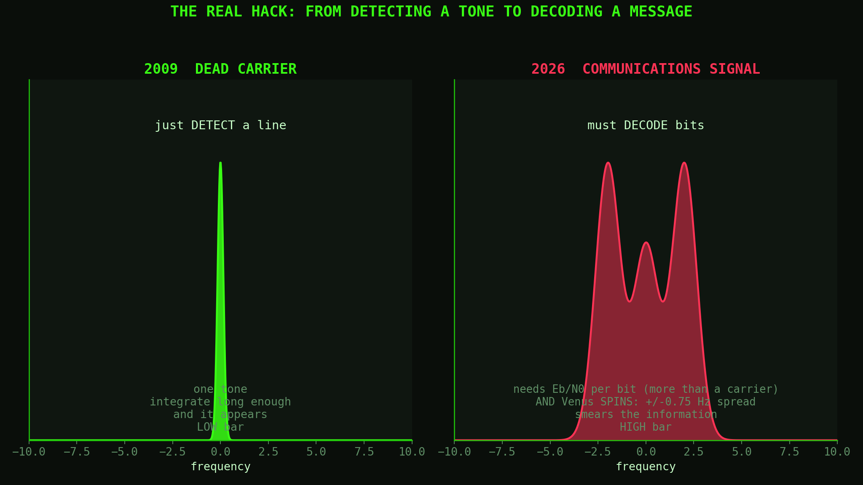
> 03 // carrier vs communications
Notes:
Here is the whole problem in one picture. On the left is 2009: a dead carrier. To hear it you just have to detect a line. On the right is what we want: a communications signal, actual bits. That raises the bar twice. Information needs more signal-to-noise than a bare carrier, and Venus spins, so the echo comes back smeared across frequency, Doppler spread. A stationary mirror does not do that; a spinning planet does. We need more margin AND a signal that survives being smeared. That is the hack.

Slide 4
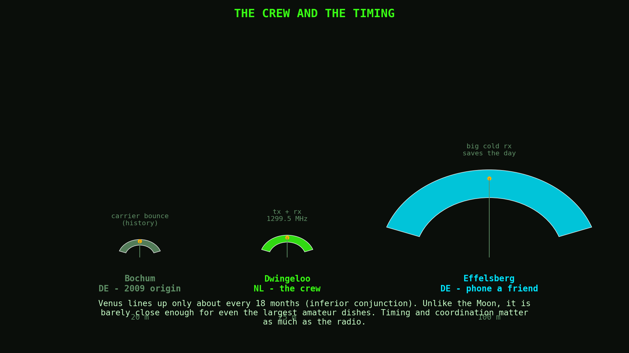
> 04 // the crew + the timing
Notes:
Who, and when? The when is brutal: Earth and Venus line up only about every eighteen months, at what is called an inferior conjunction. Unlike the Moon, which moonbouncers use every night, Venus is barely close enough even at its closest approach for the largest amateur dishes on Earth. The who: our crew is Dwingeloo, the 25-meter dish in the Netherlands, transmitting and receiving at 1299.5 megahertz. And our phone-a-friend is Effelsberg, the 100-meter giant in Germany. Timing and coordination here are every bit as hard as the radio. DSES and Bochum and Stockert are also on the crew. Stockert is receive-only. DSES is working on their transmitter. Bochum has a transmitter too, but it’s power level is substantially lower at this time than Dwingeloo.

Slide 5
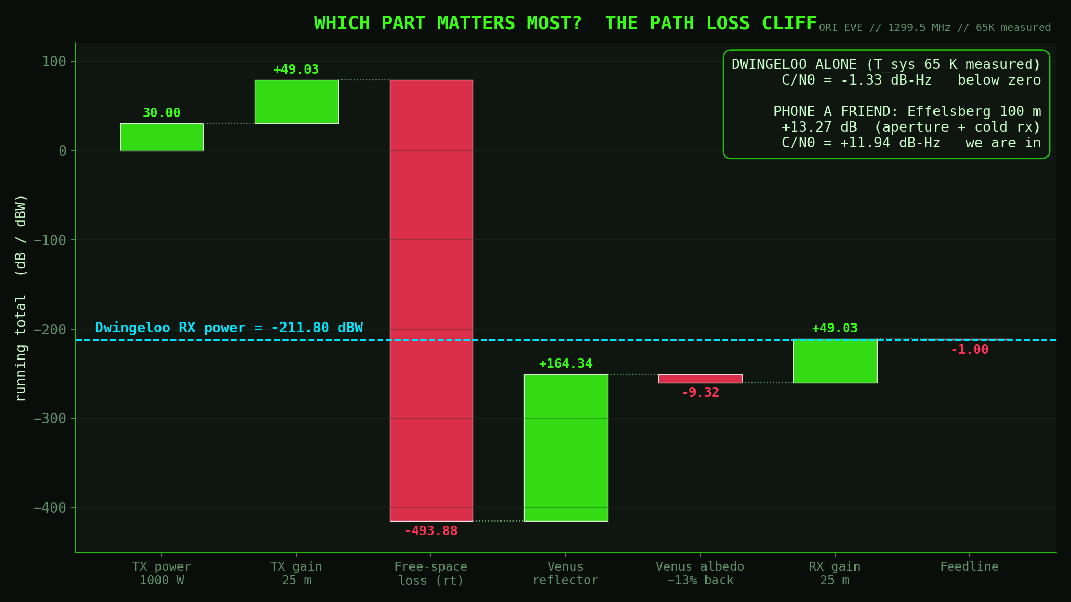
> 05 // the budget // which part matters
Notes:
This is a summary of the link budget, every gain and loss from our transmitter, listed from left to right. We start with a thousand watts and the dish gain, then the cliff: the round-trip free-space path loss is about 494 dB. Venus gives some back, the albedo takes a chunk, and with Dwingeloo's measured 65-kelvin system temperature we land, for Dwingeloo alone in October, at minus 1.33 dB-Hz. Below zero. Which part matters most? Not close. Path loss dominates, and you fix that with aperture. Hold that thought. We can also get the system noise temperature at Dwingeloo down, and this will make a big difference too. You can see that it’s like min-maxing any complex system, from a raid in Everquest to party composition in D&D.

Slide 6
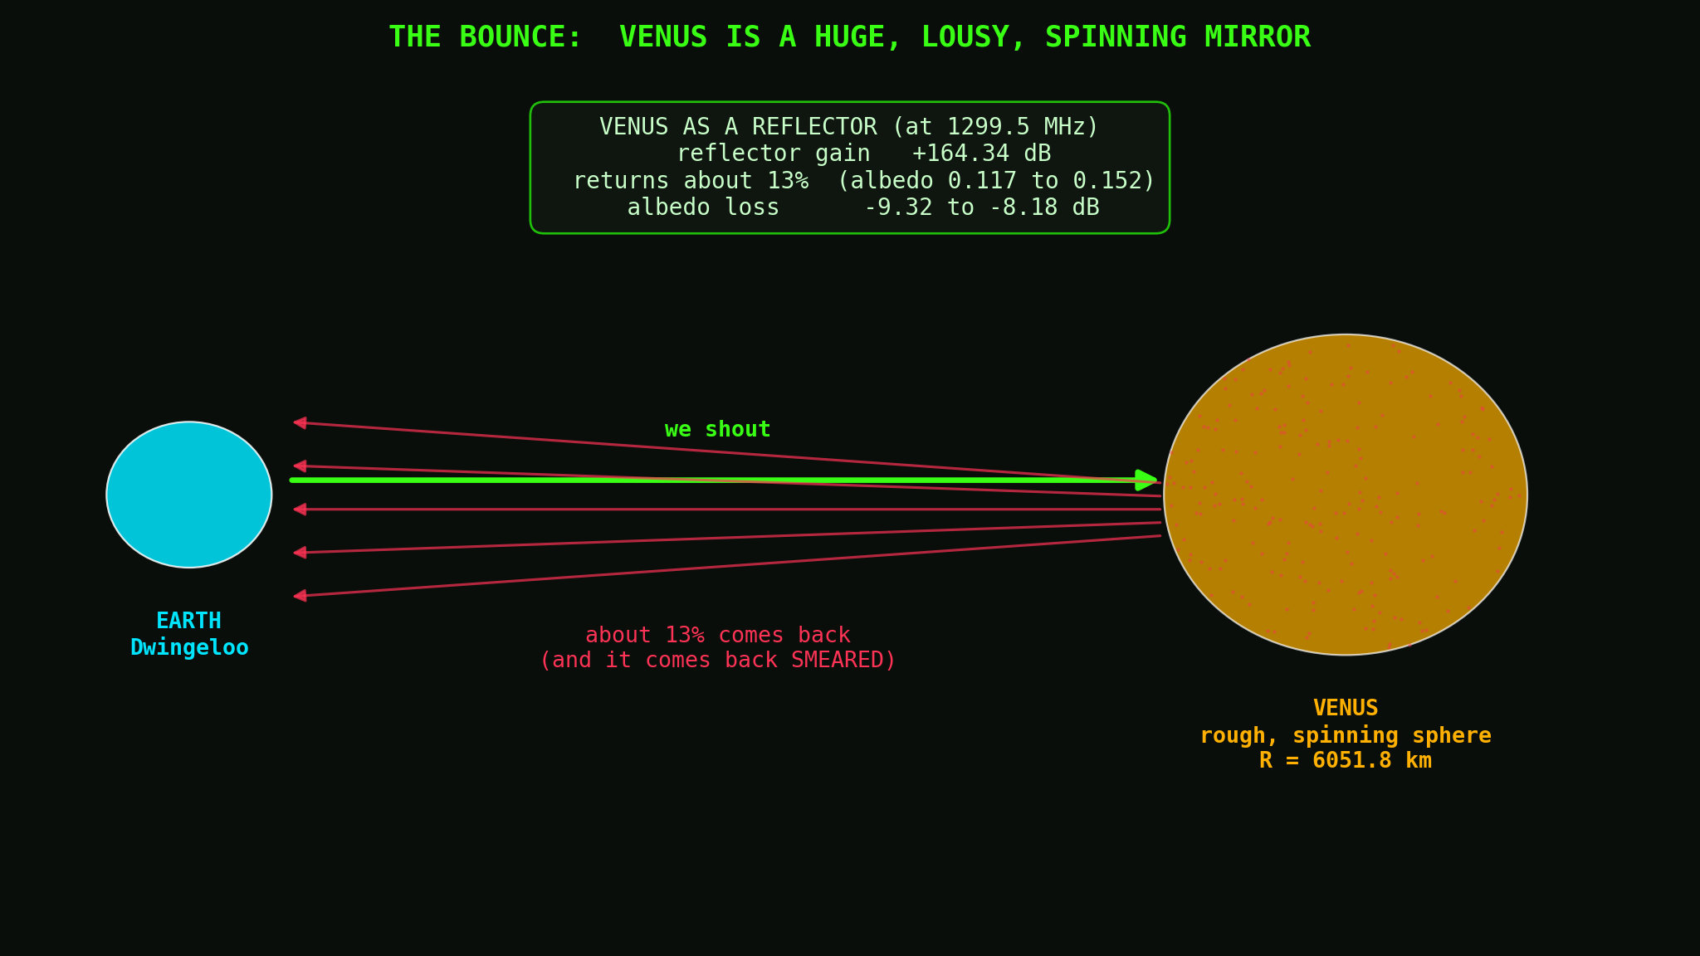
> 06 // the bounce // ~13% back
Notes:
A quick word on Venus as a reflective mirror. Venus is huge, but it is kind of lousy. Only about 13 percent of the energy that hits it comes back; the rest scatters every which way. Depending on date and band that is a radar albedo somewhere between roughly 12 and 15 percent, and for October we use the date-specific dynamic value from the Magellan map. Because it is rough and spinning, what does come back is smeared. Venus is a huge, lousy, spinning mirror, and the October 2026 numbers from the dynamic albedo calculation show it’s at the lower end. Still better than the Moon. EME folks put up with 7% albedo. But, the Moon is much closer. Path loss is “only” 260 dB or so.

Slide 7
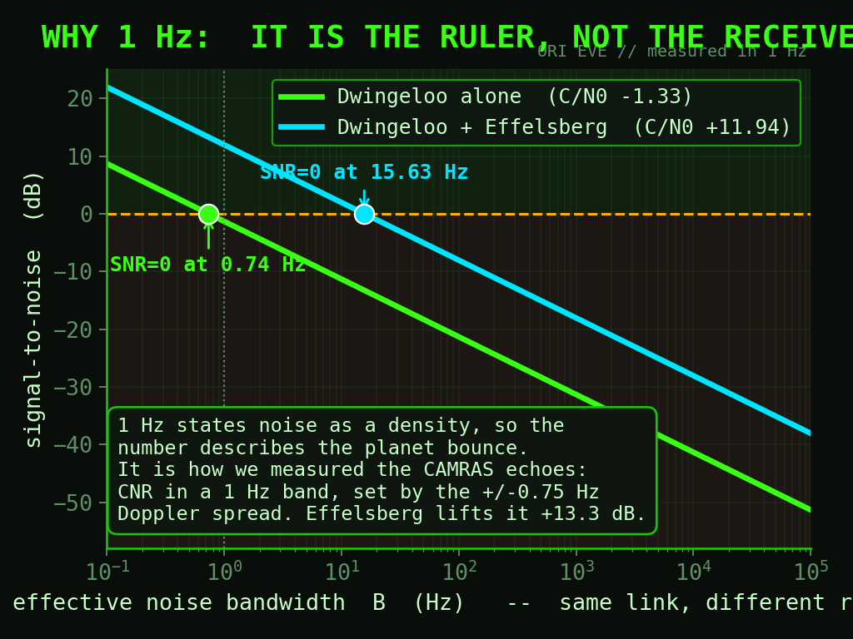
> 07 // why 1 Hz
Notes:
Now the question even professionals trip over: why do we quote everything in one hertz? People see one hertz and think we are only listening through a one-hertz radio, which sounds like cheating. We are not. One hertz is a ruler, not a receiver. Signal-to-noise in any bandwidth is just the carrier-to-noise density minus ten log of the bandwidth, one line, and every point on it is the same signal off Venus. Quoting per hertz states the noise as a density, so the number describes the planet bounce. And it is literally how we measured the real echoes: CNR in a one-hertz band, set by the Doppler spread. This makes comparisons apples to apples and not aliens to cowboys.

Slide 8
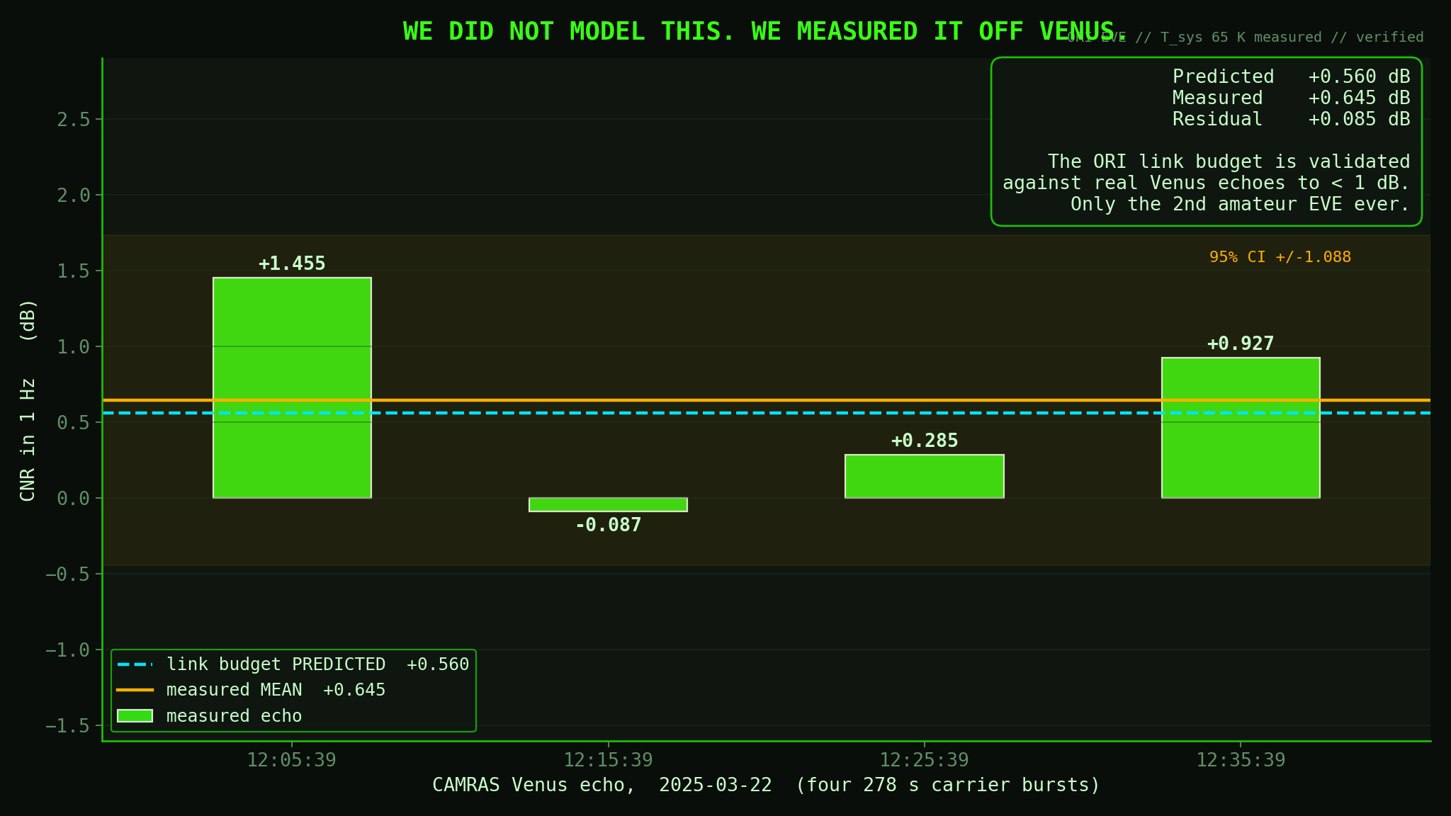
> 08 // we already measured it // CAMRAS 2025
Notes:
And here is why you should believe any of these numbers. In March 2025, CAMRAS at Dwingeloo bounced carriers off Venus, only the second amateur EVE detection in history. We measured the carrier-to-noise density in one hertz from all four echoes and got a mean of plus 0.645 dB. Our link budget had predicted plus 0.560 dB. That is a residual of eighty-five thousandths of a dB. We did not model Venus and hope. We measured it, and the model was right to a tenth of a dB. That is the ground the next slide stands on.

Slide 9
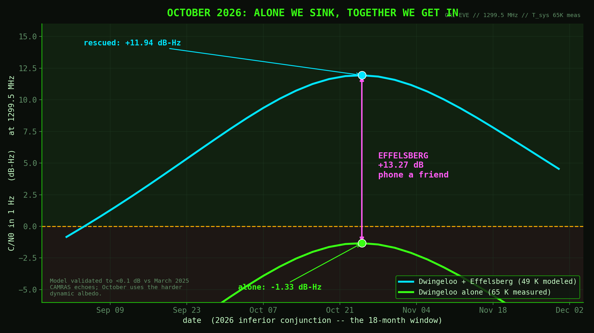
> 09 // October 2026 // the rescue
Notes:
So here is October, on the same validated model, using the dynamic albedo we will actually face, which is harder than March. The green line is Dwingeloo alone; it peaks on October 25th at minus 1.33 dB-Hz. Below zero. On its own, this is really hard. Now Effelsberg picks up the phone. The 100-meter dish plus its colder receiver adds 13.27 dB, rock solid across the whole window, independent of how bright Venus is that day. That lifts us to plus 11.94 dB-Hz. Alone we sink; together we get in. Effelsberg de-risks the whole attempt.

Slide 10
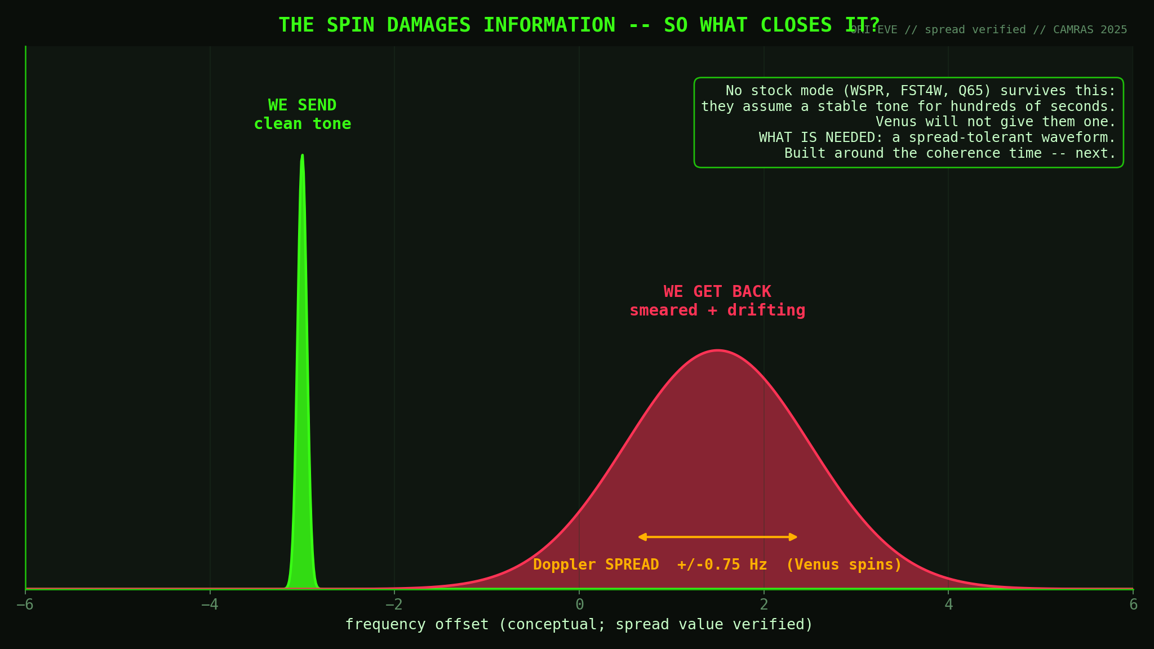
> 10 // the spin // over to Pete
Notes:
But even with that margin there is a catch, and it is why this talk has a second half. Venus spins, so the echo comes back Doppler-spread, about plus or minus three-quarters of a hertz measured by CAMRAS, and drifting. Every off-the-shelf weak-signal mode assumes a stable tone for hundreds of seconds. Venus refuses. So, no existing amateur protocol can close this link. That is what had to be built: a custom, spread-tolerant waveform. Effelsberg buys the margin; the waveform spends it.

Slide 11
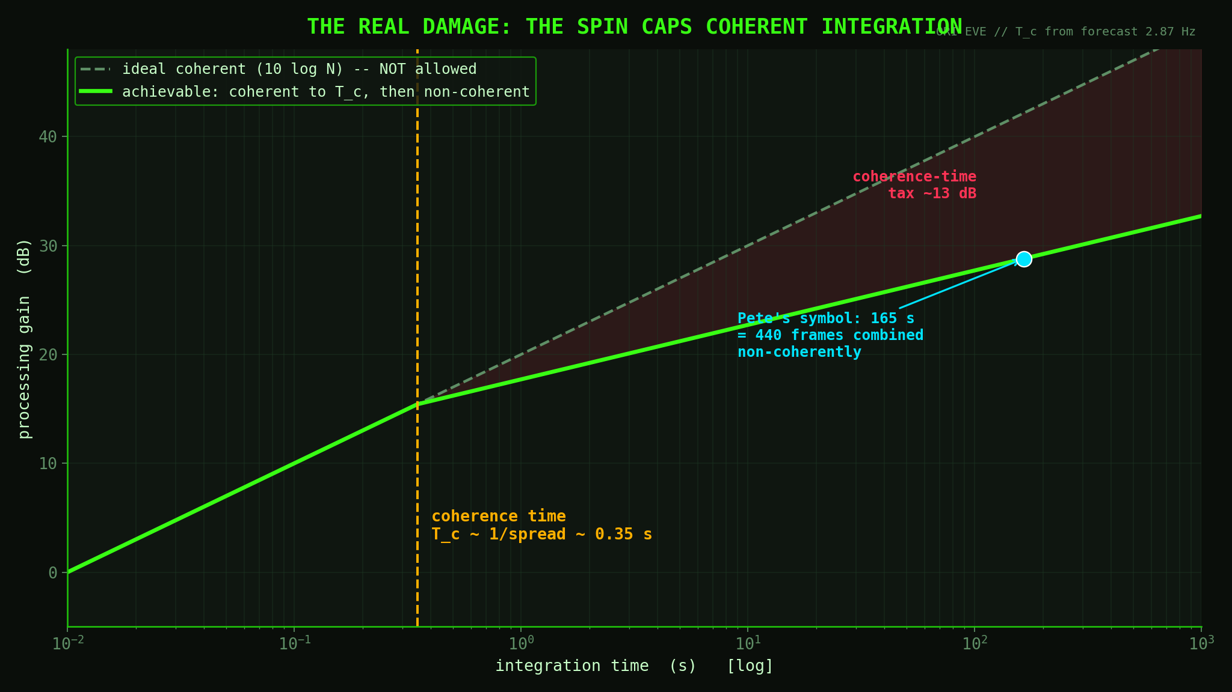
> 11 // doppler spread -> coherence time
Notes:
Here is the real damage, not just that it is smeared. The spread sets a coherence time, the reciprocal of the spread, about a third of a second for our October forecast. That is the longest you can integrate coherently before Venus scrambles the phase. The dashed line is the sensitivity you would get if you could integrate coherently forever; the solid line is what you actually get, coherent up to the coherence time then non-coherent combining, which only buys half the dB. That gap is the coherence-time tax: over 13 dB at a 165-second symbol. That tax dictates the whole waveform.

Slide 12
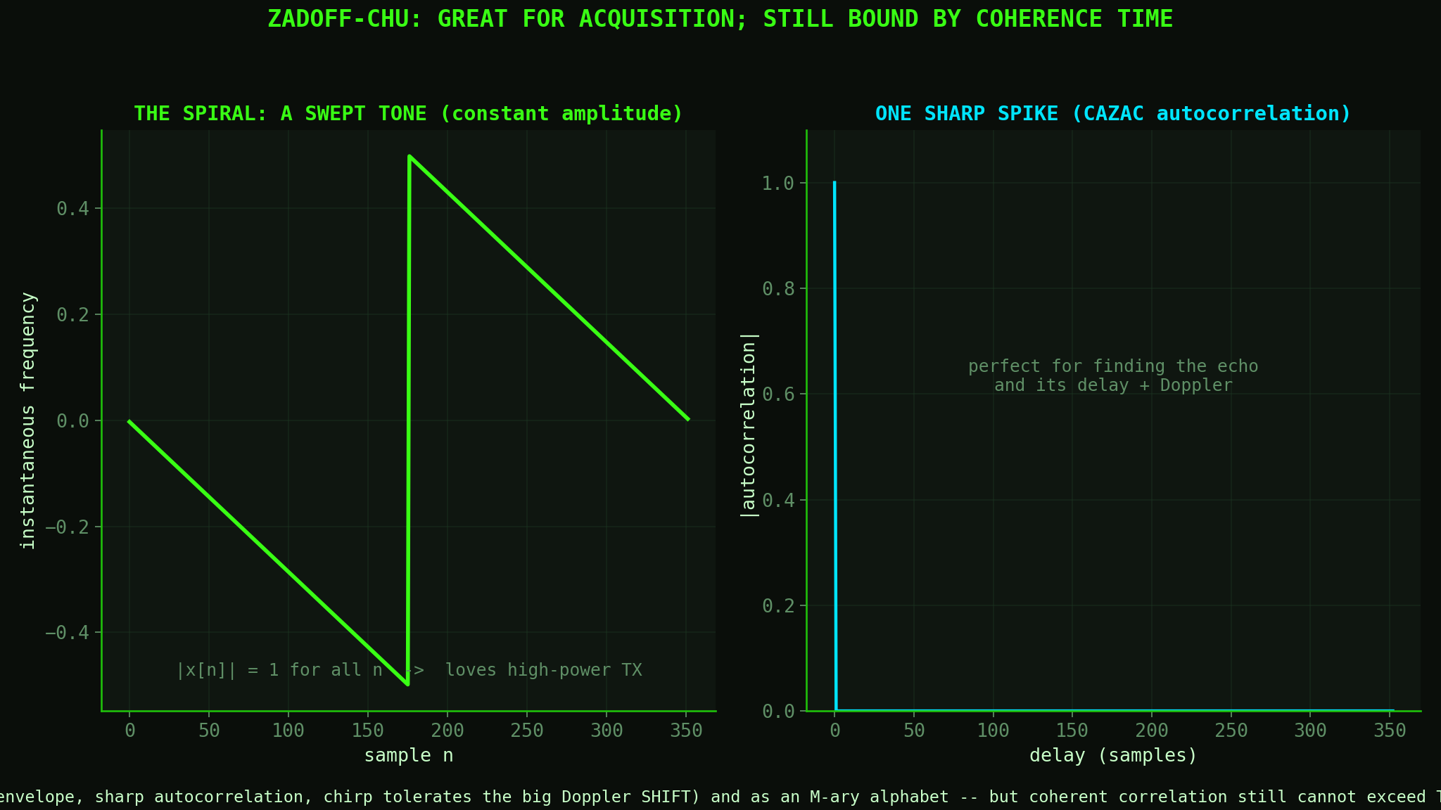
> 12 // candidate: Zadoff-Chu
Notes:
One natural candidate is a Zadoff-Chu sequence, a constant-amplitude chirp. Two lovely properties: constant envelope, so it loves a high-power transmitter; and a razor-sharp autocorrelation, one spike, superb for finding the echo and nailing its delay and Doppler. The chirp even tolerates the big Doppler shift, because a shift just slides the peak. So Zadoff-Chu is strong for acquisition and as an alphabet of orthogonal symbols. But its coherent correlation still cannot exceed the coherence time. It does not escape the tax; it pays it gracefully.

Slide 13
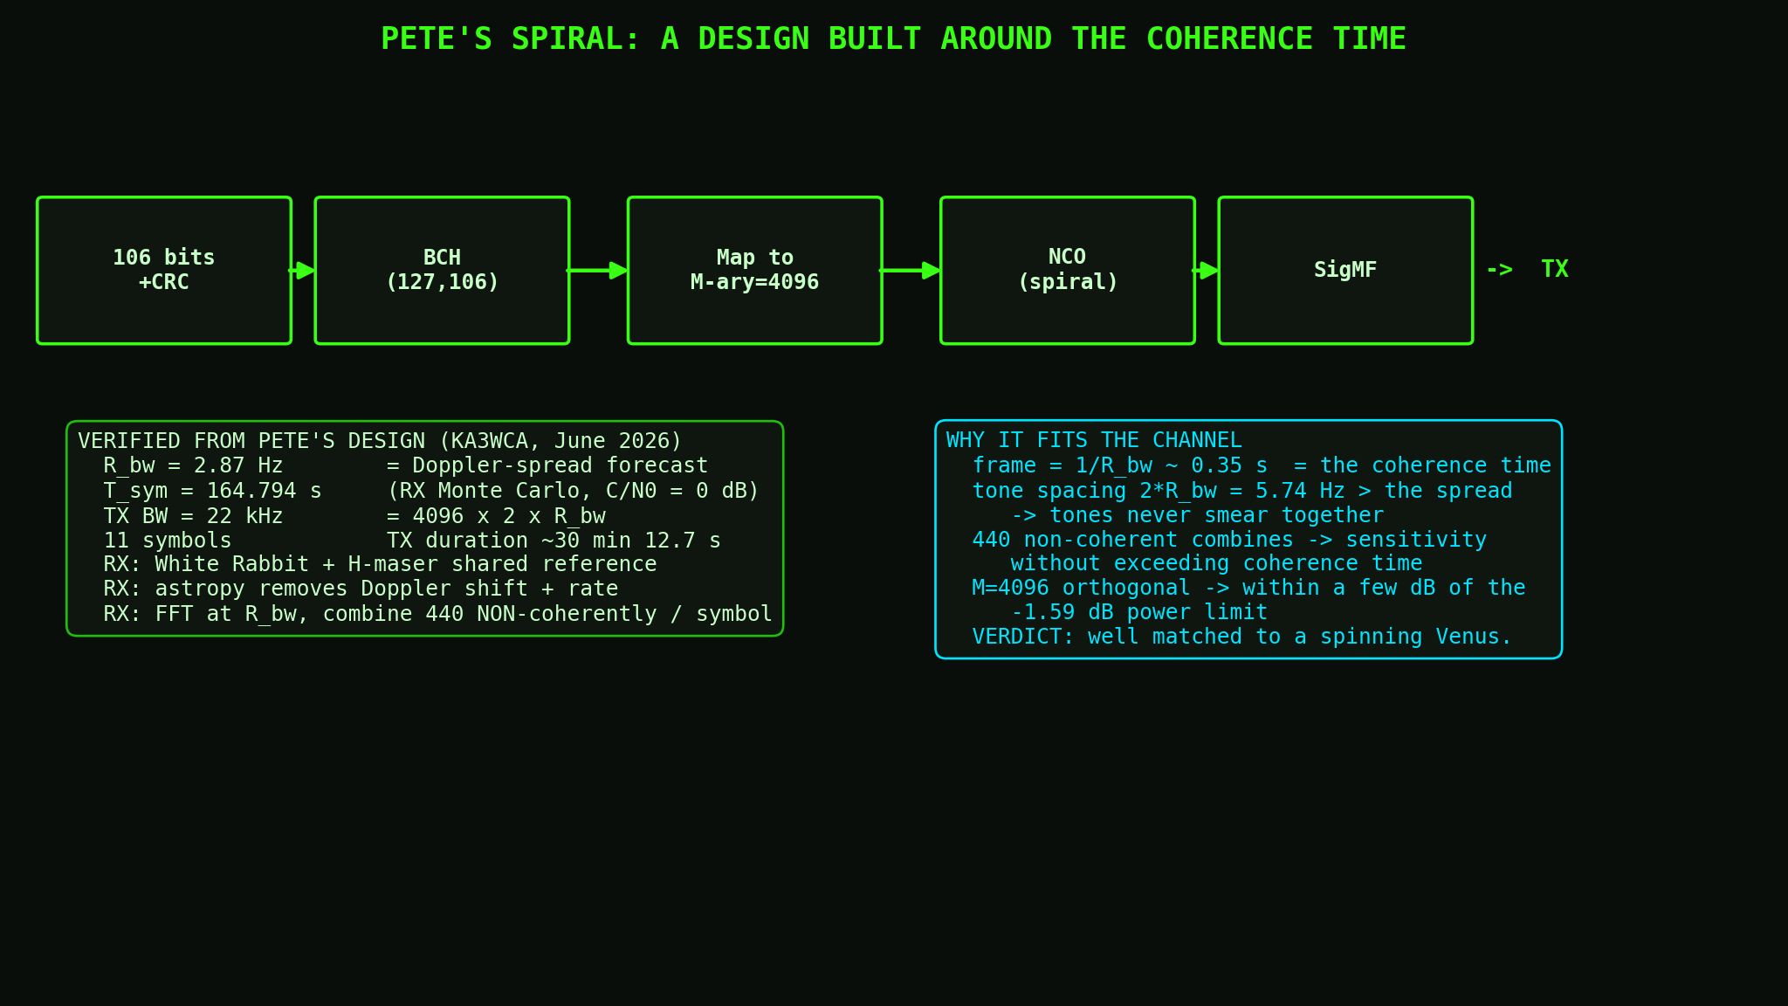
> 13 // Pete's Spiral // the design that fits
Notes:
Here is the design Pete Wyckoff built, and it is beautiful because every number is chosen around that coherence time. 106 bits, BCH-coded, mapped to 4096-ary orthogonal symbols, generated as spirals. The key: the FFT bin width is 2.87 hertz, exactly the Doppler-spread forecast, so each coherent frame is about a third of a second, right at the coherence time, and the tones are spaced wider than the spread so they never smear together. Each 165-second symbol is 440 such frames combined non-coherently, building sensitivity without ever integrating coherently past the coherence time. A waveform shaped entirely by the spinning planet.

Slide 14
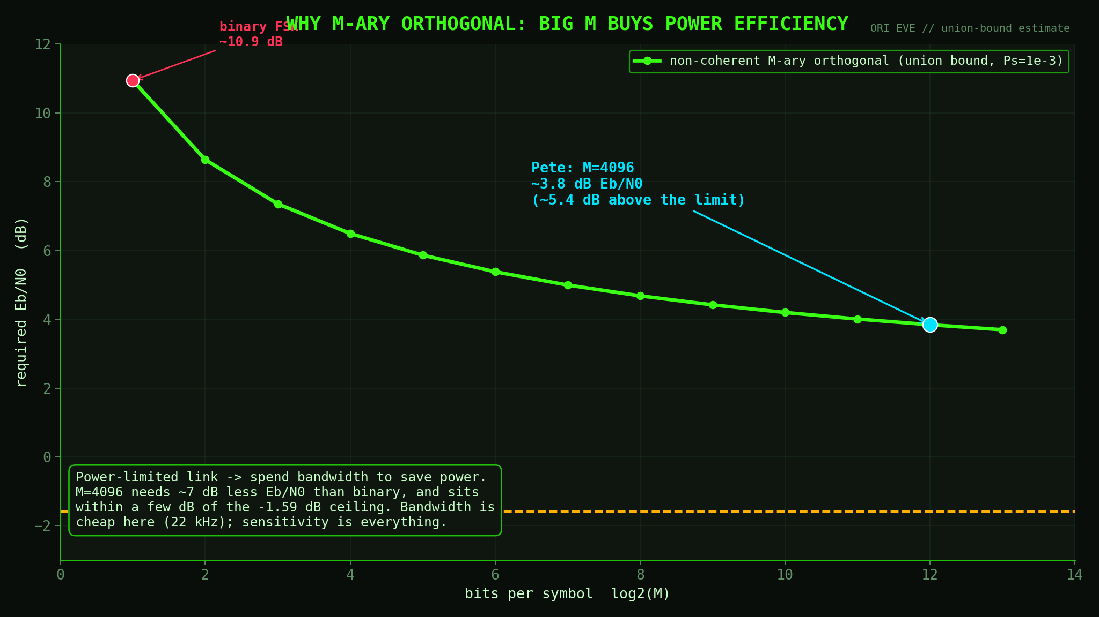
> 14 // why M-ary orthogonal
Notes:
And why 4096-ary? Because this link is power-limited, not bandwidth-limited. Orthogonal signaling gets more power-efficient as the alphabet grows: binary to 4096-ary buys about seven dB, landing within a few dB of the ultimate limit, minus 1.59 dB. We spend 22 kilohertz of bandwidth, which is free out here, to save precious dBs of power. Exactly the right trade for a planet bounce.

Slide 15
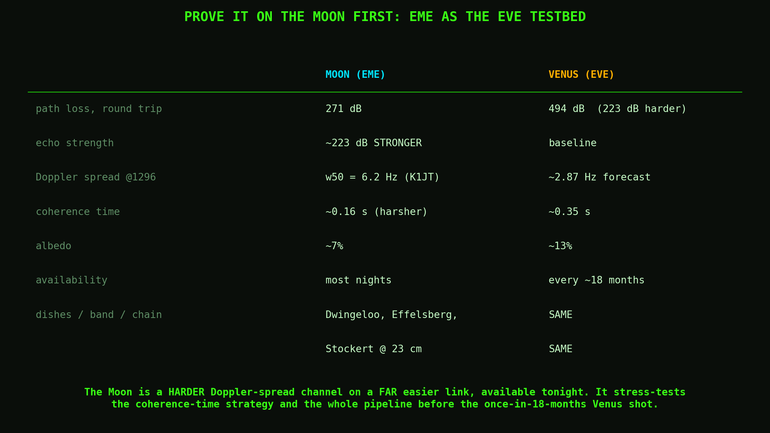
> 15 // prove it on the Moon // EME testbed
Notes:
How do we test all this before the one shot in October? The Moon. Earth-Moon-Earth is the perfect testbed. The Moon's libration gives an even harsher Doppler spread than Venus, six hertz versus our three, measured by Joe Taylor at 1296 megahertz. But the Moon is 223 dB closer in path loss, so the echo is much stronger than Venus. Right now, we are stress-testing the exact coherence-time strategy, harder than Venus will, but with signal to spare, using the much smaller dishes and amplifiers, but on the same band. And the Moon is up most nights. Prove it on the Moon, then take the shot at Venus. If you have an EME capable station, and want to help out, or if this inspires you to build an EME station, get in touch with ORI and we’ll help you…

Slide 16
LET'S HACK A PLANET
the spin damages information in a measurable way
we shaped a waveform around its coherence time
Effelsberg gives us the margin
the Moon lets us prove it first -> Venus, October 2026
waveform: Pete Wyckoff KA3WCA // CAMRAS Dwingeloo // Effelsberg // ORI
openresearch.institute >_
Notes:
So that is the hack. A spinning planet damages information in a specific, measurable way; we shaped a waveform around its coherence time; Effelsberg gives us the margin; and the Moon lets us prove it all first. In October, Earth and Venus line up again, and we will be pointed at it. Thanks to Pete Wyckoff for the waveform, to CAMRAS and Dwingeloo and Effelsberg, and to Open Research Institute. Let's hack a planet.

