Slide 1
2304 MHz EVE/EME
LHC/RHC Horn Antenna
Simulation Results
Brian Yee, W6BY
8/16/2026

Slide 2
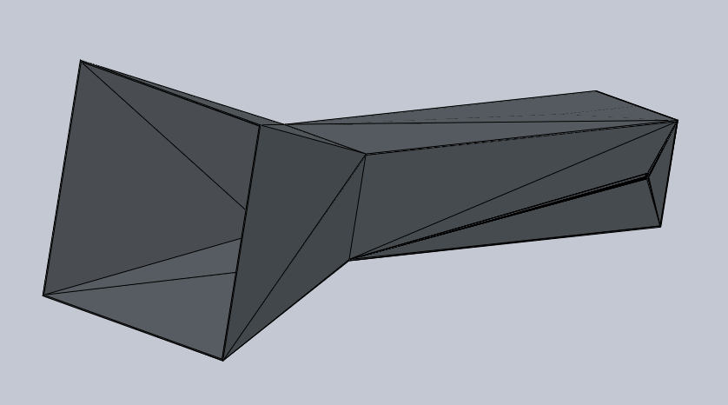
Imported STEP File
Imported STEP file from
Freecad, did not render well in Solidworks, so I reconstructed the desgn from scratch using the dimensions on the imported file

Slide 3
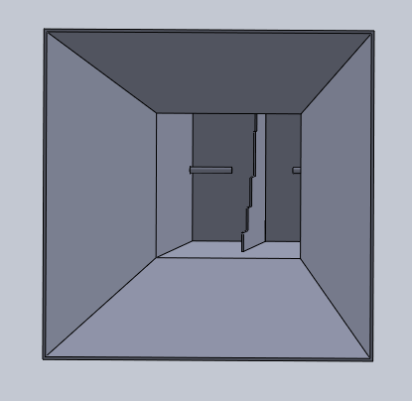
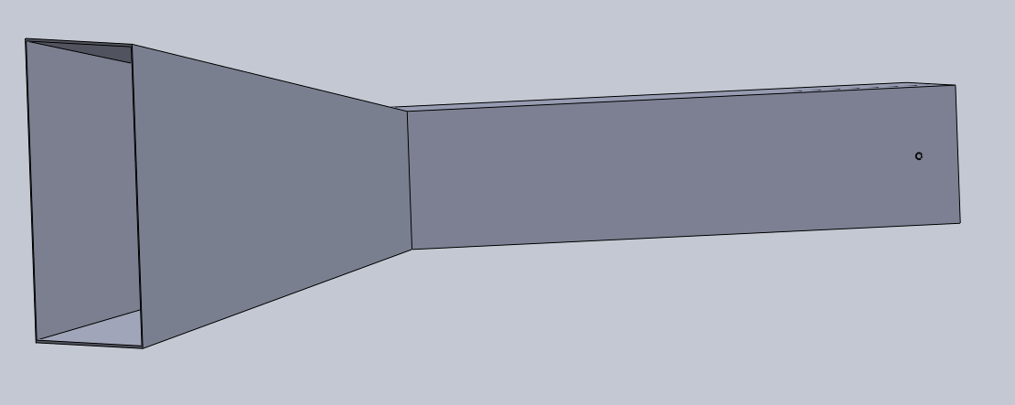
Reconstructed Design in Solidworks

Slide 4
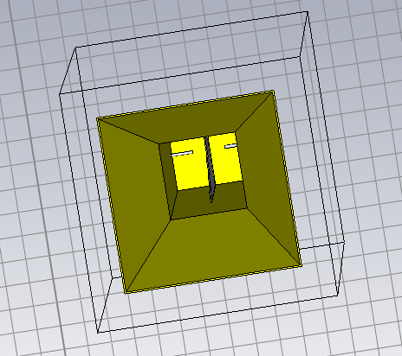
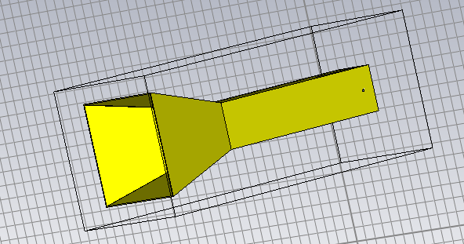
Design Imported to CST

Slide 5
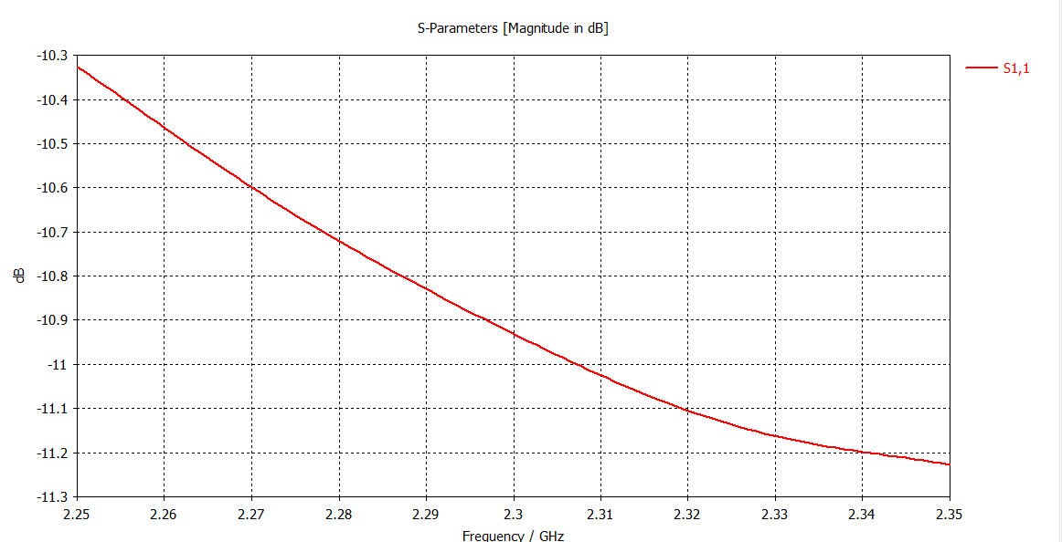
S11, Port 1

Slide 6
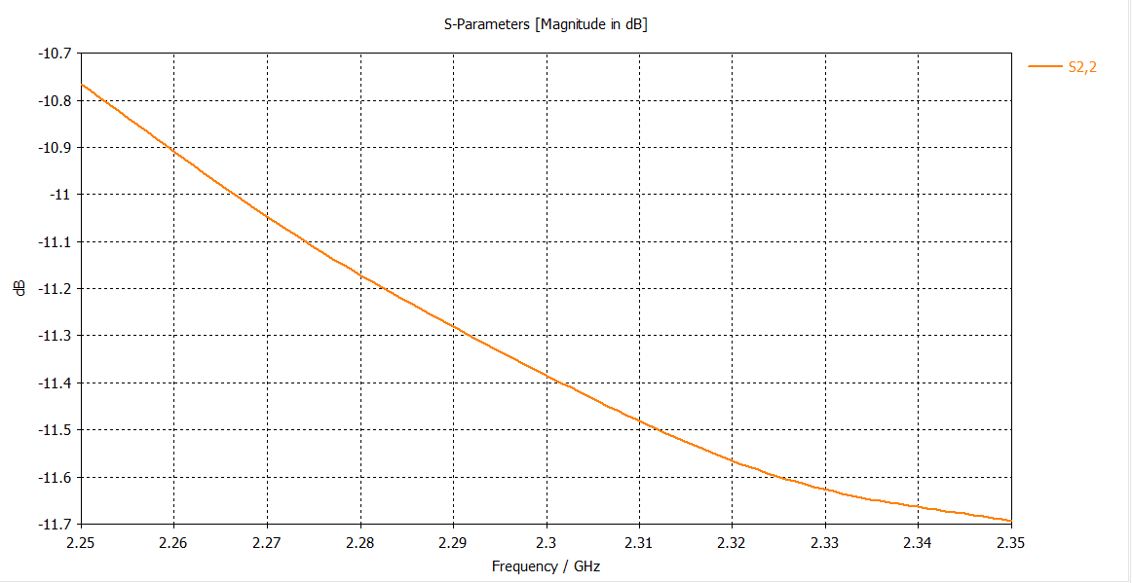
S11, Port 2

Slide 7
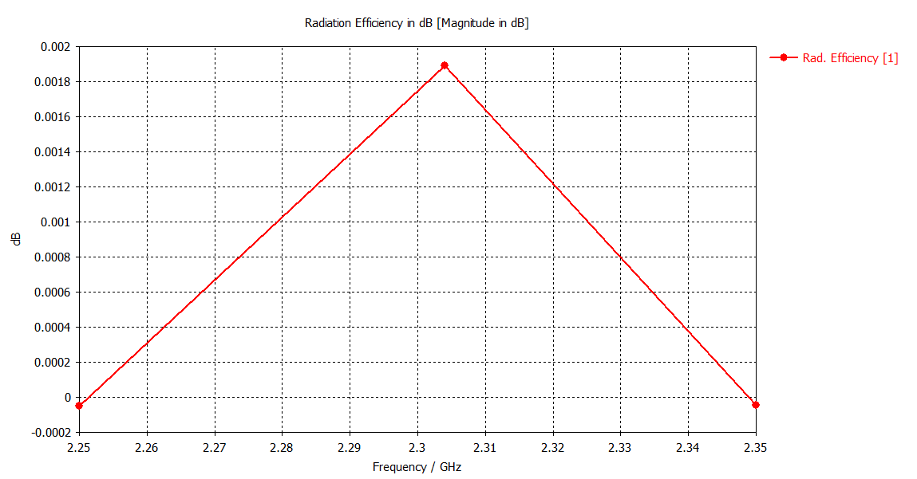
Radiation Efficiency, Port 1

Slide 8
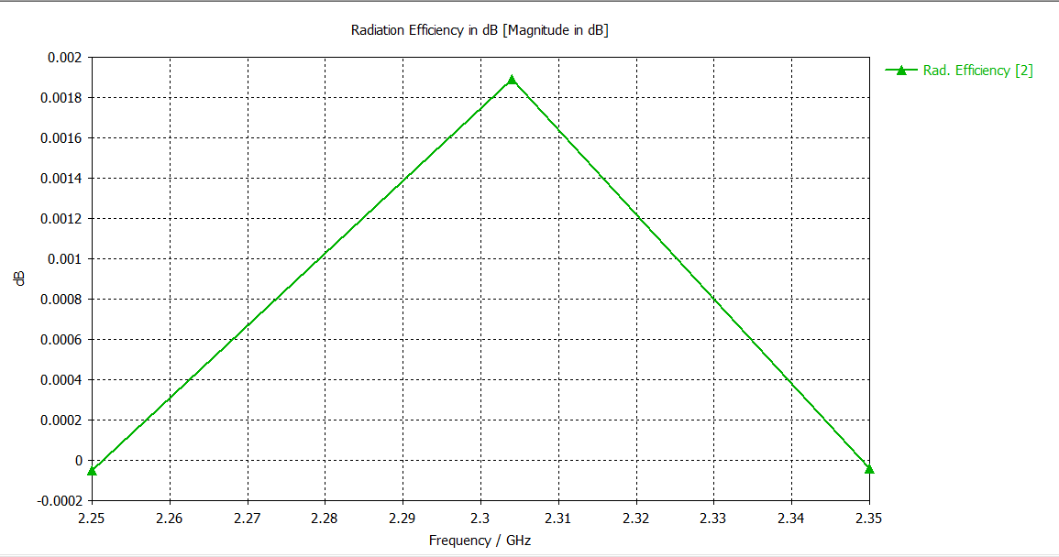
Radiation Efficiency, Port 2

Slide 9
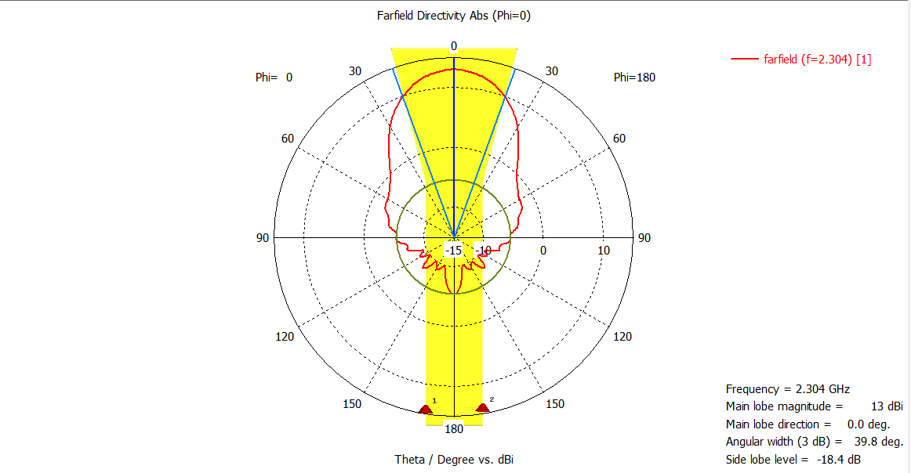
Farfield Directivity (Gain) Port 1 @2304 MHz

Slide 10
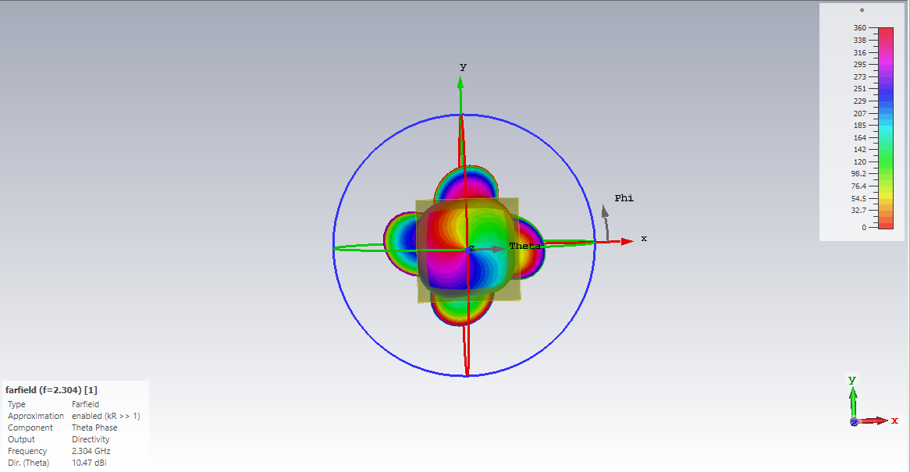
Theta Phase, Port 1 @2304 MHz

Slide 11
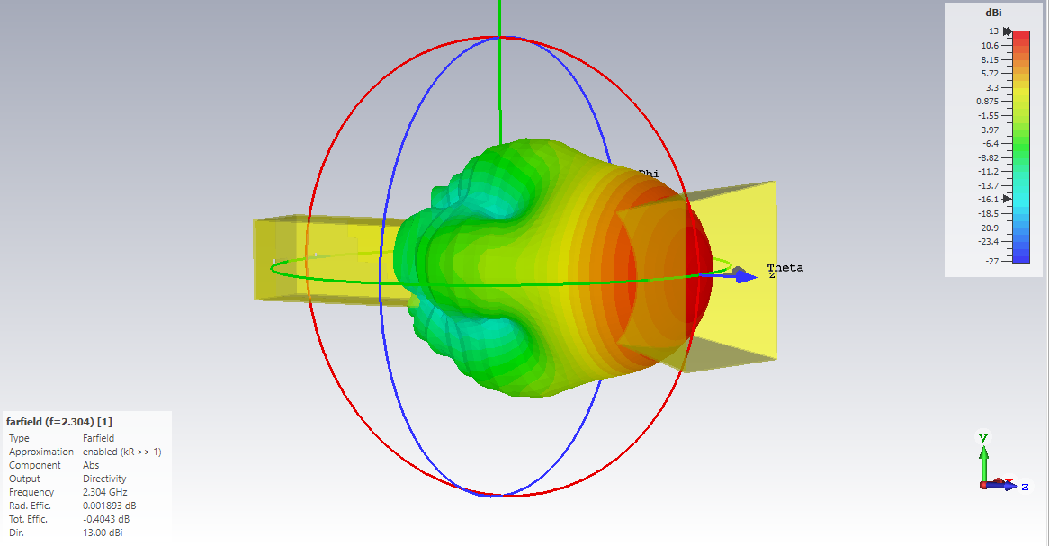
3D Farfield View, Port1 @2304 MHz

Slide 12
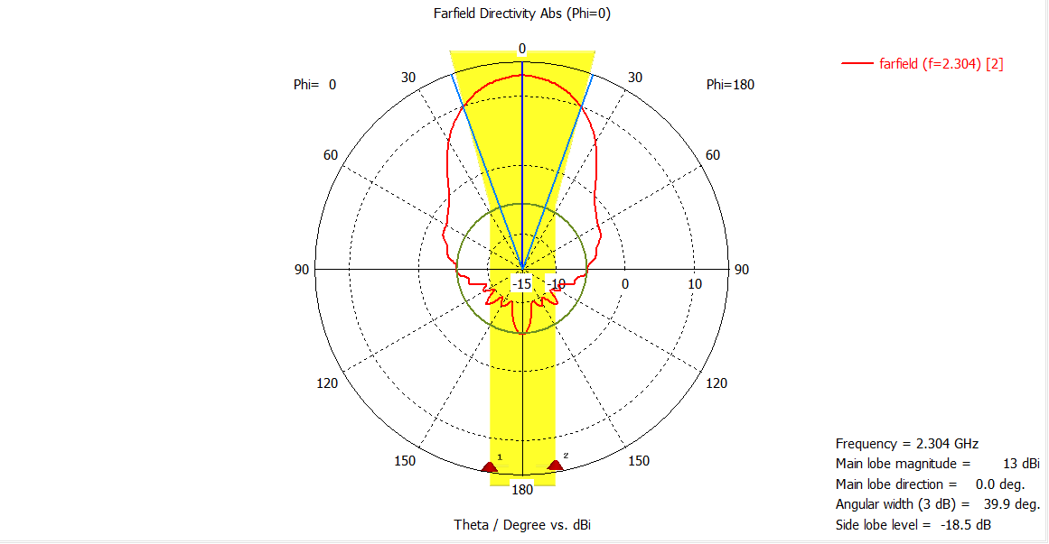
Farfield Directivity (Gain) Port 2 @2304 MHz

Slide 13
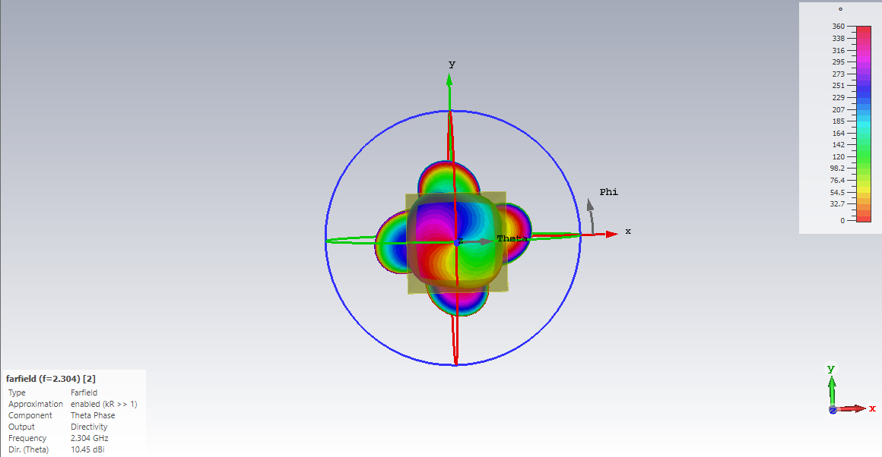
Theta Phase, Port 2 @2304 MHz

Slide 14
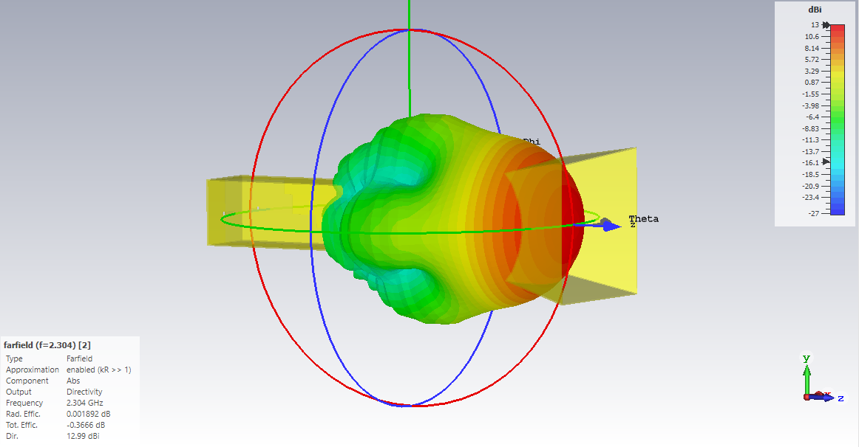
3D Farfield View, Port 2 @2304 MHz

