Slide 1
AREx System Architecture Update 25 June 2020
Hardware State Table reviewed
Initial reliability trade document reviewed
Interface Diagram reviewed
Payload Interface declared
Use Cases, User Experience, User Interface begun

Slide 2
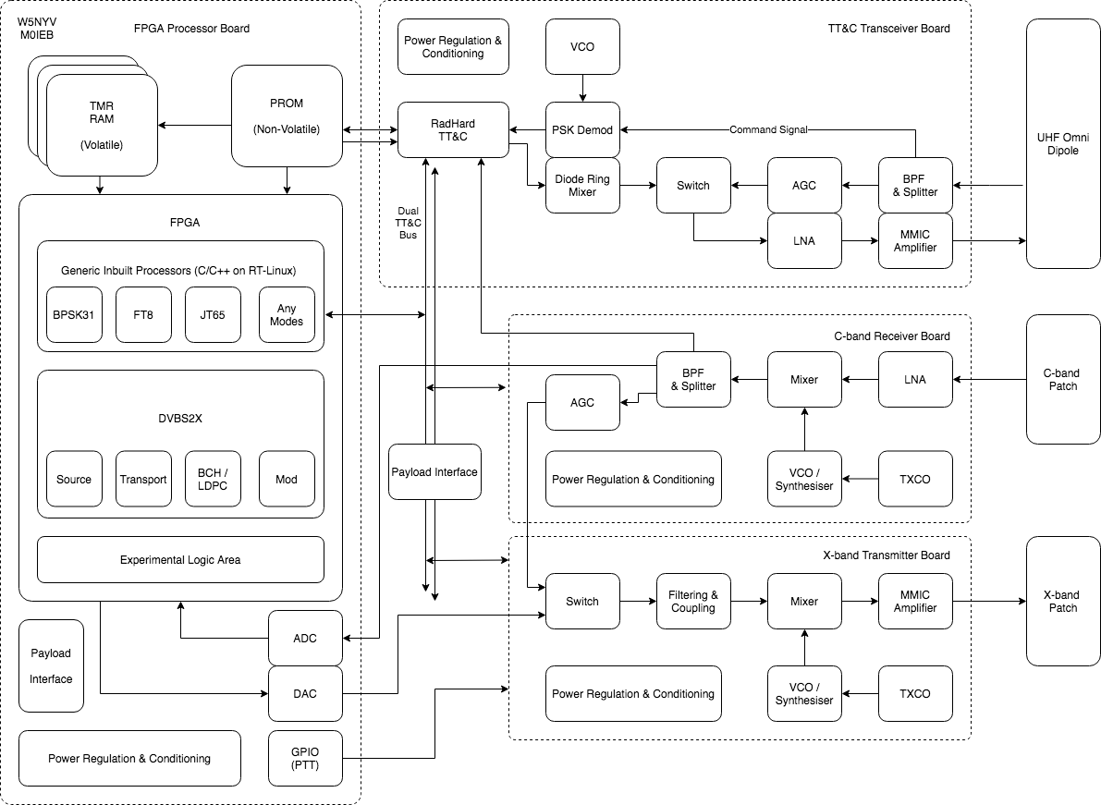
AREx
Architecture

Slide 3
UHF Transponder
(in event of failure)
Command TT&C
To all HW units
FPGA Processors ARM (Xil, Actel)
Existing OS Code ✔️
C-b Transponder
(in event of digital failure)
FPGA SDR Board
“Looks like” AstroSDR, Pluto = MK1
Existing P4 Code ✔️

Slide 4
TT&C Switch
Tx X-band Switch

Slide 5
UHF Transponder
(in event of failure)
Command TT&C
To all HW units
FPGA Processors ARM (Xil, Actel)
Existing OS Code ✔️
C-b Transponder
(in event of digital failure)
FPGA SDR Board
“Looks like” AstroSDR, Pluto = MK1
Existing P4 Code ✔️
Losses!

Slide 6
Proposed
AREx
Architecture
TRL Path
What exists?
What mission opportunities?
Green = available / qualified now
Yellow = circuits
Believed to be
Used on other
Missions. Red = high risk
ESA LUCE (2022/23)
Phase 4 + QO-100
OrigamiSat-1 5.84 GHZ DL
FITSAT-1 5.8 GHz DL, 115.2kbps + visible light CW
Antenna
Source?
FUNcube-LX X-band transmitter (2021/22)

Slide 7
Hardware States = RF Switch States
State | TT&C | Rx C-band | Tx X-band | SDR
Transponder | 0 (Unpowered, default) = UHF Transponder | ON | 0 (Unpowered, default) = X-band Transponder | N/A
Digital Mode | 0 (Unpowered, default) = UHF Transponder | ON | 1 = SDR Input | Default Output (File-based Ops)
Transponder + UHF Telemetry | 1 = TT&C Active | ON | 0 (Unpowered, default) = X-band Transponder | N/A
Digital Mode + UHF Telemetry | 1 = TT&C Active | ON | 1 = SDR Input | Default Output (File-based Ops)
SDR has preloaded Default Directory with Control.txt & IQ Files of each test mode (e.g. FT8.uint16.raw)
Control.txt ASCII file is edited by TT&C Command to add/remove IQ files for transmission
= Low data method to control SDR output

Slide 8
Interfaces (Detail)
TT&C System is a ‘Intelligent’ Router
Sample, receive, decode, route incoming packets / frames to all systems (& the reverse too)
Collect telemetry to make local Safety Decisions with Updatable Defaults
E.g. HPA is too hot, or timer default values need updating to new values
TT&C Bus needs to be Multi-Master , Hot Swappable & Low Power
Multi-master means TT&C can control / drive switches & payload state
Hot Swappable means systems can be plugged / powered in or out (in testing, through failure, etc)
AND SDR FPGA can do the exactly same
= Fast & Flexible Design
Interface should be reusable where possible (mech, elec, software)

Slide 9
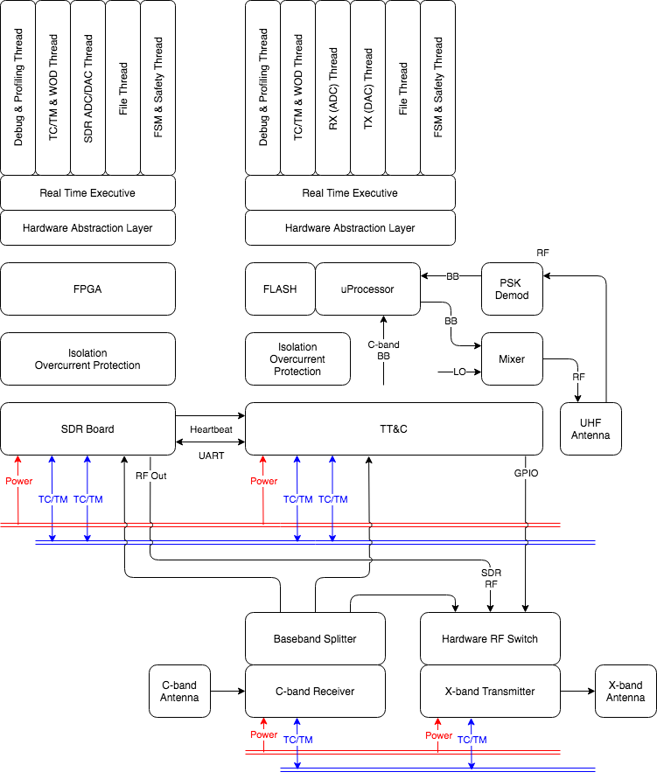
AREx
Interface
Diagram
TT&C will be collecting Telemetry (TM) & running a Finite State Machine (FSM) to manage Switches & GPIO
Transmit ON / OFF (essentially a PTT GPIO line) for Safety & ITU
SDR UART goes from 1k2 > 115k2 to 1) Operate Command Line & 2) Transfer Files
SDR Heartbeats are GPIO ON / OFF pulses that if stopped indicate error. FSM manages attempts to reset.

Slide 10
Fault Detection, Isolation & Recovery (FDIR)
Concept must cover both Digital & Analogue Electronic Systems
Undesired Effects (non-exhaustive) | Mitigation Strategies
Single Event Upsets, Transients, Glitches = Software Recoverable | SW Heartbeats & Watchdogs (between ANY clocked processor) TMR (FPGA SDR) Scrubbing (FPGA SDR, Volatile Memories) Error Correction & Detection (ANY read / write possible, e.g. BCH)
Digital Latchups, Switching / Interfacing, Power Fluctuations = Semi-Recoverable | H/W Heartbeats Isolation & Filtering Circuitry / Differential Signals for Bus Cross-strapping (e.g. Dual Bus Configuration) Power Cycling
Total Ionising Dose (TID) Gate Burnout / Rupture, FLASH write cycles = Non-recoverable | Part Selection (NASA / ESA / Heritage Parts) Redundancy (based on Critical Path) Design for ‘Graceful Degradation’ Testing & Validation > Evidence-led Decision Points

Slide 11
User Experience, Use Cases, User Interface
Default
DVBS2X Interleaves Packets
Payload Channels sent to the ground
State, Power, RF, Packet Counters, etc
Callsign List (Users on the transponder)
RF Analysis (Bandwidth, RSSI, …)
Linear = Controllable (GPIO)
Regenerative = Controllable (Digital)
SDR Capabilities via DVBS2X Packet:
Digital Transponder = Repeater, supports ALL modes
Digital Transponder + Telemetry = Repeater + Telemetry (Payload, Callsign List, RF Analysis)
Digital Transponder + Telemetry + Access Control
Unlicensed?
Too loud? Too wide?
How should it be handled?

Slide 12
Camera Options
SDR FPGA has Payload Interface
Tightly Coupled, can only operate when SDR FPGA is in operation
Power Modes also coupled
Likely to be fast
SDR FPGA Testing coupled with Camera
Camera has own TT&C Bus Interface
Decoupled, but needs additional interface & processing circuit
Flexible to power / mode requirements
Likely to be slower
Camera needs independent testing

