Slide 1
Working Through Loop HDL
15 October 2024 ORI FPGA Meetup

Slide 2
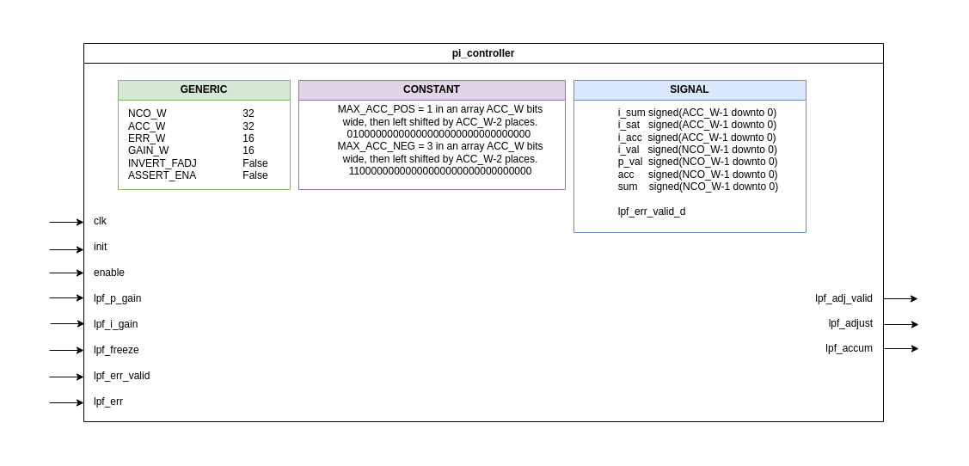

Slide 3
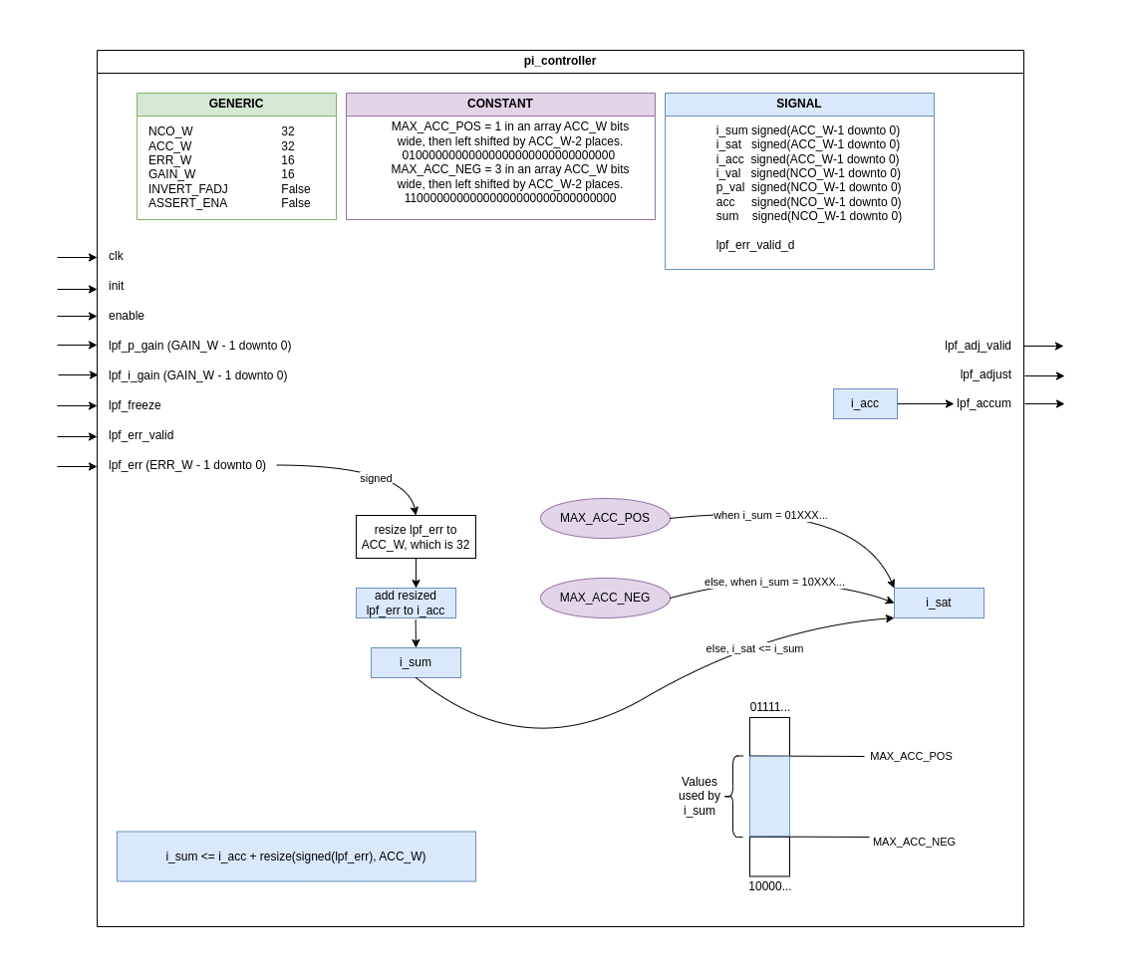

Slide 4
