Slide 1
LDPC
For Normal People
Low Density Parity Check codes

Slide 2
Who are you?
W5NYV
MSEE Information Theory from USC
Active in IEEE Information Theory Society
Forward Error Correction is central to Info Theory
LDPC is one of the best FECs we have ever made
Co-founder of Open Research Institute
Phase 4 Ground project – LDPC is a core technology
You need to know about LDPC codes!

Slide 3
A Compelling History
Discovered in 1963 by Robert Gallagher.
Impractical to implement. Promptly “lost”.
Interpreted in graphical form by Michael Tanner in 1981. We use Tanner Graphs today.
Still impractical to implement. “Lost” again.
Revived by Sir David MacKay in 1996 in a paper.
Chosen for DVB-S2 standard in 2003.
Since then, LDPC has surpassed Turbo codes in error floor and performance, especially at higher code rates. Huge area of academic research in FEC.
Notes:
Gallagher coded this up and ran it an IBM 7090 in 1963. Block length was 500. It was simulated with large probability of error, using all zero codeword only, still took hours.

Slide 4
How Good are LDPC codes?
“Long LDPC codes with iterative decoding based on belief propagation are a fraction of a dB from the Shannon limit.” Implementable decoders!
LDPC codes don’t need interleavers at all or trellis on decode. Parallelizable decoders!
They have great block error and burst error performance.
Error floors occur at lower bit error rates.
Decoding complexity increases linearly with the number of entries in the parity check matrix.
Single code good for many channel models.
Notes:
“The thought is the language, as Wittgenstein has put it. A technical vocabulary is merely a language within a language. A consideration of this technical vocabulary will be at the same time an attempt to discover the reality which the words disclose or reveal” R.D. Laing The Divided Self p 19

Slide 5
What is the Trade Off?
There are a lot of factors that all affect LDPC quality. We are still finding out new things.
Code construction is challenging and surprising. The useful codes that get a couple hundredths away from the Shannon limit required extensive computer search algorithms to find.
“Code design and construction are more of an art than a science.” – LDPC Code Designs, Constructions, and Unification by Lin/Costello 2017
We have an error floor! Because trapping sets.
We have complex encoders, and connectivity on the decoder side can get very difficult to manage.
Use turbo codes instead of LDPC for short code lengths.

Slide 6
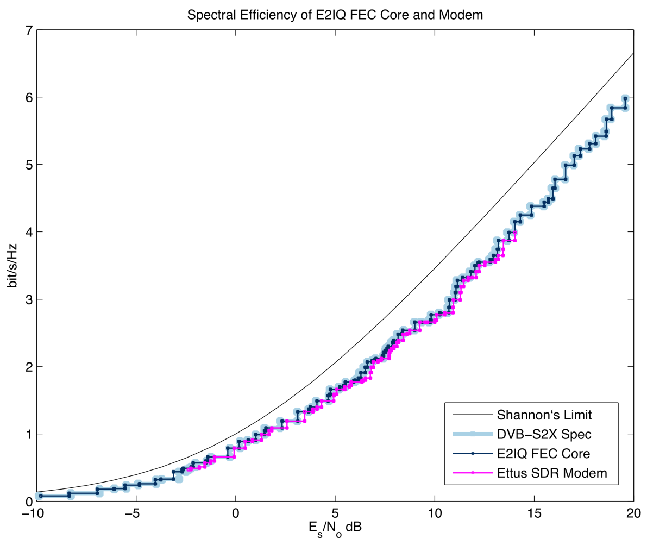
What is this Shannon Limit Thing?
The One True Slide

Slide 8


Slide 9
In Phase 4 Ground ACM!
DVB-S2/X has something called ACM.
Adaptive Coding and Modulation lets you adjust to changing signal-to-noise ratios on a per-frame basis.
Best possible throughput for the channel conditions with the radio you have.
This is why we put up with all the math.

Slide 10


Slide 11
It’s all about the matrix
0 0 0 0 0 0 0 0 0 0 0 0 0 0 0 0 0 1 0 0 0
0 0 0 1 1 1 0 0 0 0 0 0 0 0 0 0 0 1 0 0 1
1 1 0 0 0 0 0 0 0 1 0 1 0 0 0 0 0 0 0 1 0
0 0 1 1 1 1 1 1 1 0 1 1 1 1 1 1
1 0 0 0 1 1 0 1 0 0 1 1
0 0 1 1 0 0 0 1 0 1 1 1
1 1 0 1 0 0 1 0 1 1 0 0
0 1 1 1 1 0 1 1 1 1 1 1
Notes:
We want to send a digital message in a systematic and orderly way.
Linear block codes are super awesome at this.
LDPC codes are linear block codes.
How do we use them?
We get our messages, figure out how many, make a list.
We notice that there’s some unnecessary redundancy.
Alice is really talkative. Bob has too many message that are similar.
He’s always saying pretty much the same thing.

Slide 12
It’s all about the matrix
0 0 0 0 1 0 0 0 k = 4
0 0 0 1 1 0 0 1 2⁴ = 16
0 0 1 0 1 0 1 0
0 0 1 1 1 0 1 1
0 1 0 0 1 1 0 0
0 1 0 1 1 1 0 1
0 1 1 0 1 1 1 0
0 1 1 1 1 1 1 1
Notes:
We fix this. We remove unnecessary redundancy.
There’s lots of ways to do this.
Each block has k digits. In our example, k = 4.
We now have 2^{k} distinct binary messages. In our example, two to the fourth = 16.
So what’s the big deal? Just send them.

Slide 13
It’s all about the matrix
0 0 0 0 1 0 0 0
0 0 0 1 1 0 0 1
0 0 1 0 1 0 1 0
0 0 1 1 1 0 1 1
0 1 0 0 1 1 0 0
0 1 0 1 1 1 0 1
0 1 1 0 1 1 1 0
0 1 1 1 1 1 1 1
Notes:
Uh oh. Errors. From noise, fading, interference.
So what do we do?

Slide 14
It’s all about the matrix
Select message 1 0 1 1 and make a codeword.
message * G
1 0 1 1 * 1 1 0 1 0 0 0
0 1 1 0 1 0 0
1 1 1 0 0 1 0
1 0 1 0 0 0 1
= 1 0 0 1 0 1 1
Add good redundancy! Message now n = 7 bits long.
Notes:
We take these messages and we transform them into codewords.
We put in a good type of redundancy. The 2k codewords are now each longer by a fixed number of bits.
We have spread them out in math space using special super powers.
Get some breathing room in there so each bit can get knocked around by noise.
But wow that’s a lot of messages to store.
Can’t we use some sort of clever trick?
Yes we can! We don’t have to store all of them. We only have to store k of them. Whaaat that’s crazy.

Slide 15
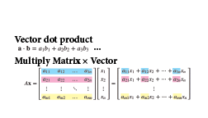
Welcome to the Math
Notes:
You have a little card that covers two important and related mathematical operations that we must know to appreciate and love LDPC codes.
Dot product
Matrix multiplication

Slide 16
My matrix brings the boys
message * G
(1) * (1 1 0 1 0 0 0)
+ (0) * (0 1 1 0 1 0 0)
+ (1) * (1 1 1 0 0 1 0)
+ (1) * (1 0 1 0 0 0 1)
= (1 0 0 1 0 1 1)
Notes:
The special super powers are contained in the structure of G.
G is a set of codewords that are linearly independent.
All you need are these 4 codewords and you can make all 16 codewords.
Linear independence is awesome.
It means that any codeword added to another codeword is a codeword.
And since they aren’t right next to each other,
we can lose a bit or two here or there
and still tell what the original codeword was.

Slide 17
To the yard
G=
(1 1 0 1 0 0 0)
(0 1 1 0 1 0 0)
(1 1 1 0 0 1 0)
(1 0 1 0 0 0 1)
Notes:
How do we get the original codeword back, even with errors?
With another matrix!
Let’s look closer at G.
Let’s let G stand for Generator matrix.

Slide 18
And they’re like
G=
(1 1 0 1 0 0 0)
(0 1 1 0 1 0 0)
(1 1 1 0 0 1 0)
(1 0 1 0 0 0 1)
= ( P I_{k} )

Slide 19
It’s better than yours
G=
(1 1 0 1 0 0 0)
(0 1 1 0 1 0 0)
(1 1 1 0 0 1 0)
(1 0 1 0 0 0 1)
= ( P I_{k} )
Notes:
We need a matrix that detects valid codewords.
When we get a codeword, wouldn’t it be great if we could just multiply it by something, and if everything is ok, the result is zero?
We can make that matrix!
This is our parity check matrix!
Here’s a cool trick.

Slide 20
Code rate is better than yours
G => H:
(1 1 0 1 0 0 0)
(0 1 1 0 1 0 0)
(1 1 1 0 0 1 0)
(1 0 1 0 0 0 1)
= (I_{n-k} P^{T} )
Notes:
Parity check matrix moves over.
Identity matrix changes size.

Slide 21
I could dot you
H=
(1 0 0 1 0 1 1)
(0 1 0 1 1 1 0)
(0 0 1 0 1 1 1)
= (I_{n-k} P^{T} )
Notes:
Parity check matrix moves over and gets transposed.
Identity matrix changes size.
This matrix is called H and is in the null space of G.
That means that any codeword generated by G, when multiplied by this matrix, is zero.
Any codeword is orthogonal to H.
Null! Convenient test for whether or not we have a codeword.

Slide 22
But I’d have to charge
H=
(1 0 0 1 0 1 1)
(0 1 0 1 1 1 0)
(0 0 1 0 1 1 1)
Notes:
Pink for Parity

Slide 23
It’s all about the matrix
H= (1 0 0 1 0 1 1)
(0 1 0 1 1 1 0)
(0 0 1 0 1 1 1)
We received a codeword!
Let’s check it!

Slide 24
A déjà vu is usually
H= (1 0 0 1 0 1 1)
(0 1 0 1 1 1 0)
(0 0 1 0 1 1 1)
First we have to transpose H so it’s the right dimensions to multiply by something n bits long.

Slide 25
A glitch in the matrix. It happens
H^{T} = (1 1 0)
(0 1 1)
(1 1 1)
(1 0 1)
(1 0 0)
(0 1 0)
(0 0 1)
Don’t worry. We do this all the time.

Slide 26
when they change something
H^{T} = (1 1 0)
(0 1 1)
(1 1 1)
(1 0 1)
(1 0 0)
(0 1 0)
(0 0 1)
r = 1 0 0 1 1 1 1
Notes:
Here’s message, but with an error.

Slide 27
When they change something
r*H^{T} = (1 0 0 1 1 1 1) * (1 1 0)
(0 1 1)
(1 1 1)
(1 0 1)
(1 0 0)
(0 1 0)
(0 0 1)
(1 by 7) * (7 by 3) gives a (1 by 3) result.
Notes:
It better be zero

Slide 28
Does it change you too?
r*H^{T} = (1 0 0 1 1 1 1) * (1 1 0)
(0 1 1)
(1 1 1)
(1 0 1)
(1 0 0)
(0 1 0)
(0 0 1)
That result is zero when r is a valid codeword.
Notes:
It better be zero

Slide 29
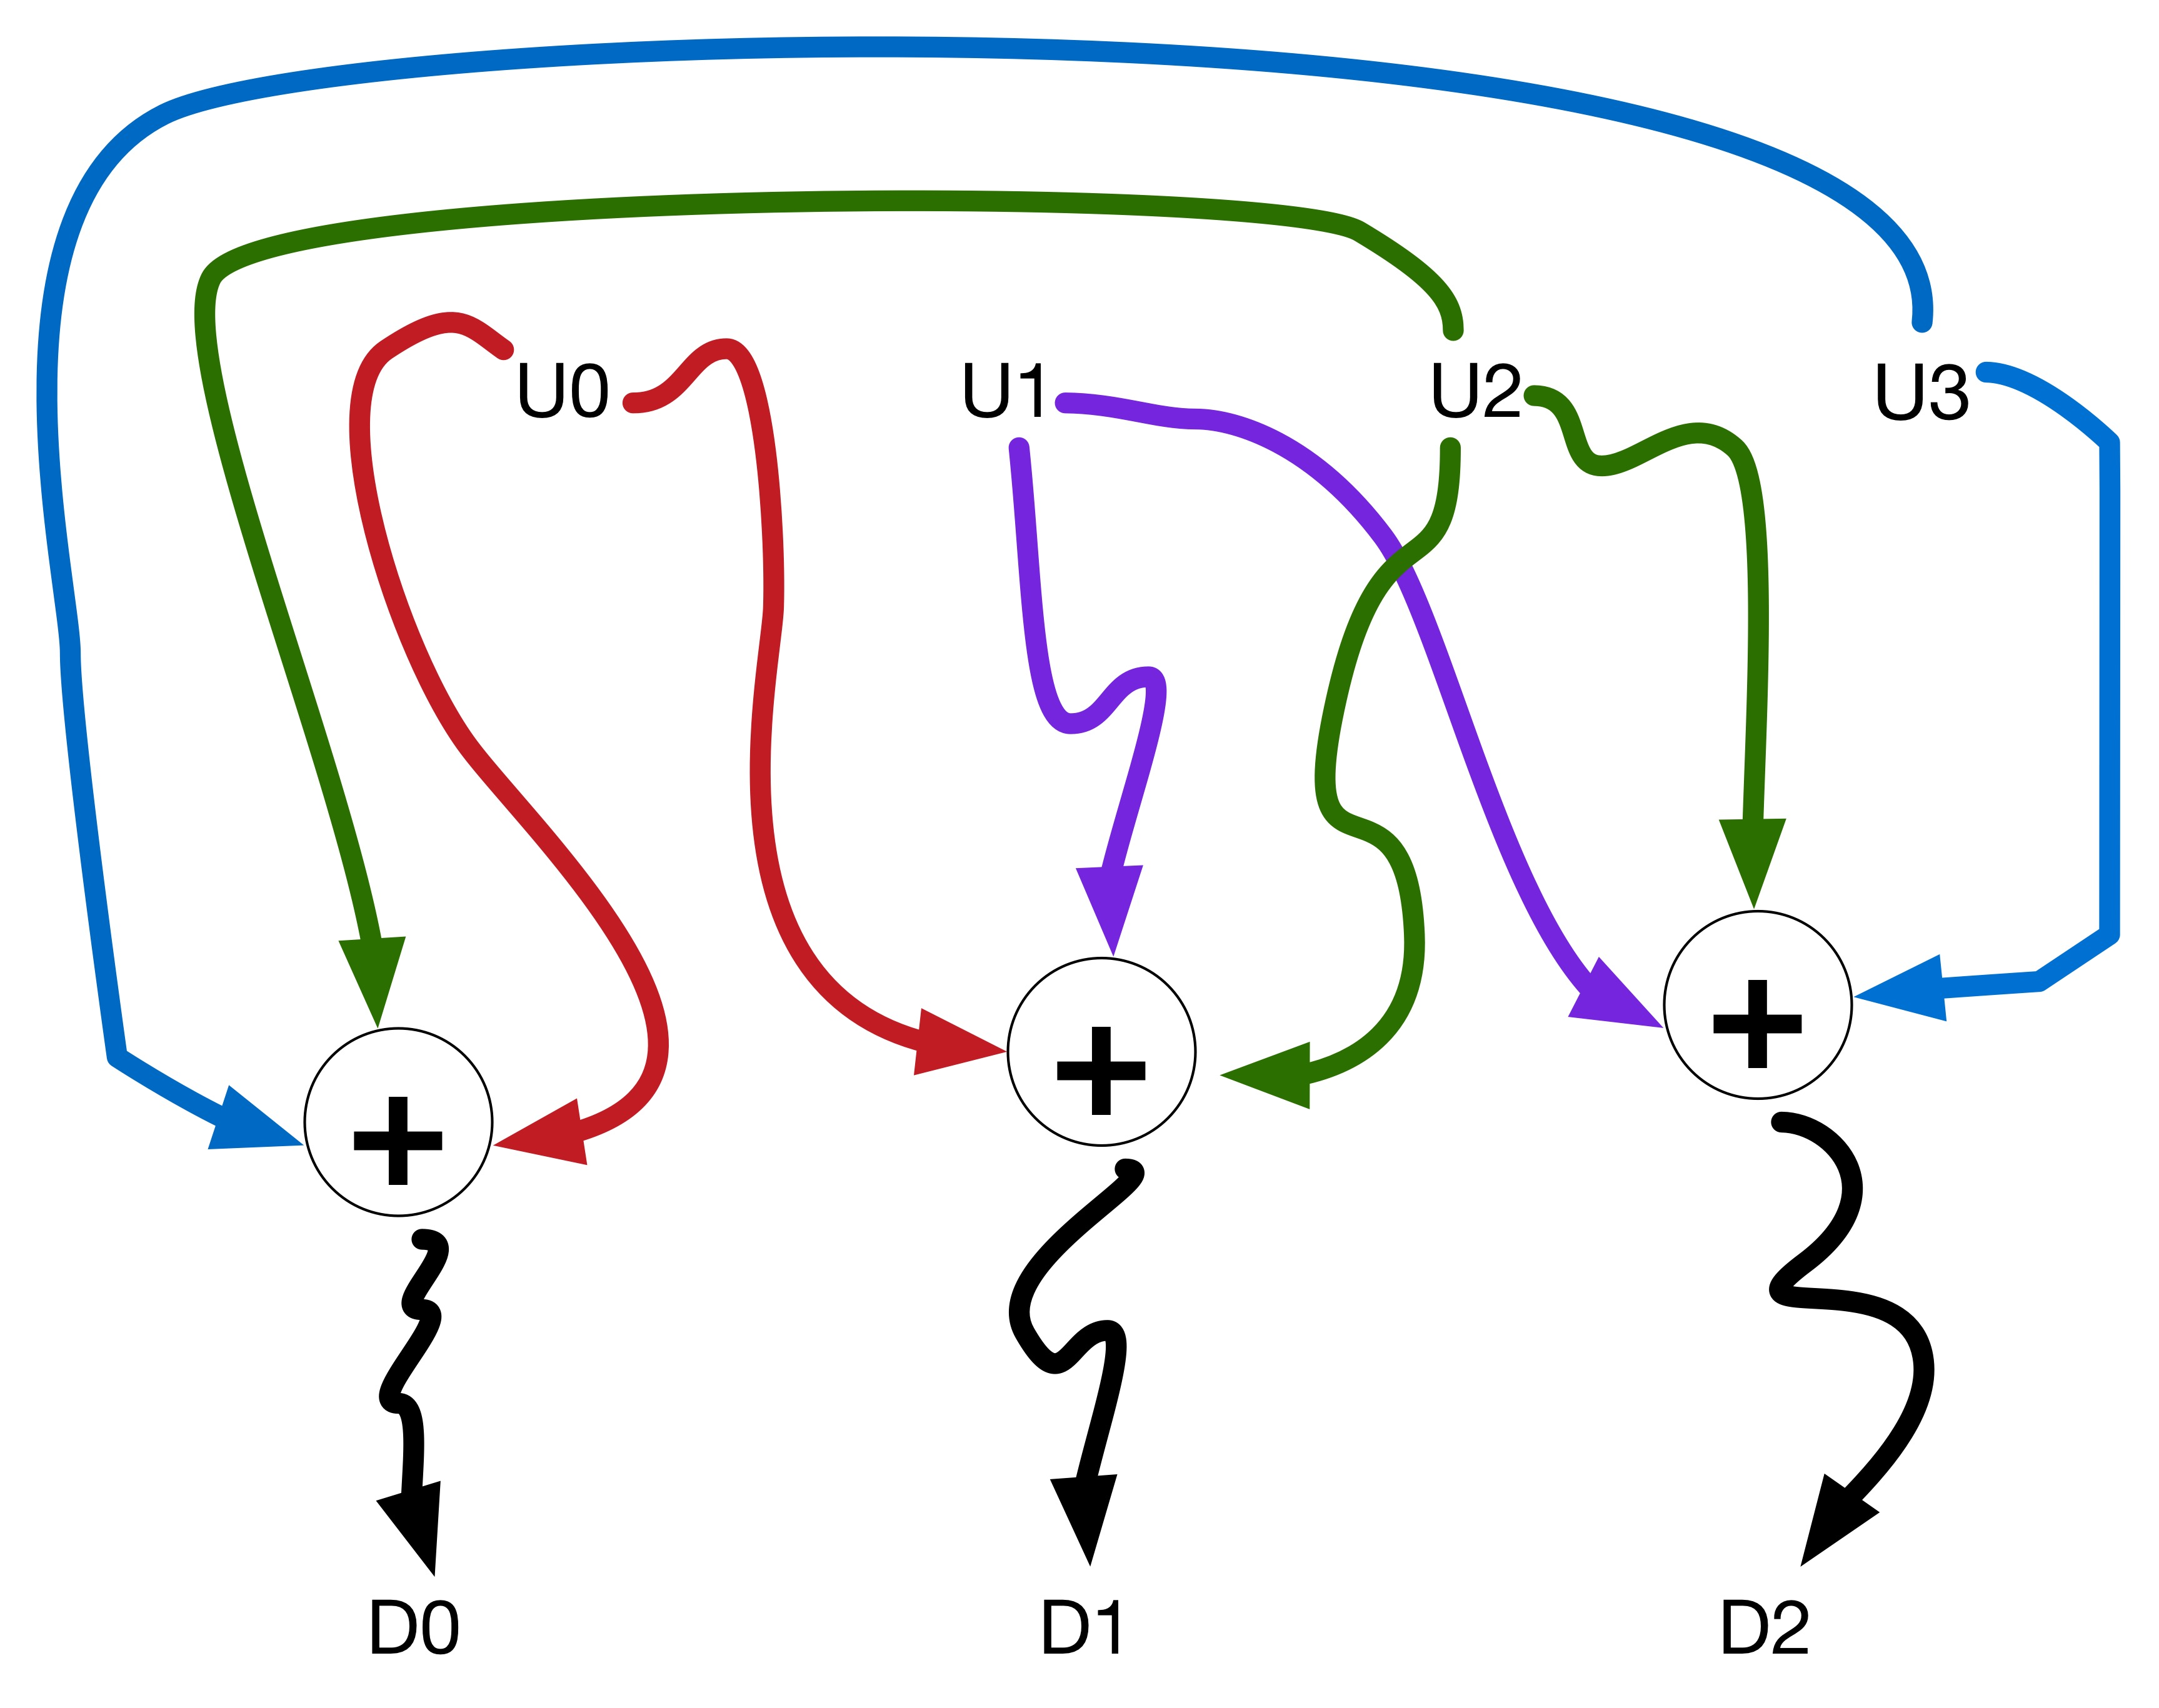
Notes:
Parity check equations drawn out

Slide 30
Like a harmonic balancer
r*H^{T} = (1 0 0 1 1 1 1) * (1 1 0)
(0 1 1)
(1 1 1)
(1 0 1)
(1 0 0)
(0 1 0)
(0 0 1)
Not zero! = (1 0 0)
Notes:
This is called the syndrome and we can use it to not just detect but correct some number of errors.
There are 2⁴ error patterns that could fit this syndrome.
How do we pick the right one?
Pick the one with the fewest bits wrong. It was probably the error pattern.
If we are really doing these codes right, we make a lookup table and we are flying.

Slide 31
Inside a skyscraper in Japan
H =
1 1 1 1 0 0 0 0 0 0
1 0 0 0 1 1 1 0 0 0
0 1 0 0 1 0 0 1 1 0
0 0 1 0 0 1 0 1 0 1
0 0 0 1 0 0 1 0 1 1
Notes:
My matrix brings all the boys to the yard
And they’re like, it’s better than yours
Error rate, it’s better than yours,
I could teach you, at DCC.

Slide 32
During high winds
H =
1 1 1 1 0 0 0 0 0 0
1 0 0 0 1 1 1 0 0 0
0 1 0 0 1 0 0 1 1 0
0 0 1 0 0 1 0 1 0 1
0 0 0 1 0 0 1 0 1 1
We start with H for LDPC codes!
Notes:
We have the Parity Check part down.
What is so special about Low Density?
At first it sounds like low density means low information, less power, and no good. Like sparse when it’s your hair isn’t good.
This is a tiny LDPC code but anything bigger than this is just impossible to work with.
LDPCs have much fewer 1’s in the parity check matrix than other codes.
But that is NOT the key thing.
LDPC matrix H – any two columns and any two rows share at most one 1. And this is part of the secret sauce.
How do we find H? We know the rule, we can construct it using this rule. Or we can use computer searches.

Slide 33
It’s all about the matrix
H = (J by n matrix)
1 1 1 1 0 0 0 0 0 0
1 0 0 0 1 1 1 0 0 0
0 1 0 0 1 0 0 1 1 0
0 0 1 0 0 1 0 1 0 1
0 0 0 1 0 0 1 0 1 1
Number of columns = codeword length = n.
Each row of the J rows is used to produce a parity check sum.
Notes:
My matrix brings all the boys to the yard
And they’re like, it’s better than yours
Error rate, it’s better than yours,
I could teach you, at DCC.

Slide 34
How do we decode with this sparse matrix H?
Majority logic
Bit flipping
Weighted bit flipping
A posteriori decoding
Iterative decoding based on belief propagation, or Sum Product
Notes:
OK Yeah which one looks the hardest? Let’s do that one.

Slide 35
How do we decode with this sparse matrix H?
Majority logic
Bit flipping
Weighted bit flipping
A posteriori decoding
Iterative decoding based on belief propagation, or Sum Product
Notes:
First off. We don’t just multiply. OOOHhh no that’s way too easy.

