Slide 1
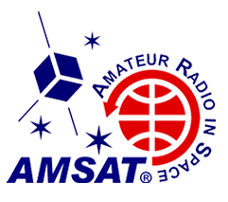

AMSAT Phase 4 Ground Station Project
Status Update
Steve Conklin, AI4QR
Phase 4 B Ground Station Linux Platform Lead
https://github.com/phase4ground/documents/tree/master/Papers_Articles_Presentations/LCA

Slide 2

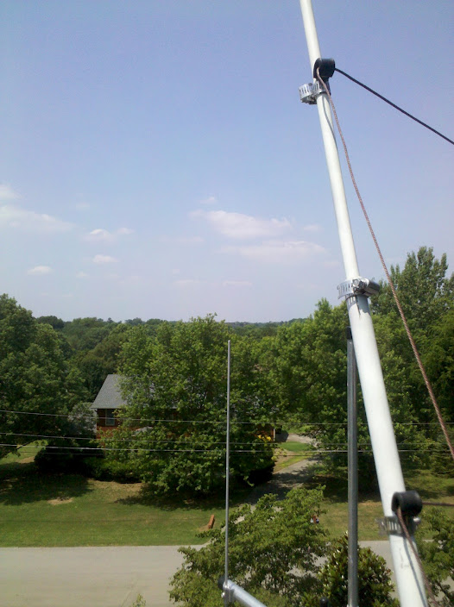
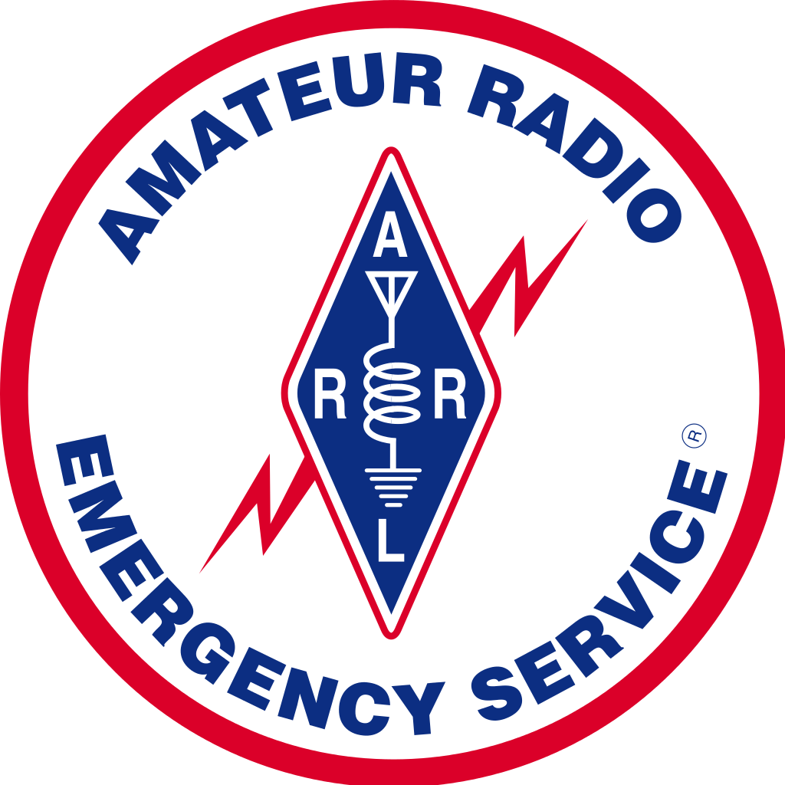




Hello!
CQ VK7 DE AI4QR
(16,000 km)
Notes:
Amateur Operator U.S. Call Sign AI4QR
Hardware/Software/Embedded Engineer
Linux Engineer
I ported a kernel driver that's on orbit now
GLASS project, Maritime tracking

Slide 3
This is Amazing
And here’s why
Notes:
This project covers the intersection of radio, networking, and signal processing.
It will enable digital connectivity without terrestrial infrastructure.
For hobby, and emergency communications
And it’s all open source.

Slide 4

Amateur Radio
Down The Rabbit Hole
“Down the Rabbit Hole”, Mayumi Tokuda
https://creativecommons.org/licenses/by-nc-nd/3.0/
Notes:
A multi-faceted hobby/avocation
A lifetime of things to learn and do:
Local, DX, building, Moonbounce (openradio miniconf), Meteor Scatter, Contesting, radiosport df, ionospheric research, etc, etc
Radio amateurs led many developments
Packet Radio
Mesh Networking
There's a revival beginning.
We are in a unique position to be at the forefront.
Digital + Radio is opening new frontiers
SDR, AI and cognitive radio have arrived
But – we’re here to talk about satellites!

Slide 5
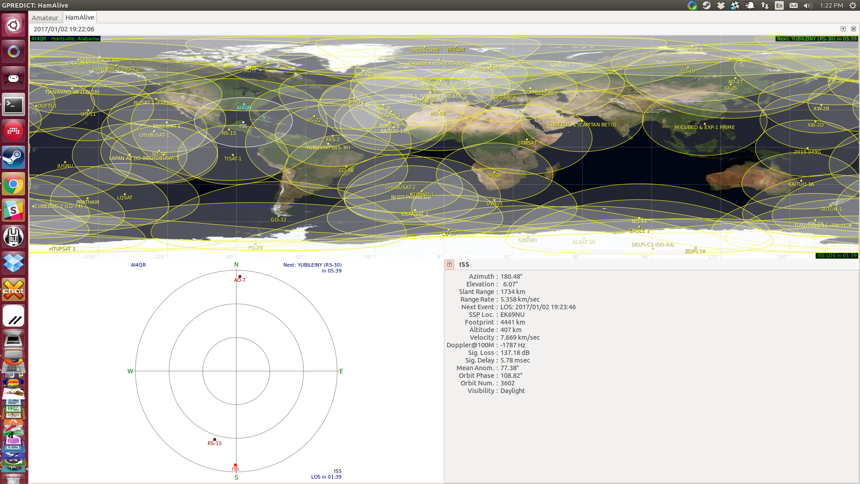
Amateur Radio
Satellites
Notes:
Satellites!
This is a snapshot of most amateur satellites on Jan 2nd. (not all operational). Gpredict.
Some relay communications
Some broadcast telemetry
The vast majority can be 'worked' with a First license
AMSAT is a worldwide collection of organizations
This project is part of AMSAT-NA
Volunteer-run nonprofit
Rideshare - opportunities on commercial flights
Payload Rings used during test flights
Cubesats
Space shared with commercial or Gov't payloads

Slide 6
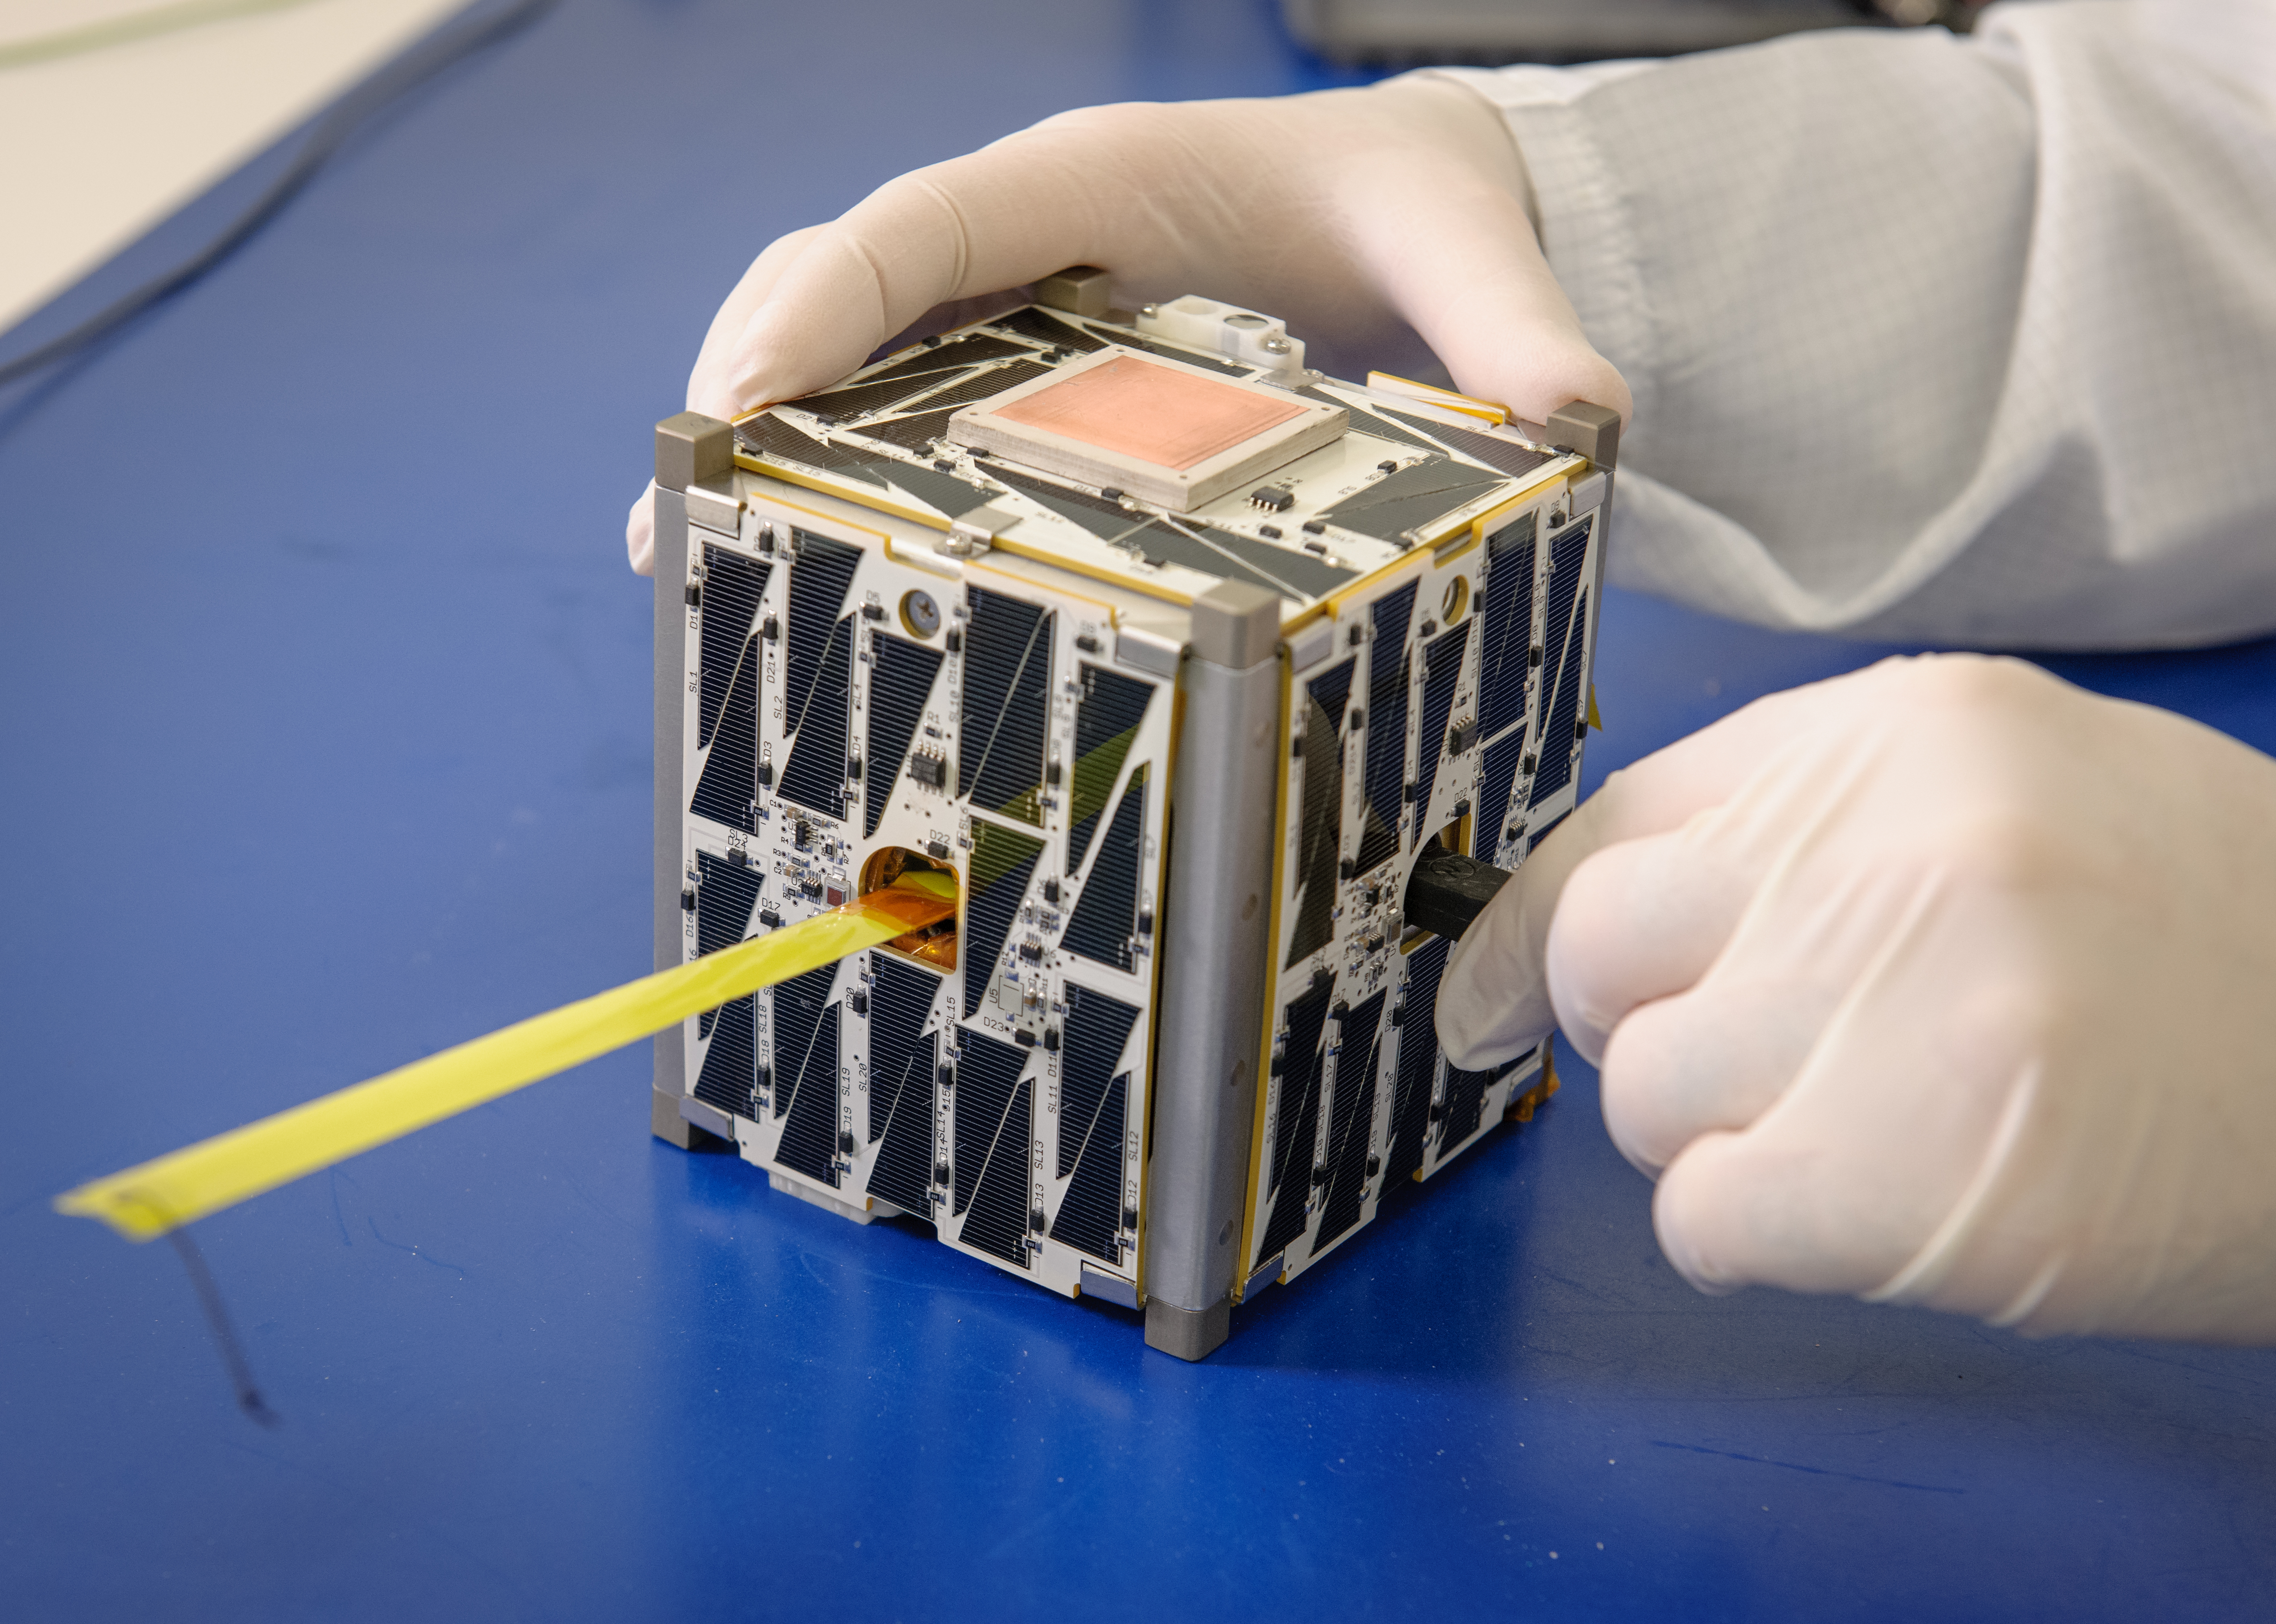
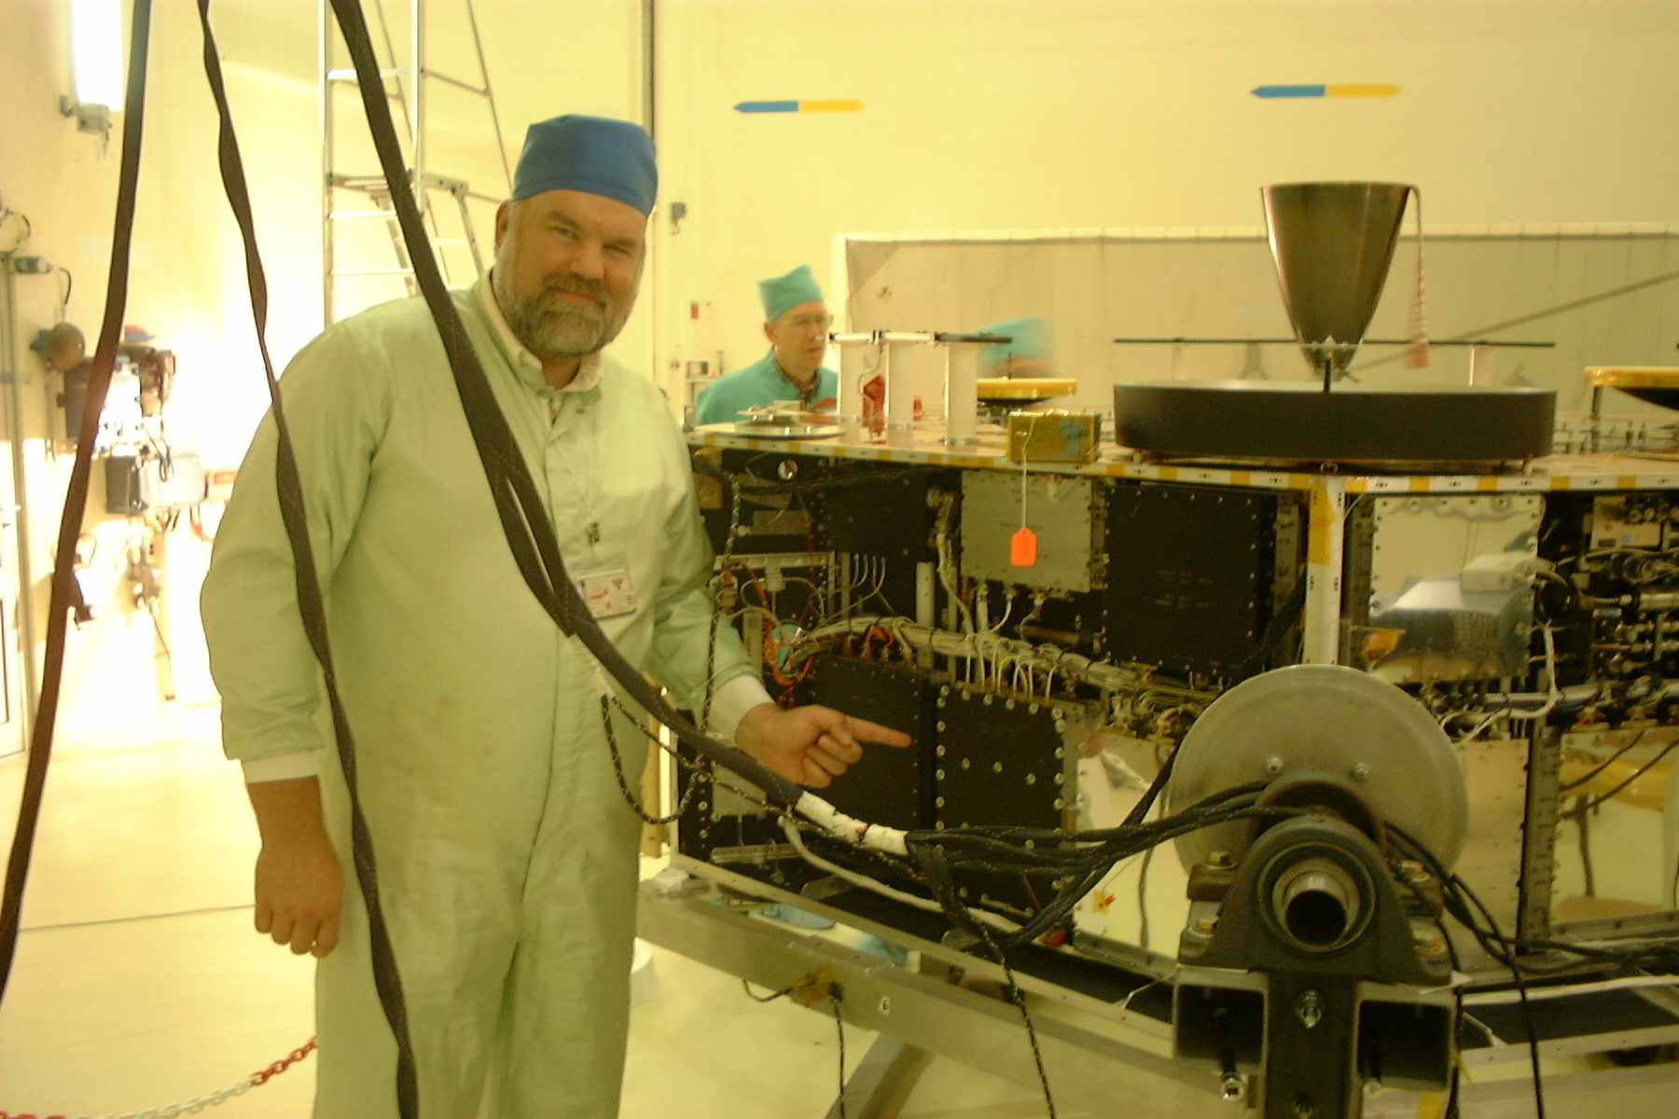
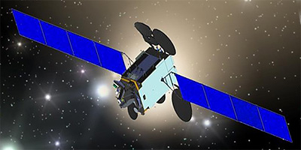
Amateur Satellites
Cubesat
Bdale Garbee, KB0G
with AO-40
Image courtesy Bdale Garby
https://creativecommons.org/licenses/by-sa/2.0/?
Es' hail 2, hosting Phase4A
AMSAT-UK, Q3 2017
Notes:
Phase 1 – Battery Power Only, short lived
Phase 2 – Solar Cells, LEO
Phase 3 – Long life, command, HEO (AO-40 pictured, with Bdale)
Phase 4 – Geosynchronous/Geostationary
Phase 5 – Lunar or planetary missions
Photos: Cubesat, Bdale with AO-40, Phase 4 A
Geosynchronous
For any location with visibility, the satellite is always in the same position in the sky at the same time of day
Geostationary
A special case of a Geosynchronous orbit with the orbit directly over the equator
The satellite is always in the same position in the sky at all times
Phase 4A will probably launch first, although they are deleyed by the SpaceX launch slips

Slide 7
Modes
Communication Modes
Conventional Transponders
  Phase 4A is this type
Phase 4B will be all Digital
  Provides data connections. You can encode voice on that if you want to.
  In some sense, a ‘router in the sky’
Notes:
Conventional transponders receive a band of frequencies, and retransmit them elsewhere, possible mirrored
These are called “bent pipes”, and
Simple relays of an FM modulated signal with audio passband
Phase 4 will be Digital, Packetized and Channelized
Provides voice (with codecs) and data, with multiple connected data streams
In some sense, a ‘router in the sky’

Slide 8
Why is this awesome?
Geo + Digital = Amazing
Not limited to short passes
Easy integration with existing networks
Ability to partition 'traffic'
Emergency Communications
Notes:
Long contacts possible with minimal antenna movement
Everything is data (voice with codecs)
Emergency communications
Provide voice and data communications anywhere within the ground footprint of the satellite
Allow assigning some channels for authorized EMCOMM use only
Ground station design goal is a station one person can carry, at a cost of under $1000 USD.

Slide 9
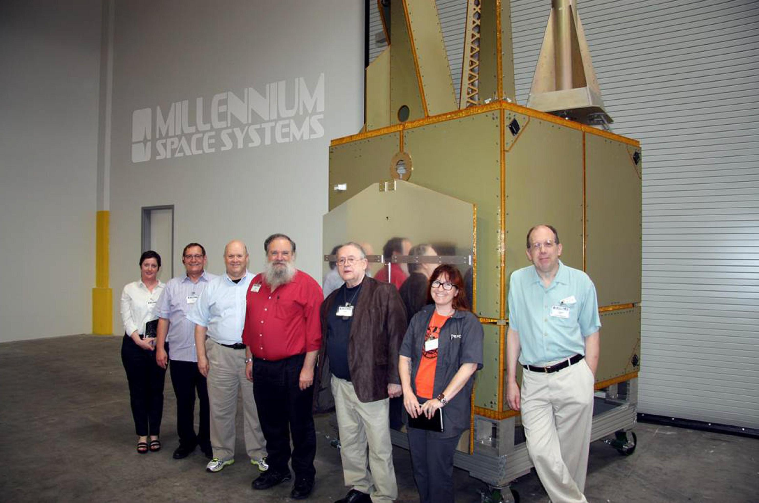
Project Organization
Two Projects
(L-R) Sonya Rowe, KK4NLO; Jerry Buxton, N0JY; Bob McGwier, N4HY; Franklin Antonio, N6NKF; Tom Clark, K3IO; Michelle Thompson, W5NYV; and Phil Karn, KA9Q standing next to the Aquila M8 Bus flight article.
Notes:
Flight Side (a separate team):
Virginia Tech University
Dr. Robert McGwier, N4HY
Various sponsors and government entities
We get space, a power budget, and space for antennas
Flight side development is closed, due to ITAR and sponsor requirements
Telemetry, firmware updates, and possibly authentication of users are all closed.
Ground Side:
Managed by Michelle Thompson, W5NYV
Completely open
Many interesting problems to solve
Several sub-projects – contact logging, authentication, etc

Slide 10

Phase 4 Ground Station
But I don’t live in the US!
Notes:
More Satellites could follow
We're working to the DVB-S2 and DVB-T standards
Terrestrial Applications
We're working to the DVB-S2 and DVB-T standards
Opens potential for point-to-point terrestrial networks

Slide 11
Stack Overview
Frequencies: 5 GHz up and 10 GHz down
100% Digital Modulation
DVB-S2 and DVB-T
Data Encapsulation
Demodulation/Decode on the Satellite
Notes:
5 GHz uplink and 10 GHz downlink
Full Duplex
Usable with an entry-level license in most countries
We want to increase utilization of these bands
Would like to use a single small antenna
Anyone know why this is a challenge?
Harmonic interference
DVB-S and DVB-T
Why are Space and terrestrial different?
Multipath
Reference designs and dedicated chips available
Can be implemented in FPGA
Data Encapsulation within DVB specification
Generic Stream Encapsulation (GSE)
A Data Link Layer protocol
This is a major sub-project for phase4
Demodulation/decode on the Satellite - Why?
Error detection path is halved
Channel/user assignments
Authentication/Authorization

Slide 12
Channelization
Allows many independent users
Allows partitioning of channels
Polyphase filter implementation
  An example of cutting edge open design needs
Notes:
Many channels up, one TDM channel down (slots).
Implemented in DSP or FPGA
Undecided, but likely to be either 1000 channels of 10 MHz each, or 100 channels of 100 MHz each.
There has been some discussion of channel bonding, but this complicates things, including ground station power amplifier design.
Channels will be assignable
A FOSS Polyphase Filter is needed
In very early stages of R&D
An interesting project

Slide 13
Ground Station Platform
Ground Station 'appliance' Design
It’s a radio server. No UI. A network jack.
Initially - homebrew lashups
Integrated station design
  General Purpose Computer + special hardware
Commercial product
  Flex Radio has expressed an interest
  FEMA is interested in a commercial product
Notes:
A standalone system
CPU + Dedicated DVB chip and/or FPGA
Linux OS
Accessible for developers
Ease of connectivity
Gateways, contact logging, user apps, etc
Large overlap in Linux and ham communities
One or two small dishes
Goal of a single dish, but there are challenges
W1GHZ prototype feedhorn
Transverters, RF amps, etc are all TBD
There are plans for a commercial product
U.S. FEMA has expressed an interest for use in disaster zones

Slide 14
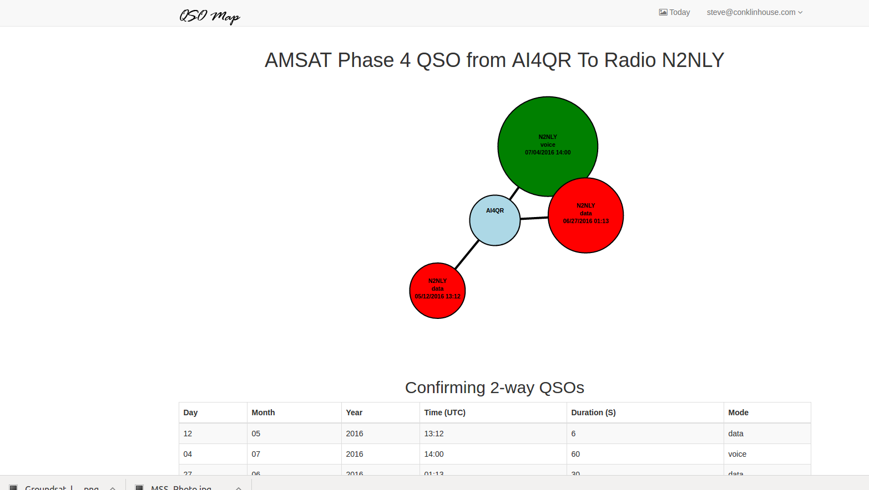
Ancillary Projects
QSO logging and visualization
Notes:
Cloud based contact Logging and visualization
Skeleton is done
Ruby/Rails app
The application framework is in place
There’s an example for visualizing contacts
Boundless possibilities
Need Ruby/Rails developers
Need more data visualizations
A generalized Ruby Gem for ADIF file processing would be awesome.

Slide 15
Ancillary Projects
Identification and Authorization
Identification and Authentication
  Easy to use
  Not dependent on connectivity for user
Notes:
Needed to assure licensing compliance in with governmental authorities
Needed to allow channel reservations
Probably similar to ARRL’s LOTW:
Token sent to postal address associated with the license.

Slide 16
Ancillary Projects
User Aplications
Text, Digital, and Voice modes
  All using underlying data transport layer
Unlimited potential for applications
  Some challenges due to latency
  Some restrictions by law
    No encryption or obfuscation of information

Slide 17
Current Status
Flight Hardware Team
RF Link budgets
  Calculated and terrestrial testing
  This will affect channelization
Ground station mock-ups
  So far, no DVB, but using gnuradio on both ends

Slide 18
Current Status
DVB-S/T development
Data Encapsulation (GSE)
  Work is ongoing by the ground team
Notes:
GSE
GNURadio, wireshark, FPGA
Very active development and testing
Comparison of FPGA and chip implementations

Slide 19
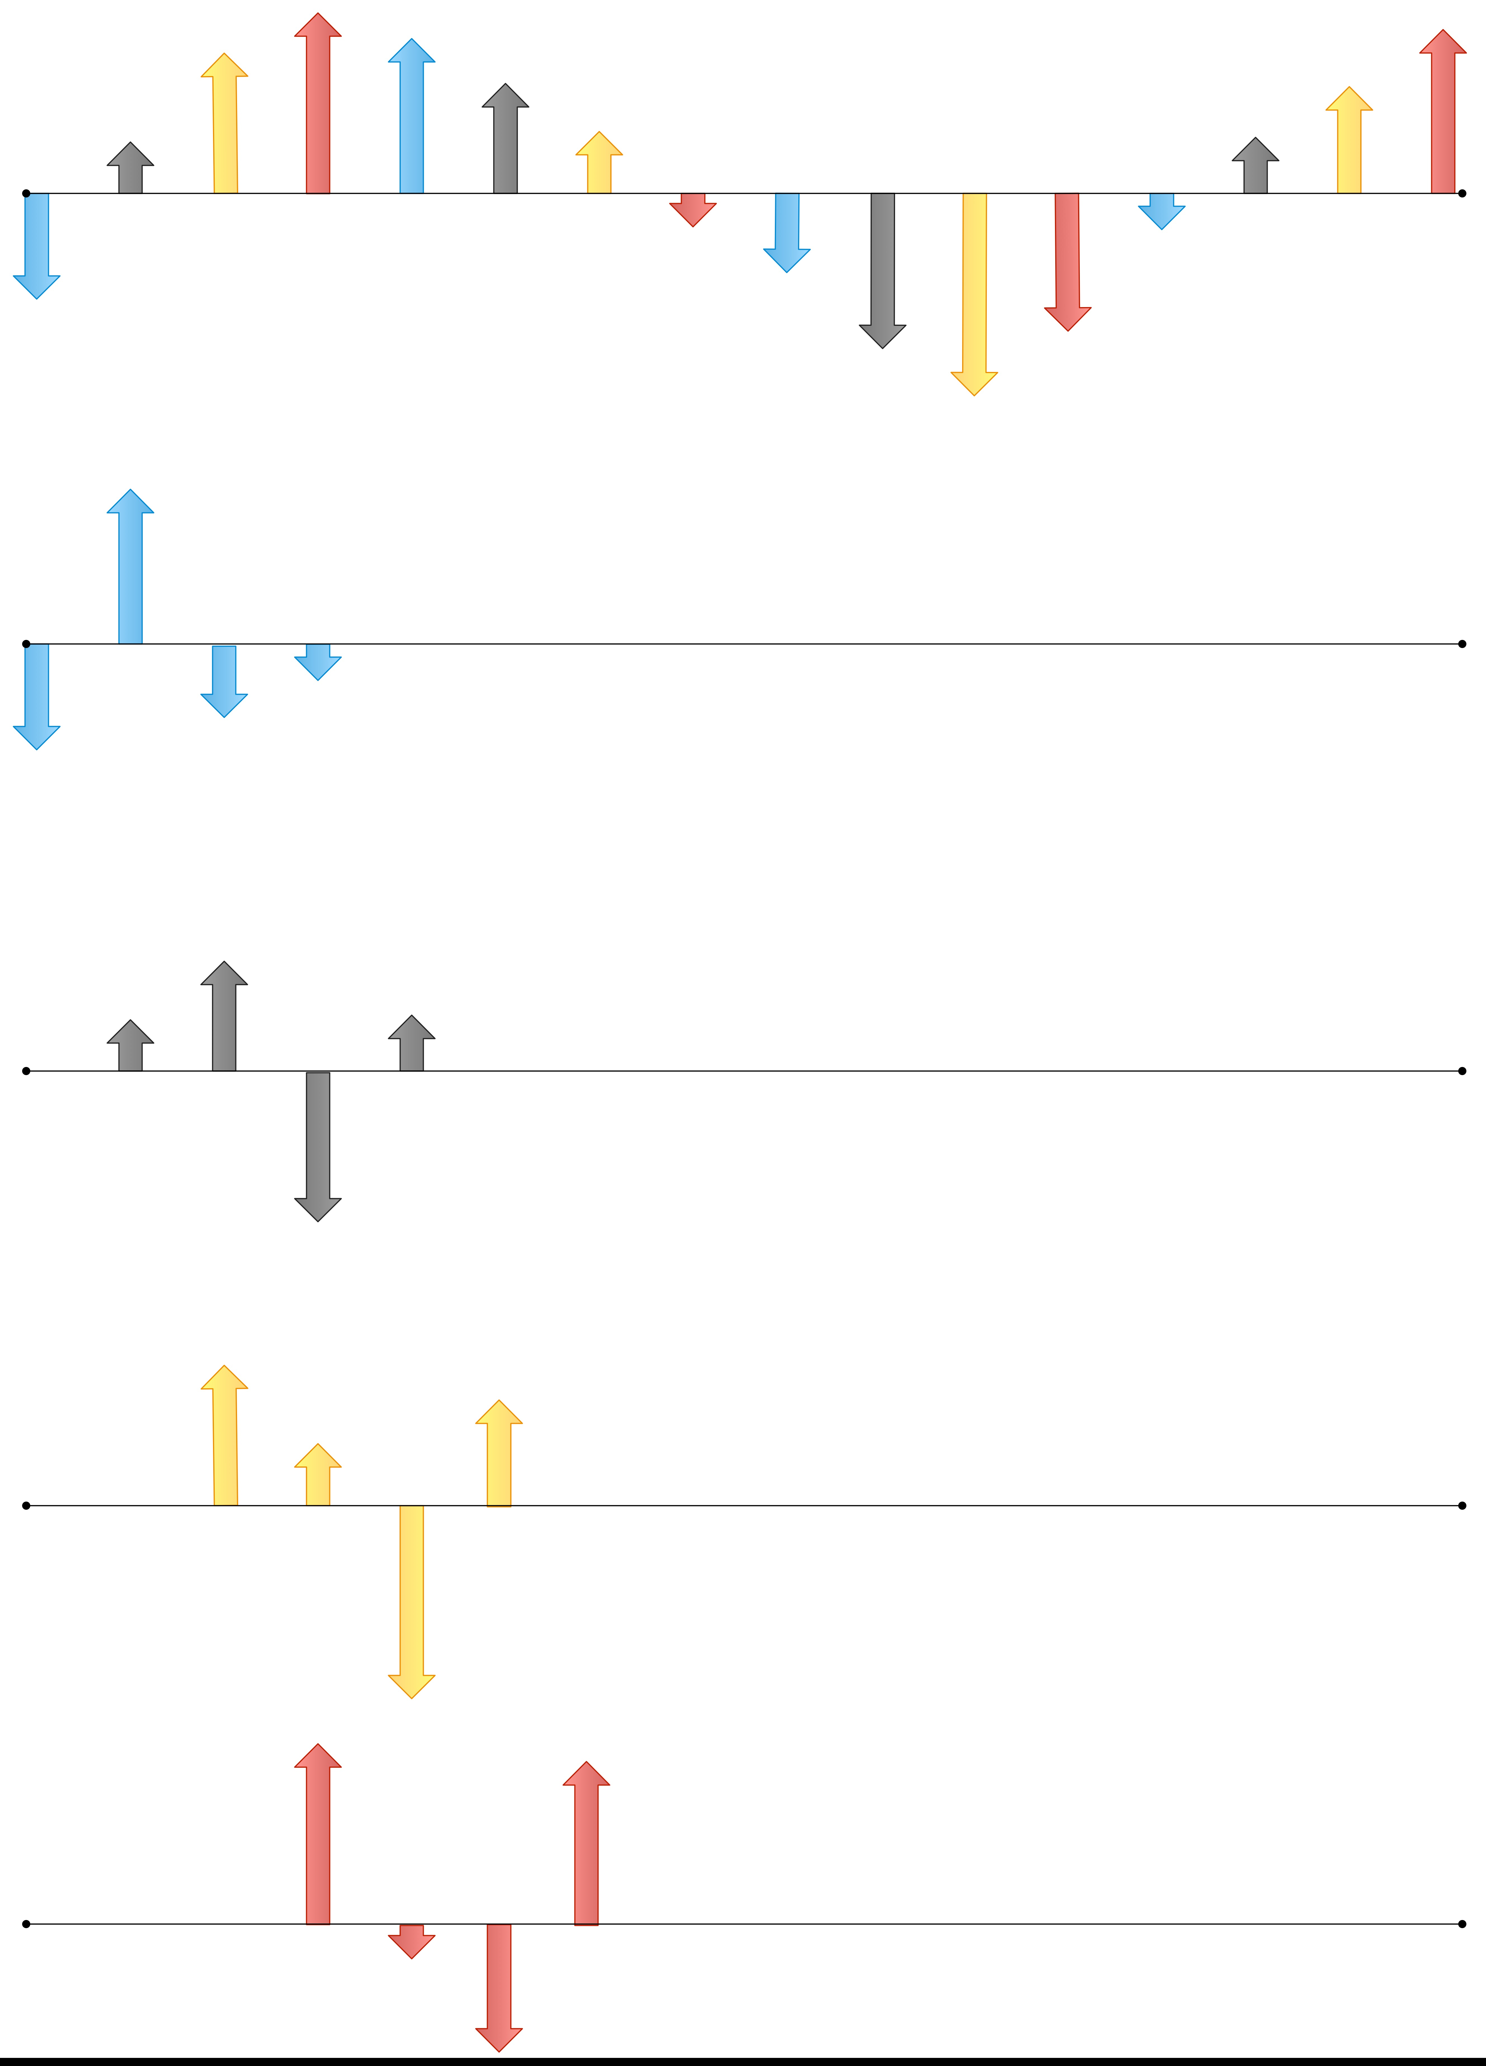
Current Status
Polyphase Filters
Image: Michelle Thompson
Notes:
Polyphase Filter Development
Just barely starting
We need a good open implementation
FPGA or DSP implementation
Developers needed

Slide 20
Current Status
Ground Station platform design
We need you for this
A major project that will gain momentum
Not yet started in earnest
  Too many design decisions in the air
We need you
Notes:
The intent is to have a Linux platform. Details will depend on the additional hardware required, and those decisions have not been made
It might be possible to start with platforms like Red Pitaya, LimeSDR, or others.
A commercial chip for DVB would probably be much cheaper than FPGA
In addition to the ‘obvious’ skills, we need documentation, promotion, build and release management, and more.
Plus apps. Lots of apps.

Slide 21
How Can I Contribute?
Where to find things?
Github
  github.com/phase4ground
  phase4ground.github.io
AMSAT team signup
  amsat.org/?page_id=1096
  Ignore the ITAR-only warning for phase4ground
Slack
  phase4ground.slack.com
Weekly reports and other video
  https://www.youtube.com/playlist?list=PLavdGnjBLuiX97DAKk32NJ1bCF1a0cv01

Slide 22
How Can I Contribute?
All levels of experience welcome
Follow along, and find what interests you
It's ok to just follow development and ask questions
Introduce yourself, and engage on Slack
Get up to date with the weekly reports

Slide 23
Questions?
Steve@conklinhouse.com

