Slide 1

Cork Constraint Computation Centre
CAPACITY OPTIMIZER™
Solving Resource Allocation and
Energy Saving Problems
for Large Data Centers

Slide 2
Smarter Data Centre
All large data centers today face a very important everyday problem: monitoring and optimizing utilization of their valuable resources.
While the advanced monitoring is well supported by many commercial systems, finding optimal solutions for constantly arising capacity bottleneck problems and automatically generating practical recommendations for system administrators remains a complex research issue.
Virtualization and cloud computing make these real-world problem even more important.
CAPACITY OPTIMIZER™ addresses these problems using the latest advances in the business analytics, rules, event processing, and constraint optimization technologies.
CAPACITY OPTIMIZER™ has been developed under the Enterprise Ireland grant "Applying Integrated Rules and Constraint Technology to Diagnose and Resolve Capacity Deficiency Problems for Large Data Centres (CDDC)".

Slide 3
Data Centre Capacity Planning and Management
"As data centers struggle with server consolidation and server virtualization, capacity planning becomes the key to maintaining or improving service quality while containing costs.”
The Capacity Planning Software Market
Forrester Research
Objective:
  Define a generic model and practical tools for capacity planning and management of a large data centre
  Generate practical recommendations for system administrators: an optimal way to reconfigure resource capacities and move workload around
Using Integrated Technologies (BR+CP+CEP):
  Business Rules Management System (oriented to business users)
  Constraint Programming (for solving complex optimization problems)
  Complex Event Processing (for monitoring and problem identification)

Slide 4
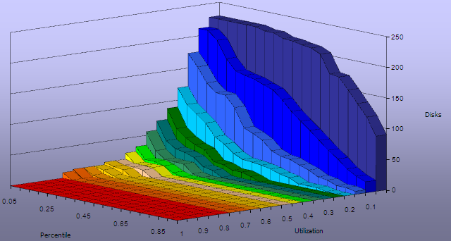
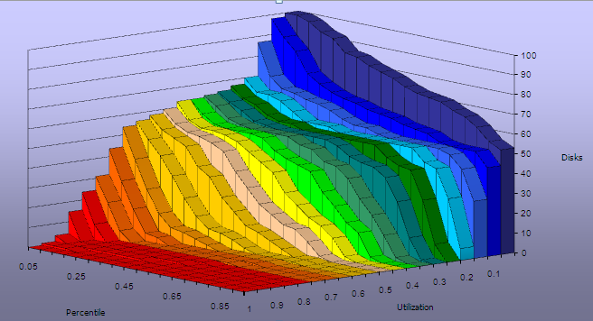
Data Centre Performance Problems

Slide 5
Examples of Resource Allocation Constraints
Disks should not spend a certain percentage of time above a certain utilization percentage, e.g. no disk should spend more than 50% of the time above 70% utilization
The time and utilization should be configurable
No disk should spend a certain amount of time above a 70% utilization. i.e. it is ok for the disks to spend 1 sample above 90% of utilization several times a day but at 2 consecutive samples, the peak is too long and would cause unacceptable delays.
The utilization of a disk should not be more than a certain percentage more than the average utilization for a specified percentage of time.
40% above the average utilization for more than 40% of the time
Limits on the standard deviation and coefficient of variance

Slide 6
More Complex Real-world Constraints
If DiskA is busy and it contains two devices (DA1, DA2) which are very busy, then look for another disk which is not busy and move one of the busy devices on to it
Devices can only be move to Disks within the same array
Allow (or not) the devices to move to devices on any array used by the host
Both disks should have a similar maximum utilization (or as defined by more complex data center configurations)
Changes are expensive! So devices should only move if the constraints are ‘bettered’ significantly enough.

Slide 7
Diagnosing and Fixing Performance Problems
Diagnosing utilization problems:
  There are disks that are above maximum thresholds of utilization, i.e.
  Thresholds of utilization, time, standard deviation or coefficient of variance are exceeded.
  Indications on whether the data load can be spread across the existing disks without the utilization threshold breaches.
Recommending solutions:
  Will reconfiguring the existing hardware provide better performance, i.e. Are there enough underutilized disks to take this load without purchasing more hardware.
  If no configuration is allowed with existing disks, how much additional disk would be required to bring the utilizations for all disks below the thresholds.
  How to move workload around (What – From – To)

Slide 8
Integrated CEP, Business Rule,s and Optimization approach
CEP Engine (complex event processing):
    analyzes event stream finding patterns
Rules Engine:
    Diagnose the capacity bottlenecks
    Generates Constraint Satisfaction Problem
Constraint Engine:
    Recommends the best way to move the workload around

Slide 9
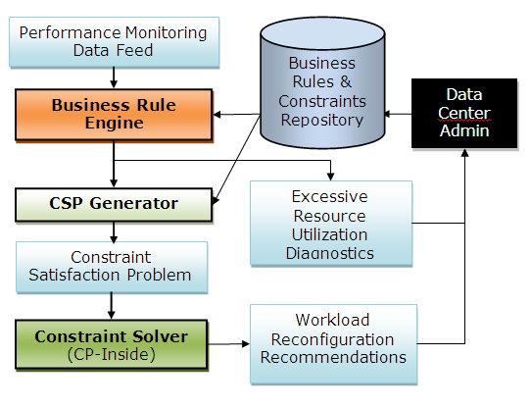
Architecture

Slide 10
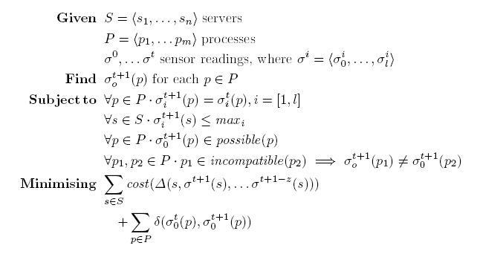
Formal Model
The model addresses capacity deficiency problems for storage, CPU, networking, etc. It is generic enough to address related problems such as optimization of active server distribution to save power and cooling costs

Slide 11
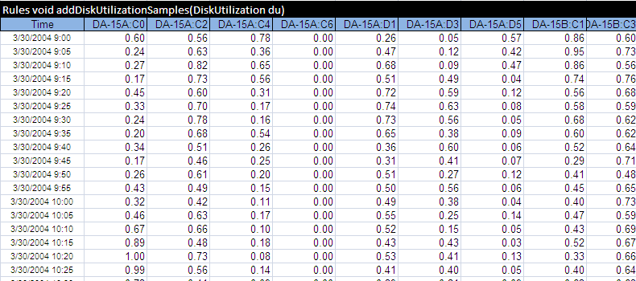
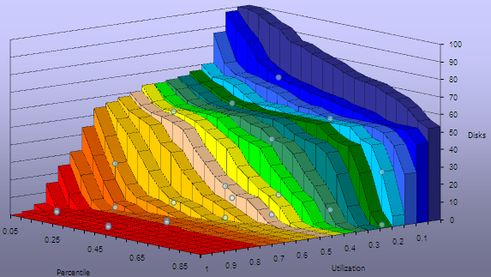
Monitoring Data
Disk Utilization Samples taken every 5 minutes

Slide 12
Example of Business Rules for Capacity Management
Rules void DiskUtilizationRules(Problem p, Disk d)
Sampling Frequency in minutes | Maximal Disk Utilization Percent | Time Utilization Percent | for Disk Utilization Percent Above | Number Of Consequtive samples | with Disk Utilization Percent Above | Produce Warning and Set Excessive Utilization Above Limit |  | Set Disk Utilization State
 |  |  |  |  |  | Warning | Utilization Limit (%)
 |  | >=40 | 45 |  |  | := "40% or more of time spent above of" | 45 | Medium
>=10 | 60 |  |  |  |  | := "At or above of" | 60 | High
<10 | 70 |  |  |  |  | := "At or above of" | 70 | High
<15 |  |  |  | >=3 | 70 | := "3 or more consecutive samples above of" | 70 | VeryHigh
>=15 |  |  |  | >=2 | 70 | := "2 or more consecutive samples above of" | 70 | VeryHigh
>=30 |  |  |  | >=1 | 70 | := "1 or more consecutive samples above of" | 70 | VeryHigh

Slide 13
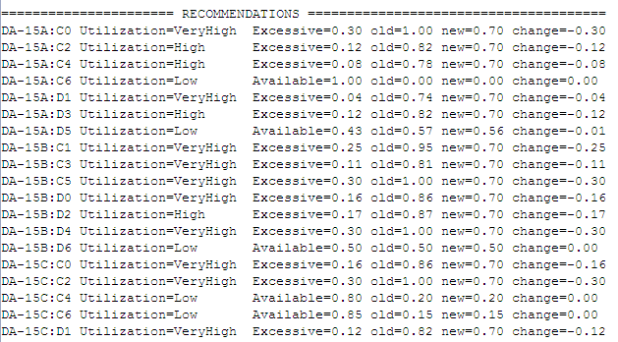
Optimal Recommendations (moving load around)
Removes Excessive Disk Utilization

Slide 14
Benefits
Practical tools for finding optimal solutions for constantly arising capacity bottleneck problems and automatically generating practical recommendations for system administrators how to move workload around
Our model is generic enough to address not only capacity deficiency, but also related problems such as optimization of active server distribution to save power and cooling costs
CAPACITY OPTIMIZER™ as a component of a generic decision support framework for Monitoring and Optimizing Resource Utilization of Large Data Centre

