Slide 1
www.jcp.org www.cpstandards.org
JSR-331
Constraint Programming API
Early Draft Review
Jacob Feldman
March 24, 2010

Slide 2
JSR-331 – Java Specification Request
Java Constraint Programming API under the roof of the Java Community Process (JCP) www.jcp.org
The Early Draft of this oncoming standard is now available for public review at www.cpstandards.org
I will present key concepts and design decisions related to the standard representation and resolution of constraint satisfaction and optimization problems.

Slide 3



CP Standardization Perspective
Business World
Top-Down View
CP Interfaces
Standard is Oriented to Application Developers while allowing CP Vendors to provide implementations
Bottom-Up View
CP World

Slide 4
Key Objectives
Make CP more accessible for business software developers
Allow a Java business application developer to easily switch between different solver implementations without any(!) changes in the application code
Assist CP vendors in creating JSR-331 practical implementations

Slide 5
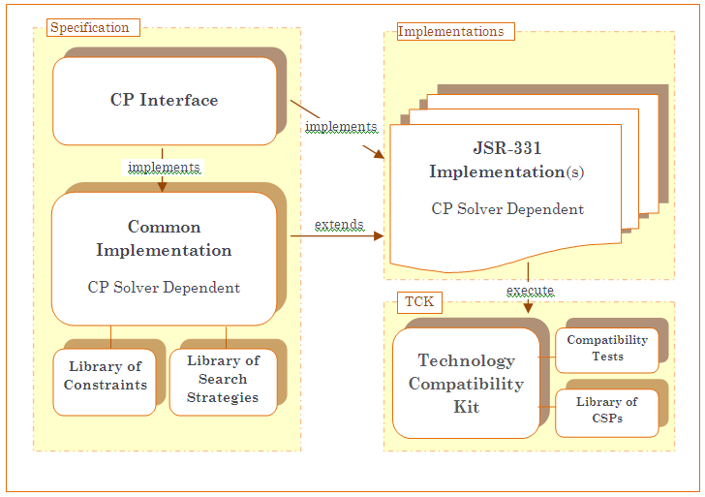
JSR-331 Architecture
javax.constraints.impl
javax.constraints
javax.constraints.impl

Slide 6
Interface “javax.constraints”
Only 6 major CP concepts:
  Problem
    ConstraintVariable
    Constraint
  Solver
    SearchStrategy
    Solution

Slide 7
Simple Example (Problem Definition)
public static void main(String[] args) {
//==== PROBLEM DEFINITION ==============================
Problem p = new Problem("Test");
//======= Define variables
Var x = p.var("X",1,10);
Var y = p.var("Y",1,10);
Var z = p.var("Z",1,10);
Var r = p.var("R",1,10);
Var[] vars = { x, y, z, r };
//======= Define and post constraints
try {
// X < Y
x.lt(y).post();
// X + Y = Z
x.add(y).eq(z).post();
// or p.linear(new Var[]{x,y}, Oper.EQ, z).post();
p.allDifferent(vars).post();
// 3x + 4y -7z + 2r > 0
int[] coef1 = { 3, 4, -7, 2 };
p.linear(coef1,vars, Oper.GT, 0).post();
// x + y + z + r >= 15
p.linear(vars, Oper.GE, 15).post();
// 2x - 4y + 5z - r > x*y
int[] coef2 = { 2, -4, 5, -1 };
p.linear(coef2,vars, Oper.GT, x.mul(y)).post();
} catch (Exception e) {
p.log("Error posting constraints: " + e);
System.exit(-1);
}

Slide 8
Simple Example (Problem Resolution)
//=== PROBLEM RESOLUTION ==============
p.log("=== Find One Solution:");
Solver solver = p.getSolver();
Solution solution = solver.findSolution();
if (solution != null)
solution.log();
else
p.log("No Solution");
solver.logStats();
=== Find One Solution:
Solution #1: X[2] Y[3] Z[5] R[9]
*** Execution Profile ***
Number of Choice Points: 5
Number of Failures: 3
Occupied memory: 683448
Execution time: 31 msec

Slide 9
Problem Definition
Problem – a factory and a placeholder for all other objects
ConstrainedVariable – a base class for:
    Var
    VarBool
    VarReal
    VarSet
    Common concepts:
        name, impl, business object, #of constraints,…
Constraint

Slide 10
Var – constrained integer variables
Getters: getMin(), getMax(), getValue(),..
But no setters, instead:
  var.le(25).post();
Creation:
    Var x = problem.var(“X”,1,10);
    int[] domain = new int[] {1,2,4,7,9};
    Var var = problem.var(“A”, domain);
    Var[] vars = problem.varArray(“A”, 0, 10, 100);
Domain type
  public enum DomainType {
  DOMAIN_SMALL,
  DOMAIN_MIN_MAX,
  DOMAIN_SCARCE,
  DOMAIN_OTHER
  }

Slide 11
Constraint: common methods
Constraint and(Constraint c)
Constraint or(Constraint c)
Constraint negation()
Constraint implies(Constraint c)
VarBool asBool()
void post() – may throw a RuntimeException
void post(ConsistencyLevel consistencyLevel)
// green bin can contain plastic, wood, copper
c1 = pb.linear(type, Oper.EQ, green);
c2 = pb.linear(counts[glass], Oper.EQ, 0);
c3 = pb.linear(counts[steel], Oper.EQ, 0);
c1.implies( c2.and(c3) ).post();

Slide 12
Constraints: examples
try {
x.lt(y).post();
p.allDifferent(vars).post();
int[] coef1 = { 3, 4, -7, 2 };
p.linear(coef1,vars, Oper.GT, 0).post();
} catch (Exception e) {
p.log("Error posting constraint: " + e);
}

Slide 13
Constraints
Currently Included:
  Linear
  AllDifferent
  Element
  Cardinality
  GlobalCardinality
Under Consideration:
  “regular”, “diffn”, “cumulative”, …

Slide 14
User-Defined Constraints
Combinations of predefined constraints
New sub-classes of ConstraintI
Controversial Concepts (postponed):
  Propagators
  PropagationEvent

Slide 15
Problem Resolution
Solver – a factory and a placeholder for search related objects
Search Methods
    Find One Solution
    Find Optimal Solution
    Iterate through solutions within custom limits
SearchStrategy
    The default strategy and implementation strategies
    Variable and Value Selectors
Solution

Slide 16
Search Strategies
For now only one search strategy is required:
SearchStrategy strategy = solver.getSearchStrategy();
strategy.setVarSelectorType( VarSelectorType.MIN_DOMAIN_MIN_VALUE);
Solver-specific strategies are listed:
  RestartSearchStrategy(RestartFunction)
  BoundedBacktrackingSearchStrategy(Steps)
  LimitedDiscrepancySearchStrategy(Disc)
  CreditBasedSearchStrategy(InitialCredit,CreditFunction,Steps)
  DepthBoundedSearchStrategy(Level,Steps)
  Other
SearchStrategy strategy = new BoundBacktrackingSearchStrategy(100); //steps
solver.setSearchStrategy(strategy);

Slide 17
Variable Selectors
INPUT_ORDER
MIN_VALUE
MAX_VALUE
MIN_DOMAIN
MIN_DOMAIN_MIN_VALUE
MIN_DOMAIN_RANDOM
RANDOM
MIN_DOMAIN_MAX_DEGREE
MIN_DOMAIN_OVER_DEGREE
MIN_DOMAIN_OVER_WEIGHTED_DEGREE
MAX_WEIGHTED_DEGREE
MAX_IMPACT
MAX_DEGREE
MAX_REGRET
CUSTOM

Slide 18
Value Selectors
IN_DOMAIN
MIN
MAX
MIN_MAX_ALTERNATE
MIDDLE
MEDIAN
RANDOM
MIN_IMPACT
CUSTOM

Slide 19
Common Implementation javax.constraints.impl
Provides default implementations for:
  solutionIterator()
  findSolution(…)
  findOptimalSolution(…)
  findAllSolutions(…)
  Most Variable and Value Selectors
  The only abstract method is:
  abstract public Solution findSolution(ProblemState restoreOrNot);

Slide 20
Queens Example (definition)
public static void main(String[] args) {
//========= Problem Representation ==================
Problem problem = new Problem("Queens");
String arg = (args.length < 1) ? "1000" : args[0];
int size = Integer.parseInt(arg);
problem.log("Queens " + size);
// create 3 arrays of variables
Var[] x = problem.varArray("x",0, size-1, size);
Var[] x1 = new Var[size];
Var[] x2 = new Var[size];
for (int i = 0; i < size; i++) {
x1[i] = x[i].add(i);
x2[i] = x[i].sub(i);
}
// post "all different" constraints
problem.allDifferent(x).post();
problem.allDifferent(x1).post();
problem.allDifferent(x2).post();

Slide 21
Queens Example (resolution)
//========= Problem Resolution ==================
// Find a solution
Solver solver = problem.getSolver();
solver.setTimeLimit(600000); // milliseconds
SearchStrategy strategy = solver.getSearchStrategy();
strategy.setVars(x);
strategy.setVarSelectorType(VarSelectorType.MIN_DOMAIN_MIN_VALUE);
strategy.setValueSelectorType(ValueSelectorType.MIN);
Solution solution = solver.findSolution();
if(solution == null)
problem.log("no solutions found");
else{
solution.log();
}
solver.logStats();
}
}
Queens 1000
Solution #1: x-0[0] x-1[555] x-2[1] x-3[502] x-4[2] x-5[507] …
*** Execution Profile ***
Number of Choice Points: 996
Number of Failures: 8
Execution time: 1093 msec

Slide 22
TCK – Technology Compatibility Kit
org.jcp.jsr331.tests
  JUnit tests Unit tests with asserts for expected results
org.jcp.jsr331.samples
  A library of well-known CSPs implemented using a pure JSR-331 API

Slide 23
JSR-331 Implementations
CP Vendors
  Support
  Compromises
On the way Implementations
  Constrainer, Choco, JaCoP, …
Oncoming JSR-331 Presentations
    Epicenter 2010 (Dublin, June)
    CPAIOR 2010 (Open Source Workshop)
    CP 2010 (Open Discussion)

Slide 24
4C Support
Thank you, Helmut!
Integration with Vizualizer
Integration with Scheduler
Adding Real and Set variables
Need a constructive critique
Become an alpha-tester and use it for your own problems!

