Slide 1
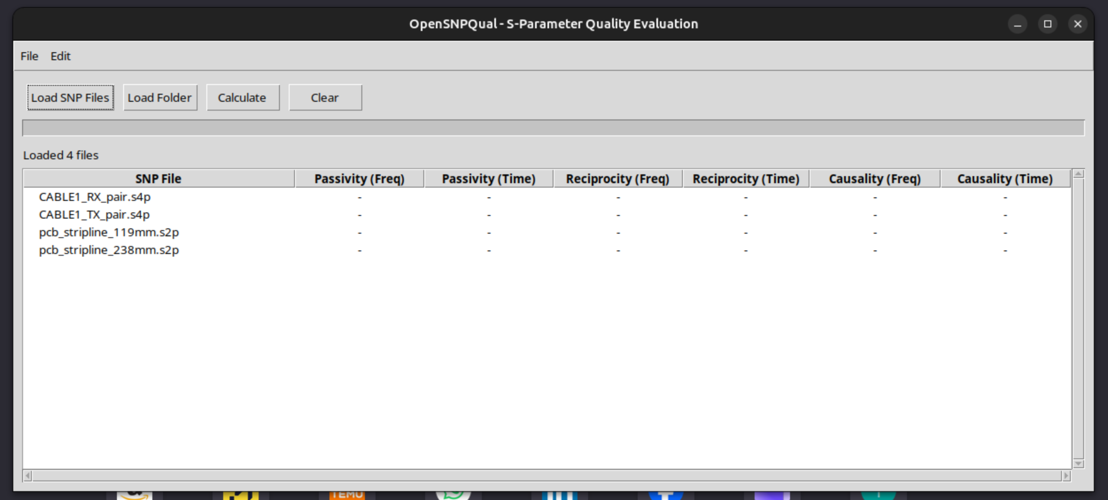
* Correlation to IEEE370
* Report a BUG
---------
* About OpenSNPQual
OpenSNPQual V0.xx – No-nonsense Quality Checker
Help
Calculate TIME DOMAIN
CLEAR
☑
1
1
4
2
5
3
6
☑
☑
☑
☑
STATUS LOG

