Slide 1
TR-1um Design Rules Summary
for Drawing Layers
2026/09/09
Reflected GitHub issues
https://github.com/OpenSUSI/TR-1um/issues

Slide 2
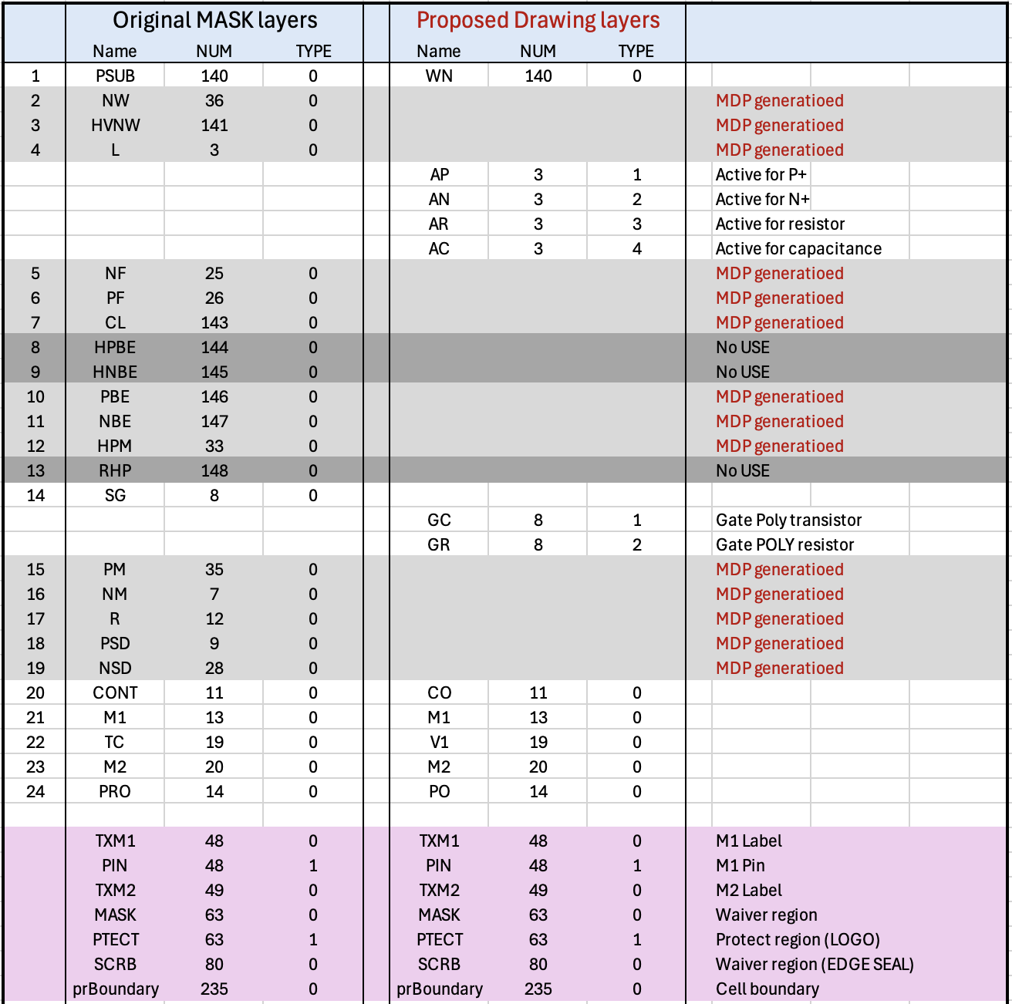
Drawing Layers Table
*IMPORTANT*
DBU: 0.001um
Scale Factor: 1.0
Min Grid: 0.05um

Slide 3
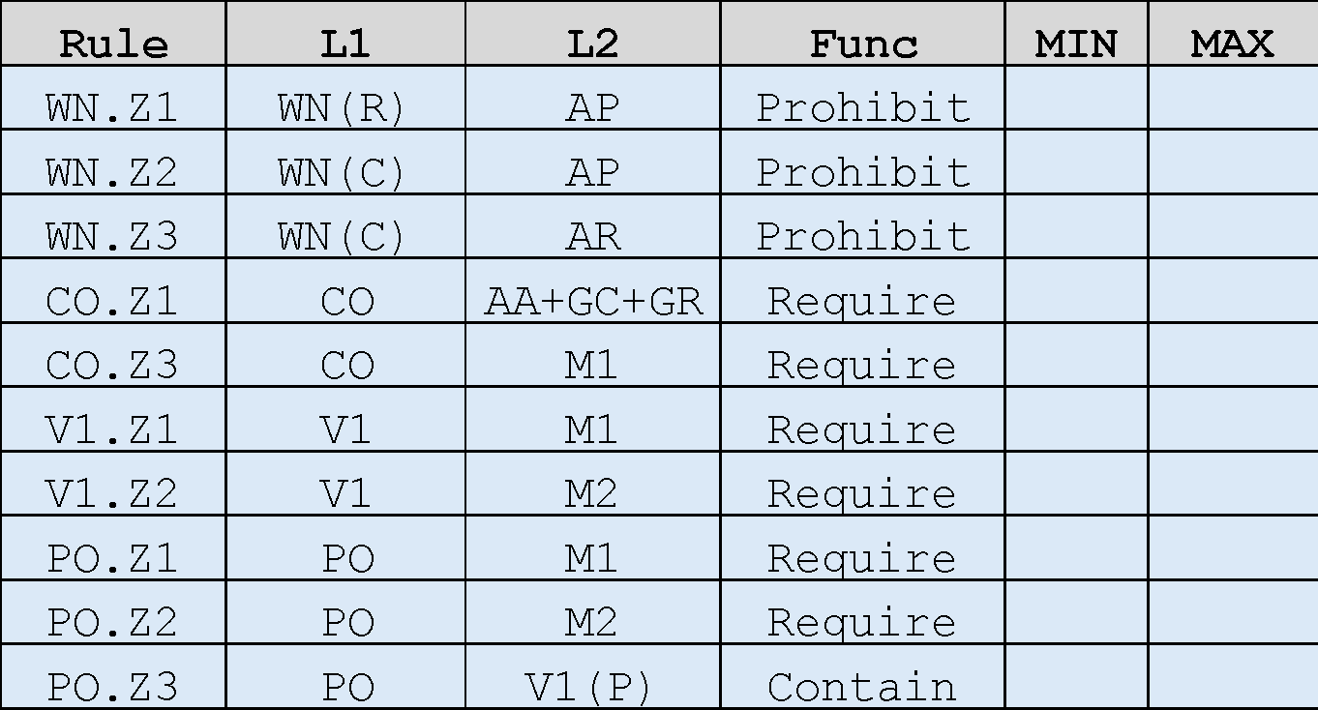
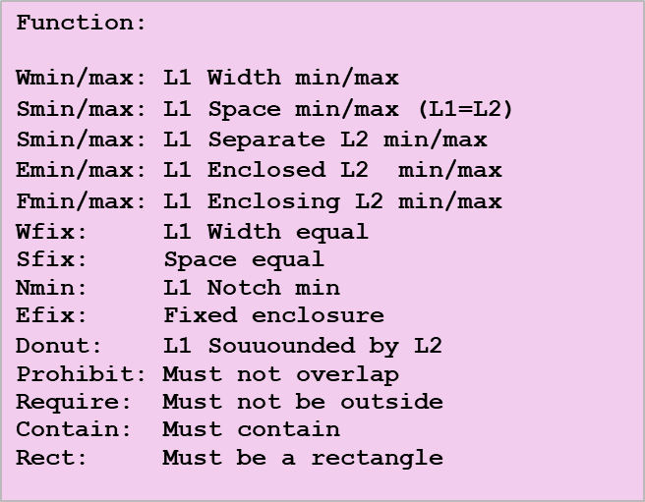
Cat-1: Prohibited
WN(R)
WN(C)
WN(C)
PO
V1(P)
AR
AC
AC
PO.Z3
AP
AP
AR
WN.Z1
WN.Z2
WN.Z3
CO
V1
PO
AP+AN
+AC+AR
+GC+GR
M1
M1
CO.Z1
V1.Z1
PO.Z1
M1
M2
M2
CO.Z3
V1.Z2
PO.Z2
AA ：AP + AN + AC + AR
WN(R)：WN covering AR
WN(C)：WN covering AC
V1(P)：V1 interacting PO

Slide 4
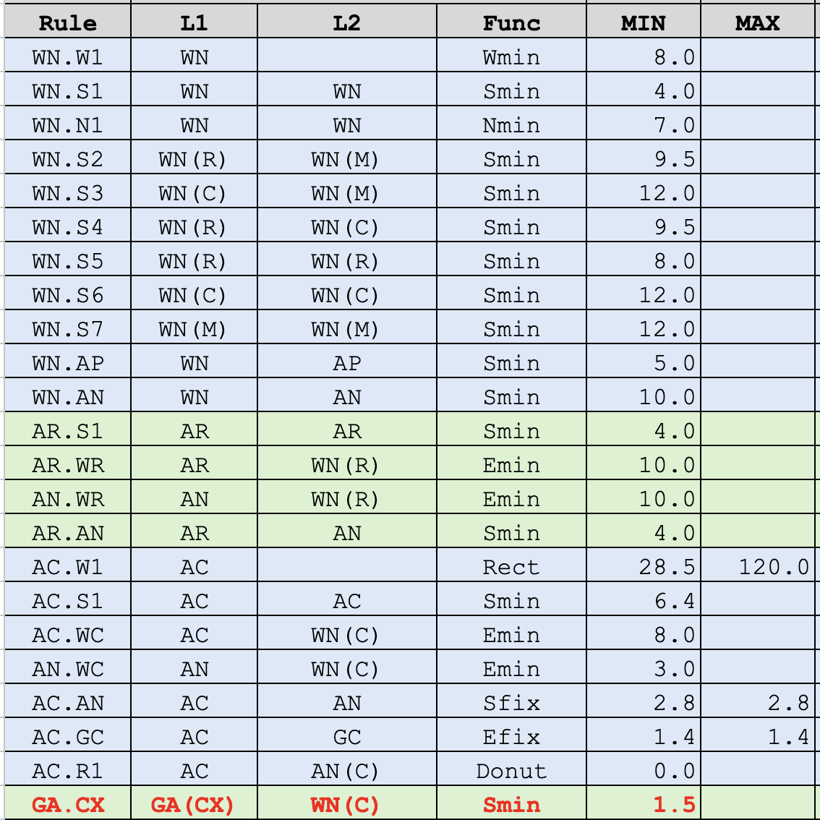
Cat-2: WN to AP/AN/AR/AC related
WN
(R)
WN
(R)
WN
(M)
WN.S5
AR
WN.S2
AR
AN
AN
AR.S1
WN.AN
WN.AP
AP
AR.WR
AR.AN
AN.WR
AN
AP
WN.S4
WN.S7
WN
(C)
WN
(C)
WN
(M)
WN.S6
GC
WN.S3
AC
AN
AC
AP
AC.GC
AC.R1
AC.S1
AC.AN
WN.W1
WN.AN
WN.AP
AC.WC
AC.W1
AN.WC
WN.AN
WN.AP
AN
AP
AC.R1(Donut)
AN
AP
WN(R)：WN covering Resistor(AR)
WN(C)：WN covering Capacitor(AC)
WN(M)：WN covering MOS/Diode(AP)
AN(C)：AN ring for Capacitor WN(C)
GA(CX): GC+GR not covering AC
GA.CX
WN
GC + GR
WN
WN.N1
WN.W1
WN.S1

Slide 5
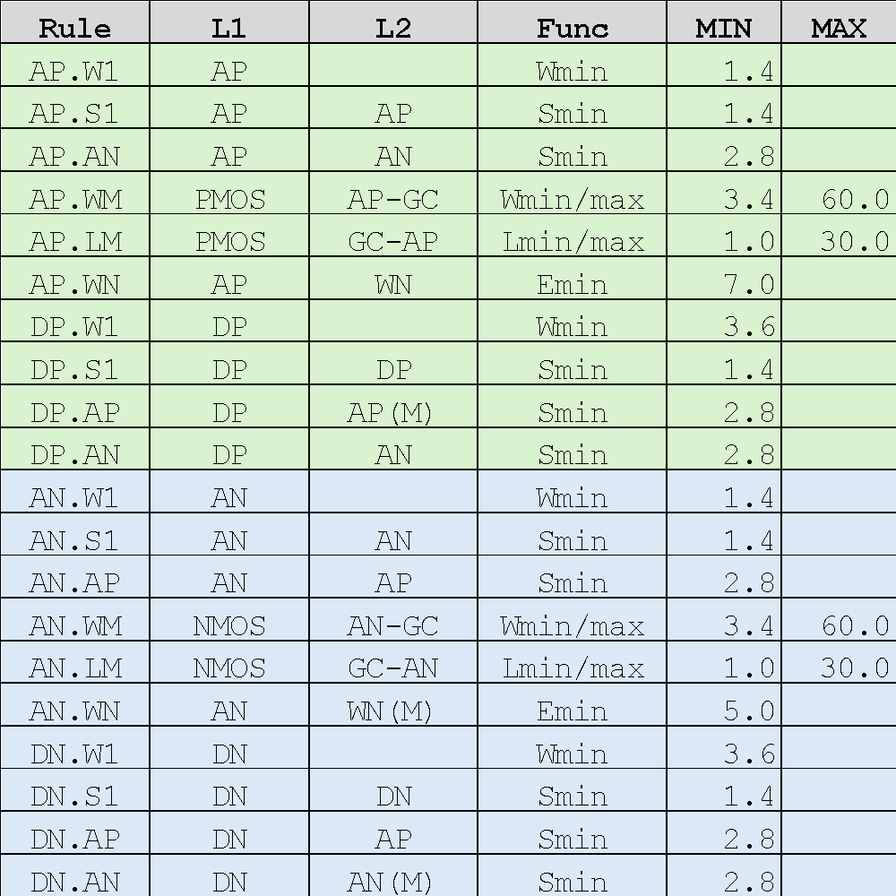
Cat-3: MOS transistor related
WN
(M)
DP.W1
AN
DP.S1
AP.S1
AN.S1
AN
AP
(D)
AP
(M)
AP.LM
AP.WM
DP.AN
DP.AP
AP.AN
AN.W1
AP.WN
AP.WN
AN.WN
GC
DN.AP
AN
(D)
DN.AN
AN
(M)
AN.AP
AP.W1
AP
AN.LM
AN.WM
DN.S1
AP.S1
AN.S1
DN.W1
AP(M)/PMOS：AP for 5V PMOS
AN(M)/NMOS：AN for 5V NMOS
AP(D)/DP ：AP for P-Diode
AN(D)/DN ：AN for N-Diode
WN(M) ：WN covering PMOS
AP

Slide 6
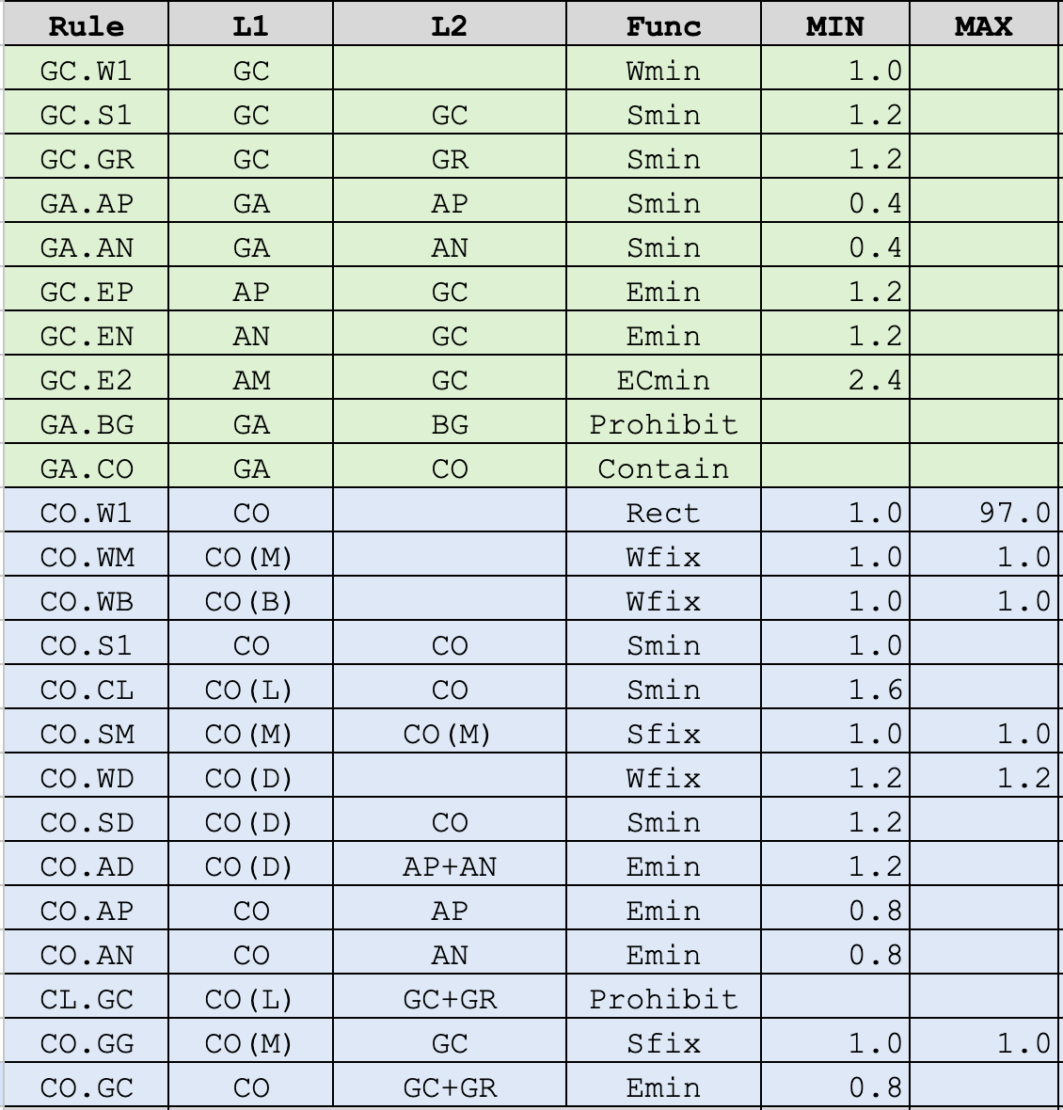
Cat-4: Contact and Poly related
WN
GR
GC.EP
GA.AP
GA.AN/GA.BG
AP
AN
CO.AD
CO.WD
CO.WM
GC.W1
CO.AP
CO(B)
GC
GC.S1
CO.SM
CO.S1
AP
(D)
CO.GG
CO.AN
CO.SM
CO.WB
GC.GR
GA.AP
CO.GC
GA.AN
GA.BG
GR
GC
CO.S1
GA.CO
CL.GC
✕
CO.W1
CO(L)
GA.AN
GA.AP
GA.BG
CO(D)
CO.SM
CO.AD
CO.WM
CO(B)
CO.WD
CO.SM
CO.S1
CO.AP
AN
(D)
CO.GG
CO.AN
CO.WB
AN
AP
GC.E2
GC.EN
GA.AP
GA.BG
GA ：GC/GR (all Poly)
BG ：AP/AN for MOS Back-gate
CO(M)：CO on PMOS/NMOS source/drain
CO(B)：CO on BG
CO(D)：CO on AP(D)/AN(D)
CO(L)：CO(Area>=1.5um²)
GA.AN
<=1.2um
<=1.2um
CO.CL
GR
CO(L)
CO
CL.GC
✕
AN
CO(L)

Slide 7
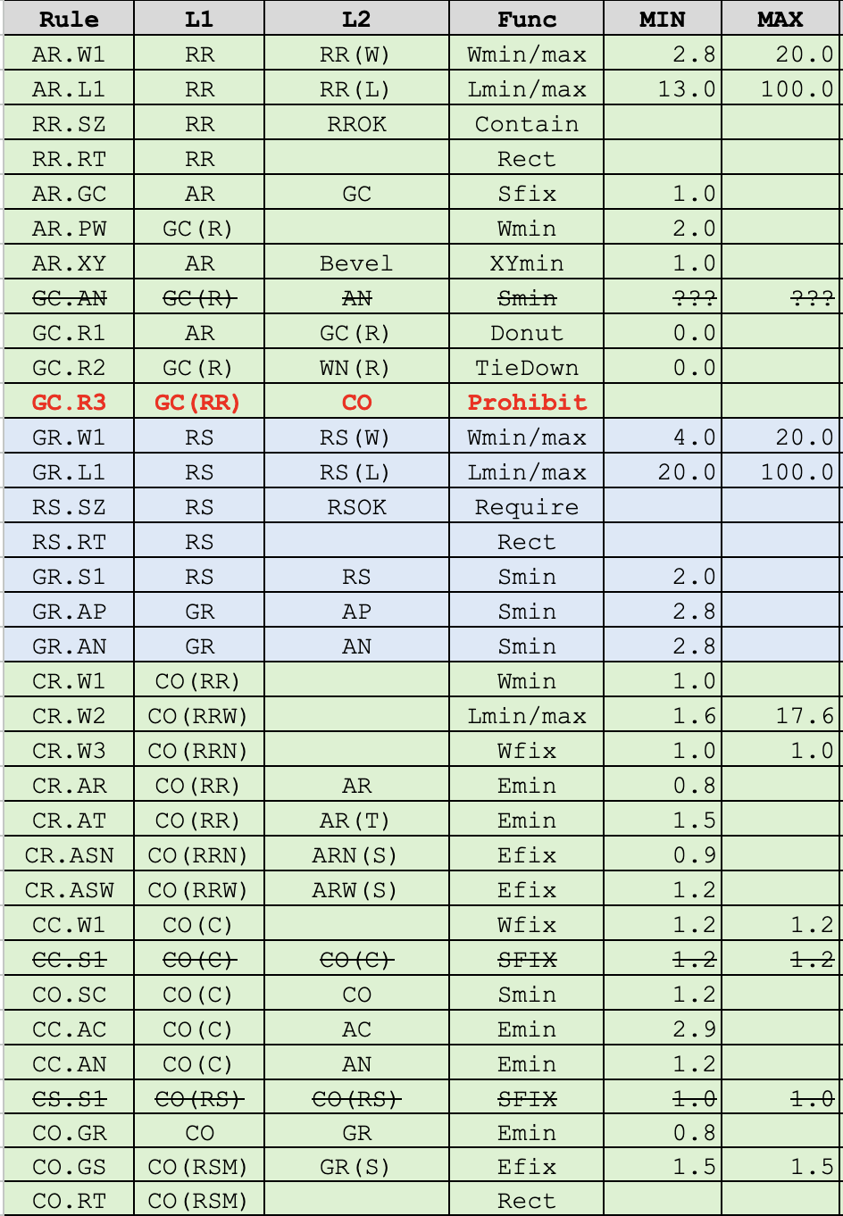
Cat-5: Resistors(AR/GR) and Capacitor(AC) related
WN(R)
GR
CO.W1
GR
CO.GR
AR.PW
CO.GS
GC(R)
CO.S1
GR.AP
GC.AN
AP
AR
AR.GC
AN
GC.R1
(Donut)
AR.W1
GR.W1
GR.S1
AR.L1
GR.L1
RS.SZ/RS.RT
CO(RR)
RS
GR.AN
AN
GC.R3
GC.R2
(TieDown)
M1
AR.XY
WN
(C)
CR.AR
CR.AT
AR.XY
AN
CR.W1
CR.W2
CR.ASN
AC
CC.AC
CC.AN
CR.W3
CR.ASW
CO(RR)
RR
CC.S1
CC.S1
CO.SC
CO.SC
CC.W1
CC.W1
AR.W1
RR(W) ：Width of AR effective
RR(L) ：Length of AR effective
RROK ：Allowed W=2.8,4,6,12,20
GC(R) ：GC in WN(R)
RS(W) ：Width of GR effective
RS(L) ：Length of GR effective
RSOK ：Allowed W=4,6,12,20
WC ：WN interacting AC
AR(T) ：AR top fringe
CO(RR) ：CO on AR
CO(RRW)：CO on AR(W>=4.0)
CO(RRN)：CO on AR(W=2.8)
ARN(S) ：AR side fringe (W=2.8)
ARW(S) ：AR side fringe (W>=4.0)
CO(C) ：CO on WC
CO(RS) ：CO on GR
GR(S) ：GR side fringe
CO(RSM)：CO(sized) & GR(S)
AR
RR.SZ/RR.RT
R.Effective region
*Strike-through rules are not yet implemented

Slide 8
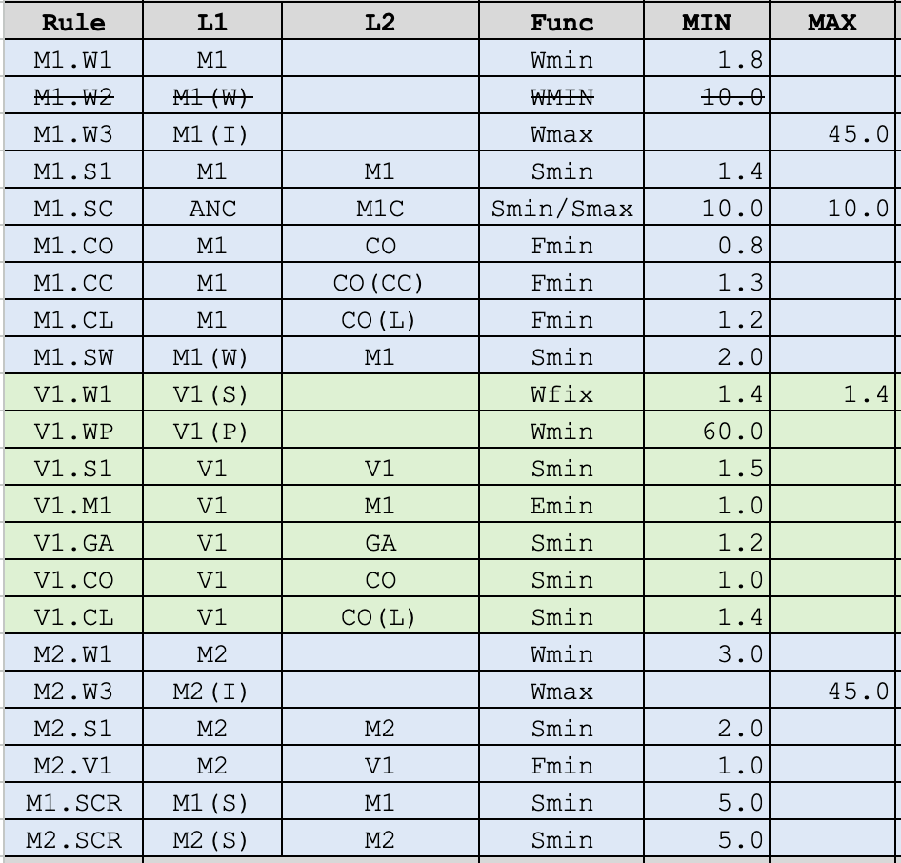
Cat-6: M1/V1/M2 related
M1(S)
M2(S)
M1.SCR
M2.SCR
M1(W)
M1
M1
M2
M2
M1.CL
M1.CO
M2.V1
V1.W1
M1.W1
M1.S1
V1.S1
M1.W3
M1.SW
M2.W1
M2.S1
M2.W3
V1.M1
M1(C)
AC
M1.CO
V1.CO
CO
M1.SC
GA ：GC/GR(all poly)
M1(W) ：Wide M1 (W>10.0um)
M1(I) ：M1 outside Pad/Capacitor
M2(I) ：M2 outside Pad/Capacitor
M1(C)/M1C ：M1 ring for Capacitor WN
M1(S) ：M1 in scribe ring
M2(S) ：M2 in scribe ring
CO(C) ：CO on M1(C) (W=1.2um)
CO(CC) ：CO on AC (W=1.2um)
CO(L) ：CO large contact (Area>=1.5um²)
V1(S) ：V1 in core region
V1(P) ：V1 on Pad
CO(CC)
CO(C)
M1
GC
V1.GA
M1.CC
CO(L)
V1.GA
V1.CL
GR
PO
V1(P)
V1.WP
M1.CL

Slide 9
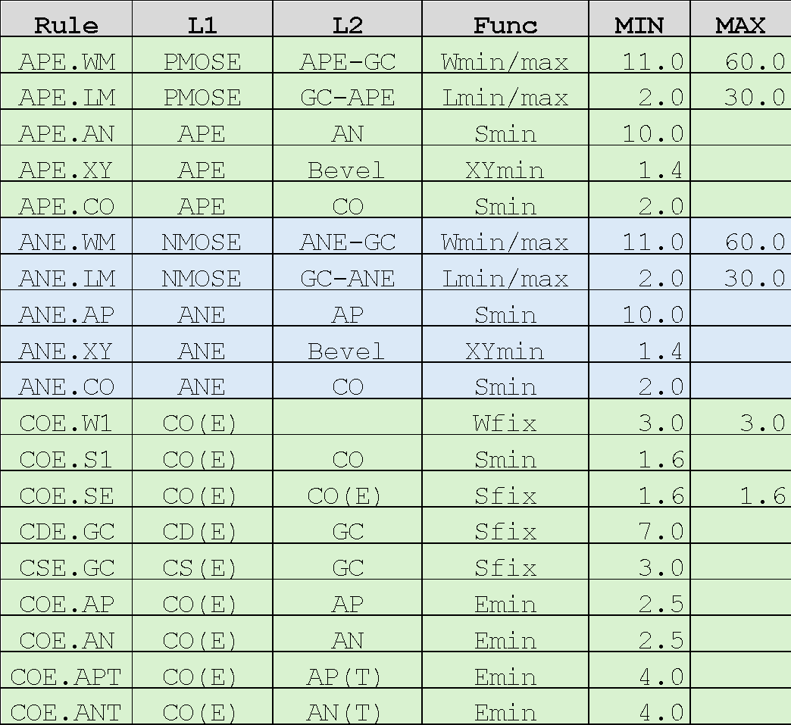
Cat-7: ESD MOS transistor related
WN
AP
APE.XY
AN
APE.XY
SOURCE
APE.LM
DRAIN
COE.W1
APE.WM
COE.APT
COE.S1
APE.AN
COE.SE
COE.AP
CSE.GC
CDE.GC
APE.CO
GC
ANE.CO
ANE.XY
ANE.XY
ANE.AP
COE.AN
ANE.WM
COE.W1
COE.ANT
COE.S1
COE.SE
CSE.GC
CDE.GC
MPE ：AP for ESD PMOS
MNE ：AN for ESD NMOS
PMOSE ：ESD PMOS Gate
NMOSE ：ESD NMOS Gate
APE ：MPE
ANE ：MNE
AP(T) ：AP Side Edges
AN(T) ：AN Side Edges
CO(E)：CO on ESD
CD(E)：CO on ESD/Drain
CS(E)：CO on ESD/Source
AP
SOURCE
ANE.LM
DRAIN
ESD

Slide 10
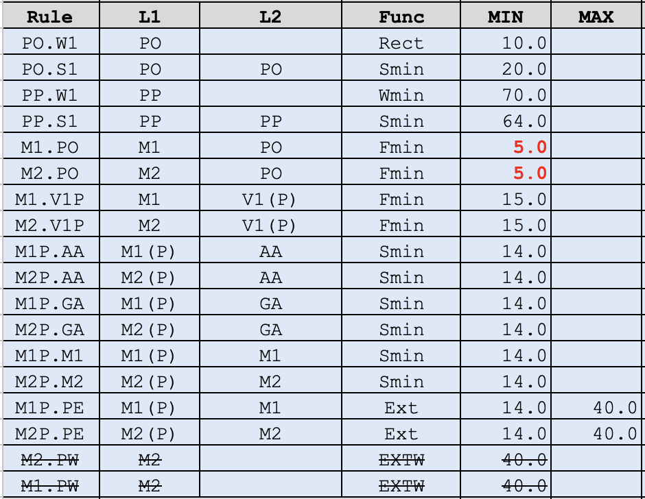
Cat-8: PAD related
M1(P)
M2(P)
PO
PO
q
q
M1.PO
V1(P)
M1.V1P
M2.PO
M2.V1P
PO.W1
PP.W1(bbox_max
>=70.0)
PO.S1
PP.S1(bbox_max
>=70.0)
M2P.PE(MAX)
M1P.PE(MIN)
M1P.XX
M2P.XX
M2P.PE(MIN)
M1P.PE(MAX)
PP ：PO for Pad (max dimension of the bbox>=70.0um)
M1(P)：M1 covering PO
M2(P)：M2 covering PO
V1(P)：V1 through M1(P)-M2(P)
AP/AN/GC/M1/M2

Slide 11
Design Rule cotrol
DRC integrity

Slide 12
DRC
Document
PCell
run.drc
DR_Table.xls
python/rules_def.py
DR_csv2drc.py
DR_csv2py.py
Cut & Paste
Method
DRC_summary.ppt
python/*.py
# ALL Critical Dimension parameters are referenced by ‘XX.YY’ rule’s name.

Slide 13
Design to Tapeout Process
Mask Data Preparation

Slide 14
Designer
OpenSUSI
Tokai Rika
local
TR-1um_USER_Project
[clone]
TR-1um_MPW_template
Signoff DRC
[push]
remote
TR-1um_USER_Project
TR-1um_MPW_XXX
Fabrication
Download GDSII
[action]
Precheck
DRC
MDP
[action]
Logo insertion
Aggregation
DRC
[Import artifact]
TR-1um_USER_Project
TR-1um_MPW_XXX
PCM TEST
Wafer out

Slide 15
Obsolete slides
2026/08/06
Reflected GitHub issues
https://github.com/OpenSUSI/TR-1um/issues

Slide 16
Cat-1: Prohibited
WN(R)
WN(C)
WN(C)
PO
V1(P)
AR
AC
AC
PO.Z3
AP
AP
Obsolete
AR
WN.Z1
WN.Z2
WN.Z3
CO
V1
PO
AP+AN
+AC+AR
+GC+GR
M1
M1
CO.Z1
V1.Z1
PO.Z1
M1
M2
M2
CO.Z3
V1.Z2
PO.Z2
AA ：AP + AN + AC + AR
WN(R)：WN covering AR
WN(C)：WN covering AC
V1(P)：V1 interacting PO

Slide 17
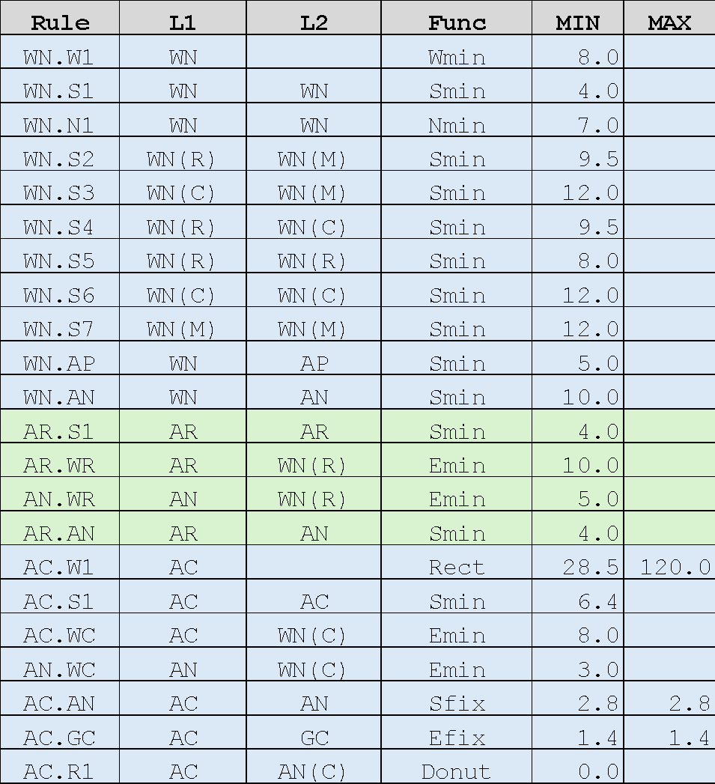
Cat-2: WN to AP/AN/AR/AC related
WN
(R)
WN
(R)
WN
(M)
WN.S5
AR
WN.S2
AR
AN
AN
AR.S1
WN.AN
WN.AP
AP
AR.WR
AR.AN
AN.WR
Obsolete
AN
AP
WN.S4
WN.S7
WN
(C)
WN
(C)
WN
(M)
WN.S6
GC
WN.S3
AC
AN
AC
AP
AC.GC
AC.R1
AC.S1
AC.AN
WN.W1
WN.AN
WN.AP
AC.WC
AC.W1
AN.WC
WN.AN
WN.AP
AN
AP
AC.R1(Donut)
AN
AP
WN(R)：WN covering Resistor(AR)
WN(C)：WN covering Capacitor(AC)
WN(M)：WN covering MOS/Diode(AP)
AN(C)：AN ring for Capacitor WN(C)
WN
WN
WN.N1
WN.W1
WN.S1

Slide 18
Cat-3: MOS transistor related
WN
(M)
DP.W1
AN
DP.S1
AP.S1
AN.S1
AN
AP
(D)
AP
(M)
AP.LM
AP.WM
Obsolete
DP.AN
DP.AP
AP.AN
AN.W1
AP.WN
AP.WN
AN.WN
GC
DN.AP
AN
(D)
DN.AN
AN
(M)
AN.AP
AP.W1
AP
AN.LM
AN.WM
DN.S1
AP.S1
AN.S1
DN.W1
AP(M)/PMOS：AP for 5V PMOS
AN(M)/NMOS：AN for 5V NMOS
AP(D)/DP ：AP for P-Diode
AN(D)/DN ：AN for N-Diode
WN(M) ：WN covering PMOS
AP

Slide 19
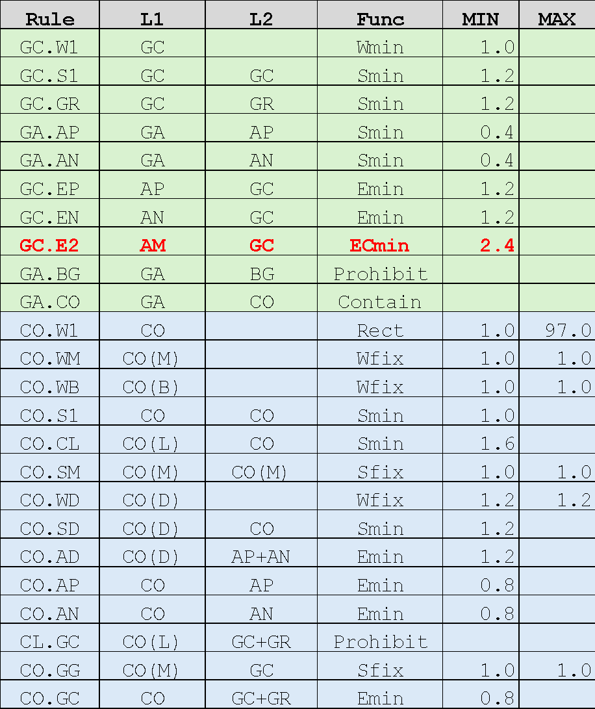
Cat-4: Contact and Poly related
WN
GR
GC.EP
GA.AP
GA.AN/GA.BG
AP
AN
CO.AD
CO.WD
CO.WM
GC.W1
CO.AP
CO(B)
GC
GC.S1
CO.SM
CO.S1
AP
(D)
CO.GG
Obsolete
CO.AN
CO.SM
CO.WB
GC.GR
GA.AP
CO.GC
GA.AN
GA.BG
GR
GC
CO.S1
GA.CO
CL.GC
✕
CO.W1
CO(L)
GA.AN
GA.AP
GA.BG
CO(D)
CO.SM
CO.AD
CO.WM
CO(B)
CO.WD
CO.SM
CO.S1
CO.AP
AN
(D)
CO.GG
CO.AN
CO.WB
AN
AP
GC.E2
GC.EN
GA.AP
GA.BG
GA ：GC/GR (all Poly)
BG ：AP/AN for MOS Back-gate
CO(M)：CO on PMOS/NMOS source/drain
CO(B)：CO on BG
CO(D)：CO on AP(D)/AN(D)
CO(L)：CO(Area>=1.5um²)
GA.AN
<=1.2um
<=1.2um
CO.CL
GR
CO(L)
CO
CL.GC
✕
AN
CO(L)

Slide 20
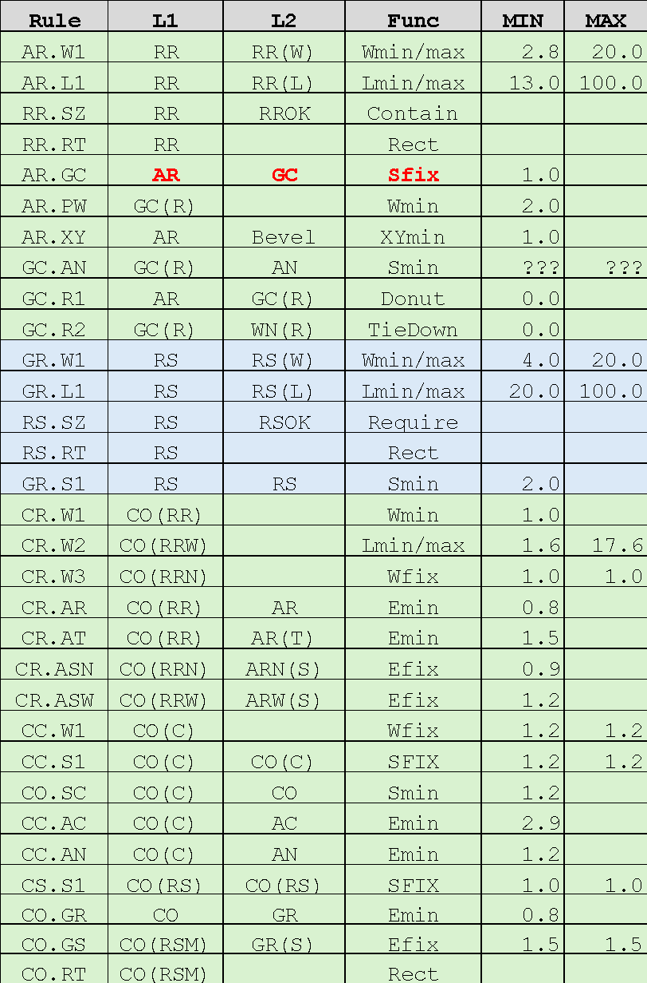
Cat-5: Resistors(AR/GR) and Capacitor(AC) related
WN(R)
GR
CO.W1
GR
CO.GR
AR.PW
CO.GS
GC(R)
CO.S1
GC.AN
AR
AR.GC
AN
GC.R1
(Donut)
AR.W1
GR.W1
GR.S1
AR.L1
GR.L1
RS.SZ/RS.RT
Obsolete
CO(RR)
RS
GC.R2
(TieDown)
M1
AR.XY
WN
(C)
CR.AR
CR.AT
AR.XY
AN
CR.W1
CR.W2
CR.ASN
AC
CC.AC
CC.AN
CR.W3
CR.ASW
CO(RR)
RR
CC.S1
CC.S1
CO.SC
CO.SC
CC.W1
CC.W1
AR.W1
AR
RR(W) ：Width of AR effective
RR(L) ：Length of AR effective
RROK ：Allowed W=2.8,4,6,12,20
GC(R) ：GC in WN(R)
RS(W) ：Width of GR effective
RS(L) ：Length of GR effective
RSOK ：Allowed W=4,6,12,20
WC ：WN interacting AC
AR(T) ：AR top fringe
CO(RR) ：CO on AR
CO(RRW)：CO on AR(W>=4.0)
CO(RRN)：CO on AR(W=2.8)
ARN(S) ：AR side fringe (W=2.8)
ARW(S) ：AR side fringe (W>=4.0)
CO(C) ：CO on WC
CO(RS) ：CO on GR
GR(S) ：GR side fringe
CO(RSM)：CO(sized) & GR(S)
RR.SZ/RR.RT
R.Effective region
*Strike-through rules are not yet implemented

Slide 21
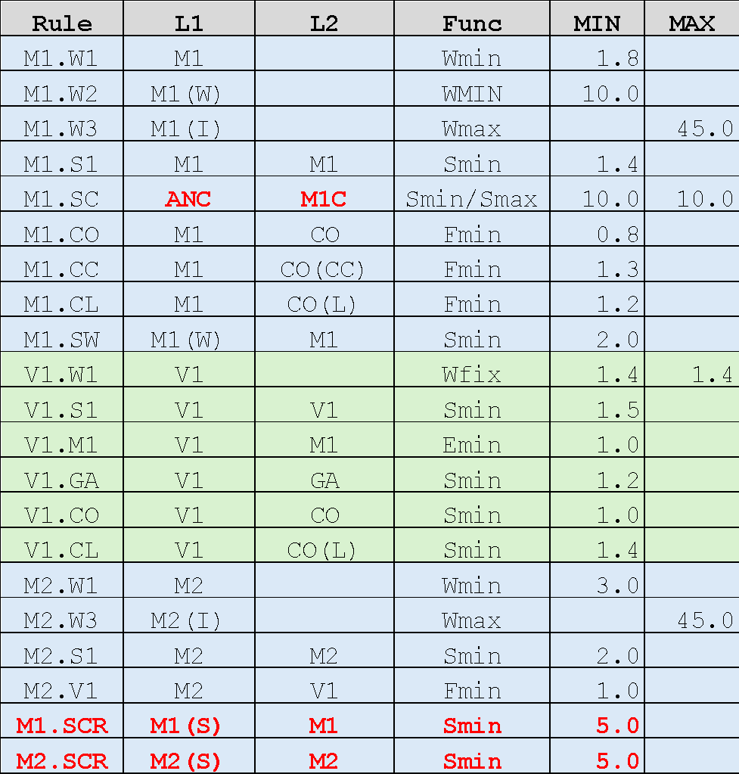
Cat-6: M1/V1/M2 related
M1(S)
M2(S)
M1.SCR
M2.SCR
M1(W)
M1
M1
M2
M2
M1.CL
M1.CO
M2.V1
Obsolete
V1.W1
M1.W1
M1.S1
V1.S1
M1.W3
M1.SW
M2.W1
M2.S1
M2.W3
V1.M1
M1(C)
V1.CO
CO
AC
M1.CO
M1.SC
V1.GA
M1
GA ：GC/GR(all poly)
M1(W) ：Wide M1 (W>10.0um)
M1(I) ：M1 outside Pad/Capacitor
M2(I) ：M2 outside Pad/Capacitor
M1(C)/M1C ：M1 ring for Capacitor WN
M1(S) ：M1 in scribe ring
M2(S) ：M2 in scribe ring
CO(C) ：CO on M1(C) (W=1.2um)
CO(CC) ：CO on AC (W=1.2um)
CO(L) ：CO large contact (Area>=1.5um²)
CO(CC)
CO(C)
GC
CO(L)
M1.CC
V1.GA
V1.CL
GR
M1.CL

Slide 22
Cat-7: ESD MOS transistor related
WN
AP
APE.XY
AN
APE.XY
SOURCE
APE.LM
DRAIN
COE.W1
APE.WM
COE.APT
COE.S1
APE.AN
COE.SE
Obsolete
COE.AP
CSE.GC
CDE.GC
APE.CO
GC
ANE.CO
ANE.XY
ANE.XY
ANE.AP
COE.AN
ANE.WM
COE.W1
COE.ANT
COE.S1
COE.SE
CSE.GC
CDE.GC
MPE ：AP for ESD PMOS
MNE ：AN for ESD NMOS
PMOSE ：ESD PMOS Gate
NMOSE ：ESD NMOS Gate
APE ：MPE
ANE ：MNE
AP(T) ：AP Side Edges
AN(T) ：AN Side Edges
CO(E)：CO on ESD
CD(E)：CO on ESD/Drain
CS(E)：CO on ESD/Source
AP
SOURCE
ANE.LM
DRAIN
ESD

Slide 23
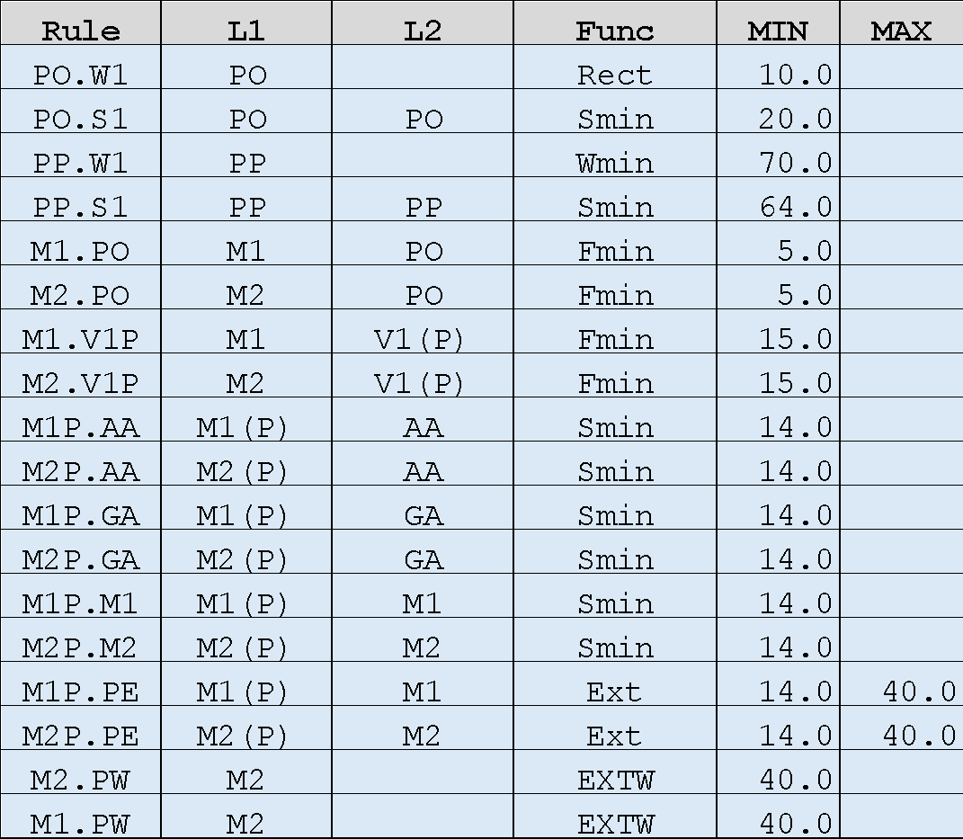
Cat-8: PAD related
M1(P)
M2(P)
PO
PO
q
q
M1.PO
V1(P)
Obsolete
M1.V1P
M2.PO
M2.V1P
PO.W1
PP.W1(bbox_max
>=70.0)
PO.S1
PP.S1(bbox_max
>=70.0)
M2P.PE(MAX)
M1P.PE(MIN)
M1P.XX
M2P.XX
M2P.PE(MIN)
M1P.PE(MAX)
PP ：PO for Pad (max dimension of the bbox>=70.0um)
M1(P)：M1 covering PO
M2(P)：M2 covering PO
V1(P)：V1 through M1(P)-M2(P)
AP/AN/GC/M1/M2

Slide 24
Obsolete slides
2026/07/31
Reflected GitHub issues
https://github.com/OpenSUSI/TR-1um/issues

Slide 25
Cat-1: Prohibited
WN(R)
WN(C)
WN(C)
PO
V1(P)
AR
AC
AC
PO.Z3
AP
AP
Obsolete
AR
WN.Z1
WN.Z2
WN.Z3
CO
V1
PO
AP+AN
+AC+AR
+GC+GR
M1
M1
CO.Z1
V1.Z1
PO.Z1
M1
M2
M2
CO.Z3
V1.Z2
PO.Z2
AA ：AP + AN + AC + AR
WN(R)：WN covering AR
WN(C)：WN covering AC
V1(P)：V1 interacting PO

Slide 26
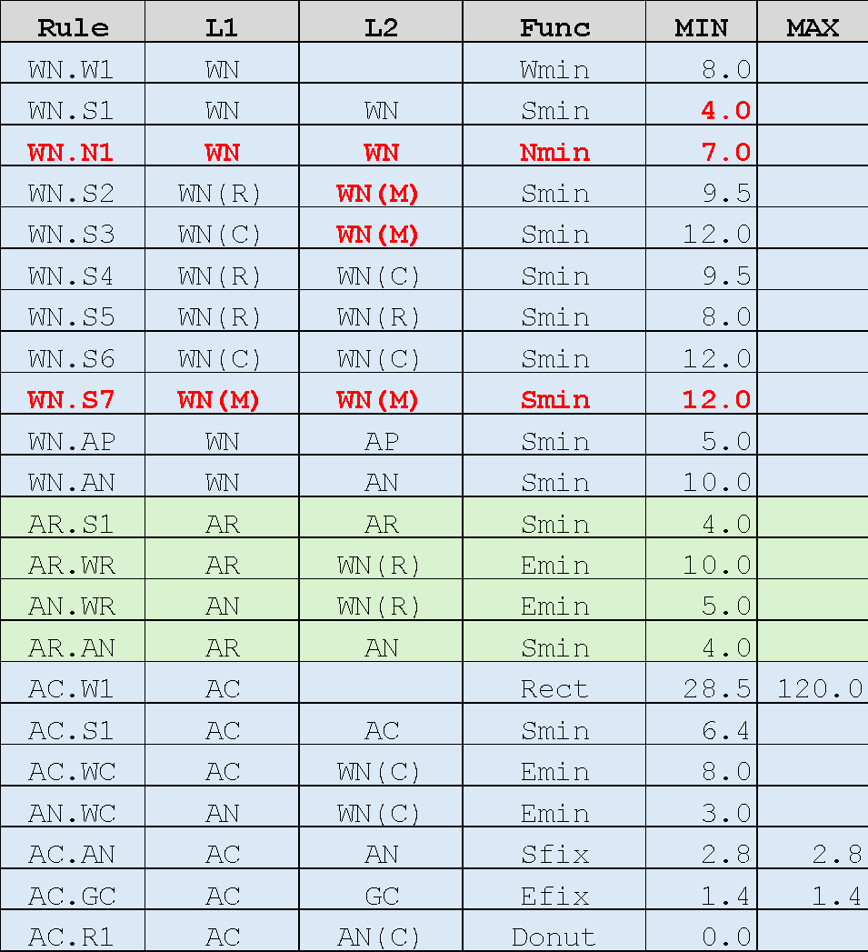
Cat-2: WN to AP/AN/AR/AC related
WN
(R)
WN
(R)
WN
(M)
WN.S5
AR
WN.S2
AR
AN
AN
AR.S1
WN.AN
WN.AP
AP
AR.WR
AR.AN
AN.WR
Obsolete
AN
AP
WN.S4
WN.S7
WN
(C)
WN
(C)
WN
(M)
WN.S6
GC
WN.S3
AC
AN
AC
AP
AC.GC
AC.R1
AC.S1
AC.AN
WN.W1
WN.AN
WN.AP
AC.WC
AC.W1
AN.WC
WN.AN
WN.AP
AN
AP
AC.R1(Donut)
AN
AP
WN(R)：WN covering Resistor(AR)
WN(C)：WN covering Capacitor(AC)
WN(M)：WN covering MOS/Diode(AP)
AN(C)：AN ring for Capacitor WN(C)
WN
WN
WN.N1
WN.W1
WN.S1

Slide 27
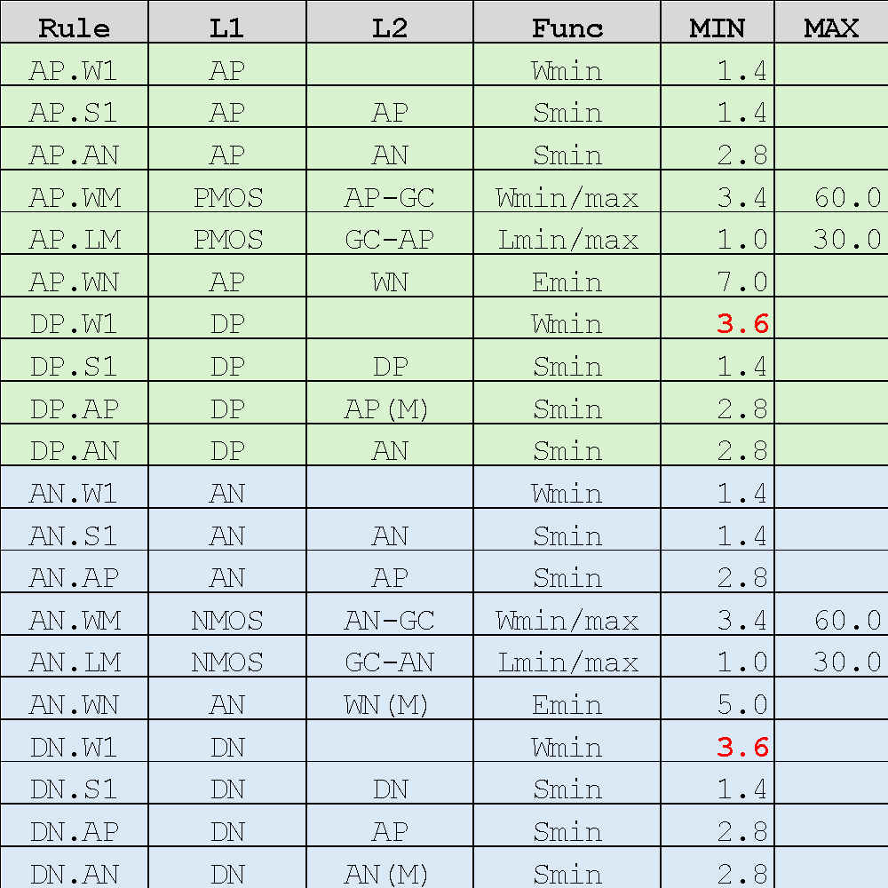
Cat-3: MOS transistor related
WN
(M)
DP.W1
AN
DP.S1
AP.S1
AN.S1
AN
AP
(D)
AP
(M)
AP.LM
AP.WM
Obsolete
DP.AN
DP.AP
AP.AN
AN.W1
AP.WN
AP.WN
AN.WN
GC
DN.AP
AN
(D)
DN.AN
AN
(M)
AN.AP
AP.W1
AP
AN.LM
AN.WM
DN.S1
AP.S1
AN.S1
DN.W1
AP(M)/PMOS：AP for 5V PMOS
AN(M)/NMOS：AN for 5V NMOS
AP(D)/DP ：AP for P-Diode
AN(D)/DN ：AN for N-Diode
WN(M) ：WN covering PMOS
AP

Slide 28
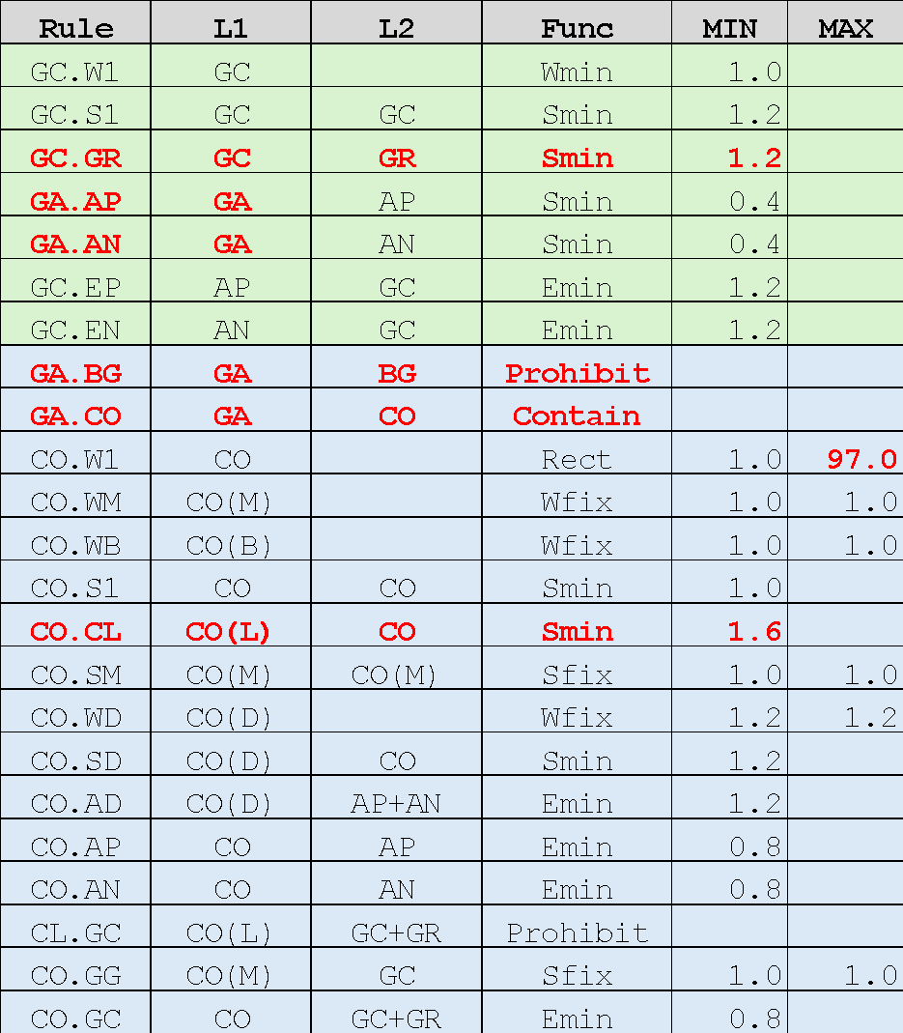
Cat-4: Contact and Poly related
WN
GR
GC.EP
GA.AP
GA.AN/GA.BG
AP
AN
CO.AD
CO.WD
CO.WM
GC.W1
CO.AP
CO(B)
GC.S1
CO.SM
CO.S1
AP
(D)
CO.GG
Obsolete
CO.AN
CO.SM
CO.WB
GC
GA.AP
CO.GC
GA.AN
GA.BG
GC
CO.S1
GA.CO
GC.GR
CL.GC
✕
CO.W1
CO(L)
GA.AN
GA.AP
GA.BG
GR
CO(D)
CO.SM
CO.AD
CO.WM
CO(B)
CO.WD
CO.SM
CO.S1
CO.AP
AN
(D)
CO.GG
CO.AN
CO.WB
AN
AP
GA ：GC/GR (all Poly)
BG ：AP/AN for MOS Back-gate
CO(M)：CO on PMOS/NMOS source/drain
CO(B)：CO on BG
CO(D)：CO on AP(D)/AN(D)
CO(L)：CO(Area>=1.5um²)
GC.EN
GA.AN
GA.AP
GA.BG
CO.CL
GR
CO(L)
CO
CL.GC
✕
CO(L)

Slide 29
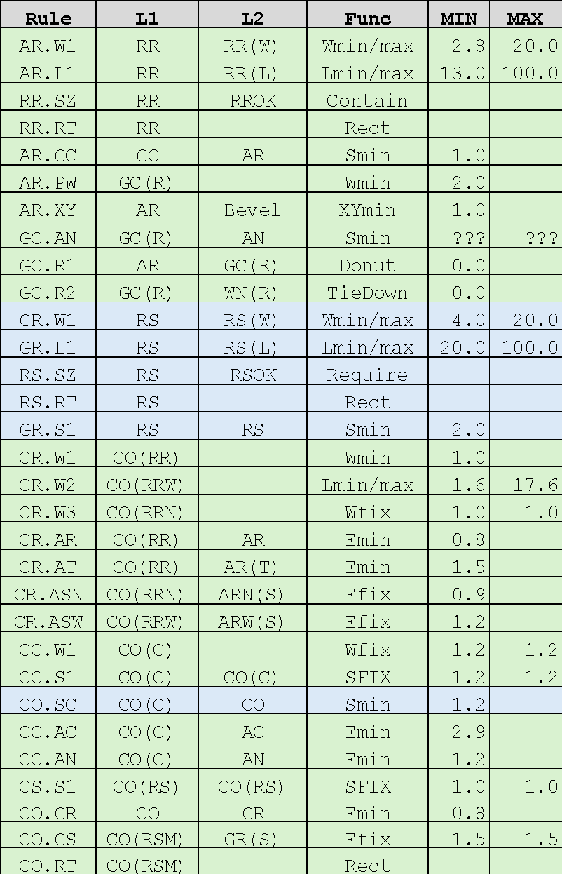
Cat-5: Resistors(AR/GR) and Capacitor(AC) related
WN(R)
GR
CO.W1
GR
CO.GR
AR.PW
CO.GS
GC(R)
CO.S1
GC.AN
AR
AR.GC
AN
GC.R1
(Donut)
AR.W1
GR.W1
GR.S1
AR.L1
GR.L1
RS.SZ/RS.RT
Obsolete
CO(RR)
RS
GC.R2
(TieDown)
M1
AR.XY
WN
(C)
CR.AR
CR.AT
AR.XY
AN
CR.W1
CR.W2
CR.ASN
AC
CC.AC
CC.AN
CR.W3
CR.ASW
CO(RR)
RR
CC.S1
CC.S1
CO.SC
CO.SC
CC.W1
CC.W1
AR.W1
AR
RR(W) ：Width of AR effective
RR(L) ：Length of AR effective
RROK ：Allowed W=2.8,4,6,12,20
GC(R) ：GC in WN(R)
RS(W) ：Width of GR effective
RS(L) ：Length of GR effective
RSOK ：Allowed W=4,6,12,20
WC ：WN interacting AC
AR(T) ：AR top fringe
CO(RR) ：CO on AR
CO(RRW)：CO on AR(W>=4.0)
CO(RRN)：CO on AR(W=2.8)
ARN(S) ：AR side fringe (W=2.8)
ARW(S) ：AR side fringe (W>=4.0)
CO(C) ：CO on WC
CO(RS) ：CO on GR
GR(S) ：GR side fringe
CO(RSM)：CO(sized) & GR(S)
RR.SZ/RR.RT
R.Effective region
*Strike-through rules are not yet implemented

Slide 30
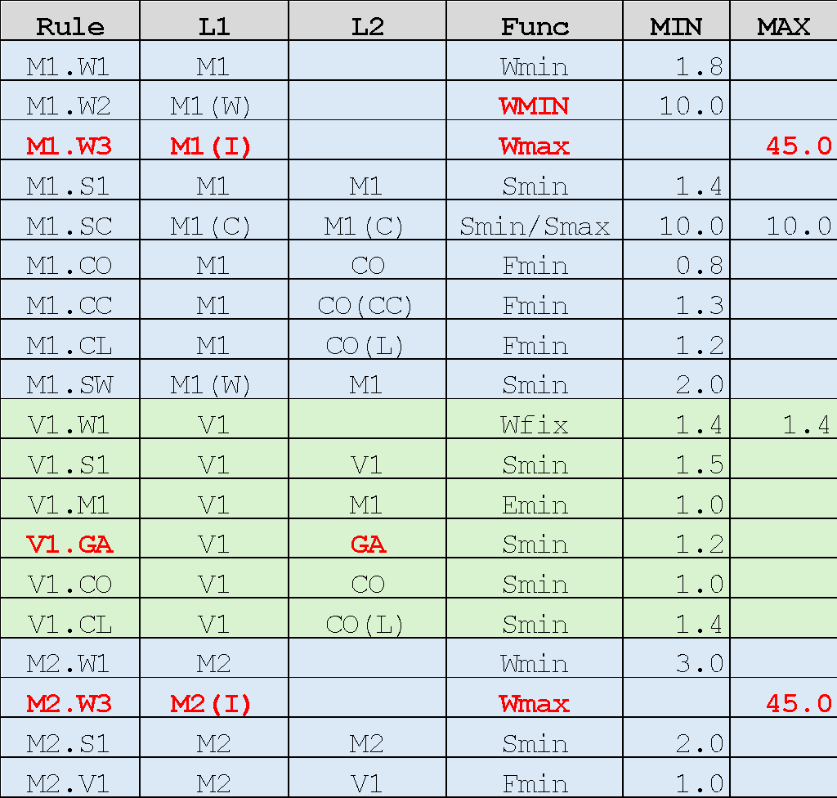
Cat-6: M1/V1/M2 related
M1(W)
M1
M1
M2
M2
M1.CL
M1.CO
M2.V1
Obsolete
V1.W1
M1.W1
M1.S1
V1.S1
M1.W3
M1.SW
M2.W1
M2.S1
M2.W3
V1.M1
M1(C)
V1.CO
CO
AC
M1.CO
M1.SC
V1.GA
M1
GA ：GC/GR(all poly)
M1(W) ：Wide M1 (W>10.0um)
M1(I) ：M1 outside Pad/Capacitor
M2(I) ：M2 outside Pad/Capacitor
M1(C) ：M1 ring for Capacitor WN
CO(C) ：CO on M1(C) (W=1.2um)
CO(CC)：CO on AC (W=1.2um)
CO(L) ：CO large contact (Area>=1.5um²)
CO(CC)
CO(C)
GC
CO(L)
M1.CC
V1.GA
V1.CL
GR
M1.CL

Slide 31
Cat-7: ESD MOS transistor related
WN
AP
APE.XY
AN
APE.XY
SOURCE
APE.LM
DRAIN
COE.W1
APE.WM
COE.APT
COE.S1
APE.AN
COE.SE
Obsolete
COE.AP
CSE.GC
CDE.GC
APE.CO
GC
ANE.CO
ANE.XY
ANE.XY
ANE.AP
COE.AN
ANE.WM
COE.W1
COE.ANT
COE.S1
COE.SE
CSE.GC
CDE.GC
MPE ：AP for ESD PMOS
MNE ：AN for ESD NMOS
PMOSE ：ESD PMOS Gate
NMOSE ：ESD NMOS Gate
APE ：MPE
ANE ：MNE
AP(T) ：AP Side Edges
AN(T) ：AN Side Edges
CO(E)：CO on ESD
CD(E)：CO on ESD/Drain
CS(E)：CO on ESD/Source
AP
SOURCE
ANE.LM
DRAIN
ESD

Slide 32
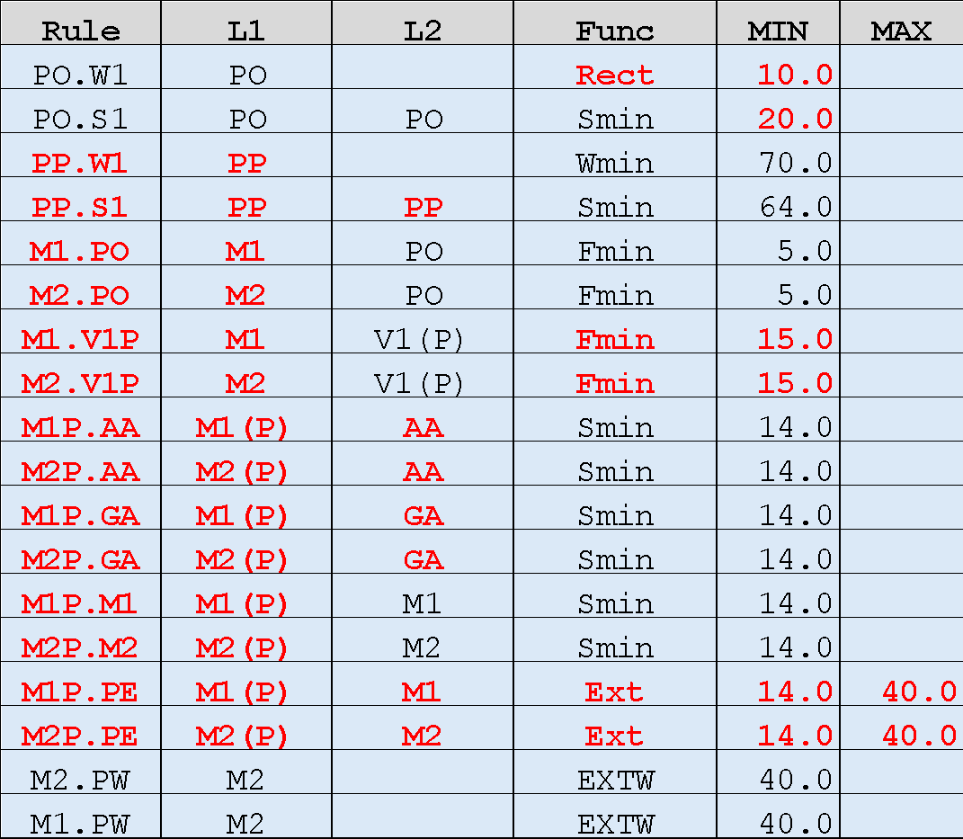
Cat-8: PAD related
M1(P)
M2(P)
PO
PO
q
q
M1.PO
V1(P)
Obsolete
M1.V1P
M2.PO
M2.V1P
PO.W1
PP.W1(bbox_max
>=70.0)
PO.S1
PP.S1(bbox_max
>=70.0)
M2P.PE(MAX)
M1P.PE(MIN)
M1P.XX
M2P.XX
M2P.PE(MIN)
M1P.PE(MAX)
PP ：PO for Pad (max dimension of the bbox>=70.0um)
M1(P)：M1 covering PO
M2(P)：M2 covering PO
V1(P)：V1 through M1(P)-M2(P)
AP/AN/GC/M1/M2

Slide 33
Obsolete slides
2026/07/27
Reflected GitHub issues
https://github.com/OpenSUSI/TR-1um/issues

Slide 34
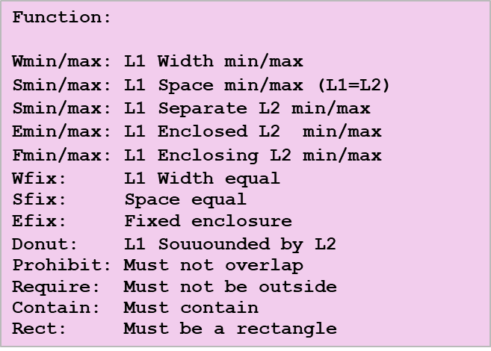
Cat-1: Prohibited
WN(R)
WN(C)
WN(C)
PO
V1(P)
AR
AC
AC
PO.Z3
AP
AP
Obsolete
AR
WN.Z1
WN.Z2
WN.Z3
CO
V1
PO
AP+AN
+AC+AR
+GC+GR
M1
M1
CO.Z1
V1.Z1
PO.Z1
M1
M2
M2
CO.Z3
V1.Z2
PO.Z2
AA ：AP+AN+AC+AR
WN(R)：WN covering AR
WN(C)：WN covering AC
V1(P)：V1 interacting PO

Slide 35
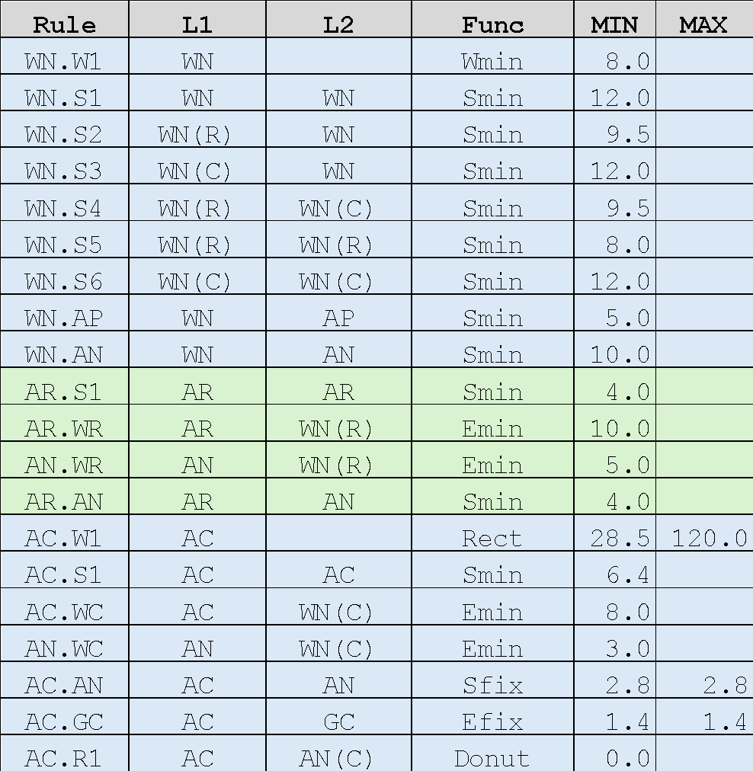
Cat-2: WN to AP/AN/AR/AC related
WN
(R)
WN
(R)
WN
WN.S2
WN.S5
AR
AR
AN
AN
AR.S1
WN.AN
WN.AP
AP
AR.WR
AR.AN
AN.WR
Obsolete
AN
AP
WN.S4
WN.S1
WN
(C)
WN
(C)
WN
WN.S6
GC
WN.S3
WN.W1
AC
AN
AC
AP
AC.GC
AC.R1
AC.S1
AC.AN
WN.AN
WN.AP
AC.WC
AC.W1
AN.WC
WN.AN
WN.AP
WN(R)：WN covering AR
WN(C)：WN covering AC
AN(C)：AN in WN(C)
AN
AP
AC.R1(Donut)
AN
AP

Slide 36
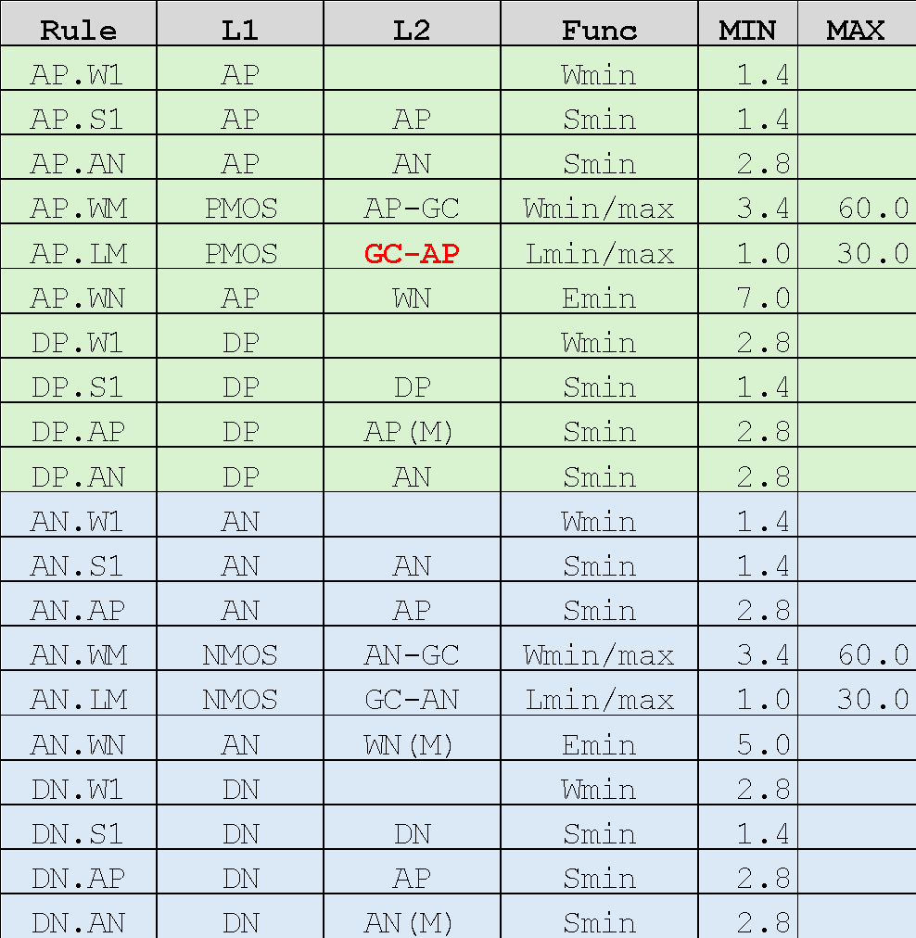
Cat-3: MOS transistor related
WN
DP.W1
AN
DP.S1
AP.S1
AN.S1
AN
AP
(D)
AP
(M)
AP.LM
AP.WM
Obsolete
DP.AN
DP.AP
AP.AN
AN.W1
AP.WN
AP.WN
AN.WN
GC
DN.AP
AN
(D)
DN.AN
AN
(M)
AN.AP
AP.W1
AP
AN.LM
AN.WM
DN.S1
AP.S1
AN.S1
DN.W1
PMOS ：AP&GC-ESD
NMOS ：AN&GC-ESD
DP/AP(D)：AP not interacting(GC) inside WN
DN/AN(D)：AN not interacting(GC) outside WN
AN(M) ：AN-AN(D)
AP(M) ：AP-AP(D)
WN(M) ：WN–(WN covering AC)
AP

Slide 37
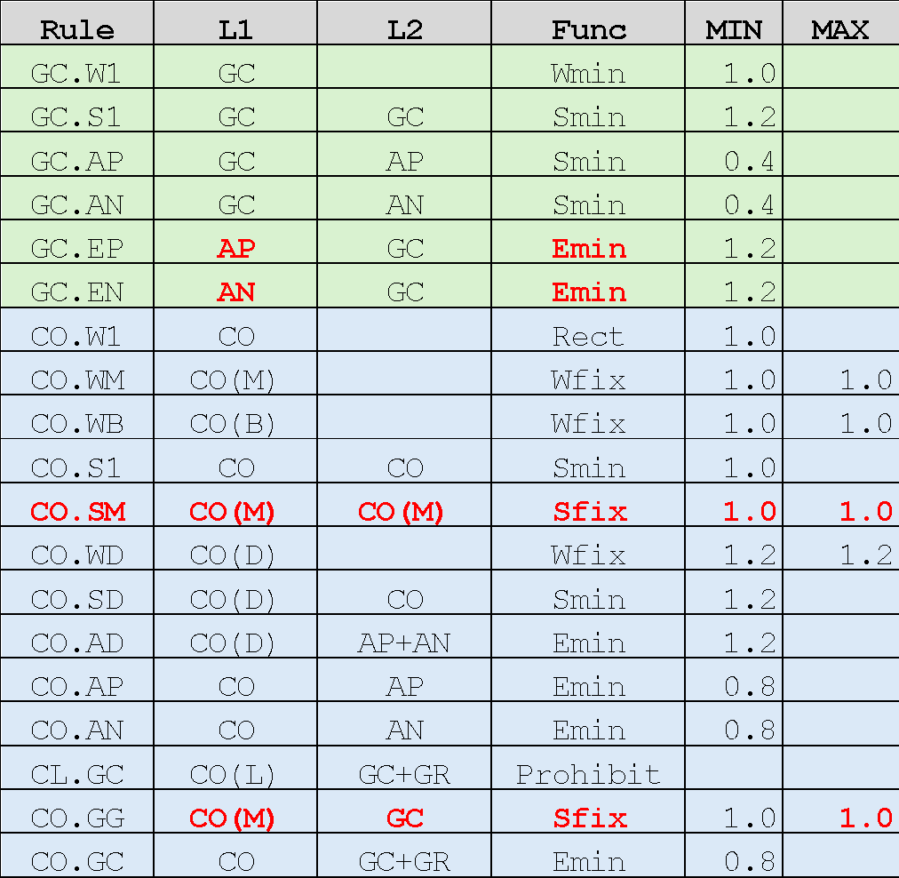
Cat-4: Contact and Poly related
WN
GC.EP
AP
AN
CO.AD
CO.WD
CO.W1/CO.WM
GC.W1
CO.AP
GC.S1
CO.S1/CO.SM
CO.S1
AP
(D)
CO.GG
Obsolete
CO.AN
GC(G)
CO.AP/CO.SM
CO.W1/CO.WB
GC.AP
CO.GC
GC
CO.S1
CO(L)
✕
CO.W1
GC.AN
CO(D)
CO.AN/CO.SM
CO.AD
CO.W1/CO.WM
CO.WD
CO.S1/CO.SM
CO.S1
GC(G)
CO.AP
PMOS ：AP&GC-ESD
NMOS ：AN&GC-ESD
AP(D)：AP not interacting GC
AN(D)：AN not interacting GC
CO(M)：CO on PMOS/NMOS
CO(B)：CO on BG
CO(D)：CO on AP(D)/AN(D)
CO(L)：CO(Area>=1.5um²)
GP：AN&WN
GN：AP-WN
WC：WN covering AC
BG：(GP+GN)-WC
AN
(D)
CO.AN
CO.W1/CO.WB
CO.GG
AN
AP
GC.EN

Slide 38
Cat-5: Resistors(AR/GR) and Capacitor(AC) related
WN(R)
GC
(RS)
CO.W1
GC
(RS)
CO.GR
AR.PW
CO.GS
GC(R)
CO.S1
GC.AN
AR
AR.GC
AN
GC_R1
(Donut)
AR.W1
GR.W1
GR.S1
AR.L1
GR.L1
RS.SZ/RS.RT
Obsolete
CO(RR)
RS
GC.R2
(TieDown)
M1
AR.XY
WN
(C)
CR.AR
CR.AT
AR.XY
AN
CR.W1
CR.W2
CR.ASN
AC
CC.AC
CC.AN
CR.W3
CR.ASW
CO(RR)
RR
CC.S1
CC.S1
CO.SC
CO.SC
CC.W1
CC.W1
AR.W1
AR
RR(W) ：Width of AR effective
RR(L) ：Length of AR effective
RROK ：Allowed W=2.8,4,6,12,20
GC(R) ：GC in WN(R)
RS(W) ：Width of GR effective
RS(L) ：Length of GR effective
RSOK ：Allowed W=4,6,12,20
WC ：WN interacting AC
AR(T) ：AR top fringe
CO(RR) ：CO on AR
CO(RRW)：CO on AR(W>=4.0)
CO(RRN)：CO on AR(W=2.8)
ARN(S) ：AR side fringe (W=2.8)
ARW(S) ：AR side fringe (W>=4.0)
CO(C) ：CO on WC
CO(RS) ：CO on GR
GR(S) ：GR side fringe
CO(RSM)：CO(sized) & GR(S)
RR.SZ/RR.RT
R.Effective region
*Strike-through rules are not yet implemented

Slide 39
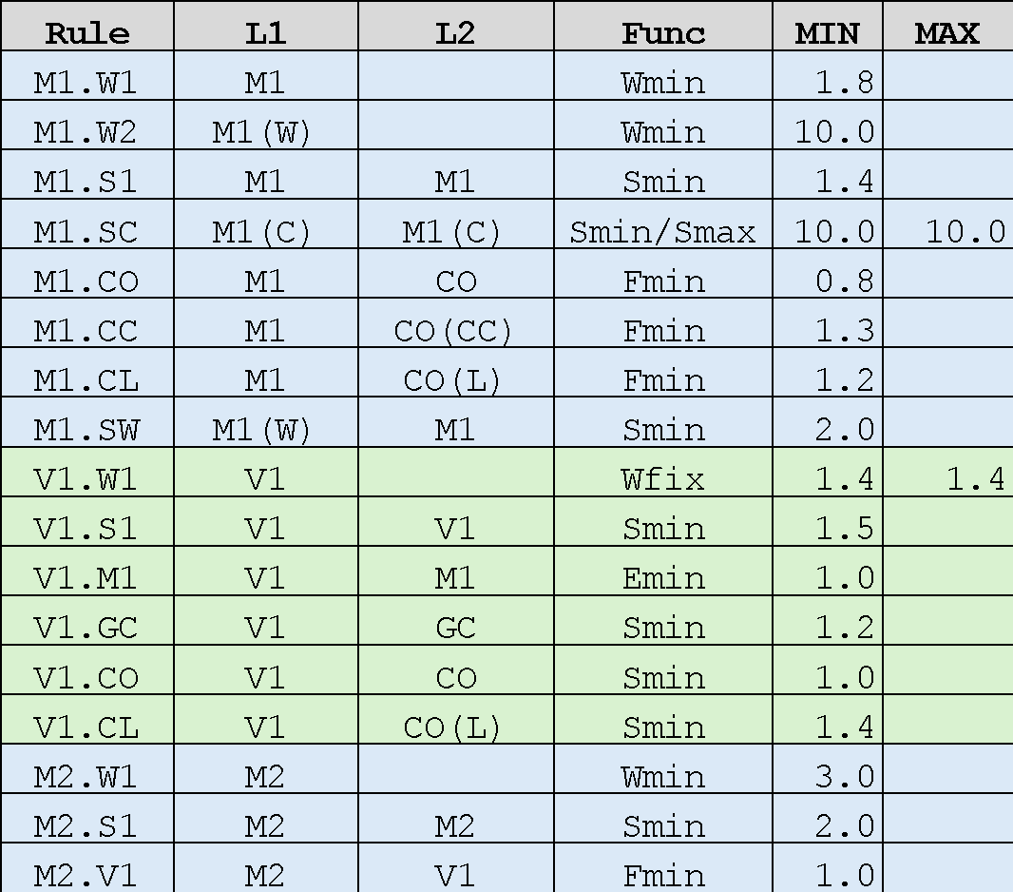
Cat-6: M1/V1/M2 related
M1(W)
M1
M1
M2
M2
M1.CL
M1.CO
M2.V1
Obsolete
V1.W1
M1.W1
M1.S1
V1.S1
M1.W2
M1.SW
M2.W1
M2.S1
V1.M1
M1(C)
V1.CO
CO
AC
M1.CO
M1.SC
V1.GC
M1
CO(CC)
CO(C)
GC
M1(W) ：Wide M1 (W>=10.0)
WN(C) ：WN covering AC
M1(C) ：M1 interacting (AN & WN(C))
CO(C) ：CO on M1(C) (W=1.2um)
CO(CC)：CO on AC (W=1.2um)
CO(L) ：CO large contact (Area>=1.5um²)
CO(L)
M1.CC
V1.CL
M1.CL
*Strike-through rules are not yet implemented

Slide 40
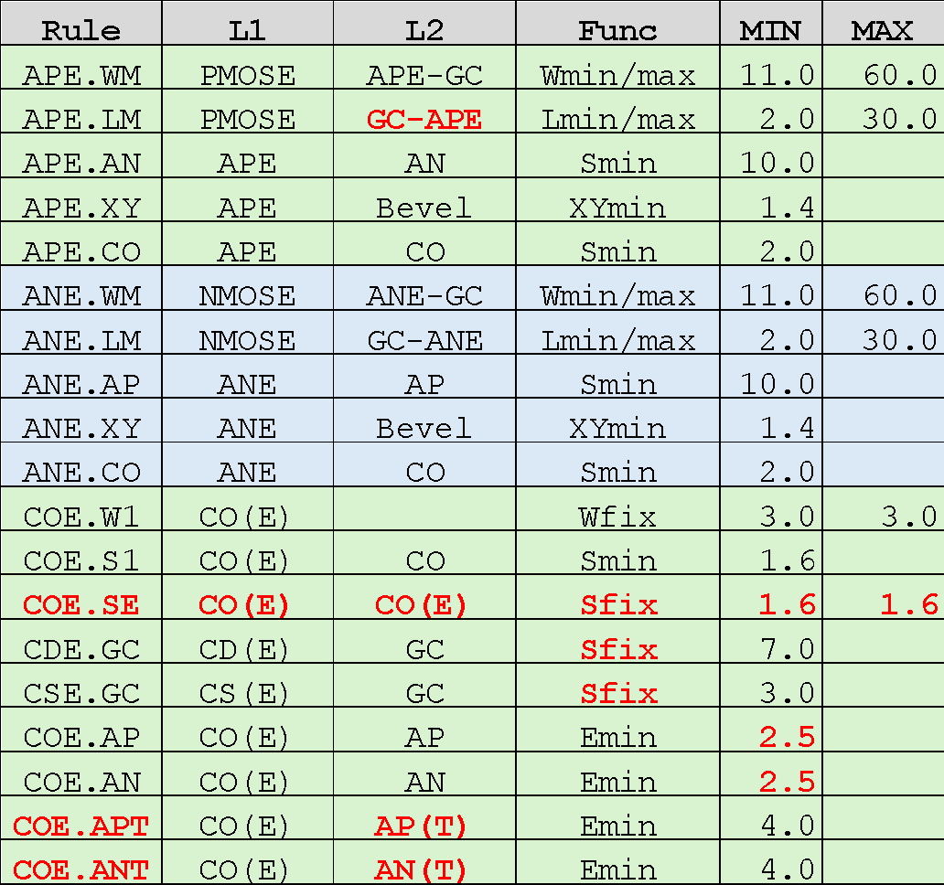
Cat-7: ESD MOS transistor related
WN
AP
APE.XY
AN
APE.XY
SOURCE
APE.LM
DRAIN
COE.W1
APE.WM
COE.APT
COE.S1
APE.AN
COE.SE
Obsolete
COE.AP
CSE.GC
CDE.GC
APE.CO
GC
ANE.CO
ANE.XY
ANE.XY
ANE.AP
COE.AN
ANE.WM
COE.W1
COE.ANT
COE.S1
COE.SE
CSE.GC
CDE.GC
MPE ：AP interacting(GC) & WN & ESD
MNE ：AN interacting(GC) - WN & ESD
PMOSE ：MPE & GC
NMOSE ：MNE & GC
APE ：MPE
ANE ：MNE
AP(T) ：AP Side Edges
AN(T) ：AN Side Edges
AP
SOURCE
ANE.LM
DRAIN
ESD
CO(E)：CO on ESD
CD(E)：CO on ESD/Drain
CS(E)：CO on ESD/Source

Slide 41
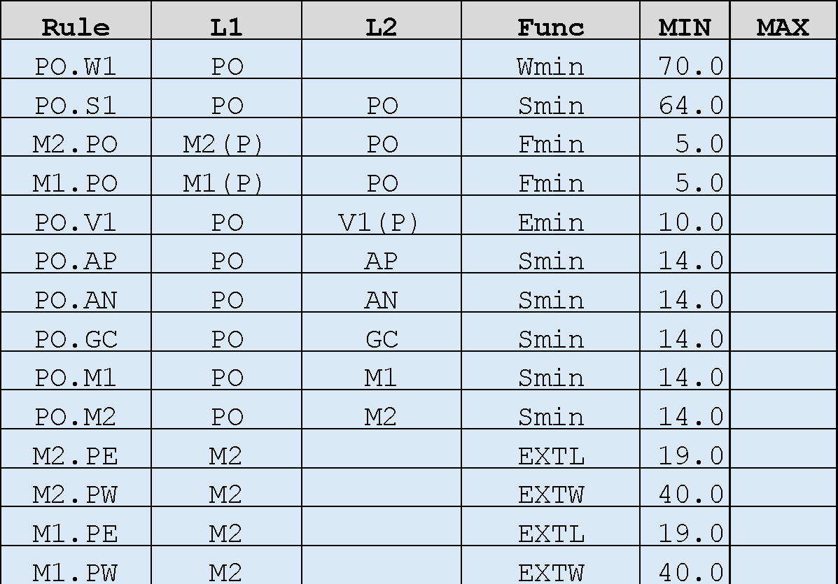
Cat-8: PAD related
M1(P)
M2(P)
PO
PO
q
q
M1.PO
V1(P)
PO.V1
Obsolete
M2.PO
PO.W1
PO.S1
M2.PE
M1.PE
PO.XX
** Not yet implemented
M2.PW
M1.PW
M1(P)：M1 covering PO
M2(P)：M2 covering PO
V1(P)：V1 through M1(P)-M2(P)
AP/AN/GC/M1/M2

Slide 42
Obsolete slides
2026/06/30
Reflected GitHub issues
https://github.com/OpenSUSI/TR-1um/issues

Slide 43
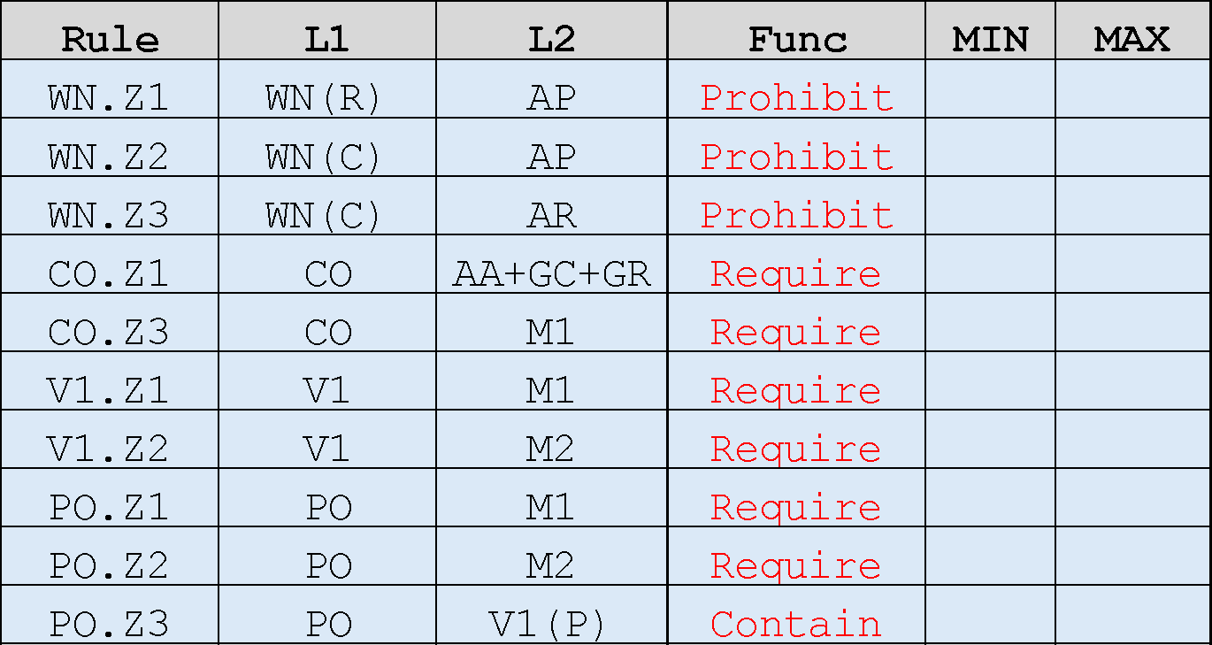

Cat-1: Prohibited
WN
WN
WN
PO
V1(P)
AR
AC
AC
AP
AP
Obsolete
AR
CO
V1
PO
AP+AN
+AC+AR
+GC+GR
M1
M1
M1
M2
M2
WN(R)：WN covering AR
WN(C)：WN covering AC
V1(P)：V1 interacting PO

Slide 44
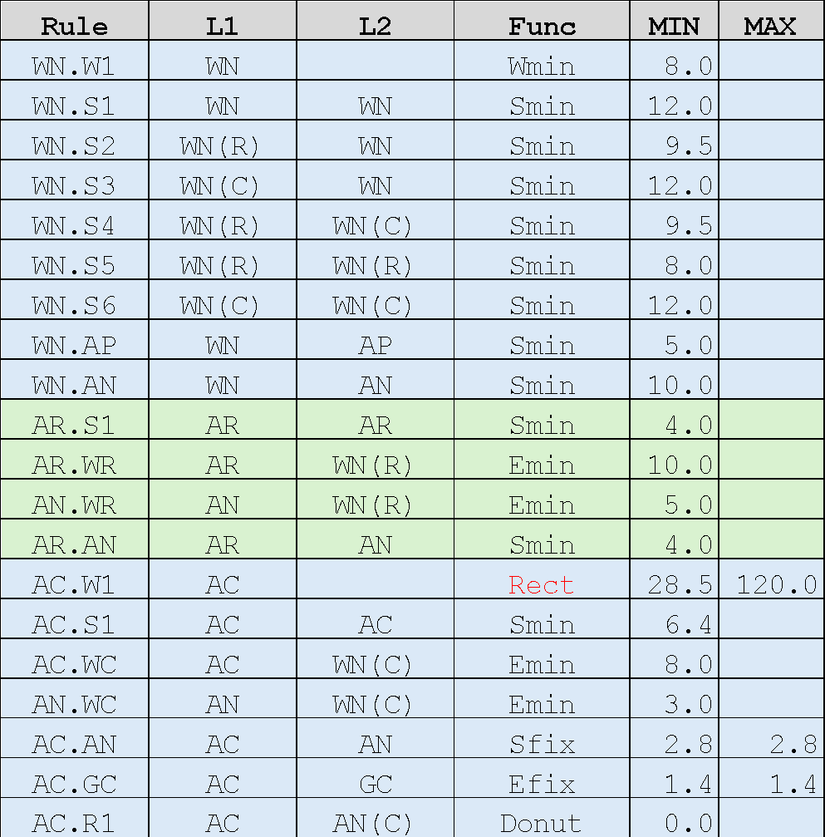
Cat-2: WN to AP/AN/AR/AC related
WN
(R)
WN
(R)
WN
WN.S2
WN.S5
AR
AR
AN
AN
AR.S1
WN.AN
WN.AP
AP
AR.WR
AR.AN
AN.WR
Obsolete
AN
AP
WN.S4
WN.S1
WN
(C)
WN
(C)
WN
WN.S6
WN.S3
WN.W1
AC
AN
AC
AP
AC.GC
AC.R1
AC.S1
AC.AN
WN.AN
WN.AP
AC.WC
AC.W1
AN.WC
WN.AN
WN.AP
WN(R)：WN covering AR
WN(C)：WN covering AC
AN(C)：AN in WN(C)
AN
AP
AN
AP

Slide 45
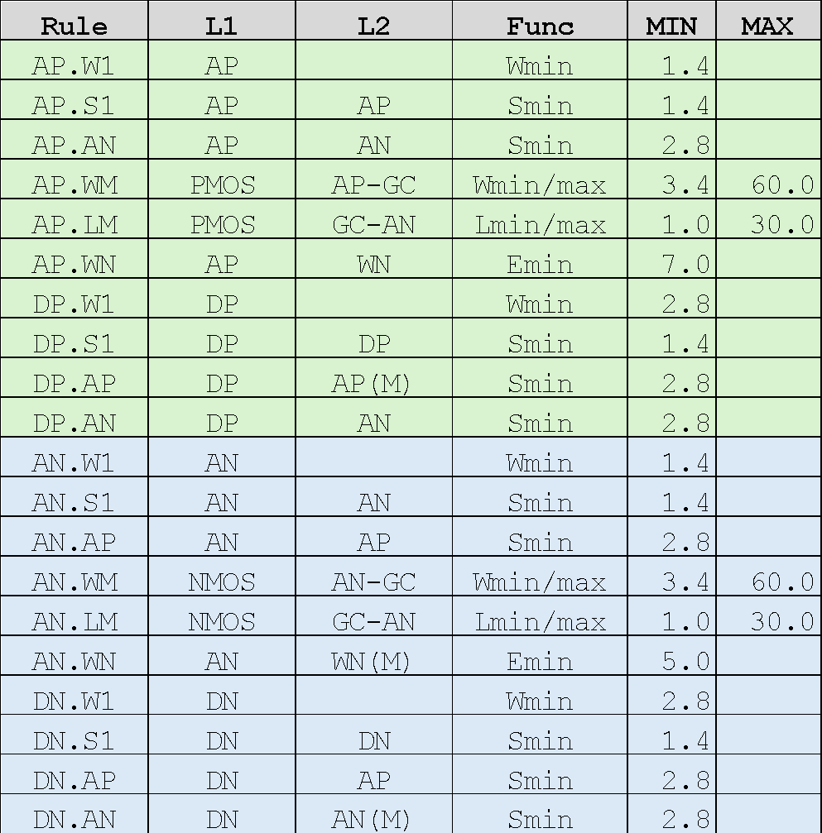
Cat-3: MOS transistor related
WN
DP.W1
AN
DP.S1
AP.S1
AN.S1
AN
AP
(D)
AP
(M)
AP.LM
AP.WM
Obsolete
DP.AN
DP.AP
AP.AN
AN.W1
AP.WN
AP.WN
AN.WN
GC
DN.AP
AN
(D)
DN.AN
AN
(M)
AN.AP
AP.W1
AP
AN.LM
AN.WM
DN.S1
AP.S1
AN.S1
DN.W1
AP
PMOS ：AP&GC
NMOS ：AN&GC
DP/AP(D)：AP not interacting GC inside WN
DN/AN(D)：AN not interacting GC outside WN
AN(M) ：AN-AN(D)
AP(M) ：AP-AP(D)
WN(M) ：WN–(WN covering AC)

Slide 46
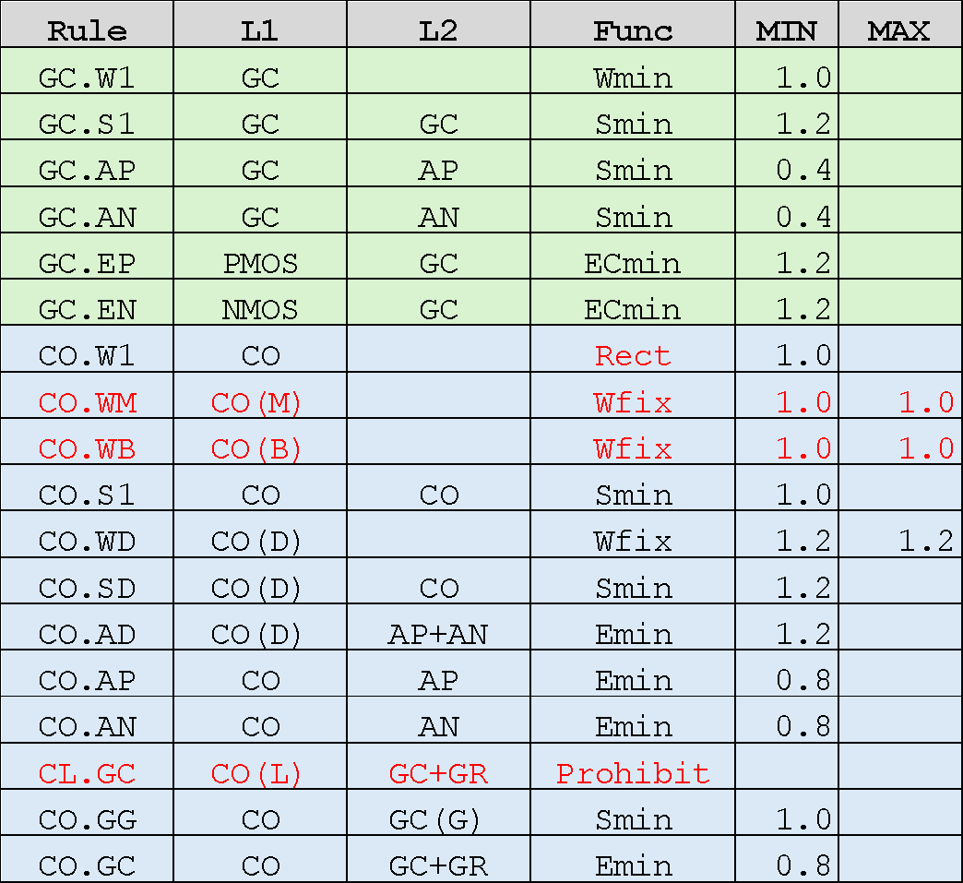
Cat-4: Contact and Poly related
WN
GC.EP
AP
AN
CO.AD
CO.W1
CO.WM
CO.WD
GC.W1
CO.AP
AP
(D)
GC.S1
CO.S1
CO.S1
CO.GG
Obsolete
CO.AN
GC(G)
CO.AP(>=0.8)
CO.APY(<=1.8)
CO.W1
CO.WB
GC.AP
CO.GC
GC
CO.S1
CO.W1
GC.AN
CO.AN(>=0.8)
CO.ANY(<=1.8)
CO(D)
CO.AD
CO.W1
CO.WM
CO.WD
CO.S1
CO.S1
GC(G)
CO.AP
AN
(D)
CO.AN
CO.W1
CO.GG
PMOS ：AP&GC
NMOS ：AN&GC
AP(D)：AP not interacting GC
AN(D)：AN not interacting GC
CO(M)：CO on PMOS/NMOS
CO(B)：CO on BG
CO(D)：CO on AP(D)/AN(D)
CO(L)：CO(Area>=1.5um²)
GC(G)：GC for PMOS/NMOS
GP：AN&WN
GN：AP-WN
WC：WN covering AC
BG：(GP+GN)-WC
AN
AP
GC.EN

Slide 47
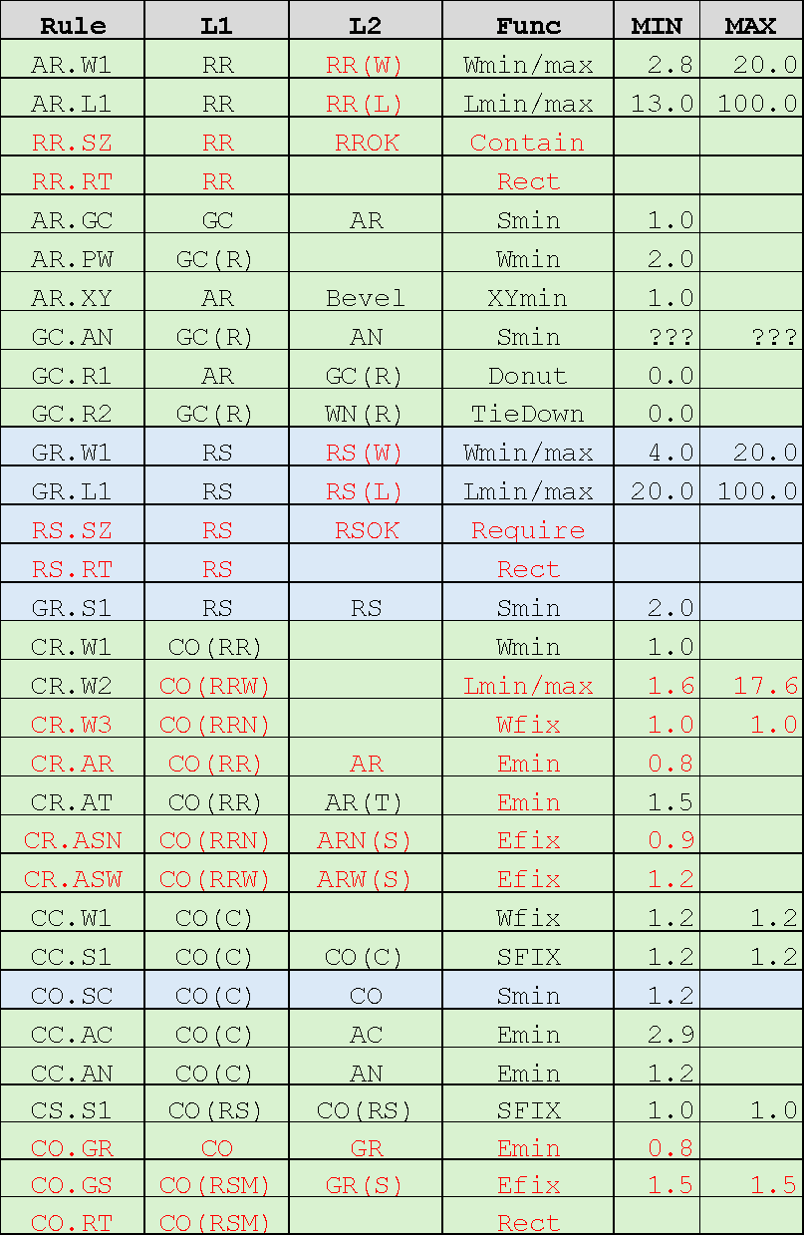
Cat-5: Resistors(AR/GR) and Capacitor(AC) related
WN(R)
GC
(RS)
CO.W1
GC
(RS)
CO.GR
AR.PW
GC(R)
CO.S1
CO.GS
GC.AN
AR
AR.GC
AN
AR.W1
GR.W1
GR.S1
AR.L1
GR.L1
Obsolete
CO(RR)
RS
AR.XY
WN
(C)
CR.AR
CR.AT
AR.XY
AN
CR.W1
CR.W2
CR.ASN
AC
CC.AC
CC.AN
CR.W3
CR.ASW
CO(RR)
RR
CC.S1
CC.S1
CO.SC
CO.SC
CC.W1
CC.W1
AR.W1
AR
RR(W) ：Width of AR effective
RR(L) ：Length of AR effective
RROK ：Allowed W=2.8,4,6,12,20
GC(R) ：GC in WN(R)
RS(W) ：Width of GR effective
RS(L) ：Length of GR effective
RSOK ：Allowed W=4,6,12,20
WC ：WN interacting AC
CO(RR) ：CO on AR
CO(RRW)：CO on AR(W>=4.0)
CO(RRN)：CO on AR(W=2.8)
ARN(S) ：AR side fringe (W=2.8)
ARW(S) ：AR side fringe (W>=4.0)
CO(C) ：CO on WC
CO(RS) ：CO on GR
GR(S) ：GR side fringe
CO(RSM)：CO(sized) & GR(S)
R.Effective region
*Strike-through rules are not yet implemented

Slide 48
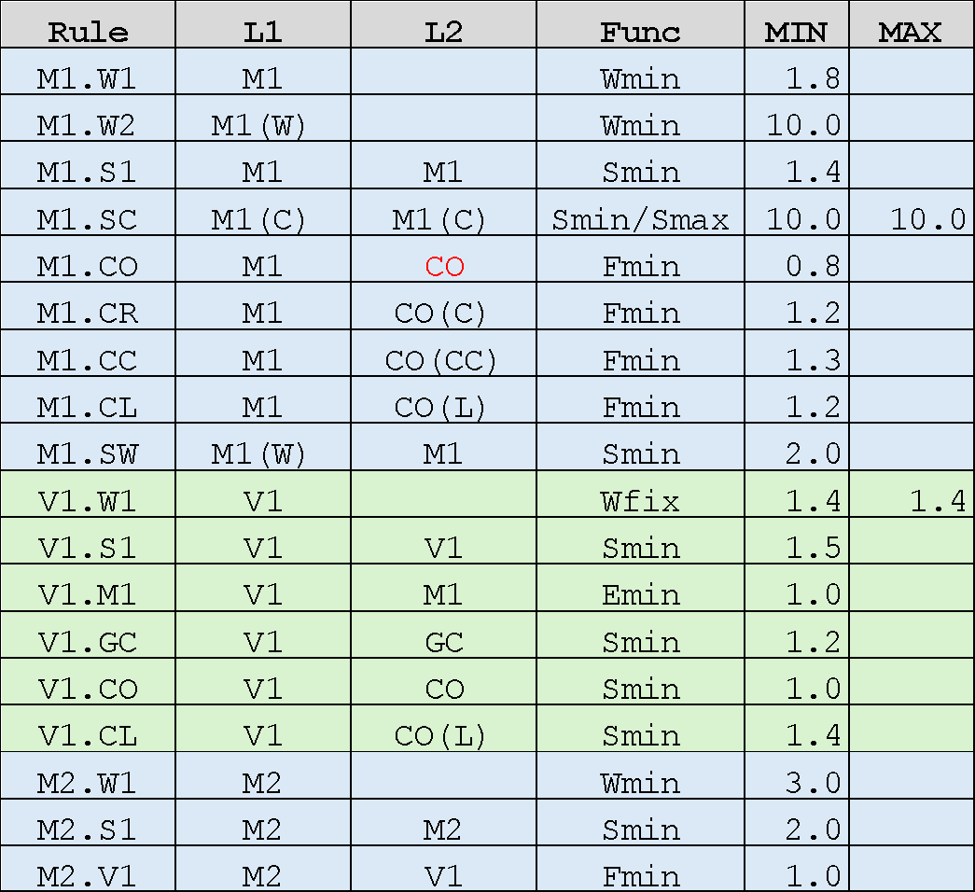
Cat-6: M1/V1/M2 related
M1(W)
M1
M1
M2
M2
M1.CL
M1.CO
M2.V1
Obsolete
V1.W1
M1.W1
M1.S1
V1.S1
M1.W2
M1.SW
M2.W1
M2.S1
V1.M1
M1(C)
V1.CO
CO
AC
M1.CR
M1.CO
M1.SC
V1.GC
M1
CO(CC)
CO(C)
GC
M1(W) ：Wide M1 (W>=10.0)
WN(C) ：WN covering AC
M1(C) ：M1 interacting (AN & WN(C))
CO(C) ：CO on M1(C) (W=1.2um)
CO(CC)：CO on AC (W=1.2um)
CO(L) ：CO large contact (Area>=1.5um²)
CO(L)
M1.CC
V1.CL
M1.CL
*Strike-through rules are not yet implemented

Slide 49
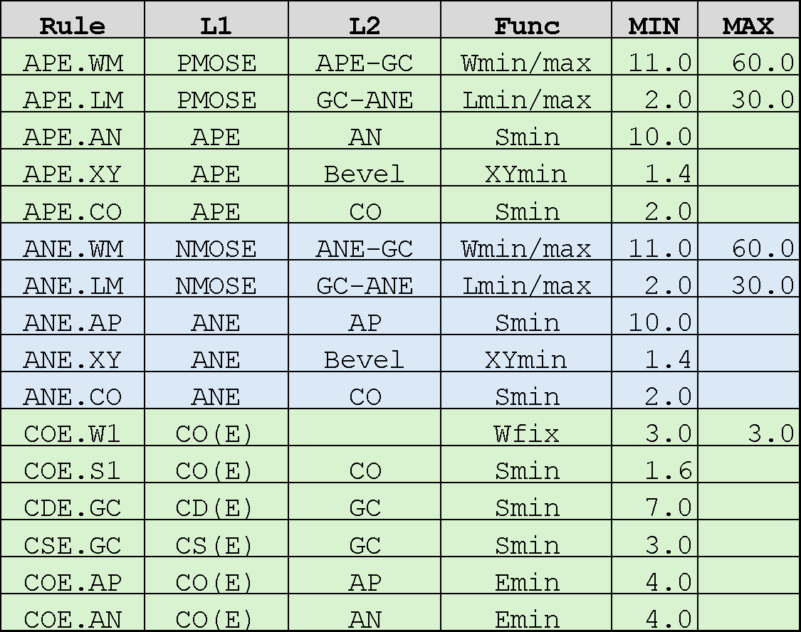
Cat-7: ESD MOS transistor related
WN
AP
APE.XY
AN
APE.XY
SOURCE
APE.LM
DRAIN
COE.W1
APE.WM
COE.AP
COE.S1
APE.AN
Obsolete
CSE.GC
CDE.GC
APE.CO
GC
ANE.CO
ANE.XY
ANE.XY
ANE.AP
ANE.WM
COE.W1
APE/ANE：AP/AN on ESD
CO(E) ：CO on ESD
COE.AN
COE.S1
CSE.GC
ANE.LM
CDE.GC
AP
SOURCE
DRAIN
ESD

Slide 50
Cat-8: PAD related
M1(P)
M2(P)
PO
PO
q
q
M1.PO
V1(P)
PO.V1
Obsolete
M2.PO
PO.W1
PO.S1
M2.PE
M1.PE
PO.XX
** Not yet implemented
M2.PW
M1.PW
M1(P)：M1 covering PO
M2(P)：M2 covering PO
V1(P)：V1 through M1(P)-M2(P)
AP/AN/GC/M1/M2

Slide 51
Obsolete slides
2026/06/11
Reflected GitHub issues
https://github.com/OpenSUSI/TR-1um/issues

Slide 52
Cat-1: Prohibited
WN
WN
WN
PO
Rule | L1 | L2 | Func | MIN | MAX
WN.Z1 | WN(R) | AP | None | 0.0
WN.Z2 | WN(C) | AP | None | 0.0
WN.Z3 | WN(C) | AR | None | 0.0
CO.Z1 | CO | AA+GC+GR | None | 0.0
CO.Z3 | CO | M1 | None | 0.0
V1.Z1 | V1 | M1 | None | 0.0
V1.Z2 | V1 | M2 | None | 0.0
PO.Z1 | PO | M1 | None | 0.0
PO.Z2 | PO | M2 | None | 0.0
PO.Z3 | PO | V1(P) | Exist | 0.0
V1(P)
AR
AC
AC
AP
AP
Obsolete
AR
CO
V1
PO
Function: Wmin/max: L1 Width min/max
Smin/max: L1 Space min/max (L1=L2)
Smin/max: L1 Separate L2 min/max
Emin/max: L1 Enclosed L2 min/max
Fmin/max: L1 Enclosing L2 min/max
ECmin: MOS Endcap min
Wfix: L1 Windth equal
Sfix: Space equal
Donut: L1 Souuounded by L2
None: Not Exist
AP+AN
+AC+AR
+GC+GR
M1
M1
M1
M2
M2
V1(P)：V1 on PE

Slide 53
Cat-2: WN to AP/AN/AR/AC related
Rule | L1 | L2 | Func | MIN | MAX
WN.W1 | WN |  | Wmin | 8.0
WN.S1 | WN | WN | Smin | 12.0
WN.S2 | WN | WN(R) | Smin | 9.5
WN.S3 | WN | WN(C) | Smin | 12.0
WN.S4 | WN(R) | WN(C) | Smin | 9.5
WN.S5 | WN(R) | WN(R) | Smin | 8.0
WN.S6 | WN(C) | WN(C) | Smin | 12.0
WN.AP | WN | AP | Smin | 5.0
WN.AN | WN | AN | Smin | 10.0
AR.S1 | AR | AR | Smin | 4.0
AR.WR | AR | WN(R) | Emin | 10.0
AN.WR | AN | WN(R) | Emin | 5.0
AR.AN | AR | AN | Smin | 4.0
AC.W1 | AC |  | Wmin/max | 28.5 | 120.0
AC.S1 | AC | AC | Smin | 6.4
AC.WC | AC | WN(C) | Emin | 8.0
AN.WC | AN | WN(C) | Emin | 3.0
AC.AN | AC | AN | Sfix | 2.8 | 2.8
AC.GC | AC | GC | Efix | 1.4 | 1.4
AC.R1 | AC | AN(C) | Donut | 0.0
WN
(R)
WN
(R)
WN
WN.S2
WN.S5
AR
AR
AN
AN
AR.S1
WN.AN
WN.AP
AP
AR.WR
AR.AN
AN.WR
Obsolete
AN
AP
WN.S4
WN.S1
WN
(C)
WN
(C)
WN
WN.S6
WN.S3
WN.W1
AC
AN
AC
AP
AC.GC
AC.R1
AC.S1
AC.AN
WN.AN
WN.AP
AC.WC
AC.W1
AN.WC
WN.AN
WN.AP
WN(R)：WN overlapped AR
WN(C)：WN overlapped AC
AN(C)：AN in WN(C)
AN
AP
AN
AP

Slide 54
Cat-3: MOS transistor related
Rule | L1 | L2 | Func | MIN | MAX
AP.W1 | AP |  | Wmin | 1.4
AP.S1 | AP | AP | Smin | 1.4
AP.AN | AP | AN | Smin | 2.8
AP.WM | PMOS | AP-GC | Wmin/max | 3.4 | 60.0
AP.LM | PMOS | GC-AN | Lmin/max | 1.0 | 30.0
AP.WN | AP | WN | Emin | 7.0
DP.W1 | DP |  | Wmin | 2.8
DP.S1 | DP | DP | Smin | 1.4
DP.AP | DP | AP(M) | Smin | 2.8
DP.AN | DP | AN | Smin | 2.8
AN.W1 | AN |  | Wmin | 1.4
AN.S1 | AN | AN | Smin | 1.4
AN.AP | AN | AP | Smin | 2.8
AN.WM | NMOS | AN-GC | Wmin/max | 3.4 | 60.0
AN.LM | NMOS | GC-AN | Lmin/max | 1.0 | 30.0
AN.WN | AN | WN(M) | Emin | 5.0
DN.W1 | DN |  | Wmin | 2.8
DN.S1 | DN | DN | Smin | 1.4
DN.AP | DN | AP | Smin | 2.8
DN.AN | DN | AN(M) | Smin | 2.8
WN
DP.W1
AN
DP.S1
AP.S1
AN.S1
AN
AP
(D)
AP
(M)
AP.LM
AP.WM
Obsolete
DP.AN
DP.AP
AP.AN
AN.W1
AP.WN
AP.WN
AN.WN
GC
DN.AP
AN
(D)
DN.AN
AN
(M)
AN.AP
AP.W1
AP
AN.LM
AN.WM
DN.S1
AP.S1
AN.S1
AN(M)：AN-DN
AP(M)：AP-DP
WN(M)：WN overlapped AN/AP
DN.W1
AP

Slide 55
Cat-4: Contact and Poly related
Rule | L1 | L2 | Func | MIN | MAX
GC.W1 | GC |  | Wmin | 1.0
GC.S1 | GC | GC | Smin | 1.2
GC.AP | GC | AP | Smin | 0.4
GC.AN | GC | AN | Smin | 0.4
GC.EP | PMOS | GC | ECmin | 1.2
GC.EN | NMOS | GC | ECmin | 1.2
CO.W1 | CO |  | Wfix | 1.0 | 1.0
CO.S1 | CO | CO | Smin | 1.0
CO.WD | CO(D) |  | Wfix | 1.2 | 1.2
CO.AD | CO(D) | AP+AN | Emin | 1.2
CO.AP | CO | AP | Emin | 0.8
CO.AN | CO | AN | Emin | 0.8
CO.GG | CO | GC(G) | Smin | 1.0
CO.GC | CO | GC+GR | Emin | 0.8
WN
GC.EP
AP
AN
CO.AD
CO.WD
CO.W1
GC.W1
CO.AP
AP
(D)
GC.S1
CO.S1
CO.S1
Obsolete
CO.AN
GC(G)
CO.W1
CO.GG
GC.AP
CO.GC
GC
CO.S1
CO.W1
GC.AN
CO(D)
CO.W1
CO.AD
CO.AN
CO.WD
CO.S1
AP(D)：AP not interacted GC
AN(D)：AN not interacted GC
CO(D)：CO on AP(D)/AN(D)
GC(G)：GC for PMOS/NMOS
CO.S1
GC(G)
CO.AP
AN
(D)
CO.GG
CO.W1
AN
AP
GC.EN

Slide 56
Cat-5: Resistor(AR/RS) and Capacitor(AC) related
CO.WS
Rule | L1 | L2 | Func | MIN | MAX
AR.W1 | RR | RR(L) | Wmin/max | 2.8 | 20.0
AR.WF | AR | ARF | Require
AR.L1 | RR | RR(W) | Lmin/max | 13.0 | 100.0
AR.GC | GC | AR | Smin | 1.0
AR.PW | GC(R) |  | Wmin | 2.0
AR.XY | AR | Bevel | XYmin | 1.0
GC.AN | GC(R) | AN | Smin | ??? | ???
GC.R1 | AR | GC(R) | Donut | 0.0
GC.R2 | GC(R) | WN(R) | TieDown | 0.0
GR.W1 | RS | RS(L) | Wmin/max | 4.0 | 20.0
GR.L1 | RS | RS(W) | Lmin/max | 20.0 | 100.0
GR.S1 | RS | RS | Smin | 2.0
CR.W1 | CO(RR) |  | Wmin | 1.0
CR.W2 | CL(RR) |  | Wmin/max | 1.0 | 20.0
CR.AR | CO(RR) | AR | Emin | 0.8
CR.AT | CO(RR) | AR(T) | Emin | 1.5
CR.AS | CO(RR) | AR(S) | Efix | 0.9@W=2.8 | 1.2@W=>4
CC.W1 | CO(C) |  | Wfix | 1.2 | 1.2
CC.S1/CO.SC | CO(C) | CO(C) | Sfix/Smin | 1.2 | 1.2
CC.AC | CO(C) | AC | Emin | 2.9
CC.AN | CO(C) | AN | Emin | 1.2
CO.WS | CO(S) |  | Wfix | 1.0 | 1.0
CS.S1 | CO(RS) | CO(RS) | Sfix | 1.0 | 1.0
GR.AT | CO(RS) | GR(T) | Efix | 0.8 | 0.8
GR.AS | CO(RS) | GR(S) | Efix | 1.5 | 1.5
WN(R)
GC
(R)
GC
(R)
GR.AT
AR.PW
GC(AR)
CS.S1
GR.AS
GC.AN
AR
AN
AR.GC
GR.W1
GR.S1
AR.L1
GR.L1
Obsolete
CO(RR)
RS
AR.XY
WN
(C)
CR.AR
CR.AT
AR.XY
AN
CC.AC
CC.AN
CR.W1
CR.W2
CR.AS
AC
RR
CL(RR)
CC.S1
CC.S1
CO.SC
CC.W1
CC.W1
AR.W1
AR
GC(AR)：GC in WN(R)
RS(L) ：Length of AR effective
RS(W) ：Width of AR effective
CO(RR)：CO short side on AR
CL(RR)：CO long side on AR
AR(T) ：AR top fringe
AR(S) ：AR side fringe
AR.W1 ：allow only 2.8,4,6,12,20
GR.W1 ：allow only 4,6,12,20
CO(C) ：CO on AC
CO(S) ：Small(1um□) CO
CO(RS)：CO on GR
GR(T) ：GR top fringe
GR(S) ：GR side fringe
R.Effective region

Slide 57
Cat-6: M1/V1/M2 related
Rule | L1 | L2 | Func | MIN | MAX
M1.W1 | M1 |  | Wmin/max | 1.8 | 10.0
M1.W2 | M1(W) |  | Wmin | 10.0
M1.S1 | M1 | M1 | Smin | 1.4
M1.SC | M1(C) | M1(C) | Sfix | 10.0 | 10.0
M1.CO | M1 | CO(S) | Fmin | 0.8
M1.CC | M1 | CO(C) | Fmin | 1.3
M1.CL | M1 | CO(L) | Fmin | 1.2
M1.SW | M1(W) | M1 | Smin | 2.0
V1.W1 | V1 |  | Wfix | 1.4 | 1.4
V1.S1 | V1 | V1 | Smin | 1.5
V1.M1 | V1 | M1 | Emin | 1.0
V1.GC | V1 | GC | Smin | 1.2
V1.CO | V1 | CO | Smin | 1.0
V1.CL | V1 | CO(L) | Smin | 1.4
M2.W1 | M2 |  | Wmin | 3.0
M2.S1 | M2 | M2 | Smin | 2.0
M2.V1 | M2 | V1 | Fmin | 1.0
M1(W)
M1
M1
M2
M2
M1.CL
M1.CO
M2.V1
Obsolete
V1.W1
M1.W1
M1.S1
V1.S1
M1.W2
M1.SW
M2.W1
M2.S1
V1.M1
M1(C)
V1.CO
CO(S)
AC
M1.SC
V1.GC
M1
CO(C)
CO(C)
GC
M1.CL
CO(L)
M1(C)：M1 in WN(C)
CO(C)：CO on AC
CO(S)：CO small contact
CO(L)：CO large contact (only on AR)
M1(W)：Wide M1
M1.CC
V1.CL

Slide 58
Cat-7: ESD MOS transistor related
Rule | L1 | L2 | Func | MIN | MAX
APE.WM | PMOSE | APE-GC | Wmin/max | 11.0 | 60.0
APE.LM | PMOSE | GC-ANE | Lmin/max | 2.0 | 30.0
APE.AN | APE | AN | Smin | 10.0
APE.XY | APE | Bevel | XYmin | 1.4
APE.CO | APE | CO | Smin | 2.0
ANE.WM | NMOSE | ANE-GC | Wmin/max | 11.0 | 60.0
ANE.LM | NMOSE | GC-ANE | Lmin/max | 2.0 | 30.0
ANE.AP | ANE | AP | Smin | 10.0
ANE.XY | ANE | Bevel | XYmin | 1.4
ANE.CO | ANE | CO | Smin | 2.0
COE.W1 | CO(E) |  | Wfix | 3.0 | 3.0
COE.S1 | CO(E) | CO(E) | Smin | 1.6
CDE.GC | CD(E) | GC | Smin | 7.0
CSE.GC | CS(E) | GC | Smin | 3.0
COE.AP | CO(E) | AP | Emin | 4.0
COE.AN | CO(E) | AN | Emin | 4.0
WN
AP
APE.XY
AN
APE.XY
SOURCE
APE.LM
DRAIN
COE.W1
APE.WM
COE.AP
COE.S1
APE.AN
Obsolete
CSE.GC
CDE.GC
APE.CO
GC
ANE.CO
ANE.XY
ANE.XY
ANE.AP
ANE.WM
COE.W1
COE.AN
COE.S1
APE/ANE)：AP/AN on ESD)
CO(E)：CO on ESD
CSE.GC
ANE.LM
CDE.GC
AP
SOURCE
DRAIN
ESD

Slide 59
Cat-8: PAD related
Rule | L1 | L2 | Func | MIN | MAX
PO.W1 | PO |  | Wmin | 70.0
PO.S1 | PO |  | Smin | 64.0
M2.PO | M2(P) | PO | Fmin | 5.0
M1.PO | M1(P) | PO | Fmin | 5.0
PO.V1 | PO | V1(P) | Emin | 10.0
PO.AP | PO | AP | Smin | 14.0
PO.AN | PO | AN | Smin | 14.0
PO.GC | PO | GC | Smin | 14.0
PO.M1 | PO | M1 | Smin | 14.0
PO.M2 | PO | M2 | Smin | 14.0
M2.PE | M2 | Extention |  | 19.0
M2.PW | M2 | Extention | Wmin | 40.0
M1.PE | M2 | Extention |  | 19.0
M1.PW | M2 | Extention | Wmin | 40.0
M1(P)
M2(P)
PO
PO
q
q
M1.PO
V1(P)
PO.V1
Obsolete
M2.PO
PO.W1
PO.S1
M2.PE
M1.PE
** Not yet implemented
PO.XX
M2.PW
M1.PW
M1(P)：M1 on PO
M2(P)：M2 on PO
V1(P)：V1 on PO
AA/GC/M1/M2

