Slide 1


Copyright management for the music industry using Hyperledger Fabric
Jacob Cunningham
Mentors: Subhashini Sivagnanam, Manu Shantharam
UCSD San Diego Supercomputer Center REHS Program
August 14, 2020

Slide 2
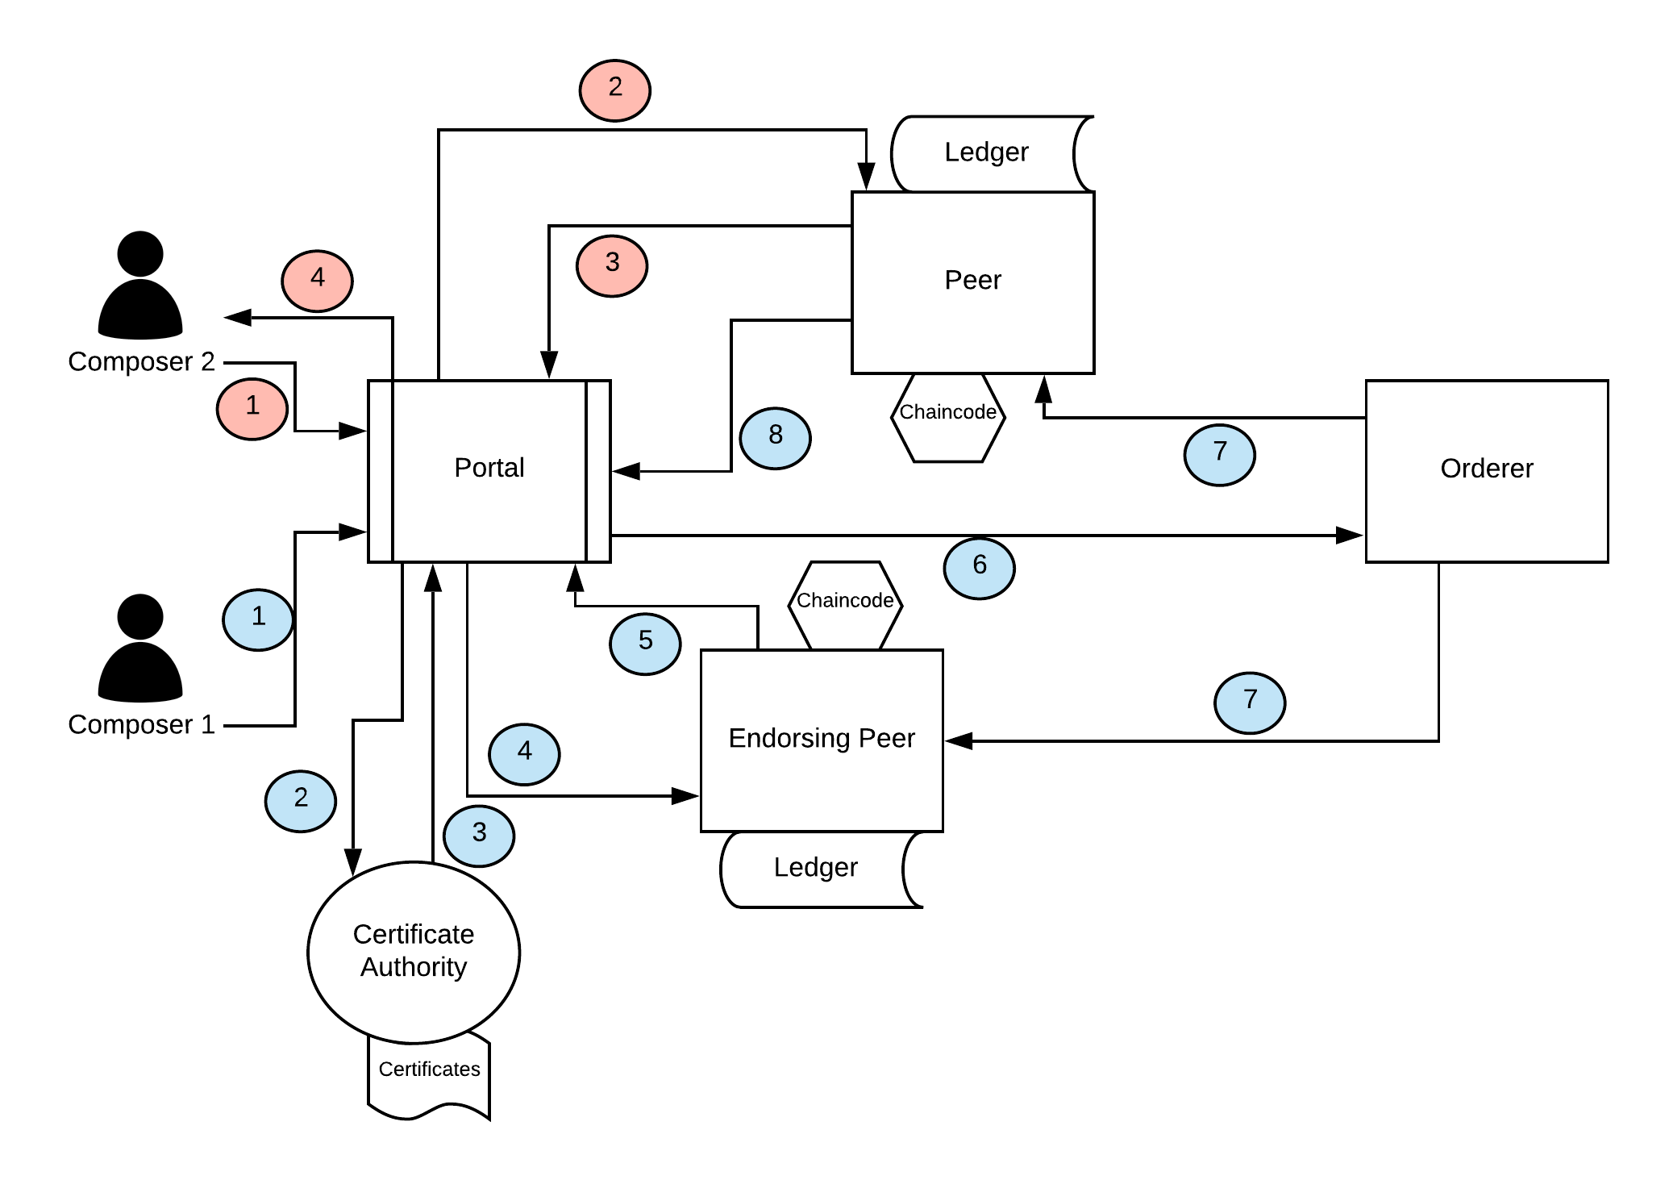
Problem
Proposal
Musical copyright relies on the affixing of the music to a tangible medium and undeniable proof of time of creation. This process is largely decentralized and makes locating music that has been copyrighted difficult.
Creating a consortium blockchain, in which all music contributors are known entities, to provide immutable and trustworthy proof of the the music’s existence and creation time. The distributed ledger also allows for music to be searched for easily.
Search Music
Blockchain
Network
Add Music

Slide 3
Goals
Research the application of a consortium blockchain in the music industry
Learn to structure and setup a Hyperledger Fabric network
Create an audio fingerprinting and matching algorithm
Integrate the algorithm with the blockchain through chaincode

Slide 4

Software Used
Hyperledger Fabric blockchain network (https://www.hyperledger.org/use/fabric)
Open source distributed ledger framework created December 2015 by the Linux Foundation, and has received contributions from IBM, Intel and SAP Ariba.
Network of organized peers updated by an ordering service
Contributing users of the network are known/trusted entities
My contributions
Javascript chaincode to handle transactions on the network
Network configuration files
Wallet application to invoke chaincode

Slide 5

Software Used (Cont.)
Docker (https://www.docker.com/)
OS-level virtualization software that allows the execution of software bundled with their own software, libraries and configuration files.
Solves the common “works on my machine” problem when attempting to use software such as hyperledger fabric.
My contributions
Configuration Files
Software Developed:
Audio-fingerprint-identifying-python (https://github.com/Skipperj7/audio-fingerprint-identifying-python)
Python application to identify a song based on the matching of audio fingerprints
Hashing and matching algorithm

Slide 6
Network Flow ( )
Adding Music
(1) Users authenticate using valid logins, such as with their label company.
(2) Users are mapped to individual identities within the blockchain network.
(3) The client endpoint, the portal, submits a transaction request for the user, the composer, to the endorsing peer.
(4) The endorsing peers executes the chaincode with the transaction request, validating the transaction request format and certificate details to ensure that the user has the authority to update the block to add their music.
(5) If the transaction is valid, the endorsing peer returns an endorsement response back to the client without updating the
ledger at this point. An invalid transaction is returned and no further action is taken.
(6) The client, portal, sends the approved transaction to the orderer node that properly includes it in a block. The transactions in the block are validated to ensure that the endorsement policy is fulfilled and then sent to all the nodes in the network atomically.
(7) The peers in the network then update their own ledgers
with the latest block.
(8) The client, portal, is notified with a response that the transaction has been added to the chain.

Slide 7
Network Flow ( )
Searching Music
(1) Users access the client application, either identified or not. They then upload their music.
(2) The client endpoint, the portal, submits a query request for the user, the composer, to the peer that holds the updated ledger.
(3) The peer executes the query of its ledger, matching the hashes of the uploaded music to those in its ledger and returns the results to the client.
(4) The user can view the results of their search.

Slide 8
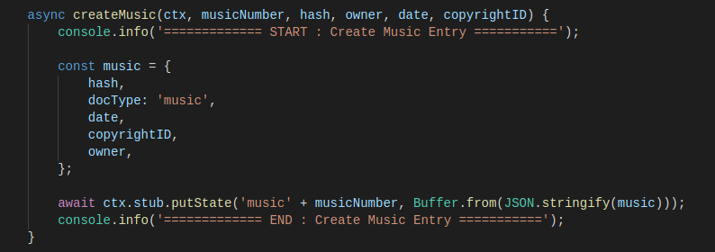
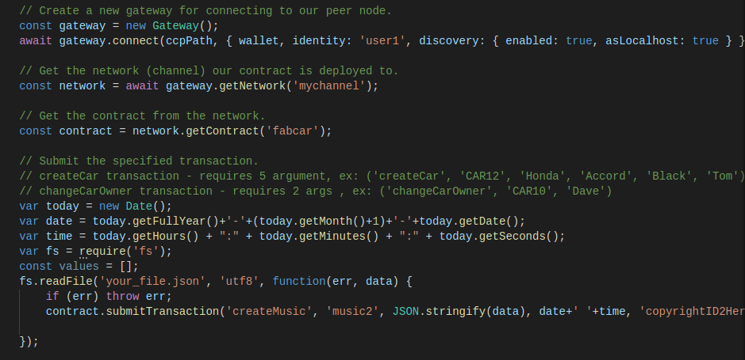
Chaincode
Figure 2 Example of how to invoke the chaincode to add music
Figure 1 Function within chaincode to conduct a transaction to add music

Slide 9
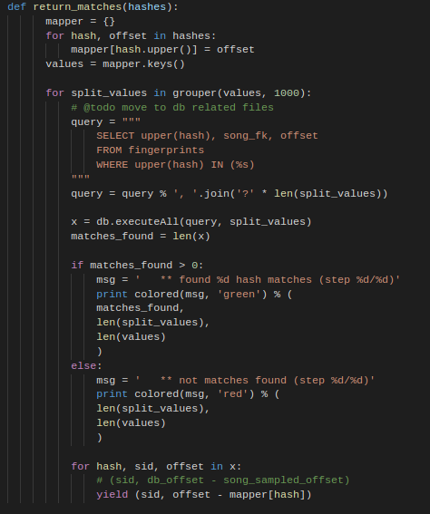
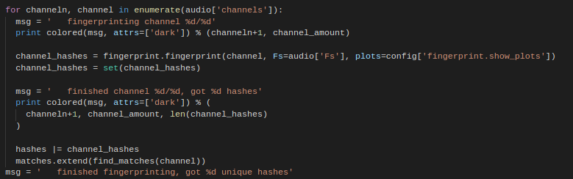
Music Hashing and Matching
Figure 4 Loop to gather the hashes of each audio frequency into a list
Figure 3 Function to find hash matches between the entered music and stored hashes

Slide 10
Summary
Implemented
Future Plans
The use of distributed ledger software provides an immutable reference to the existence and date of creation of the added information.
Consortium blockchains allow for trust to be formed between participants based on identification of users, allowing for its application to cases such as copyright or research data.
Created an audio fingerprinting and matching algorithm
Configured the Hyperledger Fabric network
Created and deployed integrating chaincode
Complete chaincode to finish integration
Create a user portal to interact with the network
Research and configure certificate authority

