Slide 1
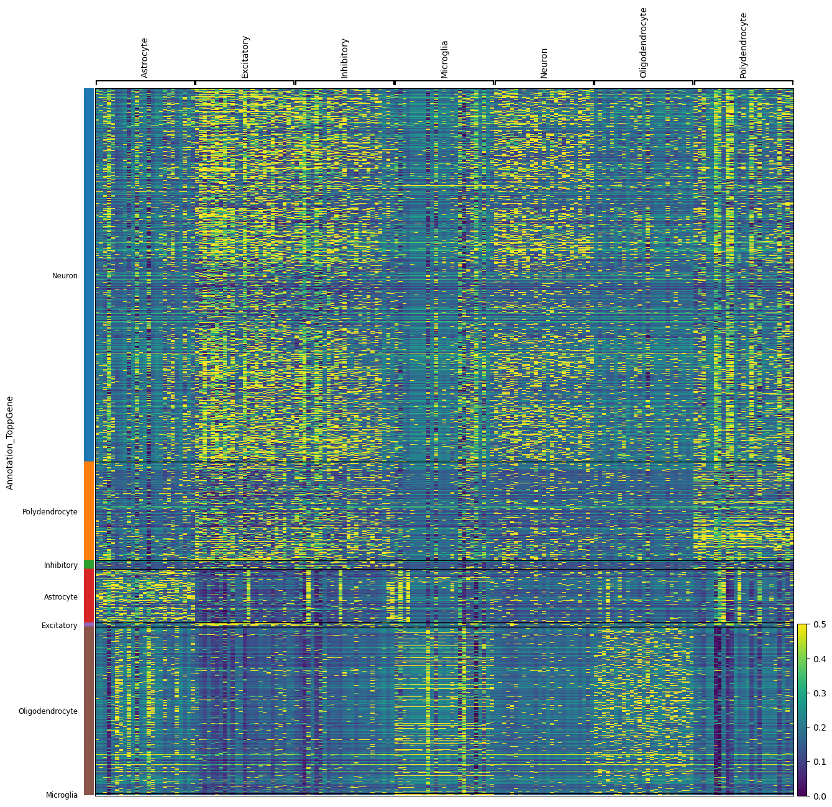
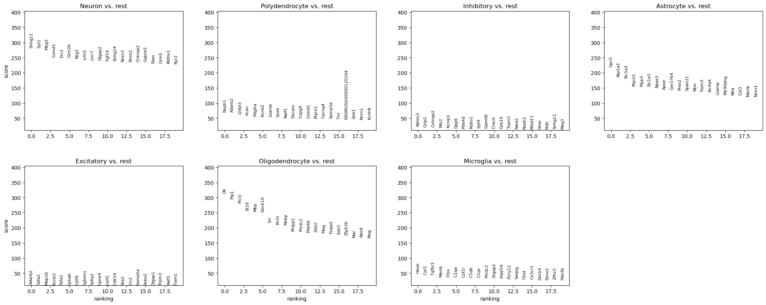
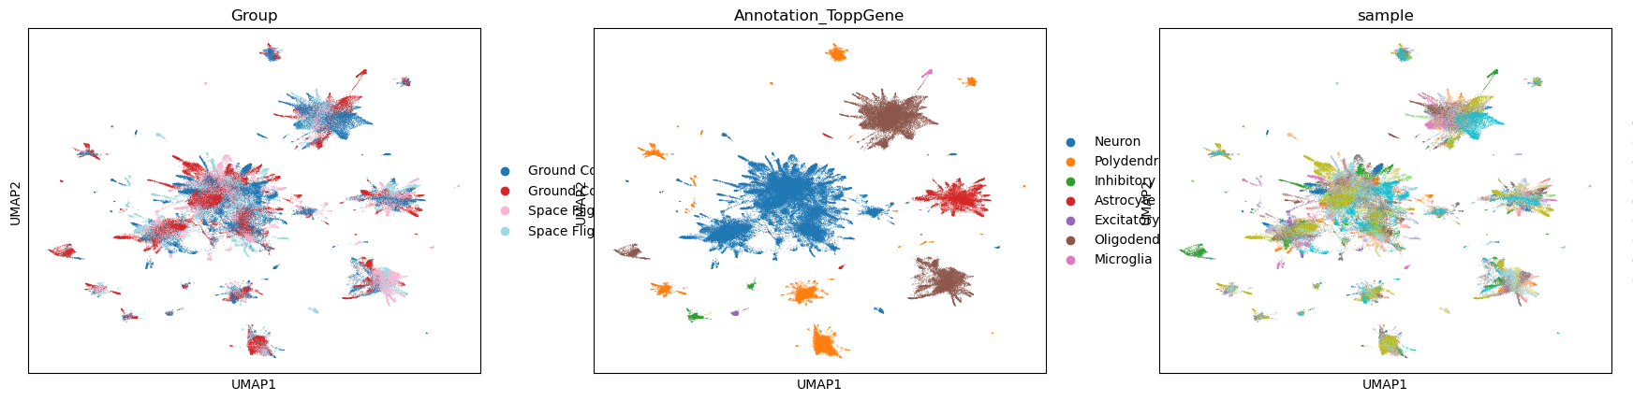

Slide 2
Potential Plans
Improve Integration
  Tweak Harmony
    Sample-aware? Batch-aware?
    Genes retained for integration (HVGs? And how calculated, see below)
    Other parameters
  ScVI
  Start with lighter batch-correction methods?
  Other approaches
Preprocessing Parameters
  Filtering criteria
  Hb, Rb % content
  HVG calculation (sample-aware? batch-aware?)
Keep Tweaking Clustering and/or Annotation?
  Sub-clustering parameters
  Annotate by pre-defined markers
  Integrate CellTypist-, ToppGene-, and Map My Cells-based annotations

Slide 3
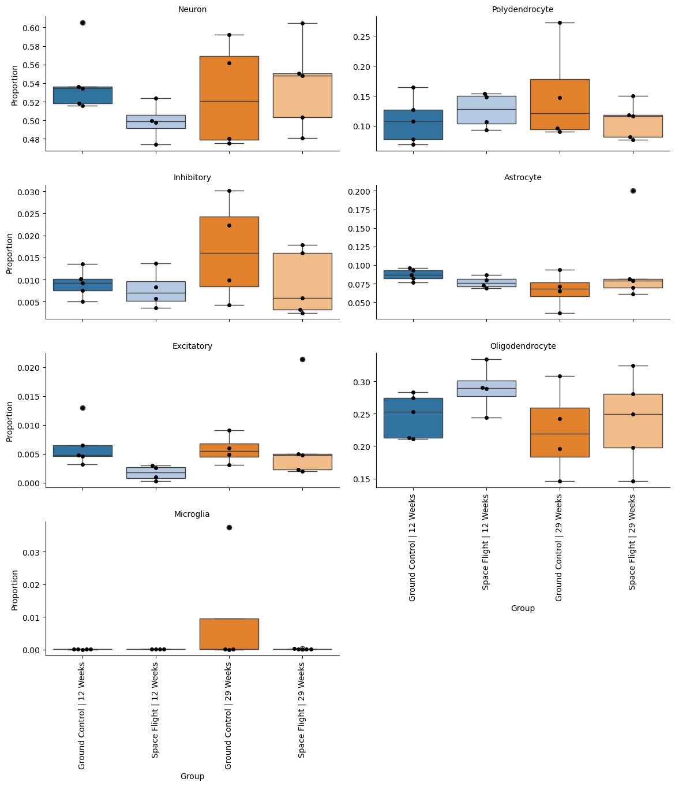
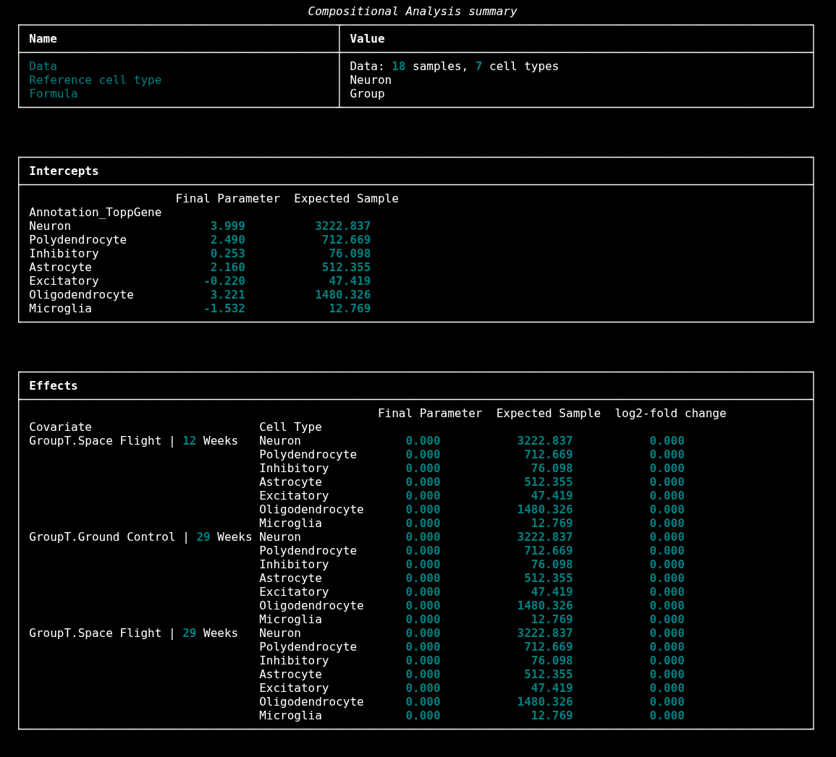
Perturbation Analyses: Cell Type Composition

Slide 4
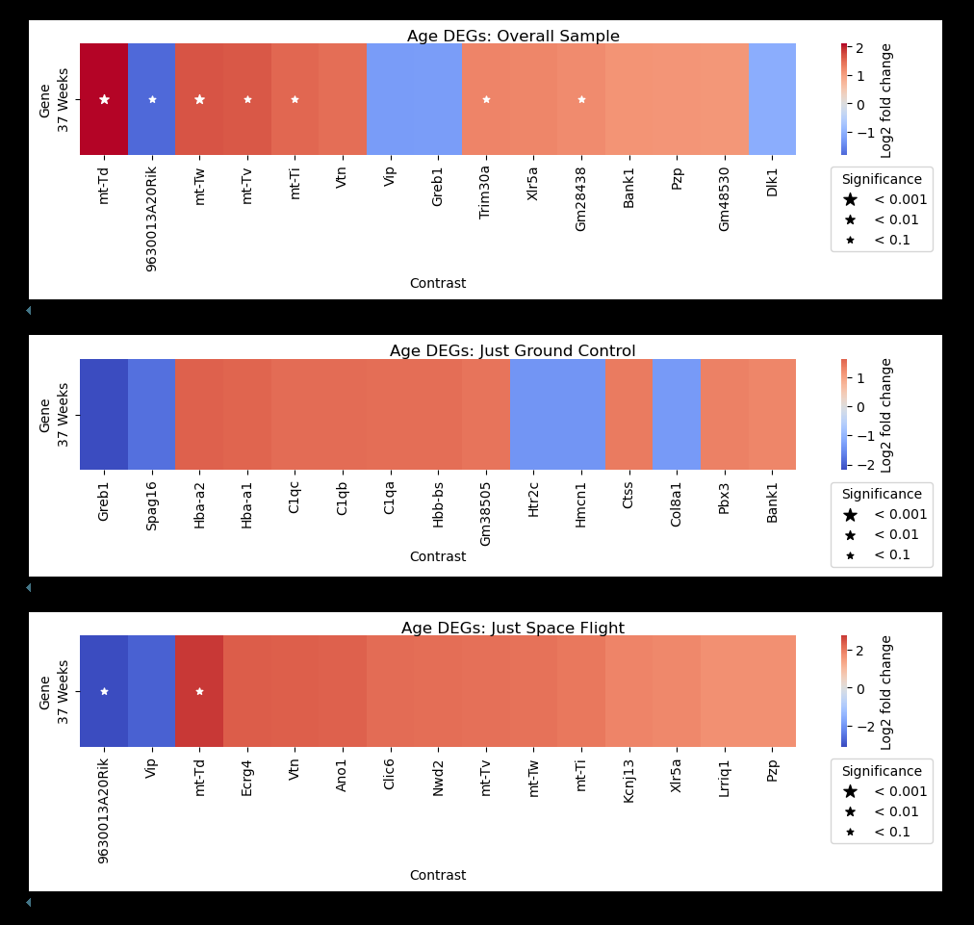
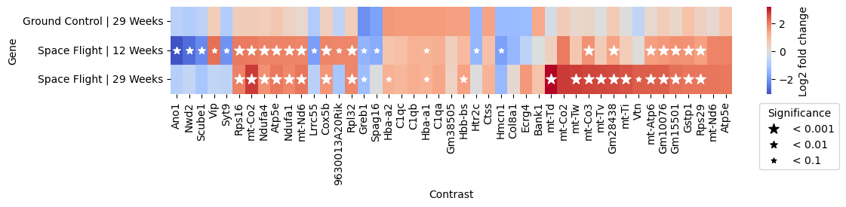
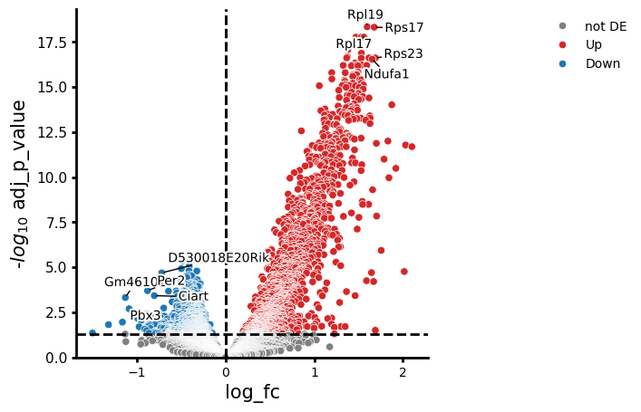
Perturbation Analyses: DEGs

Slide 5
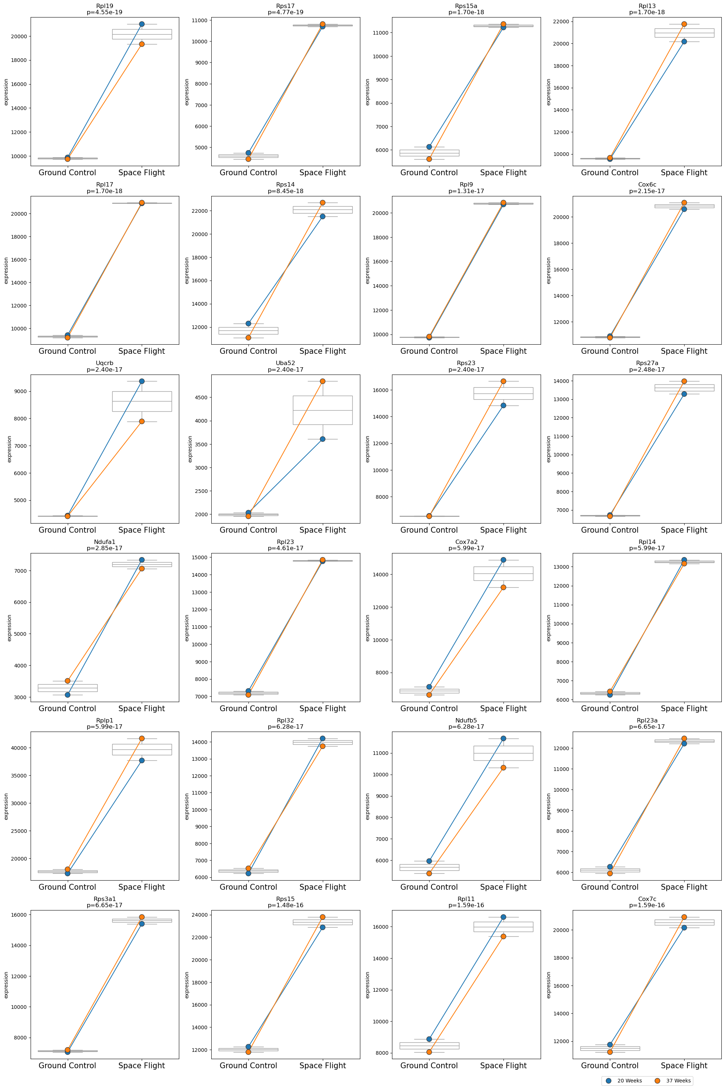
Perturbation Analyses: DEGs

Slide 6
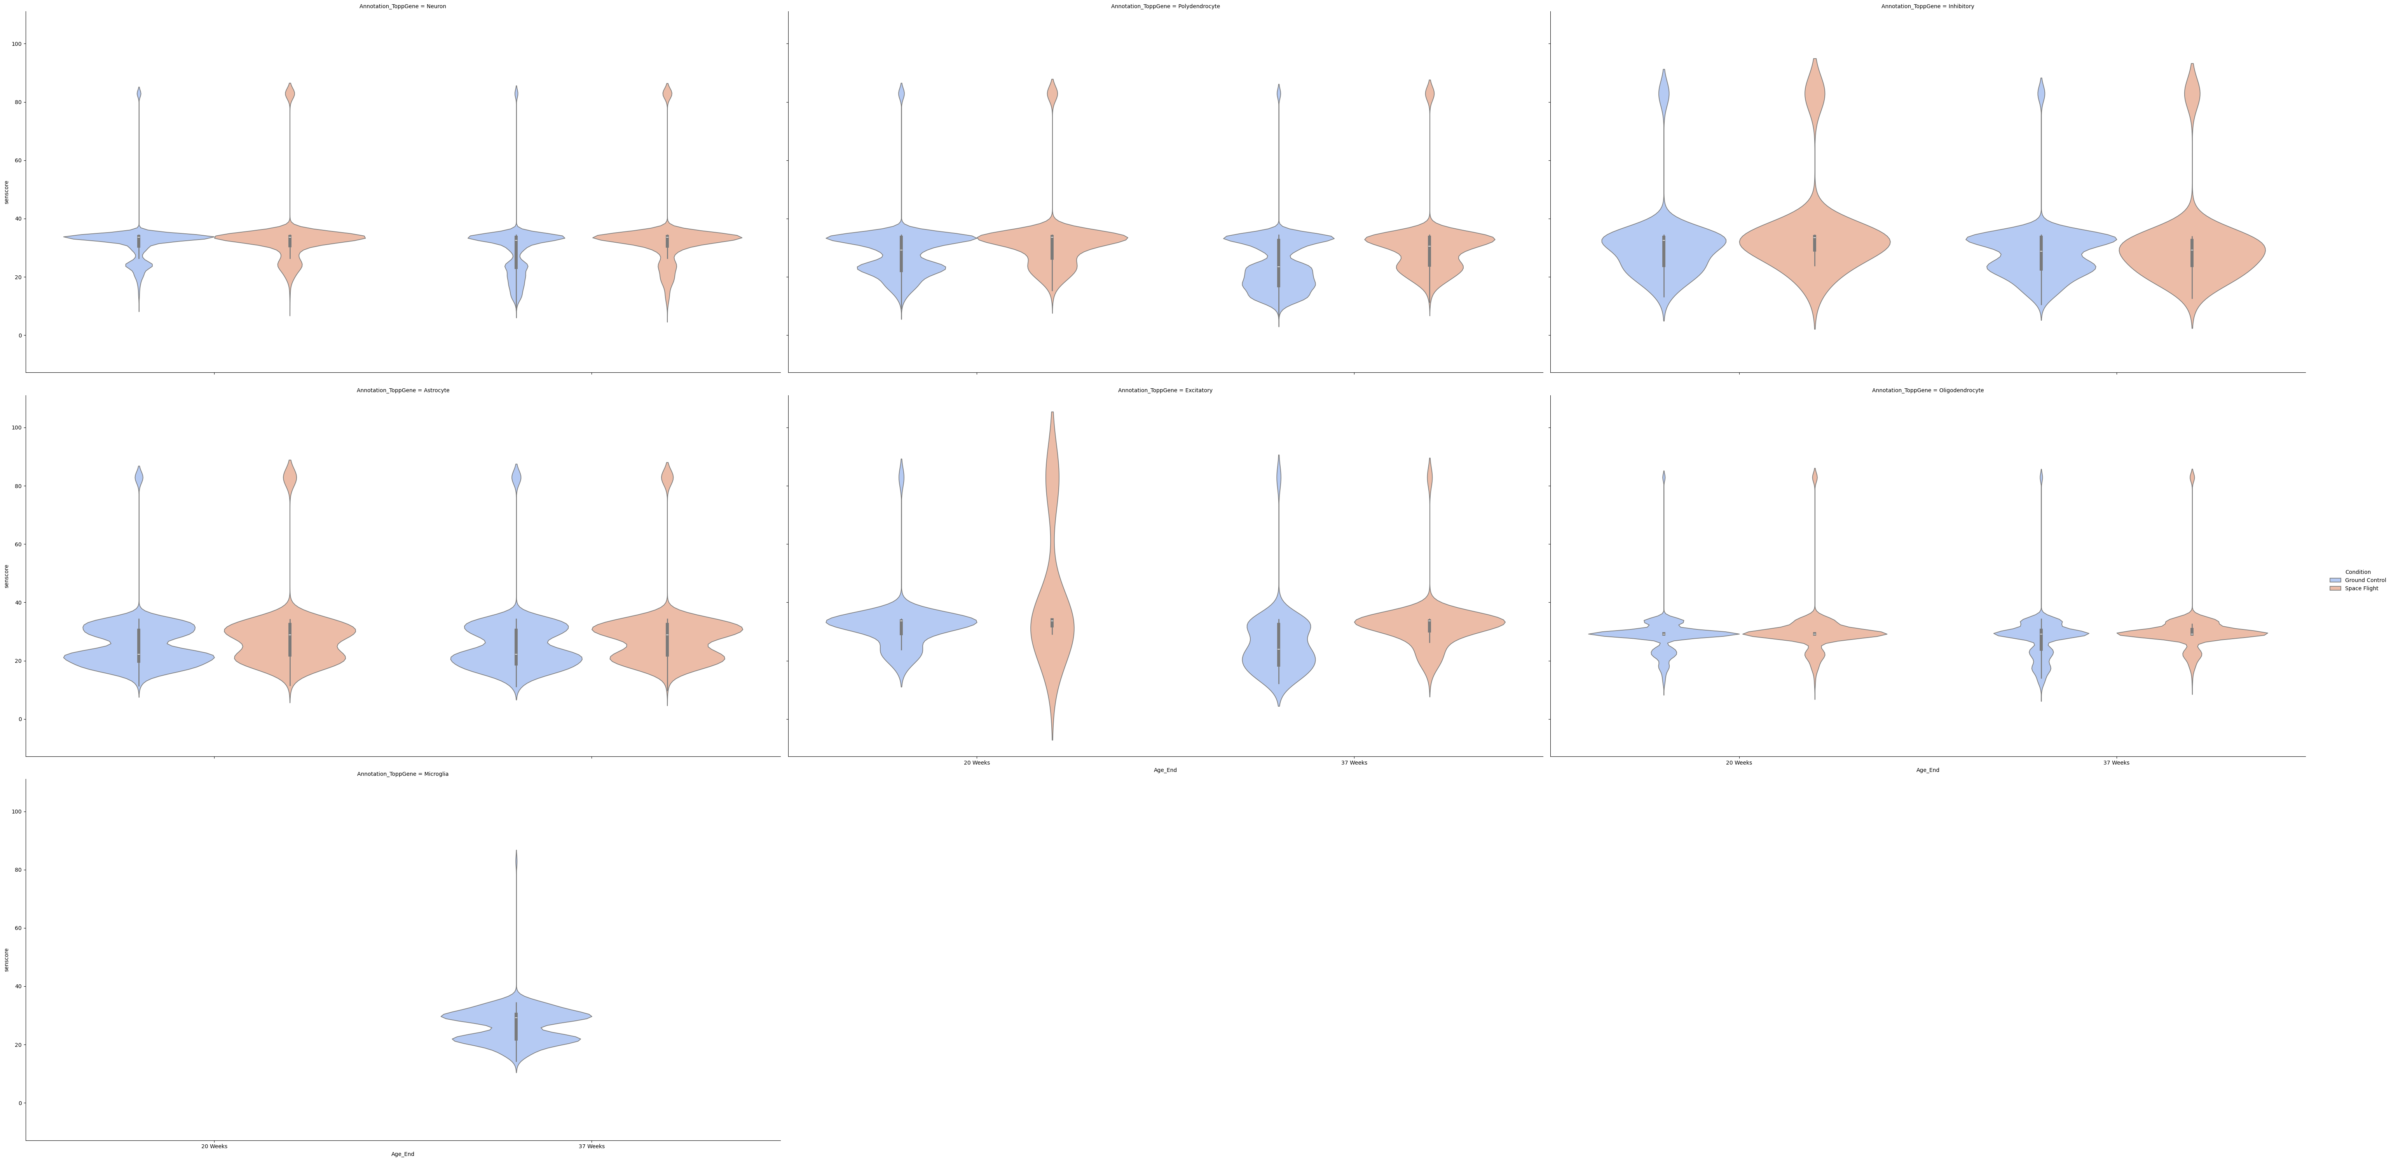
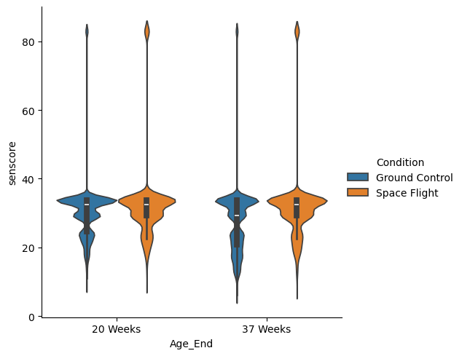
Senescence Scoring
Other Composite Score Approaches (SenMayo)
Refine Downstream Analysis
Literature Search

