Slide 1

Why Open Science
Slow, wasteful, locked away
Ruled by commercial interests
Reproducibility crises
Questionable research practices
Closed science means people suffer
Science is not working as it should be
@OpenScienceMOOC
Notes:
1

Slide 2
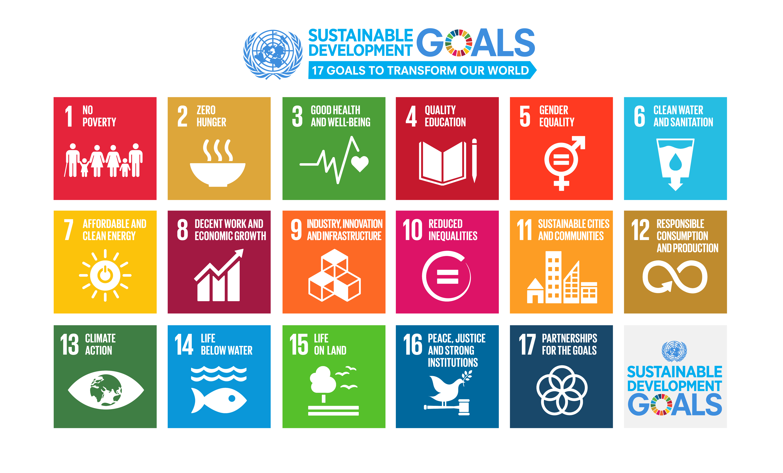
We need science if we are going to help quickly and sustainably solve these
Notes:
2

Slide 3
Our vision of the future
To help make ‘Open’ the default setting for all global research.
We want to help create a welcoming and supporting community, with good tools, teachers, and role-models, and built upon a solid values-based foundation of freedom and equitable access to research.
@OpenScienceMOOC
Notes:
3

Slide 4
The way we do research has changed for good
We now have new expectations
Transparency
Not secrecy
Collaborative
Not solo
Continuous
Not discretised
@OpenScienceMOOC
Notes:
4

Slide 5
We should be training ourselves
Sustained community engagement across disciplines
Being active both politically and at a community level
Rethinking our mindset
Changing the incentive system
@OpenScienceMOOC
Notes:
5

Slide 6
How do we get to where we want?
Imagine a future defined by the values of Open Science:
        Freely available public good
        Rigorous and reproducible
        Open to ALL
        Isn’t that just GOOD science?
@OpenScienceMOOC
Notes:
6

Slide 7
The best researchers have already reinvented themselves into Openness
We need everyone to be collaborating together if we are going to help solve the challenges humanity faces.
#OpenScience
@OpenScienceMOOC
Notes:
7

Slide 8
How do we fit in?
Community
Common values
Collaboration not competition
@OpenScienceMOOC
Notes:
8

Slide 9
Introducing the Open Science MOOC
A peer-to-peer value-based community that works towards better science for society
@OpenScienceMOOC
Notes:
9

Slide 10
What do researchers care about?
Saving time and effort
Problem solving
Advancing research
We give them the knowledge and skills to do this
@OpenScienceMOOC
Notes:
10

Slide 11
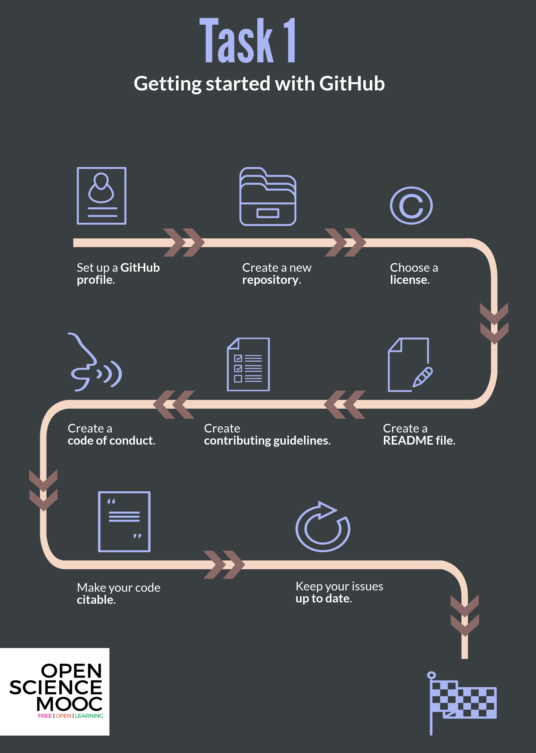
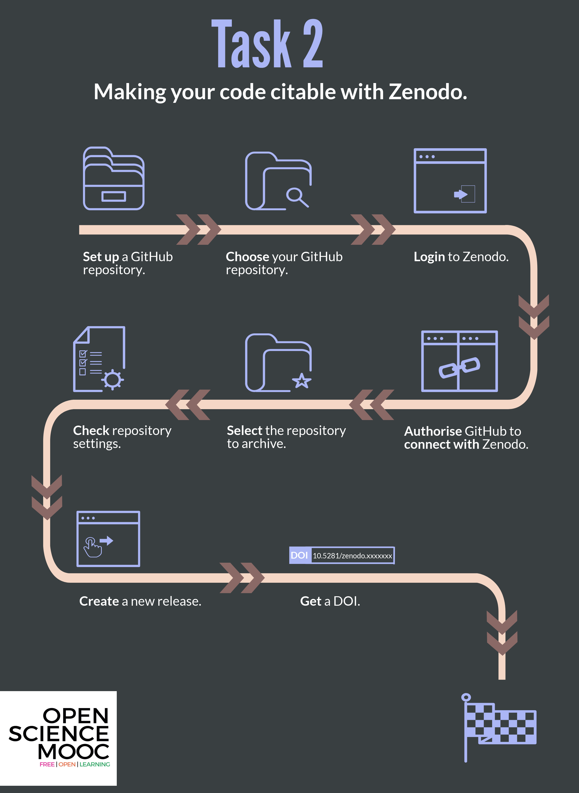
Notes:
11

Slide 12

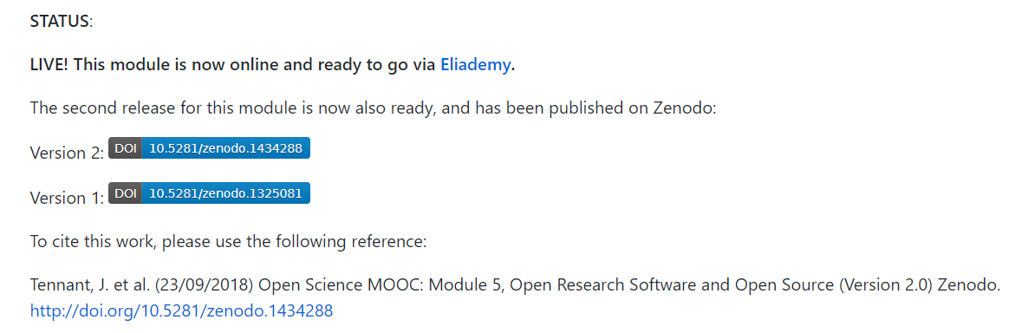
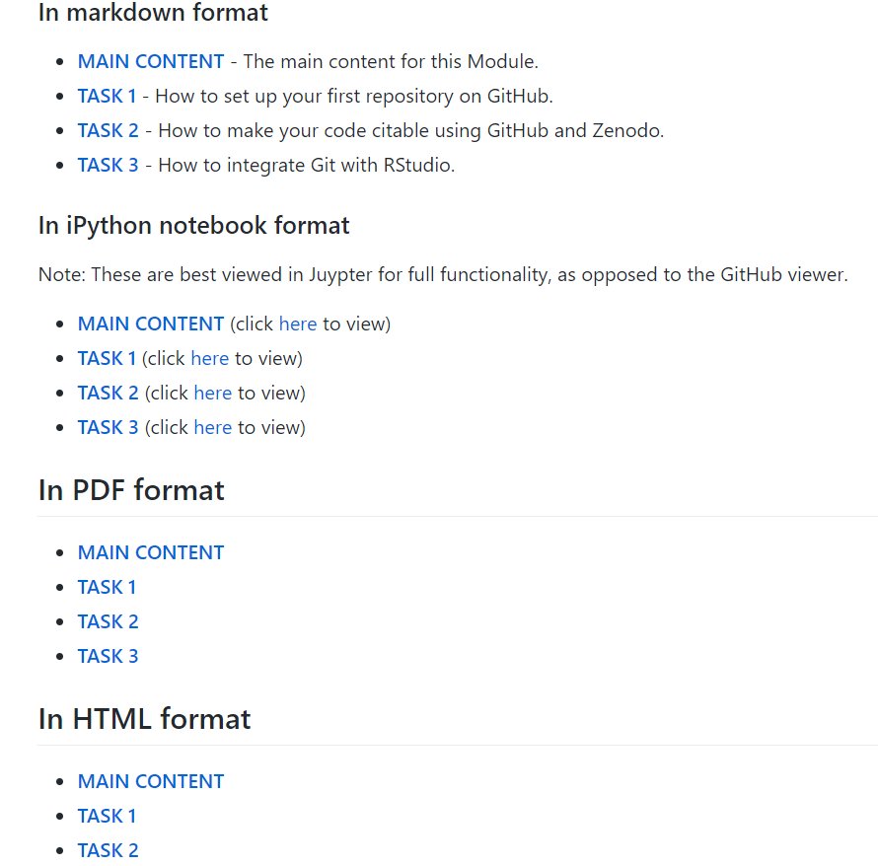
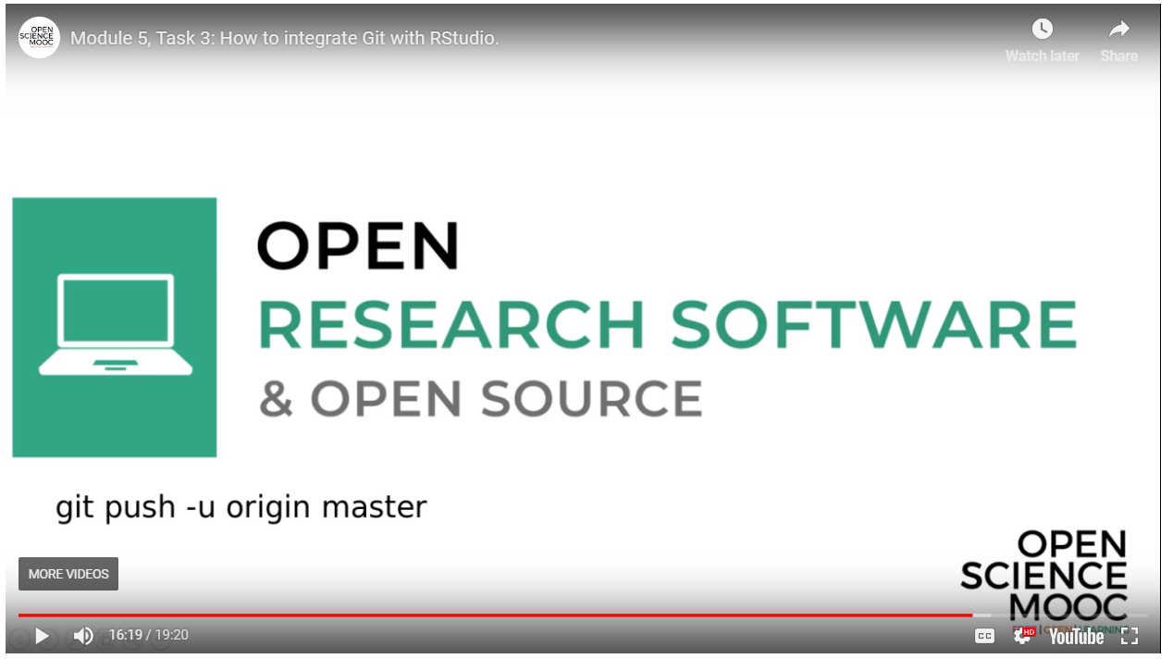
Open for re-use
Notes:
12

Slide 13
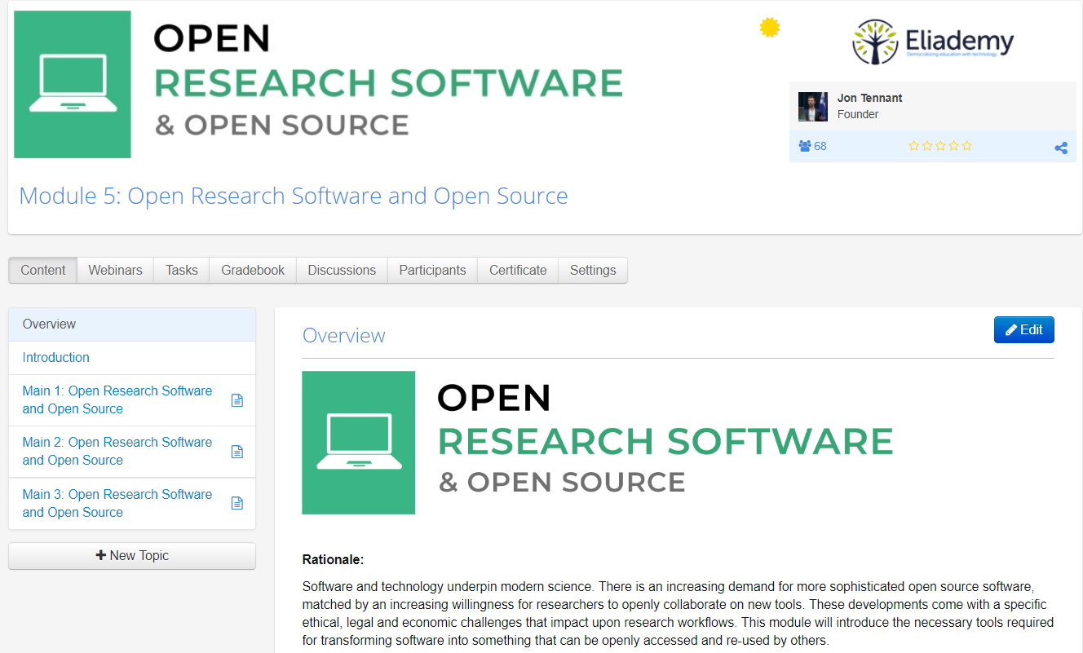
https://eliademy.com/catalog/oer/module-5-open-research-software-and-open-source.html

Slide 14
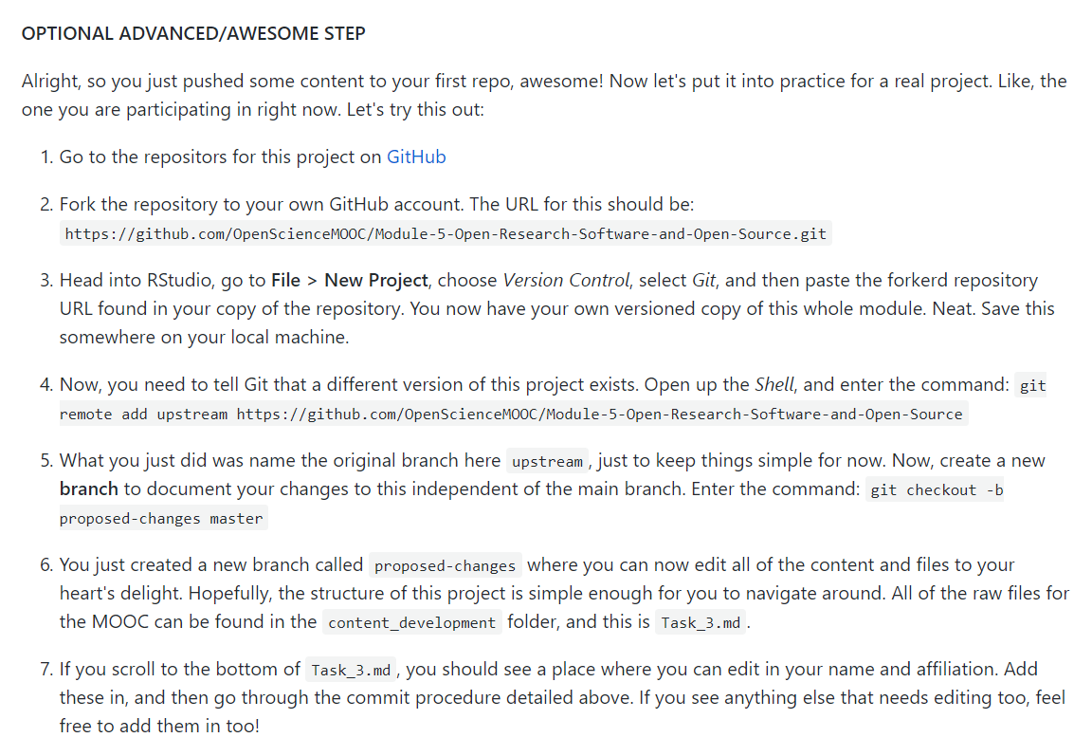
A fully interactive learning style
This allows learners to actually edit the MOOC content for this module. Nice.
Learning is based on participation and collaboration.
Notes:
14

Slide 15
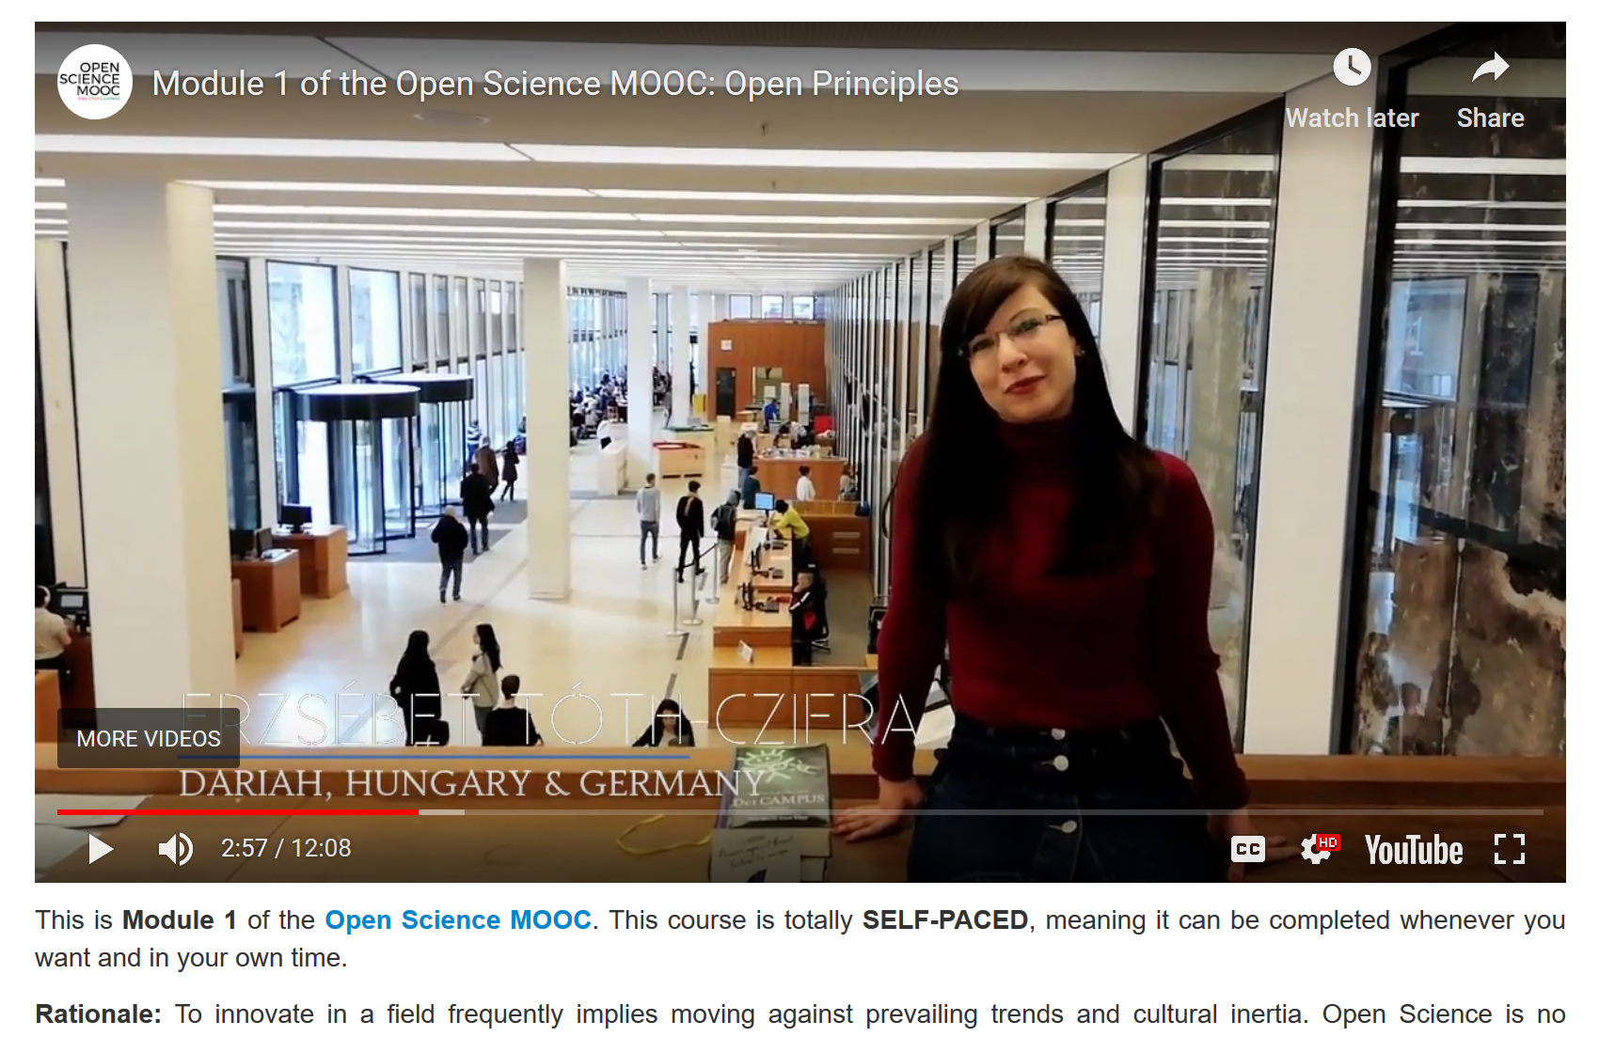
Way more than just an online course
We want to build more than a tool, a platform or a service.
We are committed to build an open and inclusive community!
Go check out our Module 1 on Open Principles, starring real #OpenScience heroes
https://eliademy.com/catalog/oer/module-1-open-principles.html
Notes:
15

Slide 16
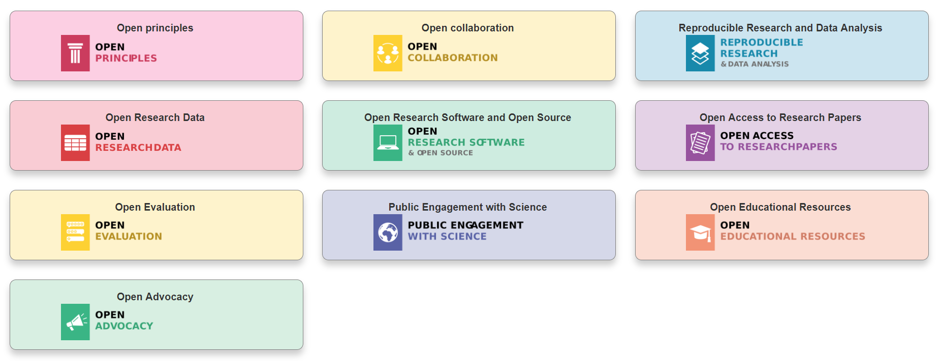
Modular learning
@OpenScienceMOOC
Designed by: Mike Morrison
Notes:
16

Slide 17
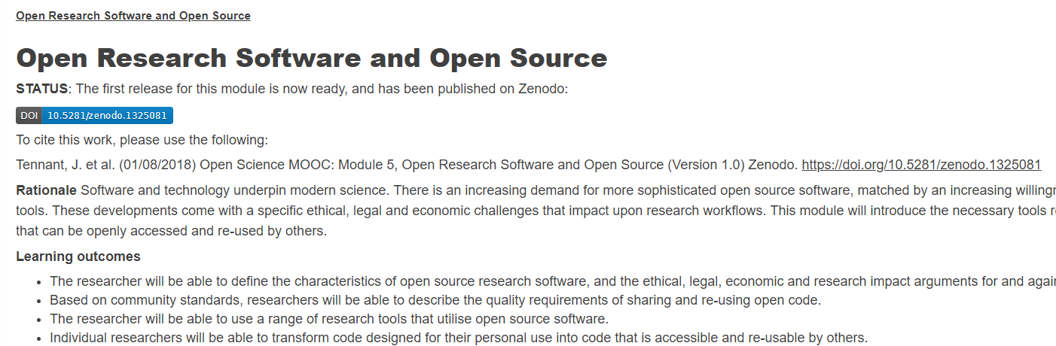

Open for re-use
Notes:
17

Slide 18
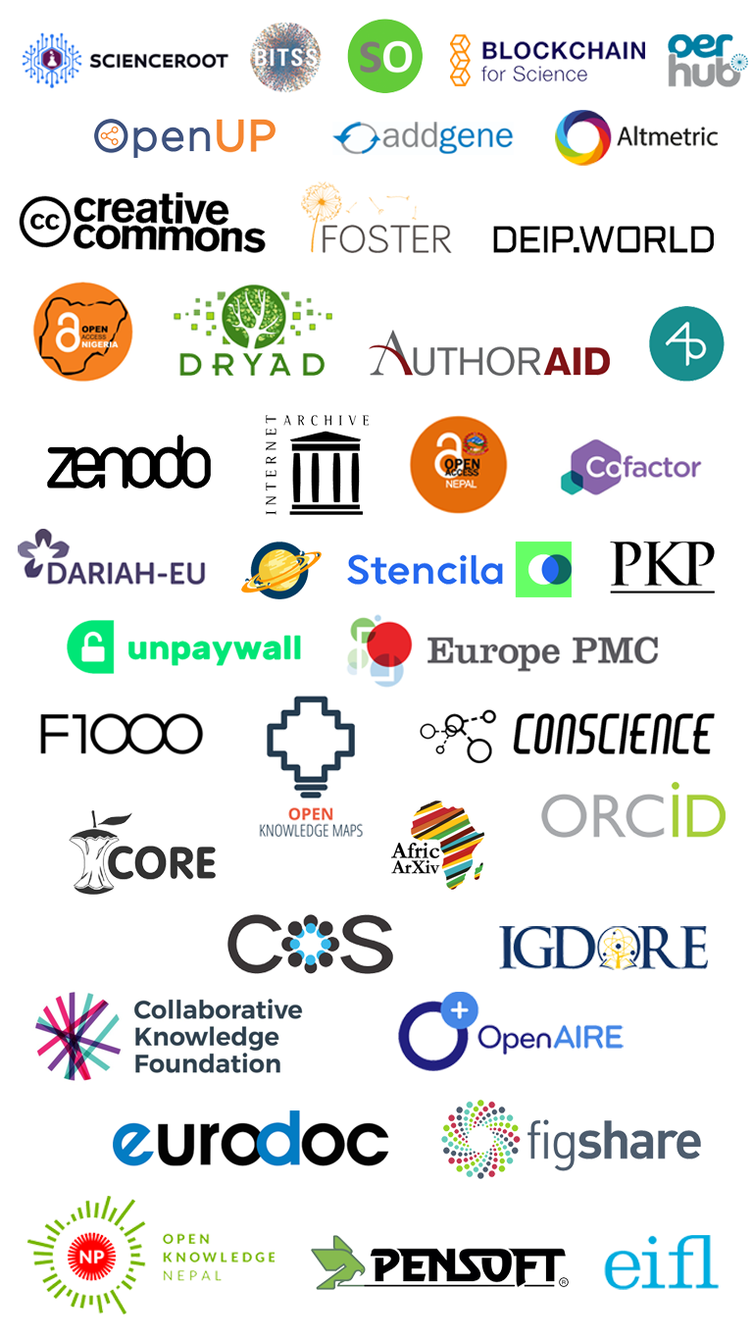
We are not alone
Notes:
18

Slide 19
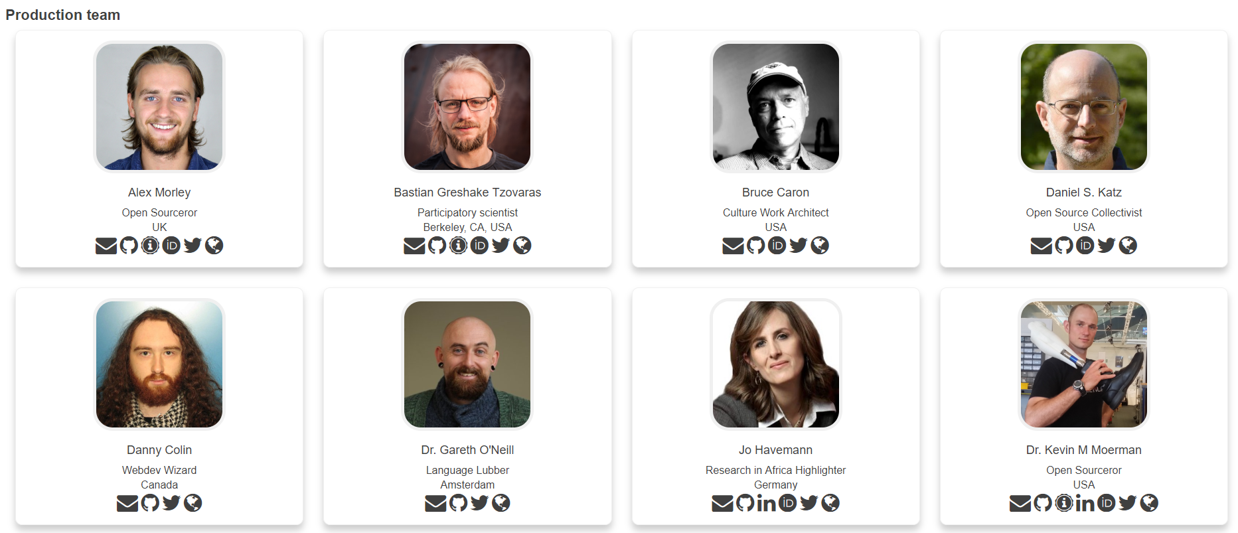
Some of our Production Team
Notes:
19

Slide 20
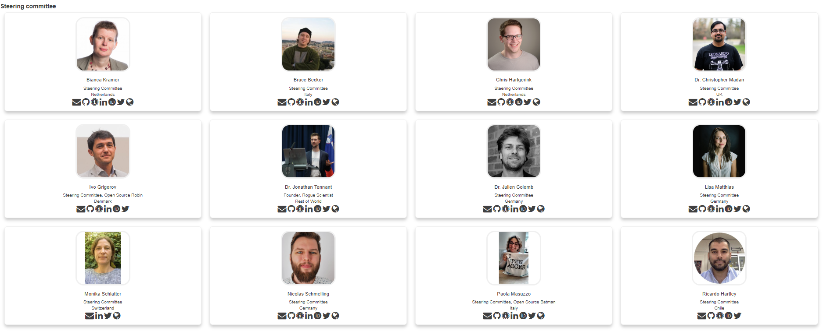
We are guided by passion
Notes:
20

Slide 21
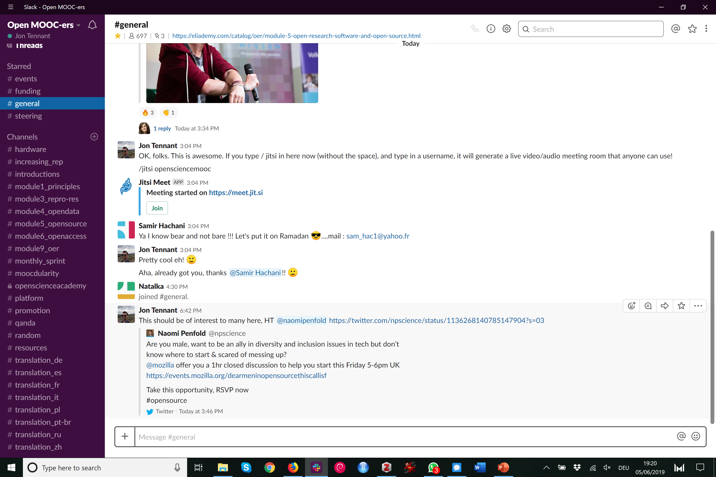
https://osmooc.herokuapp.com/
Notes:
21

Slide 22
Skeptical? You should be.
But it’s not as new as you think.
Science was founded on openness.
We closed it down.
It’s time to open it up again.
@OpenScienceMOOC
Notes:
22

Slide 23
Status
In development
700 Slack community members
6500 Twitter followers
45 strategic partnerships
650 people enrolled in Module 5 and 150 in Module 1
Agile development so people are already using content
Iterative feedback is our design
@OpenScienceMOOC
Notes:
23

Slide 24
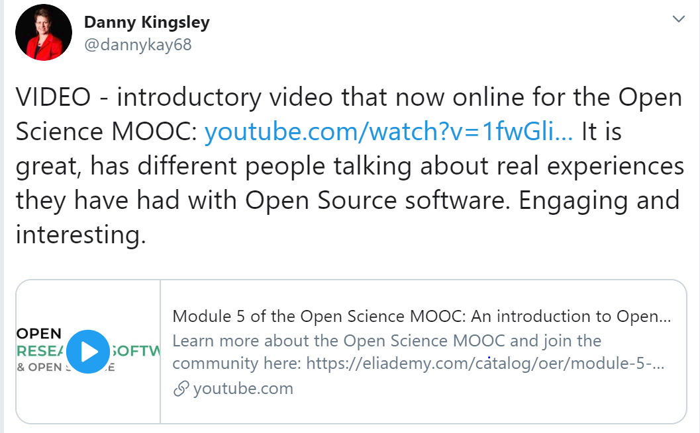
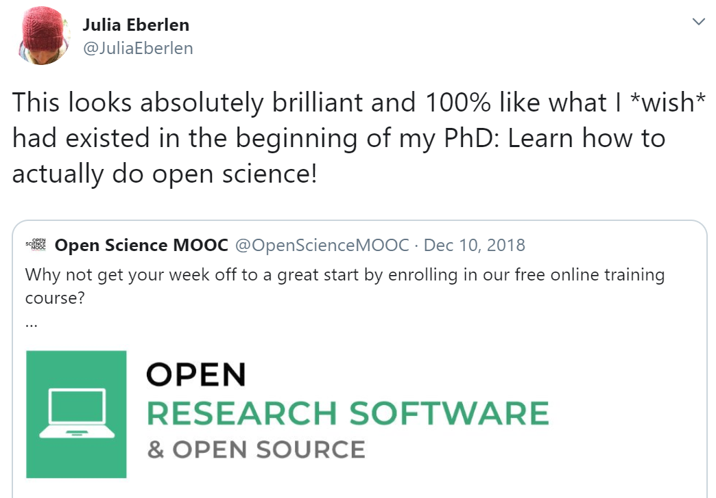
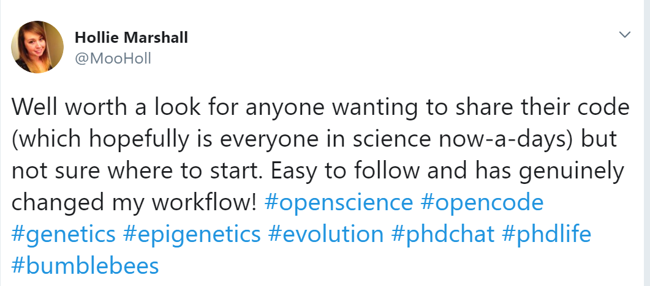
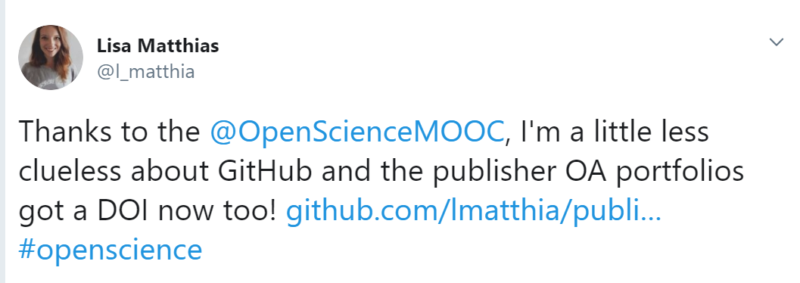
What people say of the MOOC

Slide 25
How do you want to shape your identity as a scientist?
Researchers can be world-changing heroes
We will give them the power to achieve that
@OpenScienceMOOC
Notes:
25

Slide 26
Help science work for society again
People not profits!
Students, teachers, journalists, bloggers, startups, entrepreneurs, policymakers, citizen scientists, NGOs, charities, health practitioners.
We are here for you.
@OpenScienceMOOC
Notes:
26

Slide 27

The end
Melanie Imming, & Jon Tennant. (2018, June 8). Sticker open science: just science done right.
Zenodo. https://zenodo.org/record/1285575
Notes:
27

Slide 28

Thanks!
GitHub: https://github.com/OpenScienceMOOC
Website: https://opensciencemooc.eu
Twitter: @OpenScienceMOOC
Email: info@opensciencemooc.eu
Notes:
28

