Slide 1

Commoning Open Infrastructures for Open Science
Sergio Andreozzi
Strategy and Policy Manager, EGI Foundation
Open Science for an Open Society 20 Sep 2016, Amsterdam
sergio.andreozzi@egi.eu
@digitalities

Slide 2
Open Science
Opening of the creation and dissemination
of scholarly knowledge
towards a multitude of stakeholders,
from professional researchers to citizens

Slide 3
Open Science: as a Complex Resource System
Scientific instruments
Research data
Scientific publications
Digital services
Software
Educational and training material
Expertise
Funding
…
Digital services and applications
Knowledge & Expertise
Research Data
Instruments

Slide 4
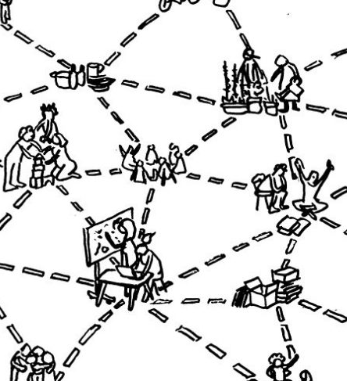
Open Science: as a Commons-based Peer Production (CBPP)
Open
Access to participation
Transparent
Access to information
Decentralised
Allocation of resources
Horizontal
Autonomy
Shared resources
Integrated, easy and fair access
Engaged communities
Interdependent
Mapping CBPP: http://ipp.oii.ox.ac.uk/sites/ipp/files/documents/IPP2014_Maldonado.pdf

Slide 5
Example: Commons dimensions for an Online Creation Community
Collective mission or goal of the process
Cultural principles and social norms
Design of the platform of participation
Conditions for self-management of contributions
Formal rules or policies for community interaction
License
Decision-making and conflict resolution systems
Infrastructure provision
Source: “Governing Knowledge Commons” book (2014), p.288

Slide 6

Open Science: as an Open Value Network (OVN)
Co-create and aggregate value
Responsible steward of assets
Account for inputs/outcomes in a common ledger system
Distribute value equitably
Share returns amongst contributors
In proportion to their contributions
OVN model: http://valuenetwork.referata.com/ A working OVN: http://sensoricablog.blogspot.fr/2016/09/sensorica-and-health-care.html

Slide 7
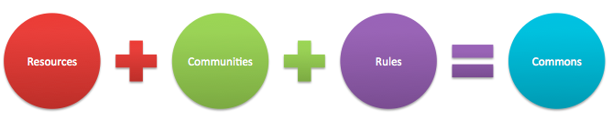
Commons and Commoning
Institutionalised community governance of the production and/or sharing of a particular type of resource (from natural to intellectual)
Wikipedia
Linux
Constructing Genome Commons
…
Internet
GÉANT: European Communications Commons
e-Infrastructure Commons

Slide 8
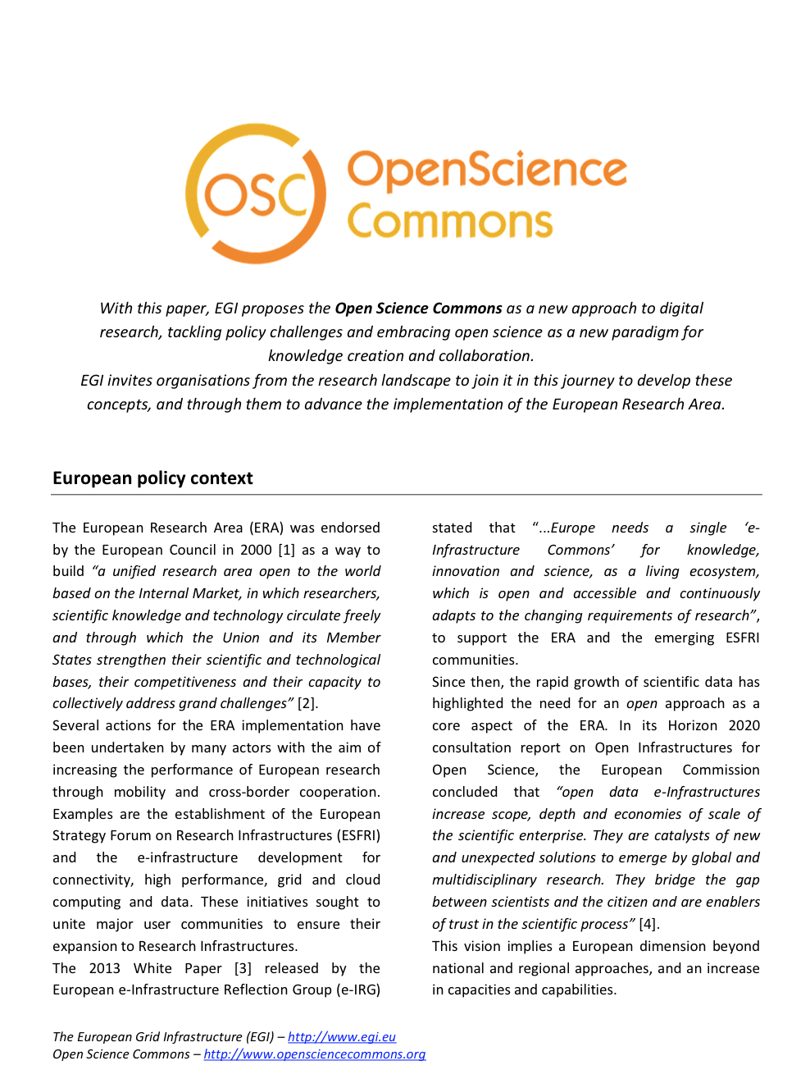


Open Science Commons: Definition
A set of interrelated resource systems governed as commons that support the open creation and dissemination of scholarly knowledge
An area of study in the commons theory applied to open science
Digital services and applications
Knowledge & Expertise
Research Data
Instruments
website: www.opensciencecommons.org - paper: http://go.egi.eu/osc

Slide 9






















A common endeavor (EU perspective)
Digital services and applications
Knowledge & Expertise
Research data
Instruments
Innovation Centres
Centres of Excellence

Slide 10
Towards a European Open Science Cloud

Slide 11
(Some) Challenges in Commoning Open Infrastructures for Open Science
Governance
Balance between private vs. public vs. community
Rules to access and participation
E.g. guidelines for access policies to Research Infrastructures
Rules for decision-making and conflict resolution
Funding
Ensuring long-term support
Sustainable models
Integration and interoperability
Standards

Slide 12
Summary
Open science
as complex resource system
as commons-based peer production process
as an open value network
Open infrastructures
essential inputs to OS
managed as commons

Slide 13

A final note (1) EC policy making on open science
Commissioner Moedas priorities
Open Science Policy Platform (OSPP)
25 experts to provide advice on the development and implementation of open science policy in Europe
8 policy ambitions:
FAIR data
European Open Science Cloud
Altmetrics
Business models for scholarly comm
Rewards
Research integrity
Open science skills
Citizen science
E-mail me to receive updates and/or to contribute your feedback

Slide 14
A final note (2) European Commons Assembly
16 Nov 2016 at the European Parliament
Also in live streaming
http://europeancommonsassembly.eu/open-agenda-for-november-16/
Target audience:
Commons activists, policy makers, interested citizens
Goals
Increase visibility and credibility for the commons movement
Make concrete legislative and funding proposals
Promote direct democratic participation in EU institutions

Slide 15
sergio.andreozzi@egi.eu
@digitalities

