Slide 1
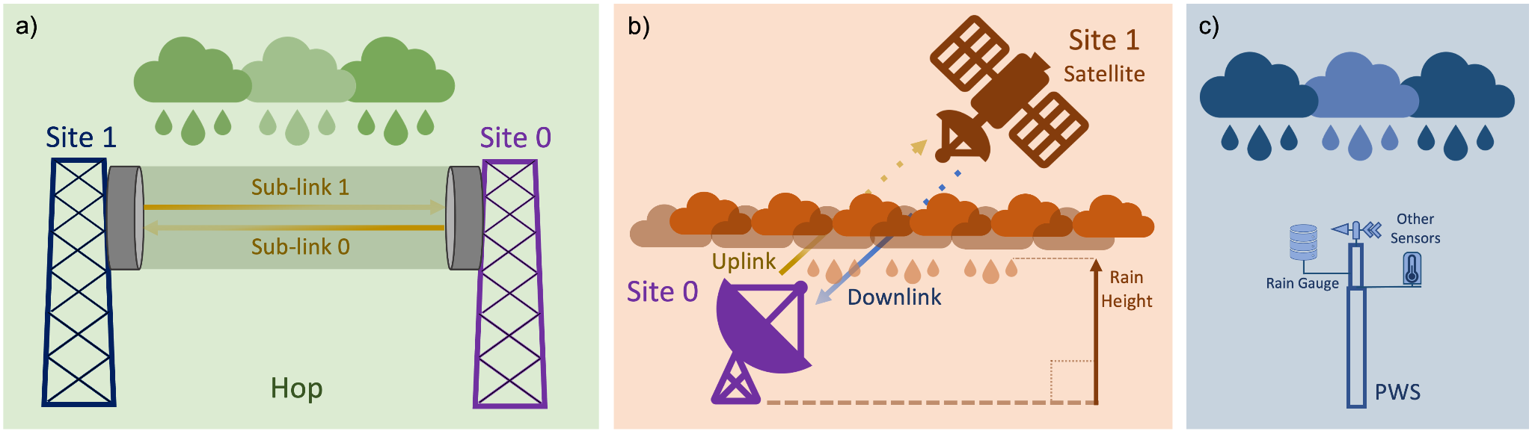
Commercial microwave links
(CML)
for rainfall estimation

Slide 2
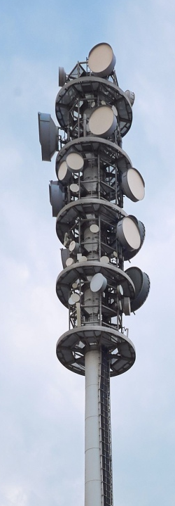
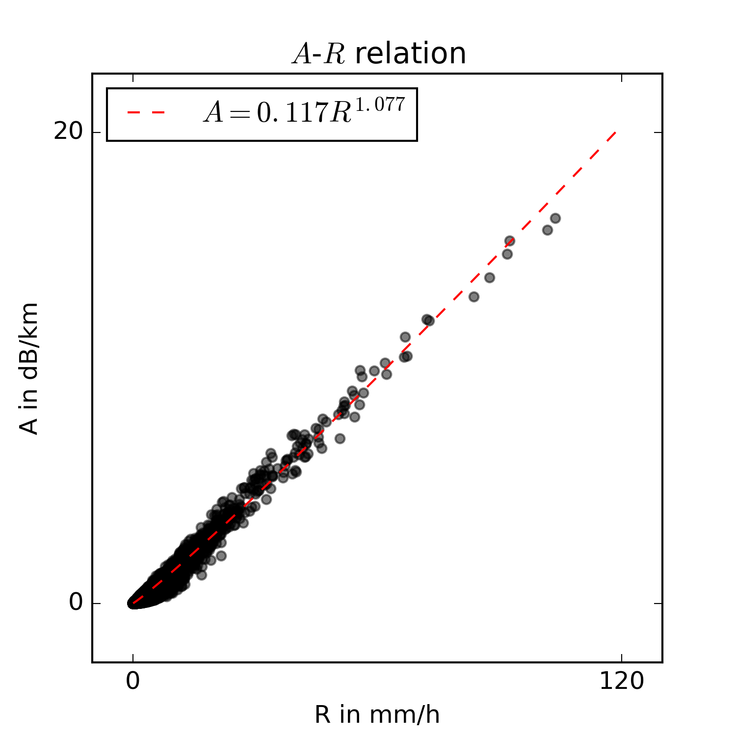

CML rainfall estimation
transmitted microwave signal
transmitted microwaves
directional radio antenna
base station antenna
strong attenuation
due to rain drops
mobile communications tower
[mm/h]
A-R power law:
$$A=aR^{b}$$
[dB/km]
Experimentally measured relation
between attenuation A and rain rate R

Slide 3
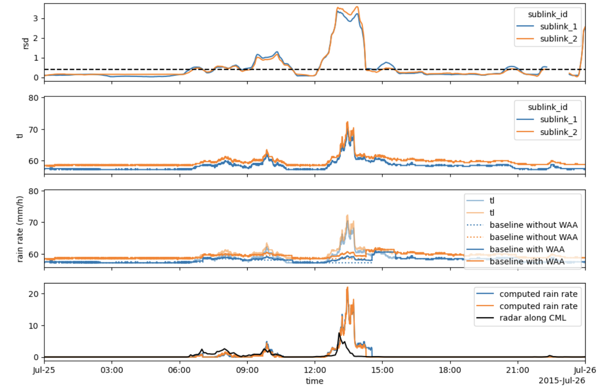
CML processing
TL = transmitted – received signal level

Slide 4
CML processing
rolling standard deviation (60 minute), together with a trehsold, is used to detect rain events

Slide 5
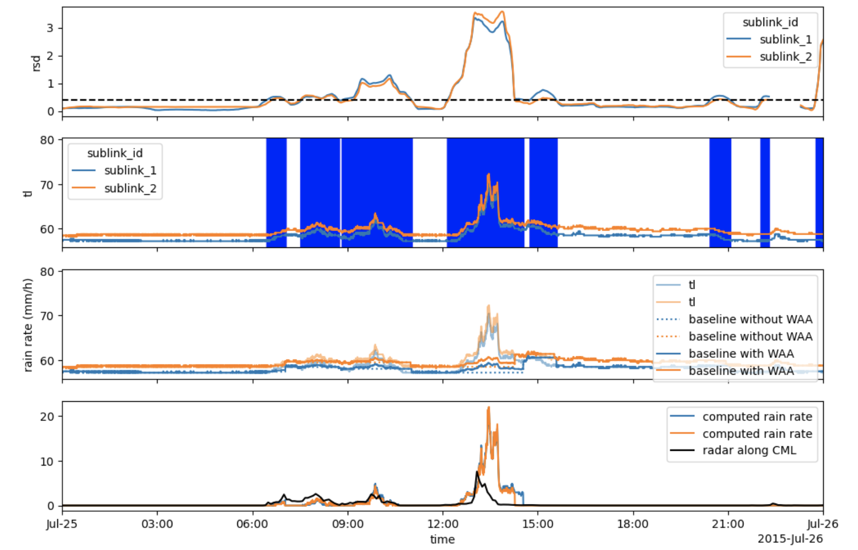
CML processing
rolling standard deviation (60 minute), together with a trehsold, is used to detect rain events

Slide 6
CML processing
a baseline during rainy periods is estimate
wet antenna attenuation (from rain drops on the antennas) is compensated for

Slide 7
CML processing
via the k-R relation, rain rates are calculated

Slide 8
... switching to the notebook now

