Slide 1
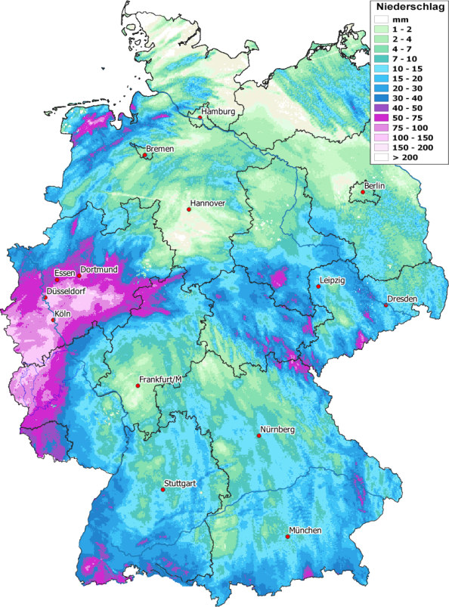
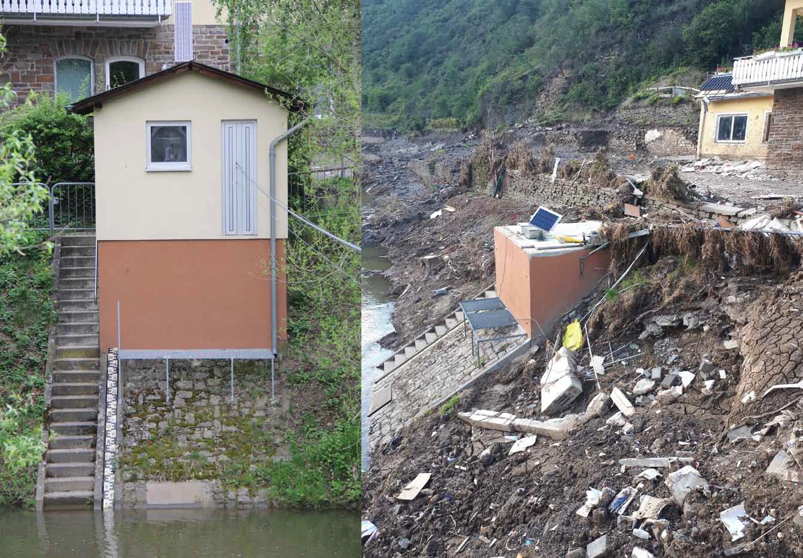
The Ahr valley flood in July 2021
Severe Rainfall in Western parts of Germany and adjacent areas
Flood in the Ahr valley lead to severe damages and loss of lives
Correct precipitation estimates is still a major challenge in Hydrology
Peak discharges of this flood events still unknown/uncertain

Slide 2
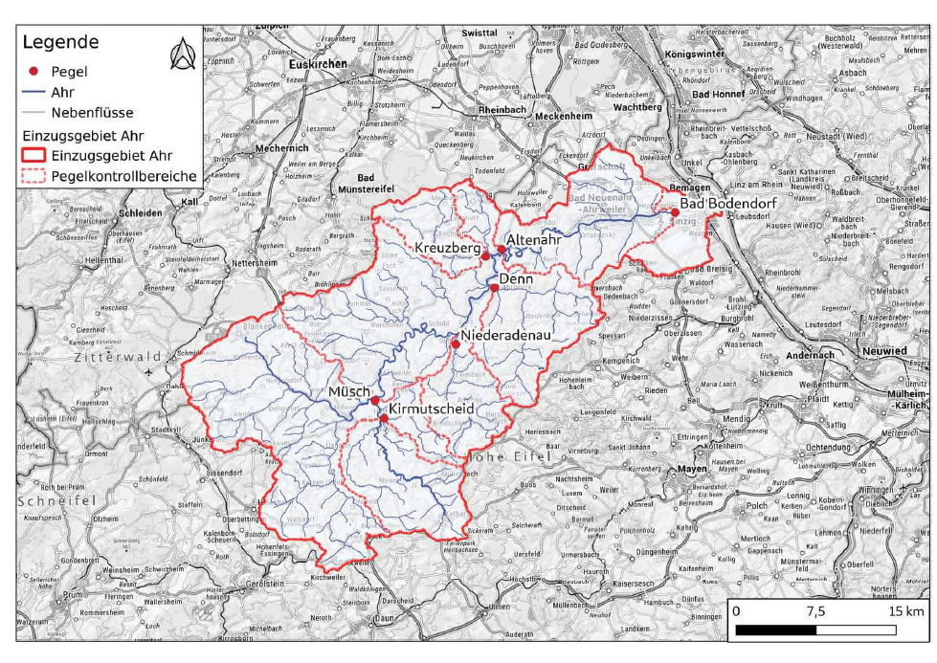
The Ahr valley flood in July 2021

Slide 3
Gauge adjusted radar product
Notes:
Hier eine Übersicht mit verschiedenen Bilder die die einzelnen Punkte des PICOs symbolisieren

Slide 4
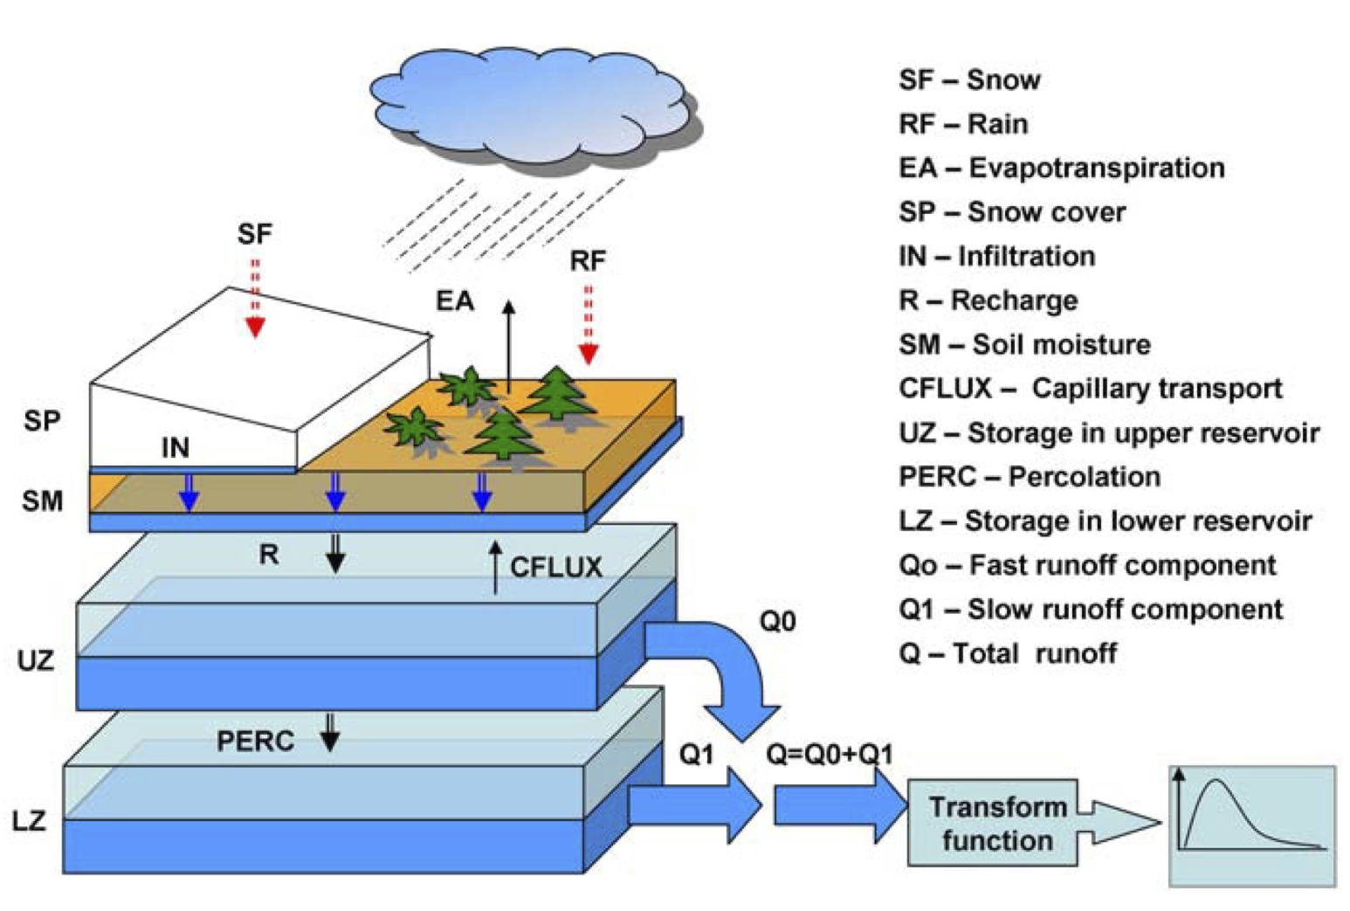
The HBV Model
Conceptual hydrological model
Developed by Bergström et al. In the 1970s in Sweden
Shrestha & Solomantine (2008)

Slide 5
Update your git repo
Navigate to the dir of TrainingSchoolMergingApplication
git add * # tells git to track all new/changed files
git commit –m „day2 changes“ # tells git to commit added files to history
git checkout main # move from day2 to main branch
git pull # get updates from parent repo
git checkout –b day3 # branch off for day

