Slide 1
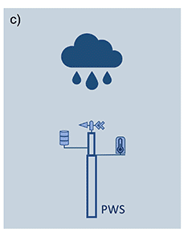
Personal Weather Stations
PWS
for rainfall monitoring

Slide 2
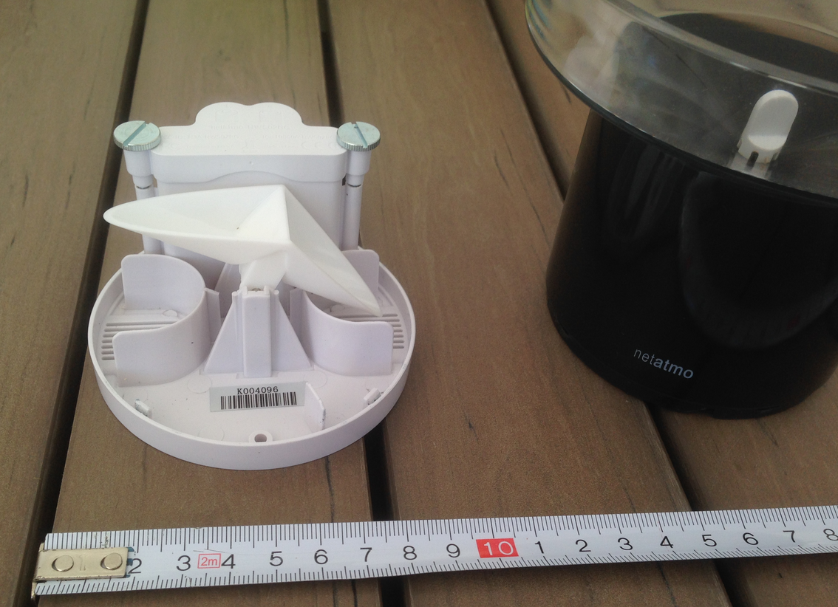
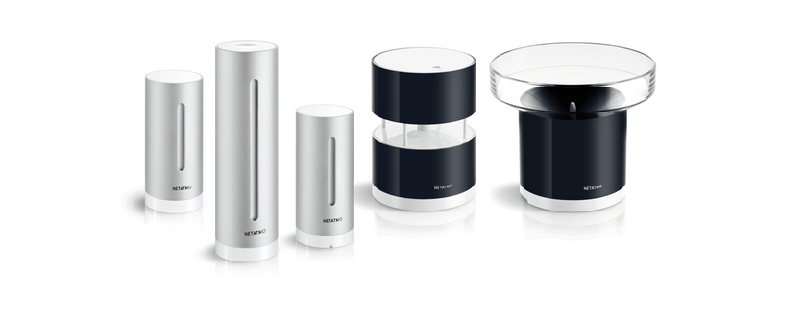
PWS e.g. from Netatmo
There are other manufactuerers e.g. Davis
Personal Weather Stations
(e.g. from Netatmo)
netatmo.com
http://www.aragonvalley.com/

Slide 3
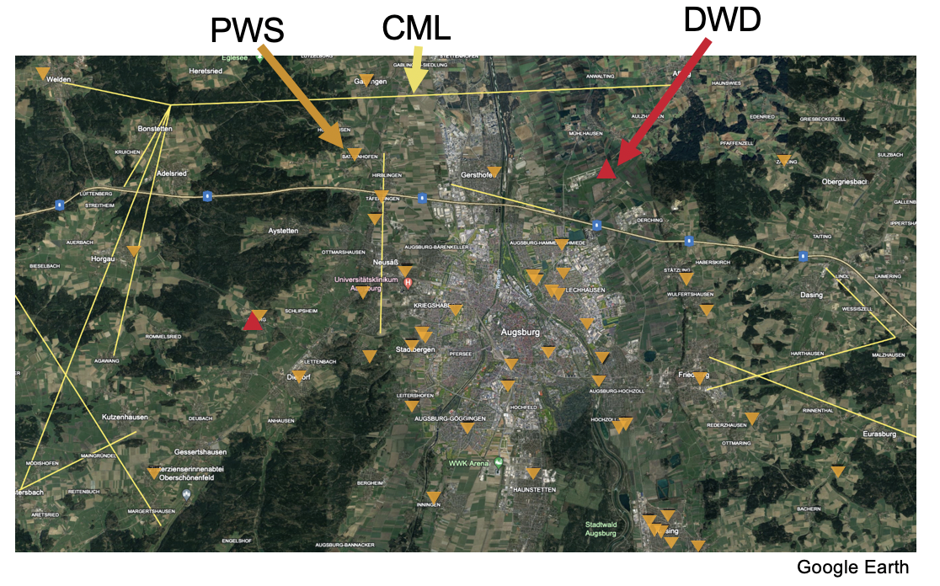
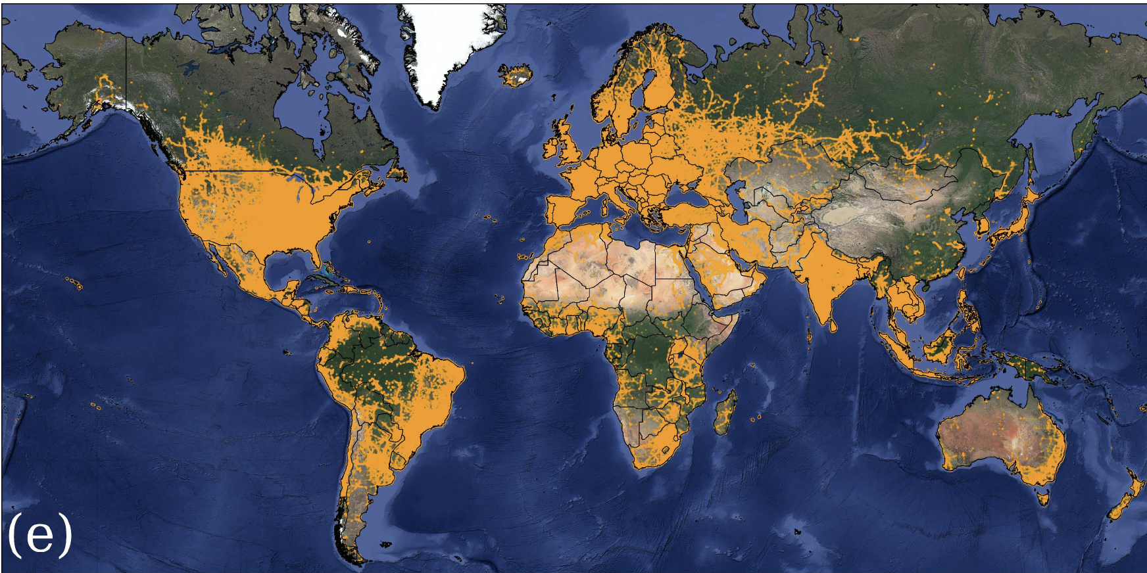
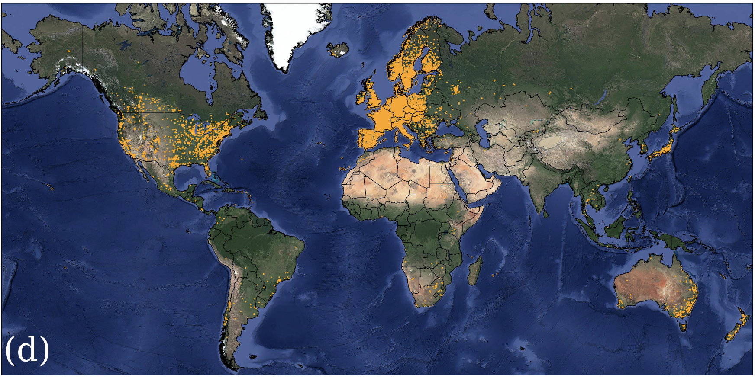
There are at least ten times more PWS in Europe than met service rainfall stations
Commercial microwave links (CML)
Personal weather stations (PWS)
Overeem et al. 2024

Slide 4
Faulty zero filter (FZ)
Median rainfall of neighbouring stations in certain distance (max_distance) is larger than zero for at least nint time intervals while the station itself reports zero rainfall.
The FZ flag remains 1 until the station reports nonzero rainfall.
Filter cannot be applied if less than n_stat neighbours are reporting data (FZ flag is set to -1)
Default parameters from de Vos et al. 2019
nint=5
n_stat=6

Slide 5
High influx filter (HI)
If median rainfall of neighbours is below threshold ϕA, then high influx if rainfall above threshold ϕB
If median rainfall of neighbours is above ϕA, then high influx if rainfall exceeds median times ϕB/ϕA
Filter cannot be applied if less than n_stat neighbours are reporting data (HI flag is set to -1)
Default parameters from de Vos et al. 2019
hi_thres_a=0.4
hi_thres_b=10
nint=6
n_stat=5

Slide 6
Station outlier filter
Median of the rolling pearson correlation with all neighboring stations within range max_distance is less than threshold gamma
Filter cannot be applied if less than n_stat neighbours are reporting data (SO flag is set to -1)
Filter cannot be applied if there are less than n_stat neighbours with less than mmatch intervals overlapping with the evaluated station (SO flag is set to -1)
Default parameters from de Vos et al. 2019
evaluation_period = 8064 # two weeks
mmatch = 200
gamma = 0.15
n_stat = 5
max_distance = 10e3

Slide 7
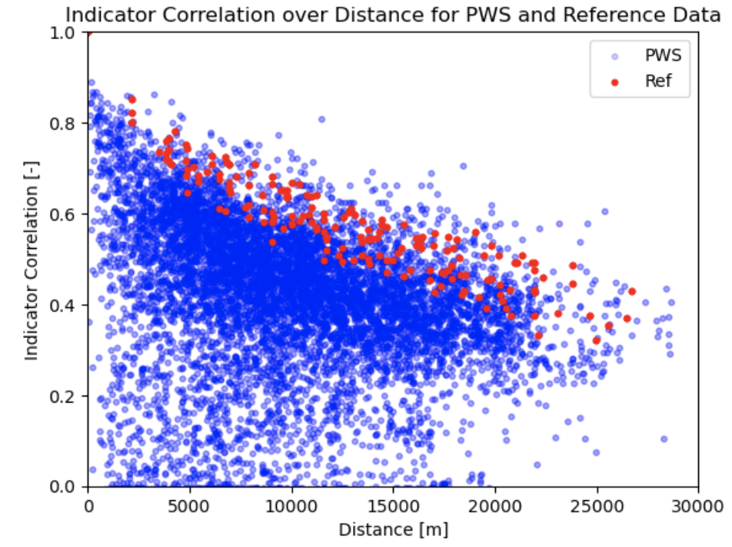
Indicator correlation filter
Flags whole time series based on the indicator time series of PWS and trustworthy reference stations

