Slide 1



www.cost.eu
Training School on Merging and Application of Opportunistic Rainfall Sensor Data
01. – 04. April 2025
Budapest University of Technology and Economics
OPENSENSE brings together scientists investigating different opportunistic sensors, experts from national weather services, owners of sensor networks, and end-users of rainfall products to build a worldwide reference opportunistic sensing community.
https://opensenseaction.eu/
COST (European Cooperation in Science and Technology) is a funding agency for research and innovation networks. Our Actions help connect research initiatives across Europe and enable scientists to grow their ideas by sharing them with their peers. This boosts their research, career and innovation.

Slide 2
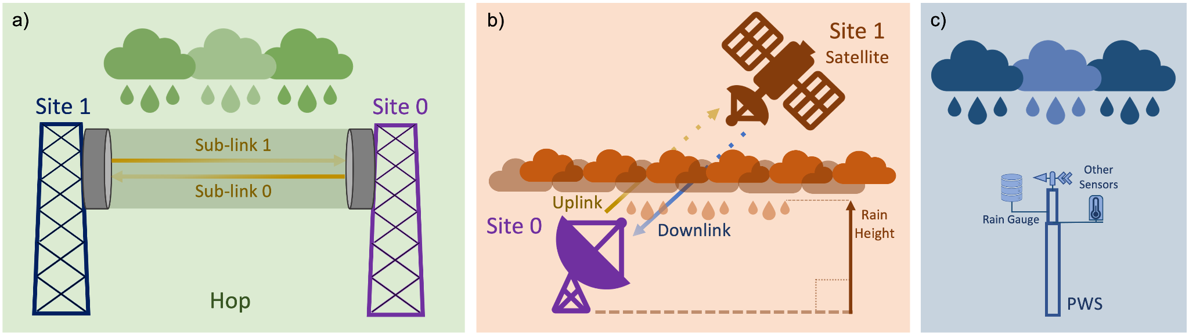
What is „Opportunistic Precipitation Sensing“?
To opportunistically (in a positive sense) use data from devices that were not meant to measure rainfall or which where not meant to provide high-quality rainfall data.
CML
Commercial microwave link
SML
Satellite microwave link
PWS
Personal
weather station

Slide 3
What are the goals of OpenSense?
Connect stakeholders
Hydrology & meteorology
Improve access to OS observations
Radio-wave propagation
Connect experts
Data owners
Researchers
End users
Improve reliability of OS observations
Signal processing
Use OS in operational setting
Telecommunication

Slide 4
The OpenSense working groups
WG 1
data
WG 4
involves stakeholders
WG 2
methods
WG 3
application
WG 5
capacity building

Slide 5
Some achievements of OpenSense

Slide 6
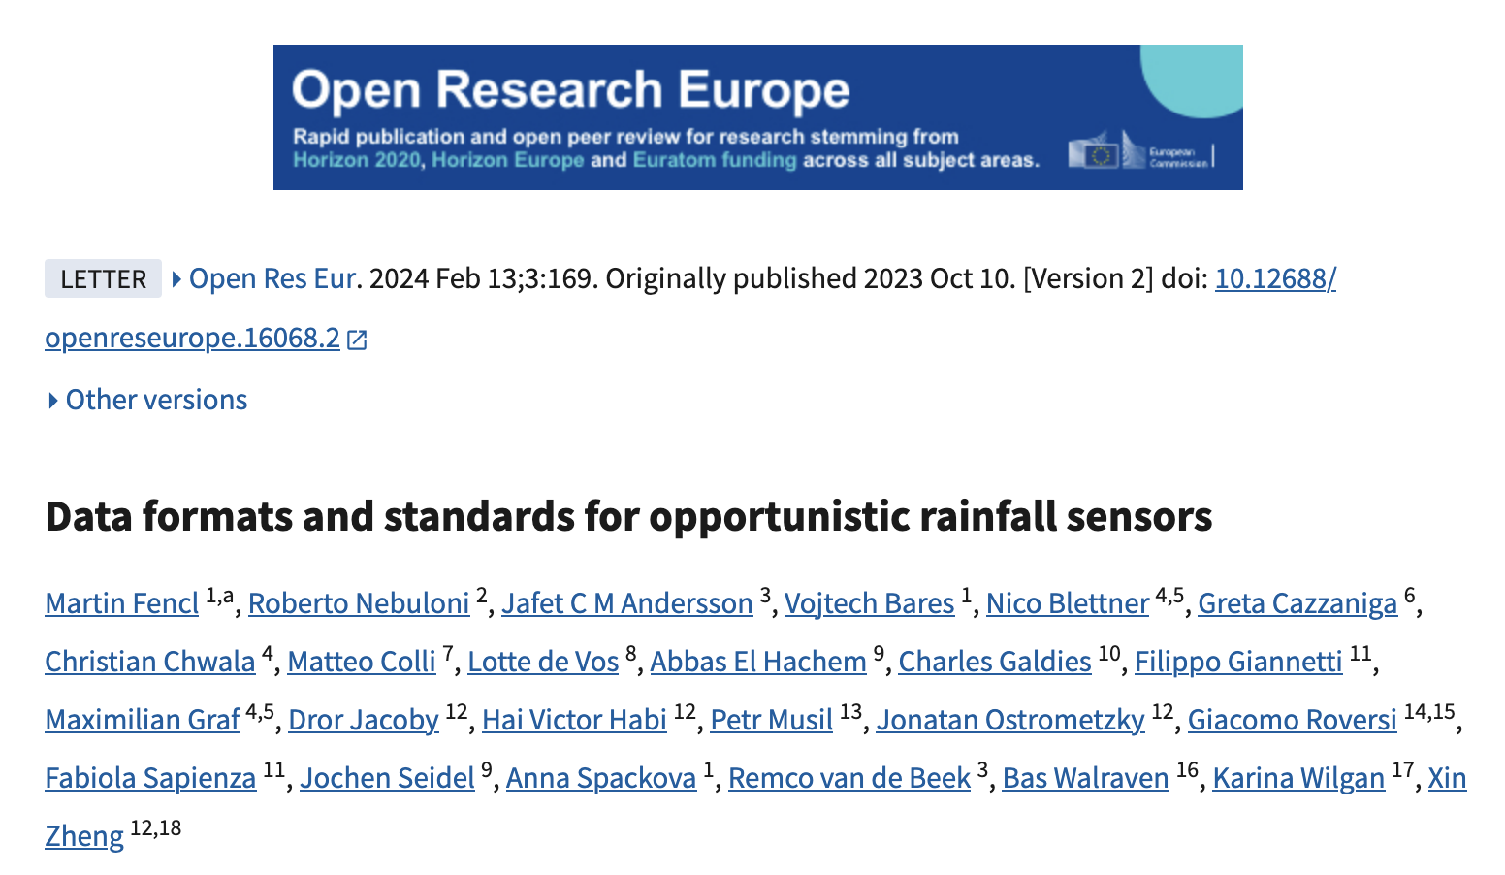
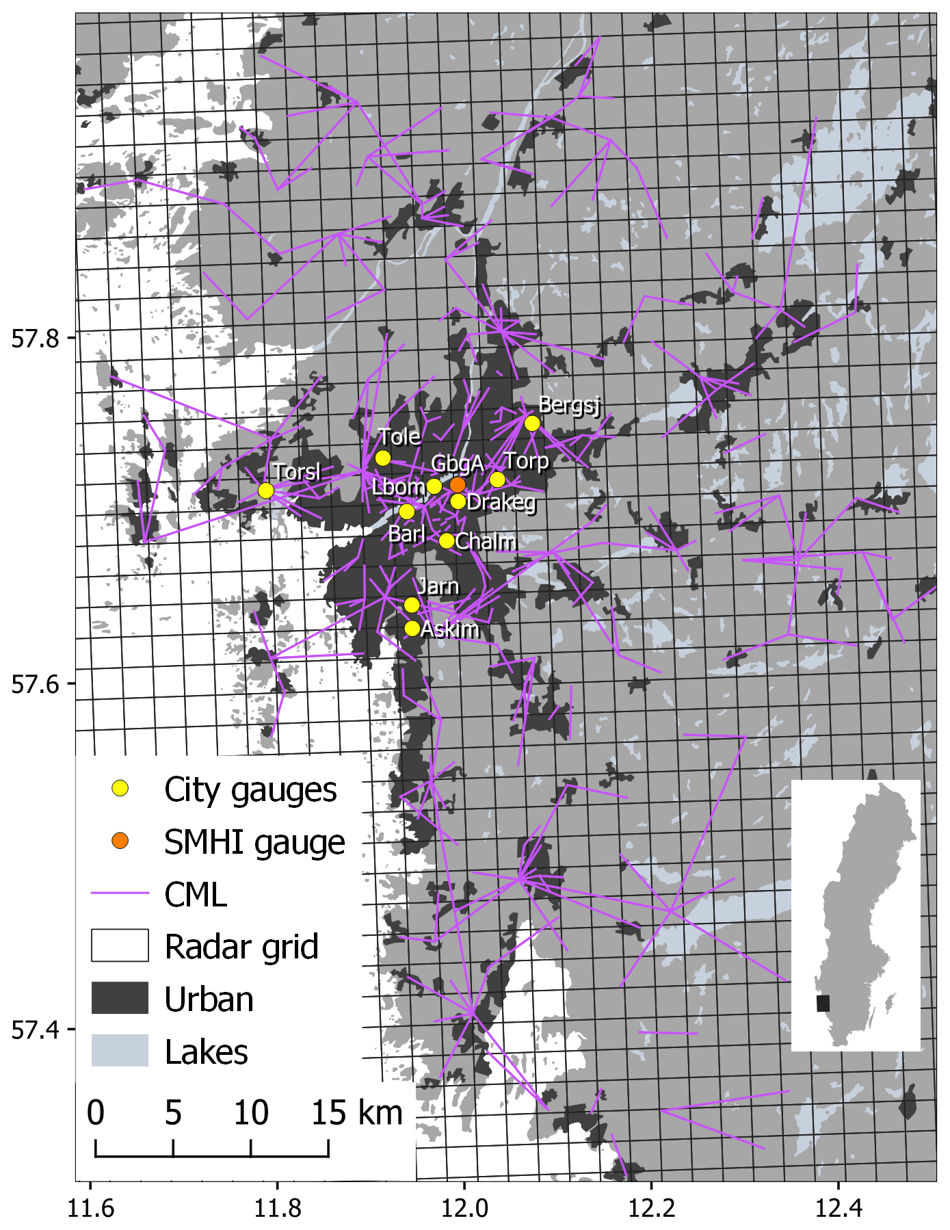
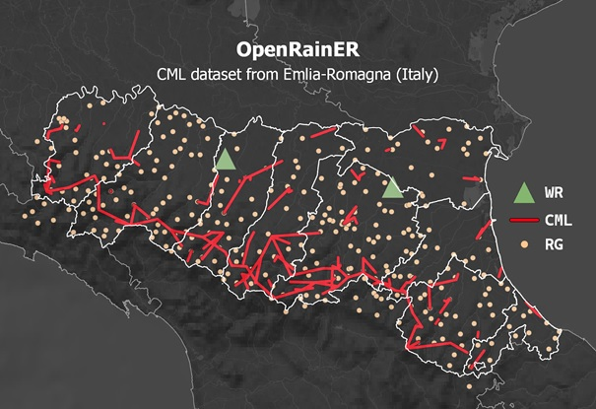
Working group “Data”
Defined a standard for data storage and naming conventions
Supported the publication of two open datasets with CML, gauge and radar data
OpenMRG (city of Gothenburg, Sweden) Andersson et al. (2022) https://doi.org/10.5194/essd-14-5411-2022
OpenRainER (Emilia-Romagna, Italy) Covi and Roversi (2024) https://doi.org/10.5281/zenodo.10593848

Slide 7
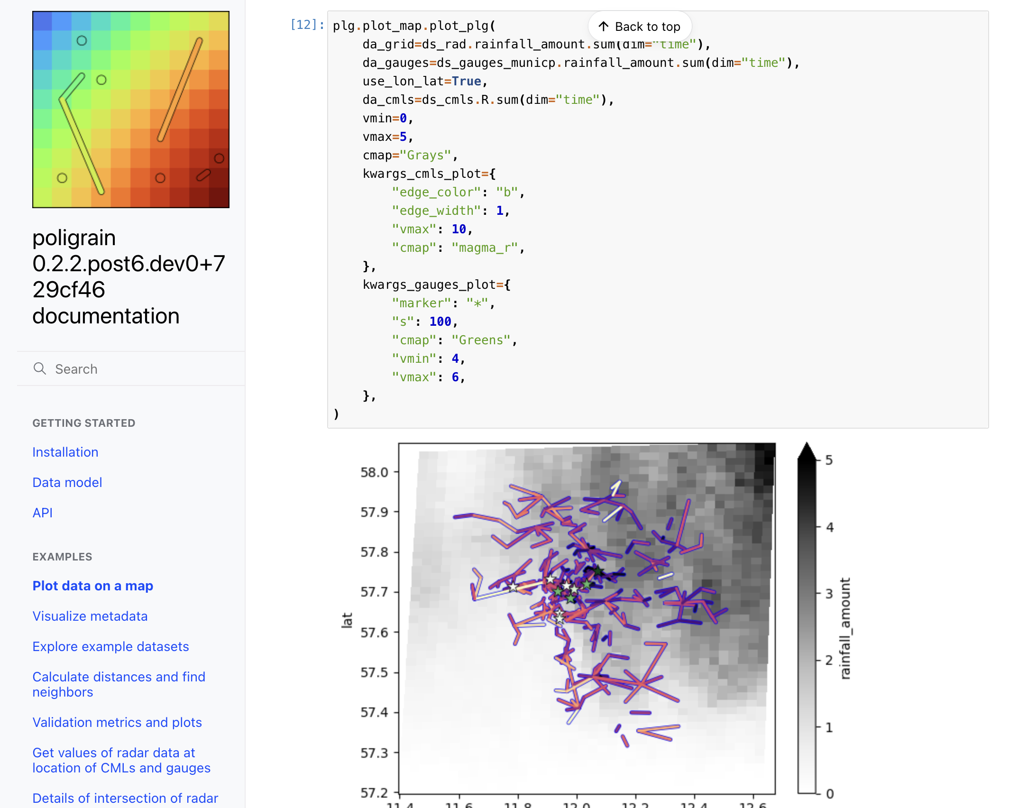
Working group “Software & Methods”
Review of existing implementations
Joint development of:
poligrain
Simplify common tasks for working with point, line and gridded rainfall sensor data
https://github.com/OpenSenseAction/poligrain
pycomlink
Processing methods for CML rainfall estimation
https://github.com/pycomlink/pycomlink
pypwsqc
Quality control methods for PWS data
https://github.com/OpenSenseAction/pypwsqc
mergeplg
Interpolation and merging of radar data with OS
https://github.com/OpenSenseAction

Slide 8
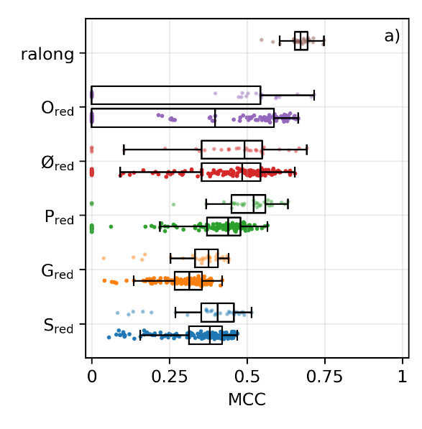
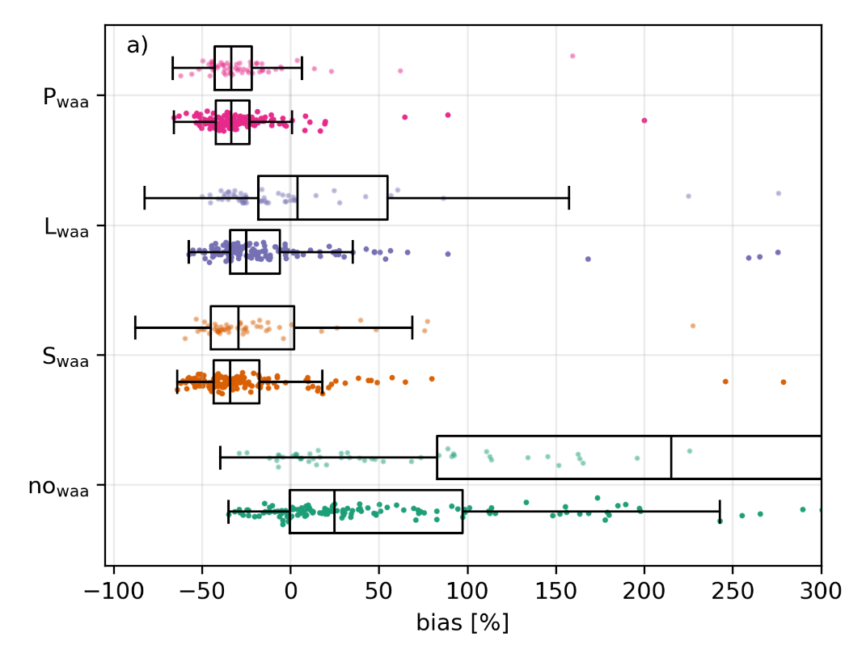
Working group “Software & Methods”
Intercomparison of CML processing methods
Comparison of rain event detection and wet antenna estimation methods
Using OpenMRG and OpenRainER dataset
Graf et al. (in preparation)
Performance of different rain event detection methods
Bias depending on wet antenna correction methods

Slide 9
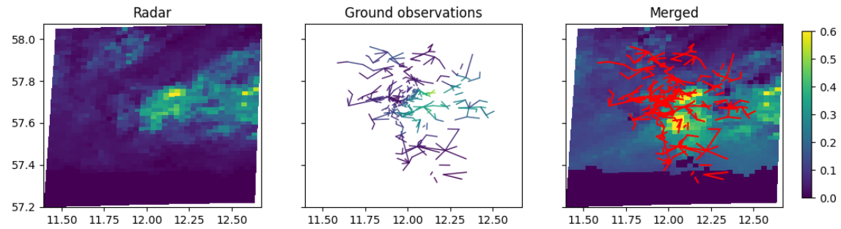
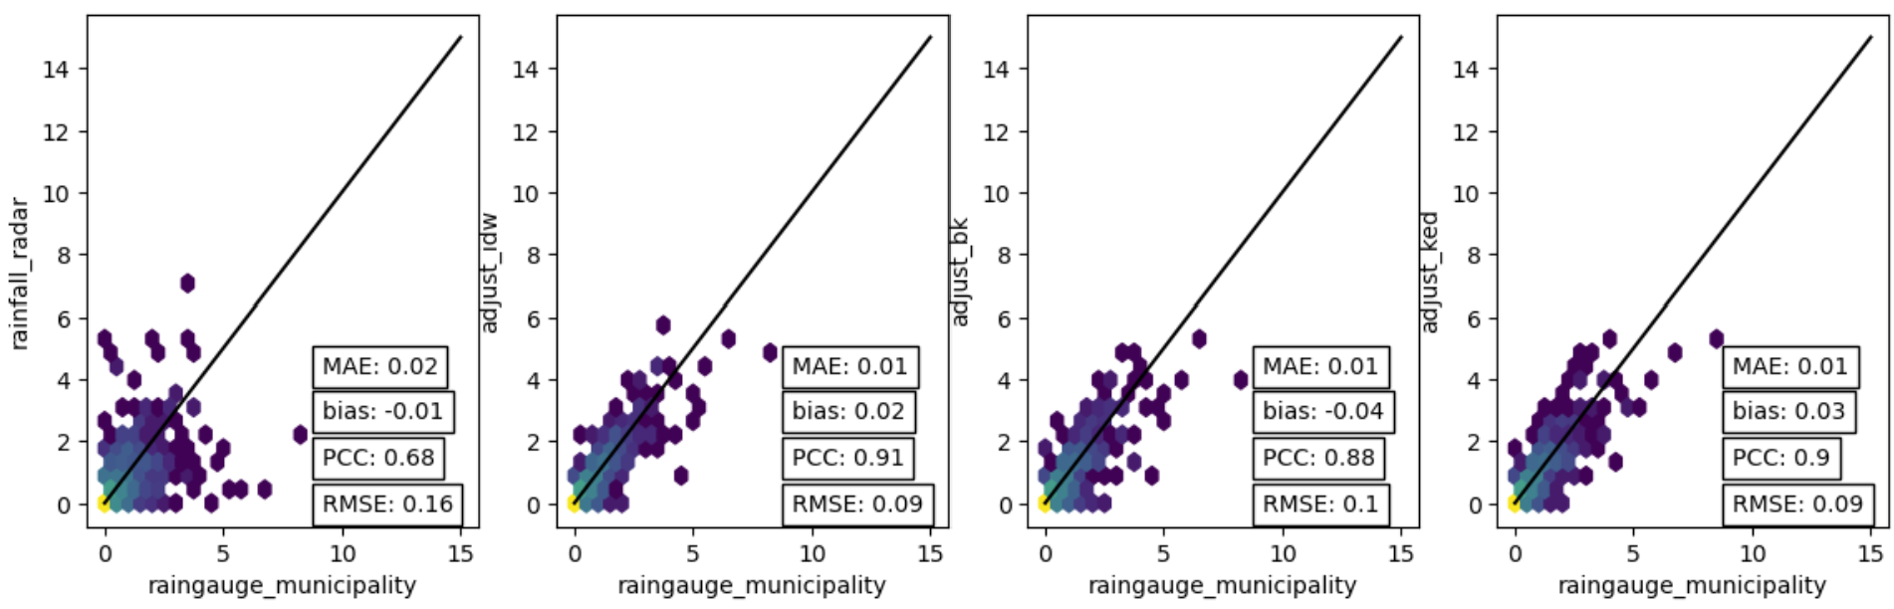
Working group “Merging and application”
Method intercomparison for radar-CML merging
Using two large open datasets
Fully reproducible
Comparing different methods:
Additive-IDW
Multiplicative-IDW
Block Kriging
KED
Unadjusted radar
Additive IDW
Block Kriging
KED

Slide 10
… now to the next days!

Slide 11
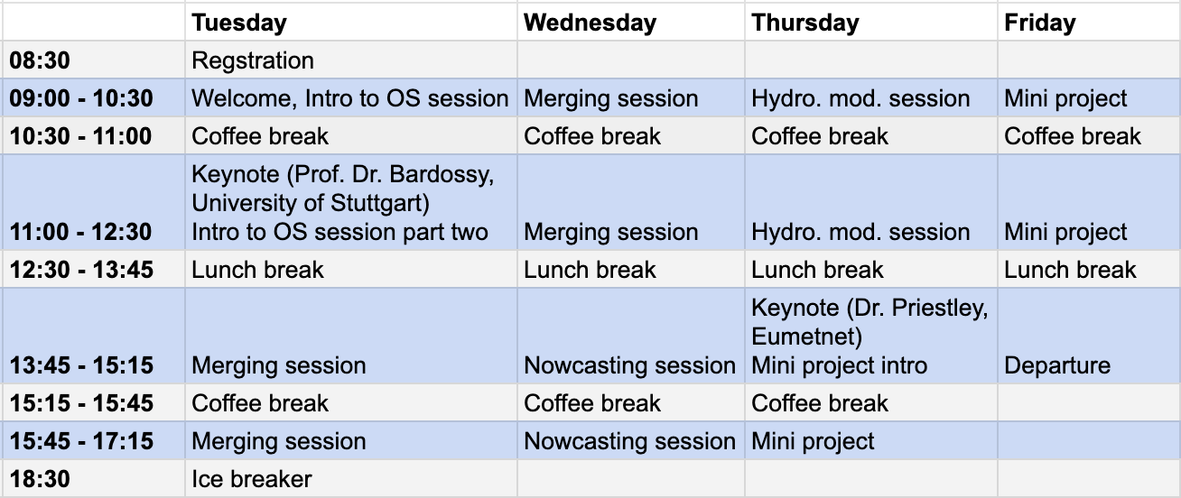
Agenda

Slide 12
Software cosmos in Training School (1)
poligrain
Simplify common tasks for working with point, line and gridded rainfall sensor data
https://github.com/OpenSenseAction/poligrain
pycomlink
Processing methods for CML rainfall estimation
https://github.com/pycomlink/pycomlink
pypwsqc
Quality control methods for PWS data
https://github.com/OpenSenseAction/pypwsqc
mergeplg
I nterpolation and merging of radar data with OS
https://github.com/OpenSenseAction
Intro session
plot data (poligrain)
process CML data (pycomlink)
QC PWS data (pypwsqc)
Merging session
interpolate and merge (adjust radar data) with OS data (mergeplg)
plot, analyze and go back to raw data (poligrain, pycomlink, pypwsqc)

Slide 13
Software cosmos in Training School (2)
Nowcasting session
Intro to the world of nowcasting
Optical flow and extrapolation with differnt (OS) input rainfall maps
Uses pysteps
Hydrological modelling session
Hydrological modelling for two small chatchment using a lumped HBV model
Using different (OS) input datasets
pysteps
mature package for nowcasting methods
https://pysteps.github.io/
HBV
Processing methods for CML rainfall estimation
https://en.wikipedia.org/wiki/HBV_hydrology_model
Literature:

Slide 14
Intro round
raise your hand if you feel addressed:
I am a trainer or organizer of this training school
I am a PhD student (or similar early career scientist)
I have worked with OS
I have a background or work in meteorology/atmospheric sciences (not hydrology)
I have a background or work in hydrology
I have a completely different background
Introduce yourself in one breath – as short or as long as you want (or can)
Notes:
last comment: we take pictures..

Slide 15
Add workshop material from github
Get training school content with: git clone https://github.com/OpenSenseAction/TrainingSchoolMergingApplication.git
Make sure you conda env is activate (conda activate opensense_training)
Navigate to repo (cd TrainingSchoolMergingApplication)
Branch for Day1 (git checkout –b day1)
Initialize submodules (git submodule update --init)
Start Jupyter lab (jupyter lab -–no-browser)

