Slide 1
Robust Kite Control
Flight path and winch control of kite power systems using optimal flight path planning
Uwe Fechner
This project has received funding from the European Union’s Horizon Europe programme under Grant Agreement No. 101084216

Slide 2
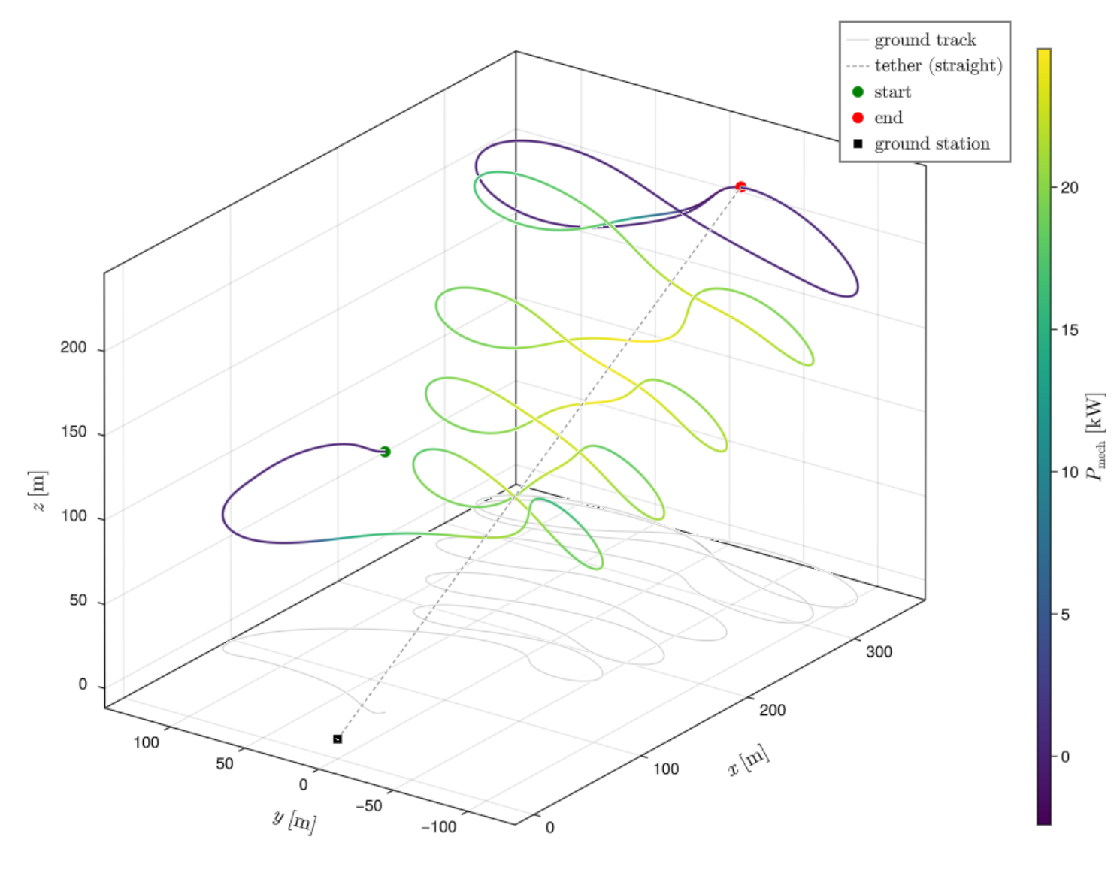
Overview
Goal: fly a soft kite on optimal figures of eight over a wide range of wind conditions, robustly and without re-tuning.
The path-following controller
The linearized model
Stability analysis
Results
Outlook and conclusion

Slide 3
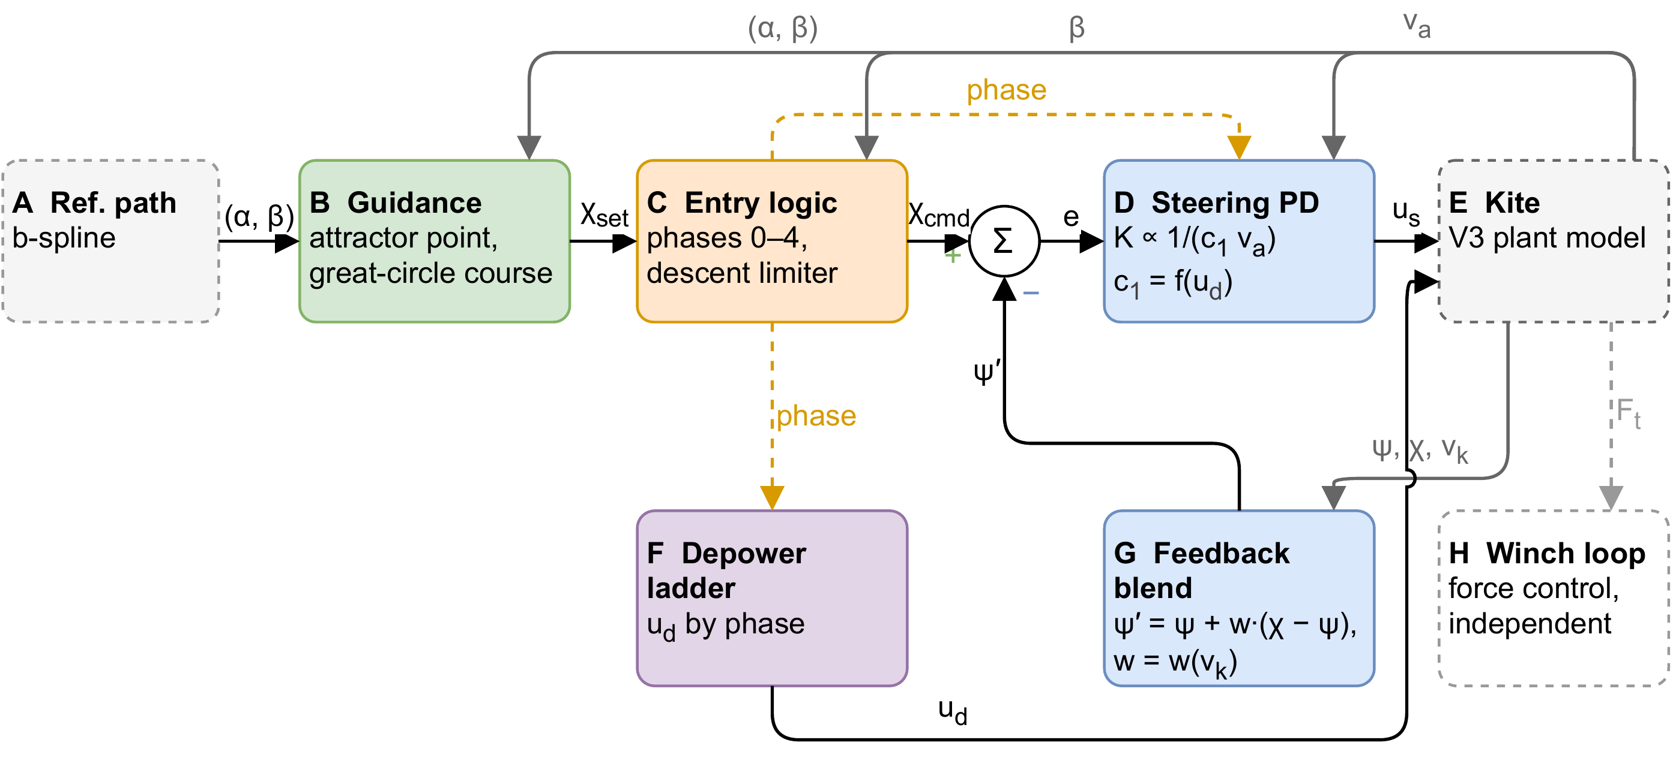
The path-following controller
Path planner: uses optimal control, one figure of eight per lap [1], every path checked by a harness
Guidance: attractor point 1.05 s of flight ahead on the path [2]
PD course controller, gain scheduled with 1/(c1 va)
Feed-forward of path curvature and gravity
Winch: vo = kv √F, as in the planner
[1] Optimal Reel-Out Trajectories for Soft Kites. O. Cayon, R. Schmehl, 2026
[2] L0 and L1 Guidance and Path-Following Control for AWE Systems. M. Fernandes et al., 2022

Slide 4
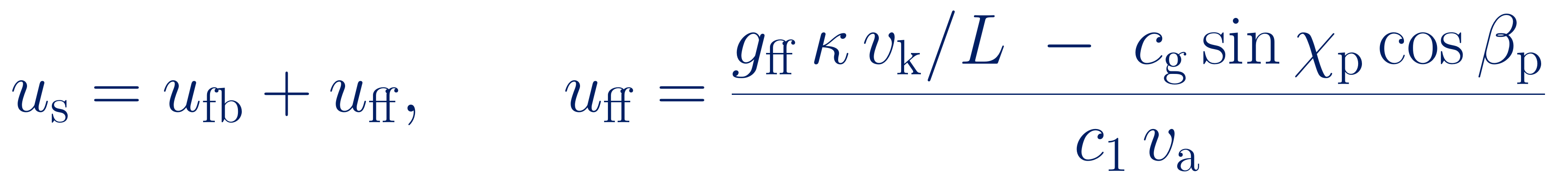
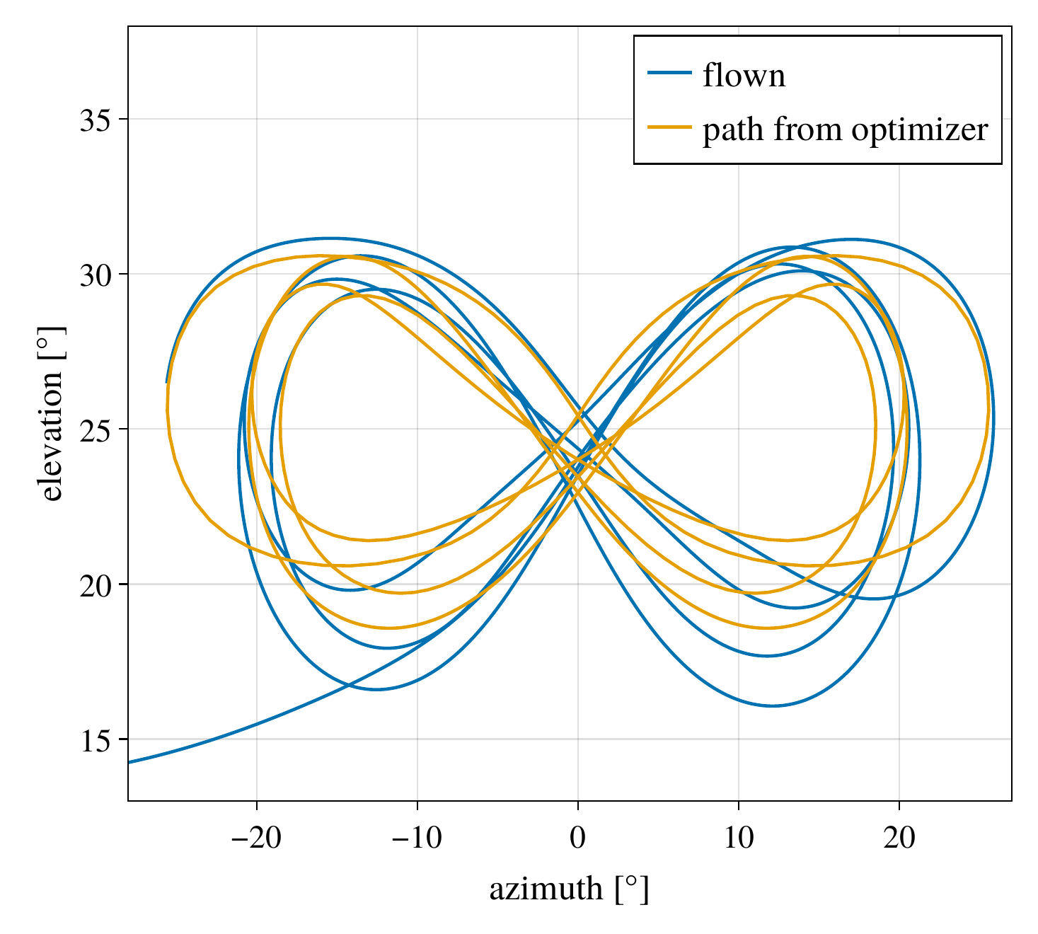
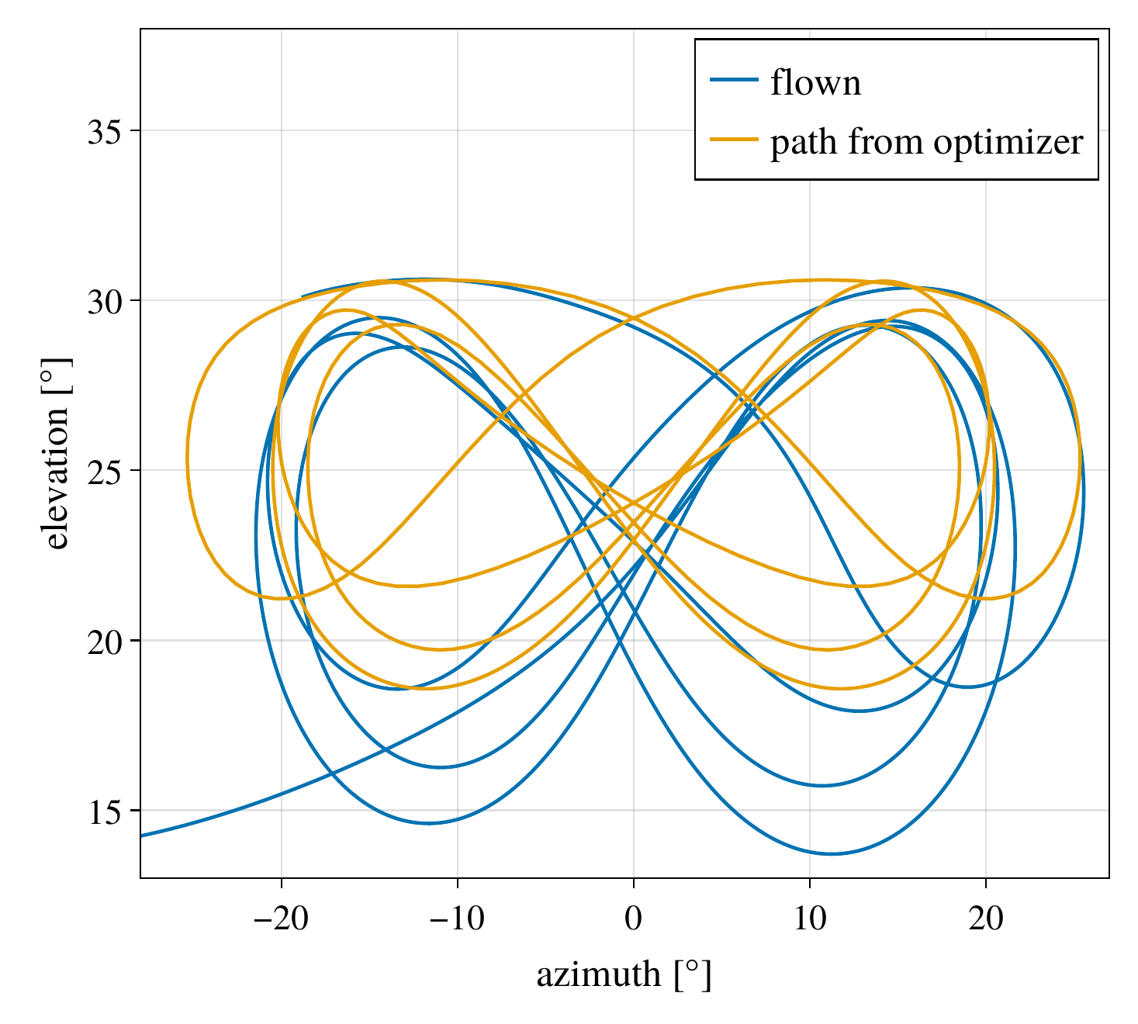
The path-following controller: feed-forward
Applies the known part of the turn before an error builds up
Curvature κ of the path read 0.35 s ahead, the steering delay
Gravity term removes the offset below the path
Outside the loop: stability margins unchanged
RMS path error 1.89° → 1.03°, lowest elevation 13.7° → 16.1°
with feed-forward
without feed-forward
Cabauw, wind speed 5.75 m/s at 6 m height

Slide 5
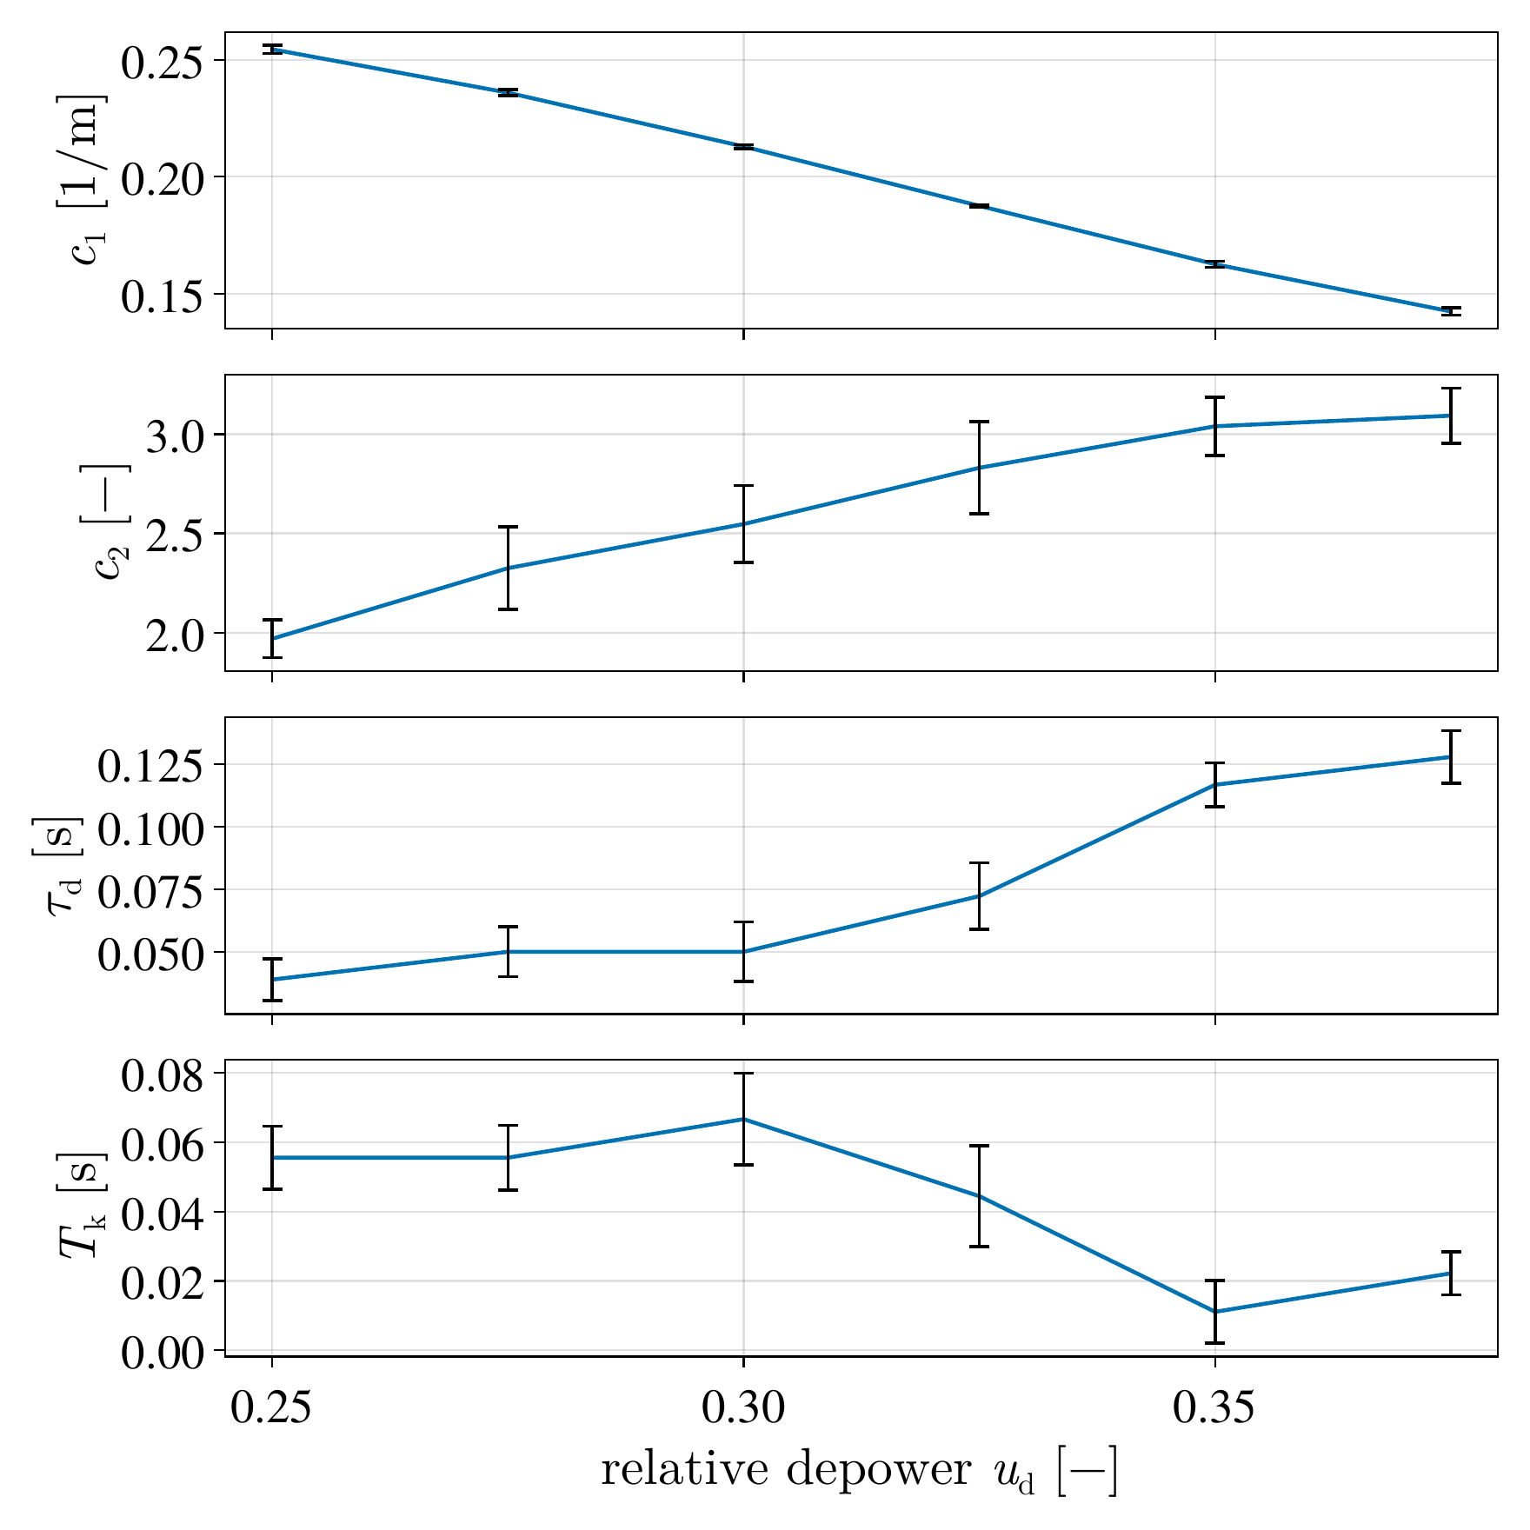
Linearized model: turn-rate law
c1: steering, c2: gravity, dead time τd and lag Tk
Identified with relay experiments on the aero-structural V3 kite model [1], flying low and crosswind
c1 falls from 0.255 to 0.142 rad/m between depower 0.25 and 0.375, compensated by the gain schedule
τd + Tk = 0.10 … 0.15 s; on the pattern a function of the apparent wind speed
[1] Coupled aerodynamic-structural simulation of a leading-edge inflatable kite: validating against flight test data. B. van de Lint and J. A. W. Poland, 2026

Slide 6
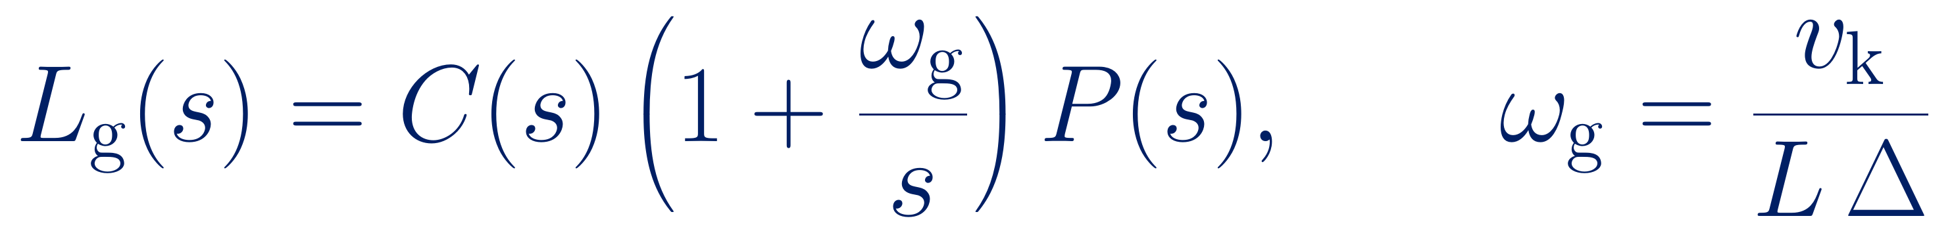
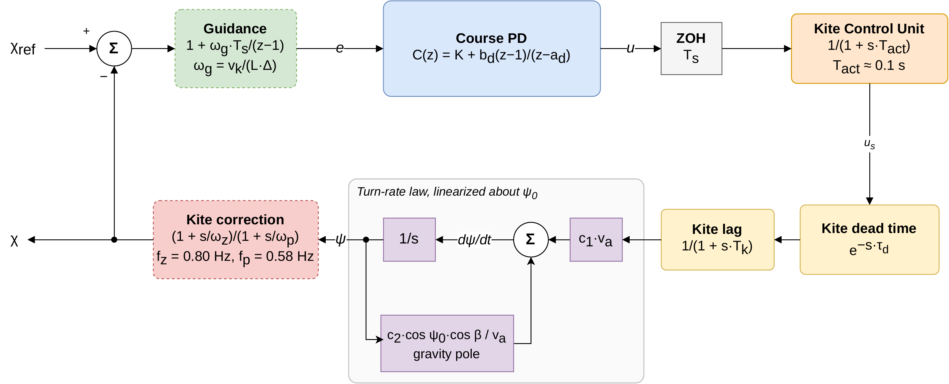
Linearized model: The guided course loop
The loop broken at the steering input. Elements: The discrete PD controller, actuator lag, kite with dead time, lag and gravity pole. The guidance acts like an integral path with the corner frequency ωg:

Slide 7
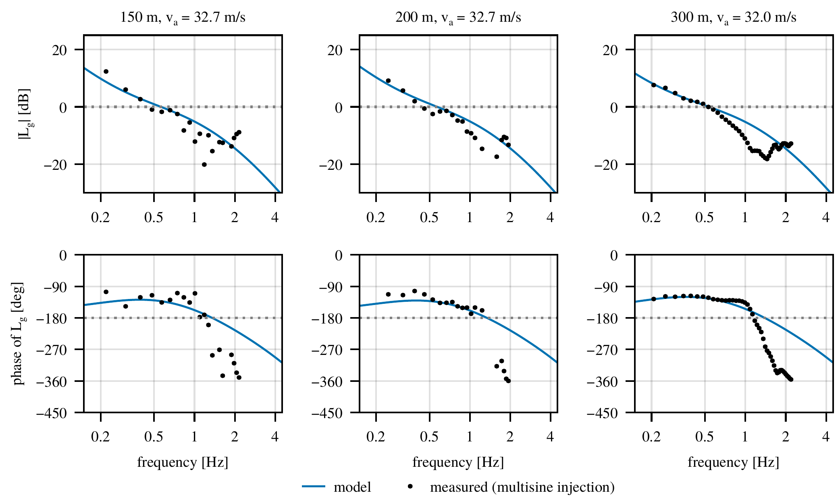
Linearized model: validation
Multisine injection into the steering command, figures of eight at 150, 200 and 300 m tether length
Up to 1.2 Hz (crossover and −180° crossing): gain within −12 … +5 dB, phase within −18 … +56°
The model is conservative: gain margin 2.7–2.9 against 5.6–7.1 measured

Slide 8
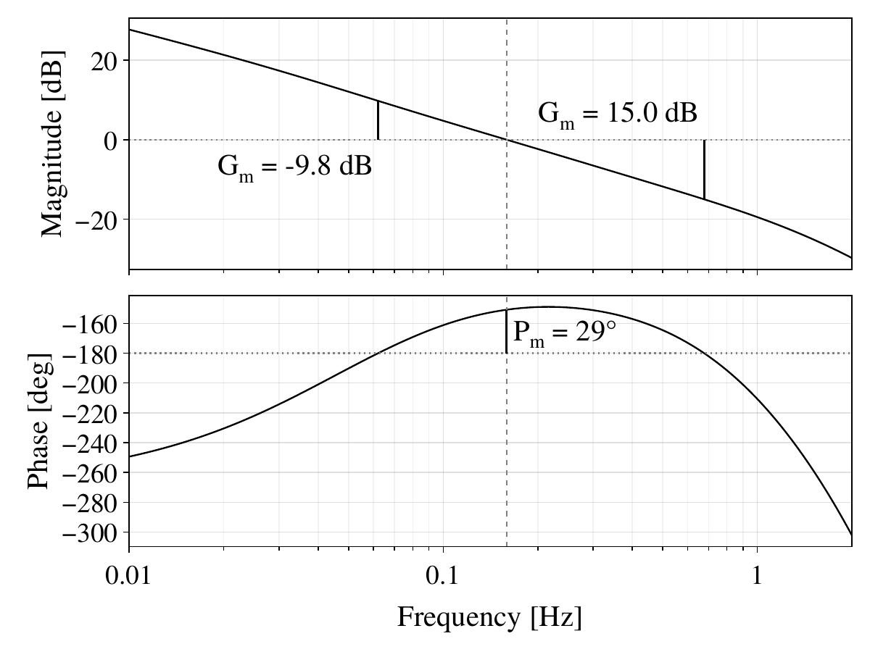
Stability analysis: worst case, Bode plot
Worst operating point of all 22 runs: Maasvlakte 3.5 m/s, L = 200 m, va = 8.7 m/s, ud = 0.29
Gain crossover at 0.16 Hz: phase margin 29°
Lower gain margin 0.33 (−9.8 dB): with less gain, gravity wins; its unstable pole (0.04 Hz) grows as va falls
Upper gain margin 5.6 (+15 dB): with more gain, dead time and lags make the steering oscillate at 0.68 Hz

Slide 9
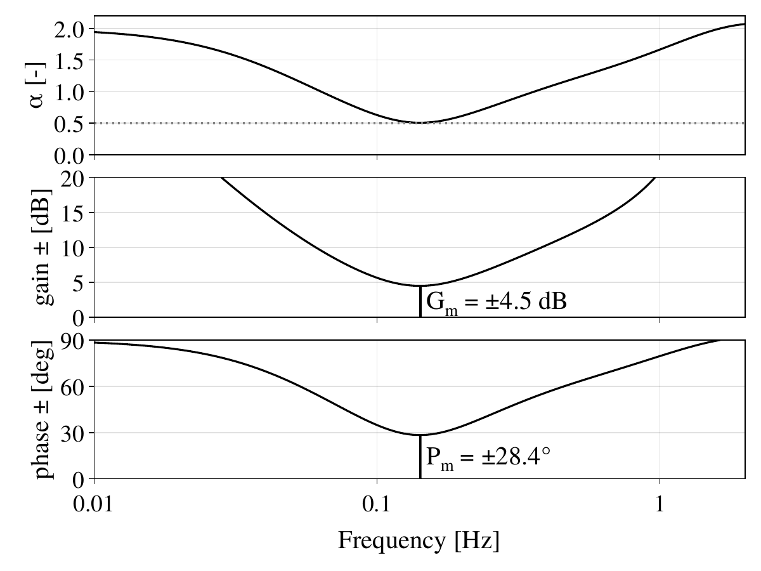
Stability analysis: worst case, disk margin
Disk margin [1] per frequency: minimum α = 0.51 at 0.14 Hz, near the gain crossover
There: gain ±4.5 dB (0.60 … 1.68) combined with phase ±28.4°
Stricter than the classical margins, which vary gain or phase alone
α > 1 outside 0.05 … 0.4 Hz
[1] An Introduction to Disk Margins. P. Seiler, A. Packard and P. Gahinet, IEEE Control Systems Magazine, 2020

Slide 10
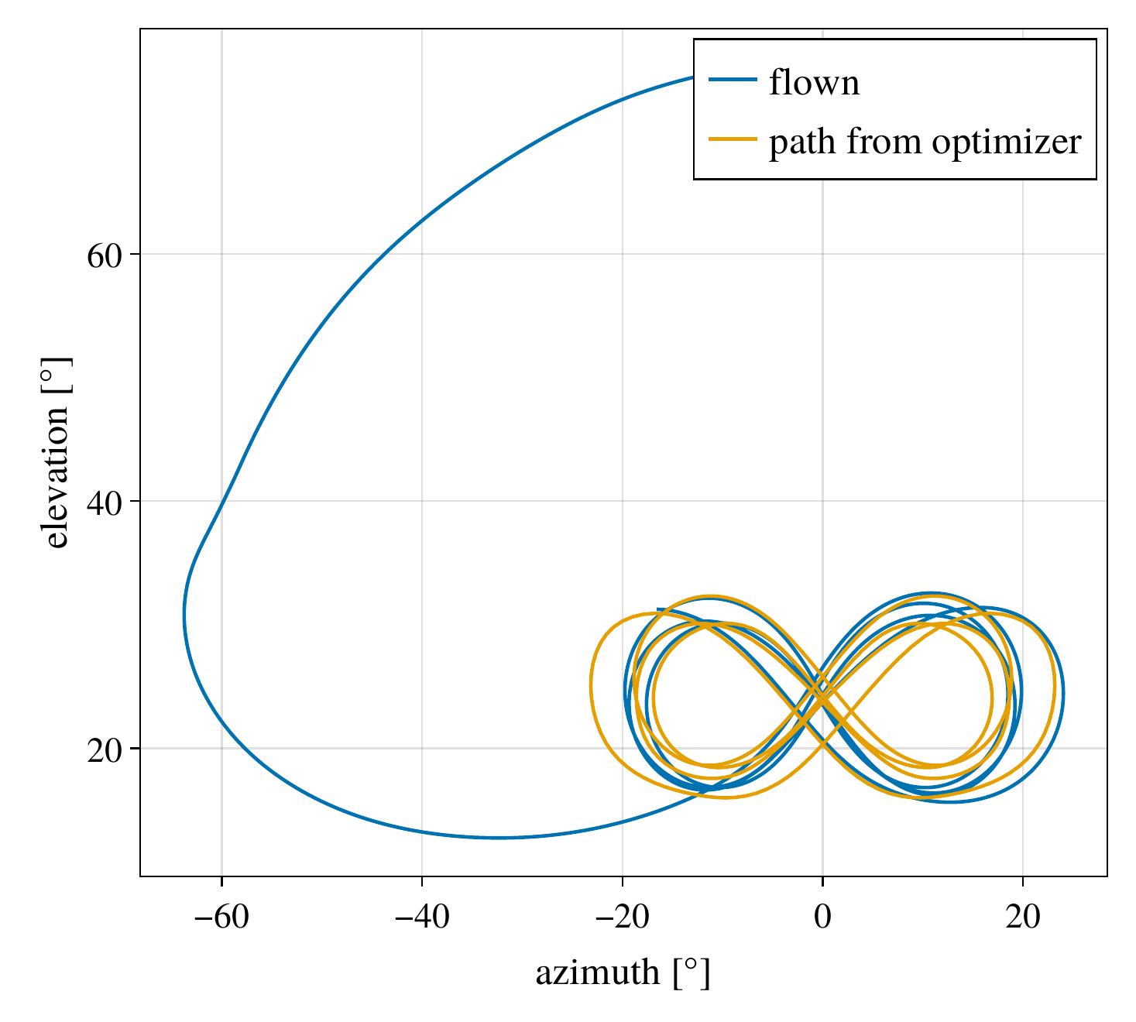
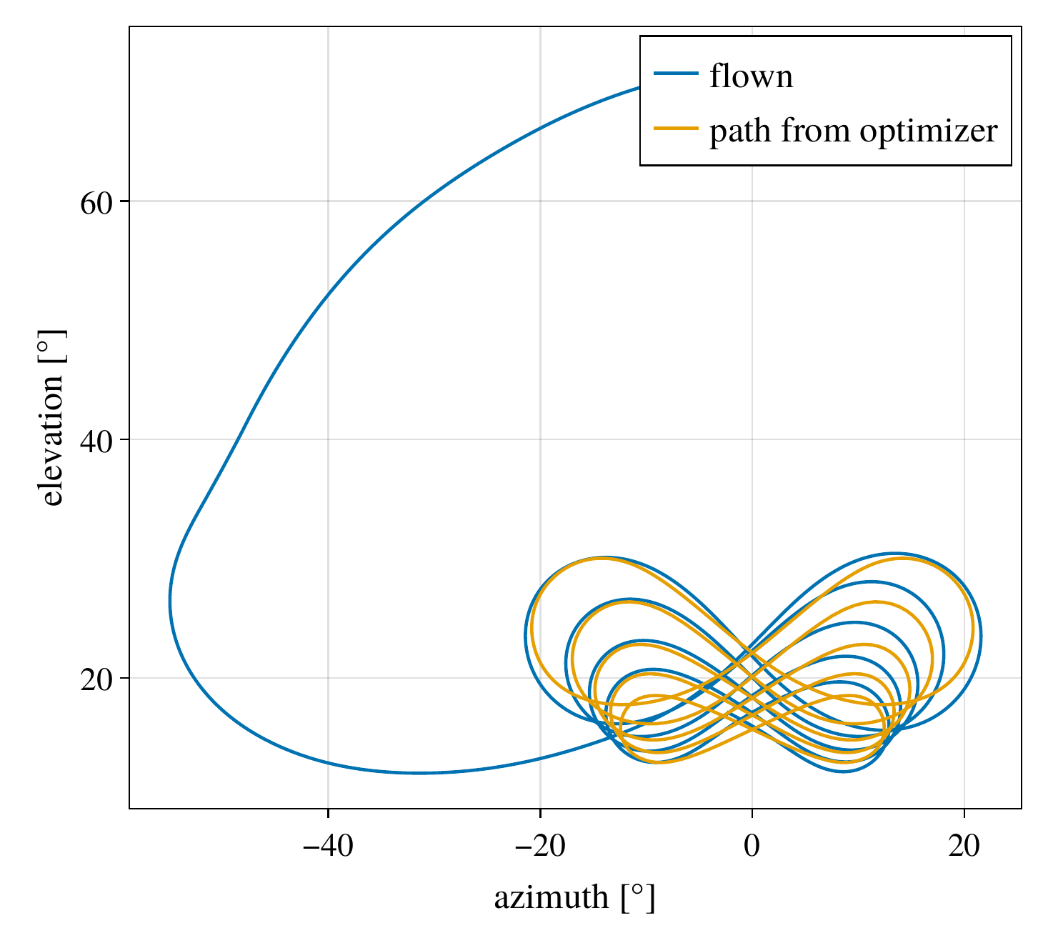
Results I: trajectories
22 reel-out runs: Maasvlakte (near shore, 3.5 … 11 m/s) and Cabauw (onshore, turbulent, 3 … 10 m/s)
No parameter re-tuned between runs
All runs pass 10 automated success criteria
RMS path error 0.6 … 1.4°
Power flown/planned: 0.95 … 1.05
All 22 runs robustly stable (α ≥ 0.5)
Cabauw, 7 m/s, 24.8 kW
Maasvlakte, 7 m/s, 12.0 kW

Slide 11
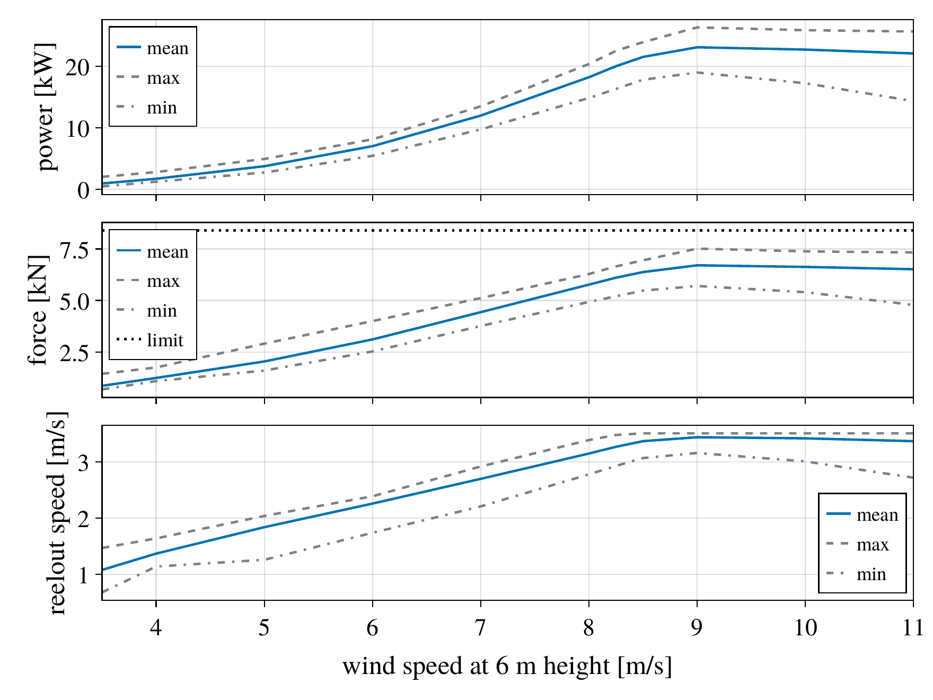
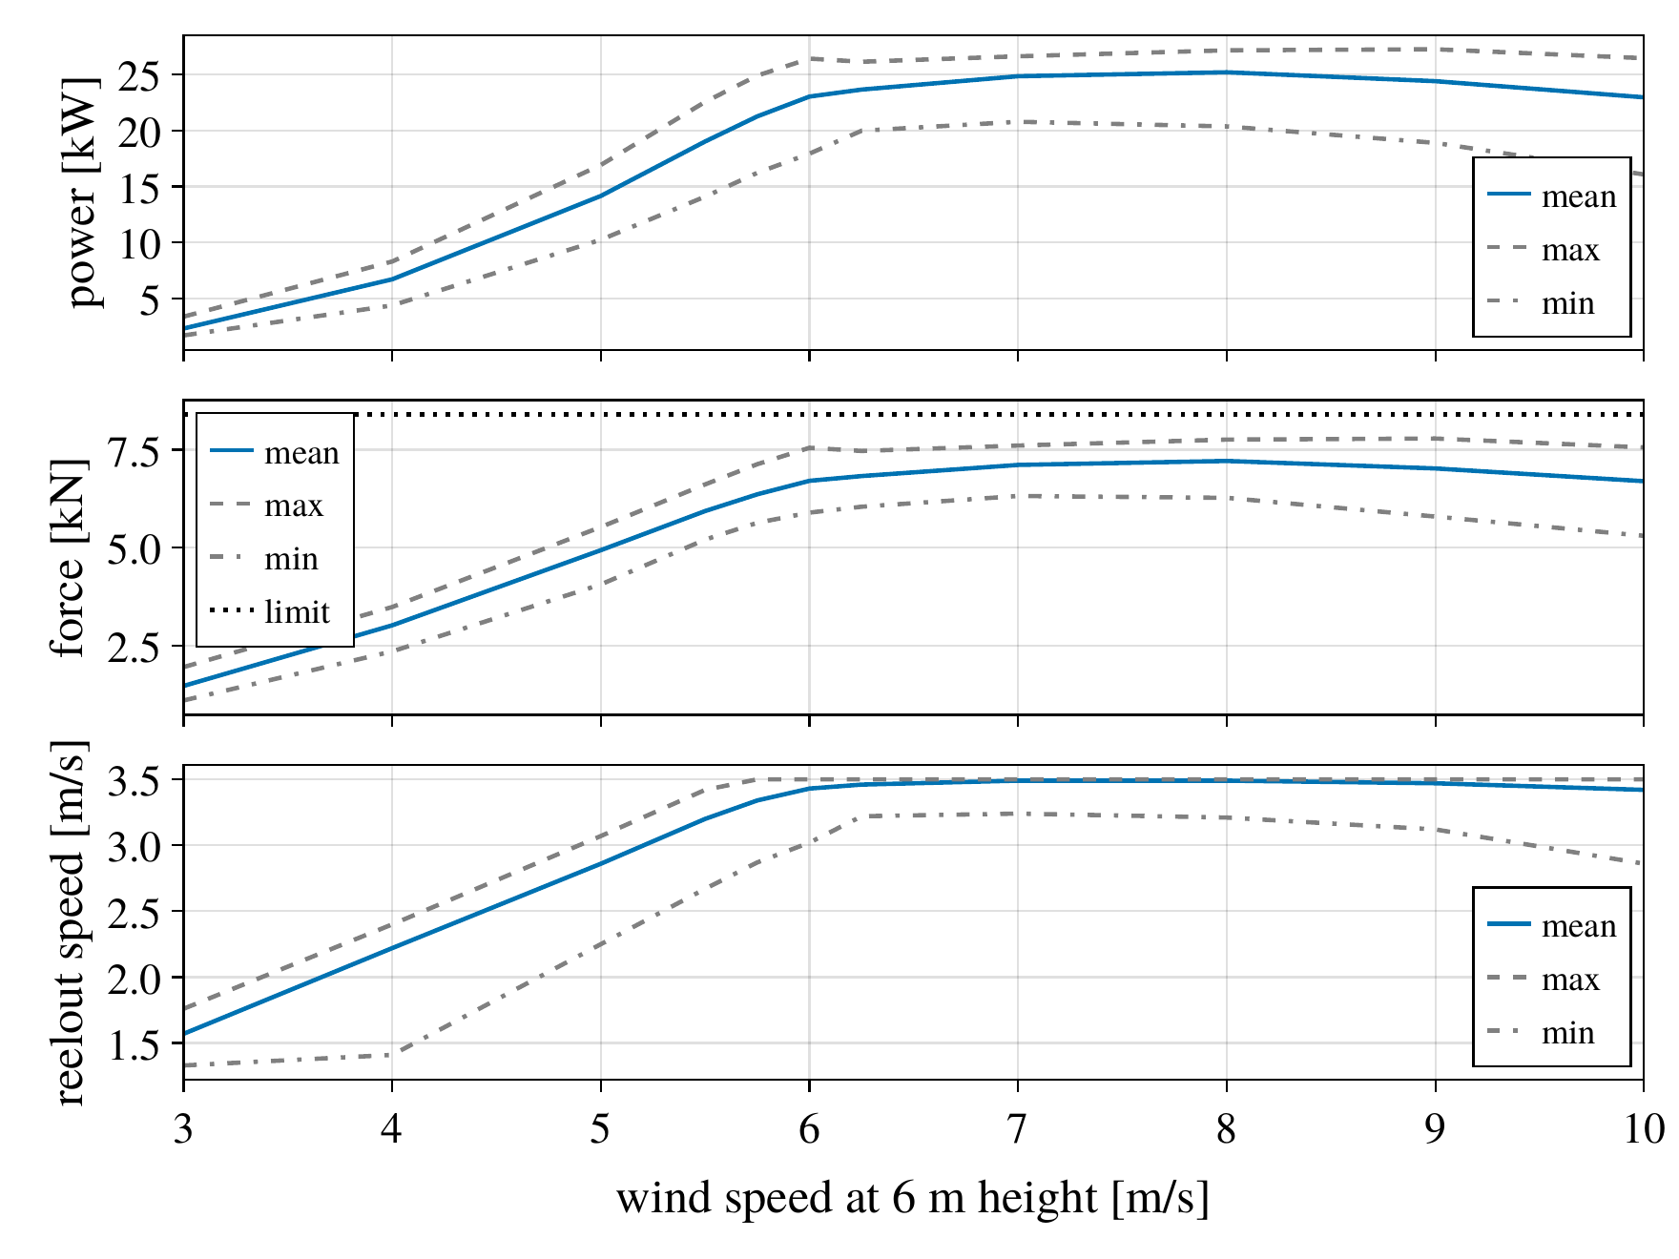
Results II: power
Nominal power of 20 kW reached at 8.25 m/s (Maasvlakte) and 5.75 m/s (Cabauw); tether force ≤ 8400 N and peak power ≤ 30 kW in all runs.
Maasvlakte, near shore
Cabauw, onshore

Slide 12
Outlook and conclusion
Conclusion
Optimal path planner with harness and path-following controller, flown on a validated aero-structural kite model
Feed-forward of curvature and gravity: smaller path error with lower feedback gains
Linear model of the guided course loop, validated by multisine injection, conservative
Robust stability in all 22 runs from 3 to 11 m/s, without re-tuning
Outlook
Real-time planning: pre-computed trajectories or parallel solves to avoid retries
Full pumping cycles, electrical machine model, launch and landing; wind veer
Code: github.com/OpenSourceAWE/SimpleKiteControllers.jl
Results: opensourceawe.github.io/SimulationResults

Slide 13
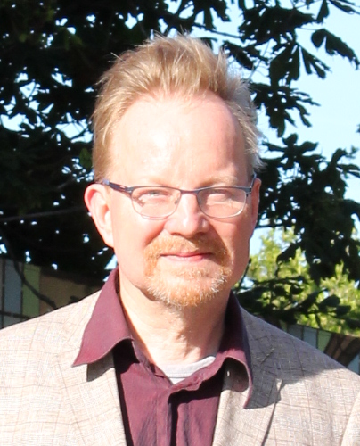
Questions?
Postdoctoral Researcher at Delft University of Technology
PhD from Delft University of Technology in 2016
”A Methodology for the Design of Kite-Power Control Systems”
Homepage:
https://www.tudelft.nl/staff/u.fechner.1/
Open source software:
https://github.com/OpenSourceAWE
Key publication:
Fechner, U., Vlugt, R. V. D., Schreuder, E. & Schmehl, R. (2015). Dynamic Model of a Pumping Kite Power System. Renewable Energy, 83, doi:10.1016/j.renene.2015.04.028
This project has received funding from the European Union’s Horizon Europe programme under Grant Agreement No. 101084216

