Slide 1
EtherCAT Communication
Confidential 1

Slide 2
Overview
Introduction
Features
State Machine
Master
Slave Structure
Distributed Clocks and Synchronization
EtherCAT Network Information File (ENI)
Resources
Confidential 2

Slide 3
Introduction
EtherCAT
Ethernet for Control Automation Technology
A real-time Ethernet based fieldbus
Developed by Beckhoff Automation
Full-duplex of 100 Mbit/s BASE-TX
Standard RJ45 connector

Slide 4
EtherCAT Features
Master/Slave communication model
Processing data “on the fly” for cyclic data
Mailbox communication for acyclic data
Synchronization – Distributed Clocks (DC)
Flexible topology
Protocols
CAN application protocol over EtherCAT (CoE)
File transfer over EtherCAT(FoE)
Servo drive profile over EtherCAT (SoE)

Slide 5
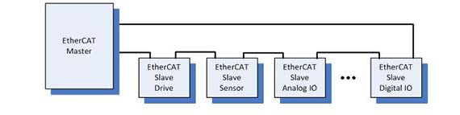
Master/Slave Communication Model

Slide 6
Processing Data “on the fly”
Process data is extracted and inserted on the fly
https://en.wikipedia.org/wiki/File:EthercatOperatingPrinciple.webm

Slide 7
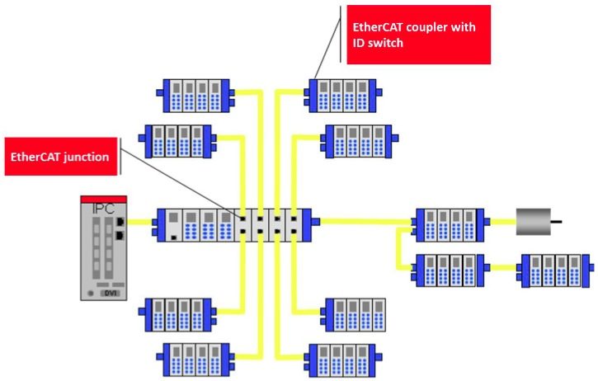
EtherCAT Network Topology
Star

Slide 8
EtherCAT State Machine
Init
Initial state after switching on
No mailbox and process data communication
Pre-Operational(Pre-OP)
Mailbox communication is possible
No process data communication
Safe-Operational(Safe-OP)
Mailbox and process data communication is possible
Only inputs are evaluated but outputs are in “safe” mode
Operational (OP)
Mailbox and process data communication is possible
Inputs and outputs are valid
Bootstrap
FoE

Slide 9
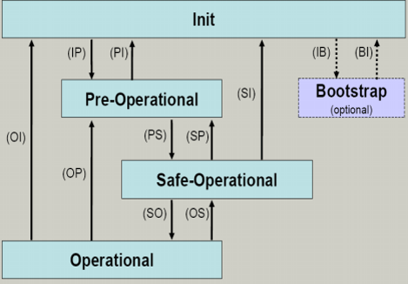
EtherCAT State Machine

Slide 10
EtherCAT Master
Software solution based by using either an on-board PC Ethernet controller or add-on network card
No special hardware is required
Two types
Class A – standard EtherCAT master device with full features
Class B – master device with limited features such as in embedded system with limited resources
Master Stack
Acontis master stack running under RTX
EtherCAT network information file (ENI)

Slide 11
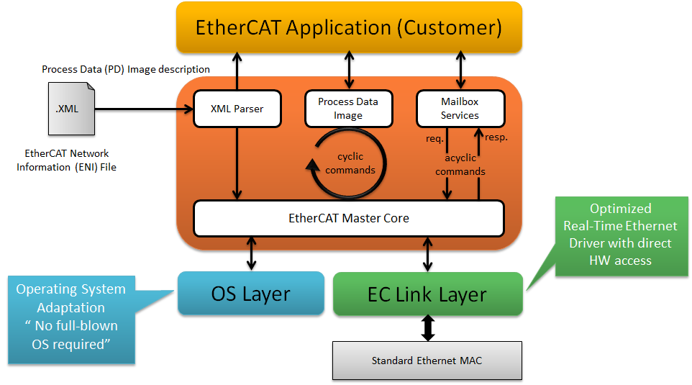
EtherCAT Master Architecture (Acontis)

Slide 12
EtherCAT Slave Structure
Each slave uses one EtherCAT slave controller (ESC) in the form of ASIC, FPGA or integrated in a standard microcontroller
EtherCAT slave information (ESI) file
Each slave type comes with one EtherCAT slave information (ESI) file provided by vendor
Contains the complete description of slave device network accessible properties
Used by network configuration tool to configure the slave device

Slide 13
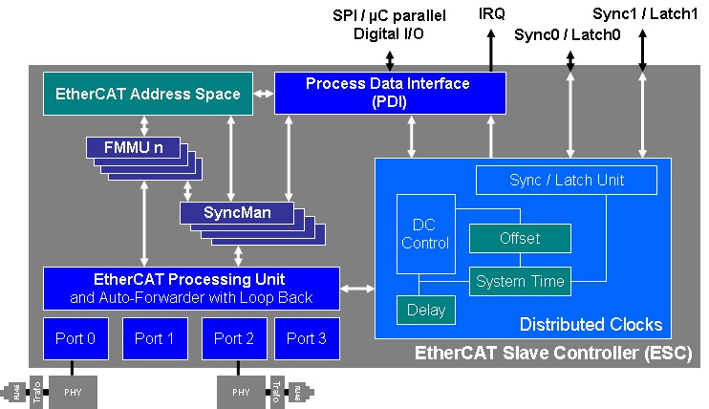
EtherCAT Slave Controller (ESC)

Slide 14
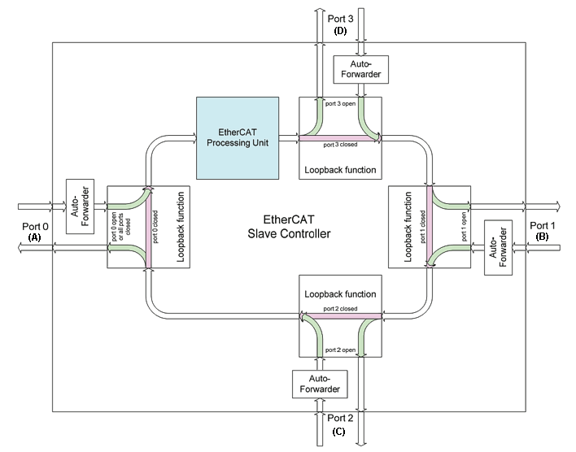
Frame Processing in the ESC

Slide 15
EtherCAT Slave Address
Auto-Increment Address
Each slave address is determined based on its physical position on the bus
Fixed Address
The address of each slave is set by master in the configuration file
Beckhoff hub device CU1128
Slave may have secondary address (station alias). The address can be set on slave via two rotary switches or software
Yaskawa SGDV.
Rexroth IndraDrive
The station alias address can be used to identify each slave

Slide 16
Distributed Clocks (DC)
Synchronization of EtherCAT slaves
System time can be selected either 32-bit or 64-bit
The first DC capable slave is selected as a reference clock
Master cyclically distributes the reference clock value to other slaves

Slide 17
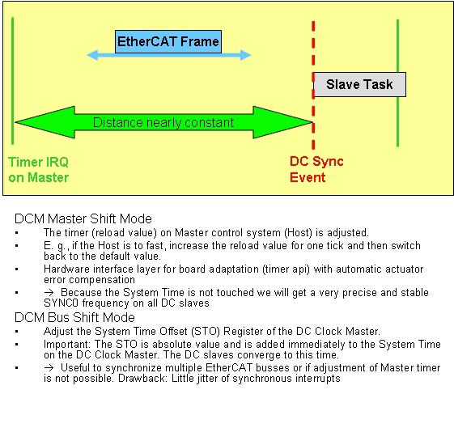
Master Synchronization

Slide 18
EtherCAT Network Configuration
EtherCAT Slave Information File (ESI)
Provided by vendor
EtherCAT Configuration Tool
The tool is used to generate EtherCAT network information file.
EtherCAT Configurator (ET9000)
TwinCAT
Winmax EniBuilder
EtherCAT Network Information File (ENI)
Describes network topology, initialization commands for each slave, PDO data mapping
Used by master
XML file based on a predefined file schema

Slide 19
WinMax EtherCAT Architecture
Win32
RTX
EniBuilder.exe
EcatFoeTool.rtss
EcatScanBus.rtss
WinMax RT
EtherCAT.lib
Acontis Master Stack
emllI8254x.rtdll
emllRTL8169.rtdll
Ethernet NIC (LAN1)

Slide 20
Resources
ETG
www.ethercat.org
UserName/Password: Hurco/h46268
Beckhoff
www.beckhoff.com
Acontis
www.acontis.com
Developer’s Corner
RT\EtherCAT Technology

