Slide 1
Lean Six Sigma Toolbox

Slide 2
Lean Six Sigma: Potential Tools For Each DMAIC Phase
Define | Measure | Analyze | Improve | Control
Project Charter Stakeholder Analysis QFD Kano Model SIPOC Process Map Gantt Chart | Process Capability Analysis Pareto Charts Histograms Scatter Plots Tests for Normality C&E Matrix | Cause & Effect Matrix FMEA (Failure Modes Effects Analysis) Hypothesis Testing Regression Analysis The Five Whys Fishbone Analysis | Force Field Analysis Brainstorming Affinity Diagram Solution Evaluation Matrix | Control Charts Control Plans Best Practice Transfers Audit Check Sheets

Slide 3
Define Phase

Slide 4
Define Phase
Expected Duration:
2-4 Weeks
Objectives:
Confirm that the project is viable
Define and confirm scope
Confirm sponsor and stakeholder support
Finalize team members
Begin to detail the problem, process, and project
Estimate benefits and costs
Deliverables:
Project Charter
Problem statement
Business impact estimate
Key metrics
Team members
VOC/Critical to Quality Tree
SIPOC
High-level Process Map
Project Management tools
Stakeholder Analysis
Communication Plan
Project Plan
Project Risk Assessment

Slide 5
Lean Six Sigma Project Charter
Project Title |  |  | Process |  | Process Owner
Problem Statement:
Start Date |  |  |  | Team Members/Role
Sponsor
Executive Sponsor
Project Lead
Finance Rep
Scope |  | IS: IS NOT:
Project Goals: Qualitative & Quantitative
Key Risks/Dependencies
Aligned with which Strategic Goal
Define: PROJECT CHARTER
Notes:
A project charter is the first step in the Six Sigma methodology. It takes place in the Define step of DMAIC (Define, Measure, Analyze, Improve, Control), and the charter can make or break a successful project. It can make it by specifying necessary resources and boundaries that will in turn ensure success; it can break it by reducing team focus, effectiveness and motivation.
Necessary Project Charter Areas
Project Title
It may not be evident at project inception, but you are going to complete the project and over time this project will hopefully serve as a best practice for other people within your business. It i’s important to name the project with a properly descriptive title that will allow others to quickly view and select your project based on the keywords and phrases. If you are increasing call center effectiveness, a possible title may be Call Center Cycle Time or Call Center Variation Reduction.
Black Belt/Green Belt
This is the person leading the process improvement project. It is important to identify the project leader so management knows who is leading the effort, and others can locate the leader for gathering further knowledge at a later date.
Mentor/Master Black Belt
It is important to identify a resource for the project leader to lean on if any project questions or issues arise (and they always do). Everyone needs a helping hand – a successful project ensures that when it’s needed, the helping hand has already been identified.
Project Start Date
No project can maintain momentum indefinitely. This field is mainly for documentation purposes. It is the date the project or project leader formally started working on the project.
Anticipated Project End Date
The anticipated project end date will probably be set by the mentor, master black belt or quality leader. The duration of the project will provide the leader and team adequate time to complete the project, given business conditions, work-load, holiday schedules, and such. Many businesses set general guidelines around how long projects should take.
Process Problem
Once we have a high level view of why the process is important to the business, we talk about how it is broken. For instance, there is no online data checking, customers can’t instantly open accounts which leads to frustration, redundant processes lead to human error, no validation of customer typed information leads to mis-shipments of collateral, etc.
Process Start/Stop Points
We cannot solve world hunger or boil the ocean (if anyone knows of any other sayings, please send them to me for inclusion), so how do we make sure we are biting off something we can chew 100 times before swallowing? Bound the project with a start and stop point: From the time a customer calls until the time the complaint is handled and customer is informed of the decision. Then, when the inevitable issue arises confusing the group’s mission, you can ask – ‘Does that action/issue occur between our process stop and start points?’ If the answer is no, table it and get the team focused on the task at hand.
Project Goals
What results do you anticipate from this project? Will cycle time be reduced 50 percent? Will defects be eliminated or at least reduced 90 percent? Will variable costs be identified and capped to a certain dollar figure per transaction? Set challenging but realistic goals.
Process Measurements
What are the measures that you’ll use to determine effectiveness of the project. Will it be $/item or cycle time in days, or call queue time in seconds? Specify all you think may be necessary, but make sure that they are within the scope (process start/stop points) of your project.
Team Members
List the following roles and who will be filling the roles: Sponsor Project leader Subject matter experts – it is sometimes a useful reference to list the subject matter in parentheses next to each name, especially if the team is cross functional and employees do not know each other.
Project Timeframe
We have already identified the project start and (estimated) stop points. What are the major milestones (e.g., presentations, phases of the Six Sigma methodology, etc.) between those dates? Mentors and MBBs are very helpful in creating this part of the charter because they’ve done projects and have an idea for how long each step requires.

Slide 6
Define: Stakeholder Analysis
Stakeholder | Level of Support (H, M, L) | Level of Influence (H, M, L) | Communication Requirements – What will they want to know? | Who will inform them? | How? How often?
Notes:
The Stakeholder Analysis is a chart which gauges the positioning of stakeholders relative to change and commitment to the goals of the team.
Objective:
Projects involve change and this often stirs emotions and encounters resistance. The higher the impact of the projected change the more important this tool becomes. The output of the Stakeholder Analysis is a representation of where the impacted people both inside and outside the system stand relative to change.
It is important that the team starts its journey with team members and stakeholders that minimize resistance to change.
This tool is commonly used in DFSS or DMAIC projects throughout the duration especially if it is a longer term project. It's objective is to detect and "out of control" position by a key team member and get it correctd by continually monitoring this behavioral pattern. Those that are not at the level of commitment or willingness to accept change need to be converted.
STEPS
1. List all stakeholder names on the team. Other stakeholders are the community, customers, stockholders, but are not included in this exercise.
2. Provide a number of 1-5 to indicate their CURRENT and DESIRED willingness to embrace change and make cultural commitment to advocate the change.
Note that not all members may need to be a 4 or 5, but since a major breakthrough, technical, or cultural change requires a team effort it is important to have the core team neutral or better before starting or proceeding to the next step.
1 = Strong Resistance2 = Resistance3 = Neutral4 = Willing To Change5 = Strong willingness to accept and embrace change
3. Document the roles and the relationships members that impact one another, boss, co-worker, material handler, operator, etc.
4. Develop a plan to get individuals to desired rating quickly. If the plan is not working the person may need to be replaced before proceeding.
The Stakeholder Analysis tool may be used at any time during any phase to gauge the member's positioning. Overuse might indicate a trust issue within the team.

Slide 7
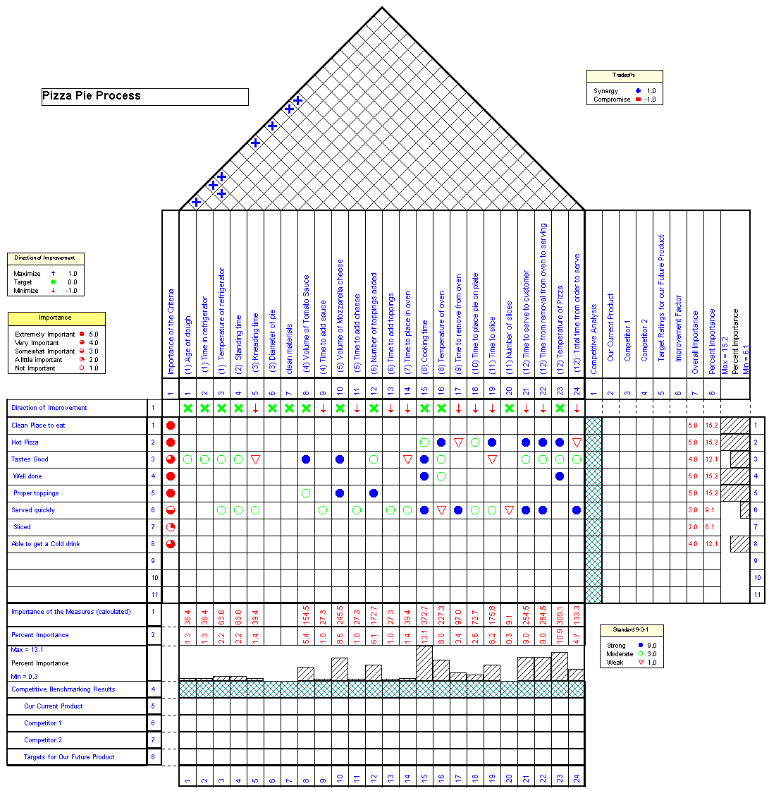
Define: QFD Matrix
Notes:
In Six Sigma DMAIC, Quality Function Deployment (QFD) is a methodology and tool used in the Define stage. QFD is used to:
1-Collect customer’s requirements/desires as specified by the customers in their own words
2-Prioritize these desires
3-Translate them into engineering/process requirements
4-Establish targets to meet the requirements.
QFD is also termed as:
Voice of the Customer
House of Quality
Customer-Driven Engineering
Matrix Product Planning
QFD is a customer driven product or service planning process. It is a methodology for translating customer requirements into company requirements at each stage from Concept Definition (R&D) to Process Engineering and Production and into the marketplace. The QFD matrix is a tool to translate CCRs (Critical To Customers) into CTQs (Critical to Quality).
QFD collects the voice of the customer (VOC) in their own lingo and incorporates this VOC into the companies cross-functional team’s project management of the integrated development process. The QFD process establishes customer objectives and measures and records them on a series of matrices

Slide 8
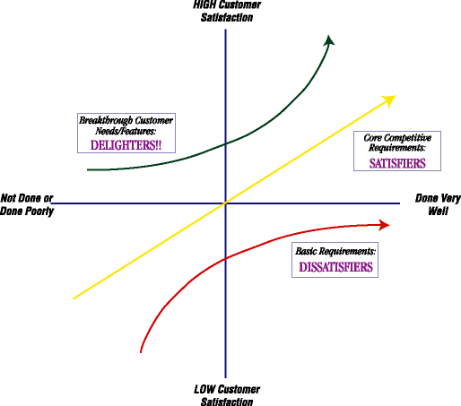
Define: KANO MODEL
Basic Needs | More the Better | Wow Factors
Implicit needs MUST be met for customer to engage | Performance requirements. Explicit AND have direct impact on customer satisfaction | Implicit, can be difficult to determine but will create positive customer experience
Notes:
The Kano model addresses the three types of requirements:
-Satisfying basic needs: Allows a company to get into the market.
-Satisfying performance needs: Allows a company to remain in the market.
-Satisfying excitement needs: Allows a company to excel, to be world class.
Dissatisfiers or Basic Needs - Expected features or characteristics of a product or service (legible forms, correctly spelled name, basic functionality). These needs are typically “unspoken.” If these needs are not fulfilled, the customer will be extremely dissatisfied. An example of an “unspoken” need when staying at a hotel is cleanliness. This includes a clean bathroom, clean linens and a pleasant, fresh aroma in the air. When a person books a reservation at a hotel, they do not request a clean room. They expect it. If this basic need is not met, they will be extremely dissatisfied.
Satisfiers or Performance Needs - Standard characteristics that increase or decrease satisfaction by their degree (cost/price, ease of use, speed). These needs are typically “spoken.” Using the hotel example again, “spoken” needs could be Internet access, a room away from the elevators, a non-smoking room, the corporate rate, etc.
Delighters or Excitement Needs - Unexpected features or characteristics that impress customers and earn the company “extra credit.” These needs also are typically “unspoken.” Think of the Doubletree Hotels. Those who stay there are delighted by a freshly baked, chocolate chip cookie delivered to their room during turn-down service.

Slide 9
Define: SIPOC
Process Definition
Process Name: |  |  | Process Owner:
Process Starts With: |  |  | Process Ends With:
S | I | P |  | O | C
Suppliers | Inputs | Process |  | Outputs | Customers
Notes:
A SIPOC diagram is a tool used by a team to identify all relevant elements of a process improvement project before work begins. It helps define a complex project that may not be well scoped, and is typically employed at the Measure phase of the Six Sigma DMAIC (Define, Measure, Analyze, Improve, Control) methodology. It is similar and related to process mapping and ‘in/out of scope’ tools, but provides additional detail.
The tool name prompts the team to consider the suppliers (the ‘s’ in SIPOC) of your process, the inputs (the ‘i’) to the process, the process (the ‘p’) your team is improving, the outputs (the ‘o’) of the process, and the customers (the ‘c’) that receive the process outputs. In some cases, requirements of the customers can be appended to the end of the SIPOC for further detail.
The SIPOC tool is particularly useful when it is not clear:
-Who supplies inputs to the process?
-What specifications are placed on the inputs?
-Who are the true customers of the process?
-What are the requirements of the customers?

Slide 10
DEFINE/Measure: Critical to Quality (CTQ) Tree
Customer Need Drivers CTQ (Metrics)
Notes:
CTQs are the internal critical quality parameters that relate to the wants and needs of the customer. They are not the same as CTCs (Critical to Customer), and the two are often confused.
CTCs are what is important to the customer; CTQs are what’s important to the quality of the process or service to ensure the things that are important to the customer.
A quality function deployment (QFD) or CTQ tree relates the CTQs to the CTCs.

Slide 11
Define/Measure: Example Process Map
Notes:
A Process Map is detailed flow diagram of the process using color coded symbols that drill further into the high level map generated on the SIPOC.
The purpose is to visually represent the process as it really is. Complete the current state map by walking and experiencing the process. This is a valuable learning experience and you will quickly gain insight about the actual flow. Don’t sit in a room and think it through yourself or with the team. Patience, time, asking questions are all part of the completing this map.

Slide 12
Define: Gantt Chart
Schedule of Activities | Month 1 | Month 2 | Month 3 | Month 4 | Month 5 | Month 6
Define
Measure
Analyze
Improve
Control
Notes:
A Gantt chart is used for planning and scheduling the steps of projects. It is a horizontal bar chart that serves as a visual tool for project management. It illustrates dependent steps and where the project is at any given time.
It is a form of Visual Management that people can quickly see and understand the start and finish dates of the terminal elements and summary elements of a project. A Gantt chart allows you to estimate project duration, sequence of events, coordination, and resource allocation.
The chart was developed by Henry Laurence Gantt, born in 1861. He began his career as a mechanical engineer later becoming a management consultant and social scientist. Gantt charts were likely used in the late 1800's but it was around 1917 that Gantt first applied his chart. The Gantt chart was used to manage projects like the Hoover Dam and the interstate highway system. The chart focuses on the the timing of the project and serve more effectively as a scheduling tool than a cost management or scope management tool.
It is a not as complex (nor detailed) as the Critical Path Method (CPM) or the ProgramEvaluation and Review Technique (PERT) that was invented by the United States Navy. The advantage the PERT chart has over the Gantt chart is the illustration of task dependencies. The added detail can make the PERT chart more difficult to interpret, especially on complex projects. Often project management involves a comobination of the tacking methods described above, rarely is only one used especially on complex projects.

Slide 13
Measure Phase

Slide 14
Measure Phase
Expected Duration:
2-6 Weeks (depending on data availability)
Objectives:
Identify critical variables
Validate measurements and measurement system
Determine key output variables (Ys)
Determine key input variables (Xs)
Collect and display baseline data
Determine baseline process capability
Deliverables:
Detailed Process Map
Key metrics
Input/Process/Output Metrics
Operational definitions
Data collection plan
Measurement System Analysis
Baseline data display
Histograms
Run charts
Control charts
Pareto charts
Capability analysis

Slide 15
Measure: Capability Analysis
Notes:
In the Six Sigma quality methodology, process performance is reported to the organization as a sigma level. The higher the sigma level, the better the process is performing.
Another way to report process capability and process performance is through the statistical measurements of C_{p}, C_{pk}, P_{p}, and P_{pk}.
Definitions C_{p}= Process Capability. A simple and straightforward indicator of process capability. C_{pk}= Process Capability Index. Adjustment of C_{p} for the effect of non-centered distribution. P_{p}= Process Performance. A simple and straightforward indicator of process performance. P_{pk}= Process Performance Index. Adjustment of P_{p} for the effect of non-centered distribution.
Interpreting C_{p}, C_{pk} “C_{pk} is an index (a simple number) which measures how close a process is running to its specification limits, relative to the natural variability of the process. The larger the index, the less likely it is that any item will be outside the specs.”
“If you hunt our shoot targets with bow, darts, or gun try this analogy. If your shots are falling in the same spot forming a good group this is a high C_{p}, and when the sighting is adjusted so this tight group of shots is landing on the bullseye, you now have a high C_{pk}.”
“C_{pk} measures how close you are to your target and how consistent you are to around your average performance. A person may be performing with minimum variation, but he can be away from his target towards one of the specification limit, which indicates lower C_{pk}, whereas C_{p} will be high. On the other hand, a person may be on average exactly at the target, but the variation in performance is high (but still lower than the tolerance band (i.e., specification interval). In such case also C_{pk} will be lower, but C_{p} will be high. C_{pk} will be higher only when you r meeting the target consistently with minimum variation.”
“You must have a C_{pk} of 1.33 [4 sigma] or higher to satisfy most customers.”

Slide 16
Measure: Pareto Chart
Notes:
Pareto Charts show which factors contribute the most to a given problem. The power of Pareto Charts lies in the Pareto Principle, which states that a small number of factors will typically control a given outcome the most. Identifying and focusing on these critical factors will maximize results, oftentimes with far less effort than would be required if all factors were treated equally.
The following steps can be used to create a Pareto Chart.
1. Define the Problem Scope
Clearly state the problem or goal that the Pareto chart will address. Goal statements like, “Improve product quality in the Final Assembly area,” are too general and will not provide the focus needed for good data collection. Instead, focus on a specific metric like, “Reduce the final audit defect rate from 17,000 PPM to 9,000 PPM in Final Assembly.”
2. First Look for Existing Data
Oftentimes there is sufficient data already available to create a top-level Pareto Chart for the problem being addressed. In the case of our assembly defect rate example, the production floor will likely have historical data showing defect types and associated quantities for whatever time period is needed. Unless there is a specific timeframe of interest, retrieve historical data for at least one month, and preferably three months. Too short a timeframe (less than one month) may not show the complete picture of all causes, and too long a timeframe (more than three months) may dilute the current set of problems with past problems that have already been solved.
3. Plan for Data Collection if Needed
If sufficient data does not already exist, then a data collection plan must be implemented. Structuring the data collection effort with appropriate check-sheets or forms will go a long way toward a successful outcome.
4. Assemble Data Into Pareto Categories
A typical Pareto Chart will have ten or fewer problem categories, and data should be grouped to achieve something in this range. If there are too many categories then the chart will be difficult to read. Too few problem categories (typically less than five) are an indication that problem categories are not specific enough to create an “actionable” Pareto Chart.
5. Arrange the Pareto Categories in Descending Order, and Enter Into the Spreadsheet
Pareto data is usually organized by frequency of occurrence (number of defects over a given timeframe for a given defect type). Sort the groups in descending order, and you are ready to enter your data into the Excel spreadsheet.
Pareto Charts are simple but powerful tools for problem solving – give them a try and they will likely find a permanent place in your problem solving arsenal.

Slide 17
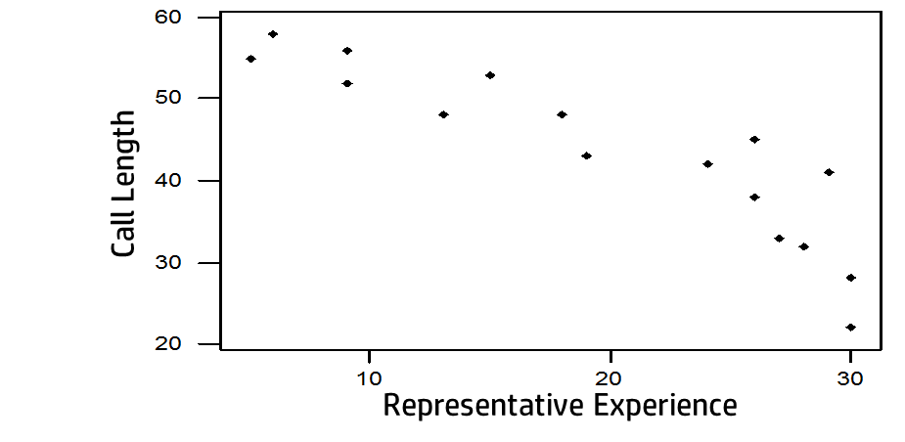
Measure: Scatter Plot
Notes:
A scatter plot, also called a scatter diagram or a scattergram, is a basic graphic tool that illustrates the relationship between two variables. The dots on the scatter plot represent data points. See the tool Scatter Plot.
Scatter plots are used with variable data to study possible relationships between two different variables. Even though a scatter plot depicts a relationship between variables, it does not indicate a cause and effect relationship. Use Scatter plots to determine what happens to one variable when another variable changes value. It is a tool used to visually determine whether a potential relationship exists between an input and an outcome.

Slide 18
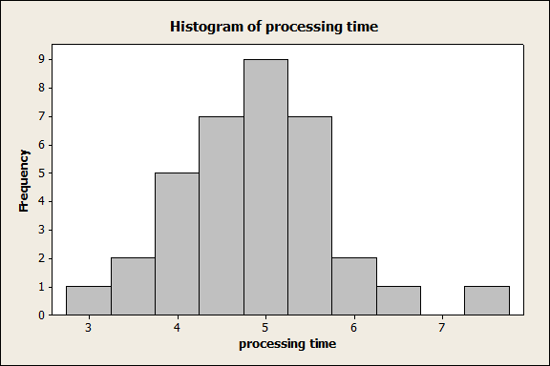
Measure: Histogram
Notes:
Histograms are graphs of a distribution of data designed to show centering, dispersion (spread), and shape (relative frequency) of the data. Histograms can provide a visual display of large amounts of data that are difficult to understand in a tabular, or spreadsheet form.

Slide 19
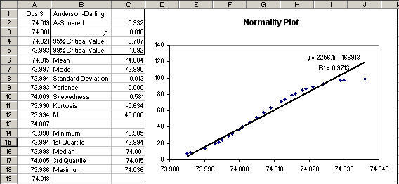
Measure: Test for Normality
Notes:
A normality test is a statistical process used to determine if a sample or any group of data fits a standard normal distribution. A normality test can be performed mathematically or graphically.

Slide 20
Measure: Data Collection Plan
Data Collection Plan
Measure | Operational Definition | How will Data be Collected? | Who will Collect the data? | When will Data be Collected? (frequency and for how long) | How much will be collected?
Notes:
A document that defines all the details concerning data collection, including how much and what type of data is required and when and how it should be collected.

Slide 21
Measure: Gage R & R
Sl. No | Transactions |  |  | Employee A |  |  |  | Match for Repeatability of Employee A | Employee B |  | Match for Repeatability of Employee B | Employee 3 |  | Match for Repeatability of Employee C |  | Match for Reproducibility
 |  | True value |  | Trial 1 |  | Trial 2 |  |  | Trial 1 | Trial 2 |  | Trial 1 | Trial 2
1 | 80630269588 | W/O error |  | Y |  | Y |  | 1 | Y | Y | 1 | Y | Y | 1 |  | 1
2 | 80630269591 | W/O error |  | Y |  | Y |  | 1 | Y | Y | 1 | Y | Y | 1 |  | 1
3 | 80630269596 | W/O error |  | Y |  | Y |  | 1 | Y | Y | 1 | Y | Y | 1 |  | 1
4 | 80630269640 | With error |  | Y |  | Y |  | 1 | N | Y | 0 | Y | Y | 1 |  | 0
5 | 80630269643 | W/O error |  | Y |  | Y |  | 1 | Y | Y | 1 | Y | Y | 1 |  | 1
6 | 80630269660 | With error |  | Y |  | Y |  | 1 | Y | Y | 1 | Y | Y | 1 |  | 1
7 | 80630289785 | With error |  | Y |  | Y |  | 1 | Y | Y | 1 | Y | Y | 1 |  | 1
8 | 80630289787 | With error |  | Y |  | Y |  | 1 | Y | Y | 1 | Y | Y | 1 |  | 1
9 | 80630289794 | W/O error |  | Y |  | Y |  | 1 | Y | Y | 1 | Y | Y | 1 |  | 1
10 | 80630417144 | With error |  | Y |  | Y |  | 1 | Y | Y | 1 | Y | Y | 1 |  | 1
11 | 80630417155 | W/O error |  | Y |  | Y |  | 1 | Y | Y | 1 | Y | Y | 1 |  | 1
12 | 80630417203 | With error |  | N |  | Y |  | 0 | Y | Y | 1 | Y | Y | 1 |  | 0
13 | 80630269563 | W/O error |  | Y |  | Y |  | 1 | Y | Y | 1 | Y | Y | 1 |  | 1
14 | 80630269580 | W/O error |  | Y |  | Y |  | 1 | Y | Y | 1 | Y | Y | 1 |  | 1
15 | 80630269586 | W/O error |  | Y |  | Y |  | 1 | Y | Y | 1 | Y | Y | 1 |  | 1
16 | 80630435761 | W/O error |  | Y |  | Y |  | 1 | Y | Y | 1 | N | N | 1 |  | 0
17 | 80630435792 | W/O error |  | Y |  | Y |  | 1 | Y | Y | 1 | Y | Y | 1 |  | 1
18 | 80630435850 | With error |  | Y |  | Y |  | 1 | Y | Y | 1 | Y | Y | 1 |  | 1
19 | 80630297728 | With error |  | Y |  | Y |  | 1 | Y | Y | 1 | Y | Y | 1 |  | 1
20 | 80630297729 | W/O error |  | Y |  | Y |  | 1 | Y | Y | 1 | Y | Y | 1 |  | 1
21 | 80630297752 | W/O error |  | Y |  | Y |  | 1 | Y | Y | 1 | Y | Y | 1 |  | 1
22 | 80630421271 | With error |  | Y |  | Y |  | 1 | Y | Y | 1 | Y | Y | 1 |  | 1
23 | 80630421281 | With error |  | Y |  | Y |  | 1 | Y | Y | 1 | Y | Y | 1 |  | 1
24 | 80630421294 | With error |  | Y |  | Y |  | 1 | Y | Y | 1 | Y | Y | 1 |  | 1
25 | 80630286600 | W/O error |  | Y |  | Y |  | 1 | Y | Y | 1 | Y | Y | 1 |  | 1
26 | 80630286610 | W/O error |  | Y |  | Y |  | 1 | Y | Y | 1 | Y | Y | 1 |  | 1
27 | 80630286639 | W/O error |  | Y |  | Y |  | 1 | Y | Y | 1 | Y | Y | 1 |  | 1
28 | 80630290656 | With error |  | Y |  | Y |  | 1 | Y | Y | 1 | Y | Y | 1 |  | 1
29 | 80630290659 | W/O error |  | Y |  | Y |  | 1 | Y | Y | 1 | Y | Y | 1 |  | 1
30 | 80630290690 | With error |  | Y |  | Y |  | 1 | Y | Y | 1 | Y | Y | 1 |  | 1
 |  |  |  |  |  |  |  | 29 |  |  | 29 |  |  | 30 |  | 27
 | Total No of agreement of A,B,and C = 29+29+30 = 88 |  |  |  |  |  |  |  | Total no of opportunities = 90 |  | Repeatability= |  | 98%
Y = Agreement to true value |  |  |  |  |  |  |  |  | Gage R&R is accepted as Reproducibility is 98% and Reproducibility is 90%
N = Disagreement to true value
Notes:
Gage R&R, which stands for gage repeatability and reproducibility, is a statistical tool that measures the amount of variation in the measurement system arising from the measurement device and the people taking the measurement.
When measuring the product of any process, there are two sources of variation: the variation of the process itself and the variation of the measurement system. The purpose of conducting the GR&R is to be able to distinguish the former from the latter, and to reduce the measurement system variation if it is excessive.
Typically, a gage R&R is performed prior to using it. We repeat the gage R&R anytime we have a new operator or inspector, it is part of our training and certification process. We also repeat it annually to make sure we aren’t experiencing any erosion of skills. It is used as part of the Six Sigma DMAIC process for any variation project.

Slide 22
Analyze Phase

Slide 23
Analyze Phase
Expected Duration:
2-4 Weeks
Objectives:
Narrow down key input variables
Establish cause-effect relationships
Passively validate root causes
Refine problem statement
Deliverables:
Identify potential root causes
Process constraint ID
Brainstorming
FMEA for “as is’ process
Narrow list of root causes
Cause-Effect Diagram / Cause Screening
Pareto chart
NVA Analysis/8 Wastes
Confirm root cause to output relationship
Correlation and regression
Prioritize root causes
Pareto chart

Slide 24
Analyze: Fishbone Diagram
Methods
Materials
People
Problem / Defect
Environment
Machines
Measurements
Notes:
One way to capture these different ideas and stimulate the team’s brainstorming on root causes is the cause and effect diagram, commonly called a fishbone. The fishbone will help to visually display the many potential causes for a specific problem or effect. It is particularly useful in a group setting and for situations in which little quantitative data is available for analysis.
The fishbone has an ancillary benefit as well. Because people by nature often like to get right to determining what to do about a problem, this can help bring out a more thorough exploration of the issues behind the problem – which will lead to a more robust solution.
To construct a fishbone, start with stating the problem in the form of a question, such as “Why is the help desk’s abandon rate so high?” Framing it as a “why” question will help in brainstorming, as each root cause idea should answer the question. The team should agree on the statement of the problem and then place this question in a box at the “head” of the fishbone.
The rest of the fishbone then consists of one line drawn across the page, attached to the problem statement, and several lines, or “bones,” coming out vertically from the main line. These branches are labeled with different categories. The categories you use are up to you to decide. There are a few standard choices:

Slide 25
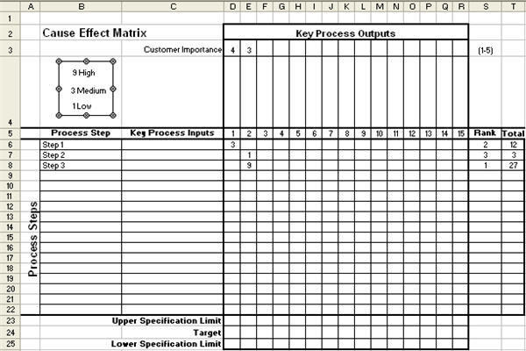
Analyze: Cause & Effect Matrix
Notes:
The Cause and Effect Matrix is a tool which is used to prioritize potential causes by examining their relationship with the CTQs.
CTQ’s are placed on the top of the matrix and causes are place along the left side. The CTQ’s are ranked in terms of importance. The relationship between the causes and CTQs are ranked. An overall score is calculated and the cause with the highest overall score should be addressed first because they will have the largest impact on the CTQs.
Steps
-List the CTQs across the top of a matrix.
-Rank and assign scores to each CTQ according to its importance to the customer.
-List the causes on the left side of the matrix
-Determine correlation scores between each cause and CTQ based on the strength of their relationship (E.g. 1 – weak, 3 – some, 9 – strong)
-Cross multiply correlation scores with priority scores and add across for each cause
-Create a Pareto chart and focus on the causes with the higher overall scores.

Slide 26
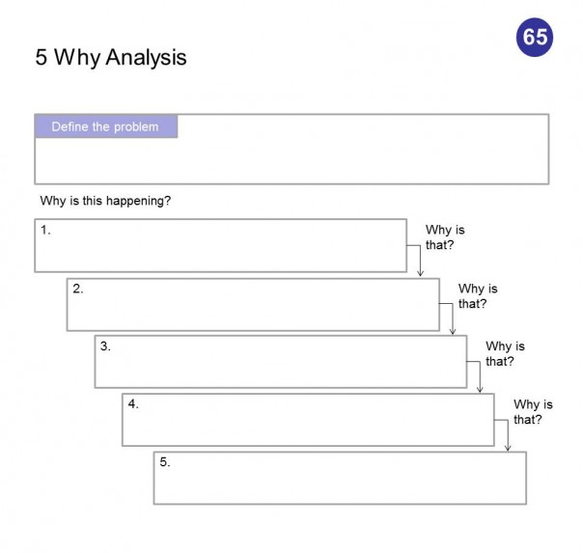
Analyze: The Five Whys
Notes:
The 5 Whys is a technique used in the Analyze phase of the Six Sigma DMAIC (Define, Measure, Analyze, Improve, Control) methodology. It is a great Six Sigma tool that does not involve data segmentation, hypothesis testing, regression or other advanced statistical tools, and in many cases can be completed without a data collection plan.
By repeatedly asking the question “Why” (five is a good rule of thumb), you can peel away the layers of symptoms which can lead to the root cause of a problem. Very often the ostensible reason for a problem will lead you to another question. Although this technique is called “5 Whys,” you may find that you will need to ask the question fewer or more times than five before you find the issue related to a problem.

Slide 27
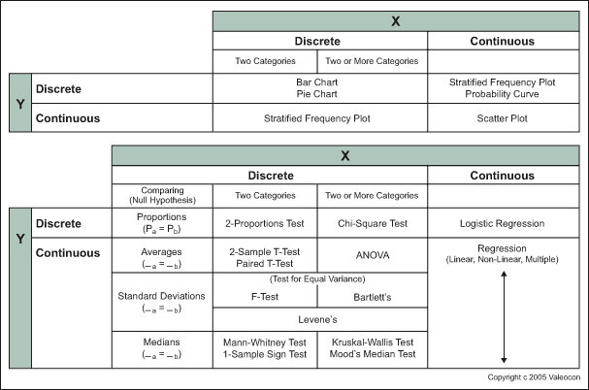
Analyze: Hypothesis Test Decision Matrix
Notes:
One of the key components in analyzing data for a Lean Six Sigma project is performing a hypothesis test. When doing this, it’s important to carefully choose both the appropriate test and interpret the results accurately. Hypothesis testing is an intimidating process, especially for those unfamiliar with statistics. This can be made easier by breaking down the process. One of the first steps in choosing the right hypothesis test, and for the Lean Six Sigma Methodology in general, is ensuring whether or not the data is normal. Those new to hypothesis testing tend to assume data normality, as that simply makes data analysis easier. However, there’s danger in these assumptions as certain projects may involve atypical data (like process cycle-time reduction). Normal data has normal variation and generally takes the shape of a bell curve. This curve represents the data’s central tendencies. The properties of this type are such that those working with it may use a probability plot for actual verification that it is distributed in a normal way. This tool is based on statistical testing. Data produced by this probability plot, if the results are considered normal, will follow a straight line. This indicates that as the value increases, so does the percentage of total data that falls within that particular range. If anywhere between 80-90 percent falls between these lines, it is considered normal. The probability plot serves as the first step in deciding which hypothesis testing is indicated. Once this information regarding the normality of the data is determined, it’s necessary to determine the type of test to use. The Hypothesis Flow Chart is used to give direction regarding the type of test. This chart encourages users to input the normal data from each “line” or “process” examined. If the comparison is being done between two or more groups, the variances of each line are examined. Tests that help determine the variance are the test for equal variance or an F-test. Lines with equal variances should then use the ANOVA for hypothesis testing. If data isn’t normal, users can try converting it to discrete. This results in a contingency table, which can easily be used in a chi-square test. This sort of test helps to determine which line is not performing like the others. Other options, if converting to discrete include non-parametric hypothesis tests like the Kruskal-Wallis test or the Mood’s median test. Once this testing is done, the results must be interpreted with a focus on the p-value. This assists in determining whether or not the null hypothesis should be accepted. Once the statistical analysis is out of the way, other Lean Six Sigma tools can then be sued to increase an organization’s profitability.

Slide 28
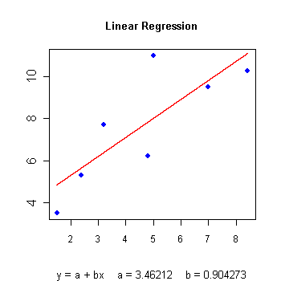
Analyze: Regression Analysis
Notes:
Regression analysis is a method to define the mathematical relationship between an output variable (y) and one or more input variable (x1, x2,….etc.) This mathematical relationship or equation is called the regression model. Basically, the regression model is an equation that can be used to predict the value of ‘y’ using the input variables i.e. ‘y’ expressed as a function of x1, x2…etc.

Slide 29
Analyze/Improve: FMEA (Failure Mode & Effects Analysis)
Process, Step, or Input | Potential Failure Mode | Potential Failure Effects | S E V E R I T Y | Potential Causes | O C C U R A N C E | Current Controls | D E T E C T I O N | R P N | Recom-mended Actions | Resp. | Actions Taken | S E V E R I T Y | O C C U R A N C E | D E T E C T I O N | R P N
What is under investigation? | In what ways does process fail? | What are impacts of failure on customer? |  | What are possible causes? |  | What are existing controls and procedures to detect cause? |  |  | What are actions for reducing occurrence of cause, or improving detection? | Who is responsible? | What are completed actions taken w/ recalculated RPN?
Notes:
Failure mode effects analysis (FMEA) is a tool you can use in Six Sigma to quantify and prioritize risk within a process, product, or system and then track actions to mitigate that risk. It’s valuable as a method for identifying and prioritizing which critical few factors you must address to improve the process in your DMAIC project. It’s also great for developing and carrying out the associated improvement plans.
An FMEA is a tabulated list of the process steps, with each step’s potential failure modes (ways in which the process step may go wrong or not produce its desired/required outcome); its associated effects and causes; how often the causes occur; and how well the causes are controlled, prevented, or detected. It basically looks like a large table.
The rows in the FMEA table correspond to individual steps of the process you’re analyzing. As you read from left to right in the table, you transition from listing the process step to that step’s potential failure modes, the potential effects, the potential causes, and the current detection or prevention controls.
For each row, you also provide a score for the severity of the effect, the frequency of occurrence of the cause, and the effectiveness of the current controls to detect or prevent the cause. The product of those scores creates the risk priority number (RPN).
For a Six Sigma DMAIC project, you should start an FMEA after you have defined the project and you have an initial understanding of the current process. An efficient FMEA effort doesn’t try to start from a blank slate. Instead, it relies heavily on the previous completion of a process map of the current state.
Other resources that you can feed into an FMEA include compiled performance data from the process, fishbone diagrams listing potential process factors, existing process instructions or standards, and so on.
Although the overall flow of an FMEA is straightforward, the effectiveness of the method lies in rigorously following the guidelines for each of the detailed elements in order.

Slide 30
Improve PHASE

Slide 31
Improve Phase
Expected Duration:
2-6 Weeks
Objectives:
Actively validate root causes
Determine optimal solution
Assess risk with new solution
Document future process
Determine financial benefit
Develop Implementation Plan
Implement new process
Deliverables:
Data showing that the problem improves/disappears with cause removal
Decision-making and evaluation tools
Criteria matrix
Impact-difficulty matrix
FMEA for “new” process
“Should be” map
Project Implementation Plan

Slide 32
Improve: Force Field Analysis
Driving Forces (helpers) | Restraining Forces (hinderers)
Positive A | Negative A
Positive B | Negative B
Positive C | Negative C
Positive D | Negative D
Note: Use length of arrows each force to indicate strength of each force
Notes:
Force Field Analysis is a brainstorming method which pits “driving” (positive) and “restraining” (negative) forces that support or oppose an idea.
In its simplest form, Force Field Analysis resembles a Pros & Cons chart, with driving forces listed on one side, and restraining forces listed on the other. A rating system can be used to identify the strengths of each of these forces, with the overall goal to maximize driving forces and minimize/eliminate restraining ones.

Slide 33
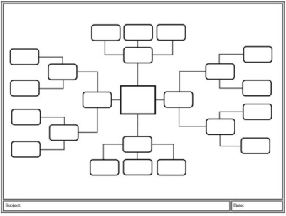
Improve: Brainstorming Analysis
Notes:
Brainstorming is a popular method of group interaction in both educational and business settings. Although it does not appear to provide a measurable advantage in creative output, brainstorming is an enjoyable exercise that is typically well received by participants and that has proven its value many times over. In Six Sigma, brainstorming is usually most valuable during the Define phase, especially when using tools such as failure mode and effects analysis.
Before brainstorming, it is important to understand not only the fundamentals of the method, but also how to prepare for and conduct a session. With the right atmosphere, team members and encouragement, the ideas will flow.

Slide 34
Improve: Solution Evaluation Matrix
 | Criteria and weights
 | Easy to implement | Low cost | Will improve customer satisfaction
Solution | 4 | 7 | 9 | Sum
New phone system | 3 (rating) x 4 (wt) = 12 | 1 (rating) x 7 (wt)= 7 | 3 (rating) x 9 (wt) = 27 | 46
More training | 4 (rating) x 4 (wt) = 16 | 3 (rating) x 7 (wt) = 21 | 1 (rating) x 9 (wt) = 9 | 46
Increase staff | 6 (rating) x 4 (wt) = 24 | 3 (rating) x 7 (wt) = 21 | 1 (rating) x 9 (wt)= 9 | 54
Notes:
All your solution-generation activities have been constrained by your discovery during Analyze and Improve. So all possible solution options should be solid, and you should have a high degree of confidence that they will solve your problem and improve performance. Still, not all solutions can be put into action plans immediately.
You have to evaluate the viability of implementing each of your proposed solutions in the spirit of managing limited resources, avoiding unnecessary risk, and accomplishing your gains in a realistic time frame. Find Affinities and Consolidate Once a number of alternative solutions have been identified, similarities between solutions can be identified through Affinity Diagrams. Basically, Affinity Diagrams enable you to organize your brainstormed solutions into proposed Action or Implementation Plans.
Potential Solutions Matrix Another way to narrow down your solution options is to subject them to two simple criteria: their quality (Impact) and their efficiency of implementation (Ease). Just plug your potential solutions into the Ease/Impact Matrix to see where they fall in the resulting nine-box grid. The Ease/Impact grid compares the impact of each potential solution and the ease of getting the solution in place. Relative positions on the grid help determine the priority of each solution.

Slide 35
Improve: Affinity Diagram
Main Theme #1
Support Idea #1
Support Idea #2
Support Idea #3
Support Idea 4
Main Theme #2
Support Idea #1
Support Idea #2
Support Idea #3
Support Idea 4
Main Theme #3
Support Idea #1
Support Idea #2
Support Idea #3
Support Idea 4
Notes:
A pool of ideas, generated from a brainstorming session, needs to be analyzed, prioritized before they can be implemented. A smaller set of ideas are easy to sift through and evaluate without applying any formal technique. Affinity diagramming is an effective technique to handle a large number of ideas. It is typically used when
-Large data set is to be traversed, like ideas generated from brainstorming and sieve for prioritization.
-Complexity due to diverse views and opinions.
-Group involvement and consensus.
Association, kinship, likeness are synonymous to affinity, and they are the underlying principle to be followed while adopting this technique. The process of affinity diagramming requires the team to categorize the ideas based on their subject knowledge thereby making it easy to sift and prioritize ideas.

Slide 36
Control Phase

Slide 37
Control Phase
Expected Duration:
4-6 Weeks
Objectives:
Develop Control Plan
Develop SOPs
Monitor performance
Complete transition meeting
Develop communication/close-out plan
Document opportunities for replication
Document additional project opportunities
Deliverables:
Solution implemented
Capability Analysis
Control chart monitoring
Training and control documents
SOPs
Process Control Plans
Training Plans
Visual process controls
Project Transition Plan
ROI validated by Finance
Project hand-off and closure
Team feedback session
Final Project Report

Slide 38
Control: Control Plan
Process Measure | Target | Spec | Sample frequency | Analysis Method | Control Methods | Reaction Plan | Owner
Notes:
A document that sets the limits within which the process should operate. This tool lists specific process activities and then states the variables or risks affecting them, as well as their specifications.

Slide 39
Control: Control chart
Notes:
The primary Statistical Process Control (SPC) tool for Six Sigma initiatives is the control chart — a graphical tracking of a process input or an output over time. In the control chart, these tracked measurements are visually compared to decision limits calculated from probabilities of the actual process performance.
The visual comparison between the decision limits and the performance data allows you to detect any extraordinary variation in the process — variation that may indicate a problem or fundamental change in the process

Slide 40
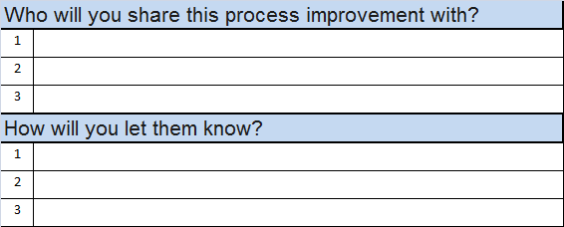
Control: Sharing Best Practices
Notes:
Lessons learned are, by definition, additional information discovered during the work effort – something that was not known before. These may be either actions that had positive results, and thus should be repeated (and perhaps considered as best practices); or they may be actions that had negative results and indicate areas for improvement. Lessons also may be learned from accidental or intentional innovations – trying something new or different. A best practice is a lesson learned or innovation that produces results so positive, and which is so widely applicable, that the action should be considered a model for others. Enough analysis needs to be done on the positive results to be able to demonstrate that the results were due only to that action, and not to some other external cause or influence.
When capturing lessons leaned and best practices, the Green Belt or Black Belt project leader should consider the scope of the recommendation as well as any assumptions made in order to perform the evaluation. Since lessons learned and best practices can be identified at any point in the DMAIC process, it is important to clearly state the scope of work for which the lesson learned or best practice was evaluated. The scope may be as simple as a single phase (e.g., Analyze), a set of phases (e.g., Define through Analyze), or an entire project cycle. Assumptions that are made to perform a valid evaluation of the submitted best practice or lesson learned should be documented as well. These assumptions usually fall into the categories of people, process or technology – which happen to be the three aspects to consider of any improvement process.
It may seem like overkill, but having a team of Six Sigma leaders evaluate formally submitted lessons learned or best practices is something to consider. Communicating these lessons learned and best practices by word of mouth may cause more harm than good. A single focal point of evaluation and integration into the adopted DMAIC toolkit for a given institution makes the dissemination of that information more consistent and more accessible to a wider audience. The power of the lesson learned and best practice is found in the ability to speed up the DMAIC process by eliminating steps that have already been proven to be wasteful, and by reducing variance in the selection of tools by already understanding which ones have worked in the past. It sounds a lot like the basic principles of Lean and Six Sigma itself.

