Slide 1
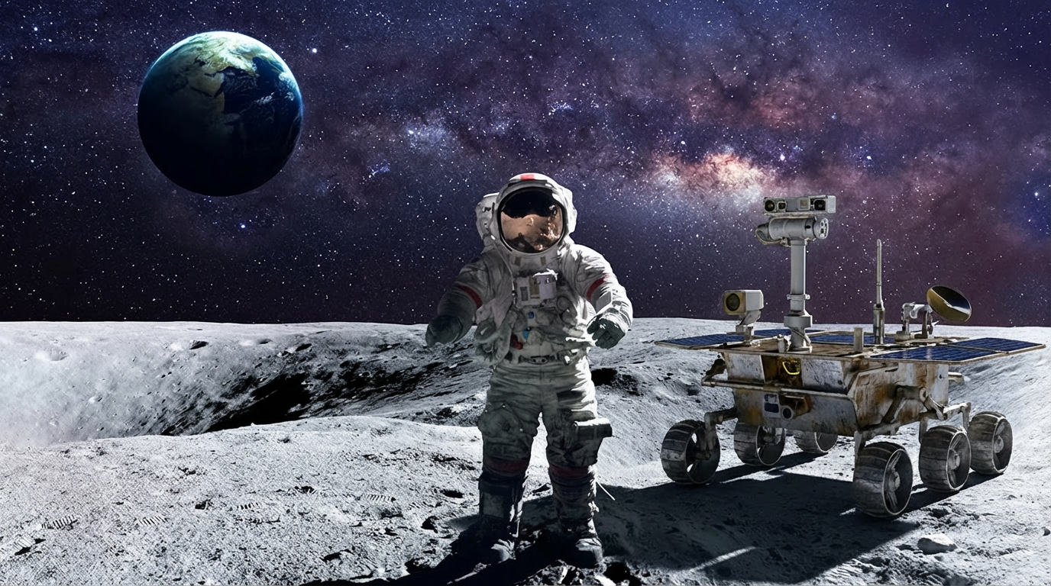


First Special Session on
Robotics in Space Exploration
——IROS2026
Call for Papers📢
Mechanical Design of Robots
Autonomous Mobile Platform
Perception and Motion Planning
Task-specific Autonomy
Robot Simulation Environments
for Space Exploration
IEEE/RSJ International Conference on Intelligent Robots and Systems (IROS) 2026
SEPTEMBER 27 - OCTOBER 1, 2026
PITTSBURGH, PA, USA
Submission Deadline: March 2, 2026
Notification of Paper Acceptance: June 16, 2026
Submision Code: r4up3
Organizers: Shenghai Yuan (NTU), Dong Li (MUST&CASIA), Muqing Cao (CMU), Yuchen Li (TUM), Long Chen (CASIA)
Inquiries:syuan003@e.ntu.edu.sg & doongli@ieee.org
Note: Special Session papers follow the same submission, review, acceptance, and publication process as regular conference papers.

Slide 2
Special Session on
Robotics in Space Exploration
@IROS2026
Call for Papers📢
Autonomous Mobile Platform
Perception and Motion Planning
Multi-robot Exploration
Task-specific Autonomy
for Space Exploration
IEEE/RSJ International Conference on Intelligent Robots and Systems (IROS) 2026
SEPTEMBER 27 - OCTOBER 1, 2026
PITTSBURGH, PA, USA
Submission Deadline: March 2, 2026
Notification of Paper Acceptance: June 16, 2026
Submision Code: 69h69
Organizers: Shenghai Yuan (NTU) Dong Li (MUST&CASIA) Muqing Cao (CMU) Yuchen Li (TUM) Long Chen (CASIA)
Inquiries:syuan003@e.ntu.edu.sg & doongli@ieee.org
Note: Special Session papers follow the same submission, review, acceptance, and publication process as regular conference papers.

Slide 3

Special Session on
Robotics in Space Exploration
@IROS2026
Call for Papers
Autonomous Mobile Platform
Perception and Motion Planning
Multi-robot exploration
Task-specific autonomy
for Space Exploration
IEEE/RSJ International Conference on Intelligent Robots and Systems (IROS) 2026
SEPTEMBER 27 - OCTOBER 1, 2026
PITTSBURGH, PA, USA
Submission Deadline: March 2, 2026
Notification of Paper Acceptance: June 16, 2026
Submision Code: 69h69
Organizers: Shenghai Yuan (NTU) Dong Li (MUST&CASIA) Muqing Cao (CMU) Yuchen Li (TUM) Long Chen (CASIA)
Inquiries:syuan003@e.ntu.edu.sg & doongli@ieee.org
Note: Special Session papers follow the same submission, review, acceptance, and publication process as regular conference papers.

Slide 4


Slide 5
Robotics in Space Exploration
Call for Papers
Autonomous Mobile Platform
Perception and motion planning
Multi-robot exploration
Task-specific autonomy
for Space Exploration,
IEEE/RSJ International Conference on Intelligent Robots and Systems (IROS) 2026
SEPTEMBER 27 - OCTOBER 1, 2026
PITTSBURGH, PA, USA
Submission Deadline: March 2, 2026
Notification of Paper Acceptance: June 16, 2026
Submision Code: 69h69
Organizers: Shenghai Yuan (NTU) Dong Li (MUST&CASIA) Muqing Cao (CMU) Yuchen Li (TUM) Long Chen (CASIA)
Inquiries:syuan003@e.ntu.edu.sg & doongli@ieee.org
Note: Special Session papers follow the same submission, review, acceptance, and publication process as regular conference papers.

Slide 6


