Slide 1
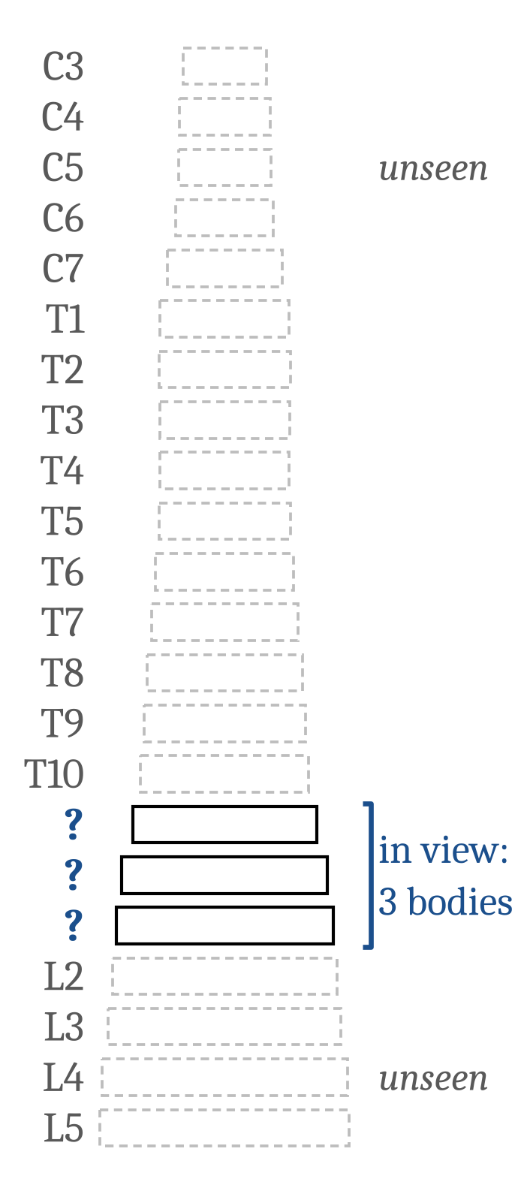
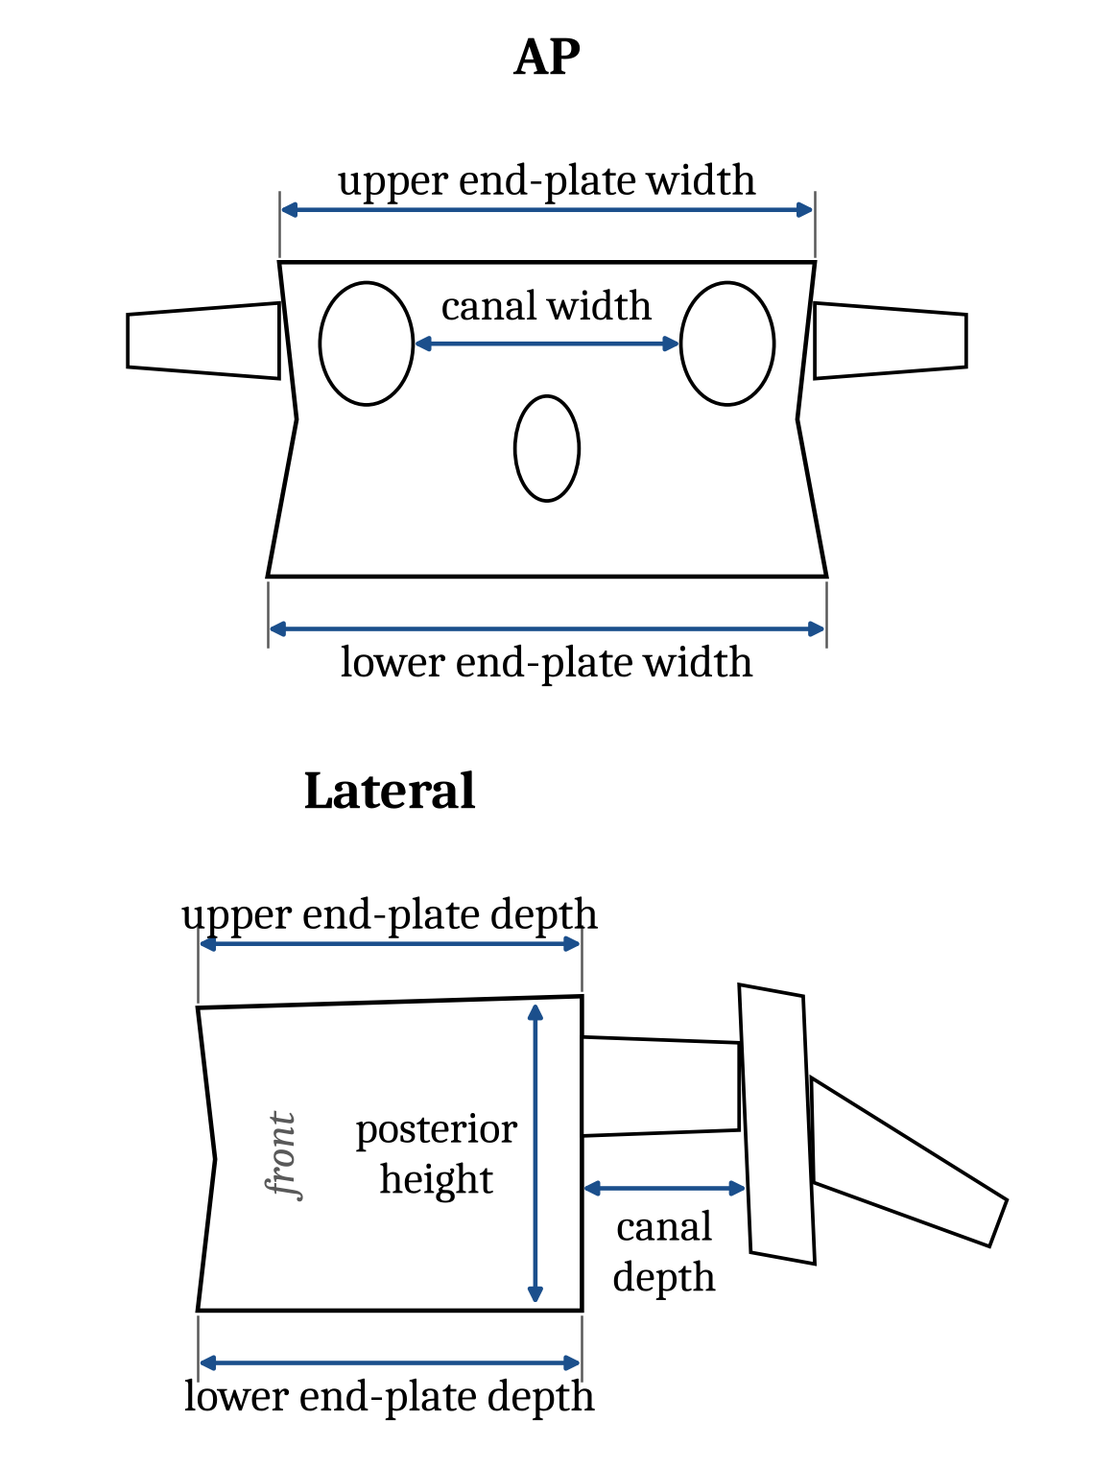
Can the bodies in view name a vertebra?
Gregory Schwing, MD, PhD
General Surgery (Wayne State University School of Medicine /
Detroit Medical Center)
A view shows a few consecutive vertebral bodies, often with no C2 or sacrum to count from. Which levels are they?
$$x_{1:n}=\left(x_{1},…,x_{n}\right), x_{i}∈R^{7}, k∈\{1,…,23−n\}$$
Seven measures per body. Body i of the field is level k + i − 1, with C3 = 1 and L5 = 22, so the place k names every body in it.
2,000 synthetic columns drawn from Panjabi's published means and spreads; every place of every column scored, so most rates below are over tens of thousands of fields.
Synthetic columns from Panjabi's published tables (Spine 1991;16:861, 888; 1992;17:299); no patient data.
Confidential: pre-filing draft, not for distribution
1 / 5
Notes:
The task: given the measurements of n consecutive vertebral bodies, seven per body, recover which levels they are. Because the bodies are consecutive, the whole labelling is one discrete latent variable, the field's place k: body i is level k + i - 1, with C3 = 1 and L5 = 22, so k takes 23 minus n values. Data come from a generative model fitted to nothing: Panjabi's published per-level means and spreads, with a column-size factor, a within-column correlation and measurement noise. We score 2,000 synthetic columns, every place of every column, and ask three questions: what is the best any function can do, can it say when it is right, and what can a single body say for certain. Headline numbers to come, on these synthetic columns: 47% named exactly from one body, 73% from three.

Slide 2
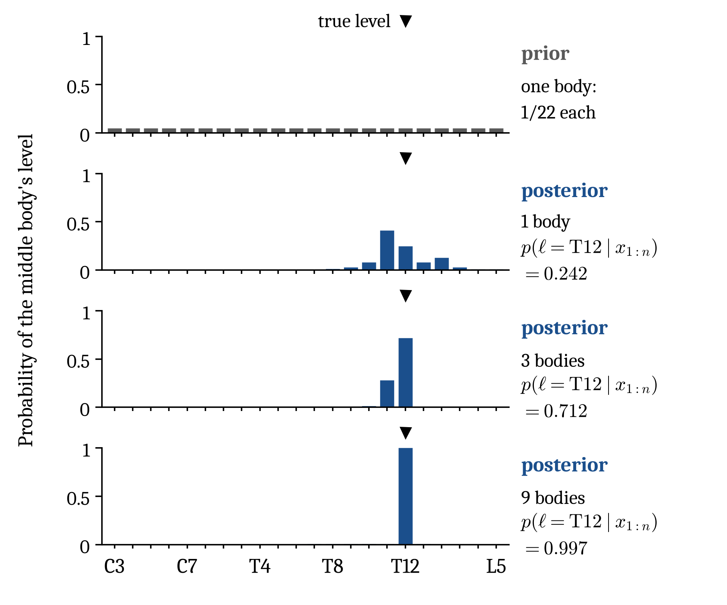
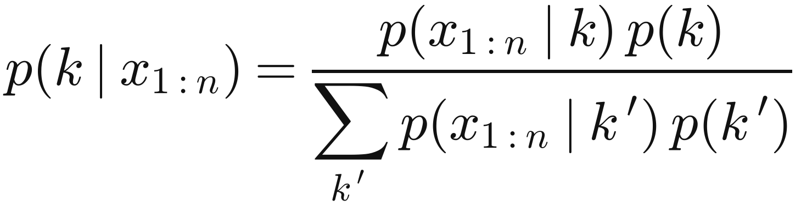
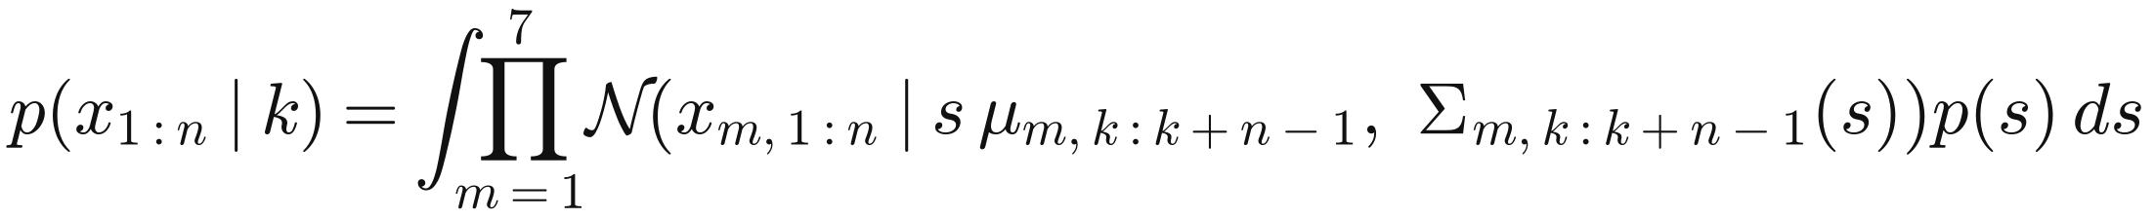
Bayes' rule over every place is the ceiling
pk∣x1:n=px1:n∣k pkk′​ px1:n∣k′ pk′
posterior ∝ likelihood × prior
$$p\left(x_{1:n}∣k\right)=∫\prod_{m=1}^{7}{N}\left(x_{m,1:n}∣s μ_{m,k:k+n−1}, Σ_{m,k:k+n−1}\left(s\right)\right)p\left(s\right) ds$$
$$Σ_{m,k:k+n−1}\left(s\right)=s^{2}ρ^{2} σσ^{T}+diag\left(s^{2}\left(1−ρ^{2}\right) σ^{2}+σ_{err}^{2}\right)$$
$$logs∼N\left(0, {0.07}^{2}\right), ρ=0.5, σ_{err}=1 mm$$
Every one of the 23 − n places is scored under the prior p(k) = 1/(23 − n); nothing is fitted.
σ: the table's spreads at levels k to k + n − 1, scaled by the column's size s; the covariance is inverted in closed form and log s is integrated by Gauss–Hermite quadrature on 161 nodes.
So it is the Bayes rule for this generator: no formula or network on the same measures names more fields correctly on average.
Synthetic columns from Panjabi's published tables (Spine 1991;16:861, 888; 1992;17:299); no patient data.
Confidential: pre-filing draft, not for distribution
2 / 5
Notes:
Exact inference by enumeration. For a field of n bodies there are 23 minus n places, each with prior 1 over 23 minus n. Given the column's size s, each measure's n values are jointly Gaussian with mean s times the table means at levels k to k plus n minus 1, and covariance s squared rho squared sigma sigma-transpose plus a diagonal of s squared times 1 minus rho squared times sigma squared, plus the error variance, with rho 0.5 and 1 mm of error; the rank-one term means the likelihood needs no matrix inverse (Sherman-Morrison). Measures are independent given s; log s is Gaussian with SD 0.07 and is integrated by 161-node Gauss-Hermite quadrature, whose error we measured. Under the uniform prior the posterior is the normalised likelihood, shown right for one column chosen by a stated rule: of 2,000, the column whose posterior at T12 sits nearest the median at one, three and nine bodies together. Because this is the generator's own posterior it is the Bayes-optimal classifier: a network can match it in expectation, never beat it, which turns 'can a network do this' into 'how far is this ceiling from one'.

Slide 3
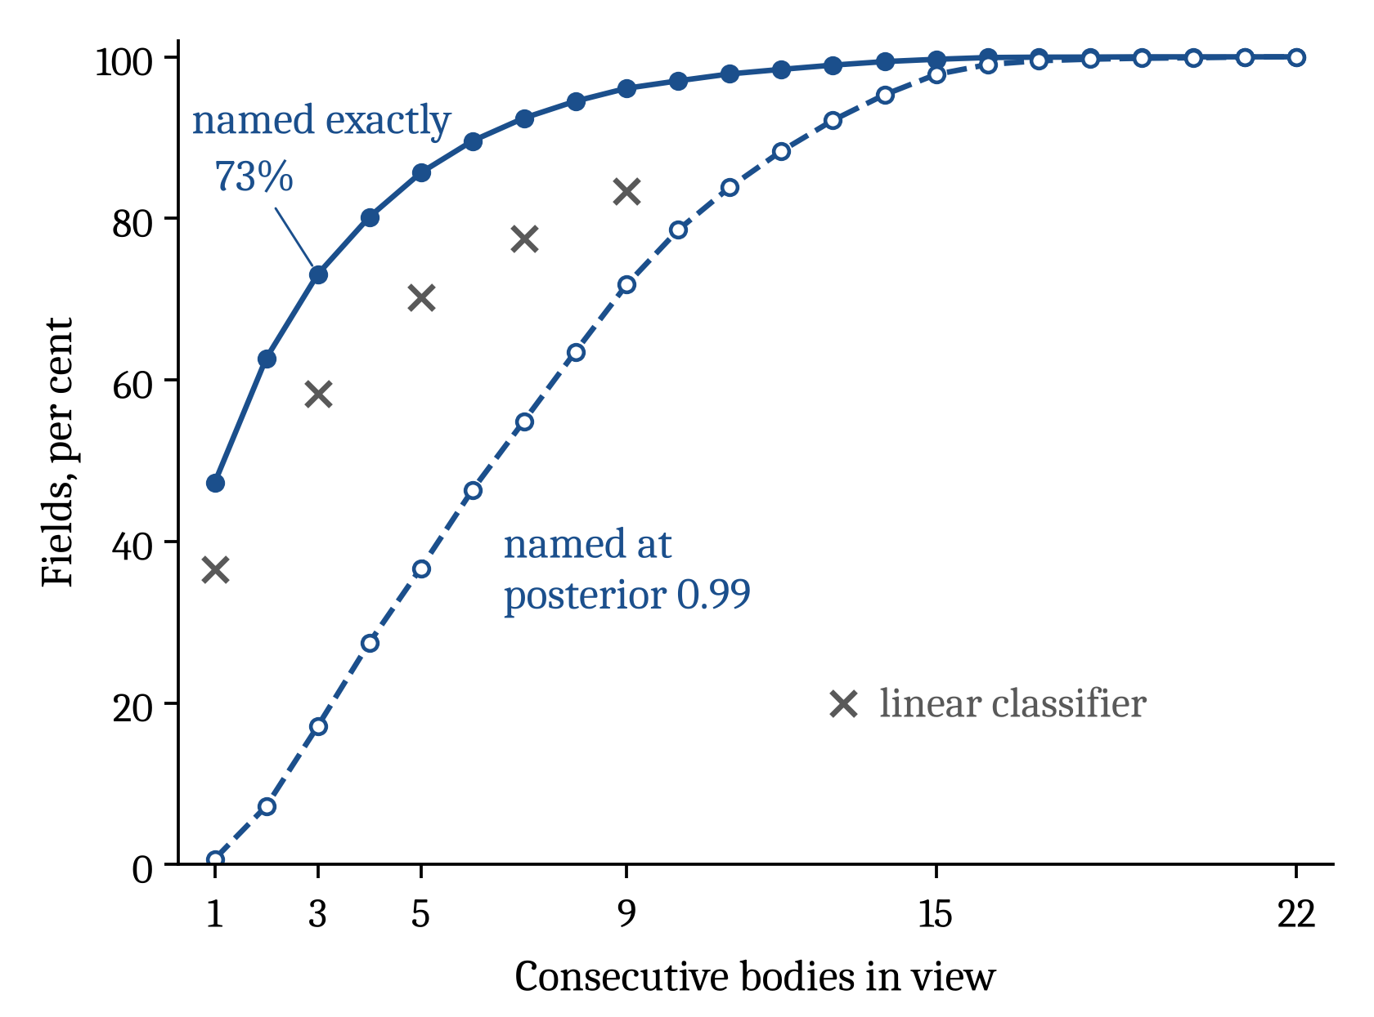
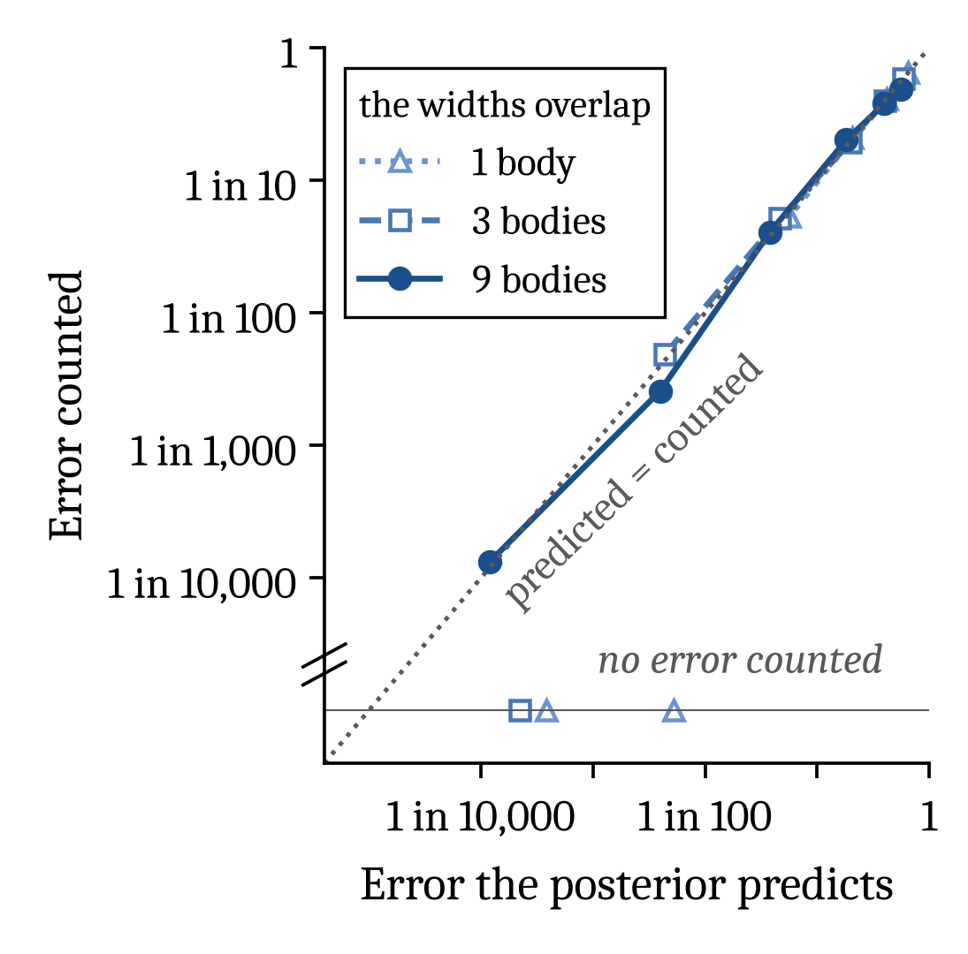
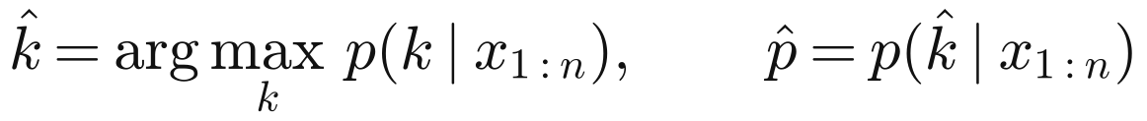
Three bodies name 73%; when sure, 99.8% are right
73%
of three-body fields named exactly (a linear classifier: 58.2%; a fitted network: 71.6%)
99.8%
of three-body names given at posterior 0.99 right (15 wrong of 6,848; named for 17% of fields)
96%
named exactly from nine bodies
Answer only when p̂ reaches 0.99, and the name is right at least 99% of the times it is given, in expectation, while the generator is the truth.
$$Pr\left(\hat{k}=k∣\hat{p}≥1−ε\right)=E\left[\hat{p}∣\hat{p}≥1−ε\right]≥1−ε$$
$$\hat{k}=arg\max_{k} p\left(k∣x_{1:n}\right), \hat{p}=p\left(\hat{k}∣x_{1:n}\right)$$
Synthetic columns from Panjabi's published tables (Spine 1991;16:861, 888; 1992;17:299); no patient data.
Confidential: pre-filing draft, not for distribution
3 / 5
Notes:
Left: exact-match accuracy of the Bayes rule against the number of bodies, 47.3% at one, 73.1% at three, 96.1% at nine; the crosses are a linear classifier fitted on separate synthetic columns, 10.8 to 15.3 points below on the same first 1,000 columns. On three bodies a fitted network reaches 71.6% and the best fitted rule 72.2%, against the rule's 73.1% on the same fields. Dashed: the share answered under selective prediction at posterior 0.99, 17.1% at three bodies and 71.8% at nine. Right: calibration, error predicted against error counted, on the diagonal to about 1 in 1,000; at 1 in 10,000 the agreement rests on 2 errors counted in 15,038 nine-body fields with posterior above 0.999, and the top bins at one and three bodies counted none. The guarantee is one line: among answers with max posterior at least 1 minus epsilon, accuracy equals the mean posterior, hence at least 1 minus epsilon, in expectation under the generator; it holds within any group chosen by the measurements, not within groups chosen by the truth. Observed: 99.78% at three bodies (15 wrong of 6,848), 99.93% at nine (15 wrong of 20,112).

Slide 4
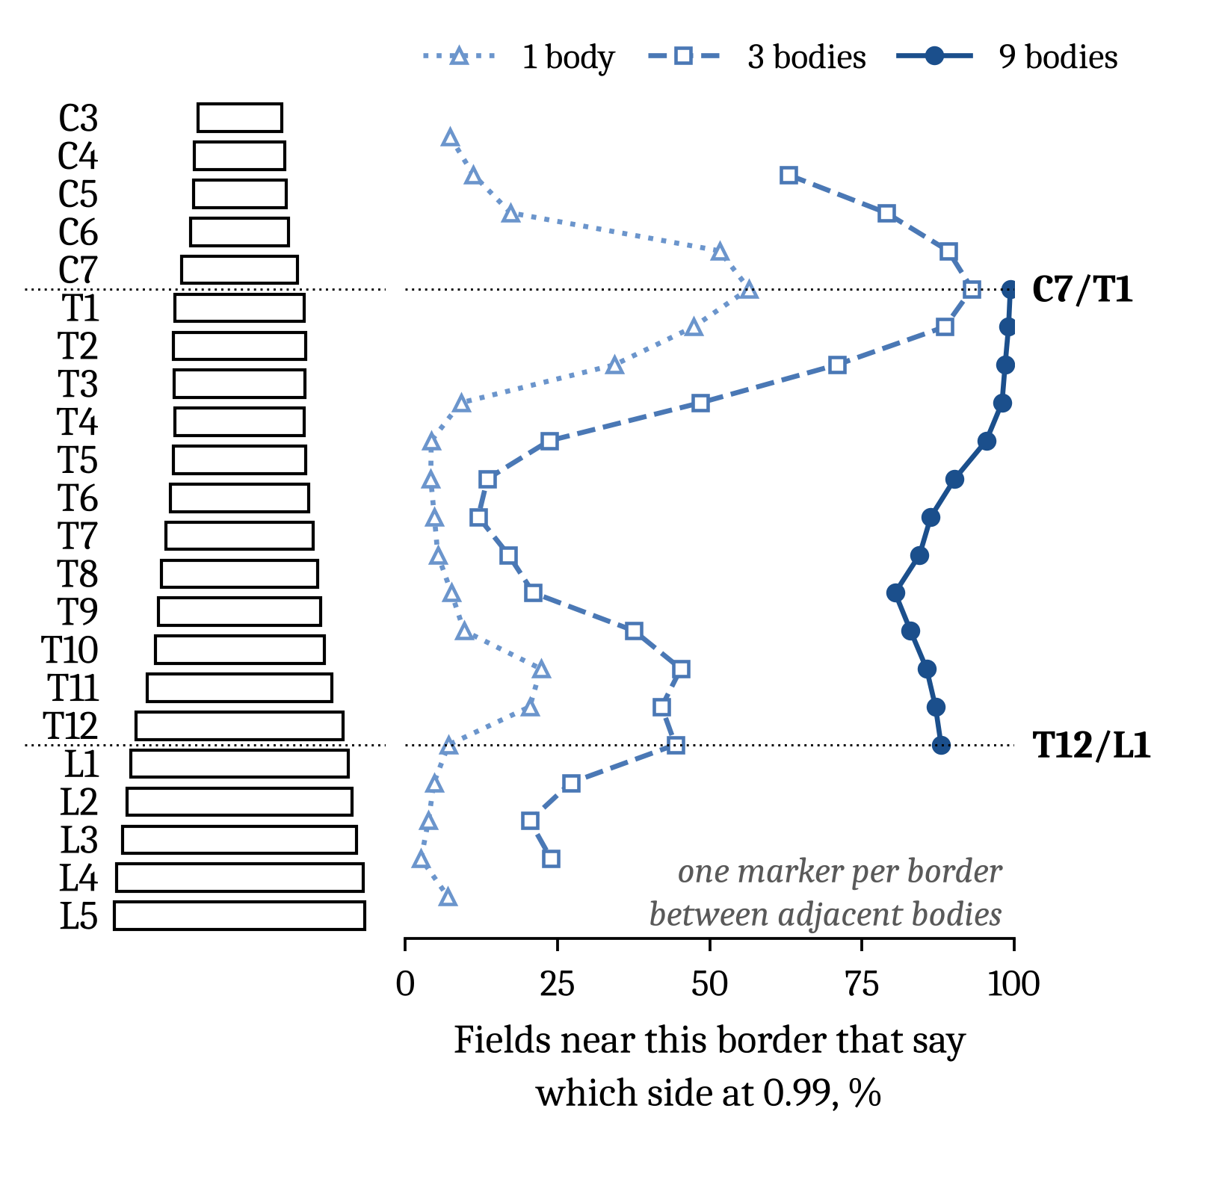
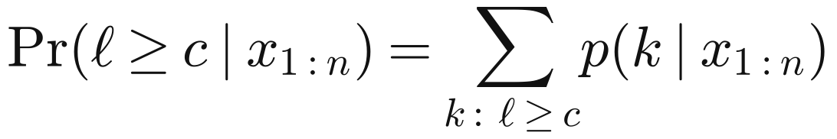

One body tells its region and its side of C7/T1, rarely of T12/L1
Prℓ≥c∣x1:n=k: ℓ≥c​pk∣x1:n
$$ℓ=k+⌊\left(n−1\right)/2⌋$$
ℓ is the middle body. Claim ℓ ≥ c when this reaches 0.99 and ℓ < c when it falls to 0.01: right at least 99% of the times made, over all fields (T12/L1 from one body: 99.96%, 13 wrong of 30,943). Below, bodies within two levels of a border, a group chosen by the true level, where it need not hold.
56%
of single bodies within two levels of C7/T1 say which side; right 99.8% (7 wrong of 4,514)
7%
of single bodies within two levels of T12/L1 say which side; right 97.9% (12 wrong of 568), short of 99%
61%
of single bodies say their region; right 99.9% (21 wrong of 26,786), only 2 of them far from both junctions
88%
of fields with middle body T11 to L1 say which side of T12/L1 from nine bodies (1 wrong of 5,279)
Synthetic columns from Panjabi's published tables (Spine 1991;16:861, 888; 1992;17:299); no patient data.
Confidential: pre-filing draft, not for distribution
4 / 5
Notes:
Weaker statements inherit the guarantee. With l = k + floor((n - 1)/2) the middle body, P(l at or caudal to c) is a sum of the same posterior over k, so a claim made at 0.99 on either side is right at least 99 per cent of the time over all fields, in expectation: at T12/L1 from one body, 99.96%, 13 wrong of 30,943. The figure conditions on the truth, fields whose middle body lies within two levels of each border, where no guarantee applies, so these are measurements. One body: the side of C7/T1 for 56.4%, precision 99.84%; the side of T12/L1 for only 7.1%, precision 97.89%, below the nominal level because the group is chosen by the truth; the region for 60.9% of all single bodies, 21 wrong of 26,786, 2 of them far from both junctions. Nine bodies settle T12/L1 for 88.0% of fields whose middle body is T11 to L1, the levels a nine-body field can centre on near it.

Slide 5
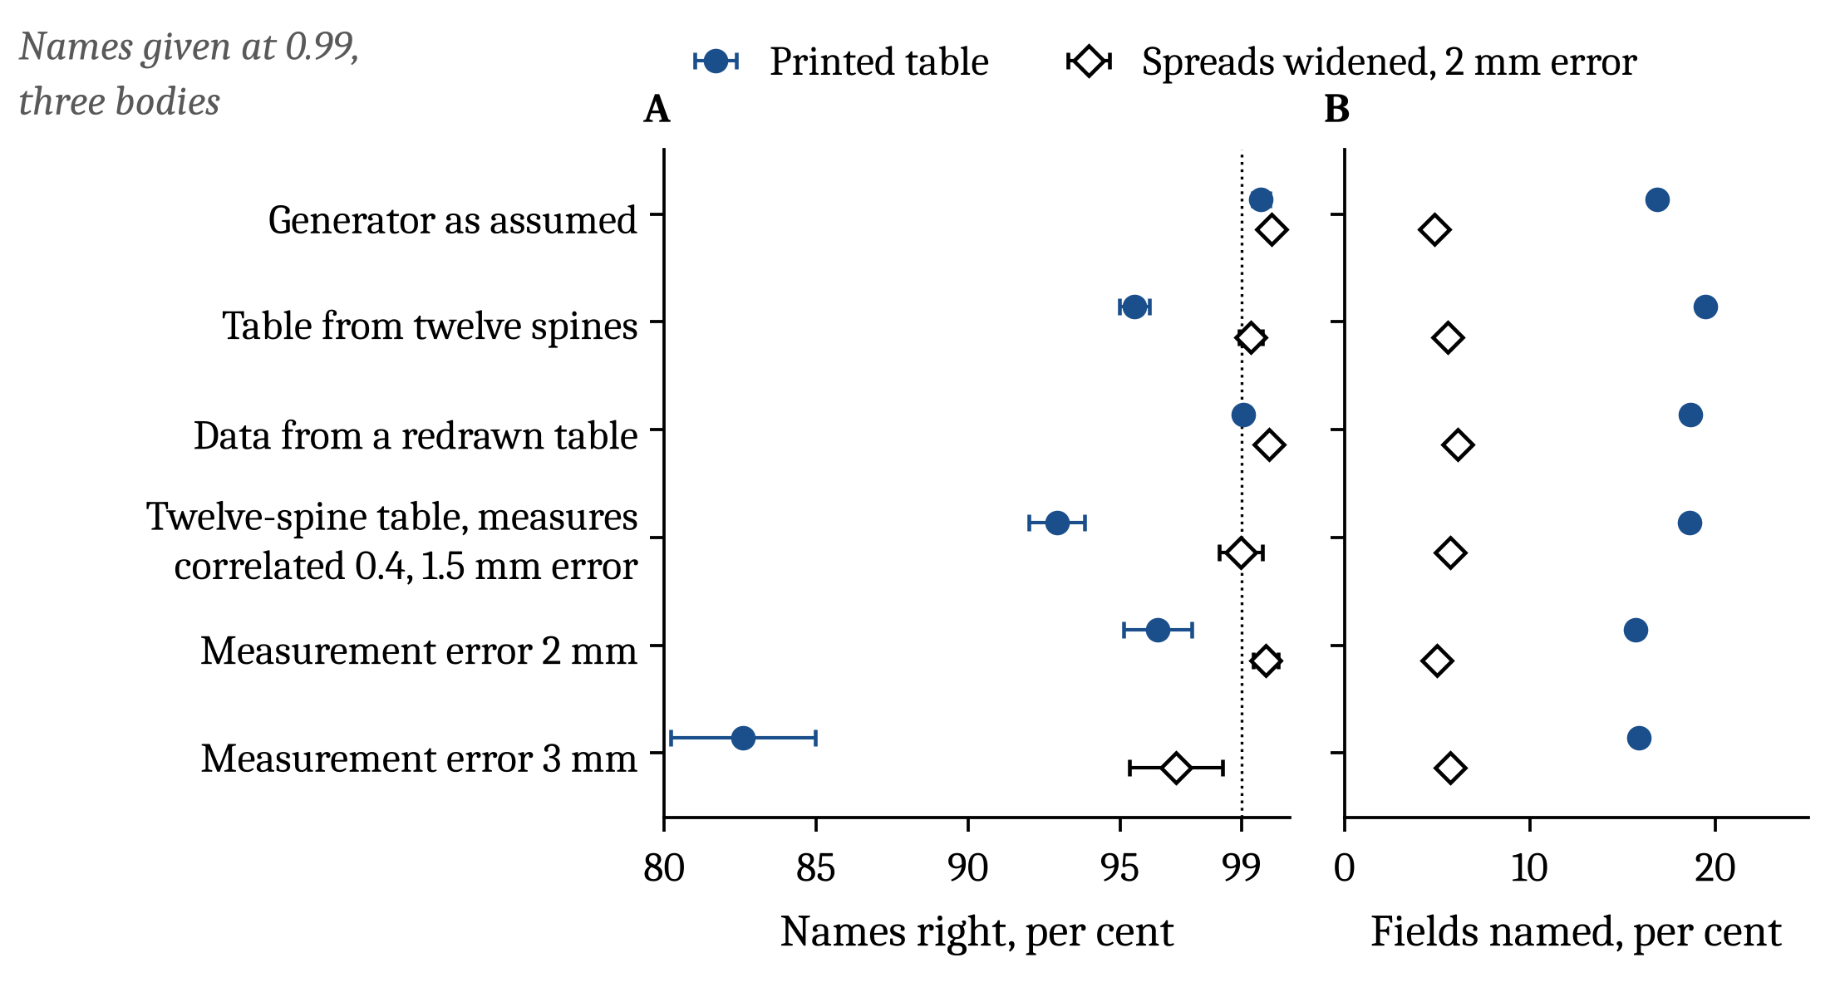
The weak point is the table, not the mathematics
95.5%
of three-body names at posterior 0.99 right when the rule's table is estimated from 12 spines, as Panjabi's tables are
99.3%
with spreads widened and 2 mm of error (the 2 mm chosen on a separate pilot), but 5.5% of fields named, not 19.5%, and lumbar names right 96.7% (8 wrong of 246)
$${\tilde{σ}}_{m,ℓ}=σ_{m,ℓ}\sqrt{1+1/12}, σ_{err}=2 mm$$
Next: measure the table on full-spine CTs counted from C2, and carry a real series' prior over places.
Synthetic columns from Panjabi's published tables (Spine 1991;16:861, 888; 1992;17:299); no patient data.
Confidential: pre-filing draft, not for distribution
5 / 5
Notes:
Robustness, three bodies. On the main scoring columns the printed-table rule is right 99.78% at 0.99, naming 17.1% of fields. The rows here are scored on separate synthetic columns, 500 per error world and 40 worlds of 100 columns for a table world. When the rule's table is itself estimated from 12 specimens, the setting Panjabi's tables come from, precision drops to 95.5%; with 3 mm of measurement error, 82.6%. Inflating each spread by the root of 1 plus 1 over 12 and assuming 2 mm of error, the 2 mm chosen on a separate pilot, brings precision back to 99.3% in the twelve-spine worlds, at the cost of coverage, 5.5% answered instead of 19.5%, and unevenly, lumbar names 96.7%. With 3 mm of error on the printed table it reaches only 96.8%, so it fails there. The predictive rule, with nothing tuned, reaches 97.6% at 14.8% named in the same twelve-spine worlds. The posterior is only as good as the table, so the open problems are a table measured on full-spine CT counted from C2 and a prior from a real series.

