Slide 1
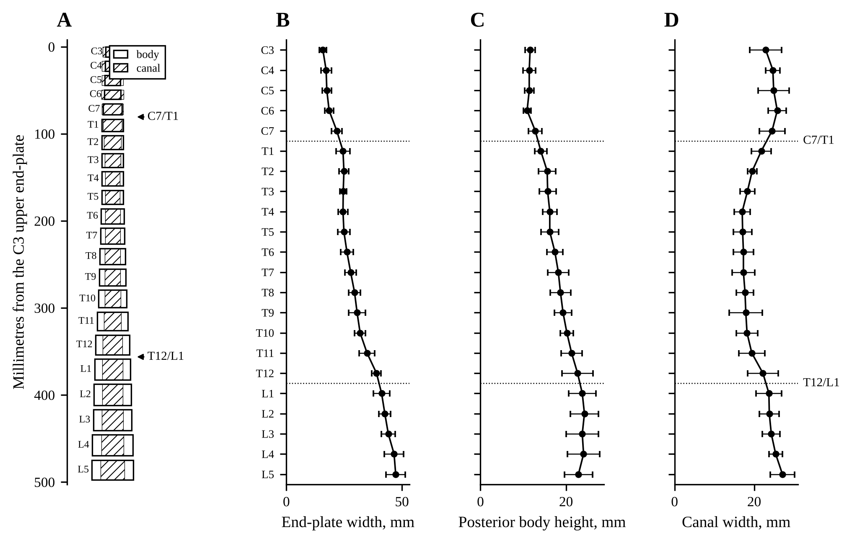
The junction, named from the shape profile alone
Panjabi's tables give every level a mean and a spread for the end-plate, the body and the canal; drawn to their millimetres, the column is the shape a reader of CT sees
The cervicothoracic step is large in every measure; the thoracolumbar step is small beside the spread of one level
A window of bodies is named by scoring every naming the column allows against this profile, with no count from either end
Panjabi MM, et al. Spine 1991;16:861 and 888; Spine 1992;17:299. Published morphometry drawn to scale; the bars are one population SD. No patient data.
Notes:
The three published tables, cervical, thoracic and lumbar, as one column drawn to the means (A: each body a box of its end-plate width and posterior height, the canal width hatched over it, the disc spaces at one height since the tables give none) and as one profile per measure (B to D). The dispersion printed in the papers is the standard error; the bar drawn is the population SD, SEM times the square root of twelve. C2 has no upper end-plate row, so the profile starts at C3.

Slide 2
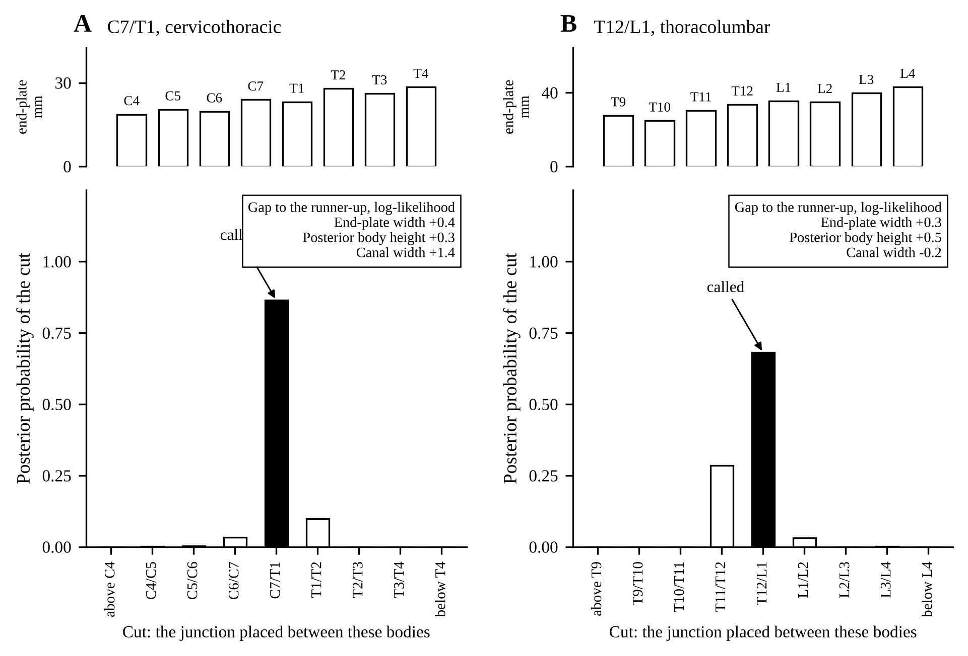
How it decides: every naming scored, the gap explained
Every naming a column with 11 to 13 thoracic and 4 to 6 lumbar bodies allows is scored per measure; a free offset per measure cancels the patient's size and the measurement convention
The posterior over the cut, averaged over the namings that share it under a flat prior, is the answer; the per-measure gap to the runner-up says why: at C7/T1 the canal width decides, at T12/L1 no measure decides strongly
A margin below a chosen floor is an abstention, not a guess
One synthetic column from the tables, eight bodies around each junction; Synthetic columns drawn from Panjabi's published means and spreads (Spine 1991;16:861, 888; 1992;17:299); no patient data. Retrospective modelling, 2026.
Notes:
The template holds the profile for every structure a column can have: eleven, twelve or thirteen rib-bearing bodies above four, five or six lumbar ones. For a window of n bodies every naming such a column allows is scored: per measure, the log-likelihood of the window's values against the profile's means and spreads, with one free offset per measure, so a large patient and a small one, or two measurement conventions, score alike. The posterior over the cut, the number of bodies above the junction, is the average over the namings that put the cut in one place, under a flat prior over the cut, so a cut is not favoured for having more ways to be named. The explanation a reader gets is the gap, per measure, between the best naming and the runner-up. On this column the canal width carries the cervicothoracic call by itself; at the thoracolumbar junction the gaps are within one log-likelihood unit, which is why that junction is the hard one.

Slide 3
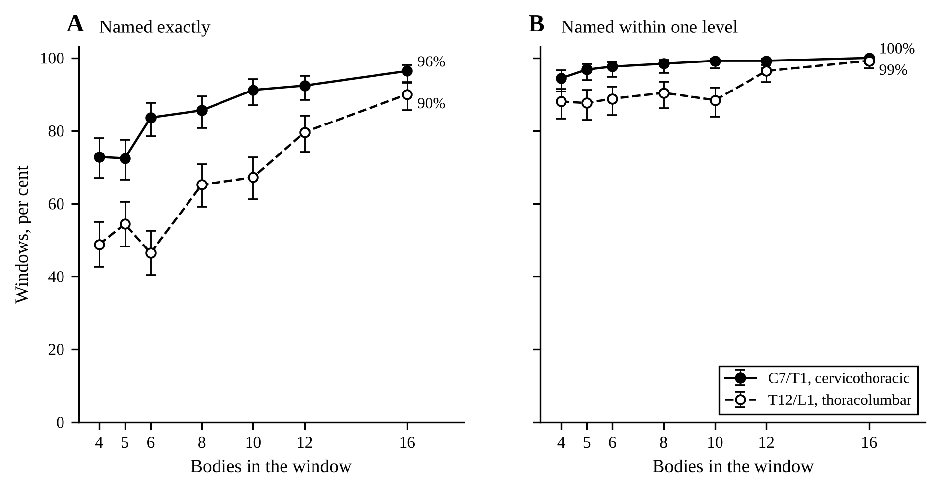
Result: C7/T1 named robustly, T12/L1 the hard junction
Eight bodies in view: C7/T1 named exactly in 86 of 100 windows and within one level in 98; T12/L1 exactly in 65, within one in 90
Sixteen bodies: 96 and 90 exactly. Four bodies: 73 and 49
Fitted on no CT: the model is read off the published tables, so every number is about the tables and the generator, not yet about a patient
Profile template, 250 synthetic typical windows per width, measures end-plate width, posterior body height, canal width; 95% Wilson intervals. Synthetic columns drawn from Panjabi's published means and spreads (Spine 1991;16:861, 888; 1992;17:299); no patient data. Retrospective modelling, 2026.
Notes:
Exact and within-one naming against the width of the window, for the profile template fitted on nothing but the tables. CT: 4 bodies 182/250 exact; CT: 5 bodies 181/250 exact; CT: 6 bodies 209/250 exact; CT: 8 bodies 214/250 exact; CT: 10 bodies 228/250 exact; CT: 12 bodies 231/250 exact; CT: 16 bodies 241/250 exact; TL: 4 bodies 122/250 exact; TL: 5 bodies 136/250 exact; TL: 6 bodies 116/250 exact; TL: 8 bodies 163/250 exact; TL: 10 bodies 168/250 exact; TL: 12 bodies 199/250 exact; TL: 16 bodies 225/250 exact. The ablation, a local rule on the ratios of each body to its neighbours, names C7/T1 in 48% and T12/L1 in 22% of windows of five to twelve bodies over every phenotype: the thoracolumbar step is too small for a local rule, which is why the whole profile is read.

Slide 4
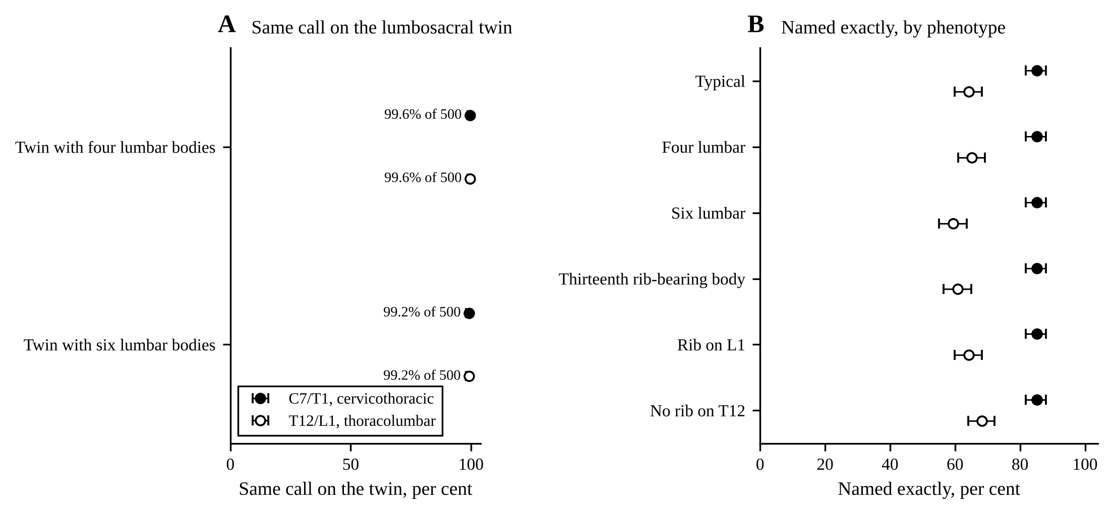
A lumbosacral anomaly does not move the junction call
One column drawn once and named two ways, four or six lumbar bodies: the C7/T1 call is unchanged in 99.6 and 99.2 of 100 twins; T12/L1 in 99.6 and 99.2
By phenotype, C7/T1 holds at 85 to 85% whatever the column; T12/L1 runs from 59% with six lumbar bodies to 68% with no rib on T12, 64% on a typical column
The lumbosacral count lies outside the junction's window; the transitional body lies inside it (next slide)
Profile template, 500 synthetic windows per class, measures end-plate width, posterior body height, canal width; 95% Wilson intervals. Synthetic columns drawn from Panjabi's published means and spreads (Spine 1991;16:861, 888; 1992;17:299); no patient data. Retrospective modelling, 2026.
Notes:
Twins: four_lumbar, ct: same call 498 of 500, both right 487; four_lumbar, tl: same call 498 of 500, both right 487; six_lumbar, ct: same call 496 of 500, both right 485; six_lumbar, tl: same call 496 of 500, both right 485. By phenotype, exact of 500: ct typical 426; ct four_lumbar 426; ct six_lumbar 426; ct t13 426; ct lumbar_rib 426; ct no_rib_t12 426; tl typical 321; tl four_lumbar 326; tl six_lumbar 297; tl t13 304; tl lumbar_rib 321; tl no_rib_t12 341. A twin is the same column with the lumbosacral levels added or taken away; the profile template reads the window's position from C3, so the levels above the anomaly are identical in both twins and the call can move only where the window reaches the anomaly, the far end of a thoracolumbar window. The cervicothoracic window never holds the lumbosacral bodies.

Slide 5
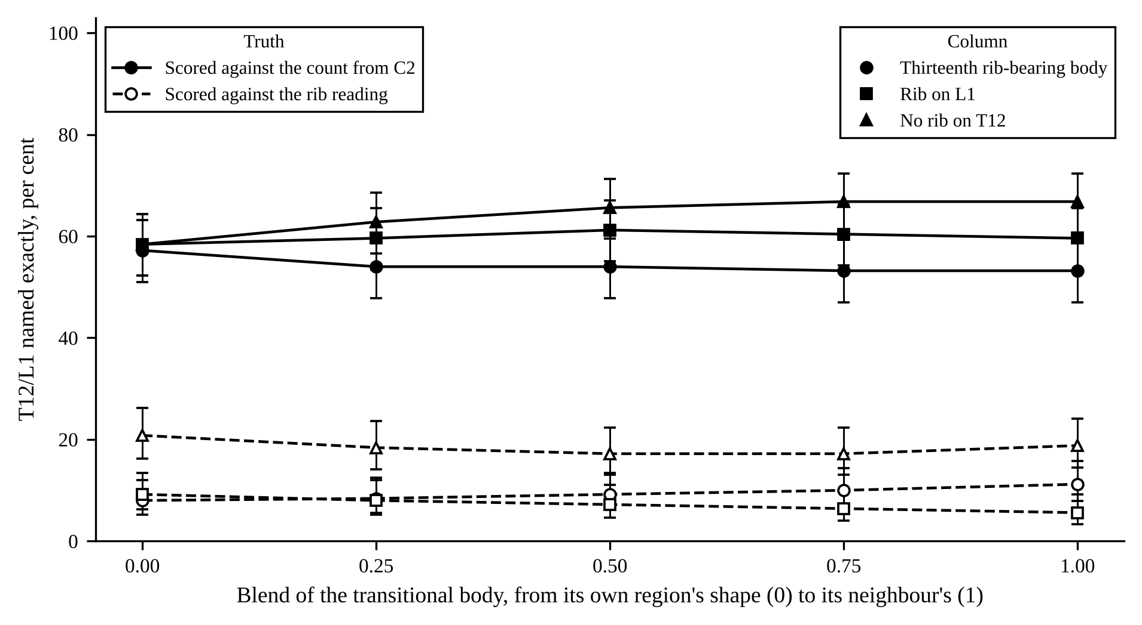
The transitional body: two truths one level apart
Blending the transitional body toward its neighbour's shape leaves T12/L1 naming by the count from C2 at 53 to 67% across the three phenotypes, and within one level at 83 to 92%
Scored against the ribs instead, the same calls are exact in only 6 to 21%: a rib-bearing L1 and a thirteenth thoracic body are one shape, and only the count from C2 tells them apart
That is the case a full-spine corpus counted from C2 meets, with the ribs read independently
Profile template, 250 synthetic windows per point; solid, scored against the count; dashed, against the ribs. Synthetic columns drawn from Panjabi's published means and spreads (Spine 1991;16:861, 888; 1992;17:299); no patient data. Retrospective modelling, 2026.
Notes:
Blend series, exact of 250 against the count, then within one level, then against the ribs: t13 0.00: 143, 220, 20; t13 0.25: 135, 218, 21; t13 0.50: 135, 223, 23; t13 0.75: 133, 225, 25; t13 1.00: 133, 230, 28; lumbar_rib 0.00: 146, 221, 23; lumbar_rib 0.25: 149, 218, 20; lumbar_rib 0.50: 153, 217, 18; lumbar_rib 0.75: 151, 213, 16; lumbar_rib 1.00: 149, 208, 14; no_rib_t12 0.00: 146, 221, 52; no_rib_t12 0.25: 157, 222, 46; no_rib_t12 0.50: 164, 222, 43; no_rib_t12 0.75: 167, 223, 43; no_rib_t12 1.00: 167, 227, 47. The nineteenth body is drawn from its own region's shape (blend 0) toward its neighbour's (blend 1); the count names it L1 whatever its rib, the rib reading names the same column one level apart, and the two thoracolumbar phenotypes with a thirteenth rib are one anatomy drawn from the two ends of the blend. With the canal depth as a fourth measure the count-exact rate moves by +7 to +16 points.

Slide 6
What is validated, what is not, and what comes next
Column | C7/T1 exact | C7/T1 within one | T12/L1 exact | T12/L1 within one
Typical | 85% (426/500) | 97% (487/500) | 64% (321/500) | 91% (453/500)
Four lumbar | 85% (426/500) | 97% (487/500) | 65% (326/500) | 89% (445/500)
Six lumbar | 85% (426/500) | 97% (487/500) | 59% (297/500) | 91% (457/500)
Thirteenth rib-bearing body | 85% (426/500) | 97% (487/500) | 61% (304/500) | 88% (439/500)
Rib on L1 | 85% (426/500) | 97% (487/500) | 64% (321/500) | 89% (447/500)
No rib on T12 | 85% (426/500) | 97% (487/500) | 68% (341/500) | 92% (459/500)
Validated: the lumbar measurements against published norms. Not validated: the same measures at cervical and thoracic levels, until each is checked against a published series there
Every number on these slides is from synthetic columns drawn from Panjabi's tables; none is from a patient
Next: full-spine CT counted from C2, every column's class with its denominator; where the shape and the count disagree, the ribs decide, never the model's own call, and the circular arm is shown beside it for scale
The thoracolumbar junction is the one still owed
Named exactly and within one level, by phenotype, 500 synthetic windows per class; the denominators are the windows with the junction in view. A thirteenth rib-bearing body and a rib on L1 are one anatomy drawn from the two ends of the blend.
Synthetic columns drawn from Panjabi's published means and spreads (Spine 1991;16:861, 888; 1992;17:299); no patient data. Retrospective modelling, 2026. Evidence status: modelling on published tables; no clinical use.
Notes:
Only the lumbar measurements of the measurement code are validated against published norms (end-plate width, canal width, transverse-process span); the thoracic and cervical figures are a pipeline test until each measure is checked against a published series at those levels, which the Panjabi tables are there for. The real test is the corpus counted from C2, by phenotype with denominators, with the rib arm as the independent relabelling and the circular arm beside it for scale, never alone.

