Slide 1
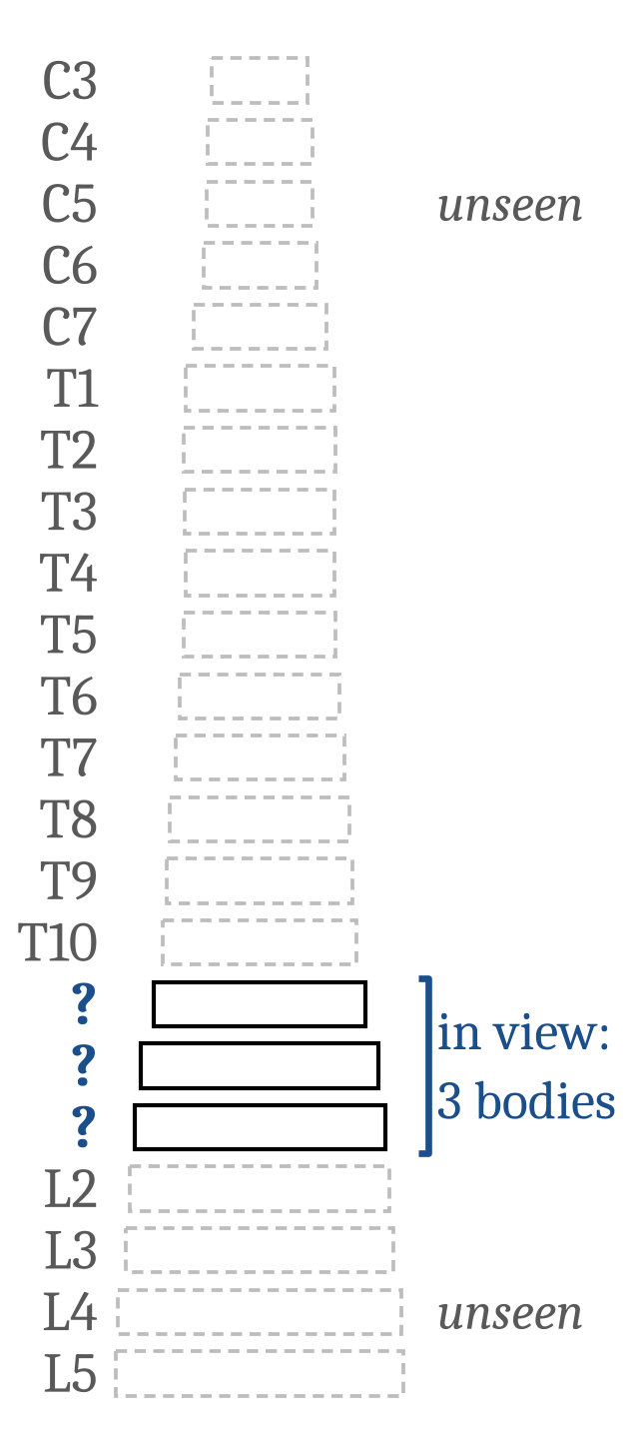
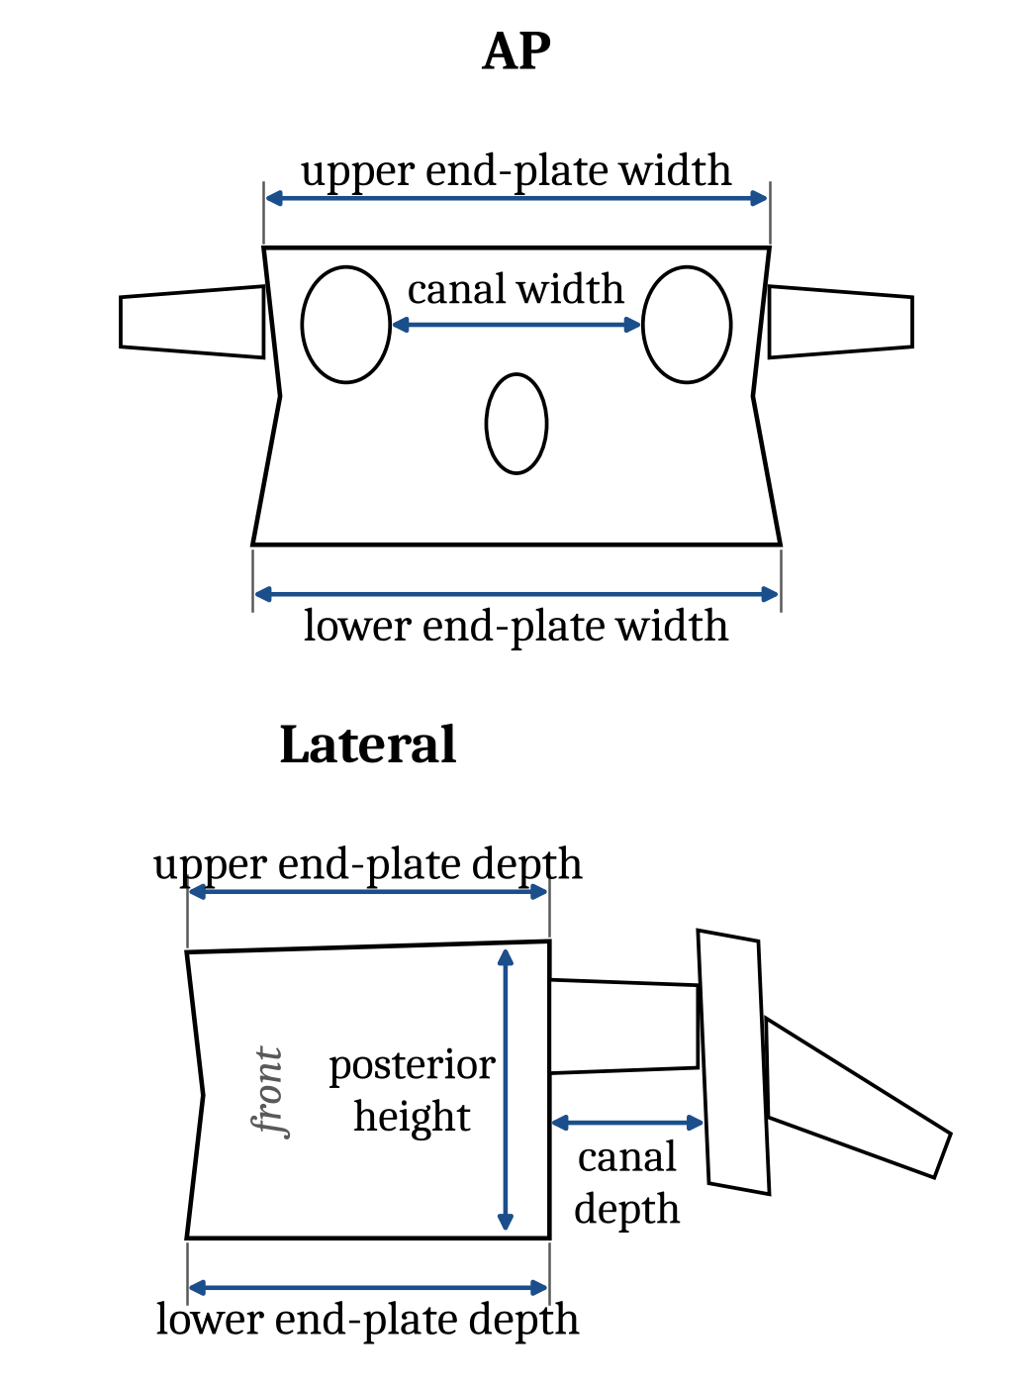
Can the bodies in view name a vertebra?
Gregory Schwing, MD, PhD
General Surgery (Wayne State University School of Medicine /
Detroit Medical Center)
A view shows a few consecutive vertebral bodies, often with no C2 or sacrum to count from.
Seven measures per body. Which levels are in view?
2,000 synthetic columns drawn from Panjabi's published means and spreads; every field of every column scored, so most rates below are over tens of thousands of fields.
Synthetic columns from Panjabi's published tables (Spine 1991;16:861, 888; 1992;17:299); no patient data.
Confidential: pre-filing draft, not for distribution
1 / 5
Notes:
Counting from C2 or the sacrum is how we name a level, and in the operating room the end we count from is often out of the picture. So the question is narrow: from the bodies we can see, and seven standard measures of each body, can we say which levels they are? Everything here is synthetic: 2,000 columns drawn from Panjabi's published morphometry, so every answer is about the anatomy those tables describe, not yet about our patients.

Slide 2
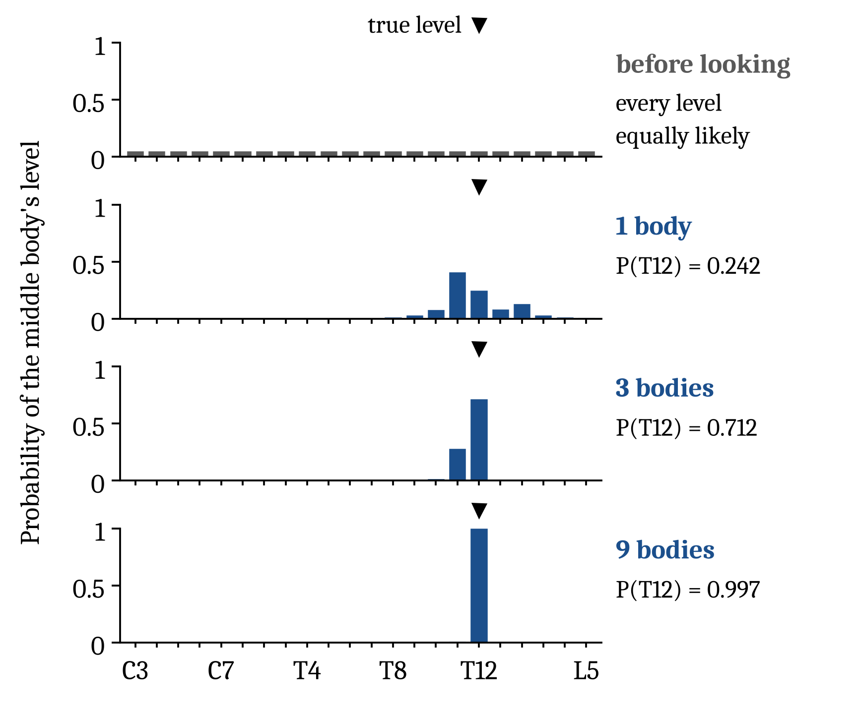
More bodies in view, more certainty about the level
Fields centred on T12 in synthetic columns, named exactly:
39%
from one body
73%
from three bodies
95%
from nine bodies
No formula or network on these measures names more fields correctly on average.
Synthetic columns from Panjabi's published tables (Spine 1991;16:861, 888; 1992;17:299); no patient data.
Confidential: pre-filing draft, not for distribution
2 / 5
Notes:
Before looking, every level is equally likely. Take the synthetic fields centred on T12. From one body the answer spreads over the levels around the thoracolumbar junction, T11 to L2 on average, and T12 is named exactly in 39% of these synthetic fields; from three bodies, 73%; from nine, 95%. The figure shows one typical synthetic column. The rule is exact for the anatomy the tables describe, so no formula or network on these measures names more synthetic fields correctly on average.

Slide 3
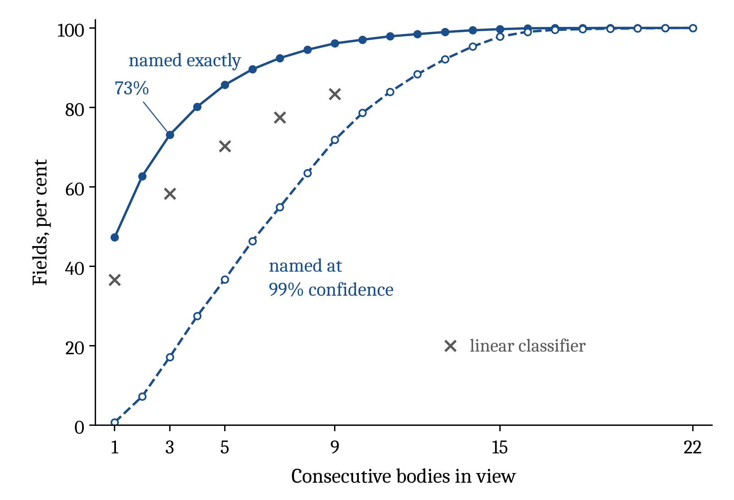
Three bodies name 73%; when sure, 99.8% are right
73%
of three-body fields named exactly (a linear classifier: 58.2%; a fitted network: 71.6%)
99.8%
of three-body names given at 99% confidence right (15 wrong of 6,848; named for 17% of fields)
96%
named exactly from nine bodies
Named only at 99% confidence, it was right 99.7% or more of the time at every number of bodies in view, from 1 to 22, on synthetic columns.
Synthetic columns from Panjabi's published tables (Spine 1991;16:861, 888; 1992;17:299); no patient data.
Confidential: pre-filing draft, not for distribution
3 / 5
Notes:
On synthetic columns drawn from the tables, with one body in view the rule names 47% of fields exactly; with three, 73%; with nine, 96%. On the same synthetic measures a linear classifier reaches 58.2% from three bodies and a fitted network 71.6%. The rule also says how sure it is. On these synthetic columns, when it says 99 per cent it is right 99.8% of the time, 15 wrong of 6,848 names, and it gives a name for 17% of three-body fields; for the rest it says it is not sure.

Slide 4
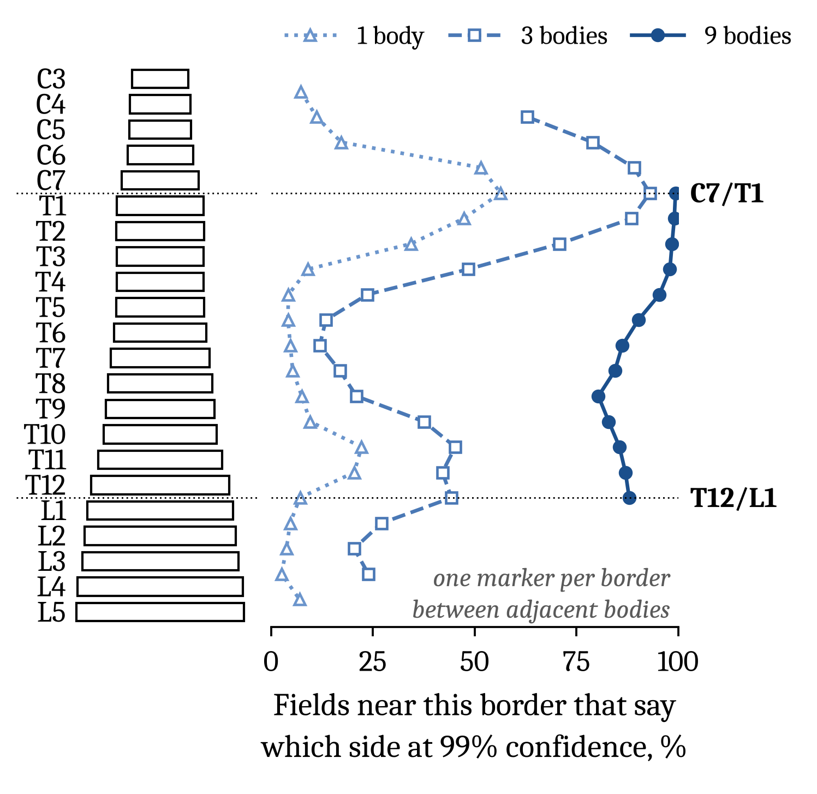
One body tells its region and its side of C7/T1, rarely of T12/L1
Claims made at 99% confidence are right at least 99% of the time over all fields (T12/L1 from one body: 99.96%, 13 wrong of 30,943). The rates below are for bodies within two levels of a border, chosen by their true level, where a claim can fall short.
56%
of single bodies within two levels of C7/T1 say which side; right 99.8% (7 wrong of 4,514)
7%
of single bodies within two levels of T12/L1 say which side; right 97.9% (12 wrong of 568), short of 99%
61%
of single bodies say their region; right 99.9% (21 wrong of 26,786), only 2 of them far from both junctions
88%
of fields with middle body T11 to L1 say which side of T12/L1 from nine bodies (1 wrong of 5,279)
Synthetic columns from Panjabi's published tables (Spine 1991;16:861, 888; 1992;17:299); no patient data.
Confidential: pre-filing draft, not for distribution
4 / 5
Notes:
Short of a name, what can one body say for certain? On the synthetic columns, two things. Its region, cervical, thoracic or lumbar, for 61% of single synthetic bodies, wrong 21 times in 26,786. And which side of the cervicothoracic junction it is on: near C7/T1 a single synthetic body says so 56% of the time, right 99.8%. Over all synthetic fields, a claim made at 99% confidence is right at least 99% of the time; at T12/L1, 99.96%. Near the thoracolumbar junction a single synthetic body commits only 7% of the time and is right 97.9%, too weak to rely on even in this synthetic setting. Nine bodies say which side for 88% of synthetic fields whose middle body is T11 to L1.

Slide 5
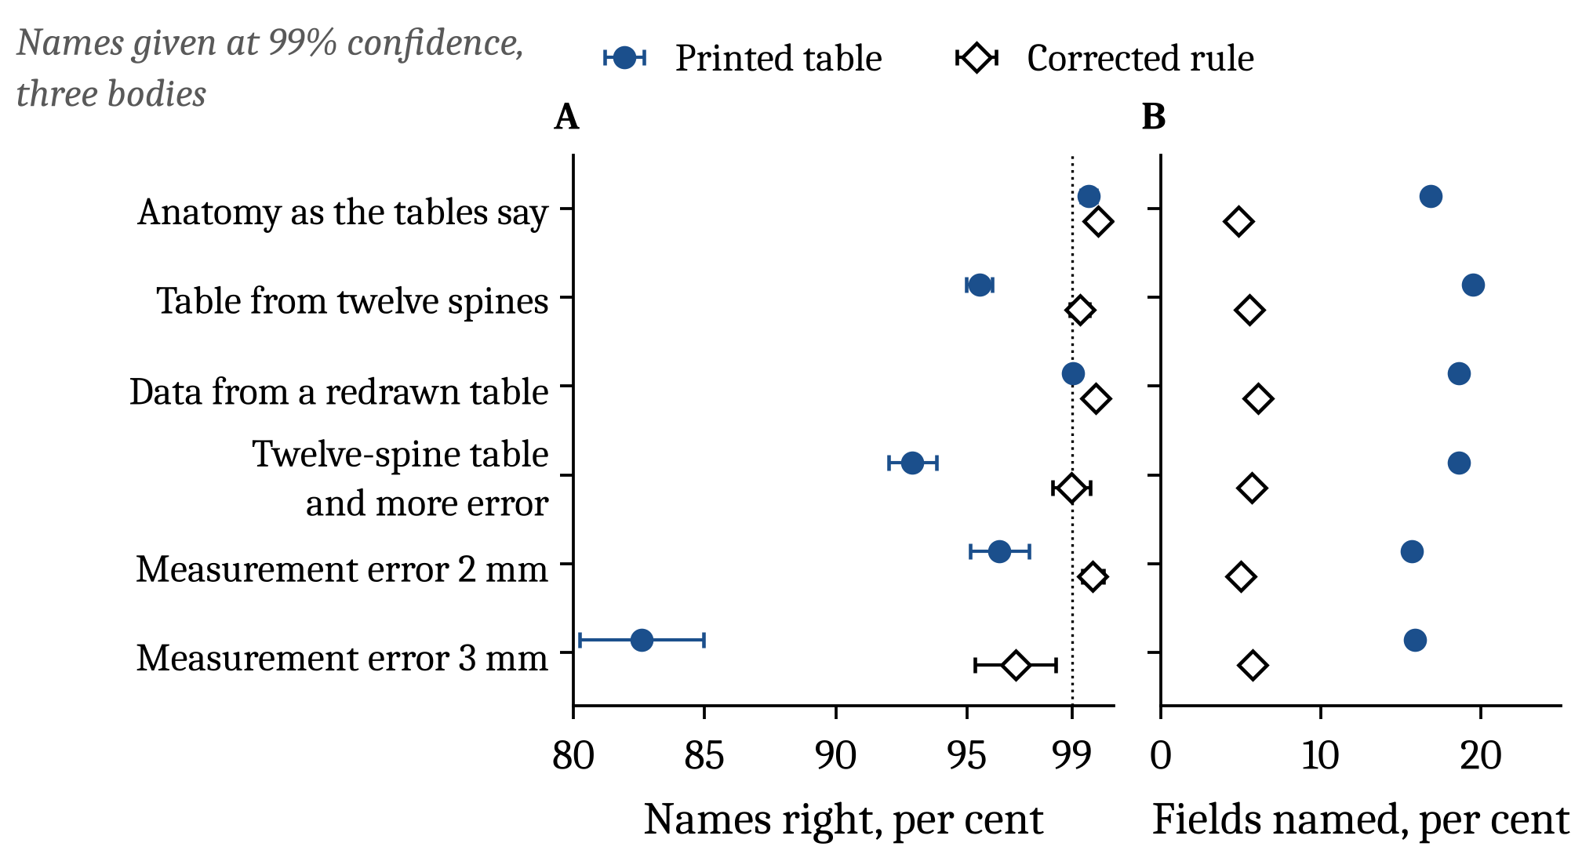
The weak point is the table, not the mathematics
95.5%
of three-body names at 99% confidence right when the rule's table is estimated from 12 spines, as Panjabi's tables are
99.3%
with a corrected rule, its one setting chosen on a separate pilot, but 5.5% of fields named, not 19.5%, and lumbar names right 96.7% (8 wrong of 246)
Next: test the rule on real full-spine CT.
Synthetic columns from Panjabi's published tables (Spine 1991;16:861, 888; 1992;17:299); no patient data.
Confidential: pre-filing draft, not for distribution
5 / 5
Notes:
Where can this go wrong? Not in the arithmetic: it is exact for the anatomy it assumes. The weak point is the anatomy table itself. Panjabi measured 12 spines; a rule built on a table that small, scored on synthetic spines drawn from a different table, is right 95.5% of the time when it says 99, not 99. A corrected rule, its one setting chosen on a separate pilot, is right 99.3% on those synthetic spines, but it then names only 5.5% of synthetic fields, and its lumbar names are right 96.7%. So the next step is to test the rule on real full-spine CT.

