Slide 1



Detroit Medical Center/Wayne State University
When the Cord Is Compressed:
Neuroradiology Essentials for Surgical Decision-Making in
Degenerative Spine Disease
MANS Lecture
Gregory Schwing, MD, PhD, PGY-1
Presented on 15AUG2026
Internal Use Only

Slide 2
Overview
Overview
Pre-operative intervention counseling
Signs of cord compression on MRI & Surgical decision-making
Post-operative recovery expectations and follow up intervals
Neuroradiology Essentials
Internal Use Only

Slide 3
Disclosures
Disclosures
No known financial or professional COI
Internal Use Only

Slide 4

Case Study
HPI
6 Months Ago
1 Months Ago
Progressive bilateral arm and neck pain
Bilaterally upper extremity weakness.
7 Years Ago
3 Months Ago
Develop left breast and left axillary mass but had repeatedly declined mammography, biopsy, imaging, treatment
Electric shock–like sensations radiating down the spine with neck movement
ACR Appropriateness Criteria® Myelopathy: 2026 Update. https://www.jacr.org/article/S1546-1440(26)00293-0/fulltext
Image: https://my.clevelandclinic.org/health/diseases/21966-myelopathy
Internal Use Only
Notes:
A woman in her 80s presented to the emergency department with a six-month history of progressive bilateral arm and neck pain. She described electric shock–like sensations radiating down the spine with neck movement, consistent with Lhermitte's phenomenon. She had a known left breast and left axillary mass that had been present for several years (first documented in 2019) but had repeatedly declined mammography, biopsy, imaging, and treatment. Her refusal of diagnostic workup was explicitly documented to have occurred in the setting of intact, demonstrated decision-making capacity.

Slide 5
Case Study
HPI
6 Months Ago
1 Months Ago
Progressive bilateral arm and neck pain
Bilaterally upper extremity weakness.
7 Years Ago
3 Months Ago
Develop left breast and left axillary mass but had repeatedly declined mammography, biopsy, imaging, treatment
Electric shock–like sensations radiating down the spine with neck movement
Internal Use Only
Notes:
A woman in her 80s presented to the emergency department with a six-month history of progressive bilateral arm and neck pain. She described electric shock–like sensations radiating down the spine with neck movement, consistent with Lhermitte's phenomenon. She had a known left breast and left axillary mass that had been present for several years (first documented in 2019) but had repeatedly declined mammography, biopsy, imaging, and treatment. Her refusal of diagnostic workup was explicitly documented to have occurred in the setting of intact, demonstrated decision-making capacity.

Slide 6
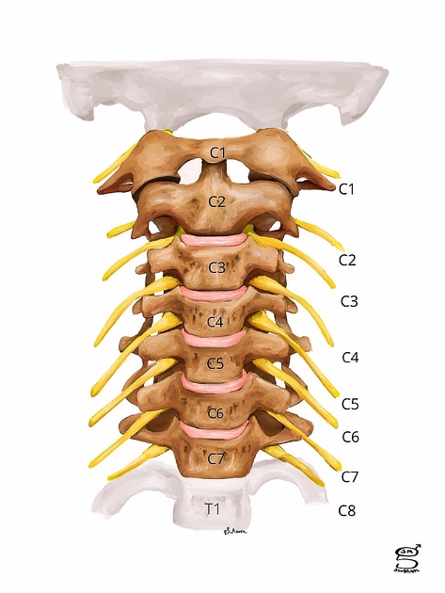
Case Study
Physical Exam
shoulder abduction (C5) was 2/5 bilaterally; this proximal deficit was noted at the bedside to be at least partly limited by pain
Elbow flexion and extension (C6) were 4/5 bilaterally.
Grip strength (C8/T1) was 5/5 bilaterally.
Lower-extremity strength was grossly preserved.
Hoffman's sign was negative, deep tendon reflexes were normal, and sensation was diminished. She denied bowel or bladder incontinence and had no saddle anesthesia.
Image: https://radiopaedia.org/cases/cervical-nerve-root-levels-illustration
Internal Use Only
Notes:
Localize the lesion

Slide 7
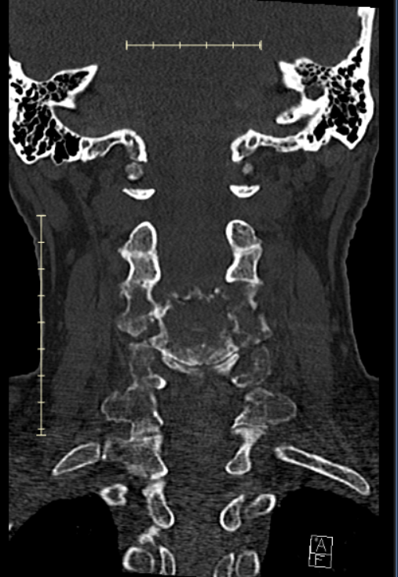
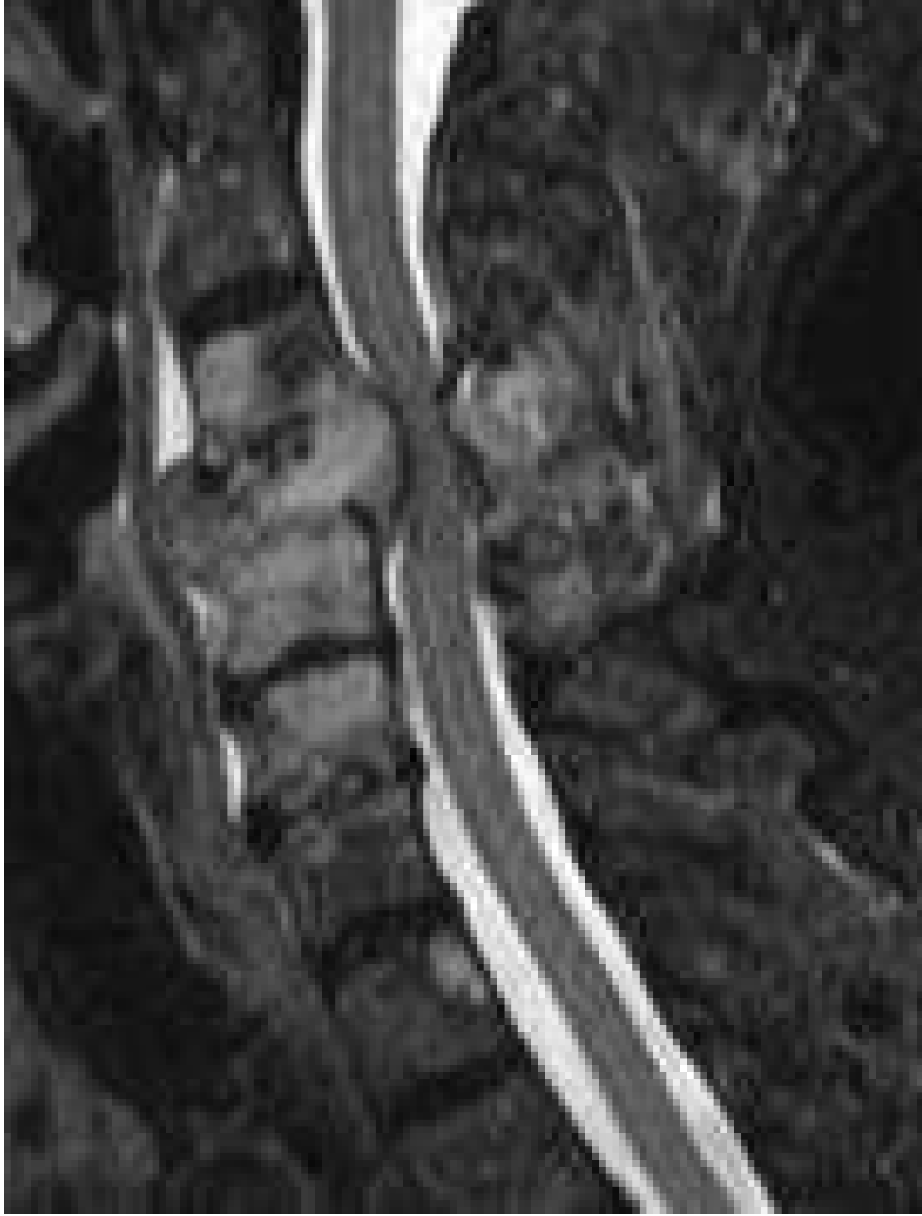
Case Study
Imaging
Non-contrast CT: severe pathologic compression deformity of C4
MRI w contrast: severe spinal canal stenosis, with mild myelopathy
Internal Use Only
Notes:
direct decompressive surgery followed by radiotherapy

Slide 8
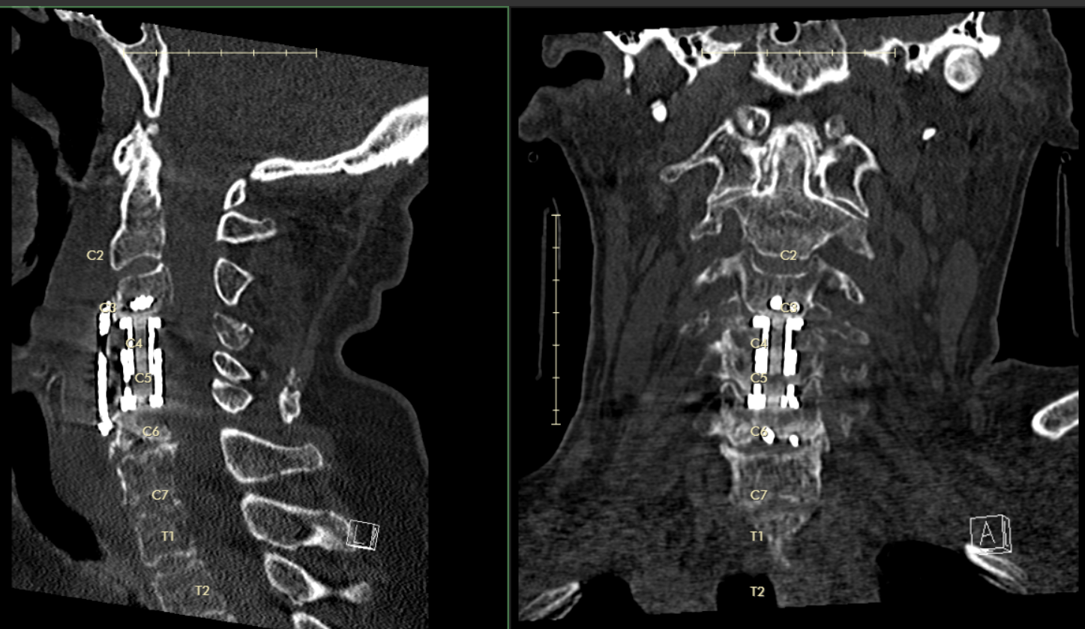
Case Study
Operative Management
Two-level (C4, C5) anterior cervical corpectomy with cage reconstruction and plating (C3–C6)
MEP/SSEP monitoring
Internal Use Only

Slide 9
Case Study
Outcome
Pre-operative function was preserved but no gains were made.
Declined radiotherapy, chemotherapy, and immunotherapy.
Discharged to SNF.
Placed on comfort-care six weeks later.
Internal Use Only

Slide 10
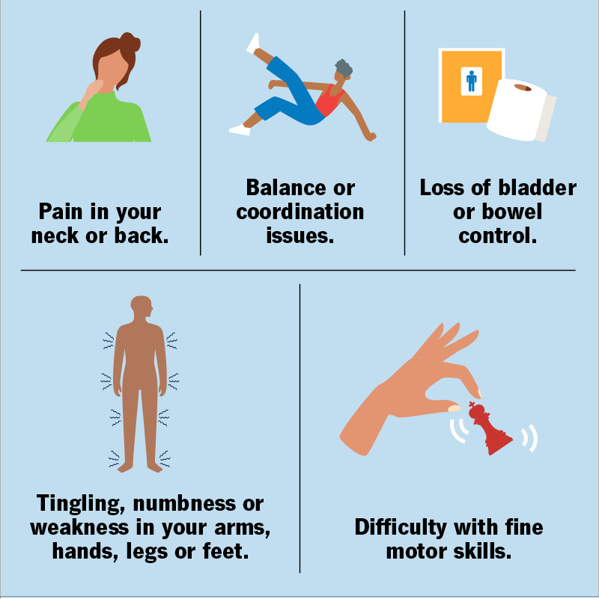
Background
Myelopathy aetiology
myelopathy → most often compressive → most often degenerative → degenerative compression is most often cervical.
Emergent priority — all patients require evaluation for cord compression¹
MRI spine area of interest without (and with) IV contrast is the imaging
mainstay for both acute and chronic/progressive onset myelopathy presentations¹
ACR Appropriateness Criteria® Myelopathy: 2026 Update. https://www.jacr.org/article/S1546-1440(26)00293-0/fulltext
Image: https://my.clevelandclinic.org/health/diseases/21966-myelopathy
Internal Use Only
Notes:
Degenerative cervical myelopathy (DCM) is the leading cause of spinal cord dysfunction in adults worldwide, necessitating timely diagnosis and treatment to prevent permanent disability.

Slide 11
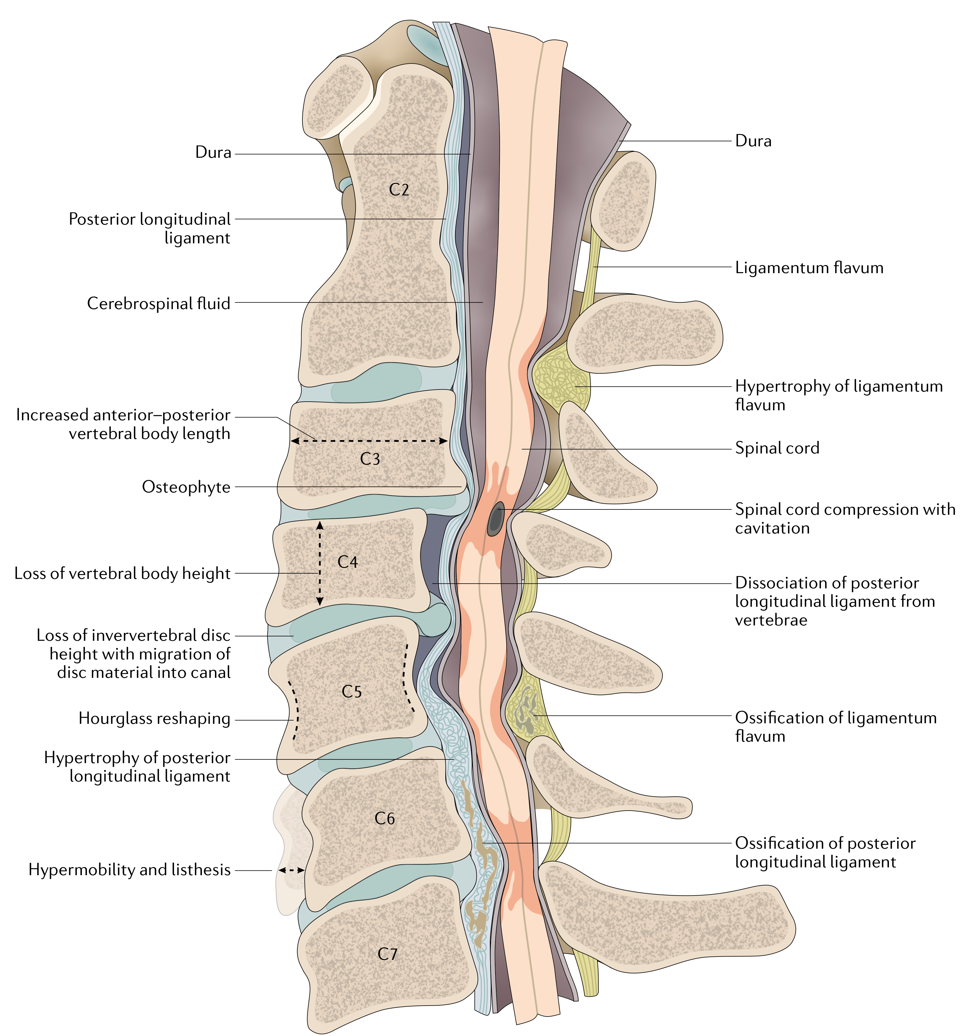
Background
Myelopathy acuity
Any acute nontraumatic myelopathy is a medical emergency until compression is excluded
Emergent (immediate, hours matter — surgical/decompressive)
Urgent (same-day workup and empiric therapy, but not immediately operative)
Non-emergent / elective (chronic degenerative cervical myelopathy)
Delayed decompression risks permanent, irreversible disability.
3. Laur O, MRI Primer for Emergency Department Radiologists. Radiographics.
Image: Badhiwala, Jetan H., et al. "Degenerative cervical myelopathy—update and future directions." Nature Reviews Neurology 16.2 (2020): 108-124.
Internal Use Only
Notes:
delayed decompression risks permanent, irreversible disability.

Slide 12
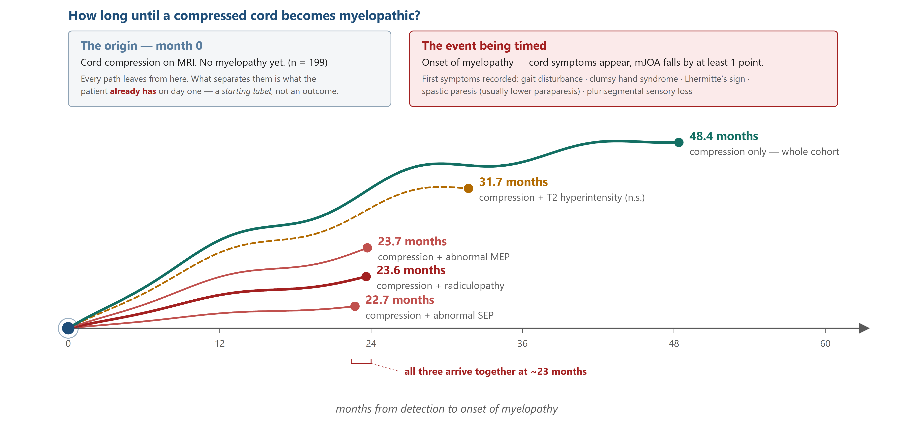
Background
Onset of Myelopathy
Bednarik J, Presymptomatic spondylotic cervical myelopathy: an updated predictive model. Eur Spine J 2008;17(3):421–431.
Internal Use Only
Notes:
199 patients with cord compression on MRI, no myelopathy, followed 2–12 yrs. 22.6% converted (mJOA drop ≥1 pt).
Numbers are 25th percentiles — the month by which 1 in 4 had converted.
Cohort 48.4 ·
T2 signal 31.7 (n.s. — if anything predicts later, not earlier) ·
MEP 23.7 ·
radiculopathy 23.6 ·
SEP 22.7 (last three P < 0.001, RR 2.9–3.7).
The exam predicts. No imaging measurement did.

Slide 13
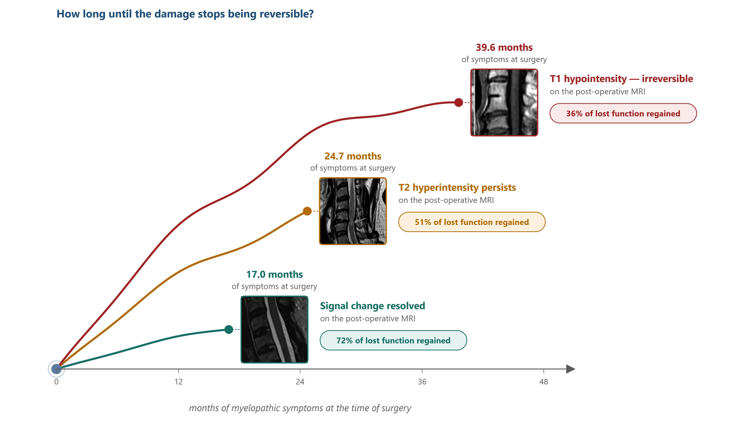
Background
Chronic Myelopathy timelines
Kato S, Nouri A, Reihani-Kermani H, et al. Postoperative resolution of MRI signal intensity changes and the associated impact on outcomes in degenerative cervical myelopathy. Spine 2018;43:824–831.
Internal Use Only
Notes:
Longer symptoms associate with less reversible cord signal
These numbers come from a subanalysis of two prospective multicentre AOSpine cohorts — CSM–North America and CSM–International. Of 757 surgically treated DCM patients, 298 had preoperative T2 hyperintensity and 167 had a complete postoperative MRI, obtained 6–24 months after decompression. Patients were grouped by what the cord looked like on that postoperative scan, then compared on symptom duration at surgery and on 2-year mJOA recovery rate (Hirabayashi method). Group comparisons used Kruskal–Wallis, α = 0.05.

Slide 14
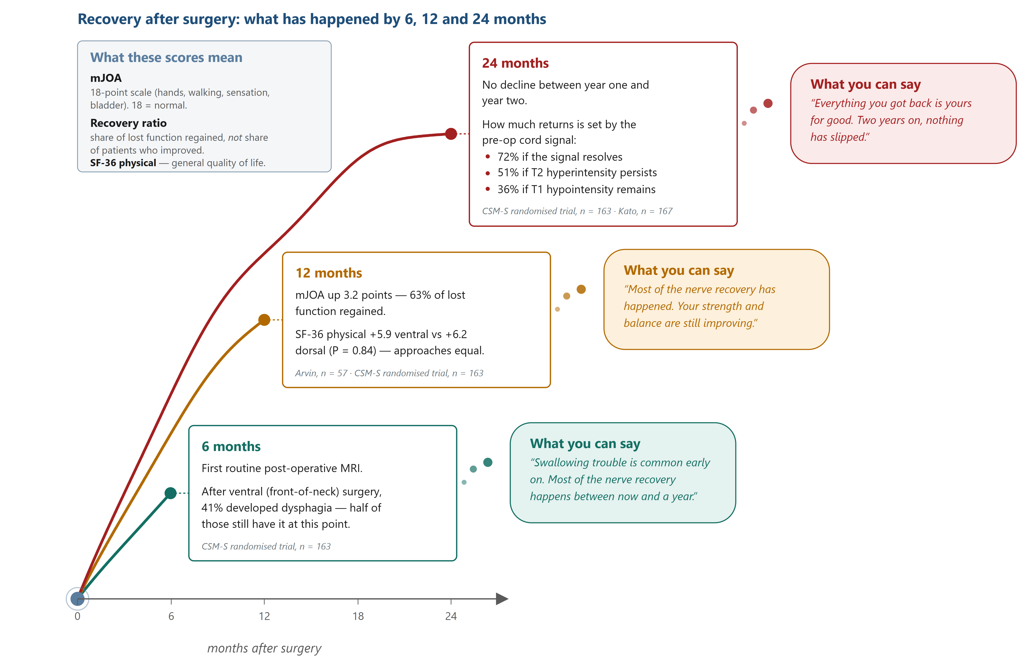
Background
Post-Op Recovery Timelines
Ghogawala Z, et al. Effect of ventral vs dorsal spinal surgery on patient-reported physical functioning in cervical spondylotic myelopathy: a randomized clinical trial. JAMA 2021;325(10):942–951. (CSM-S, n = 163)
Kato S, et al. Postoperative resolution of MRI signal intensity changes and the associated impact on outcomes in DCM. Spine 2018;43:824–831. (n = 167)
Internal Use Only
Notes:
CSM-S randomised trial (Ghogawala, JAMA 2021, n = 163) · Arvin (Spine 2013, n = 57, 1-yr follow-up 100%) · Kato (Spine 2018, n = 167).
6 mo — first routine post-op MRI. 41% dysphagia after ventral surgery; half still have it.
12 mo — mJOA +3.2 points, 63% of lost function regained. SF-36 physical +5.9 ventral vs +6.2 dorsal (P = 0.84) — approach equal.
24 mo — no decline from year one. Ceiling was set pre-op by cord signal: 72% / 51% / 36%.
Recovery lands by twelve months. Year two holds it.

Slide 15
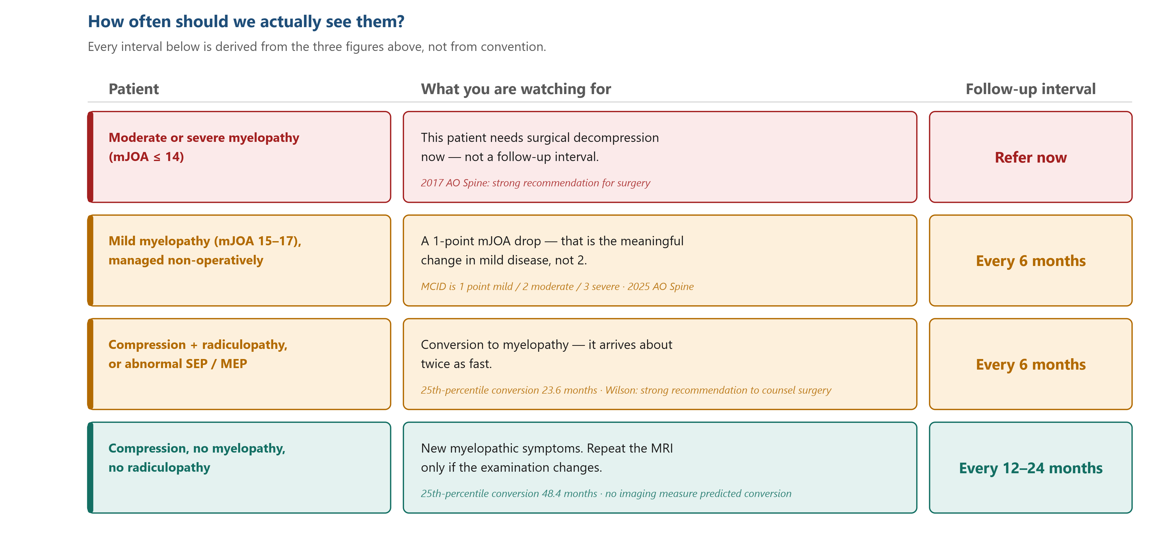
Background
Follow Up Intervals
Tetreault LA, et al. The minimum clinically important difference of the modified Japanese Orthopaedic Association scale in patients with degenerative cervical myelopathy. Spine 2015;40(21):1653–1659.
Internal Use Only
Notes:
Every interval here is derived from the three figures above, not from convention.
mJOA ≤ 14 — refer, don't schedule. 2017 AO Spine: strong recommendation for surgery in moderate and severe DCM.
Mild (15–17) — 6 months. Surgery is a valid option (2025 AO Spine, conditional; +1.26 QALY vs observation). Watch for a 1-point drop: MCID varies by severity — 1 mild / 2 moderate / 3 severe (Tetreault, n = 517) — so 1 point in a mild patient carries the weight 3 points does in a severe one.
Compression + radiculopathy or abnormal SEP/MEP — 6 months. Converts about twice as fast: 23.6 vs 48.4 months. Wilson: strong recommendation to counsel surgery (evidence moderate).
Compression alone — 12–24 months. Repeat MRI only if the examination changes.
If asked: mJOA has limited inter-observer reliability — mild vs moderate disagreement in >10% of patients (2025 AO Spine).

Slide 16
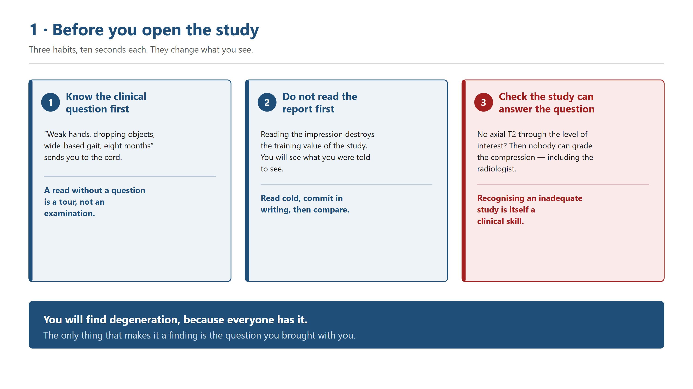
Ordering & Reading MRI
MountSinai.com [Image]
Internal Use Only

Slide 17
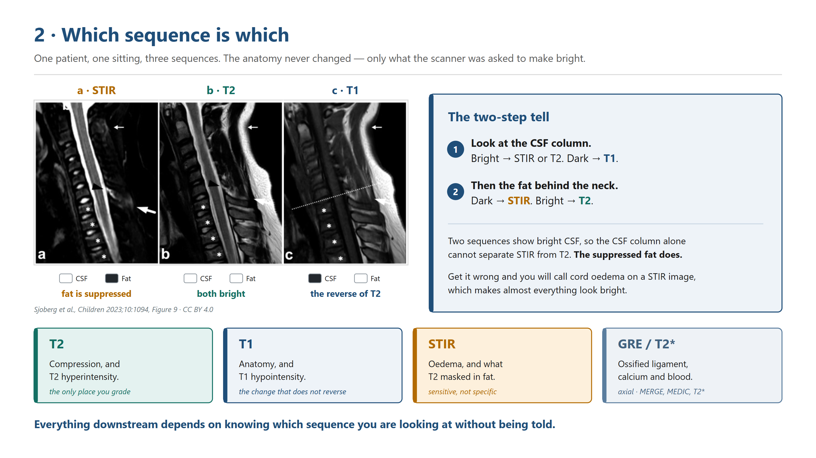
MountSinai.com [Image]
Internal Use Only

Slide 18
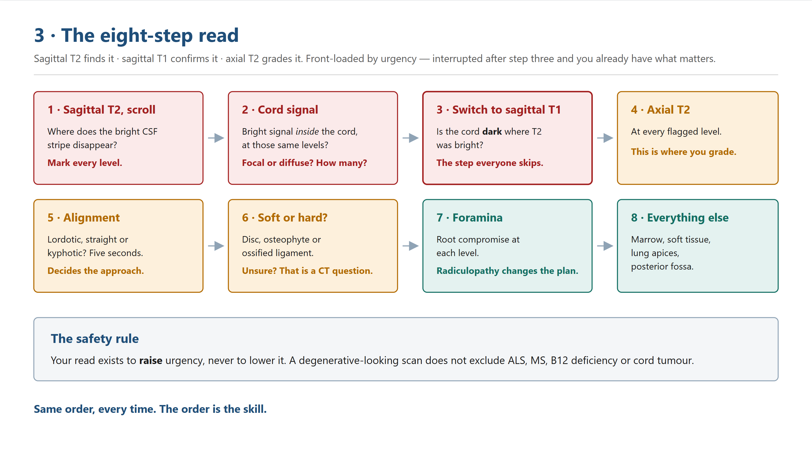
MountSinai.com [Image]
Internal Use Only

Slide 19
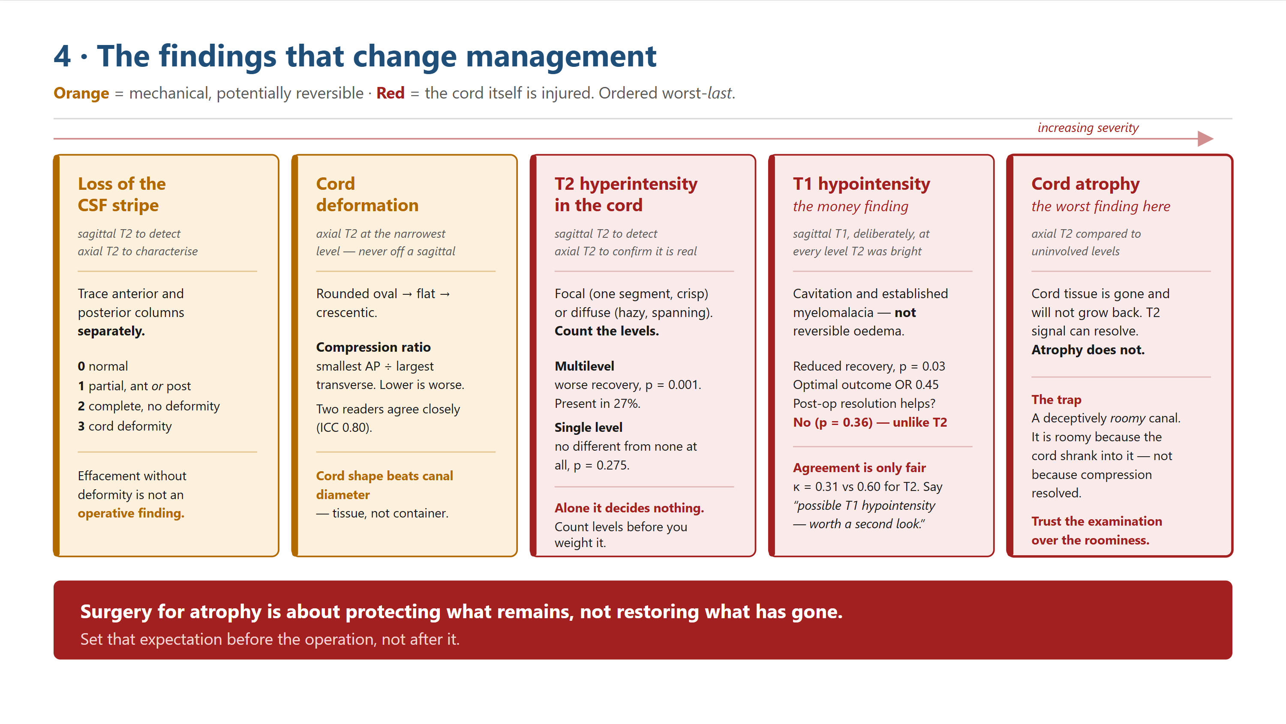
MountSinai.com [Image]
Internal Use Only

Slide 20
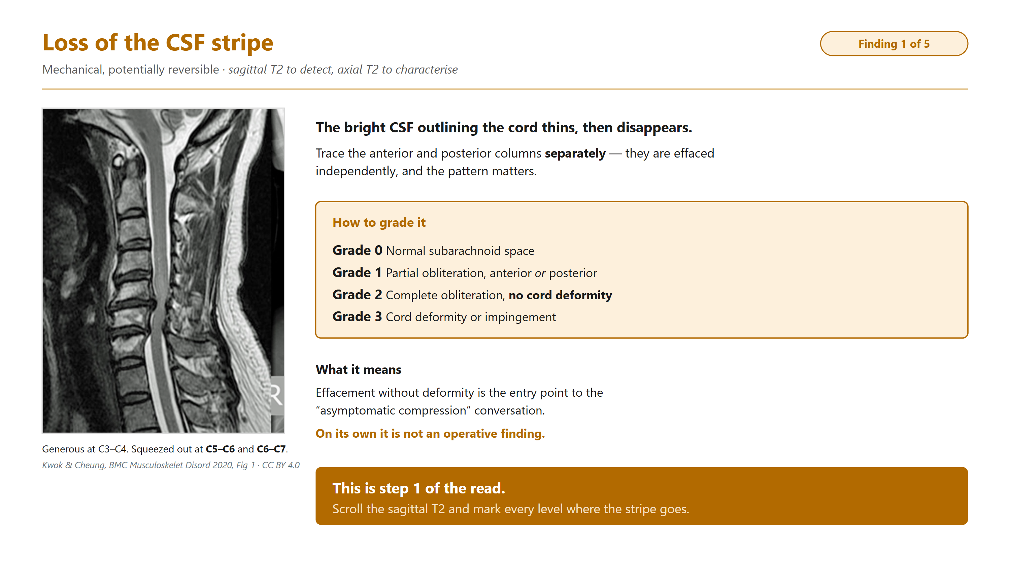
MountSinai.com [Image]
Internal Use Only

Slide 21
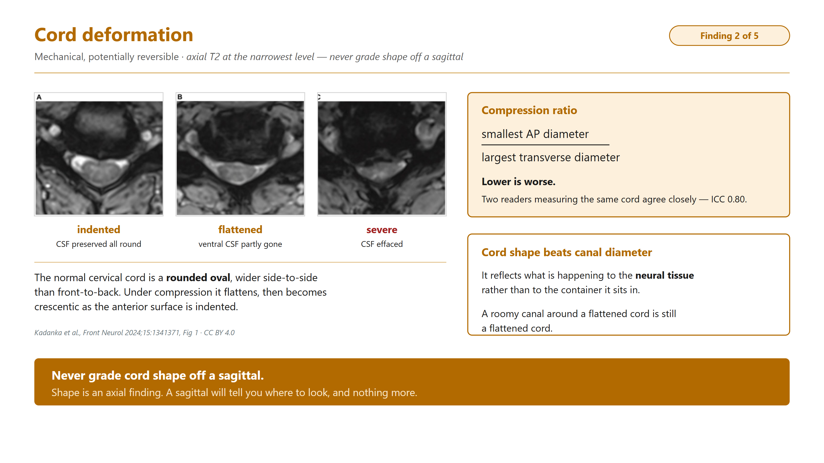
MountSinai.com [Image]
Internal Use Only

Slide 22
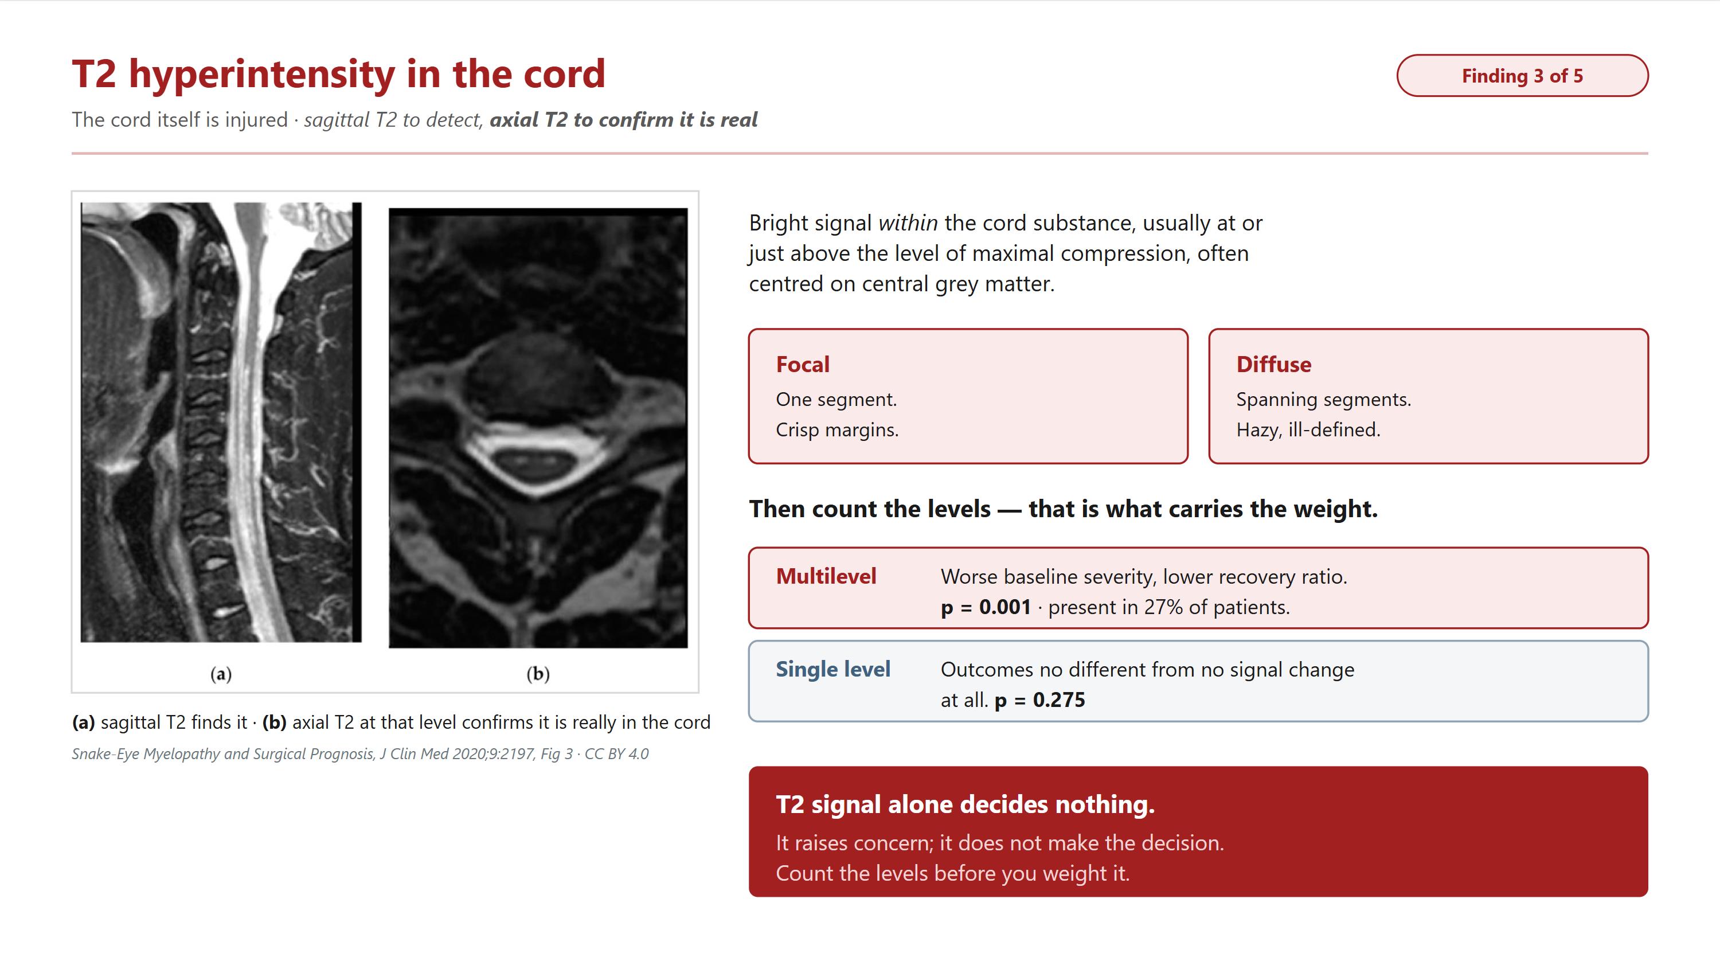
MountSinai.com [Image]
Internal Use Only

Slide 23
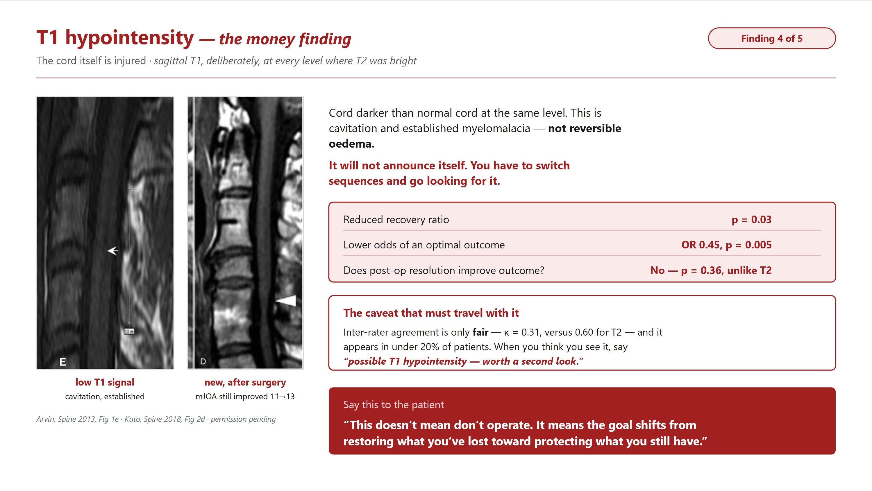
MountSinai.com [Image]
Internal Use Only

Slide 24
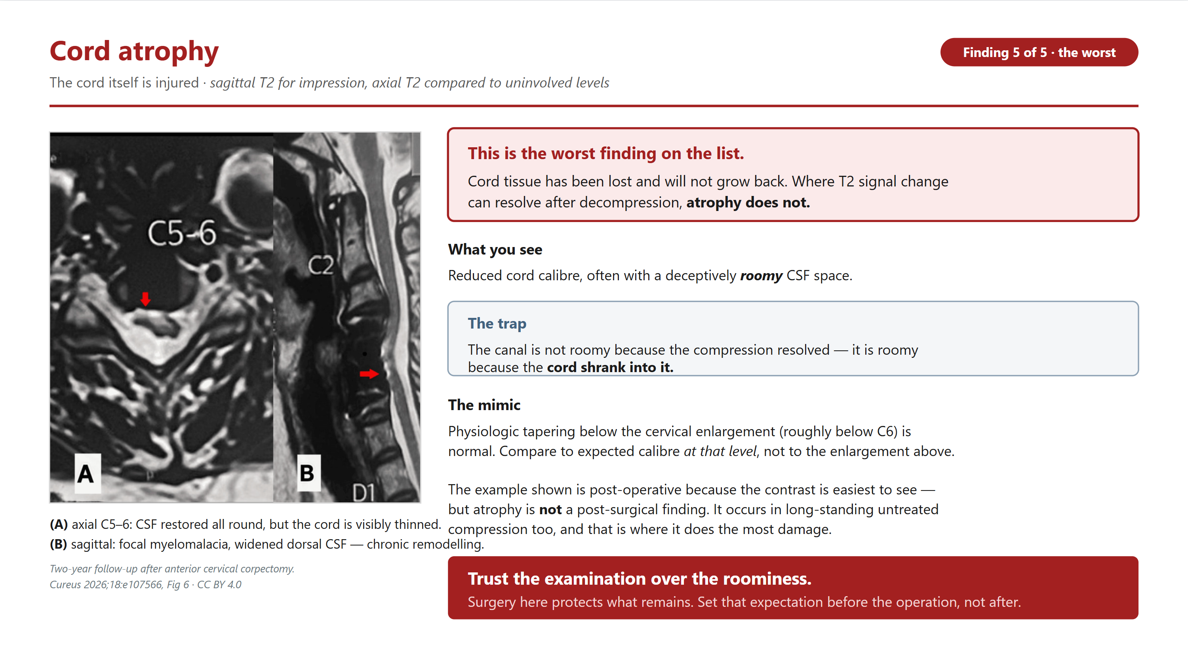
MountSinai.com [Image]
Internal Use Only

Slide 25
Detroit Medical Center/Wayne State University
Thank you for your attention!
https://openspineconsortium.com/spine-mri/index.html
Internal Use Only

