Slide 1
Not All Spines Are Created Equal: A Single-Shot CT Segmentation Model For Preoperative Detection Of Lumbar And Thoracic End Anomalies
Gregory J. Schwing, MD, PhD
Department of General Surgery, Detroit Medical Center and Wayne State University, Detroit, MI
CNS 2026 Annual Meeting, Washington, DC
Mini Podium 4, Spine Session 1 (MP4SP1) · Monday 2 November 2026, 5:21–6:00 PM · Podium 4, Ballroom ABC
Results from: Not All Spines Are Created Equal, NeurIPS 2026, Evaluations and Datasets track (accepted)
Notes:
I'm Greg Schwing, a general surgery resident at Wayne State and the Detroit Medical Center. Not all spines are created equal, and the ones that are not are expensive.

Slide 2

What a wrong site costs, and what avoiding it costs
Mehtsun WT, et al. Surgery 2013;153:465. Tan et al. Jt Comm J Qual Patient Saf 2023;49:265. Bettis T, et al. Patient Saf Surg 2026. Goodkin R, Laska LL. Surg Neurol 2004;61:323. Mody MG, et al. Spine 2008;33:194. Groff MW, et al. World Neurosurg 2013;79:585. Machin JT, et al. Eur Spine J 2018;27:2693. Harrison WD, et al. Ann R Coll Surg Engl 2015. AJNR Am J Neuroradiol 2023;44:618. Childers CP, Maggard-Gibbons M. JAMA Surg 2018;153:e176233.
Notes:
Start with the money. US malpractice payments for surgical never events reached 1.3 billion dollars, and one paid claim in four is wrong site. A closed wrong-site claim averages 136 thousand dollars, and spine leads that series. In litigated wrong-disc-level cases, 81 percent were paid. Nearly one spine surgeon in five has been sued for wrong level or side. The grey tiles are my own estimate: 420 to 1,900 wrong-level spine operations a year. And prevention costs too: a gold fiducial runs close to two thousand dollars a patient.

Slide 3


One CT, six lumbar bodies, and the labels slide a level
A, CT. B, the segmenter's output. C, ground truth, six lumbar bodies. Right, a six-lumbar spine in 3-D (Castellvi IV).
L5 Dice 0.94 on normal anatomy, 0.29 on lumbarization. L6 emitted: 0 of 1,152 CTs.
Wasserthal J, et al. Radiol Artif Intell 2023;5:e230024. Schwing GJ, et al. Not All Spines Are Created Equal: How CT Segmenters Fail on Lumbosacral Transitional Vertebrae. NeurIPS 2026 (accepted). Dataset article: arXiv 2609.22760, Fig. 2. CTSpinoPelvic1K, doi.org/10.5281/zenodo.22139642.
Notes:
Here's one reason. This is one patient. A is the CT. C is the truth: six lumbar bodies, the lowest in red. B is the most widely used open-source segmenter. It has no sixth lumbar class, so it squeezes six bodies into five labels, and below L2 every label is one level off. It looks fine, and nothing warns you. Its L5 Dice is 0.94 on normal anatomy and 0.29 on lumbarization. Across 1,152 CTs it never once said L6. On the right is a six-lumbar spine from CTSpinoPelvic1K, the public dataset I built to measure this: 802 patients, 33 transitional spines. The model I released merges L5 and L6 in training, which fixes the junction and the sacrum. It can't yet tell four lumbar bodies from five.

Slide 4
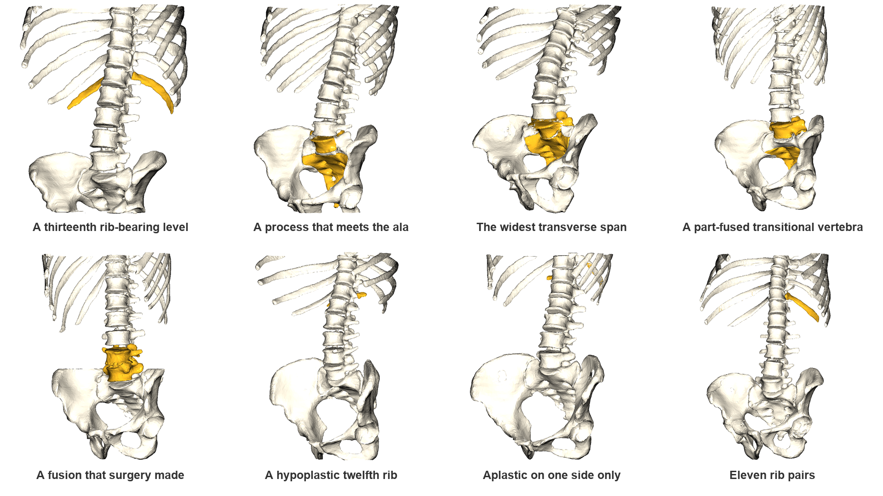
Not all spines are created equal
Turn each one yourself: openspineconsortium.com/data/gallery. Gold: what sets each spine apart. Surfaces from CTSpinoPelvic1K's labels (TCIA CT COLONOGRAPHY).
Notes:
Here are eight of them: a thirteenth rib-bearing level, a process meeting the ala, a part-fused transitional vertebra, a fusion surgery made, and twelfth ribs short, one-sided or missing. Each turns in our online gallery.
If asked: the surfaces are the gallery's own, decimated from the released segmentations; the titles say what is visible and name no level, because a transitional vertebra cannot be named from a field that does not reach C2.

Slide 5
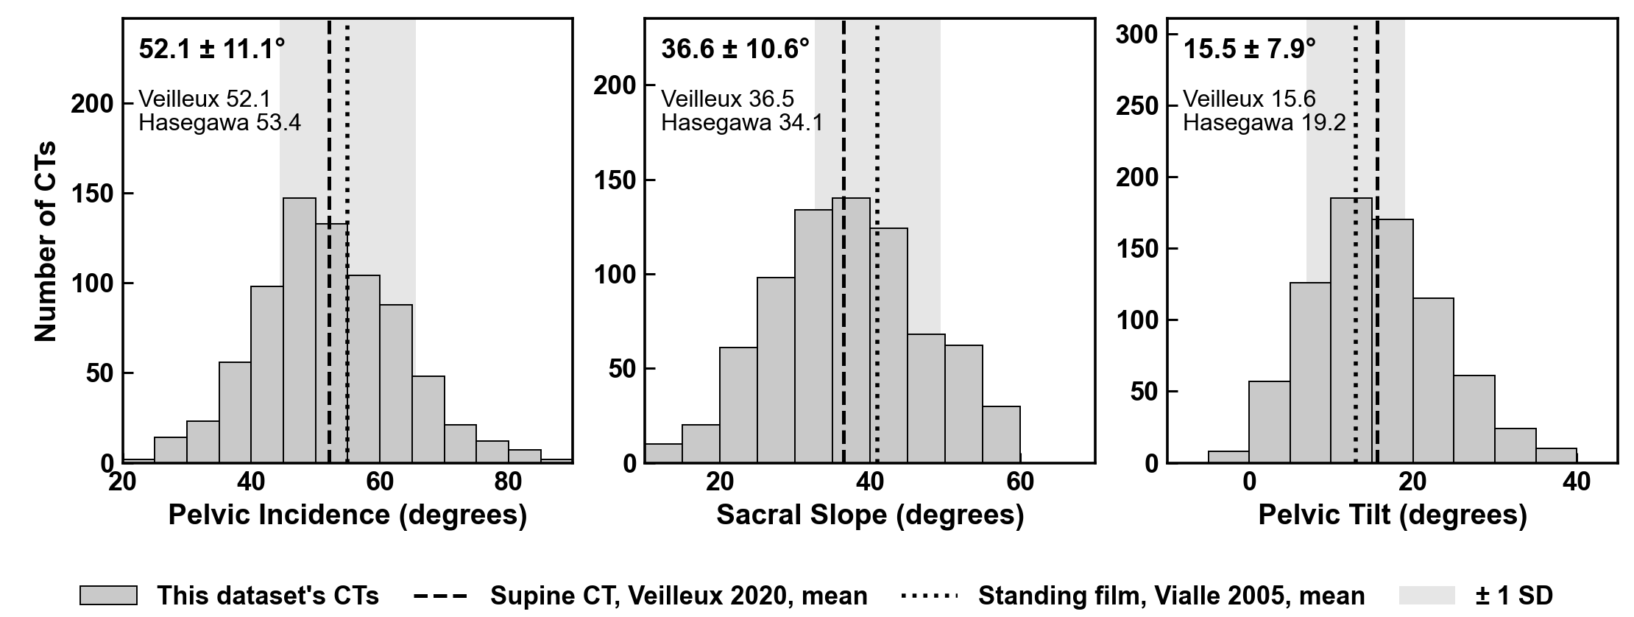

Spinopelvic angles match published supine CT
756 of 802 CTs passing the geometric gates; mean ± SD in each panel. Veilleux n = 200, Hasegawa n = 24, supine CT.
Veilleux NJ, et al. J Bone Joint Surg Am 2020;102:e130. Hasegawa K, et al. BMC Musculoskelet Disord 2018;19:437. Vialle R, et al. J Bone Joint Surg Am 2005;87:260. Dataset article: arXiv 2609.22760, Table III and Fig. S2.
Notes:
The same masks give the spinopelvic angles, in 756 of 802 patients: pelvic incidence 52.1 degrees, against 52.1 and 53.4 in the two published supine CT series, and sacral slope and pelvic tilt as close. The dashed line is standing film, a different posture.

Slide 6

The canal, T11 to L5, level by level
Median, interquartile range, 5th–95th percentile, n = 663–784 per level. Depth is the midsagittal chord at the pedicle.
Panjabi MM, et al. Spine 1991;16(8):888–901 and Spine 1992;17(3):299–306. Dataset article: arXiv 2609.22760, Fig. 3. CTSpinoPelvic1K, doi.org/10.5281/zenodo.22139642.
Notes:
And the canal, level by level from T11 to L5: depth holds near 17 millimeters, width opens from 20 to 30, and every median sits inside Panjabi's interval, now with a spread of its own.

Slide 7


The plot we learned from: one line per level
Left, vertebral body diameter (Fig. 1.1). Right, spinal canal diameter (Fig. 1.9). Benzel 2015; permission pending.
Benzel EC. Biomechanics of Spine Stabilization, 3rd ed. Thieme; 2015, chapter 1, Figs 1.1 and 1.9 (ISBN 978-1-60406-924-2). Figure data: Berry et al; Panjabi et al; White and Panjabi; Reynolds et al; McCormack et al.
Notes:
This is the textbook: Benzel, chapter 1. Body width and depth on the left, the canal on the right, one line per level, from cadaveric series of ten to thirty specimens, and no spread drawn.

Slide 8
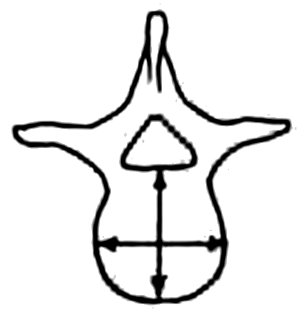
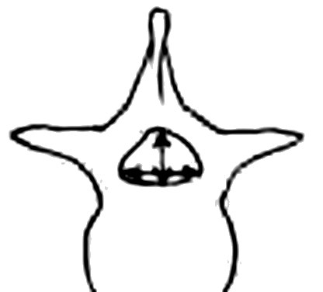

Benzel's plots, redrawn from our whole-spine CTs
Black: Benzel, digitised (permission pending). Gray: Panjabi, 12 cadavers. Purple: 984 adults' whole-spine CTs reweighted to his sex and age. Open circles: T13 and L6, every spine.
Benzel EC. Biomechanics of Spine Stabilization, 3rd ed. Thieme; 2015, ch. 1, Figs 1.1 and 1.9, digitised. Panjabi MM, et al. Spine 1991;16:861-869 and 888-901; Spine 1992;17:299-306. Gold tiers 3 and 4: public CT, C2 to the sacrum in view.
Notes:
Benzel's plots again, with our data on them. Gray is Panjabi's twelve cadavers. Purple is 984 adults' whole-spine CTs, reweighted to his sex and age: the canal's width sits within a millimeter of his. And the textbook has no place for a thirteenth thoracic or a sixth lumbar: here they are.
If asked: each of Panjabi's twelve specimens is matched to our adults of its sex within five years of its age, and the line is the mean of the twelve. T13 and L6 are every spine's means.

Slide 9
Benzel's plots, redrawn from our whole-spine CTs
Blue: our men, matched by age to Panjabi's 8 men. Red: our women, matched to his 4 women.
Benzel EC. Biomechanics of Spine Stabilization, 3rd ed. Thieme; 2015, ch. 1, Figs 1.1 and 1.9, digitised. Panjabi MM, et al. Spine 1991;16:861-869 and 888-901; Spine 1992;17:299-306. Gold tiers 3 and 4: public CT, C2 to the sacrum in view.
Notes:
Divide it by sex: men run 6 millimeters wider than women at L3, and his line sits between.
If asked: Panjabi gives no means by sex; these are the same matching over his men and his women alone.

Slide 10
Benzel's plots, redrawn from our whole-spine CTs
Gray: Tan, 10 Chinese Singaporean cadavers, 56 to 77 years. Green: our 73 adults inside their age, height and weight.
Tan SH, Teo EC, Chua HC. Eur Spine J 2004;13:137-146. Benzel EC. Biomechanics of Spine Stabilization, 3rd ed. Thieme; 2015, ch. 1, Figs 1.1 and 1.9, digitised. Gold tiers 3 and 4: public CT, C2 to the sacrum in view.
Notes:
An Asian series, Tan's cadavers, beside our adults of their age and build: smaller bodies.
If asked: Tan reports no sex; our 73 adults in their ranges are 16 men. Their canal was measured on dry bone with a digitiser, a third shallower than Panjabi's.

Slide 11
Benzel's plots, redrawn from our whole-spine CTs
Gray: Alonge, 120 Nigerian adults' CTs, L1 to L5; width at the widest pedicle cut. Orange: our adults reweighted to their sex and age.
Alonge OJ, Adeolu AA, Omololu AB, Atalabi OM. Afr J Med Med Sci 2021;50:69-76. Benzel EC. Biomechanics of Spine Stabilization, 3rd ed. Thieme; 2015, ch. 1, Figs 1.1 and 1.9, digitised. Gold tiers 3 and 4: public CT, C2 to the sacrum in view.
Notes:
An African series, Alonge's Nigerian adults on CT, against ours reweighted to them.
If asked: no African American series in the literature I hold measures these chords; the Hamann-Todd skeletons give pedicles only. Alonge's width is interpedicular, which is why it climbs to L5.

Slide 12
Benzel's plots, redrawn from our whole-spine CTs
Every decade apart, 20s to 80s. Blue, men; red, women; the deeper the colour, the farther the decade's mean age from Panjabi's cadavers' 46. 17 to 148 adults a line; canal depth not shown by decade.
Benzel EC. Biomechanics of Spine Stabilization, 3rd ed. Thieme; 2015, ch. 1, Figs 1.1 and 1.9, digitised. Panjabi MM, et al. Spine 1991;16:861-869 and 888-901; Spine 1992;17:299-306. Gold tiers 3 and 4: public CT, C2 to the sacrum in view.
Notes:
Now every decade of each sex. The farther from his cadavers' age, the deeper the colour, and the further the line strays from his.
If asked: the decades are unweighted means of every adult of that sex and decade, ten or more a level. Canal depth is left out by decade because on the CT it reads deeper with age, 16 to 23 mm at L3, the opposite of what age does: the reading leaks in older bone, and is being fixed.

Slide 13
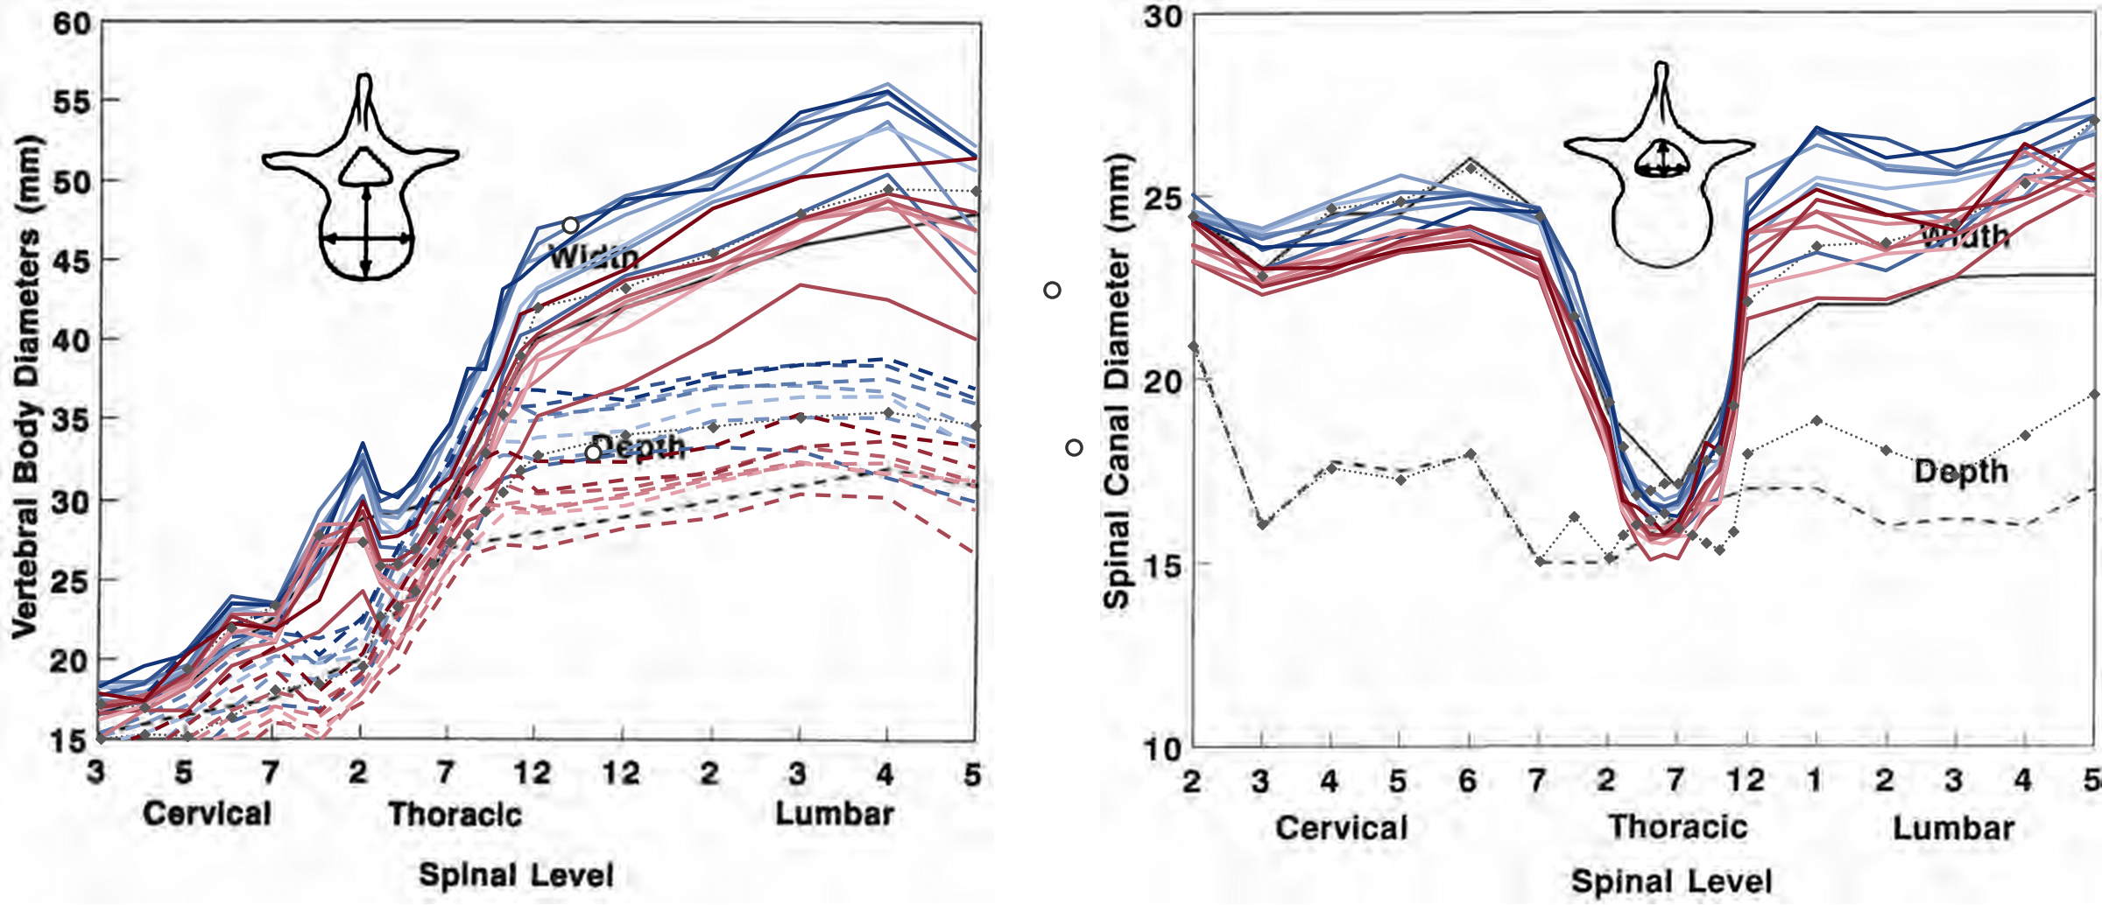
Each spine, its own fingerprint
Each decade's width and depth as one curve; four spines built from one CT, widened and deepened to their decade's means, each lit with its line; then every line becomes a ridge.
Spines: one ENHANCE.PET 1.6k whole-body CT, its vertebrae scaled level by level. Gold tiers 3 and 4: public CT, C2 to the sacrum in view.
Notes:
Turn the plot into depth and the decades come apart. Each line is a spine of its own. Every spine has its own fingerprint.
If asked: the four spines are one CT's vertebrae, each scaled about its own centre by its decade's mean width and depth over every decade's mean; the fingerprint is a drawing of the lines, not data.

Slide 14

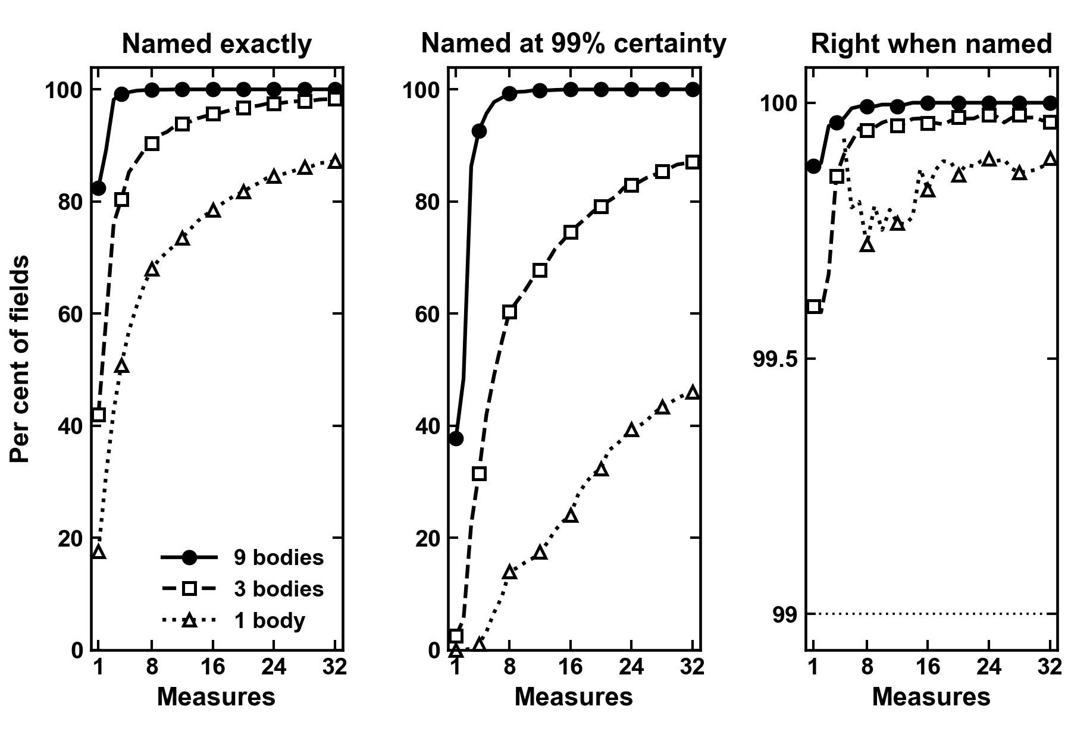
More bodies in view, surer names
Typical synthetic spines from the measured population, 2,000 of them, as the measures are added up to all 32: per cent of fields named exactly, named at 99 per cent certainty, and right when so named; 1, 3 and 9 bodies in view.
Synthetic validation, bordercall build-up study, records 2026-10-28; unpublished. Gold tiers 3 and 4: public CT, C2 to the sacrum in view.
Notes:
The more of a spine you see, the surer the name. With three bodies and all 32 measures, 98 per cent are named exactly; with nine, every one, at 99 per cent certainty, and every one right.
If asked: these are typical columns drawn from the gold tier's own measures and correlations; the rule reads every body in view at once. Of fields it names at 0.99, 99.6 to 100 per cent are right at every point drawn.

Slide 15

Masked CT in, vertebrae out
Masked CT in; vertebrae detected, predicted and classified out. Map colour is true level. Work in progress; not a cleared device.
CT and labels: CTSpinoPelvic1K, doi.org/10.5281/zenodo.22139642. VerSe: Sekuboyina A, et al. Med Image Anal 2021;73:102166. Public, de-identified data. Unpublished results.
Notes:
So what do masks buy you? Masked CT goes in. Vertebrae come out: detected, predicted and classified, including the sixth lumbar the segmenter could not name. Each dot is one vertebra, coloured by its true level, and the levels sort themselves.

Slide 16
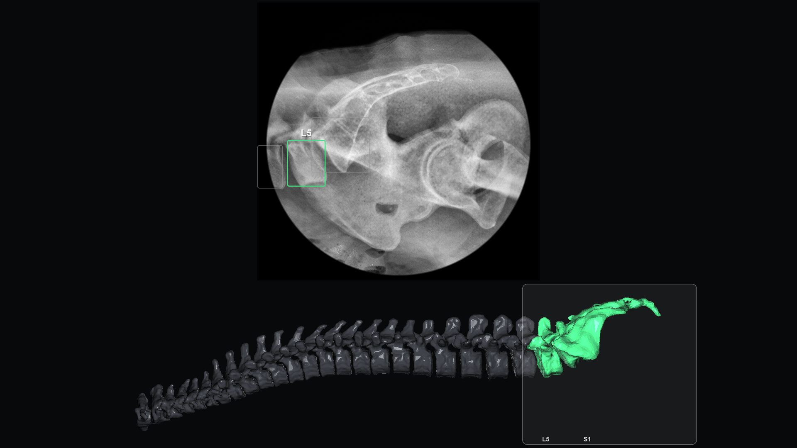
Panning up from the sacrum
Patent pending. X-ray frames made from one public whole-body CT the model never saw (ENHANCE.PET 1.6k).
Notes:
Last, a lateral pan up from the sacrum, prone, as in the room. Each body is found as it comes into view and named counting up from the sacrum, through the thoracic spine to the neck, and the three-dimensional map fills in as it goes.
If asked: the frames are made from a public CT, not a patient exposure: its shoulder bones softened, the shoulders cut away and the thoracic bodies weighted up, as a swimmer's view would show them. Boxes are the detector's own, read at a lower floor over each frame and its mirror image, and kept only on the spine's column; all 23 named bodies, L5 to C2, are counted up from the L5 it named itself, every one as the CT labels it.

Slide 17


The end. Thank you
With thanks to Patrick Schwing (LSU Health Sciences Center New Orleans); Miraziz Ismoilov and Nizar Alnabahneh (Radiology) and Loren Schwiebert (Computer Science), Wayne State University; and the annotators Ashley Schehr, Annika Tekumulla, Margret Khoushi, Ryan Christian, Dane Hubers, Faris Mahjoub, Hassan Saad, Mia Sooch, Sathyagopal Siddapureddy, Michael McLellan and Jerick Kim
Data: CTSpinoPelvic1K (doi.org/10.5281/zenodo.22139642), built on CTSpine1K, CTPelvic1K and The Cancer Imaging Archive; all de-identified
Paper: Not All Spines Are Created Equal, NeurIPS 2026, Evaluations and Datasets track (accepted)
Funding: NIH NIGMS F30GM147909. No commercial support.
Evidence status: retrospective, public de-identified data; small transitional strata; not a cleared device.
openspineconsortium.com
Weights and code:
github.com/OpenSpineConsortium/spinopelvic-seg
huggingface.co/OpenSpineConsortium
Questions
gregory.schwing@med.wayne.edu
Notes:
That is the end. The CT side is public: the data on Zenodo, the weights and code on GitHub. Thank you to the students and radiology residents who built it, and thank you for listening.

