Slide 1
Not All Spines Are Created Equal: A Single-Shot CT Segmentation Model For Preoperative Detection Of Lumbar And Thoracic End Anomalies
Gregory J. Schwing, MD, PhD
Department of General Surgery, Detroit Medical Center and Wayne State University, Detroit, MI
CNS 2026 Annual Meeting, Washington, DC
Mini Podium 4, Spine Session 1 (MP4SP1) · Monday 2 November 2026, 5:21–6:00 PM · Podium 4, Ballroom ABC
Results from: Not All Spines Are Created Equal, NeurIPS 2026, Evaluations and Datasets track (accepted)
Notes:
I'm Greg Schwing, a general surgery resident at Wayne State and the Detroit Medical Center. Not all spines are created equal, and the ones that are not are expensive.

Slide 2

What a wrong site costs, and what avoiding it costs
Mehtsun WT, et al. Surgery 2013;153:465. Tan et al. Jt Comm J Qual Patient Saf 2023;49:265. Bettis T, et al. Patient Saf Surg 2026. Goodkin R, Laska LL. Surg Neurol 2004;61:323. Mody MG, et al. Spine 2008;33:194. Groff MW, et al. World Neurosurg 2013;79:585. Machin JT, et al. Eur Spine J 2018;27:2693. Harrison WD, et al. Ann R Coll Surg Engl 2015. AJNR Am J Neuroradiol 2023;44:618. Childers CP, Maggard-Gibbons M. JAMA Surg 2018;153:e176233.
Notes:
Start with the money. US malpractice payments for surgical never events reached 1.3 billion dollars, and one paid claim in four is wrong site. A closed wrong-site claim averages 136 thousand dollars, and spine leads that series. In litigated wrong-disc-level cases, 81 percent were paid. Nearly one spine surgeon in five has been sued for wrong level or side. The grey tiles are my own estimate: 420 to 1,900 wrong-level spine operations a year. And prevention costs too: a gold fiducial runs close to two thousand dollars a patient.

Slide 3


One CT, six lumbar bodies, and the labels slide a level
A, CT. B, the segmenter's output. C, ground truth, six lumbar bodies. Right, a six-lumbar spine in 3-D (Castellvi IV).
L5 Dice 0.94 on normal anatomy, 0.29 on lumbarization. L6 emitted: 0 of 1,152 CTs.
Wasserthal J, et al. Radiol Artif Intell 2023;5:e230024. Schwing GJ, et al. Not All Spines Are Created Equal: How CT Segmenters Fail on Lumbosacral Transitional Vertebrae. NeurIPS 2026 (accepted). Dataset article: arXiv 2609.22760, Fig. 2. CTSpinoPelvic1K, doi.org/10.5281/zenodo.22139642.
Notes:
Here's one reason. This is one patient. A is the CT. C is the truth: six lumbar bodies, the lowest in red. B is the most widely used open-source segmenter. It has no sixth lumbar class, so it squeezes six bodies into five labels, and below L2 every label is one level off. It looks fine, and nothing warns you. Its L5 Dice is 0.94 on normal anatomy and 0.29 on lumbarization. Across 1,152 CTs it never once said L6. On the right is a six-lumbar spine from CTSpinoPelvic1K, the public dataset I built to measure this: 802 patients, 33 transitional spines. The model I released merges L5 and L6 in training, which fixes the junction and the sacrum. It can't yet tell four lumbar bodies from five.

Slide 4


The plot we learned from: one line per level
Left, vertebral body diameter (Fig. 1.1). Right, spinal canal diameter (Fig. 1.9). Benzel 2015; permission pending.
Benzel EC. Biomechanics of Spine Stabilization, 3rd ed. Thieme; 2015, chapter 1, Figs 1.1 and 1.9 (ISBN 978-1-60406-924-2). Figure data: Berry et al; Panjabi et al; White and Panjabi; Reynolds et al; McCormack et al.
Notes:
Those five labels assume a textbook spine. This is the textbook: Benzel, chapter 1. Vertebral body width and depth on the left, the canal on the right, one line per level. These lines come from cadaveric series of ten to thirty specimens, and no spread is drawn. They cannot tell you whether the patient in front of you is unusual.

Slide 5
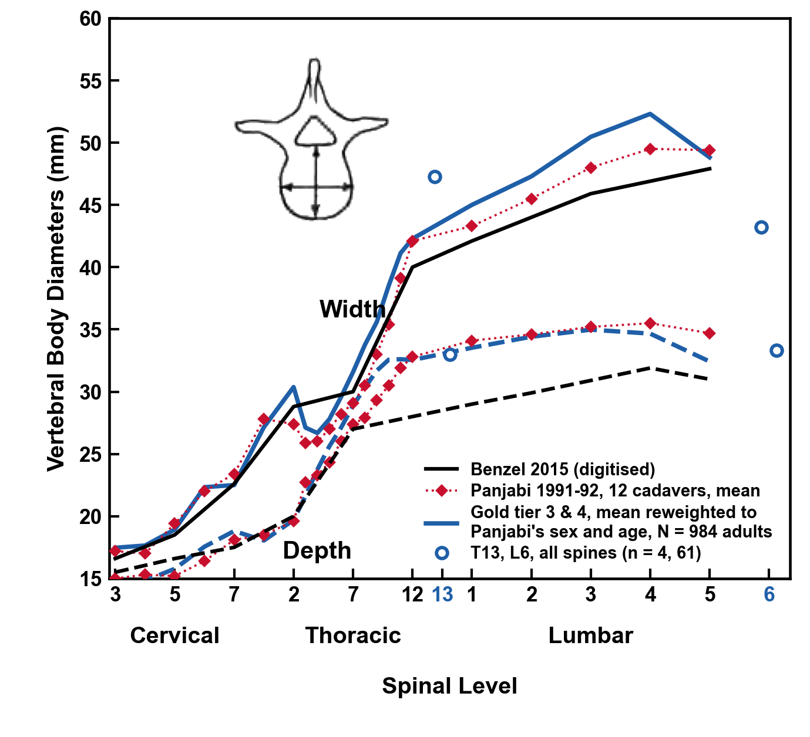
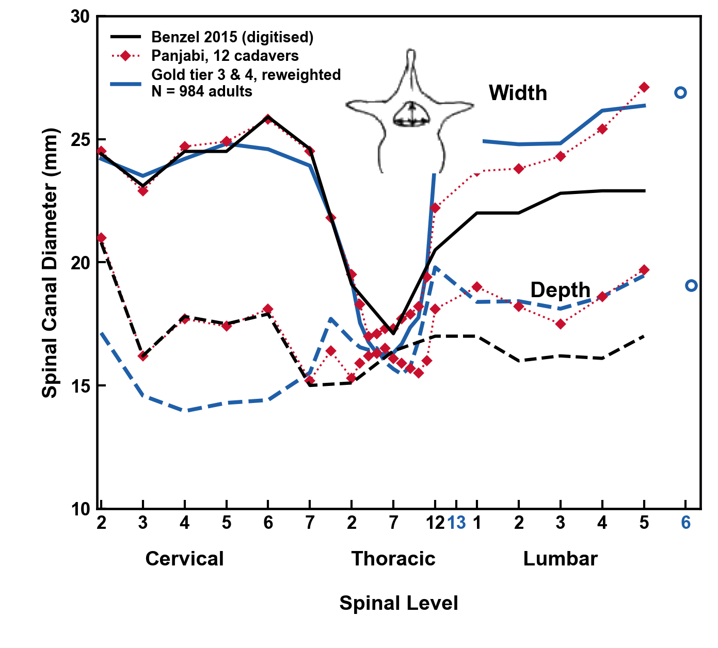

The same plots, matched to Panjabi's cadavers
Black: Benzel, digitised (permission pending). Red: Panjabi, 12 cadavers. Blue: 984 adults' whole-spine CTs reweighted to his sex and age. Width at the lower end plate, depth at the upper.
Benzel EC. Biomechanics of Spine Stabilization, 3rd ed. Thieme; 2015, ch. 1, Figs 1.1 and 1.9, digitised. Panjabi MM, et al. Spine 1991;16:861-869 and 888-901; Spine 1992;17:299-306. Gold tiers 3 and 4: public CT, C2 to the sacrum in view.
Notes:
Same two plots. Black is Benzel. Red is Panjabi's twelve cadavers; in the neck Benzel's canal figure is Panjabi's, number for number. Blue is 984 adults' CT scans of the whole spine, reweighted to his cadavers' sex and age. The canal's width sits on Panjabi's line, 0.7 millimeters from it on average, and the body's depth 1.0. But the textbook has no place for a thirteenth thoracic or a sixth lumbar vertebra: here they are, 4 and 61 spines.
If asked about the gaps: the canal is read on the CT, soft tissue flood-filled behind the body inside a ring of bone, its width within 2.0 mm of Panjabi at every level. The neck's depth reads up to 4 mm under his, as CT series of the neck do; his twelve cadavers are not a CT population. The body's width is the lower end plate's over its front half, which leaves out the pedicle bases and the transverse processes' roots: 1.5 mm from Panjabi's lower plate on average, at most 3.3; the upper plate's width takes in the uncinate processes in the neck, and the lower plate's depth its anterior lip, so each chord is read on the plate that is clean of them. T13 rests on 4 spines and is shown for its place, not its number.

Slide 6

The canal, T11 to L5, level by level
Median, interquartile range, 5th–95th percentile, n = 663–784 per level. Depth is the midsagittal chord at the pedicle.
Panjabi MM, et al. Spine 1991;16(8):888–901 and Spine 1992;17(3):299–306. Dataset article: arXiv 2609.22760, Fig. 3. CTSpinoPelvic1K, doi.org/10.5281/zenodo.22139642.
Notes:
The canal, T11 to L5, this time with L5. Depth is a midsagittal chord at the pedicle, not a maximum extent, because that is what the normative series measure. It holds near 17 millimeters at every level. Width opens from 20 to 30. Every median sits inside Panjabi's interval, and now each level has its own spread.

Slide 7

Spinopelvic angles match published supine CT
756 of 802 records passing the geometric gates, mean ± SD. Veilleux n = 200, Hasegawa n = 24. Band, standing mean ± SD.
Veilleux NJ, et al. J Bone Joint Surg Am 2020;102:e130. Hasegawa K, et al. BMC Musculoskelet Disord 2018;19:437. Vialle R, et al. J Bone Joint Surg Am 2005;87:260. Dataset article: arXiv 2609.22760, Table III and Fig. S2.
Notes:
The same masks give the spinopelvic angles, in the 756 of 802 patients that pass the geometric gates. Pelvic incidence 52.1 degrees, against 52.1 and 53.4 in the two published supine CT series. Sacral slope 36.6, against 36.5 and 34.1. Pelvic tilt 15.5, against 15.6 and 19.2. The dashed line is standing film, a different posture. I call these provisional until the sacral plate comes from a substructure label, but the pelvis in these masks measures what published CT measures.

Slide 8

Masked CT in, vertebrae out
Masked CT in; vertebrae detected, predicted and classified out. Map colour is true level. Work in progress; not a cleared device.
CT and labels: CTSpinoPelvic1K, doi.org/10.5281/zenodo.22139642. VerSe: Sekuboyina A, et al. Med Image Anal 2021;73:102166. Public, de-identified data. Unpublished results.
Notes:
So what do masks buy you? This. Masked CT goes in. Vertebrae come out: detected, predicted, classified, including the sixth lumbar vertebra the segmenter could not name. Each dot on the right is one vertebra, coloured by its true level, and the levels sort themselves. I am showing you what it does, not how. This part is unpublished work in progress.

Slide 9

The end. Thank you
With thanks to Patrick Schwing (LSU Health Sciences Center New Orleans); Miraziz Ismoilov and Nizar Alnabahneh (Radiology) and Loren Schwiebert (Computer Science), Wayne State University; and the annotators Ashley Schehr, Annika Tekumulla, Margret Khoushi, Ryan Christian, Dane Hubers, Faris Mahjoub, Hassan Saad, Mia Sooch, Sathyagopal Siddapureddy, Michael McLellan and Jerick Kim
Data: CTSpinoPelvic1K (doi.org/10.5281/zenodo.22139642), built on CTSpine1K, CTPelvic1K and The Cancer Imaging Archive; all de-identified
Paper: Not All Spines Are Created Equal, NeurIPS 2026, Evaluations and Datasets track (accepted)
Funding: NIH NIGMS F30GM147909. No commercial support.
Evidence status: retrospective, public de-identified data; small transitional strata; not a cleared device.
Weights and code:
github.com/OpenSpineConsortium/spinopelvic-seg
huggingface.co/OpenSpineConsortium
Questions
gregory.schwing@med.wayne.edu
Notes:
That is the end. The CT side is public: the data on Zenodo, the weights and code on GitHub. Thank you to the students and radiology residents who built it, and thank you for listening.

