Slide 1

43RD ANNUAL MEETING · AMERICAN ASSOCIATION OF CLINICAL ANATOMISTS
Tech Fair · Mayo Clinic, Rochester MN · June 12–15, 2026
Harnessing Algorithmic Disagreement
for Automated Lumbosacral Transitional Vertebrae Detection
Gregory J. Schwing, MD, PhD
Department of Neurosurgery · Spine Imaging & AI
Wayne State University School of Medicine · NIH F30 Fellow

Slide 2
THE CLINICAL PROBLEM
When you can't count the vertebrae, you operate on the wrong one
4–36%
~30%
4–8%
Population prevalence of LSTV across imaging modalities
Of studies mis-number lumbar levels without whole-spine imaging
Of low-back-pain patients carry symptomatic Bertolotti anatomy
Why it matters in the operating room
Wrong-level surgery — a transitional vertebra shifts every level count below it.
Distorted surgical anatomy — pedicle screw trajectories, fluoroscopic counting, and neuromonitoring all assume normal segmentation.
Altered biomechanics — a fulcrum shift accelerates degeneration at the mobile level above the transitional vertebra.

Slide 3

THE CENTRAL IDEA
Two AI segmentation models trained on normal spines will disagree precisely where the anatomy is abnormal.
That disagreement is not noise to be averaged away — it is the diagnostic signal.
1
2
3
Segment independently
Measure the offset
Read the phenotype
Run two whole-spine models that each assign a level identity to every lumbar vertebra.
Quantify how far their level labelling shifts — a Dice-based integer offset between the two.
The direction and size of the offset maps directly to sacralization or lumbarization.

Slide 4



SYSTEM ARCHITECTURE
A three-model deep-learning ensemble
TotalSpineSeg
SPINEPS / VERIDAH
Ian Pan Localiser
Vertebral level ground-truth
L6 detection + transverse processes
Independent 3D disc reference
Reliable L1–L5 body labels and the sacrum reference used for all distance measurements.
The only model that emits an L6 label, and the source of costal-process geometry for Castellvi.
Heatmap disc centres in world space give a model-agnostic anchor to arbitrate disagreements.
COUNTS LEVELS
FINDS THE ANOMALY
BREAKS THE TIE

Slide 5
READING THE DISAGREEMENT
The level offset names the phenotype
OFFSET
WHAT IT MEANS
LSTV INTERPRETATION
0
Both models agree
Normal spine — or both correctly identify the anomaly
+1
VERIDAH one level cranial
Lumbarization — VERIDAH found L6, TotalSpineSeg did not
−1
TotalSpineSeg one level cranial
Sacralization — L5 was subsumed into the sacrum
±2
Two-level shift
Extreme lumbarization / sacralization
If the disagreement goes undetected, Castellvi morphometrics are computed on the wrong vertebra — the exact failure mode this pipeline exists to prevent.

Slide 6


CLASSIFICATION
Two-phase Castellvi typing at the verified level
Phase 1 — Sagittal geometry
Phase 2 — Axial T2w signal
PCA measures transverse-process craniocaudal height; a Euclidean distance transform measures the gap to the sacrum.
A 32×32 patch at the TP–sacrum junction is classified by intensity and uniformity to separate a pseudo-joint from a bony bridge.
Height ≥ 19 mm, gap > 2 mm → Type I
Dark → Type II · Bright → Type III
Castellvi types
I
Dysplastic TP ≥ 19 mm, no contact
II
Pseudo-articulation with sacrum
III
Complete bony fusion to ala
IV
Mixed: II one side, III the other

Slide 7
GEOMETRY-GROUNDED ARBITRATION
An independent referee when the models disagree
A vertebral body sits at the midpoint of the two discs that bound it. Using disc centres detected entirely independently of voxel labels, the pipeline infers where each body must be and scores both models against that physics-based reference.
DISC MIDPOINT → INFERRED BODY
L3 / L4 disc
L4 vertebral body
✓
Model-agnostic — Disc peaks in world-space owe nothing to either segmentation's label boundaries.
L4 / L5 disc
✓
Decisive only when sure — Overrides the Dice offset only when the distance margin exceeds 5 mm.
L5 vertebral body
✓
Fails gracefully — If discs are missing, arbitration is skipped and the offset result stands.
L5 / S1 disc

Slide 8
AT THE TABLE · HANDS-ON DEMO
An interactive 3D report for every study
Each case renders to a self-contained 3D viewer — come spin one through every camera preset.
Phenotype banner
TP height rulers
Colour-coded sacralization / lumbarization / normal call, front and centre.
PCA-derived craniocaudal extent drawn on the 3D mesh, flagged at ≥ 19 mm.
TP–sacrum gap
Body-shape readout
Dashed contact line; turns red when the gap drops to ≤ 2 mm.
H/AP ratio annotated against the published lumbar-vs-sacral thresholds.
DHI disc strip
Reasoning panels
Disc heights above and below the transitional vertebra, graded by colour.
Every criterion that fired, written out in radiologic language.

Slide 9
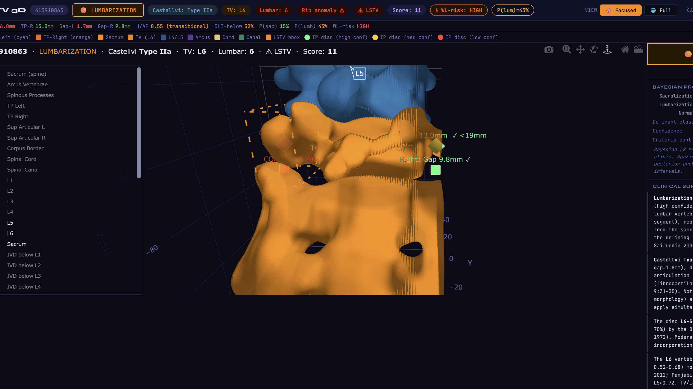

Slide 10
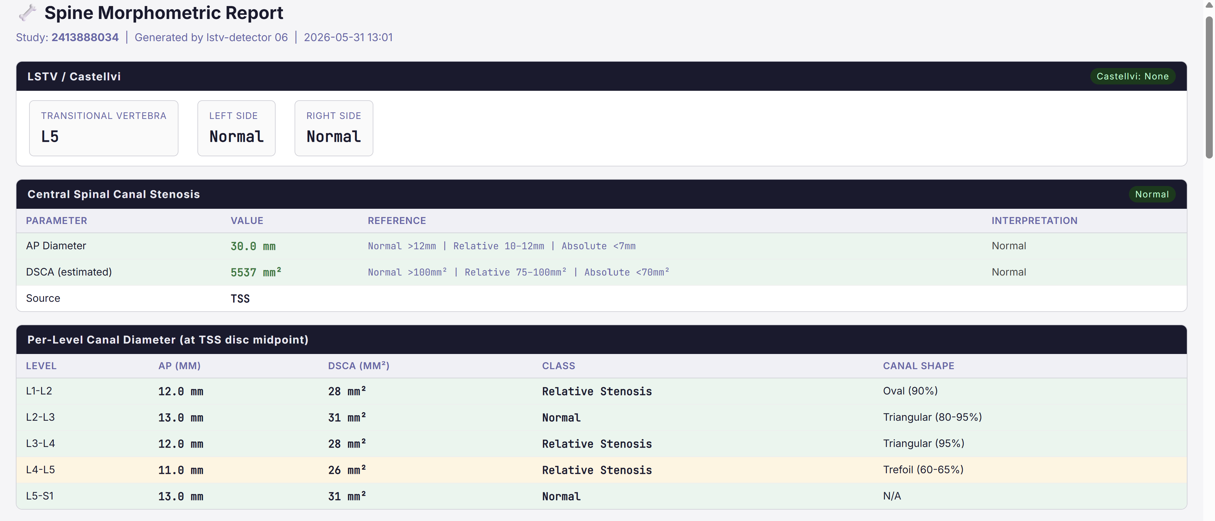

Slide 11
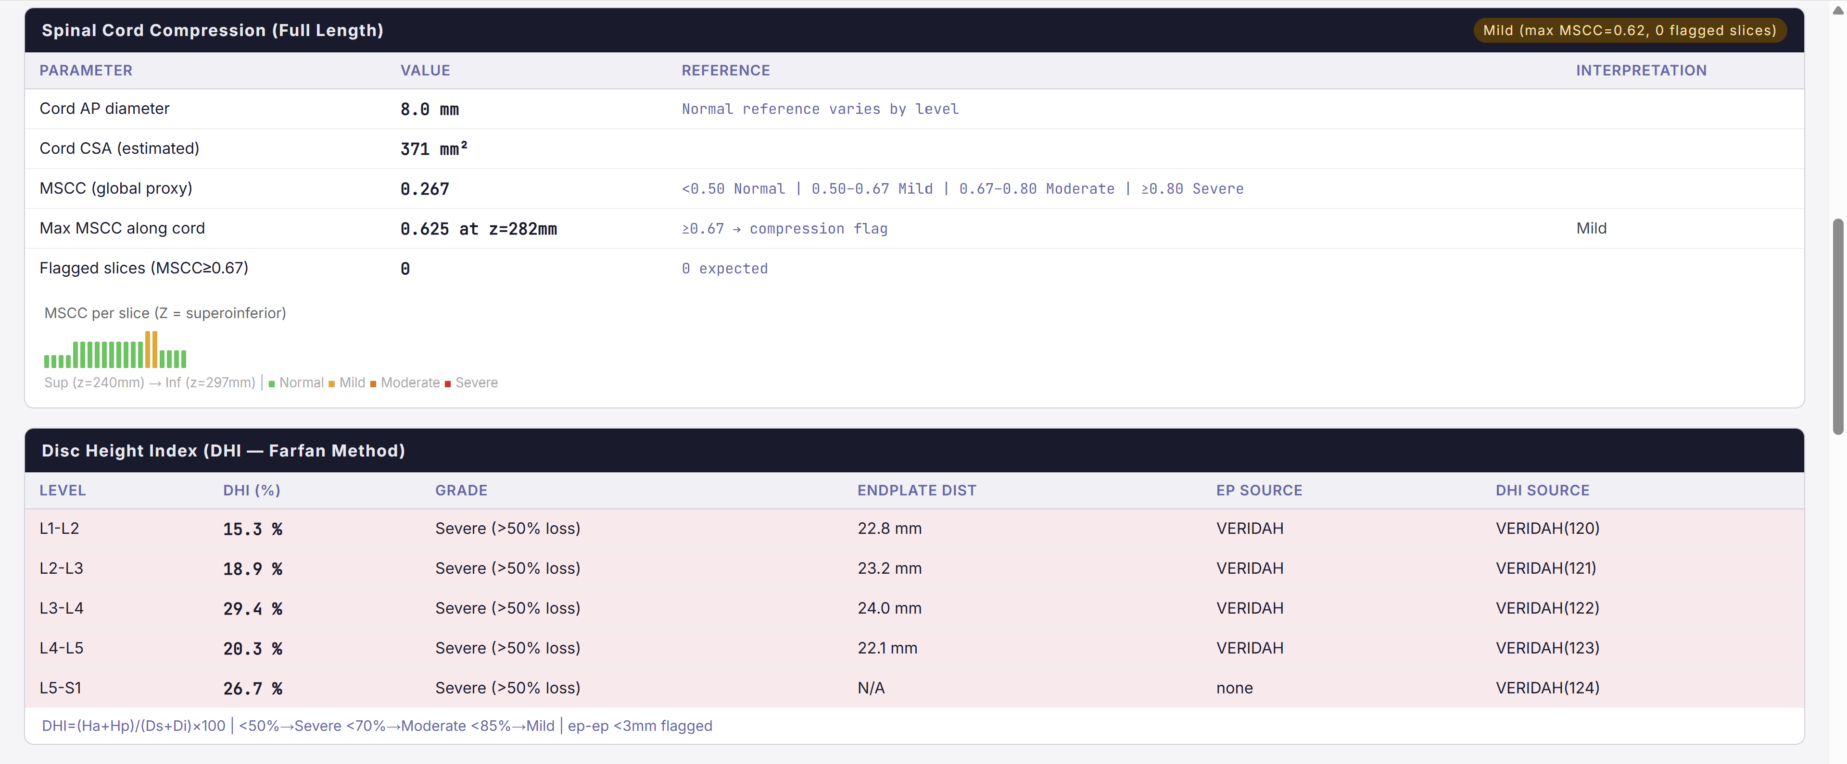

Slide 12
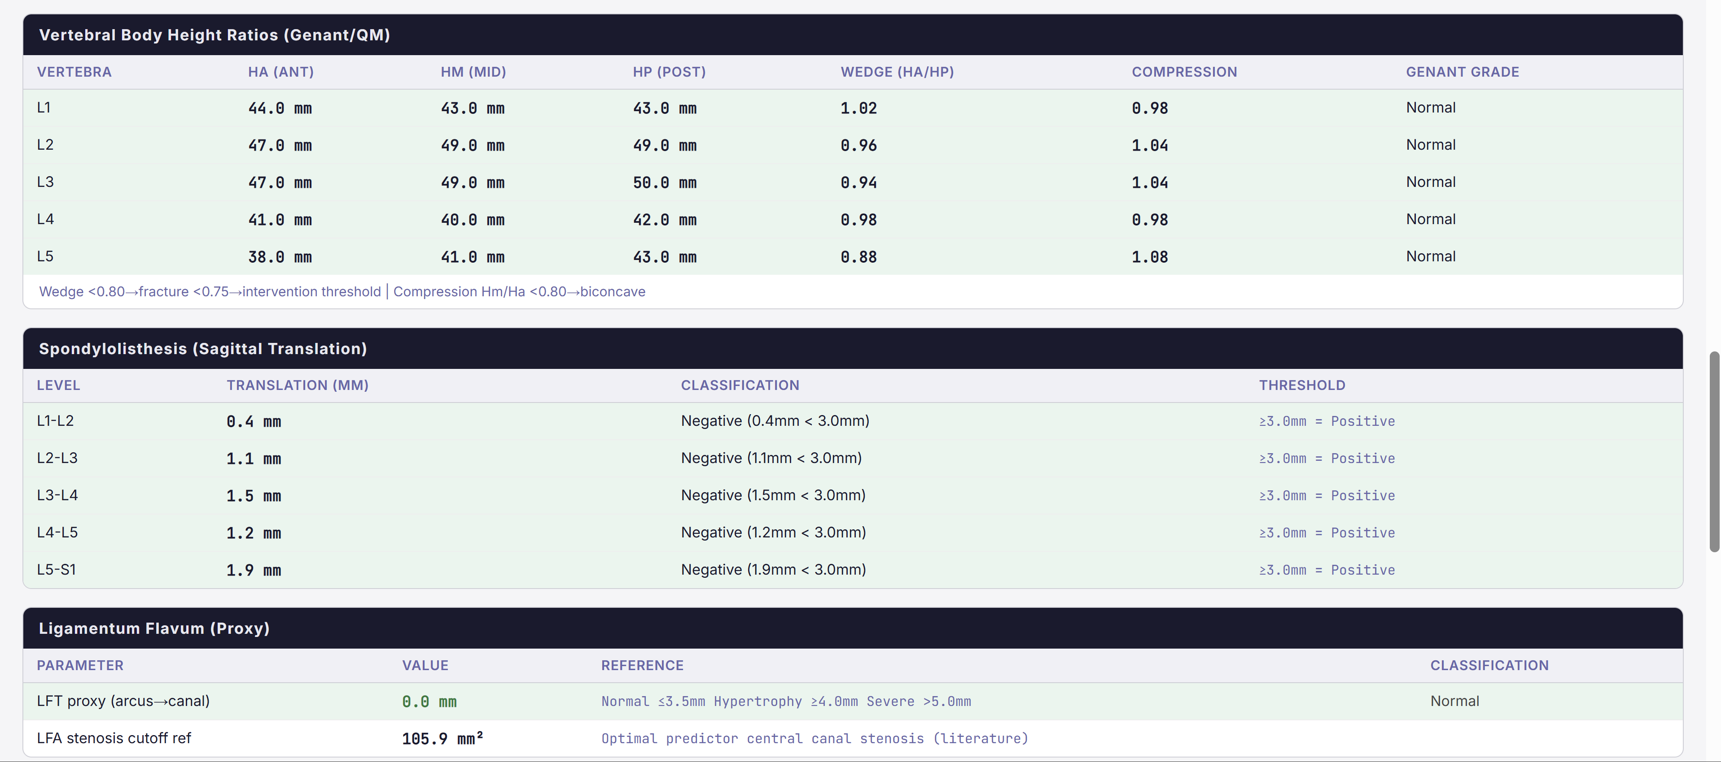

Slide 13
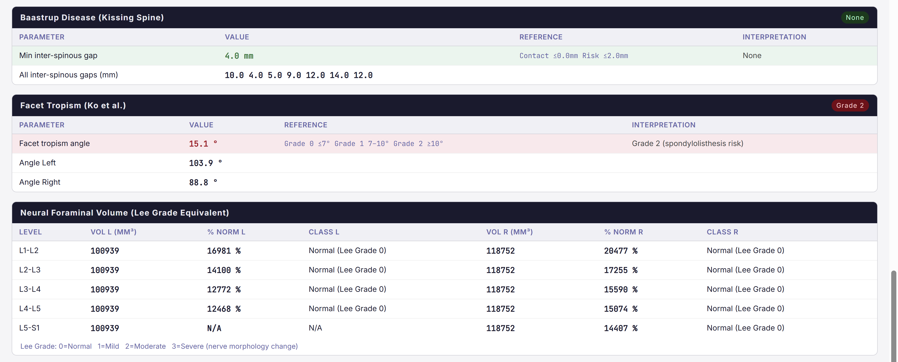

Slide 14

WHERE IT STANDS
An honest accuracy assessment
Literature-derived estimates — thresholds are not yet calibrated against CT ground truth.
Lumbarization phenotype
~80%
The honest caveat
Correct level identification
The anomalous spines we most need to classify are exactly where both segmentation models are least reliable.
~85%
Any LSTV detected
~80%
Castellvi type (given level)
The ask: 20–30 CT-confirmed cases would calibrate every threshold and yield a real sensitivity / specificity estimate.
~75%
Sacralization phenotype
~72%

Slide 15



VISIT THE TABLE
Spin a spine, break the offset model, tell me where it fails.
Open-source pipeline
github.com/Gregory-Schwing-MD-PhD/lstv-detector
Open Spine Consortium
Collaborative, open spine-CT analysis — contributors welcome
Gregory J. Schwing, MD, PhD
go2432@wayne.edu · Wayne State University · Neurosurgery / Spine Imaging & AI

