Slide 1
Not All Spines Are Created Equal: A Single-Shot CT Segmentation Model For Preoperative Detection Of Lumbar And Thoracic End Anomalies
Gregory J. Schwing, MD, PhD
Department of General Surgery, Detroit Medical Center and Wayne State University, Detroit, MI
CNS 2026 Annual Meeting, Washington, DC
Mini Podium 4, Spine Session 1 (MP4SP1) · Monday 2 November 2026, 5:21–6:00 PM · Podium 4, Ballroom ABC
Results from: Not All Spines Are Created Equal, NeurIPS 2026, Evaluations and Datasets track (accepted)
Notes:
I'm Greg Schwing, a general surgery resident at Wayne State and the Detroit Medical Center. Not all spines are created equal, and the ones that are not are expensive.

Slide 2

What a wrong site costs, and what avoiding it costs
Mehtsun WT, et al. Surgery 2013;153:465. Tan et al. Jt Comm J Qual Patient Saf 2023;49:265. Bettis T, et al. Patient Saf Surg 2026. Goodkin R, Laska LL. Surg Neurol 2004;61:323. Mody MG, et al. Spine 2008;33:194. Groff MW, et al. World Neurosurg 2013;79:585. Machin JT, et al. Eur Spine J 2018;27:2693. Harrison WD, et al. Ann R Coll Surg Engl 2015. AJNR Am J Neuroradiol 2023;44:618. Childers CP, Maggard-Gibbons M. JAMA Surg 2018;153:e176233.
Notes:
Start with the money. US malpractice payments for surgical never events reached 1.3 billion dollars, and one paid claim in four is wrong site. A closed wrong-site claim averages 136 thousand dollars, and spine leads that series. In litigated wrong-disc-level cases, 81 percent were paid. Nearly one spine surgeon in five has been sued for wrong level or side. The grey tiles are my own estimate: 420 to 1,900 wrong-level spine operations a year. And prevention costs too: a gold fiducial runs close to two thousand dollars a patient.

Slide 3


One CT, six lumbar bodies, and the labels slide a level
A, CT. B, the segmenter's output. C, ground truth, six lumbar bodies. Right, a six-lumbar spine in 3-D (Castellvi IV).
L5 Dice 0.94 on normal anatomy, 0.29 on lumbarization. L6 emitted: 0 of 1,152 CTs.
Wasserthal J, et al. Radiol Artif Intell 2023;5:e230024. Schwing GJ, et al. Not All Spines Are Created Equal: How CT Segmenters Fail on Lumbosacral Transitional Vertebrae. NeurIPS 2026 (accepted). Dataset article: arXiv 2609.22760, Fig. 2. CTSpinoPelvic1K, doi.org/10.5281/zenodo.22139642.
Notes:
Here's one reason. This is one patient. A is the CT. C is the truth: six lumbar bodies, the lowest in red. B is the most widely used open-source segmenter. It has no sixth lumbar class, so it squeezes six bodies into five labels, and below L2 every label is one level off. It looks fine, and nothing warns you. Its L5 Dice is 0.94 on normal anatomy and 0.29 on lumbarization. Across 1,152 CTs it never once said L6. On the right is a six-lumbar spine from CTSpinoPelvic1K, the public dataset I built to measure this: 802 patients, 33 transitional spines. The model I released merges L5 and L6 in training, which fixes the junction and the sacrum. It can't yet tell four lumbar bodies from five.

Slide 4


The plot we learned from: one line per level
Left, vertebral body diameter (Fig. 1.1). Right, spinal canal diameter (Fig. 1.9). Benzel 2015; permission pending.
Benzel EC. Biomechanics of Spine Stabilization, 3rd ed. Thieme; 2015, chapter 1, Figs 1.1 and 1.9 (ISBN 978-1-60406-924-2). Figure data: Berry et al; Panjabi et al; White and Panjabi; Reynolds et al; McCormack et al.
Notes:
Those five labels assume a textbook spine. This is the textbook: Benzel, chapter 1. Vertebral body width and depth on the left, the canal on the right, one line per level. These lines come from cadaveric series of ten to thirty specimens, and no spread is drawn. They cannot tell you whether the patient in front of you is unusual.

Slide 5
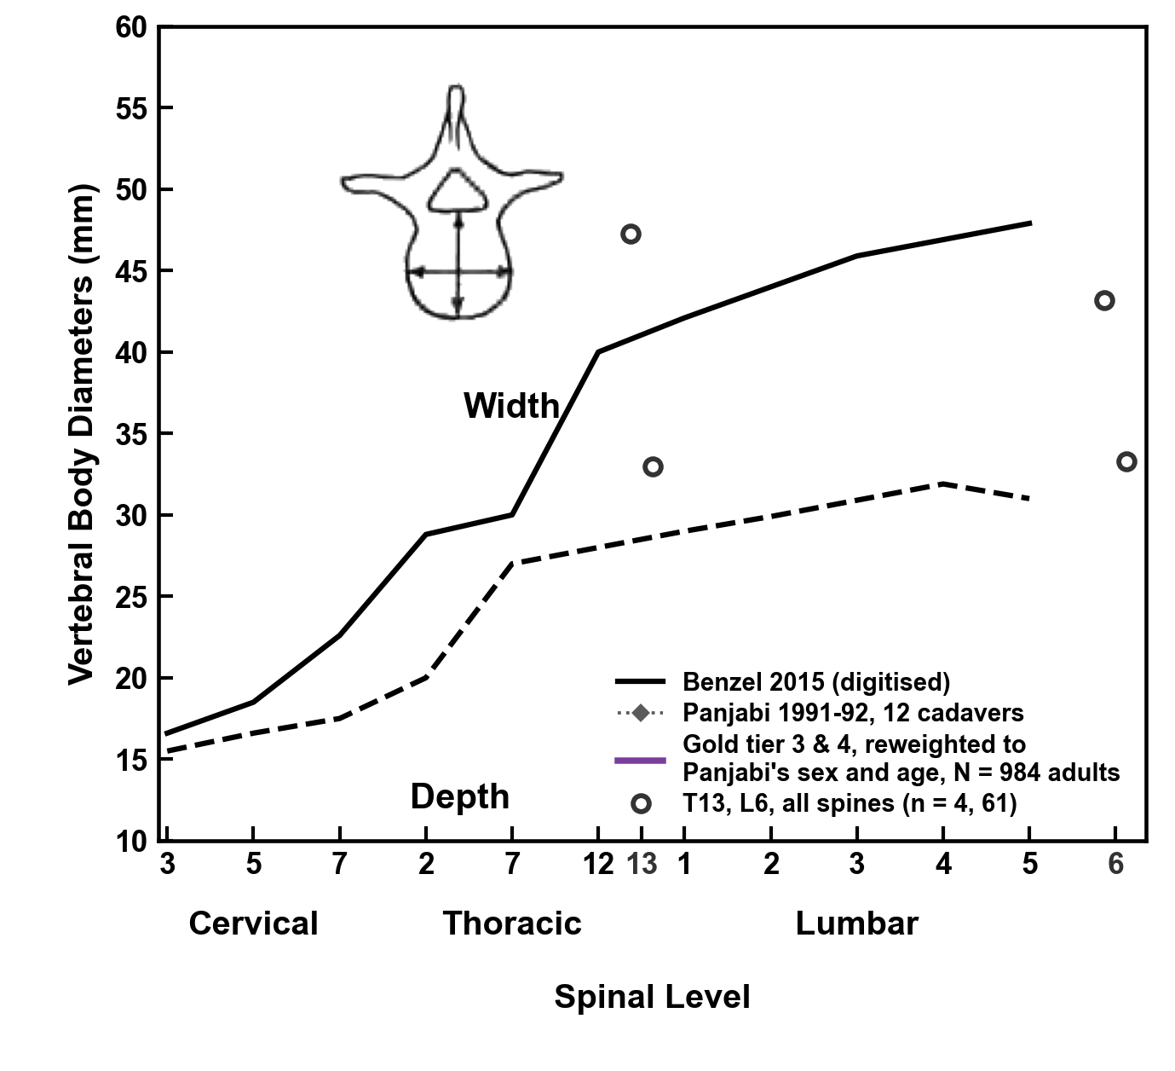
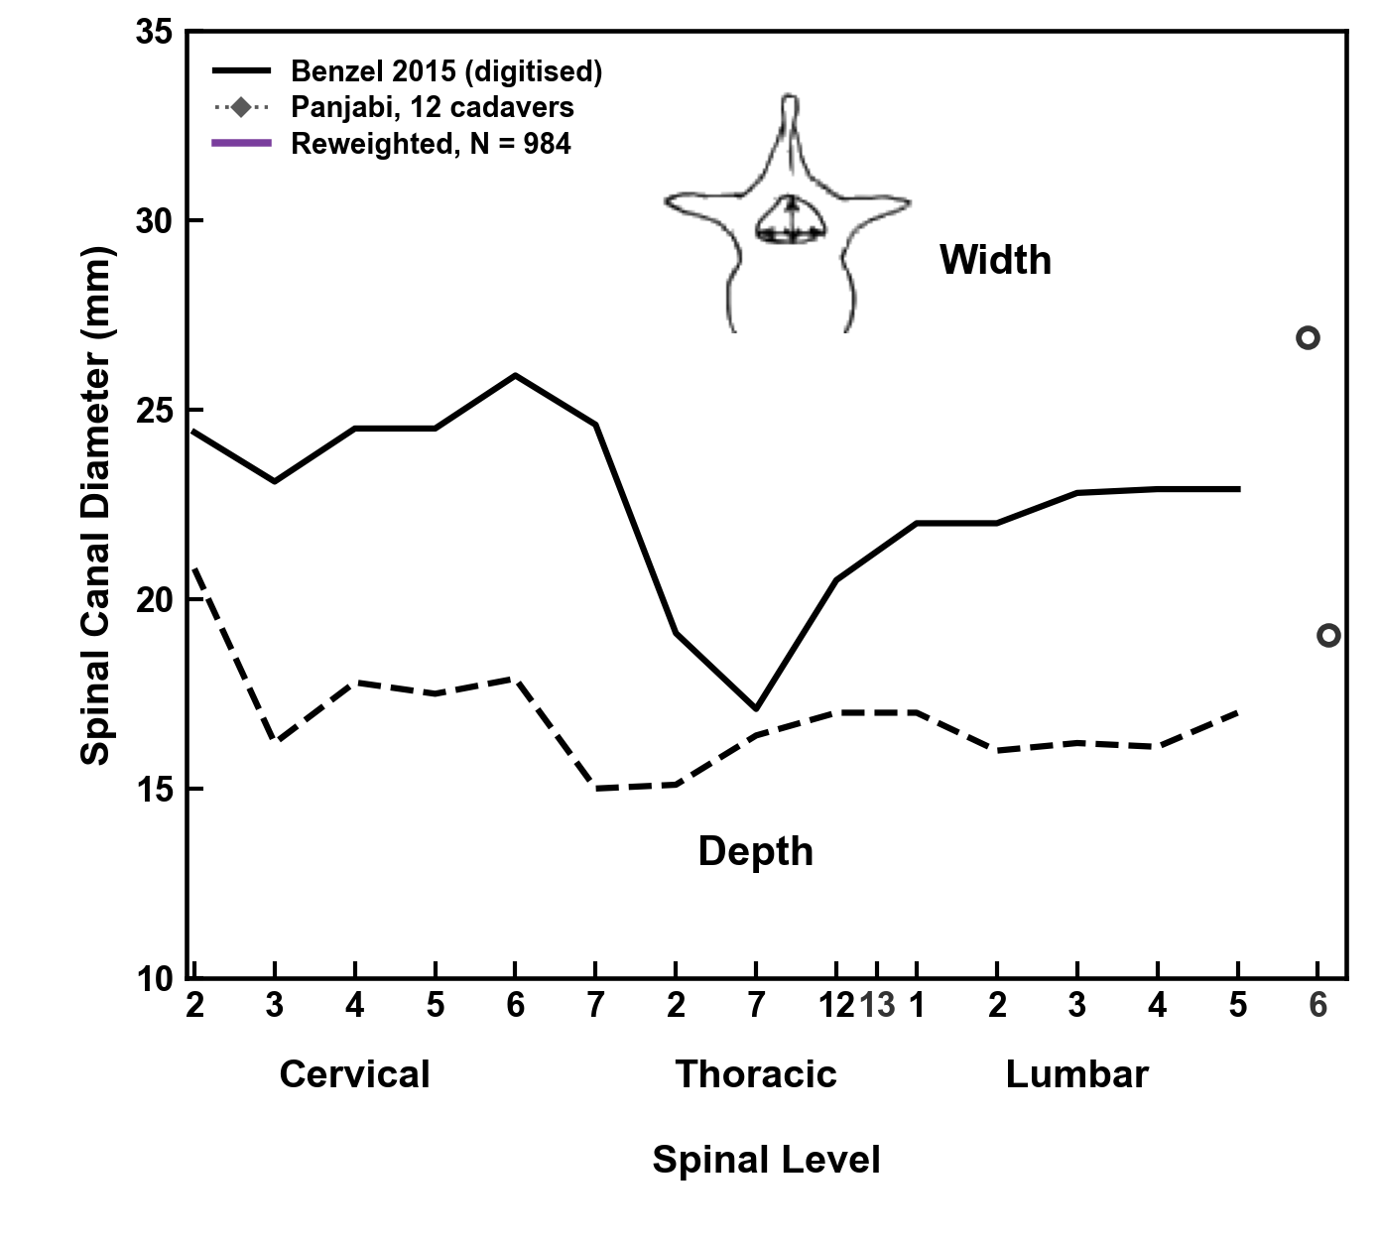

The same plots, matched to Panjabi's cadavers
Black: Benzel, digitised (permission pending). Gray: Panjabi, 12 cadavers. Purple: 984 adults' whole-spine CTs reweighted to his sex and age. Width at the lower end plate, depth at the upper.
Benzel EC. Biomechanics of Spine Stabilization, 3rd ed. Thieme; 2015, ch. 1, Figs 1.1 and 1.9, digitised. Panjabi MM, et al. Spine 1991;16:861-869 and 888-901; Spine 1992;17:299-306. Gold tiers 3 and 4: public CT, C2 to the sacrum in view.
Notes:
Same two plots. Black is Benzel, gray is Panjabi's twelve cadavers. Purple is 984 adults' whole-spine CTs, reweighted to his sex and age: the canal's width sits within a millimeter of his. And the textbook has no place for a thirteenth thoracic or a sixth lumbar: here they are.
If asked: the canal is read on the CT itself, 0.7 mm from Panjabi's width on average. Each of his twelve specimens is matched to our adults of its sex within five years of its age, and the line is the mean of the twelve. T13 and L6 are every spine's means, since the series that holds the T13s records no sex.

Slide 6
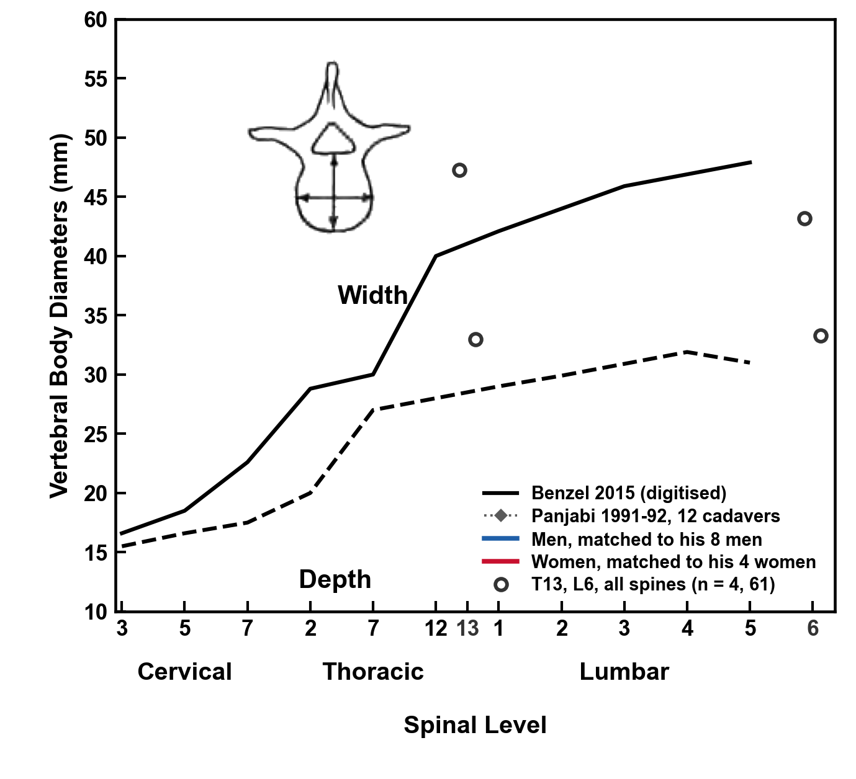
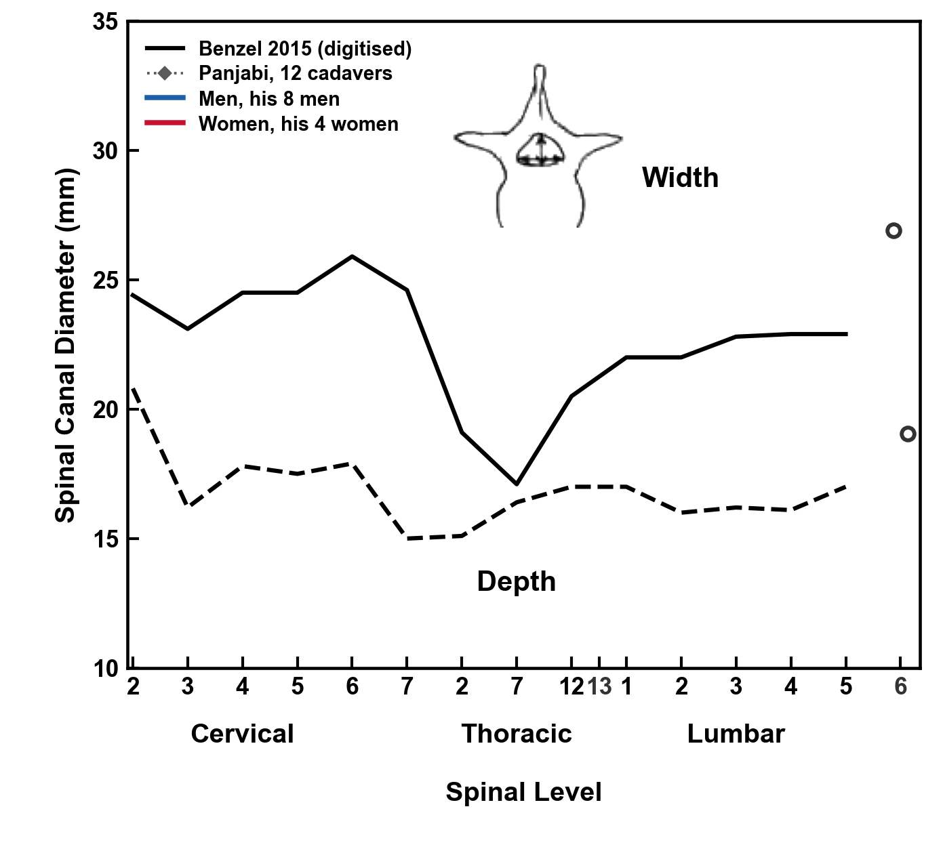
The same line, men and women apart
Blue: our men, matched by age to Panjabi's 8 men. Red: our women, matched to his 4 women. Purple was their 8 to 4 blend.
Benzel EC. Biomechanics of Spine Stabilization, 3rd ed. Thieme; 2015, ch. 1, Figs 1.1 and 1.9, digitised. Panjabi MM, et al. Spine 1991;16:861-869 and 888-901; Spine 1992;17:299-306. Gold tiers 3 and 4: public CT, C2 to the sacrum in view.
Notes:
Divide it by sex. Men run 6 millimeters wider than women at L3, and his line sits between them.
If asked: the men's and women's lines are the same matching over his men alone and his women alone; Panjabi gives no means by sex.

Slide 7
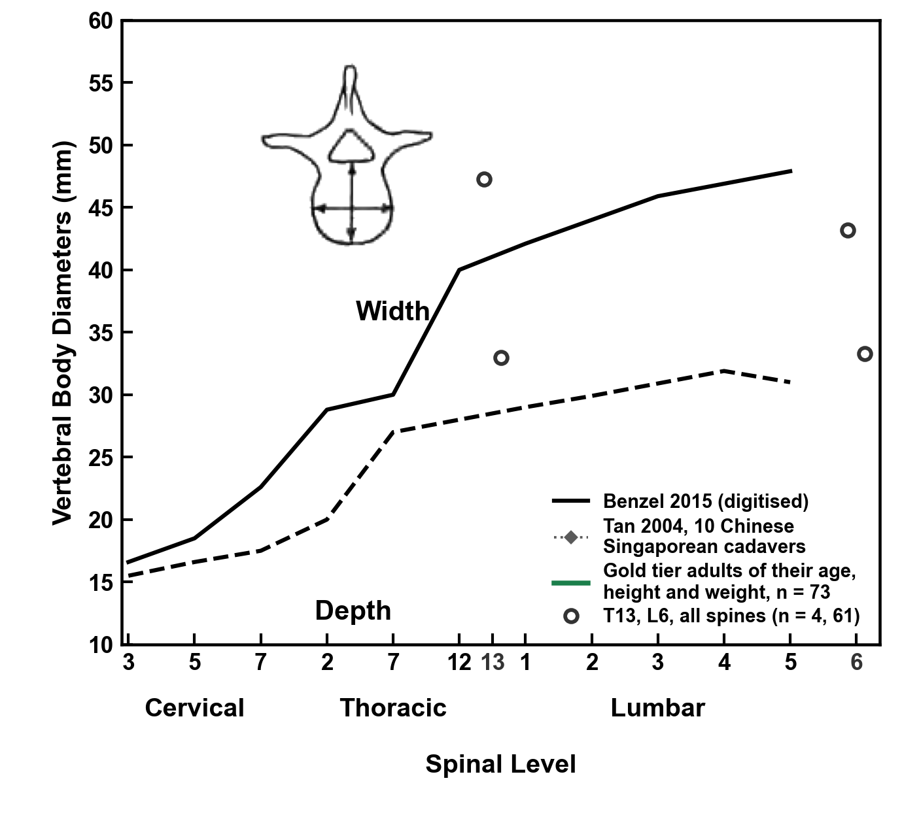
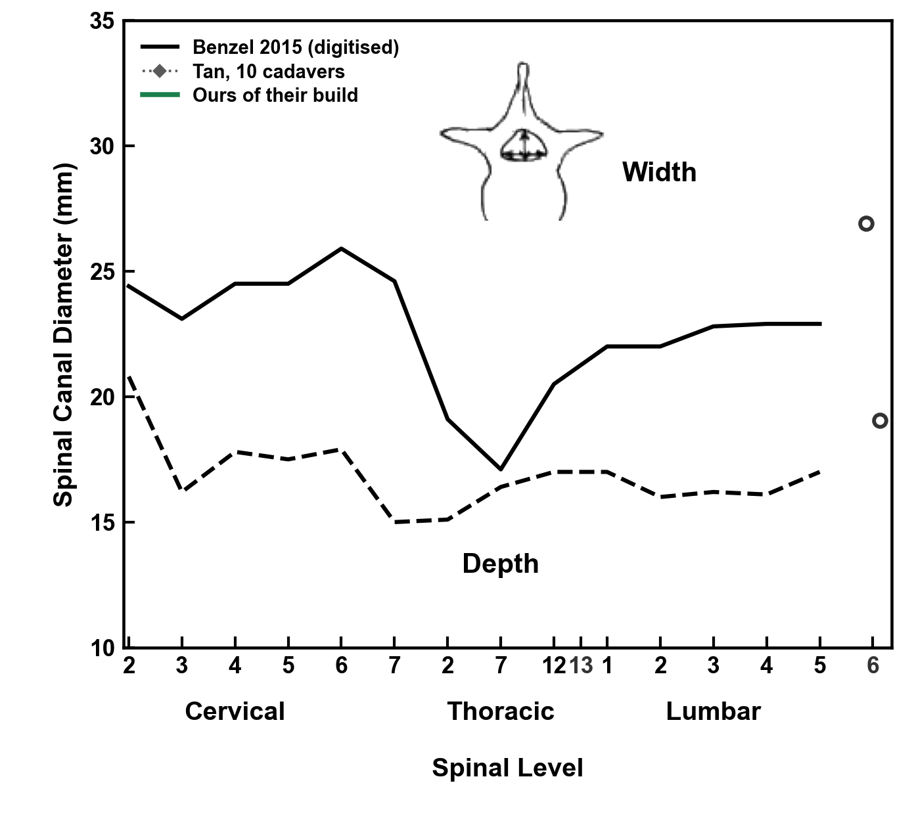
Matched to an Asian series
Gray: Tan, 10 Chinese Singaporean cadavers, 56 to 77 years. Green: our 73 adults inside their age, height and weight.
Tan SH, Teo EC, Chua HC. Eur Spine J 2004;13:137-146. Benzel EC. Biomechanics of Spine Stabilization, 3rd ed. Thieme; 2015, ch. 1, Figs 1.1 and 1.9, digitised. Gold tiers 3 and 4: public CT, C2 to the sacrum in view.
Notes:
Tan's Chinese Singaporean cadavers, beside our adults of their age and build: smaller bodies, and a canal they measured a third shallower than Panjabi's.
If asked: Tan reports no sex; our 73 adults inside their ranges of age, height and weight are 16 men. Tan's own comparison puts their canal 20 per cent narrower and 32 per cent shallower than Panjabi's, dry bone with a digitiser, so most of that gap is theirs, not the matching.

Slide 8
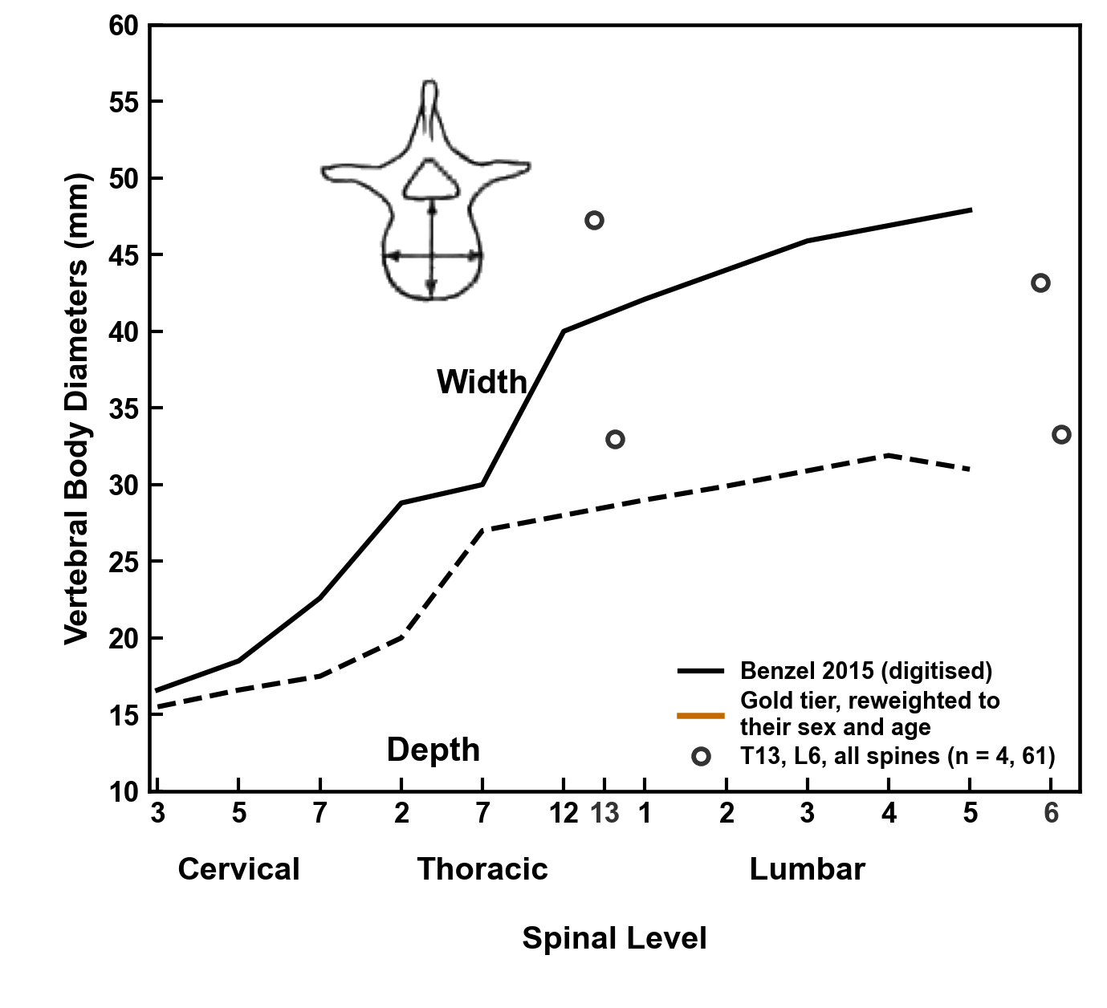
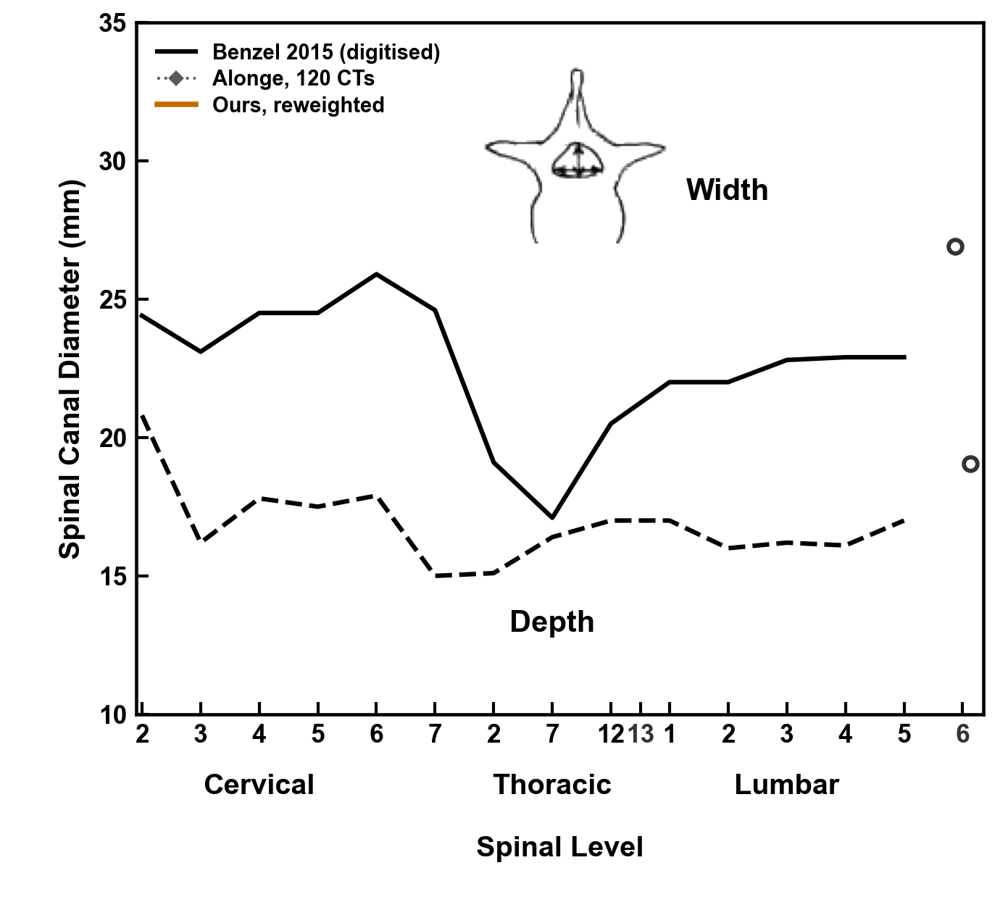
Matched to an African series
Gray: Alonge, 120 Nigerian adults' CTs, L1 to L5; their width is taken at the widest pedicle cut. Orange: our adults reweighted to their sex and age.
Alonge OJ, Adeolu AA, Omololu AB, Atalabi OM. Afr J Med Med Sci 2021;50:69-76. Benzel EC. Biomechanics of Spine Stabilization, 3rd ed. Thieme; 2015, ch. 1, Figs 1.1 and 1.9, digitised. Gold tiers 3 and 4: public CT, C2 to the sacrum in view.
Notes:
No African American series measures these chords, so here are Alonge's Nigerian adults on CT: their canal depth about 2 millimeters under ours.
If asked: of the published series I hold, African American spines appear only in the Hamann-Todd skeletons, measured at the pedicles, and in one disc-height study; neither gives these chords. Alonge's width is an interpedicular distance at the widest pedicle cut, which is why it climbs to L5; Panjabi's is the canal's widest point.

Slide 9

The canal, T11 to L5, level by level
Median, interquartile range, 5th–95th percentile, n = 663–784 per level. Depth is the midsagittal chord at the pedicle.
Panjabi MM, et al. Spine 1991;16(8):888–901 and Spine 1992;17(3):299–306. Dataset article: arXiv 2609.22760, Fig. 3. CTSpinoPelvic1K, doi.org/10.5281/zenodo.22139642.
Notes:
The canal, T11 to L5, this time with L5. Depth is a midsagittal chord at the pedicle, not a maximum extent, because that is what the normative series measure. It holds near 17 millimeters at every level. Width opens from 20 to 30. Every median sits inside Panjabi's interval, and now each level has its own spread.

Slide 10
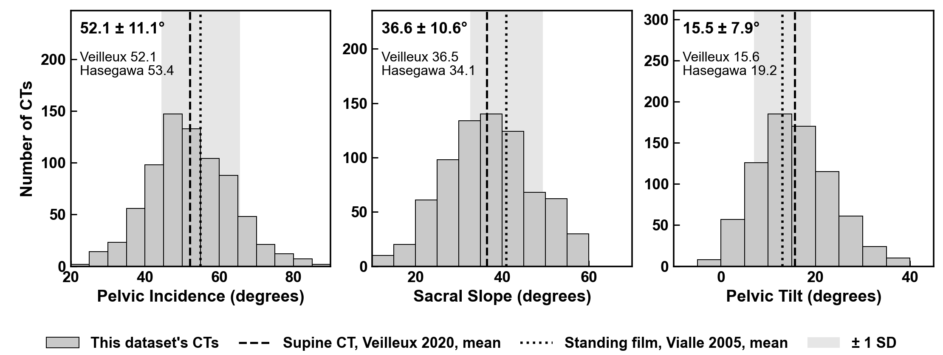

Spinopelvic angles match published supine CT
756 of 802 CTs passing the geometric gates; mean ± SD in each panel. Veilleux n = 200, Hasegawa n = 24, supine CT.
Veilleux NJ, et al. J Bone Joint Surg Am 2020;102:e130. Hasegawa K, et al. BMC Musculoskelet Disord 2018;19:437. Vialle R, et al. J Bone Joint Surg Am 2005;87:260. Dataset article: arXiv 2609.22760, Table III and Fig. S2.
Notes:
The same masks give the spinopelvic angles, in the 756 of 802 patients that pass the geometric gates. Pelvic incidence 52.1 degrees, against 52.1 and 53.4 in the two published supine CT series. Sacral slope 36.6, against 36.5 and 34.1. Pelvic tilt 15.5, against 15.6 and 19.2. The dashed line is standing film, a different posture. I call these provisional until the sacral plate comes from a substructure label, but the pelvis in these masks measures what published CT measures.

Slide 11

Masked CT in, vertebrae out
Masked CT in; vertebrae detected, predicted and classified out. Map colour is true level. Work in progress; not a cleared device.
CT and labels: CTSpinoPelvic1K, doi.org/10.5281/zenodo.22139642. VerSe: Sekuboyina A, et al. Med Image Anal 2021;73:102166. Public, de-identified data. Unpublished results.
Notes:
So what do masks buy you? This. Masked CT goes in. Vertebrae come out: detected, predicted, classified, including the sixth lumbar vertebra the segmenter could not name. Each dot on the right is one vertebra, coloured by its true level, and the levels sort themselves. I am showing you what it does, not how. This part is unpublished work in progress.

Slide 12

The end. Thank you
With thanks to Patrick Schwing (LSU Health Sciences Center New Orleans); Miraziz Ismoilov and Nizar Alnabahneh (Radiology) and Loren Schwiebert (Computer Science), Wayne State University; and the annotators Ashley Schehr, Annika Tekumulla, Margret Khoushi, Ryan Christian, Dane Hubers, Faris Mahjoub, Hassan Saad, Mia Sooch, Sathyagopal Siddapureddy, Michael McLellan and Jerick Kim
Data: CTSpinoPelvic1K (doi.org/10.5281/zenodo.22139642), built on CTSpine1K, CTPelvic1K and The Cancer Imaging Archive; all de-identified
Paper: Not All Spines Are Created Equal, NeurIPS 2026, Evaluations and Datasets track (accepted)
Funding: NIH NIGMS F30GM147909. No commercial support.
Evidence status: retrospective, public de-identified data; small transitional strata; not a cleared device.
Weights and code:
github.com/OpenSpineConsortium/spinopelvic-seg
huggingface.co/OpenSpineConsortium
Questions
gregory.schwing@med.wayne.edu
Notes:
That is the end. The CT side is public: the data on Zenodo, the weights and code on GitHub. Thank you to the students and radiology residents who built it, and thank you for listening.

