Slide 1
Characterizing the Transcriptomic Recurrence Signature of Glioblastoma Following Laser Interstitial Thermal Therapy
Gregory J. Schwing, MD, PhD¹ · Tavarekere N. Nagaraja, PhD²
Indrani Datta, DHI² · Ian Y. Lee, MD²
¹ Department of General Surgery, Detroit Medical Center and Wayne State University, Detroit, MI
² Department of Neurosurgery, Hermelin Brain Tumor Center, Henry Ford Health, Detroit, MI
CNS 2026 Annual Meeting, Washington, DC
Presentation SSTU02 (Abstract 418) · Sunrise Science Session, Tumor 2
Monday 2 November 2026, 7:00–7:06 AM
Room 147B, Walter E. Washington Convention Center
Notes:
Good morning. I'm Greg Schwing, from Wayne State and the Detroit Medical Center. I have no disclosures. Dr. Lee consults for Medtronic and Monteris.

Slide 2
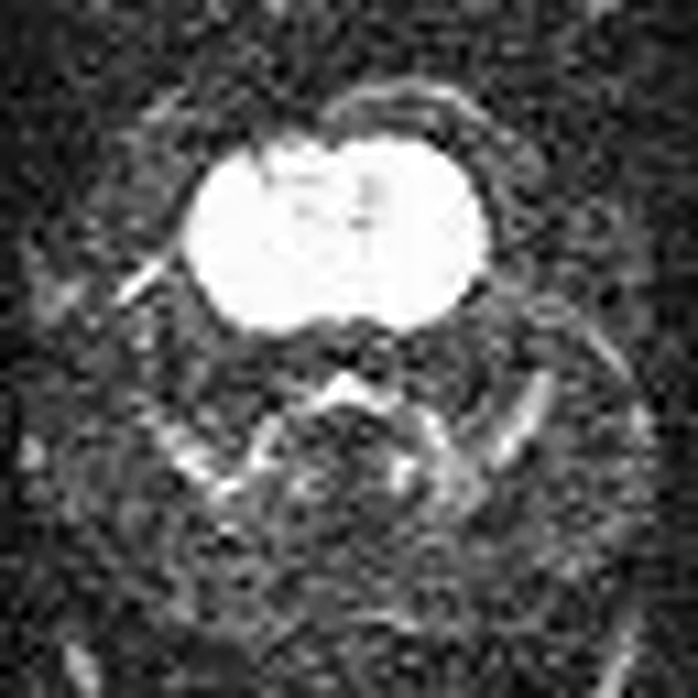
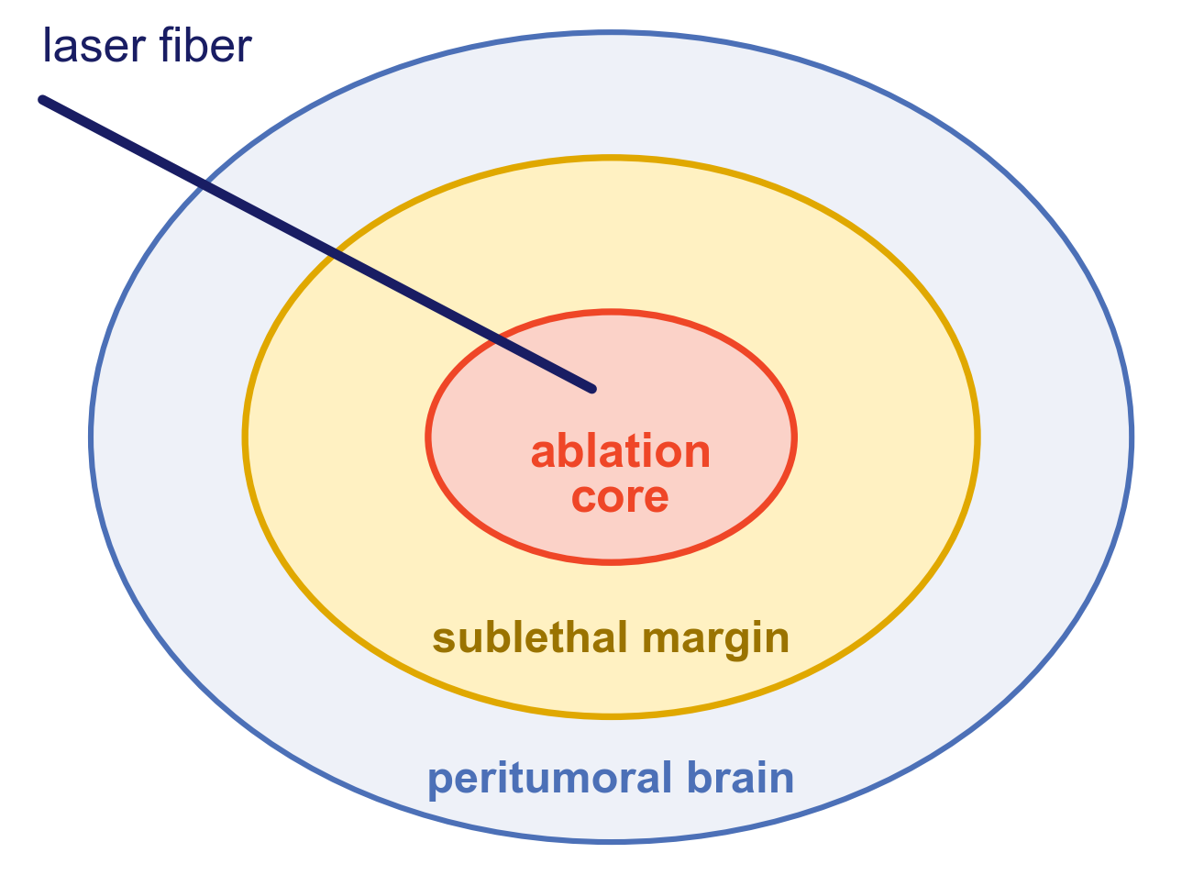
LITT kills the core. What grows back?
What is a regrowing lesion made of, and can tumor be measured away from the implant?
Video: diffusion-weighted MRI during LITT in this rat model, from Nagaraja TN, et al. Acta Neurochir 2021;163:3455-3463; permission pending. Schematic, not to scale. Chen C, et al. J Neurooncol 2021;151:429-442.
Notes:
This is diffusion MRI during LITT in this rat model. We kill the core. Cells in the margin are thought to survive, and tumor comes back. We then sample tumor and brain mixed together. So, two questions. What is a regrowing lesion made of? And can we measure tumor away from the implant?

Slide 3
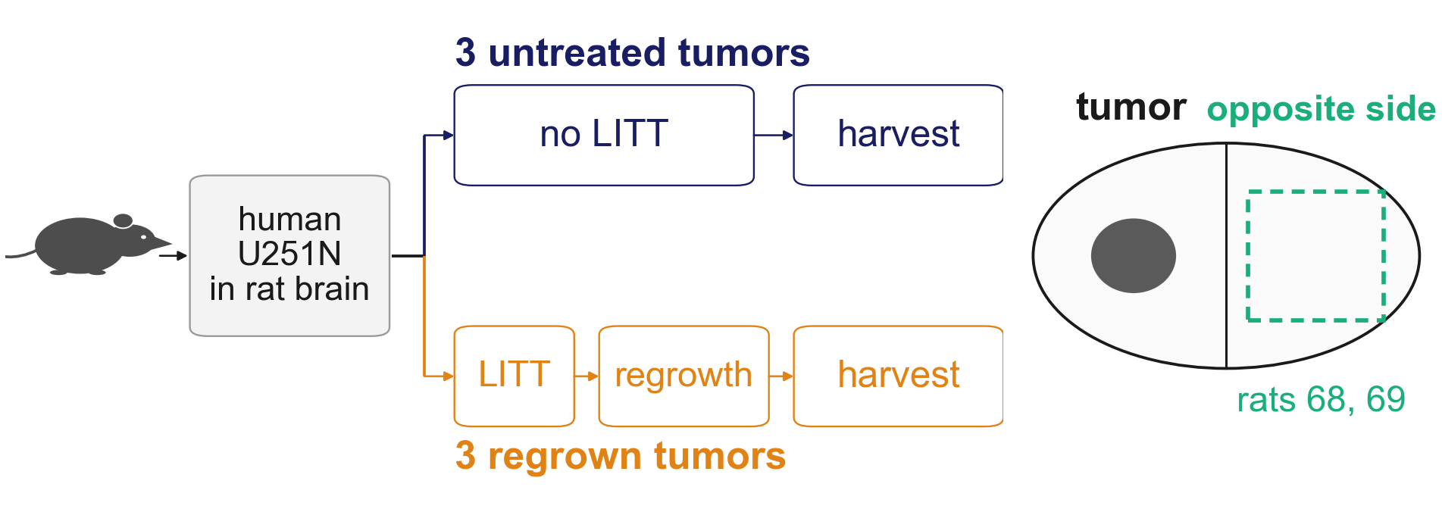
A human tumor in a rat: every read sorted by species
Every read and array probe is assigned to tumor or host by sequence.
Nagaraja TN, et al. J Neurosurg 2026;145:364-377. Eight rats implanted; rat 64's piece held no tumor, rat 65 has no library. Arrays scanned April 2022; harvest dates per animal are not recorded. Orthotopic U251N xenograft in the athymic rat, MRI-guided LITT; n = 3 per arm, one cell line; RNA data GEO GSE338105.
Notes:
Here's the design. Human U251N cells in a rat brain. Three tumors stayed untreated. Three regrew after LITT. In two rats we also took the opposite side. The tumor is human and the brain is rat, so we can sort every read by species. You can't do that in a patient.

Slide 4
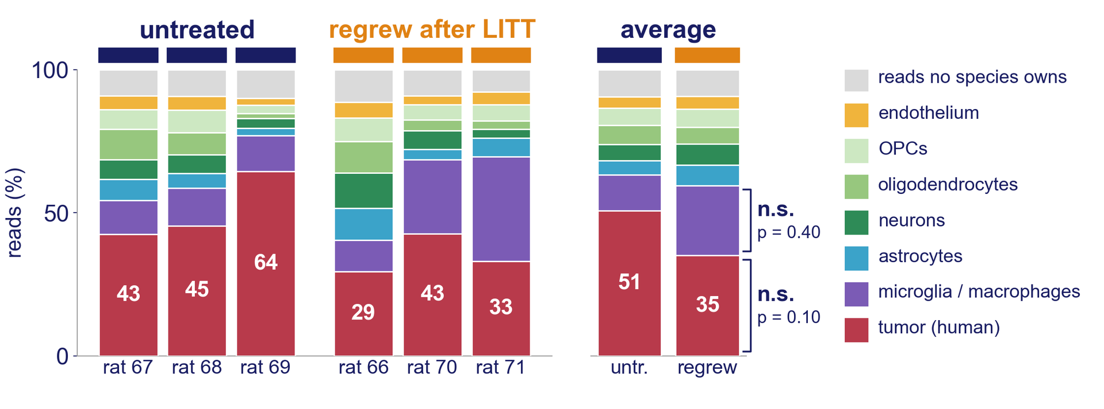
Regrowing lesions hold less tumor
Tumor share: RNA p = 0.10; the methylation array gives the same order, p = 0.05*, the smallest p six animals can give.
Read share by source: human reads by xengsort (k = 25); rat reads split into six cell types (BRETIGEA). Exact test over all 20 ways to split six animals; tumor one-sided as pre-stated, microglia two-sided; * p ≤ 0.05. Layout after Varn FS, et al. Cell 2022;185:2184-2199. Orthotopic U251N xenograft in the athymic rat, MRI-guided LITT; n = 3 per arm, one cell line; RNA data GEO GSE338105.
Notes:
Each column is one lesion, split by where its reads come from. Red is tumor. Purple is microglia and macrophages. Orange regrew after LITT, and its tumor share runs lower: 29 to 43 percent, against 43 to 64. On average, half becomes a third. The methylation array gives the same order. With six animals, p can't go below 0.05, and DNA sits at that floor.

Slide 5
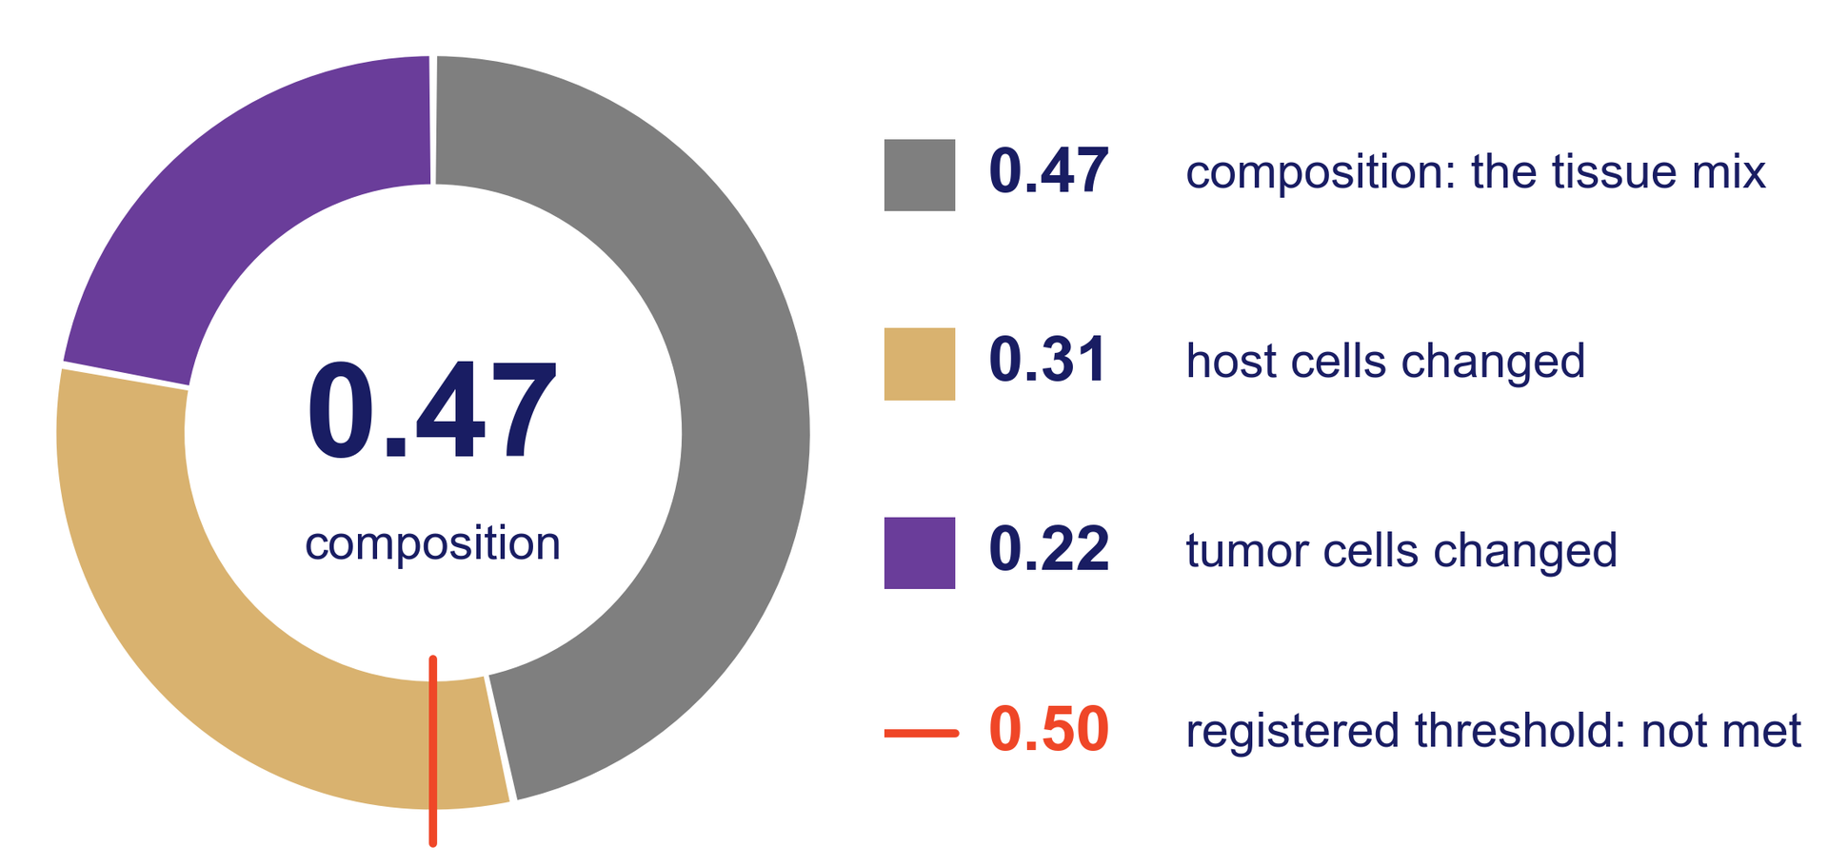
Less tumor explains under half of the change
Of the 133 genes a bulk analysis calls differential, 13 % are composition-dominant.
Shapley split of each gene's bulk fold change, 10,192 one-to-one orthologs; share of summed absolute terms. Shen-Orr SS, et al. Nat Methods 2010;7:287-289 (mixture model). Orthotopic U251N xenograft in the athymic rat, MRI-guided LITT; n = 3 per arm, one cell line; RNA data GEO GSE338105.
Notes:
So is the whole signal just less tumor? Here we can answer exactly. The ring is the change a bulk assay sees, split into three parts. Gray is the tissue mix: 0.47. It's the biggest piece, but we said in advance it had to pass one half, that red mark, and it didn't. The rest is host and tumor cells changing. The mesenchymal score, for one, falls in the tumor cells.

Slide 6
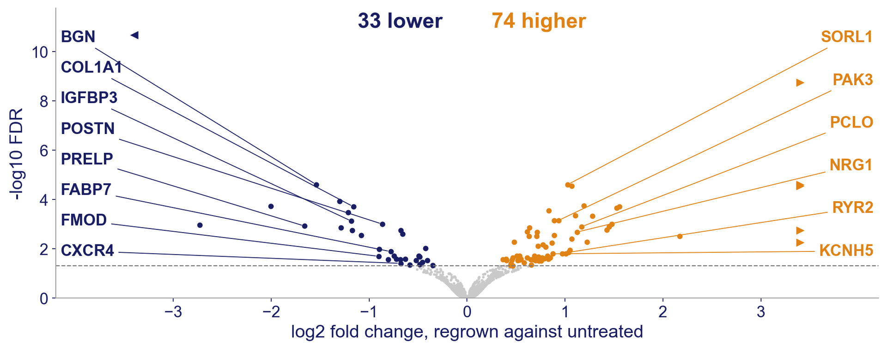
107 genes change in the regrown tumors
Lower: extracellular-matrix genes (BGN, COL1A1, POSTN, PRELP). Higher: neuronal and synaptic genes (SORL1, PAK3, PCLO, NRG1).
DESeq2 on the tumor's own (human) reads, 17,068 genes, FDR < 0.05; arrowheads, fold changes past the axis. Love MI, et al. Genome Biol 2014;15:550. Neuronal signaling also rises in recurrent IDH-wildtype glioma: Varn FS, et al. Cell 2022;185:2184-2199. Orthotopic U251N xenograft in the athymic rat, MRI-guided LITT; n = 3 per arm, one cell line; RNA data GEO GSE338105.
Notes:
Here are the genes. Each dot is a gene in the tumor's own reads. One hundred and seven change at a false discovery rate under five percent. The ones that fall are extracellular-matrix genes: biglycan, collagen, periostin. The ones that rise are neuronal and synaptic. Neuronal signaling rises in recurrent human glioblastoma too.

Slide 7
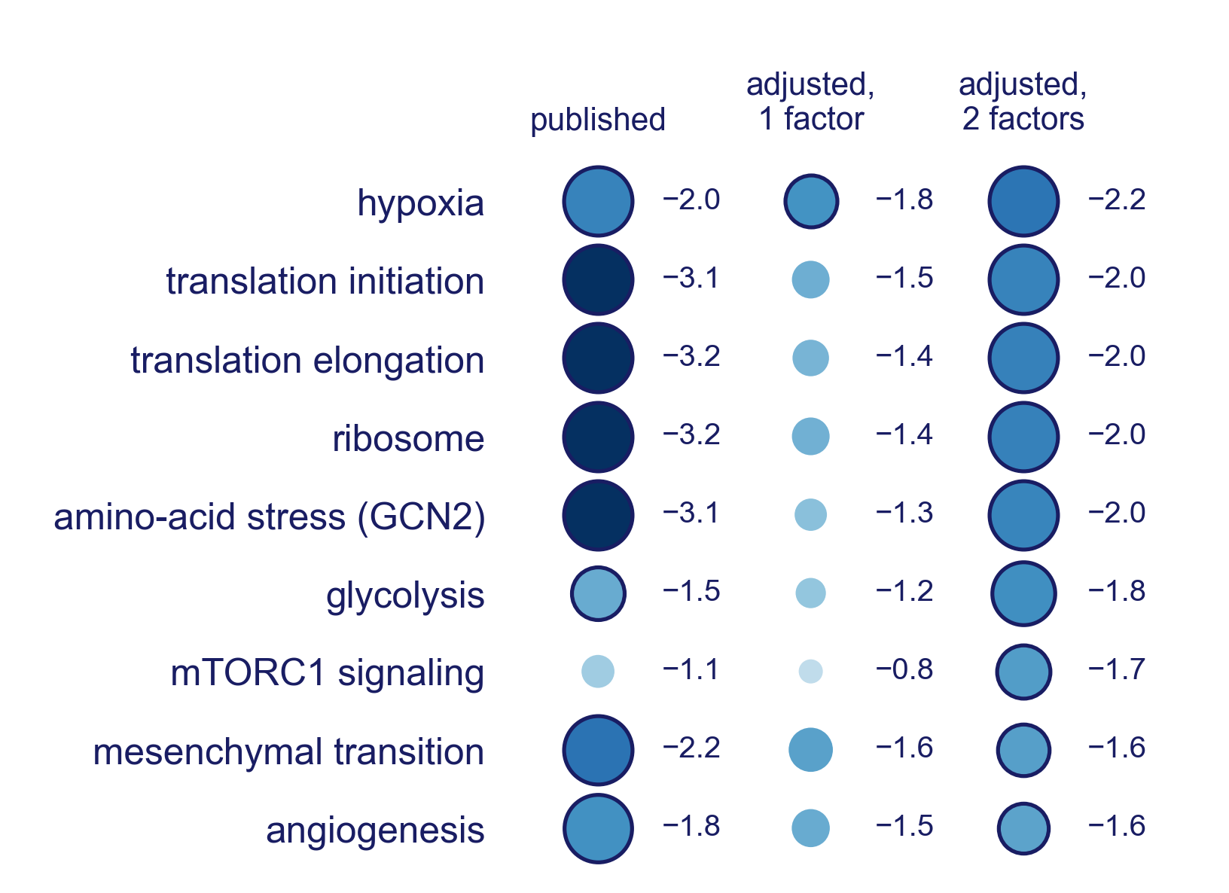
Tumor cells turn down translation and hypoxia
Translation initiation: FDR 0.02 with the animals permuted, and lower with any tumor left out. After the control adjustment, all nine programs stay lower (q < 0.05).
Bubbles: gene-ranked GSEA, 1,000 permutations (genes treated as independent, so its q is the looser one); blue, lower after LITT; area, -log10 q; ring, q < 0.05; adjusted, RUVs factors from the three control samples. Strict test: GSEA 4.3.2 with the animals permuted, the published run. Subramanian A, et al. PNAS 2005;102:15545-15550. Liberzon A, et al. Cell Syst 2015;1:417-425. Orthotopic U251N xenograft in the athymic rat, MRI-guided LITT; n = 3 per arm, one cell line; RNA data GEO GSE338105.
Notes:
Now the programs. Each row is a program, each column a way of ranking the genes, and blue means lower after LITT. Translation initiation passes the strict test, with the animals permuted, at a false discovery rate of 0.02, and it falls with any tumor left out. Once we remove the signal our control samples measure, hypoxia, translation, glycolysis and the mesenchymal programs all stay lower.

Slide 8
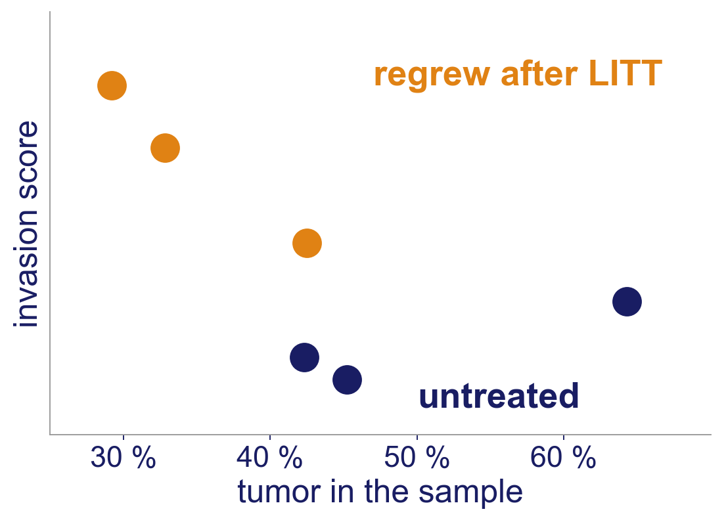
One invasion program stays up after adjustment
First of twenty labellings after adjusting for tumor share.
p = 0.05 is the floor of this design.
Regrown tumors were also harvested later: a hypothesis, not a finding.
Distal-invasion program from Chanoch-Myers R, et al. Nat Commun 2026;17:4079; singscore on floor-corrected human log-CPM; score ~ arm + tumor share. Orthotopic U251N xenograft in the athymic rat, MRI-guided LITT; n = 3 per arm, one cell line; RNA data GEO GSE338105.
Notes:
Now infiltration. Each dot is a tumor. Up is a published distal-invasion score. Orange sits above blue. Adjusted for tumor content, it's first of twenty labellings. That's p of 0.05, the floor here. These animals were also harvested later. So it's a hypothesis, not a finding.

Slide 9
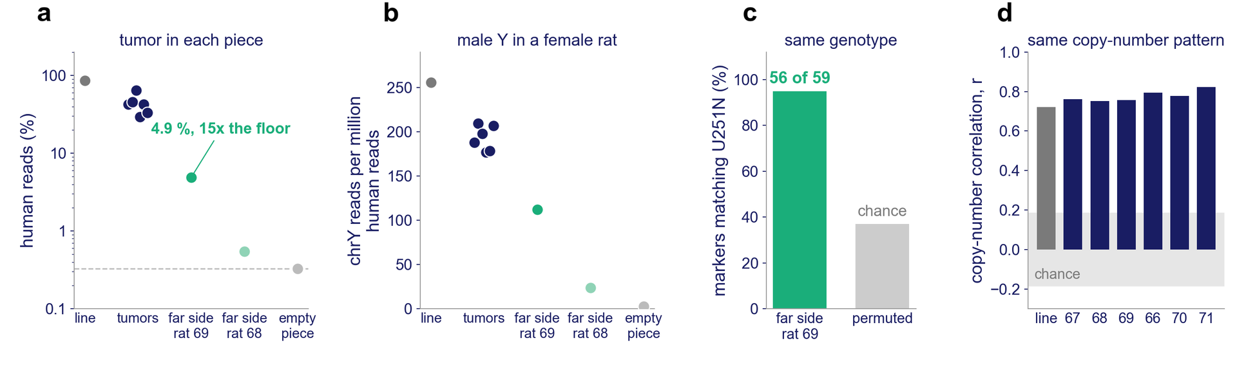
U251N identified in the opposite hemisphere
Rat 69, never ablated: its opposite hemisphere carries the cell line's Y chromosome, genotype (56 of 59 markers) and copy-number pattern.
a, human reads by xengsort; dashed, the empty piece (rat 64). b, chromosome Y reads per million human reads. c, EPIC rs-probe genotype against U251N, permutation null 37 %. d, copy-number profile correlation with the line and each tumor; band, the null's 2 SD each side (z = 8.3 for the line). a and b from RNA, c and d from the DNA array, separate aliquots. Both opposite-side animals were never ablated.
Notes:
This one surprised us. Rat 69 was never ablated, and its opposite hemisphere read 4.9 percent human, fifteen times the empty piece. Is it the cell line? It carries a male Y chromosome in a female rat. Its genotype matches U251N at 56 of 59 markers, where chance gives about a third. And its copy-number pattern matches the line and every tumor. One animal, never ablated, so nothing here speaks to LITT.

Slide 10
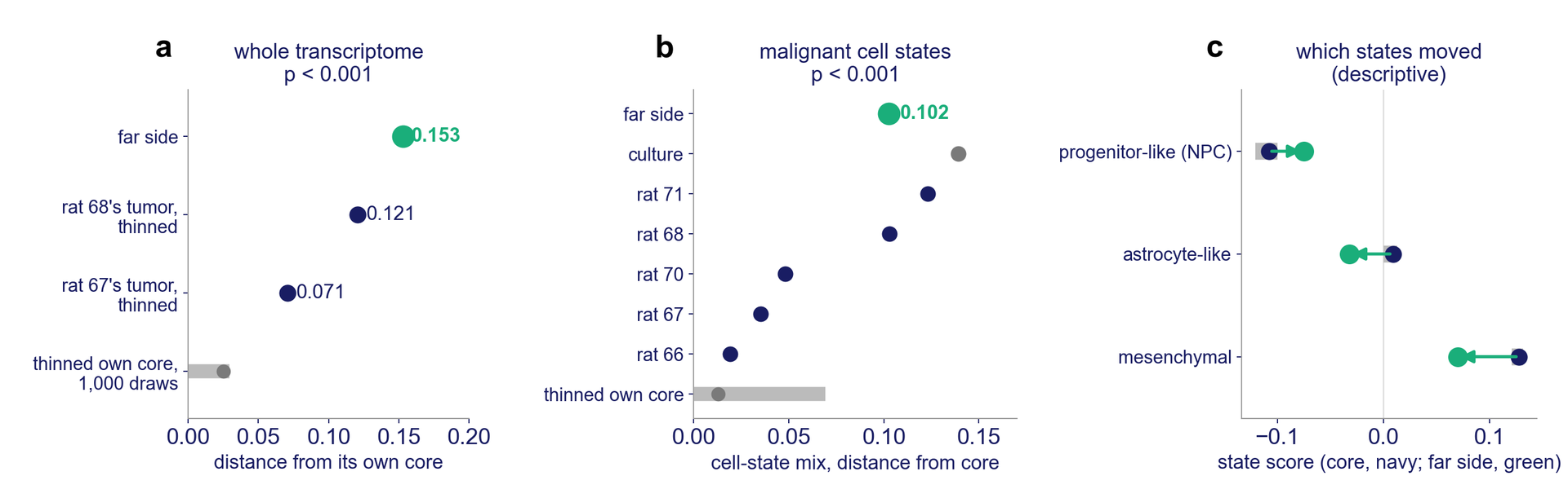
The far-side tumor is not its core, thinned
Its core thinned to the same tumor depth, 1,000 times, never comes this far: the far side differs in whole transcriptome and in cell-state mix (p < 0.001), and it is less mesenchymal.
Rat 69's core, its human counts subsampled to the far side's tumor depth plus the assignment floor of the tumor-free piece, floor-corrected alike; grey, the 1,000 draws. a, 1 - Spearman rho over 2,000 variable genes. b, total variation distance of the three GLASS malignant states (CIBERSORT). c, Neftel meta-modules, singscore; descriptive, not robust to the scoring method. Distal invaders are mesenchymal-depleted in Chanoch-Myers R, et al. Nat Commun 2026;17:4079. One animal.
Notes:
Is the far side just its core, thinned out? We thinned the core to the same depth a thousand times. The far side falls outside every draw, in its whole transcriptome and in its mix of cell states. It's less mesenchymal and more progenitor-like, the direction published distal invaders take. One animal, so a case, not a rate.

Slide 11
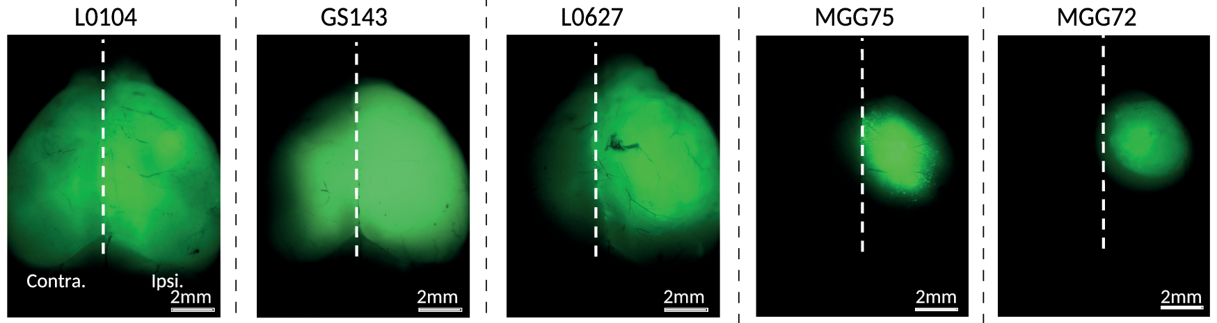
Others have tracked glioblastoma across the midline
crossed
less
did not
Mouse: 4 of 20 patient-derived models reached the far side (single-cell RNA-seq).
Patient: a second GBM in the opposite hemisphere shared the first tumor's changes.
U251N: recovered from the far side in mice by GFP; no sequence-based report found.
Panel: Chanoch-Myers R, et al. Nat Commun 2026;17:4079, Fig. 1f, cropped; green, GFP-labelled tumor; permission pending. van Nifterik KA, et al. J Neurosurg 2006;105:739-744. Johnston AL, et al. PLoS Biol 2007;5:e212. Other models; none settles rat 69.
Notes:
Others have seen this. In mice, green human tumor crossed the midline in four of twenty patient-derived models. In a patient, a second glioblastoma in the opposite hemisphere shared the first tumor's changes. For U251N, we found no sequence-based report.

Slide 12
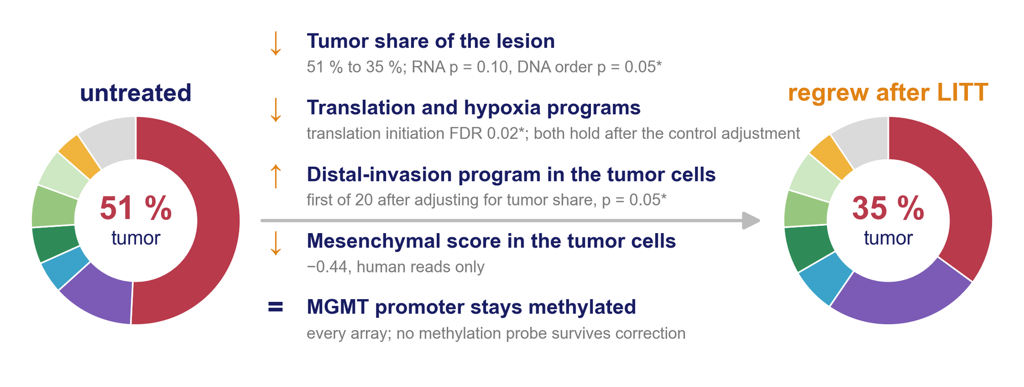
Before and after LITT: the recurrence phenotype
Three tumors per arm, one cell line: each line is a pilot result.
Rings: average read share by source, colours as on slide 4. * p ≤ 0.05 by the exact test over the 20 splits. Layout after Varn FS, et al. Cell 2022;185:2184-2199 (Fig. 7). Orthotopic U251N xenograft in the athymic rat, MRI-guided LITT; n = 3 per arm, one cell line; RNA data GEO GSE338105.
Notes:
Here's the whole picture. Left, untreated. Right, regrown after LITT. Tumor share falls from about half to a third. In the tumor cells, ribosomal-protein genes fall, a distal-invasion program rises, and the mesenchymal score falls. MGMT stays methylated. Each line is a pilot result, three per arm.

Slide 13
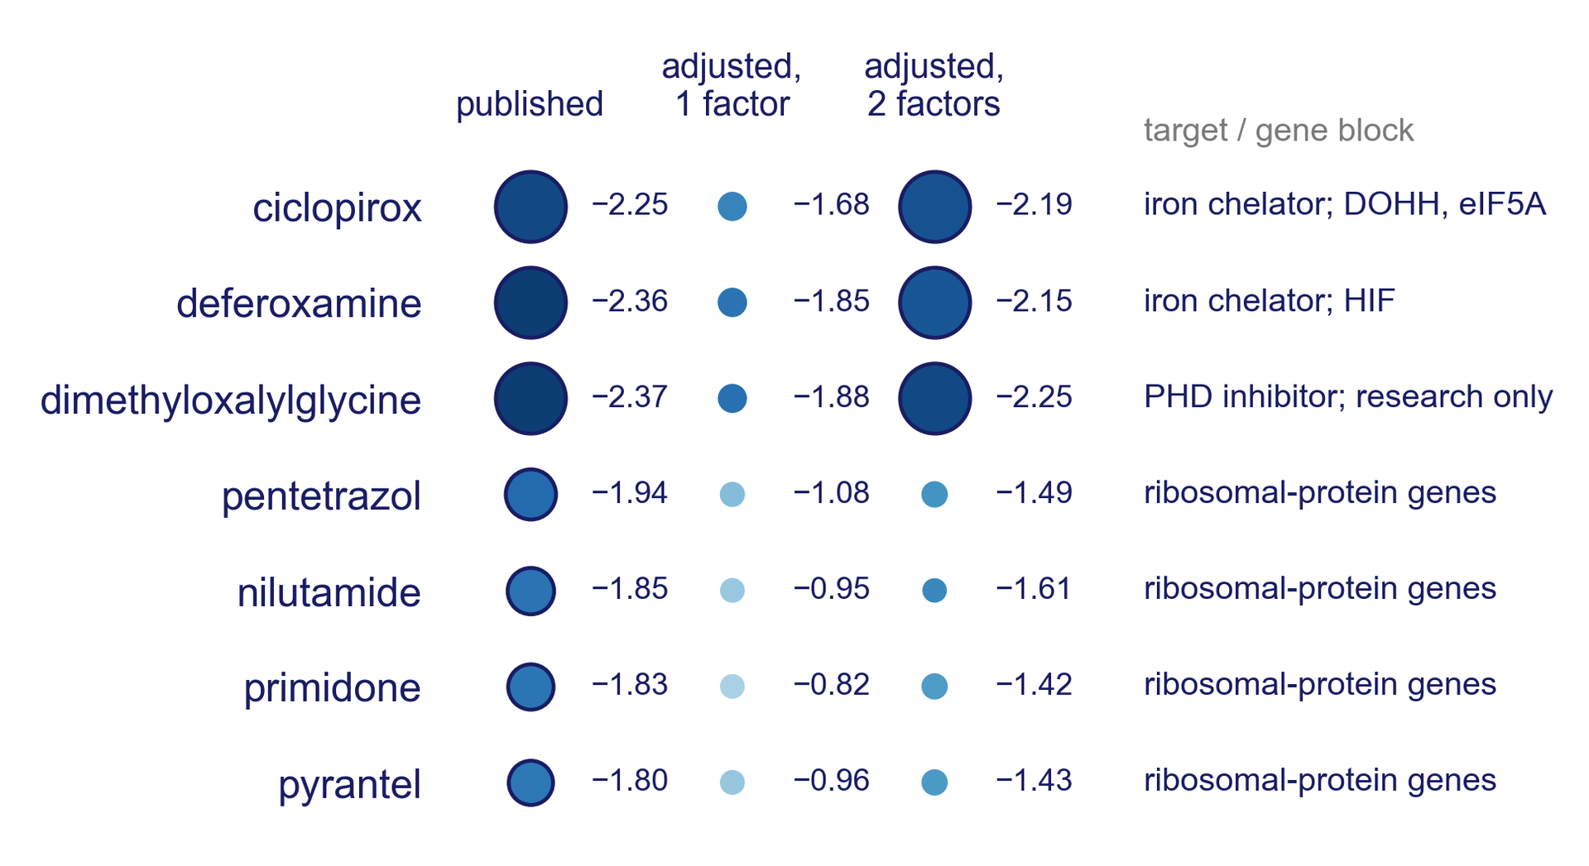
Drug targets after the control-sample adjustment
6 of the 16 published drug signatures hold (q < 0.05), all led by hypoxia genes, among them two iron chelators and an oxygen-sensor inhibitor. The ribosomal-protein drugs fall away (q > 0.8).
DSigDB v1.0 drug signatures, preranked GSEA, 1,000 permutations; blue, the signature opposes the regrown tumors' change; area, -log10 q; ring, q < 0.25. Adjusted: RUVs factors from the three control samples (IL64B, N168B, N269B). Yoo M, et al. Bioinformatics 2015;31:3069-3071. Risso D, et al. Nat Biotechnol 2014;32:896-902. Computational prediction, untested in this model.
Notes:
Now the drug screen. Each dot is a drug signature tested against the regrown tumors. Blue opposes the recurrence change, and a ring passes false-discovery control. The left column is the published screen. The other two first remove the cross-species read signal that our three control samples measure. The ribosomal-protein drugs fall away. What stays is one axis: iron-dependent enzymes. Ciclopirox and deferoxamine are approved drugs. This is a computational prediction, untested in this model.

Slide 14
Conclusions
1 Regrowing lesions hold less tumor (51 % to 35 %); the mix explains under half.
2 In the tumor cells, translation and hypoxia programs fall; an invasion program rises.
3 The drug signal that survives the control samples: iron-dependent enzymes (ciclopirox).
4 U251N in the opposite hemisphere (genotype 56 of 59) is not its core thinned: less mesenchymal.
Next: 44–58 rats per arm test how often remote tumor follows LITT (sized in advance).
Thanks: Tavarekere N. Nagaraja, PhD, Indrani Datta, DHI, and Ian Y. Lee, MD, Hermelin Brain Tumor Center, Henry Ford Health.
Henry Ford Health Physician Scientist Award A20050 (I.Y.L.). IACUC #1509; ARRIVE. RNA data: GEO GSE338105. Questions: go2432@wayne.edu
Evidence status: one cell line (U251N) in one rat xenograft model, n = 3 per arm. New and evolving work; no patient data.
Notes:
To close. Regrowing lesions hold less tumor, and that mix explains under half of the change. In the tumor cells, translation and hypoxia programs fall and an invasion program rises. The drug signal that survives our control samples is one axis, iron-dependent enzymes, with ciclopirox first. And U251N in the opposite hemisphere is not its core thinned: it is less mesenchymal. Thank you.

