Slide 1
Not All Spines Are Created Equal: A Single-Shot CT Segmentation Model For Preoperative Detection Of Lumbar And Thoracic End Anomalies
Gregory J. Schwing, MD, PhD
Department of General Surgery, Detroit Medical Center and Wayne State University, Detroit, MI
CNS 2026 Annual Meeting, Washington, DC
Mini Podium 4, Spine Session 1 (MP4SP1) · Monday 2 November 2026, 5:21–6:00 PM · Podium 4, Ballroom ABC
Results from: Not All Spines Are Created Equal, NeurIPS 2026, Evaluations and Datasets track (accepted)

Slide 2
Where this is going
1
Surgeons count vertebrae. On a transitional spine the count is wrong
2
The planning CT is read more and more through an automatic segmenter; the most widely used one has no sixth lumbar class
3
What it does on a transitional spine, measured on a public benchmark built for the purpose: 802 patients, 33 transitional, Castellvi graded
4
A released single-shot spine-and-pelvis segmenter: what it repairs, and what it does not
5
What is missing: enough transitional patients' scans

Slide 3

The level is counted, and the count is often wrong
Half of spine surgeons report a wrong-level operation in their career (Mody 2008; Groff 2013)
Registry of 34,544 operations: 0.12 %, thoracic 0.42 % (Furuya 2026)
The first exposed level is wrong in 4–15 % before the check film; verification protocols miss a third (Ammerman 2006; Dablouk 2019; Longo 2012)
Every check in use today counts the levels again, and a recount fails the same way on a transitional spine
Strong et al. 2022, Figure 3: intraoperative fluoroscopy, needle at the T10 pedicle, counted from the sacrum. J Neurosurg Spine 36:792 (PMC10193475); permission pending.
1. Mody MG, et al. Spine 2008;33:194. 2. Groff MW, et al. World Neurosurg 2013;79:585. 3. Furuya M, et al. Bone Joint J 2026;108-B:673. 4. Dablouk MO, et al. Br J Neurosurg 2019. 5. Ammerman JM, et al. Surg Neurol 2006. 6. Longo UG, et al. J Bone Joint Surg Br 2012;94-B:1546.

Slide 4

Transitional anatomy changes the count
Labelled CT, public de-identified records (CTSpinoPelvic1K). Bar, 20 mm.
8.8 % of 3,147 full-length radiographs lack 24 presacral segments (Sabri 2025); in 550 lumbar operations the count was wrong in 38 of 71 patients with a transitional vertebra (Nakagawa 2017)
The truth is on CT, where the whole column can be counted and the junction graded (Castellvi 1984)
7. Sabri SA, et al. Neurosurg Focus 2025;58(6):E13. 8. Nakagawa T, et al. 2017. 9. Castellvi AE, et al. Spine 1984;9:493. 10. CTSpinoPelvic1K, doi.org/10.5281/zenodo.22139642.

Slide 5

What a wrong site costs, and what avoiding it costs
Mehtsun WT, et al. Surgery 2013;153:465. Tan et al. Jt Comm J Qual Patient Saf 2023;49:265. Bettis T, et al. Patient Saf Surg 2026. Goodkin R, Laska LL. Surg Neurol 2004;61:323. Mody MG, et al. Spine 2008;33:194. Groff MW, et al. World Neurosurg 2013;79:585. Machin JT, et al. Eur Spine J 2018;27:2693. Harrison WD, et al. Ann R Coll Surg Engl 2015. AJNR Am J Neuroradiol 2023;44:618. Childers CP, Maggard-Gibbons M. JAMA Surg 2018;153:e176233.
Notes:
Every number is from a verified primary source except the four marked derived: the wrong-site share of the NPDB total (one quarter of paid never-event claims are wrong site), the yearly cost of the fiducial series (179 patients over 38.4 months at $34–37 per operating-room minute, 2014 dollars), and the US wrong-level operation and indemnity estimates (the two published per-procedure rates applied to 1.3–1.6 million spine operations a year, with the published litigation and payment fractions).
The $1.3 billion is all surgical never events (retained objects, wrong site, wrong procedure, wrong patient) over 1990–2010; no published wrong-site-only total exists.

Slide 6


The label on the film is only as right as the planning read
Registration scores against the labels it imported. On a transitional spine the label is only as right as the planning read
So the level is decided on the planning CT, and more and more by a segmenter
Top: De Silva et al. 2016, Figure 1 (Spine; PMC5045321). Bottom: Manbachi et al. 2018, Figure 6, labels on a 13th rib and a lumbarised S1 (Ann Biomed Eng; PMC9107073). Permission pending.
11. Otake Y, et al. Phys Med Biol 2012;57:5485. 12. De Silva T, et al. Spine 2016. 13. Manbachi A, et al. Ann Biomed Eng 2018;46:1548. 14. Peh WCG, et al. 1999. 15. Zhang R, et al. J Xray Sci Technol 2023. 16. Huang Y, et al. Comput Methods Programs Biomed 2022.

Slide 7

The planning read fails where the count fails
An open-source whole-body segmenter, unmodified, on 1,152 public CTs (Wasserthal 2023)
Normal anatomy: L5 Dice 0.94. Lumbarization: the labels slide one level, L5 Dice 0.29
L6 emitted: 0 of 1,152. Confident, well formed, one level off, no error signal
Published: Not All Spines Are Created Equal, NeurIPS 2026, Evaluations and Datasets track (accepted)
A lumbarization case with a true L6. Left, ground truth; right, the segmenter's output.
17. Wasserthal J, et al. Radiol Artif Intell 2023;5:e230024. 18. Schwing GJ, et al. Not All Spines Are Created Equal: How CT Segmenters Fail on Lumbosacral Transitional Vertebrae. NeurIPS 2026 (accepted).

Slide 8
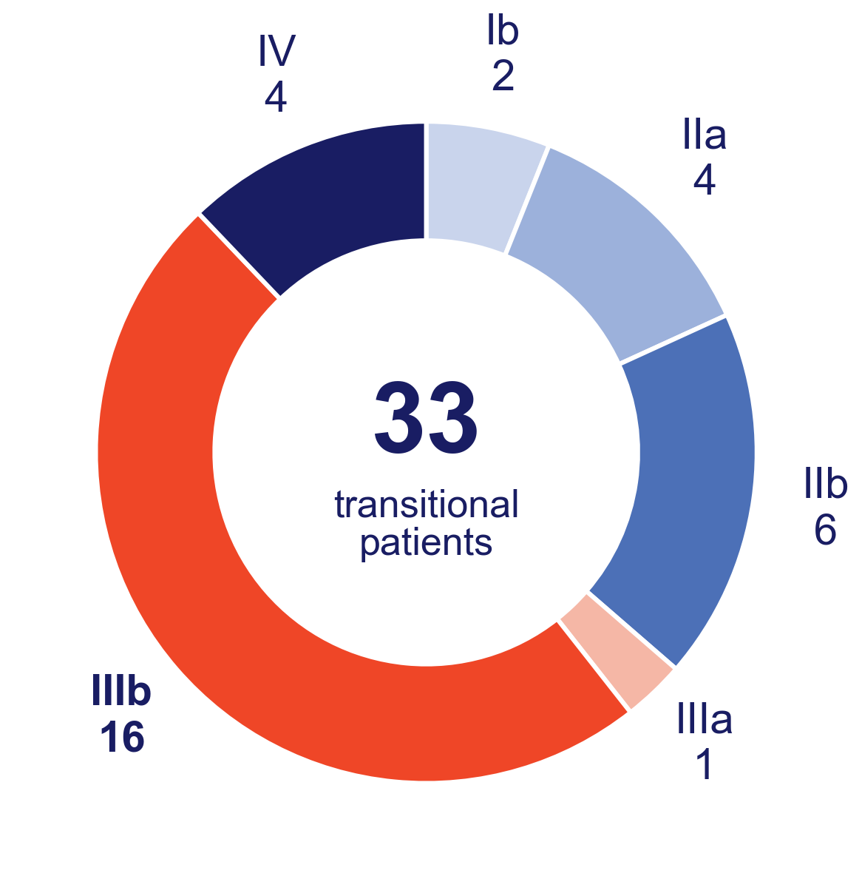
A public benchmark, transitional spines graded
CTSpinoPelvic1K: 1,153 CT records of 802 patients, spine and pelvis in one mask (CTSpine1K and CTPelvic1K, one screening cohort)
33 transitional patients in six phenotypes: 14 lumbarization, 9 four-lumbar sacralization, 6 full, 2 semi, 2 ambiguous
Castellvi graded by two radiology residents: 27 of 33 agreed (κ 0.74), six settled by consensus
16 of 33 are IIIb, all nine four-lumbar spines among them; only 2 are Type I, so this is the conspicuous end
Two-reader consensus Castellvi grade, all 33 transitional patients (NeurIPS 2026, Table 4).
19. Deng Y, et al. CTSpine1K, 2021. 20. Liu P, et al. CTPelvic1K, 2021. 21. Castellvi AE, et al. Spine 1984;9:493. 22. CTSpinoPelvic1K, doi.org/10.5281/zenodo.22139642.

Slide 9
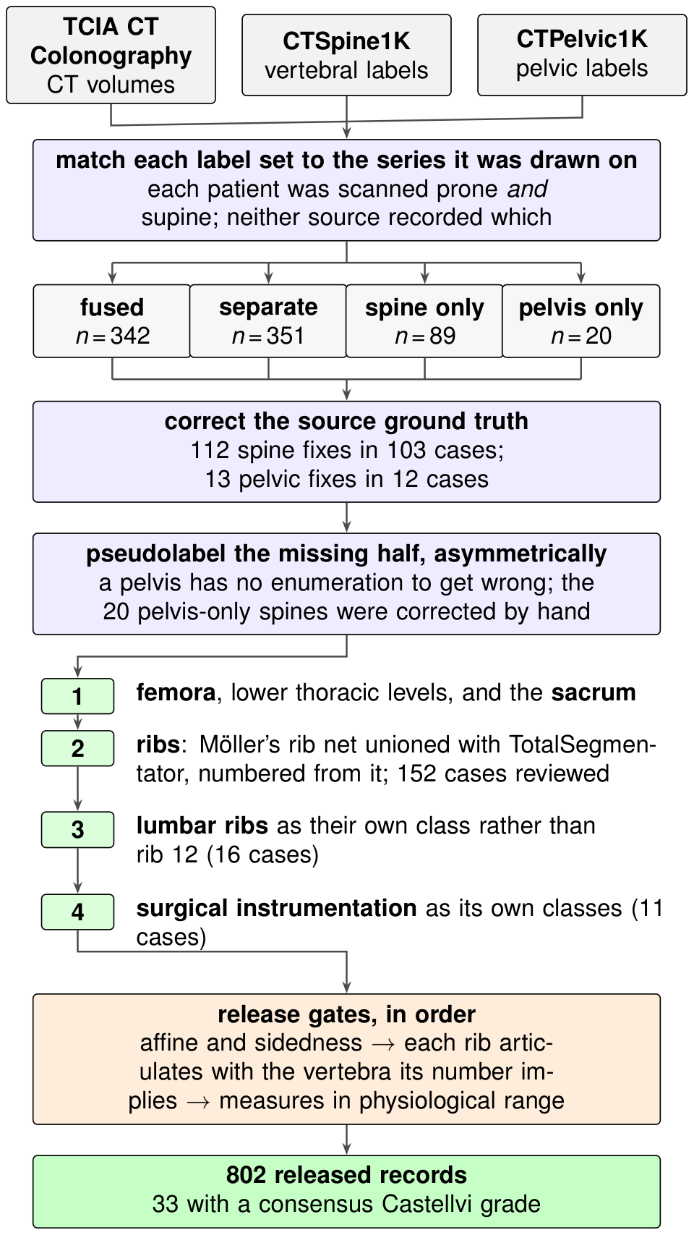
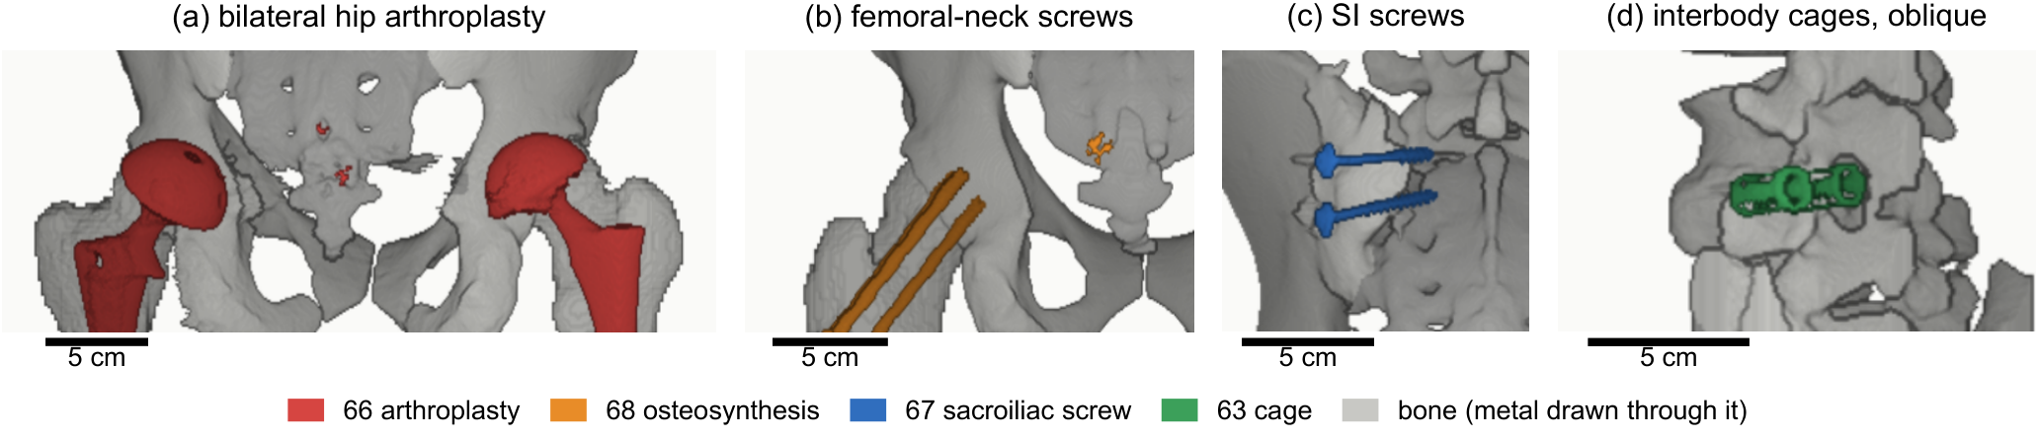
How the benchmark was built
Surgical hardware as its own classes, 11 records (MDPA Fig. S1). Bar, 5 cm.
Two public label sets matched to the CT series each was drawn on; neither source recorded which of the two scans it used
112 spine and 13 pelvic corrections to the source labels
Release gates: geometry and sides from the affine, then every measure in its physiological range
802 records, 33 with a consensus Castellvi grade; public on Zenodo
Figures: CTSpinoPelvic1K dataset article (arXiv 2609.22760, Medical Physics, submitted), Fig. 1 and Fig. S1. CTSpinoPelvic1K, doi.org/10.5281/zenodo.22139642.

Slide 10
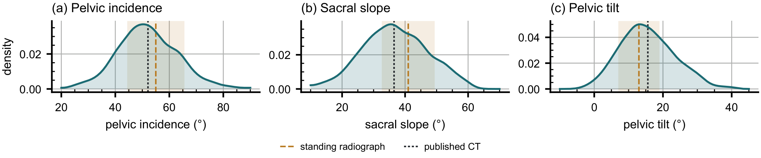
Its spinopelvic measures match published CT
756 of 802 records passing the geometric gates. Dashed, standing radiograph (Vialle 2005); dotted, published supine CT (MDPA Fig. S2).
 | This dataset, supine (n = 756) | Veilleux 2020 (n = 200) | Hasegawa 2018 (n = 24)
Pelvic incidence | 52.1 ± 11.1° | 52.1° | 53.4°
Sacral slope | 36.6 ± 10.6° | 36.5° | 34.1°
Pelvic tilt | 15.5 ± 7.9° | 15.6° | 19.2°
Pelvic incidence is a fixed property of the pelvis, so it tests the labels: 52.1° here and in Veilleux's automated supine CT series
Sacral slope and tilt, which depend on posture, sit within 0.1° of the same series
Veilleux NJ, et al. J Bone Joint Surg Am 2020;102:e130. Hasegawa K, et al. BMC Musculoskelet Disord 2018;19:437. Vialle R, et al. J Bone Joint Surg Am 2005;87:260. Dataset article: arXiv 2609.22760, Table III and Fig. S2.

Slide 11
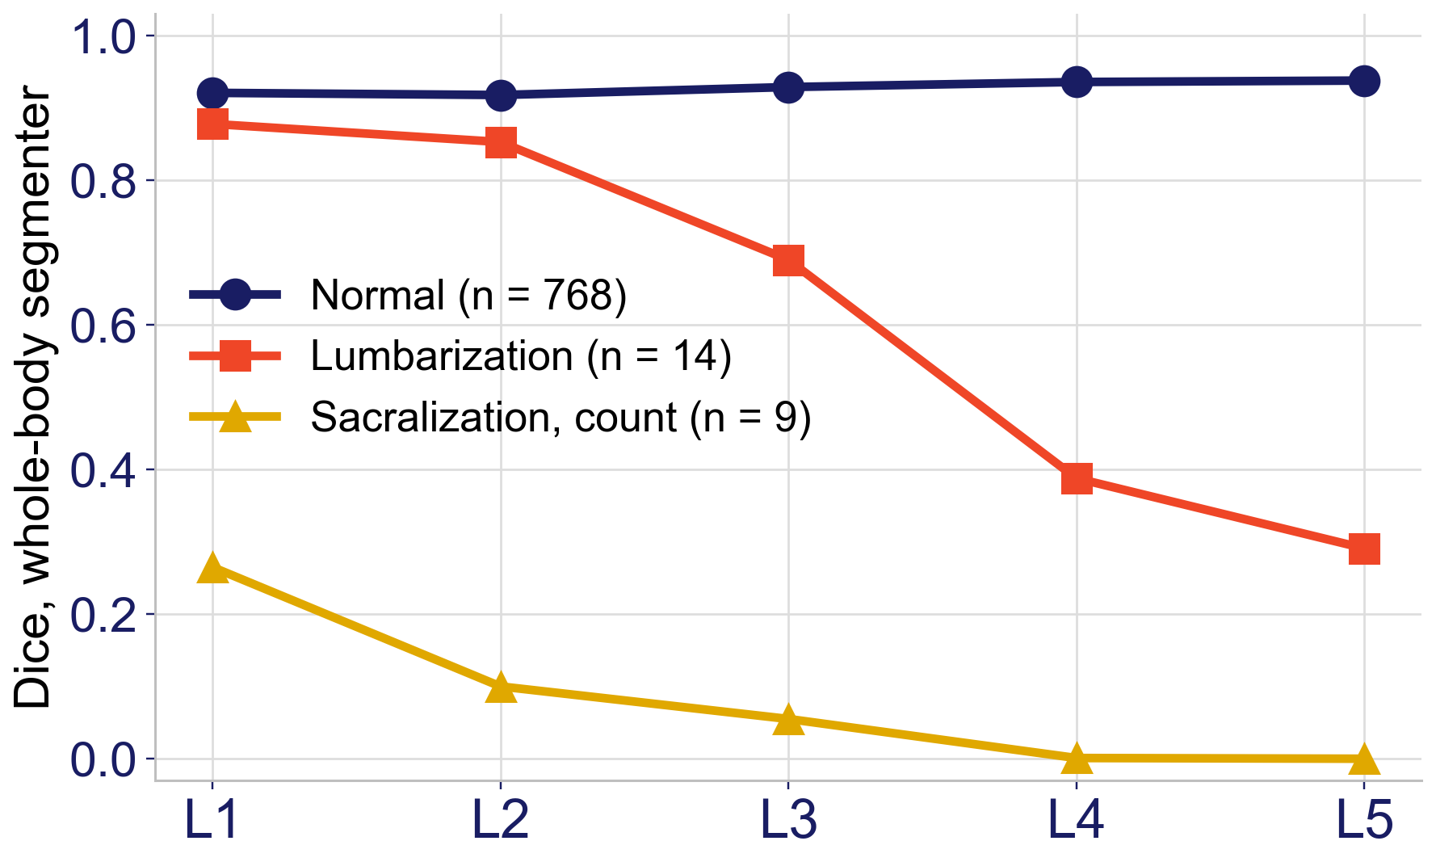
The segmenter fails by phenotype, one level at a time
Normal anatomy (768 patients): L1–L5 Dice 0.92–0.94, its published level
Lumbarization (14): falls level by level, L3 0.69, L4 0.39, L5 0.29
Four lumbar bodies (9): every label one level off, 0.265 at L1, 0.001 at L4
Per patient, L5 Dice below 0.5 in 10 of 14 lumbarizations and 9 of 9 four-lumbar spines, against 9 of 750 normal
Per-level Dice of the unmodified whole-body segmenter by phenotype; n is patients (NeurIPS 2026, Table 1).
The mechanism and how often it occurs; no wrong-level event is attributed to a segmenter
17. Wasserthal J, et al. Radiol Artif Intell 2023;5:e230024. 18. Schwing GJ, et al. Not All Spines Are Created Equal: How CT Segmenters Fail on Lumbosacral Transitional Vertebrae. NeurIPS 2026 (accepted).

Slide 12
The released model: spine and pelvis in one pass
CT
One network, one pass
Nine classes out
Abdominopelvic CT at 0.80 × 0.75 × 0.75 mm
nnU-Net, 3-D full resolution; a 256 × 320 × 320 patch holds lumbar spine and pelvis (≈100 GB, one H200)
L1–L4, last lumbar (L5 and L6 merged), sacrum, both hips
The last lumbar body is one class, L5 and L6 together, the merge VERIDAH uses for its classifier (Möller 2026)
Trained on all 1,153 records: unlabelled regions are ignored, so spine-only and pelvis-only records still teach
Transitional records oversampled to a quarter of the training samples; 5-fold cross-validation; 174 records held out, 7 of them transitional
Weights, trainer and inference code are public
23. Isensee F, et al. Nat Methods 2021;18:203. 24. Möller H, et al. VERIDAH, 2026. 25. Schwing GJ, et al. Not All Spines Are Created Equal: How CT Segmenters Fail on Lumbosacral Transitional Vertebrae. NeurIPS 2026 (accepted). Code: github.com/OpenSpineConsortium/spinopelvic-seg

Slide 13
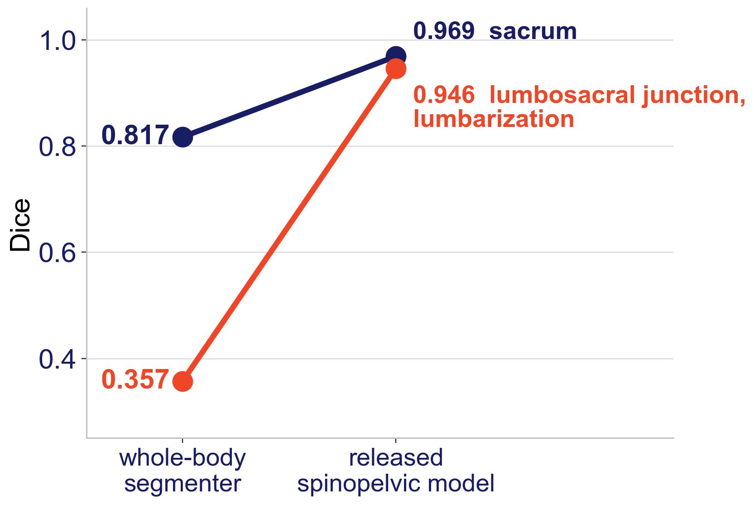
What the merge repairs: the junction and the sacrum
Lumbosacral junction on lumbarization: 0.357 (whole-body segmenter, 3 patients) to 0.946 (the one held-out patient whose truth holds L5 and sacrum)
Last lumbar emitted on 3 of 3 held-out lumbarizations and 167 of 167 normal records
Sacrum: 0.817 to 0.969 (113 held-out records with a sacral mask)
Normal L1–L4: 0.95–0.97
Dice, the unmodified whole-body segmenter against the released model (NeurIPS 2026, Tables 1, 5 and 6).
Different test sets: the whole-body segmenter zero-shot on the cohort, ours on the held-out split
18. Schwing GJ, et al. Not All Spines Are Created Equal: How CT Segmenters Fail on Lumbosacral Transitional Vertebrae. NeurIPS 2026 (accepted).

Slide 14
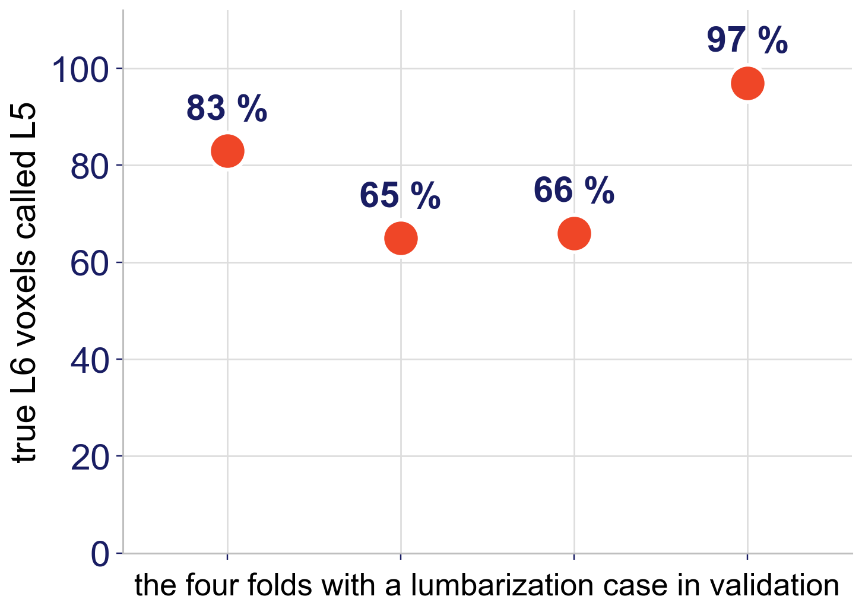
What it does not repair
The same network with an explicit L6 class and L6 oversampling still called most true L6 voxels L5; L6 Dice 0.01–0.13 against 0.91–0.95 for L5
The merge moves the collision up: on a four-lumbar spine (one held-out patient) 82.7 % of true L4 voxels were called last lumbar
On lumbarization the upper labels still slide: L2 0.61, L3 0.38, L4 0.21
The unmerged control: share of true-L6 voxels called L5, mean of the last 100 of 500 epochs (NeurIPS 2026, section 8.1).
A patch never holds both ends of the spine: telling four lumbar bodies from five needs a component that sees the whole column
18. Schwing GJ, et al. Not All Spines Are Created Equal: How CT Segmenters Fail on Lumbosacral Transitional Vertebrae. NeurIPS 2026 (accepted).

Slide 15
Limitations and next steps
Limitations
Next steps
One cohort: US screening CT, ages 45–75
Phenotypes come from the source annotations, not image reads; Castellvi is a two-resident consensus with no senior read; 2 of 33 are Type I
Seven transitional patients held out; the junction is scorable on one lumbarization
A mechanism, not an outcome: no reader study, no planning simulation
More transitional patients: VerSe labels L6 in 460 CTs without a pelvis; completing the sacrum with this segmenter gives a 1,613-volume spinopelvic cohort
This segmenter upstream of VERIDAH's sequence predictor
A senior read of all 33, and a screen of the normal cohort for Type I
Released since the paper (v11): one record per patient, per-level ribs and femora, both Castellvi reads and their consensus
18. Schwing GJ, et al. Not All Spines Are Created Equal: How CT Segmenters Fail on Lumbosacral Transitional Vertebrae. NeurIPS 2026 (accepted). 26. Sekuboyina A, et al. VerSe. Med Image Anal 2021;73:102166. 22. CTSpinoPelvic1K, doi.org/10.5281/zenodo.22139642.

Slide 16
Conclusions
The most widely used CT segmenter has no L6: on lumbarization it shifts the lumbar labels one level, confidently, with no error signal
CTSpinoPelvic1K makes that failure measurable: 802 patients, 33 transitional, Castellvi graded, public
Merging L5 and L6 in training restores the junction and the sacrum; adding an L6 class does not
Telling four lumbar bodies from five in one pass is still open
Report any spine model by phenotype, with each stratum's n
Evidence status: retrospective, public de-identified data; small transitional strata, each reported with its n; not a cleared device.

Slide 17

Acknowledgments and data availability
With thanks to Patrick Schwing (LSU Health Sciences Center New Orleans); Miraziz Ismoilov and Nizar Alnabahneh (Radiology) and Loren Schwiebert (Computer Science), Wayne State University; and the annotators Ashley Schehr, Annika Tekumulla, Margret Khoushi, Ryan Christian, Dane Hubers, Faris Mahjoub, Hassan Saad, Mia Sooch, Sathyagopal Siddapureddy, Michael McLellan and Jerick Kim
Data: CTSpinoPelvic1K (doi.org/10.5281/zenodo.22139642), built on CTSpine1K, CTPelvic1K and The Cancer Imaging Archive; all de-identified
Paper: Not All Spines Are Created Equal, NeurIPS 2026, Evaluations and Datasets track (accepted)
Funding: NIH NIGMS F30GM147909. No commercial support.
Weights and code:
github.com/OpenSpineConsortium/spinopelvic-seg
huggingface.co/OpenSpineConsortium
Questions
gregory.schwing@med.wayne.edu

