Slide 1



Detroit Medical Center / Wayne State University · OpenSpineConsortium
Naming a Lumbar Level Without Counting From C2: CTSpinoPelvic1K and a One-Shot Detector for Transitional Anatomy
Gregory J. Schwing, MD, PhD¹ · Ashley Schehr² · the OpenSpineConsortium annotators² · Miraziz Ismoilov, MD³ · Nizar Alnabahneh, MD³
¹ Department of Surgery, Detroit Medical Center / Wayne State University, Detroit, MI
² Wayne State University School of Medicine · ³ Department of Radiology, Detroit Medical Center / Wayne State University
Abstract [number pending] · [session pending]
CNS 2026, Washington, DC
CNS 2026 · Washington, DC · Abstract [number pending]
Notes:
0:00-0:12 Title. Name, institutions, and that this is a rat model of MRI-guided LITT. Do not read the title aloud.

Slide 2
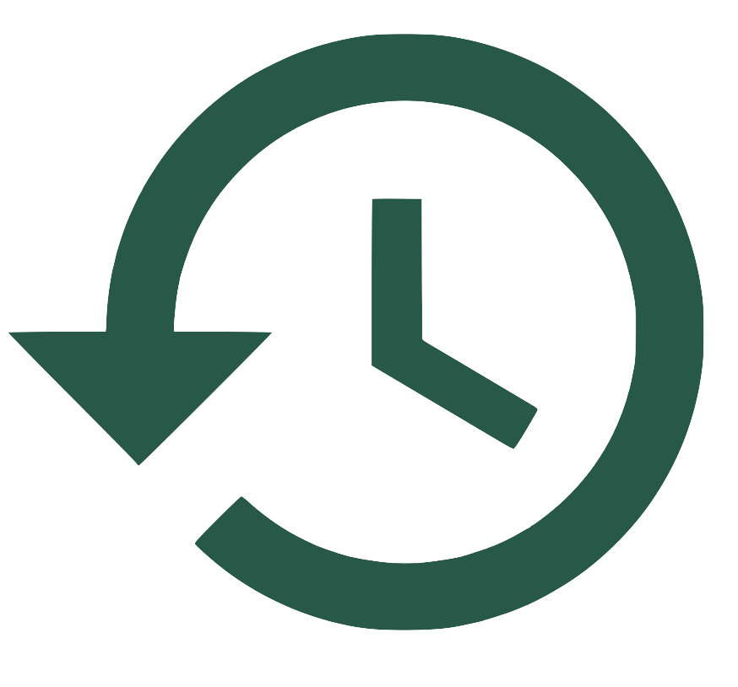
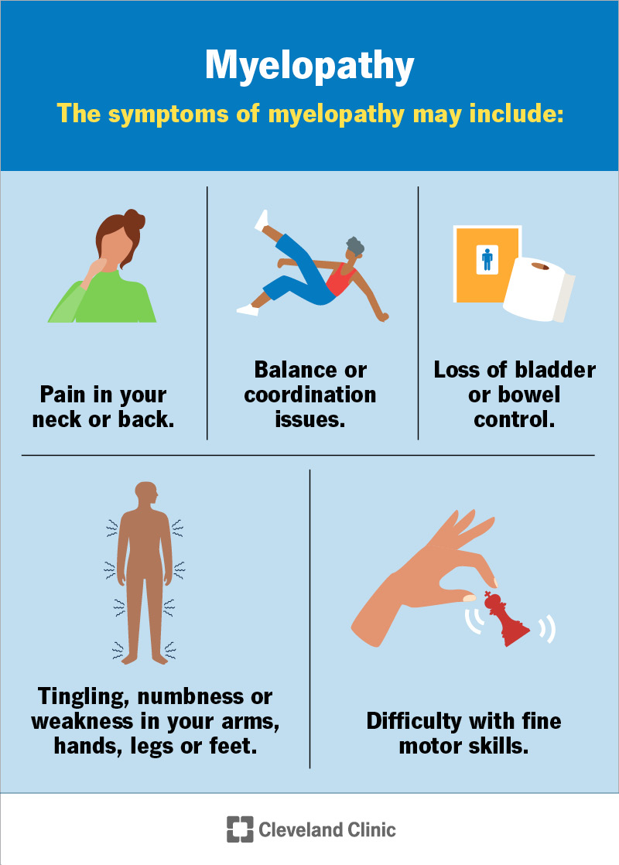
Disclosures
Disclosures
The authors have no relevant financial relationships to disclose.
All imaging is public and de-identified (TCIA CT COLONOGRAPHY); the WSU IRB determined the work is not human-participant research (2 September 2026).
Dataset, code and weights are released under open licences; nothing presented is a medical device.
CNS 2026 · Washington, DC · Abstract [number pending]
Notes:
0:12-0:22 Disclosures. Read Dr Lee's Medtronic and Monteris agreements out loud - Monteris makes the LITT system, so the room will want to hear it named.

Slide 3
Overview
Where this is going
1
The problem — a lumbar level is named by counting from C2, and the study a lumbar case is planned on has no C2
2
The dataset — 802 CT records with spine, pelvis, ribs, femora and hardware in one frame, and a class for every anomaly
3
The claim — identity is local: shape alone separates T12 from L1 at AUC 0.99 in the same patient
4
The model — a one-shot network that never counts, plus a decoder that turns its probabilities into a posterior over the readings
5
What it says about development, and about the operating room
CNS 2026 · Washington, DC · Abstract [number pending]
Notes:
0:22-0:40 Roadmap. Five beats, ten seconds. Do not linger.

Slide 4
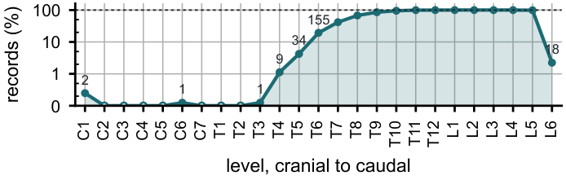
Background
The count fails exactly where the anatomy is transitional
Wrong-level spine surgery runs at about one in 3,100 spinal procedures, and the cause most often cited is transitional anatomy.¹
A lumbosacral transitional vertebra is present in roughly one patient in ten; a thoracolumbar variant (a stump twelfth rib, a lumbar rib, a thirteenth thoracic vertebra) in more.
The gold standard names a level by counting caudally from C2 on whole-spine imaging. A lumbar surgical case is planned on a lumbar study, T12 to S1. C2 is never in it.
So the name rests on local morphology, and the question is whether morphology is enough.
1. Epstein NE. Surg Neurol Int 2021;12:286. Field of view of 802 abdominopelvic CTs: the thoracic column enters from above; C2 never.
CNS 2026 · Washington, DC · Abstract [number pending]

Slide 5
Background
The same count, three anatomies
Four rib-free bodies above the sacrum
Six rib-free bodies above the sacrum
An L1 that carries a lumbar rib and is counted as thoracic,
or an L5 assimilated to the sacrum (sacralization).
Same count. Opposite surgical anatomy.
A true sixth lumbar vertebra (A),
a T12 whose ribs are aplastic, counted as lumbar (B),
or a first sacral segment that separated (C, lumbarization).
Can the vertebra's own shape, its ribs and its junction say which one it is, without the count?
2. Konin GP, Walz DM. AJNR 2010;31:1778–1786. 3. Poolman TM, et al. J Anat 2023;243:311–318.
CNS 2026 · Washington, DC · Abstract [number pending]

Slide 6
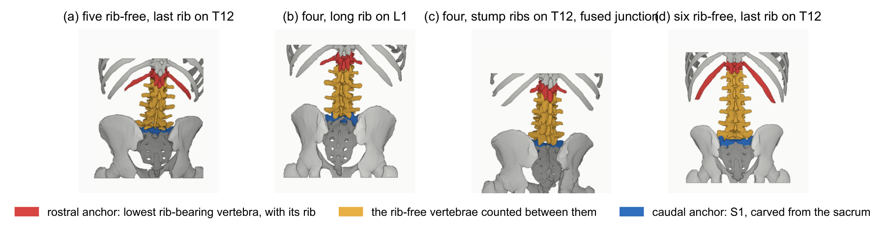
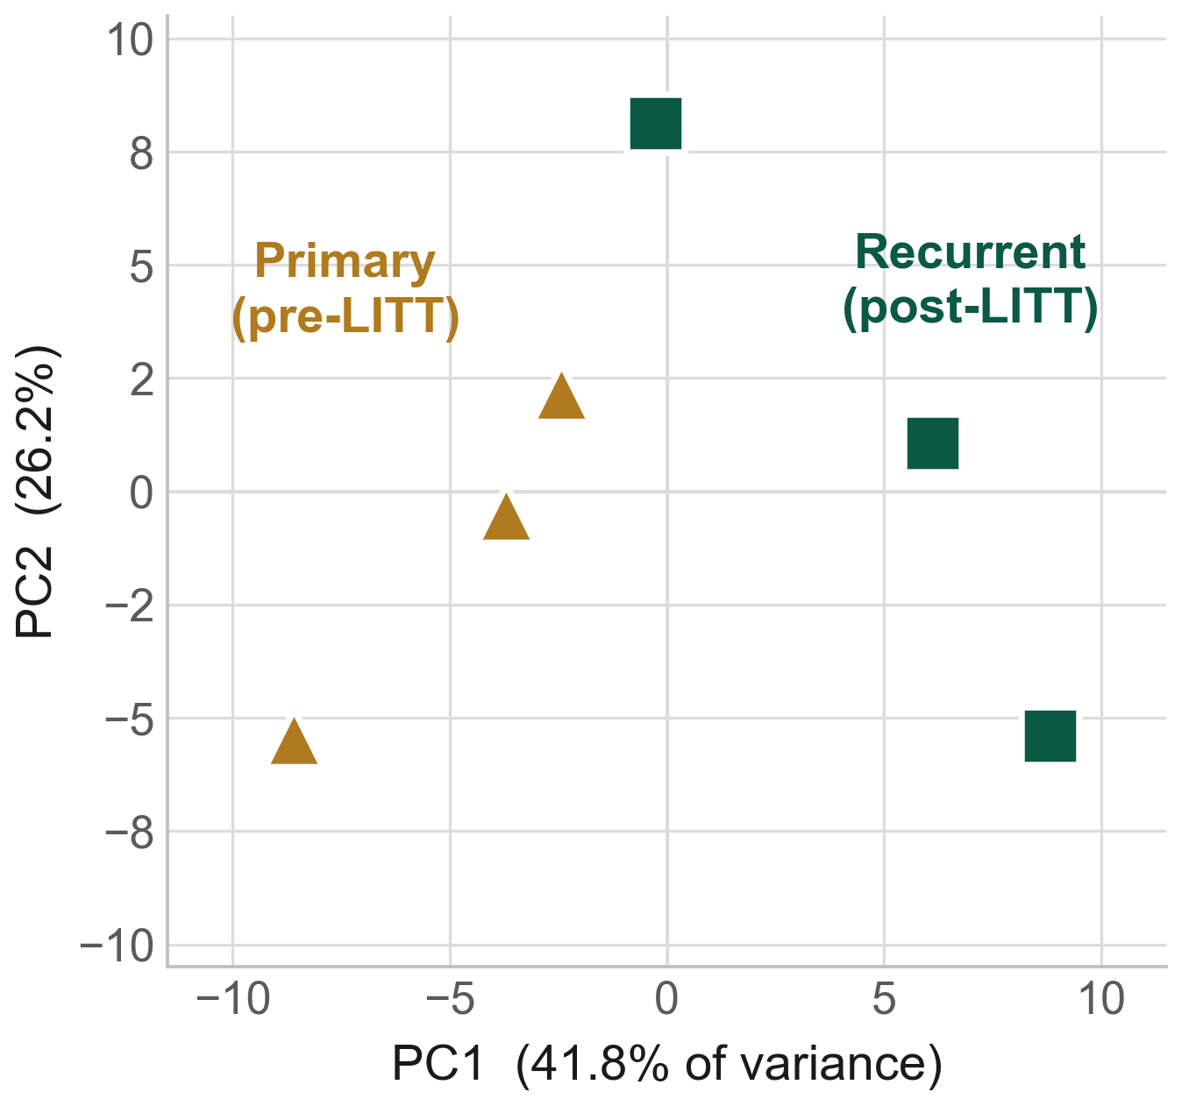
Methods
CTSpinoPelvic1K: two anchors on every record, and a class for every anomaly
802 abdominopelvic CT records from TCIA CT COLONOGRAPHY, joining CTSpine1K's vertebrae and CTPelvic1K's pelvis on one series, which neither source had done.
Added on every record: per-level ribs (thirteen per side), femora, a separate S1, and surgical hardware as its own class.
Lumbar levels are anchored on the lowest rib-bearing vertebra and on S1, not on a count. L6, T13, lumbar ribs and stump ribs are recorded as themselves.
33 records carry a two-reader Castellvi grade. Sixteen carry a lumbar rib; 98 a stump twelfth rib; 18 a sixth lumbar body.
v10 archived on Zenodo (10.5281/zenodo.22139642); build archive 10.5281/zenodo.22647933; submitted to Medical Physics.
CNS 2026 · Washington, DC · Abstract [number pending]

Slide 7
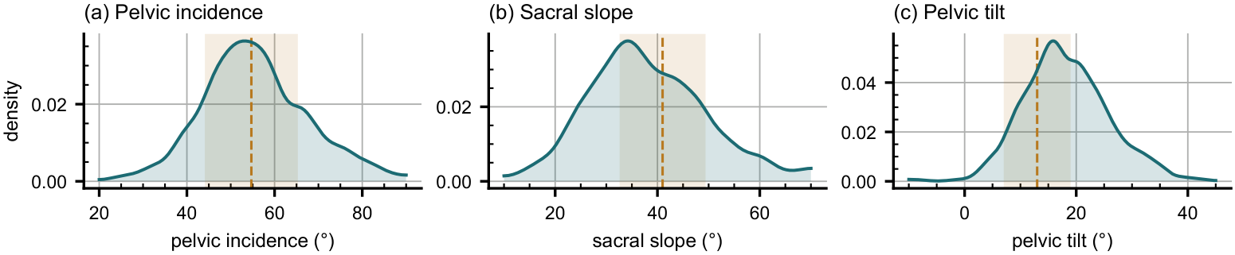
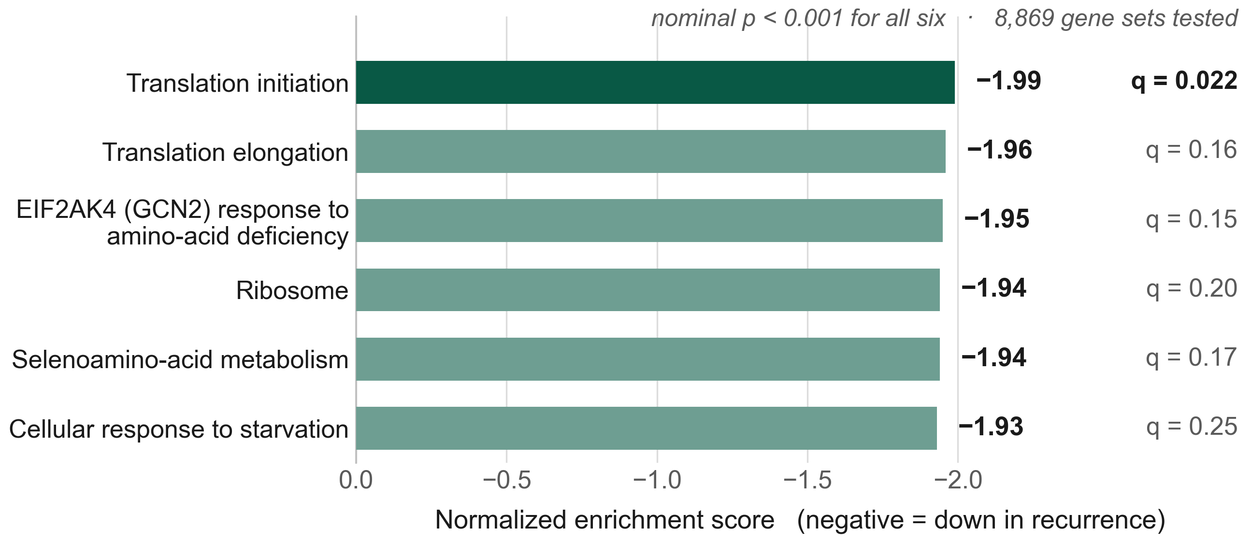
Methods
Validated at three layers before any number was believed
Geometry first: 802 of 802 records pass the invariants (one component per bone, sided structures on their side, labels on their CT grid).
Rib–vertebra incidence across 5,749 evaluable ribs: 2 residual offsets, 0.035 percent.
Derived spinopelvic measures match published reference values.
Every measurement in this talk was written to a file by a script that can be re-run on the released data.
CNS 2026 · Washington, DC · Abstract [number pending]

Slide 8
Methods
A network that never counts, and a decoder that reasons about the sequence
One-shot segmenter
Instances + type probabilities
Monotone decode
nnU-Net ResEnc-L, 24 classes: T10–T13, L1–L6,
sacrum, ribs 1–11, rib 12, rib 13, lumbar rib, hips, femur
per vertebra: P(thoracic), P(lumbar), P(sacral)
from the softmax; rib contact per body
thoracic above lumbar above sacrum;
posterior over the rib-free count and over A / B / C
Every class is a local appearance. To call a voxel L1 rather than T12 the network has to read the body's own shape and facets; to call a rib lumbar rather than twelfth it has to read the vertebra beneath it. That is the morphology classifier and the segmenter trained as one model.
What a semantic network cannot do is notice that its own sequence does not fit twelve, five and a sacrum. The decoder adds only that: instances, type probabilities, and the most likely monotone sequence, with the probability of each reading reported rather than a verdict forced.
Rare-class exposure is enforced: records carrying a lumbar rib, a T13 or a lumbosacral variant fill half of every training queue. Five patient-grouped, LSTV-stratified folds; 500 epochs each on H200 GPUs.
4. Isensee F, et al. Nat Methods 2021;18:203–211. 5. Wald T, et al. TMLR 2025 (ResEnc).
CNS 2026 · Washington, DC · Abstract [number pending]

Slide 9
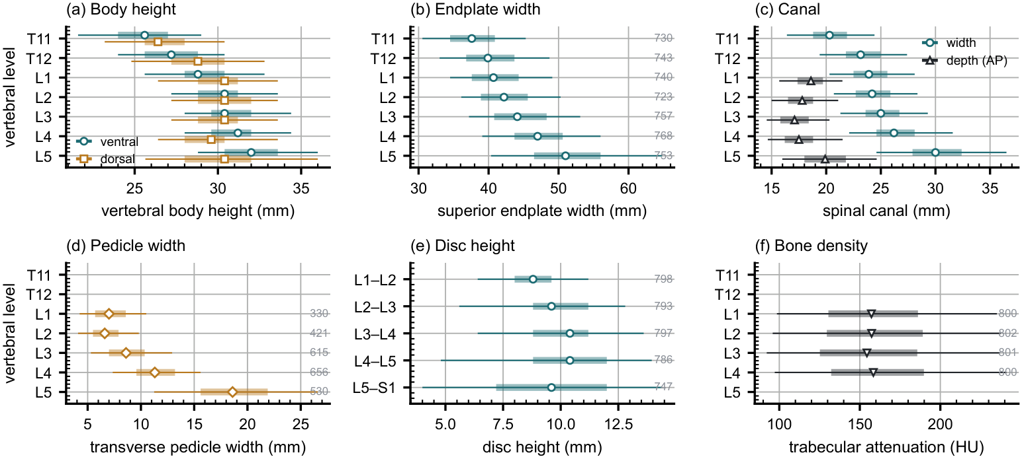
Results
Identity is local: T12 and L1 differ in shape inside the same patient
Eleven shape features per vertebra, each divided by the patient's own median across levels so size is removed and only shape remains.
Logistic regression, cross-validated by patient: thoracic against lumbar AUC 0.998; T12 against L1 AUC 0.990, accuracy 97.3 percent over 1,485 vertebrae.
Transverse-process span carries most of it. Costal facets and facet orientation are not in that feature set; the network sees them.
Morphometry by level with its spread, 802 records: the reference the model is measured against.
CNS 2026 · Washington, DC · Abstract [number pending]

Slide 10
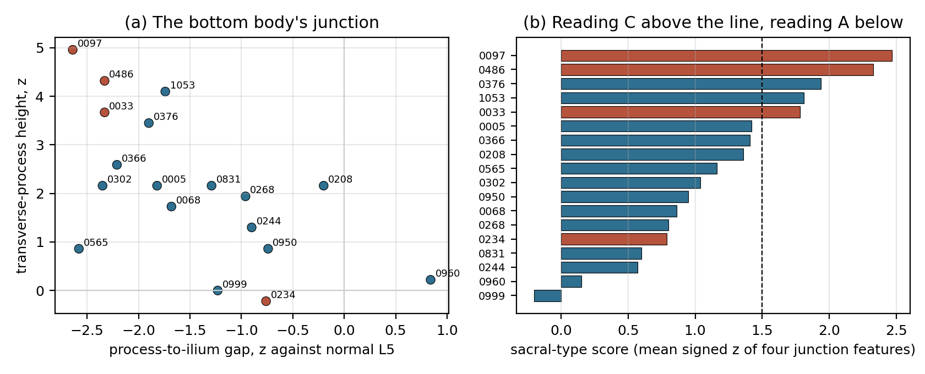
Results
Eighteen six-lumbar spines, read from the labels: where is the extra body?
Every feature as a z-score against 643 normal five-lumbar spines.
Bottom body: a transverse process 2–5 SD taller than a normal L5's, sitting 2 SD closer to the ilium, or a sacrum a segment short, reads as a lumbarized S1.
Top body: the whole column scored as labelled and with every name moved up one; a labelled L1 that fits T12 better reads as an aplastic-rib T12.
11 true L6 · 4 lumbarized S1 · 1 aplastic-rib T12 · 2 with evidence at both ends.
The label convention hides an aplastic twelfth rib (the lowest rib-bearing body is defined as T12), which is why the column-wide test, not the rib length, finds reading B.
CNS 2026 · Washington, DC · Abstract [number pending]

Slide 11
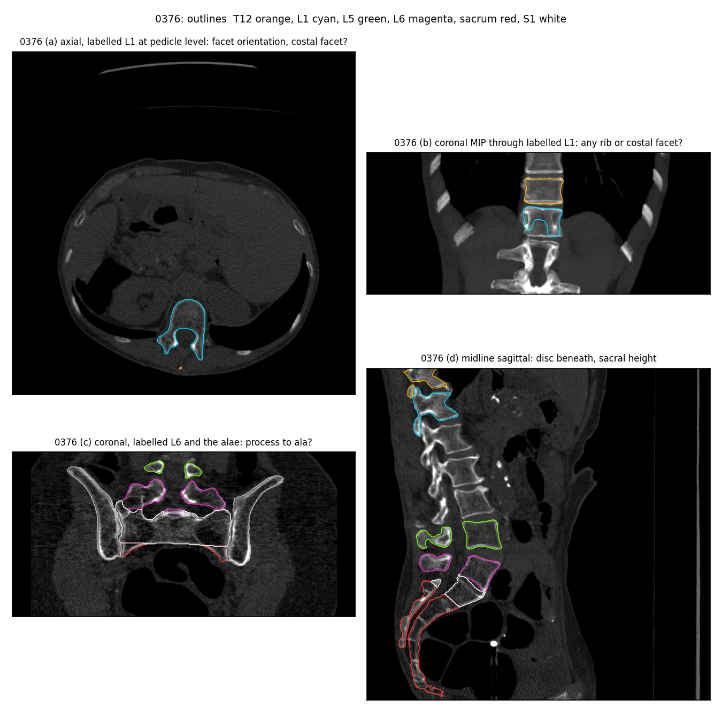
Results
What the evidence looks like on the CT
Record 0376, Castellvi IV. Top left: the labelled L1 at pedicle level. Top right: coronal MIP through it, no rib. Bottom left: the labelled sixth body sitting on both alae. Bottom right: the disc beneath it and the sacral height.
The bottom test calls it sacral-type; the column-wide test calls the top thoracic-type. A double shift is a real anatomy (presacral count 25 with a rib-less T12), and the field of view cannot exclude it.
That is the point: on this study a verdict is not available to a human either. A probability is, and it is what the decoder reports.
CNS 2026 · Washington, DC · Abstract [number pending]

Slide 12
Results
Do the two borders shift together? First look at 802 records
Thoracolumbar border
Lumbosacral border
Stump twelfth rib (12th:11th length below 0.33): 98 of 788, 12.4 percent.
Lumbar rib: 16 of 802, 2.0 percent.
No six-lumbar record carries an aplastic twelfth rib by rib length; one does by column shape.
Sacralization: stump ribs in 4 of 14 against 94 of 758 elsewhere, odds ratio 2.8, p = 0.09.
Lumbarization: no lumbar rib among the 14.
Direction agrees with Nagata 2025; power does not, at 33 graded records.
A single homeotic shift, cranial or caudal, predicts these pairings. Reading the whole cohort, and VerSe, is what tests it at full power.
6. Nagata K, et al. Skeletal Radiol 2025;54:2169–2177. 7. Du Plessis AM, et al. J Anat 2018;232:850–856.
CNS 2026 · Washington, DC · Abstract [number pending]

Slide 13
Results
The one-shot network on held-out folds
[PENDING] figure: per-class Dice, typical versus transitional records, five folds (tools/eval_oneshot.py)
Three numbers decide whether the claim holds, and none of them is overall Dice:
1. level identity accuracy on transitional records, reported apart from typical ones;
2. whether the network ever says 'lumbar rib' or 'T13' (a model that never does still scores 94 percent on short ribs);
3. the posterior on the eighteen six-lumbar spines against the label-based readings.
[PENDING] figure: rib-free count accuracy by transitional status; posterior calibration (tools/decode_sequence.py)
[PENDING] table: where ground-truth twelfth-rib, thirteenth-rib and lumbar-rib voxels went; lumbar-rib recall
Folds launched 7 September 2026 on four H200 nodes; expected complete about 12 September.
CNS 2026 · Washington, DC · Abstract [number pending]

Slide 14
Results
The same idea on the image the surgeon looks at
A multi-source radiograph corpus
A class-agnostic corner detector
33,943 vertebra instances on 5,401 films: BUU-LSPINE 19,991; AASCE full-spine 8,069; NHANES II 3,217; Mendeley 2,666.
Plus 4,000 rendered radiographs from CTSpinoPelvic1K whose corners are exact by construction.
Levels recorded as annotated or inferred from position, never invented.
Baseline on 6,073 instances: AP50 0.957, corners within 10 percent of body size 77 percent.
Retraining on the full corpus now. [PENDING] v2 numbers.
Fails today on outside films: post-operative, instrumented, thoracic levels present.
Aim: the level named on the intraoperative film, from local shape, before the incision, with a probability attached.
8. Klinwichit P, et al. BUU-LSPINE, 2023. 9. Wu H, et al. AASCE MICCAI 2019.
CNS 2026 · Washington, DC · Abstract [number pending]

Slide 15
Conclusions
Conclusions
A lumbar level can be named without counting from C2, because a T12 and an L1 are different shapes in the same patient, and a lumbarized S1 keeps sacral features. CTSpinoPelvic1K makes that measurable on 802 records, with the anomalies recorded as themselves rather than forced into an ordinary level.
Six rib-free bodies are, in this cohort, a true L6 or a caudally shifted sacral segment; the thoracolumbar border is not the usual culprit. Where the evidence sits at both ends, the honest output is a probability, and that is what the decoder gives.
For the surgeon the origin of the border vertebra decides where the mobile junction is, what the pedicle will take, which root exits beneath it, and which endplate the pelvic parameters were measured on.
Identity by local shape, with a posterior over the readings, is the deliverable a wrong-level detector needs and a count can never give.
CNS 2026 · Washington, DC · Abstract [number pending]

Slide 16
Limitations
Limitations and next steps
Limitations
Thoracic ground truth is field-of-view limited; no scan contains C2, so the readings are morphological consistency, not developmental truth.
33 Castellvi grades, two residents' consensus; the label-based readings rest on 18 six-lumbar records.
Supine screening cohort over 50; ribs are triaged-review pseudolabels; no held-out test set beyond the folds.
Next steps
Run the released weights over the 374 VerSe scans to add S1 and the anomaly classes, and read Castellvi on the whole cohort.
Replace the S1 carve with one that follows anatomy.
Train the corner detector on the enlarged radiograph corpus and on real intraoperative films with the operated level labelled.
Students: one command onboards a new annotator (openspineconsortium.com/onboarding).
CNS 2026 · Washington, DC · Abstract [number pending]

Slide 17
Thank you
Acknowledgments and data availability
Annotators and coauthors: Ashley Schehr, Annika Tekumulla, Margret Khoushi, Ryan Christian, Dane Hubers, Faris Mahjoub, Hassan Saad, Mia Sooch, Sathyagopal Siddapureddy, Michael McLellan, Jerick Kim (WSU School of Medicine); Miraziz Ismoilov and Nizar Alnabahneh (Radiology, DMC/WSU).
Data: CTSpinoPelvic1K v10, doi.org/10.5281/zenodo.22139642 (CC BY-NC-SA 4.0); build archive doi.org/10.5281/zenodo.22647933.
Code and weights: github.com/OpenSpineConsortium/CTSpinoPelvic1K; huggingface.co/OpenSpineConsortium.
Imaging: TCIA CT COLONOGRAPHY; annotations derive from CTSpine1K and CTPelvic1K.
Questions
gregory.schwing@med.wayne.edu
openspineconsortium.com
CNS 2026 · Washington, DC · Abstract [number pending]

