Slide 1
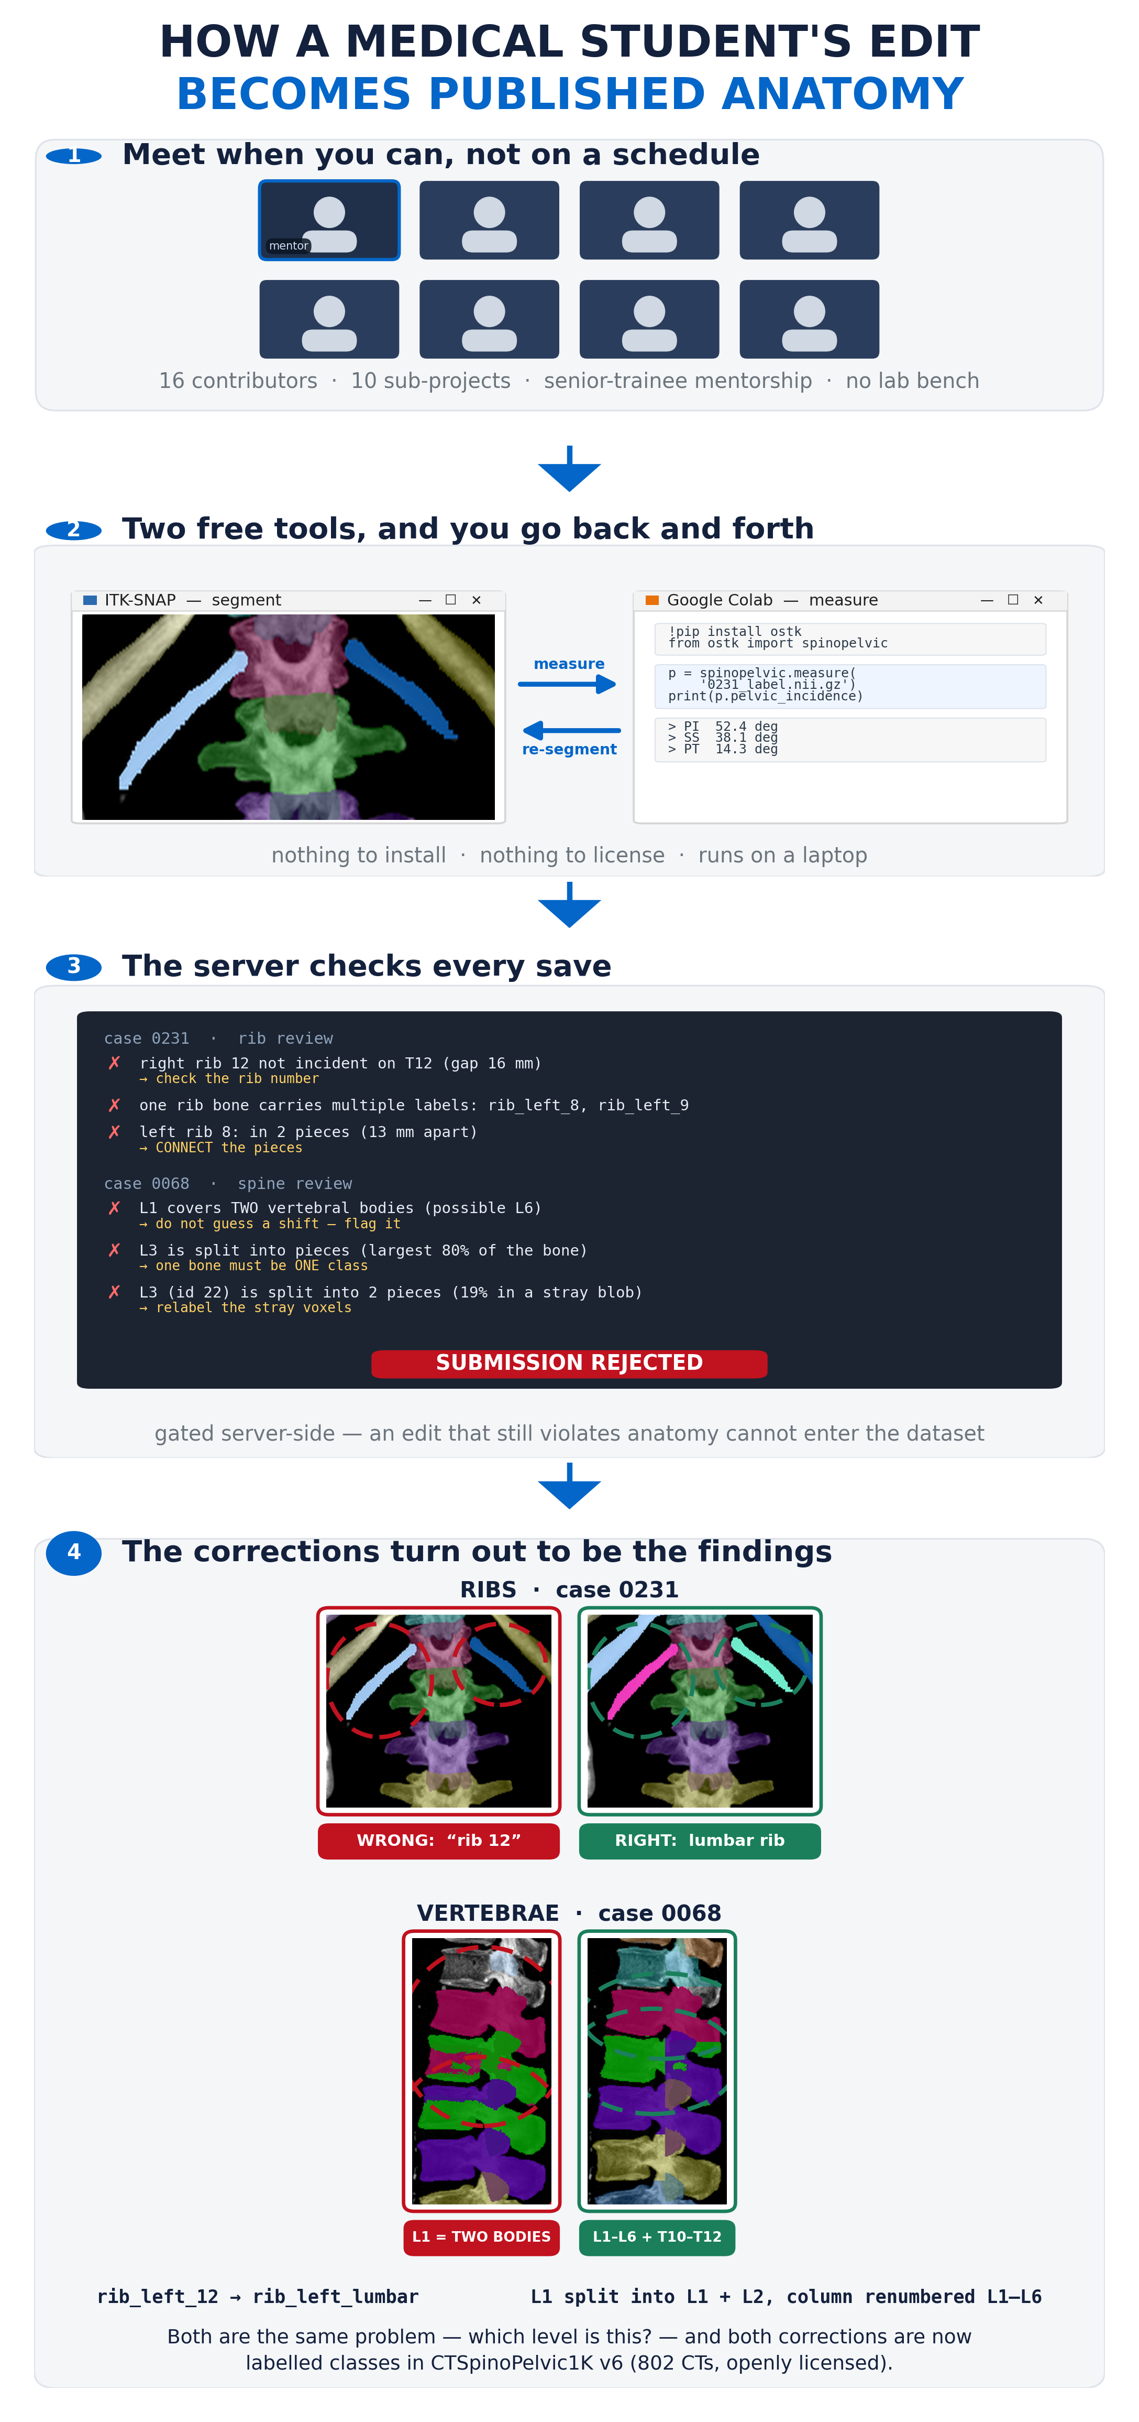
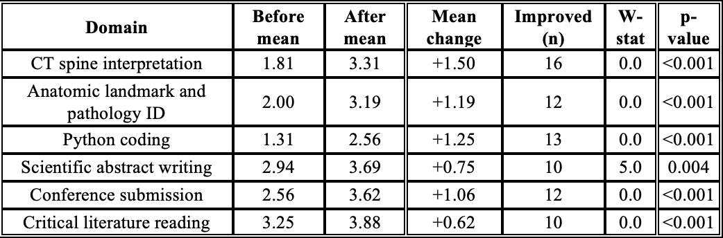
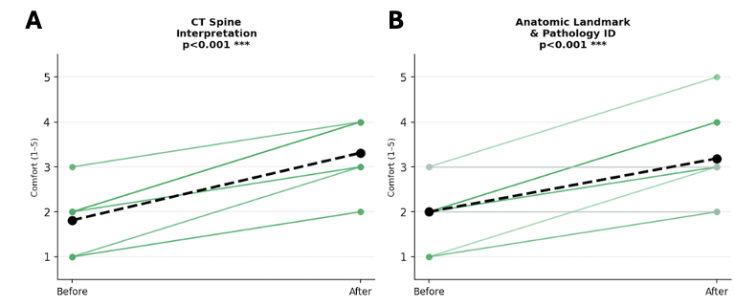
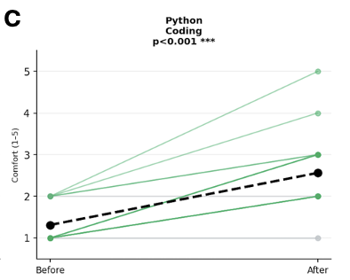
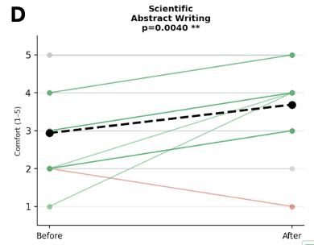
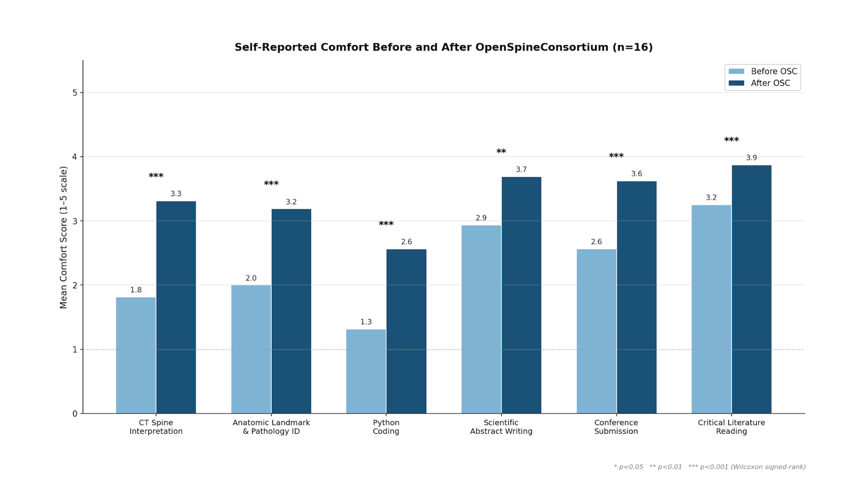
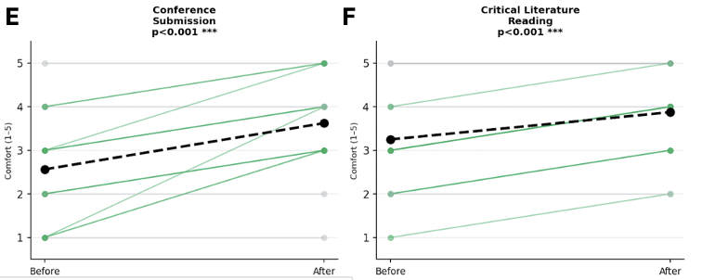
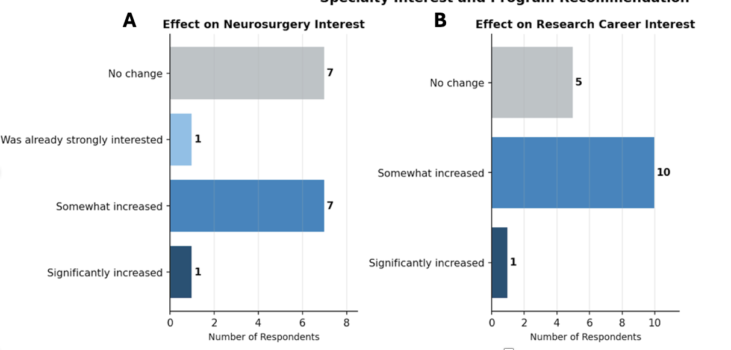

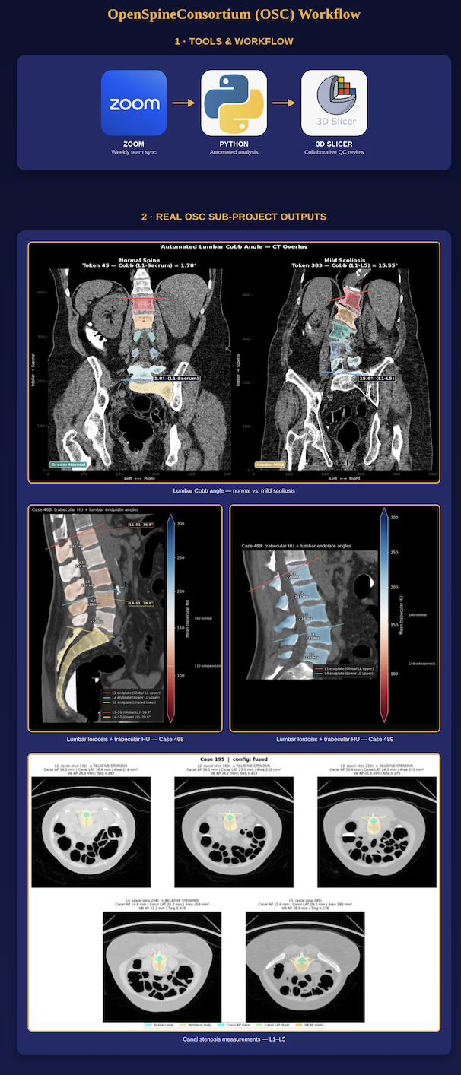
Beyond the Cadaver Lab: The OpenSpineConsortium as an Asynchronous, Open-Source Framework for Medical Student Engagement in Computational Spine Imaging Research
Gregory Schwing, MD, PhD¹, Muaaz Akhtar, BS², Ryan Christian, BS², Sephora Dafinescu, BS², Blaise DesChamps, BS², Jason Fahmy, BS², Dane Hubers, BS², Margret Khoushi, BS², Jerick Kim, BS², Faris Mahjoub, BS², Hassan Saad, BS², Ashley Schehr, BS², Mia Sooch, BA², Alexandra Thomas, BS², Namrata Vedagarbha, BS², Joshua Weiss, BS², Razanne Zaghloul, BS²
¹Department of Surgery, Detroit Medical Center, Detroit MI
²School of Medicine, Wayne State University, Detroit MI
INTRODUCTION
Research experience is heavily weighted in competitive specialties, yet preclinical schedules constrain student bandwidth.
Prior work shows students acquire coding skills quickly and that imaging-based curricula engage them in scholarship, but programs are institution-bound and rarely couple anatomical learning with authentic computational contribution.
OBJECTIVES
To combine open-source spine imaging datasets, Python coding, and a consortium model targeting a clinically high-impact anatomic region.
METHODS
OpenSpineConsortium (OSC) is a distributed, open-source collaborative unifying public imaging collections into documented, openly licensed datasets, supporting anatomy-aware machine learning for the spine and pelvis.
For medical students, this translated into analyzing spine CTs, annotating anatomical structures, and learning to automatically extract clinically useful parameters.
Onboarding covers spine anatomy, segmentation, Python, and reproducible workflows. Students completed scoped sub-projects with senior-trainee mentorship.
A post-participation survey assessed self-reported skill gains, scholarly output, and specialty interest.
Distributed, open-source training produces significant improvements across all six domains of computational spine imaging expertise in medical students, establishing OSC as a scalable model for research engagement.
RESULTS
Ten sub-projects span 16 contributors.
Self-reported comfort (five-point scale) improved significantly across all six domains (Wilcoxon, all p<0.05), with the largest gains in CT spine interpretation (1.8 to 3.3, p<0.001), anatomic landmark/pathology identification (2.0 to 3.2, p<0.001), and Python coding (1.3 to 2.6, p<0.001).
Conference submission, abstract writing, and literature reading also improved significantly.
Nine of 16 reported increased interest in neurosurgery and 11 of 16 in research-oriented careers.
All 16 would recommend OSC.
CONCLUSIONS
OSC produced significant gains in spine anatomy, computational proficiency, and scientific communication alongside 10 scholarly projects.
This supports a scalable, low-cost model bridging anatomic education, computational training, and authentic contribution within medical school's time constraints.

